Slide 1
PHYS 3313 – Section 001 Lecture #20
Monday, April 10, 2017
Dr. Amir Farbin
Infinite Square-well Potential
Finite Square Well Potential
Penetration Depth
Degeneracy
Simple Harmonic Oscillator

Slide 2
Announcements
Reminder: Homework #4
End of chapter problems on CH5: 8, 10, 16, 24, 26, 36 and 47
Due this Wednesday, Apr. 12
Quiz 3 results
Class average: 25.1
Equivalent to: 50.2/100
Previous quizzes: 21/100 and 57.6/100
Top score: 47/50
Reminder: Quadruple extra credit
Colloquium on April 19, 2017
Speaker: Dr. Nigel Lockyer, Director of Fermilab
Make your arrangements to take advantage of this opportunity

Slide 3
Reminder: Special project #6
Show that the Schrodinger equation becomes Newton’s second law in the classical limit. (15 points)
Deadline Monday, Apr. 17, 2017
You MUST have your own answers!

Slide 4
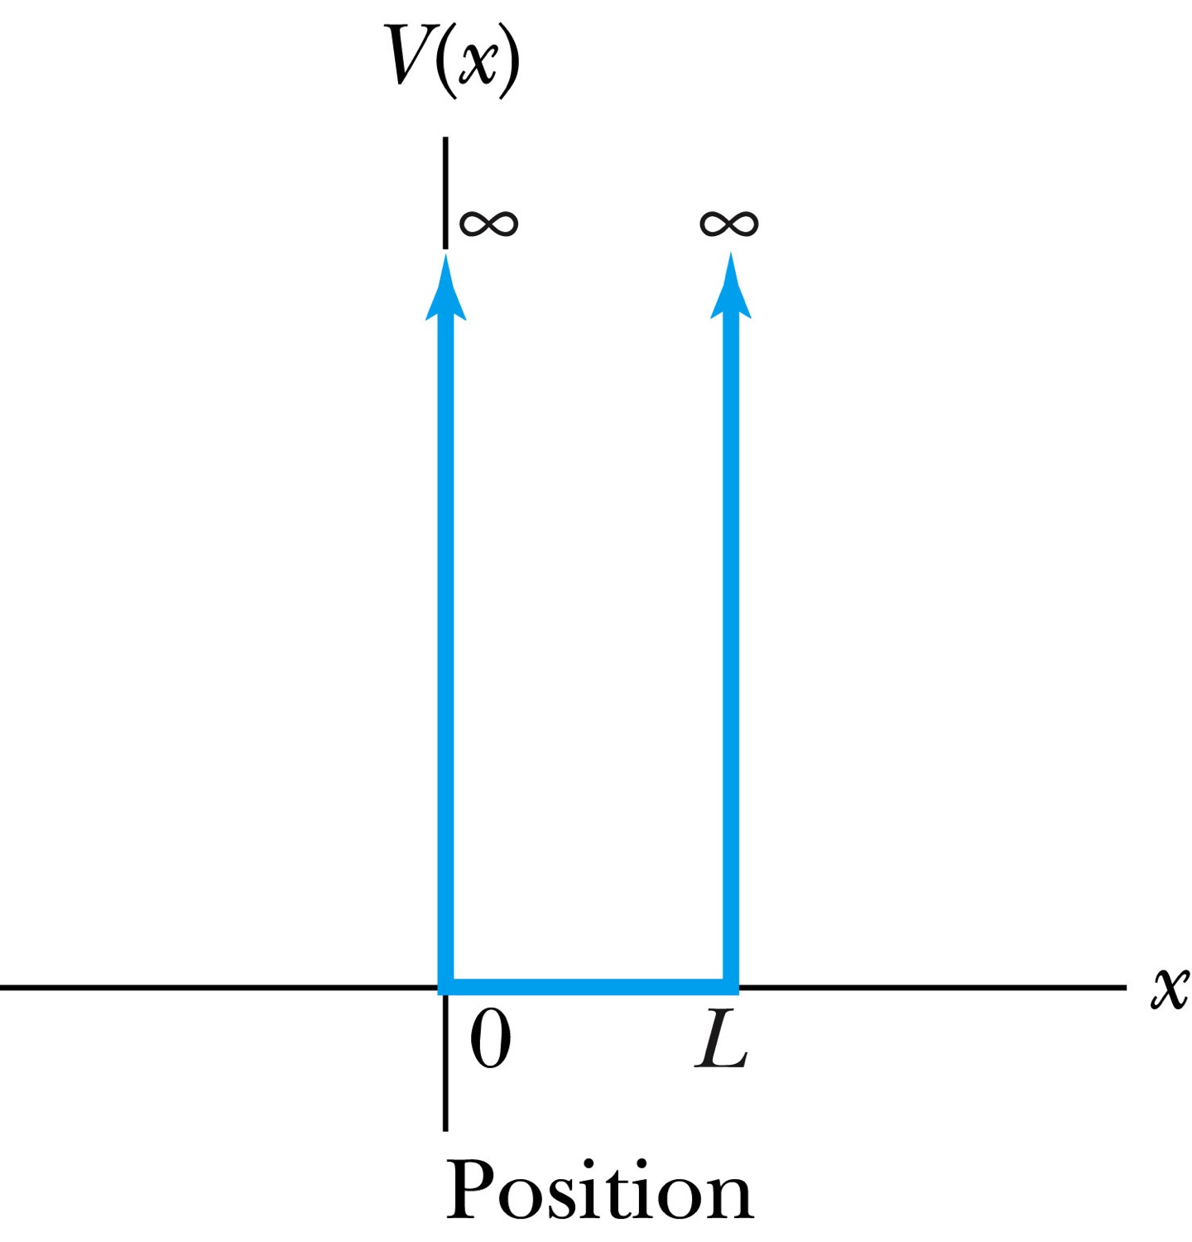
Infinite Square-Well Potential
The simplest such system is that of a particle trapped in a box with infinitely hard walls that the particle cannot penetrate. This potential is called an infinite square well and is given by
The wave function must be zero where the potential is infinite.
Where the potential is zero inside the box, the time independent Schrödinger wave equation becomes where .
The general solution is .

Slide 5
Quantization
Since the wave function must be continuous, the boundary conditions of the potential dictate that the wave function must be zero at x = 0 and x = L. These yield valid solutions for B=0, and for integer values of n such that kL = nπ ➔ k=nπ/L
The wave function now becomes
We normalize the wave function
The normalized wave function becomes
These functions are identical to those obtained for a vibrating string with fixed ends.

Slide 6
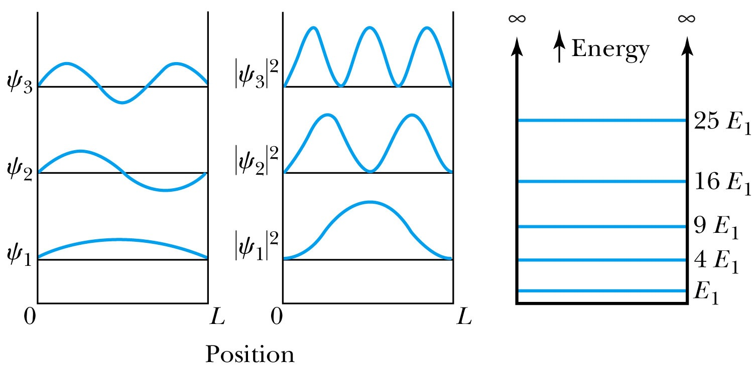
Quantized Energy
The quantized wave number now becomes
Solving for the energy yields
Note that the energy depends on the integer values of n. Hence the energy is quantized and nonzero.
The special case of n = 1 is called the ground state energy.

Slide 7
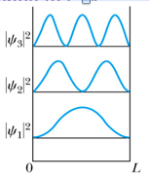
How does this correspond to Classical Mech.?
What is the probability of finding a particle in a box of length L?
Bohr’s correspondence principle says that QM and CM must correspond to each other! When?
When n becomes large, the QM approaches to CM
So when n→∞, the probability of finding a particle in a box of length L is
Which is identical to the CM probability!!
One can also see this from the plot of P!

Slide 8
Expectation Values & Operators
Expectation value for any function g(x)
Position operator is the same as itself, x
Momentum Operator
Energy Operator

Slide 9
Ex 6.8: Expectation values inside a box
Determine the expectation values for x, x², p and p² of a particle in an infinite square well for the first excited state.
What is the wave function of the first excited state?
n=?
2

Slide 10
Ex 6.9: Proton Transition Energy
A typical diameter of a nucleus is about 10⁻¹⁴m. Use the infinite square-well potential to calculate the transition energy from the first excited state to the ground state for a proton confined to the nucleus.
The energy of the state n is
What is n for the ground state?
n=1
What is n for the 1st excited state?
n=2
So the proton transition energy is

Slide 11
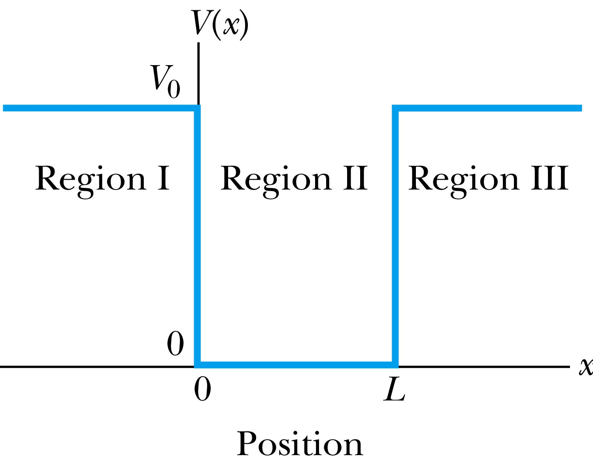
Finite Square-Well Potential
The finite square-well potential is
The Schrödinger equation outside the finite well in regions I and III is
for regions I and III, or using
yields . The solution to this differential has exponentials of the form e^{αx} and e^{-αx}. In the region x > L, we reject the positive exponential and in the region x < 0, we reject the negative exponential. Why?
This is because the wave function should be 0 as x→±infinity.

Slide 12
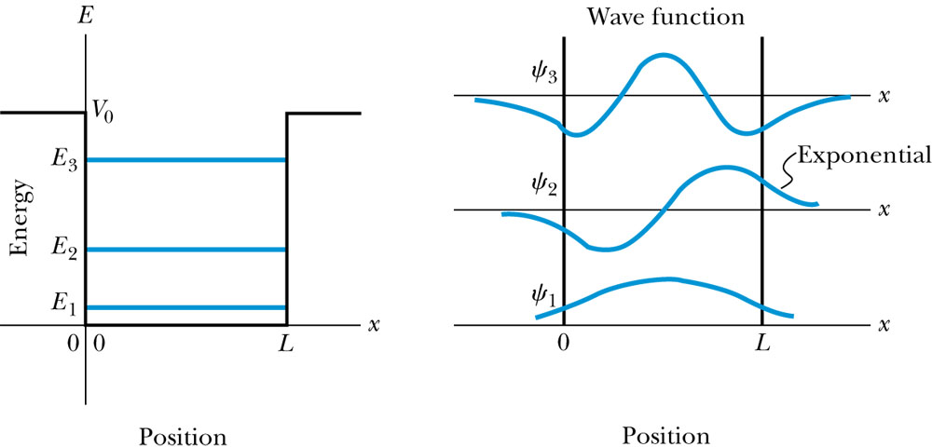
Finite Square-Well Solution
Inside the square well, where the potential V is zero and the particle is free, the wave equation becomes where
Instead of a sinusoidal solution we can write
The boundary conditions require that
and the wave function must be smooth where the regions meet.
Note that the wave function is nonzero outside of the box.
Non-zero at the boundary either..
What would the energy look like?

Slide 13
Penetration Depth
The penetration depth is the distance outside the potential well where the probability significantly decreases. It is given by
It should not be surprising to find that the penetration distance that violates classical physics is proportional to Planck’s constant.

Slide 14
Three-Dimensional Infinite-Potential Well
The wave function must be a function of all three spatial coordinates.
We begin with the conservation of energy
Multiply this by the wave function to get
Now consider momentum as an operator acting on the wave function. In this case, the operator must act twice on each dimension. Given:
The three dimensional Schrödinger wave equation is
Rewrite

Slide 15
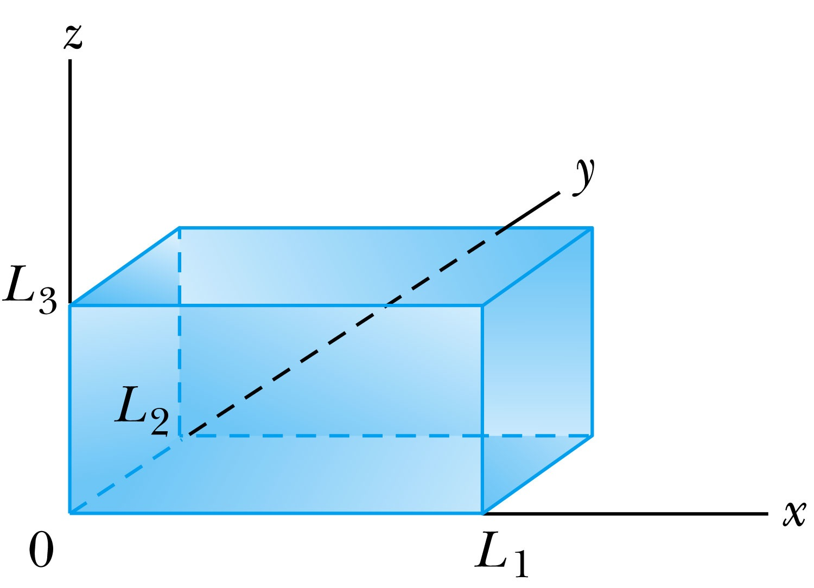
Ex 6.10: Expectation values inside a box
Consider a free particle inside a box with lengths L₁, L₂ and L₃ along the x, y, and z axes, respectively, as shown in the figure. The particle is constrained to be inside the box. Find the wave functions and energies. Then find the ground energy and wave function and the energy of the first excited state for a cube of sides L.
What are the boundary conditions for this situation?
Particle is free, so x, y and z wave functions are independent from each other!
Each wave function must be 0 at the wall!
Inside the box, potential V is 0.
A reasonable solution is
Using the boundary condition
So the wave numbers are

Slide 16
Ex 6.10: Expectation values inside a box
Consider a free particle inside a box with lengths L₁, L₂ and L₃ along the x, y, and z axes, respectively, as shown in figure. The particle is constrained to be inside the box. Find the wave functions and energies. Then find the round energy and wave function and the energy of the first excited state for a cube of sides L.
The energy can be obtained through the Schrödinger equation
What is the ground state energy?
E_{1,1,1} when n₁=n₂=n₃=1, how much?
When are the energies the same for different combinations of n_{i}?

Slide 17
Degeneracy*
Analysis of the Schrödinger wave equation in three dimensions introduces three quantum numbers that quantize the energy.
A quantum state is degenerate when there is more than one wave function for a given energy.
Degeneracy results from particular properties of the potential energy function that describes the system. A perturbation of the potential energy, such as the spin under a B field, can remove the degeneracy.
*Mirriam-webster: having two or more states or subdivisions

Slide 18
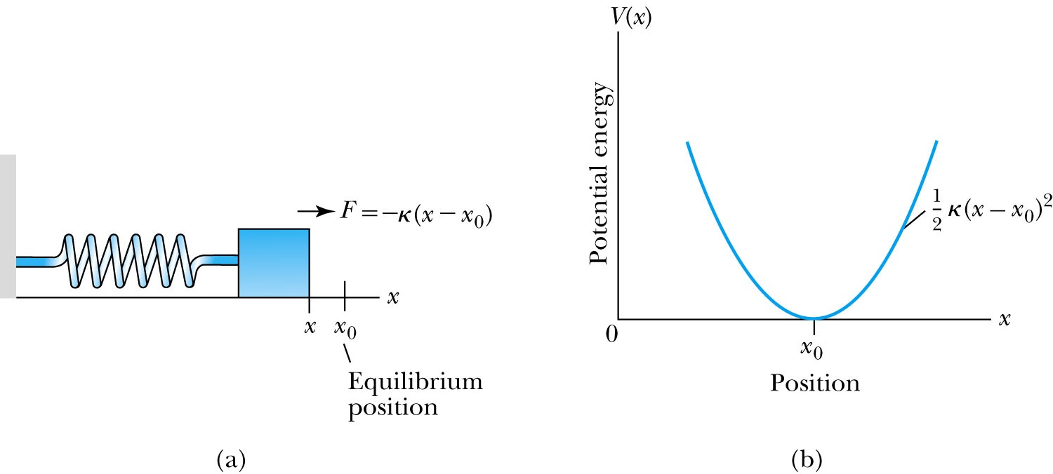
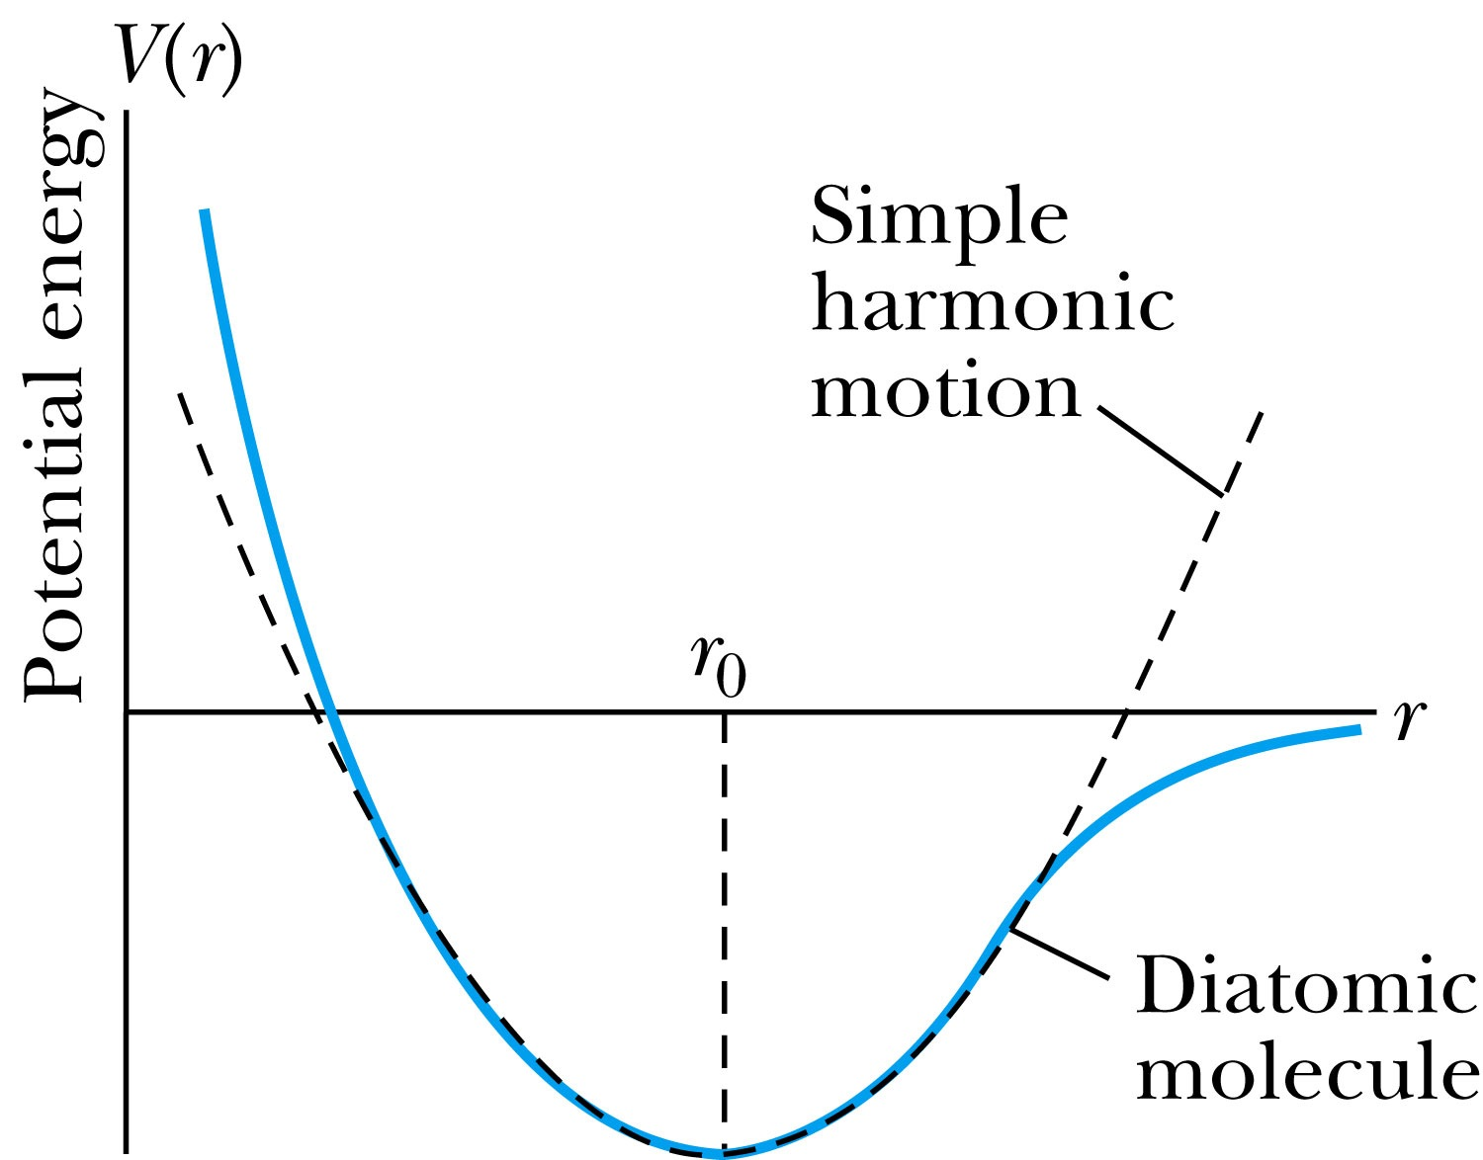
The Simple Harmonic Oscillator
Simple harmonic oscillators describe many physical situations: springs, diatomic molecules and atomic lattices.
Consider the Taylor expansion of a potential function:
The minimum potential at x=x₀, so dV/dx=0 and V₁=0; and the zero potential V₀=0, we have
Substituting this into the wave equation:
Let and which yields .

Slide 19
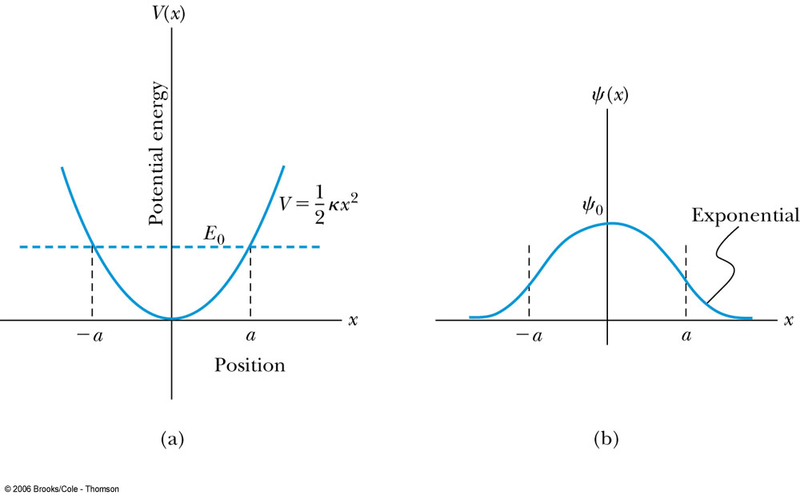
Parabolic Potential Well
If the lowest energy level is zero, this violates the uncertainty principle.
The wave function solutions are where H_{n}(x) are Hermite polynomial function of order n.
In contrast to the particle in a box, where the oscillatory wave function is a sinusoidal curve, in this case the oscillatory behavior is due to the polynomial, which dominates at small x. The exponential tail is provided by the Gaussian function, which dominates at large x.

Slide 20
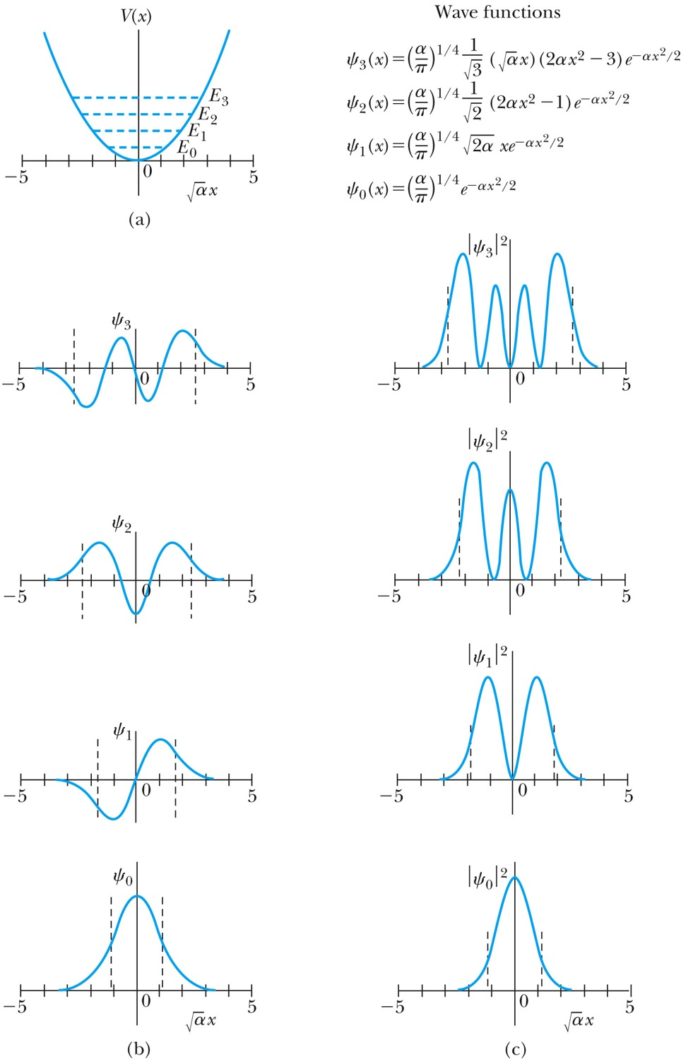
Analysis of the Parabolic Potential Well
The energy levels are given by
The zero point energy is called the Heisenberg limit:
Classically, the probability of finding the mass is greatest at the ends of motion’s range and smallest at the center (that is, proportional to the amount of time the mass spends at each position).
Contrary to the classical one, the largest probability for this lowest energy state is for the particle to be at the center.

Slide 21
Ex. 6.12: Harmonic Oscillator stuff
Normalize the ground state wave function ψ₀ for the simple harmonic oscillator and find the expectation values <x> and <x²>.

Slide 22
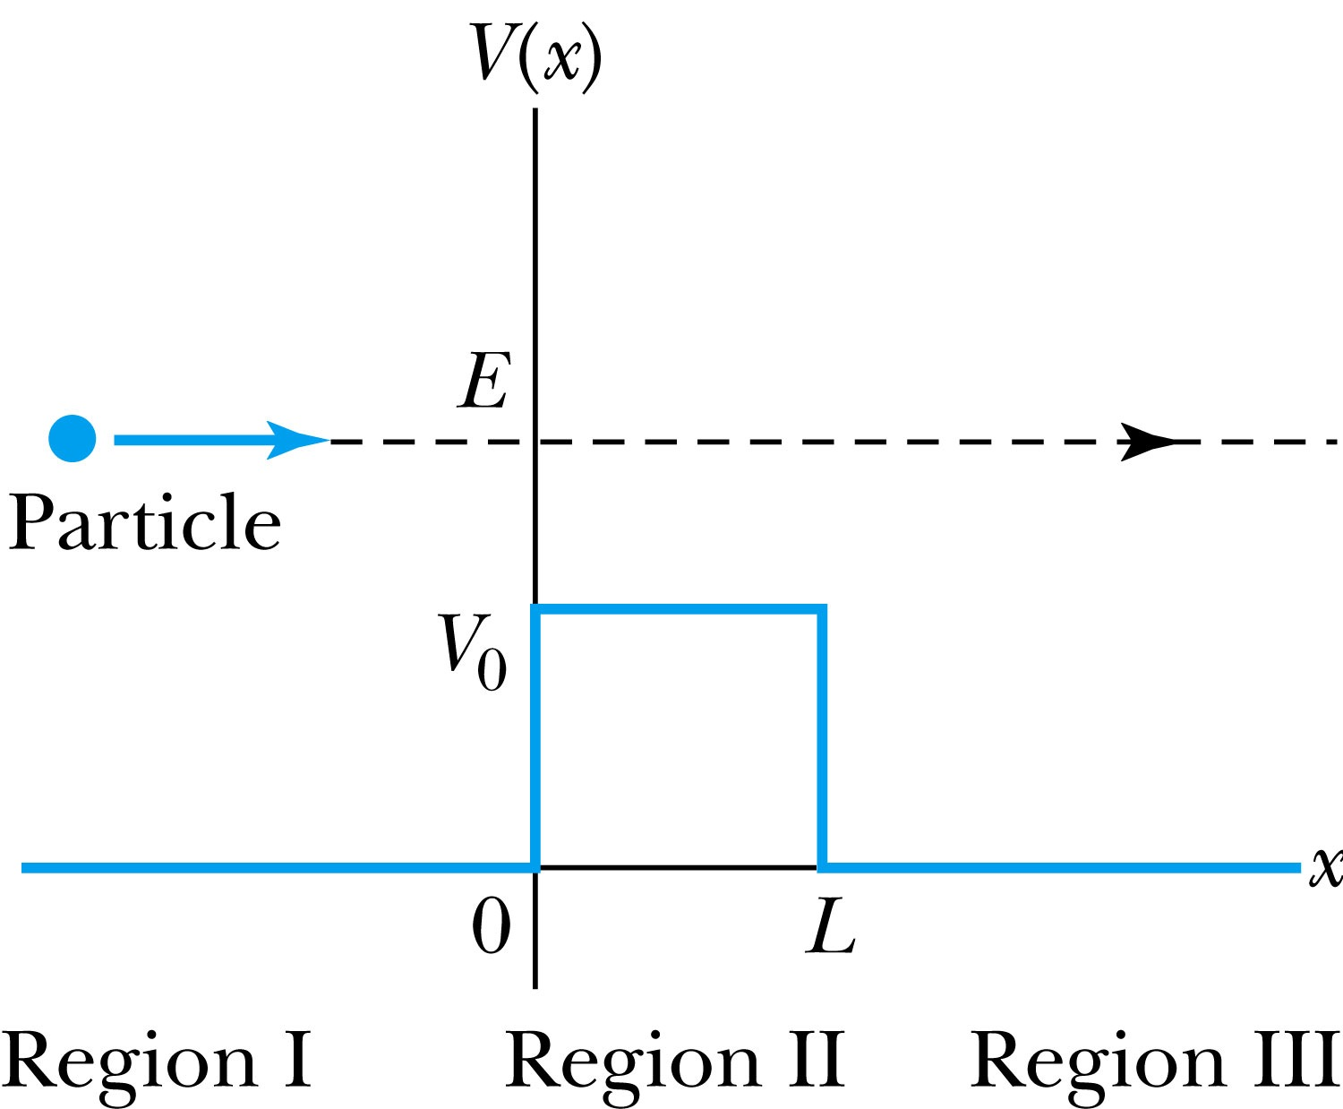
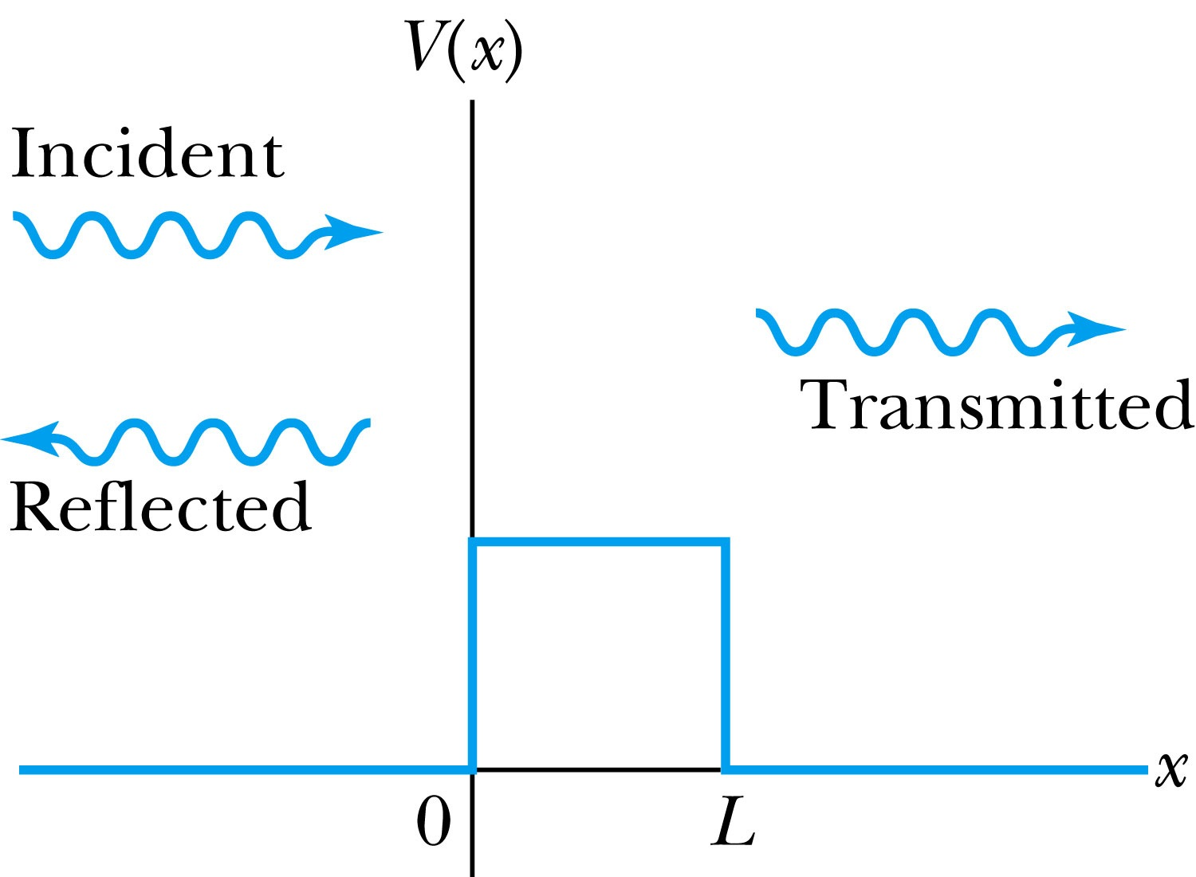
Barriers and Tunneling
Consider a particle of energy E approaching a potential barrier of height V₀ and the potential everywhere else is zero.
We will first consider the case when the energy is greater than the potential barrier.
In regions I and III the wave numbers are:
In the barrier region we have

Slide 23
Reflection and Transmission
The wave function will consist of an incident wave, a reflected wave, and a transmitted wave.
The potentials and the Schrödinger wave equation for the three regions are as follows:
The corresponding solutions are:
As the wave moves from left to right, we can simplify the wave functions to:

