Slide 1
PHYS 3313 – Section 001
Lecture #22
Monday, April 17, 2017
Dr. Jaehoon Yu
Hydrogen Atom Wave Functions
Solution for Angular and Azimuthal Equations
Angular Momentum Quantum Numbers
Magnetic Quantum Numbers
Zeeman Effects

Slide 2
Announcements
Homework #5
  CH6 end of chapter problems: 34, 46 and 65
  CH7 end of chapter problems: 7, 9, 17 and 29
  Due Monday, Apr. 22
Reading assignments
  CH7.6 and the entire CH8
Research presentation deadline is 8pm, Sunday, April 20
Research paper deadline is Wednesday, April 24
Quiz 4 this Wednesday
  At the beginning of the class this Wednesday
  Covers CH6.2 to what we finish today
  BYOF
Reminder: Quadruple extra credit
  Colloquium this Wednesday, April 19, in UH108
  Speaker: Dr. Nigel Lockyer, Director of Fermilab

Slide 3
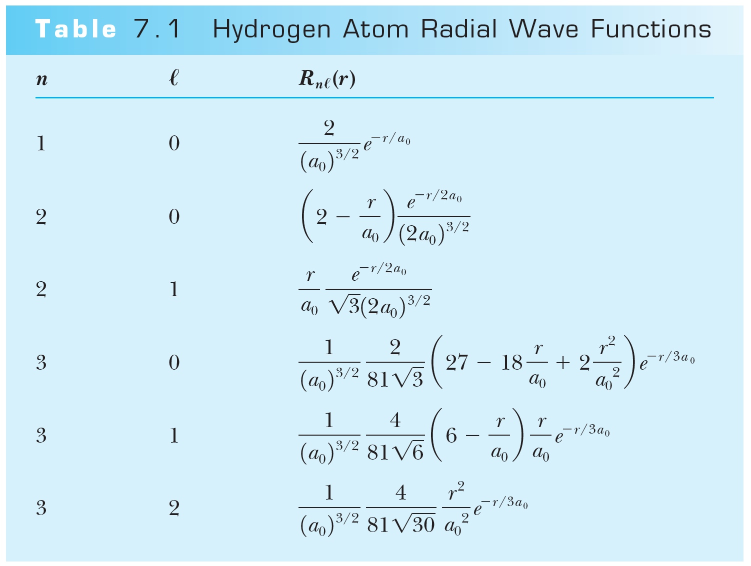
Hydrogen Atom Radial Wave Functions
The radial solution is specified by the values of n and ℓ
First few radial wave functions R_{nℓ}

Slide 4
Solution of the Angular and Azimuthal Equations
The solutions for azimuthal eq. are or
Solutions to the angular and azimuthal equations are linked because both have m_{ℓ}
Group these solutions together into functions
-------- angular equation
-------- azimuthal equation
---- spherical harmonics

Slide 5
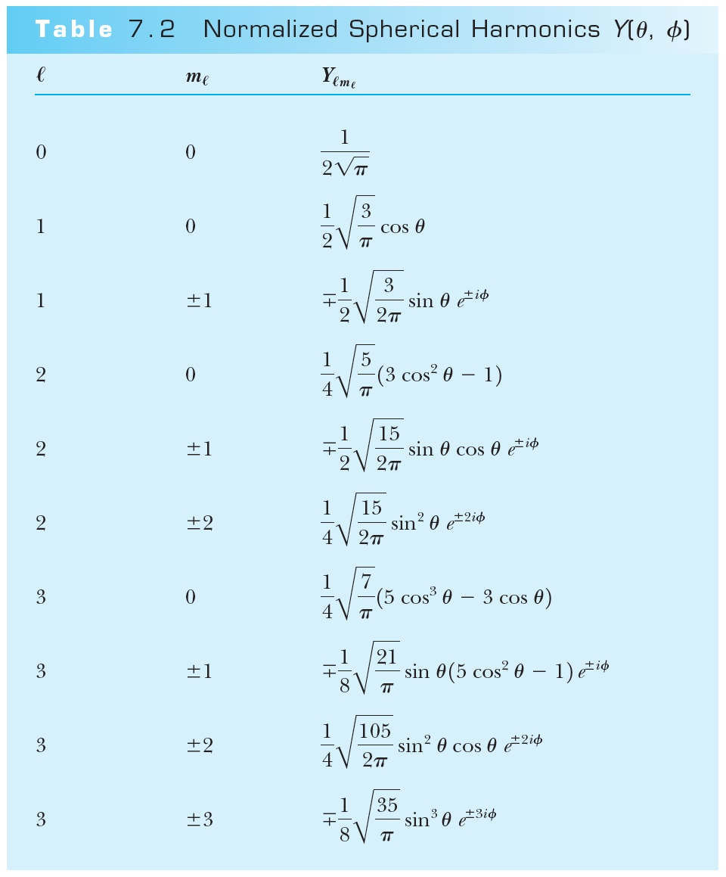
Normalized Spherical Harmonics

Slide 6
Ex 7.1: Spherical Harmonic Function
Show that the spherical harmonic function Y₁₁(θ,φ) satisfies the angular Schrodinger equation.

Slide 7
Solution for the Angular and Azimuthal Equations
The radial wave function R and the spherical harmonics Y determine the probability density for the various quantum states.
Thus the total wave function ψ(r,θ,φ) depends on n, ℓ, and m_{ℓ}. The wave function can be written as

Slide 8
Principal Quantum Number n
The principal quantum number, n, results from the solution of R(r) in the separate Schrodinger Eq. since R(r) includes the potential energy V(r).
The result for this quantized energy is
The negative sign of the energy E indicates that the electron and proton are bound together.

Slide 9
Quantum Numbers
The full solution of the radial equation requires an introduction of a quantum number, n, which is a non-zero positive integer.
The three quantum numbers:
  n Principal quantum number
  ℓ Orbital angular momentum quantum number
  m_{ℓ} Magnetic quantum number
The boundary conditions put restrictions on these
  n = 1, 2, 3, 4, . . . (n>0) Integer
  ℓ = 0, 1, 2, 3, . . . , n − 1 (ℓ < n) Integer
  m_{ℓ} = −ℓ, −ℓ + 1, . . . , 0, 1, . . . , ℓ − 1, ℓ (|m_{ℓ}| ≤ ℓ) Integer
The predicted energy level is

Slide 10
Orbital Angular Momentum Quantum Number ℓ
It is associated with the R(r) and f(θ) parts of the wave function.
Classically, the orbital angular momentum with L = mv_{orbital}r.
ℓ is related to the magnitude of L by .
In an ℓ = 0 state, .
It disagrees with Bohr’s semi-classical “planetary” model of electrons orbiting a nucleus L = nħ.

Slide 11
Orbital Angular Momentum Quantum Number ℓ
Certain energy level is degenerate with respect to ℓ when the energy is independent of ℓ.
Use letter names for the various ℓ values
  ℓ = 0 1 2 3 4 5 . . .
  Letter = s p d f g h . . .
Atomic states are referred by their n and ℓ
  s=sharp, p=principal, d=diffuse, f =fundamental, then in alphabetical order afterward
A state with n = 2 and ℓ = 1 is called the 2p state
  Is 2d state possible?
The boundary conditions require n > ℓ

Slide 12

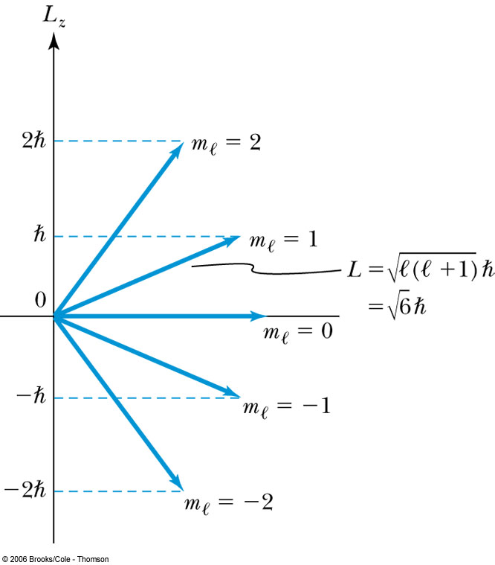

Magnetic Quantum Number m_{ℓ}
The angle φ is a measure of the rotation about the z axis.
The solution for specifies that m_{ℓ} is an integer and related to the z component of L.
The relationship of L, L_{z}, ℓ, and m_{ℓ} for ℓ = 2.
is fixed.
Because L_{z} is quantized, only certain orientations of are possible and this is called space quantization.
m_{ℓ} is called the magnetic moment since z axis is chosen customarily along the direction of magnetic field.

Slide 13
Magnetic Quantum Number m_{ℓ}
Quantum mechanics allows to be quantized along only one direction in space and because of the relationship L² = L_{x}² + L_{y}² + L_{z}², once a second component is known, the third component will also be known. ➔ violation of uncertainty principle
  One of the three components, such as L_{z}, can be known clearly but the other components will not be precisely known
Now, since we know there is no preferred direction,
We expect the average of the angular momentum components squared to be:

Slide 14
Magnetic Effects on Atomic Spectra—The Normal Zeeman Effect
A Dutch physicist Pieter Zeeman showed as early as 1896 that the spectral lines emitted by atoms in a magnetic field split into multiple energy levels. It is called the Zeeman effect.
The Normal Zeeman effect:
A spectral line of an atom is split into three lines.
Consider the atom to behave like a small magnet.
The current loop has a magnetic moment μ = IA and the period T = 2πr / v. If an electron can be considered as orbiting a circular current loop of I = dq / dt around the nucleus, we obtain
where L = mvr is the magnitude of the orbital
angular momentum

Slide 15
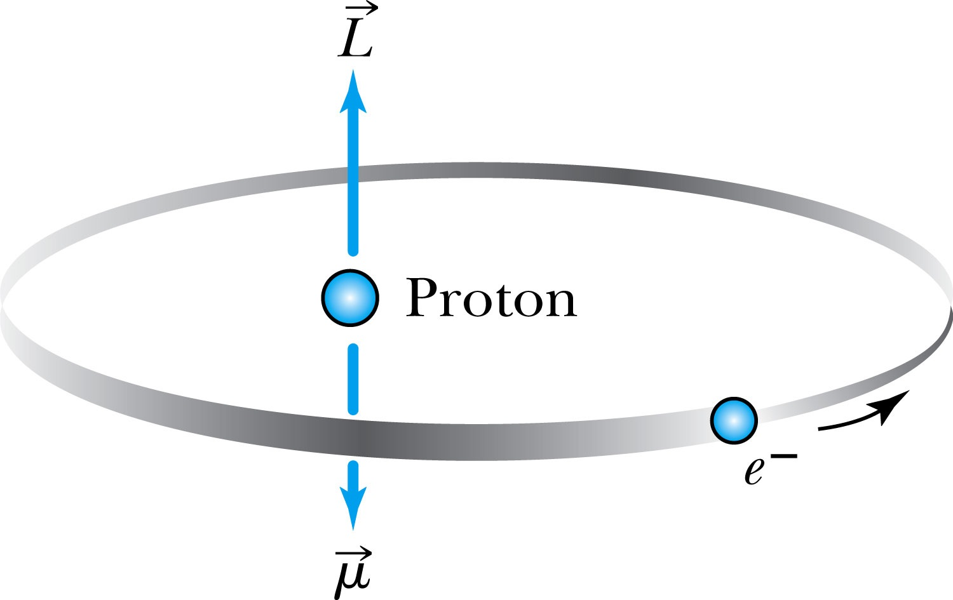
The Normal Zeeman Effect
Since there is no magnetic field to align them, points in random directions.
The dipole has a potential energy
The angular momentum is aligned with the magnetic moment, and the torque between and causes a precession of .
Where μ_{B} = eħ / 2m is called the Bohr magneton.
cannot align exactly in the z direction and
has only certain allowed quantized orientations.

Slide 16
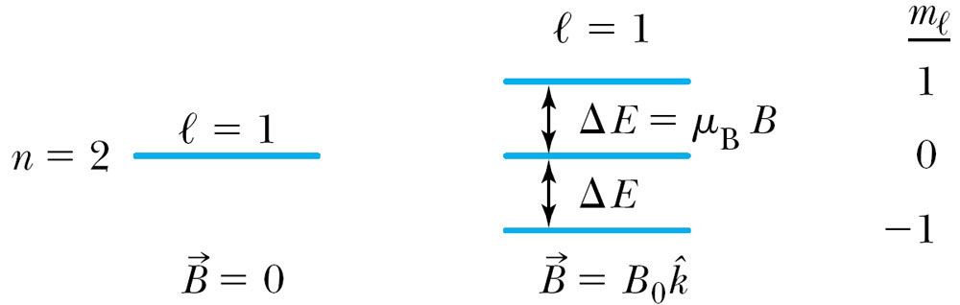
The Normal Zeeman Effect
The potential energy is quantized due to the magnetic quantum number m_{ℓ}.
When a magnetic field is applied, the 2p level of atomic hydrogen is split into three different energy states with the electron energy difference of ΔE = μ_{B}B Δm_{ℓ}.
So split is into a total of 2ℓ+1 energy states
m_{ℓ} | Energy
1 | E₀ + μ_{B}B
0 | E₀
−1 | E₀ − μ_{B}B

Slide 17
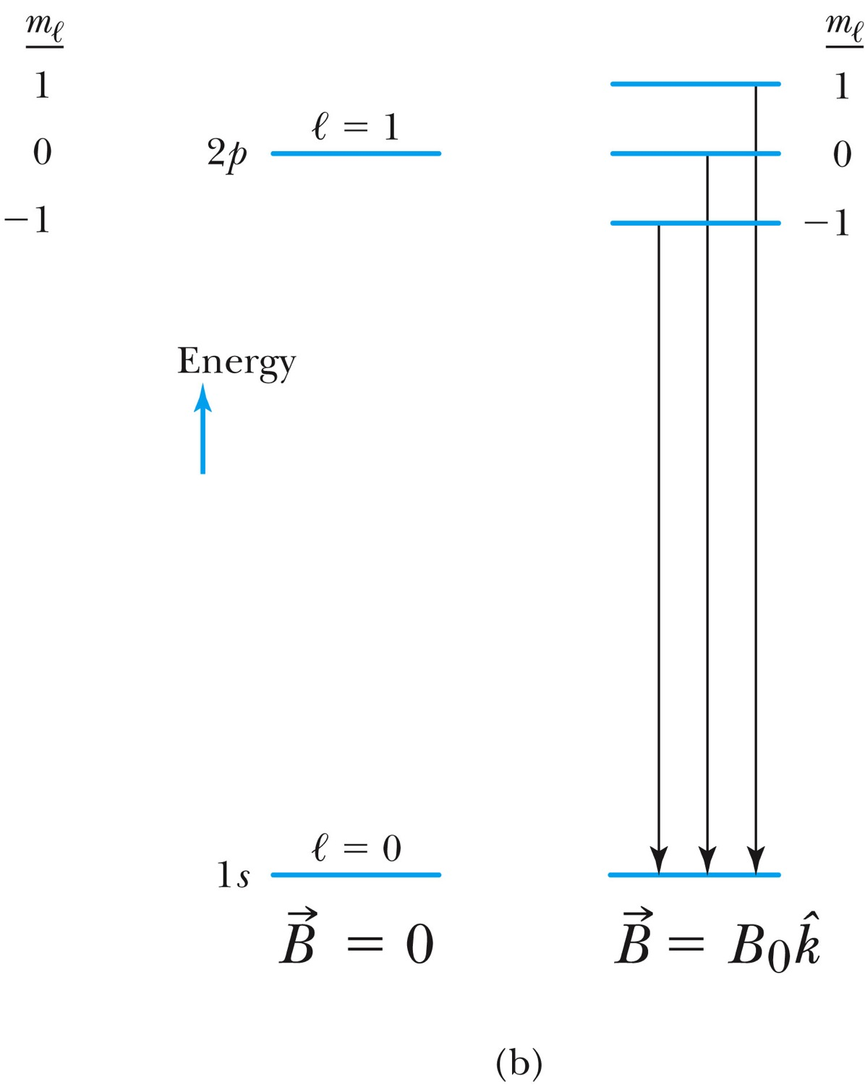
The Normal Zeeman Effect
A transition from 1s to 2p
A transition from 2p to 1s

Slide 18
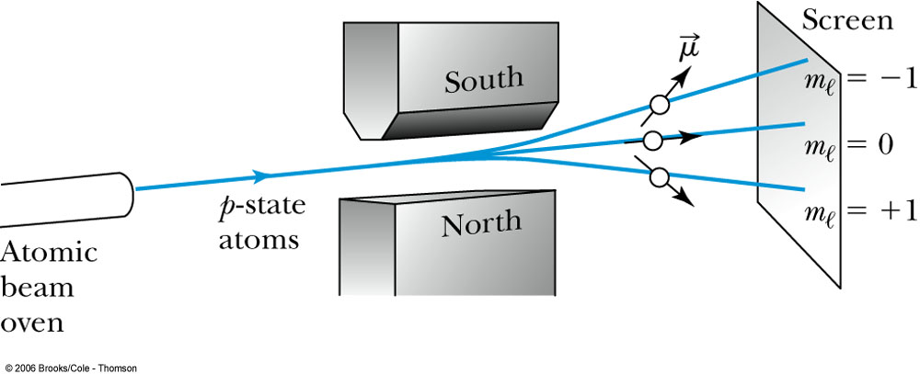
The Normal Zeeman Effect
An atomic beam of particles in the ℓ = 1 state pass through a magnetic field along the z direction. (Stern-Gerlach experiment)
The m_{ℓ} = +1 state will be deflected down, the m_{ℓ} = −1 state up, and the m_{ℓ} = 0 state will be undeflected. ➔ saw only 2 with silver atom
If the space quantization were due to the magnetic quantum number m_{ℓ}, the number of m_{ℓ} states is always odd at (2ℓ + 1) and should have produced an odd number of lines.

