Slide 1
PHYS 3313 – Section 001 Lecture #23
Wednesday, April 19, 2017
Dr. Jaehoon Yu
Intrinsic Spin
Equipartition Theorem
Quantum Distributions

Slide 2
Announcements
Reminder: Homework #5
CH6 end of chapter problems: 34, 46 and 65
CH7 end of chapter problems: 7, 9, 17 and 29
Due Monday, Apr. 24
Reminder: Reading assignments
CH7.6 and the entire CH8
Final Exam
In class, Monday, May 8
Comprehensive exam – covers CH1.1 through what we finish today (CH8?)+ math refresher
BYOF
Research presentation deadline is 8pm, Sunday, April 23
Research paper deadline is Wednesday, April 26
Reminder: Quadruple extra credit
Colloquium TODAY in UH108
Speaker: Dr. Nigel Lockyer, Director of Fermilab

Slide 3
Presentation Judging Guidelines
Contents of the presentation: 60
Inclusion of all important points as mentioned in the contents
The quality of the research and making the right points
Quality of the presentation itself: 15
Does the presentation have necessary components, such as title page, outline?
Is the presentation coherent and to the point?
Are the slides high quality? Pictures in good resolution?
Presentation manner: 10
Are the presenters professional?
Do they keep eye contact and the audience’s attention?
Q&A handling: 10
Do all the group members participate in Q&A?
Do the answers make sense and to the point?
Staying in the allotted presentation time: 5
Did the presentation stay within the allotted time?
Did the answer drag along unnecessarily?
Judging participation and sincerity: 5

Slide 4
Intrinsic Spin
In 1920, to explain spectral line splitting of Stern-Gerlach experiment, Wolfgang Pauli proposed the forth quantum number assigned to electrons
In 1925, Samuel Goudsmit and George Uhlenbeck in Holland proposed that the electron must have an intrinsic angular momentum and therefore a magnetic moment.
Paul Ehrenfest showed that the surface of the spinning electron should be moving faster than the speed of light to obtain the needed angular momentum!!
In order to explain experimental data, Goudsmit and Uhlenbeck proposed that the electron must have an intrinsic spin quantum number s = ½.

Slide 5
Intrinsic Spin
The spinning electron reacts similarly to the orbiting electron in a magnetic field. (Dirac showed that this is necessary due to special relativity.)
We should try to find L, L_{z}, ℓ, and m_{ℓ}.
The magnetic spin quantum number m_{s} has only two values, m_{s} = ±½.
The electron’s spin will be either “up” or “down” and can never be spinning with its magnetic moment μ_{s} exactly along the z axis.
For each state of the other quantum numbers, there are two spin values
The intrinsic spin angular momentum vector .

Slide 6
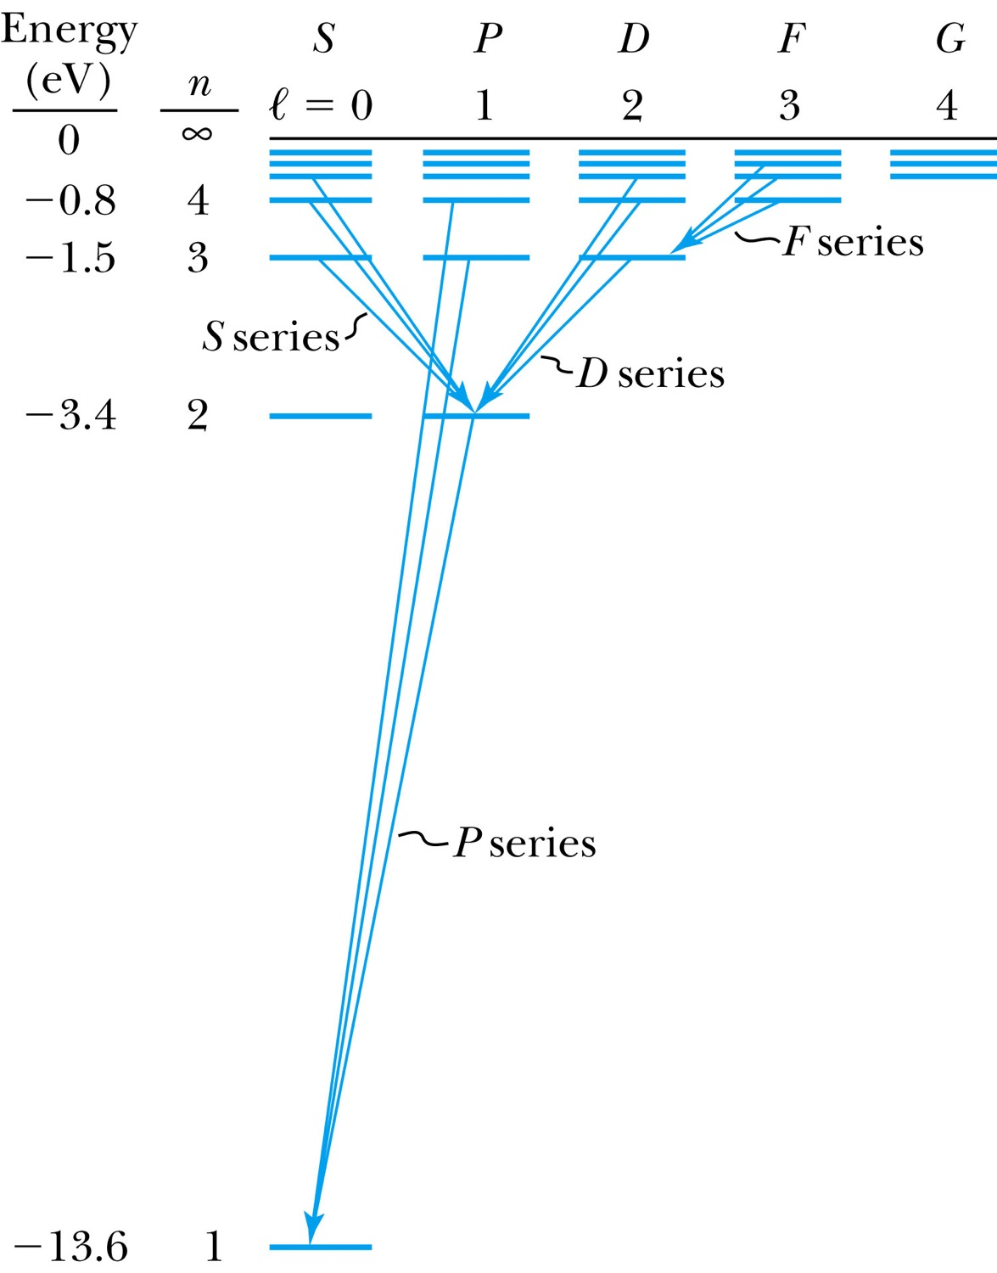
Energy Levels and Electron Probabilities
For hydrogen, the energy level depends on the principle quantum number n.
In ground state an atom cannot emit radiation. It can absorb electromagnetic radiation, or gain energy through inelastic bombardment by particles.

Slide 7
Selection Rules
We can use the wave functions to calculate transition probabilities for the electron to change from one state to another.
Allowed transitions: Electrons absorbing or emitting photons can change states when Δℓ = ±1. (Evidence for the photon carrying one unit of angular momentum!)
Δn=anything
Δℓ = ±1
Δm_{ℓ} = 0, ±1
Forbidden transitions: Other transitions possible but occur with much smaller probabilities when Δℓ ≠ ±1.

