Slide 1
PHYS 3313 – Section 001 Lecture #1
Monday, Jan. 14, 2019
Dr. Jaehoon Yu
Research and Study Group Assignment
Who am I?
From Higgs to Dark Matter!!
Class Information
What do we want from this class?
What is Physics?
Brief history of modern physics

Slide 2
Announcements
Plea to you: Please turn off your cell-phones, iPads, game consoles and computers in the class
Reading assignment #1: Read and follow through appendices 3, 5, 6 and 7 by Monday, Jan. 21
There will be a quiz next Wednesday, Jan. 23, on these reading assignments
Physics colloquium
4:00pm Wednesdays

Slide 3
Who am I?
Name: Dr. Jaehoon Yu (You can call me Dr. Yu)
Office: Rm 342, Chemistry and Physics Building
Extension: x22814, E-mail: jaehoonyu@uta.edu
My profession: High Energy Particle Physics (HEP)
Collide particles (protons on anti-protons or electrons on anti-electrons, positrons) at the energies equivalent to 10,000 Trillion degrees
To understand
Fundamental constituents of matter
Forces between the constituents (gravitational, electro-magnetic, weak and strong forces)
Origin of Mass
Search for Dark Matter and Making of Dark Matter Beams
Creation of Universe (Big Bang Theory)
A pure scientific research activity
Direct use of the fundamental laws we find may take longer than we want but
Indirect product of research contribute to every day lives; eg. WWW
Why do we do with this?
Make our everyday lives better to help us live well as an integral part of the universe

Slide 4
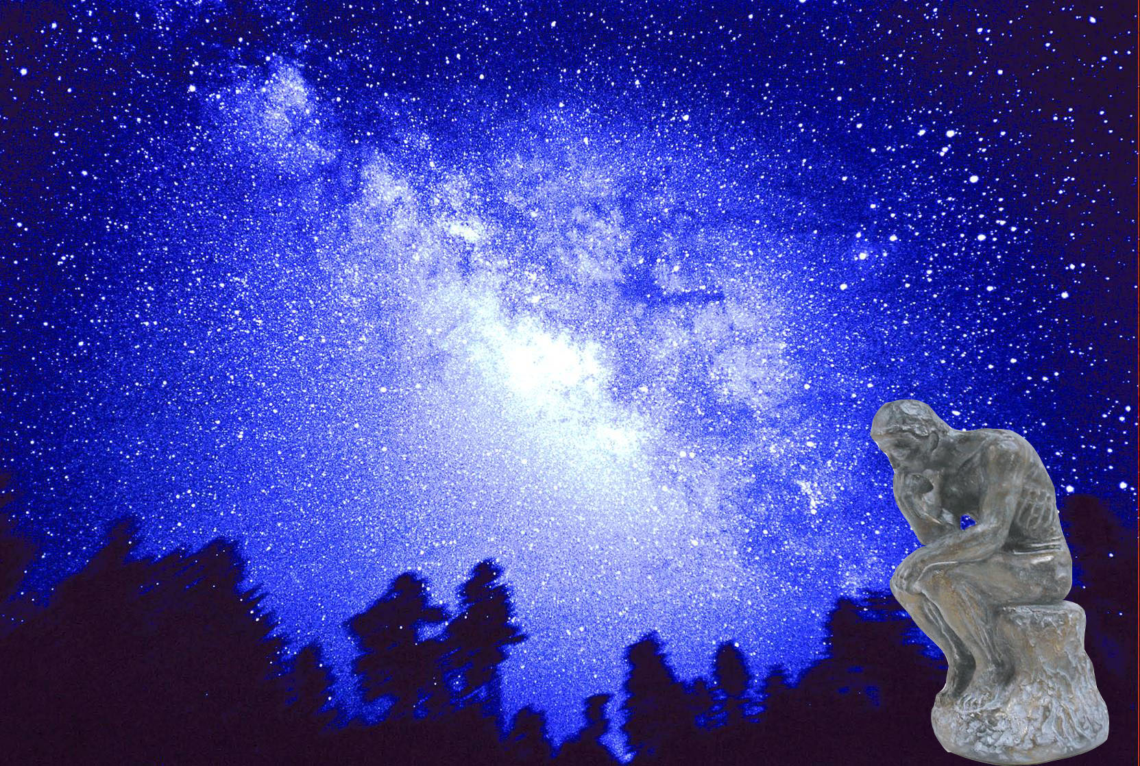
We always wonder…
What makes up the universe?
How does the universe work?
What holds the universe together?
How can we live in the universe well?
Where do we all come from?

Slide 5
High Energy Physics
Definition: A field of physics that pursues understanding the fundamental constituents of matter and basic principles of interactions between them.
Known interactions (forces):
Gravitational Force
Electromagnetic Force
Weak Nuclear Force
Strong Nuclear Force
Current theory: The Standard Model of Particle Physics

Slide 7
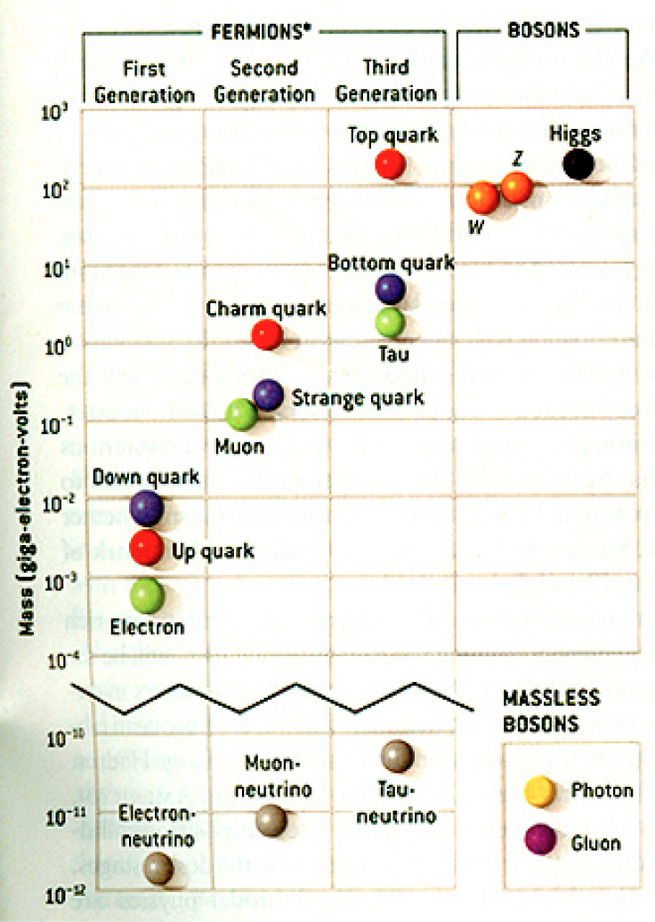
HEP and the Standard Model
Discovered in 1995, ~175m_{p}
Discovered in 2012, ~125m_{p}
Make up most ordinary matters ~0.1m_{p}
Total of 16 particles (12+4 force mediators) make up all the visible matter in the universe! ➔ Simple and elegant!!!
Tested to a precision of 1 part per million!

Slide 8
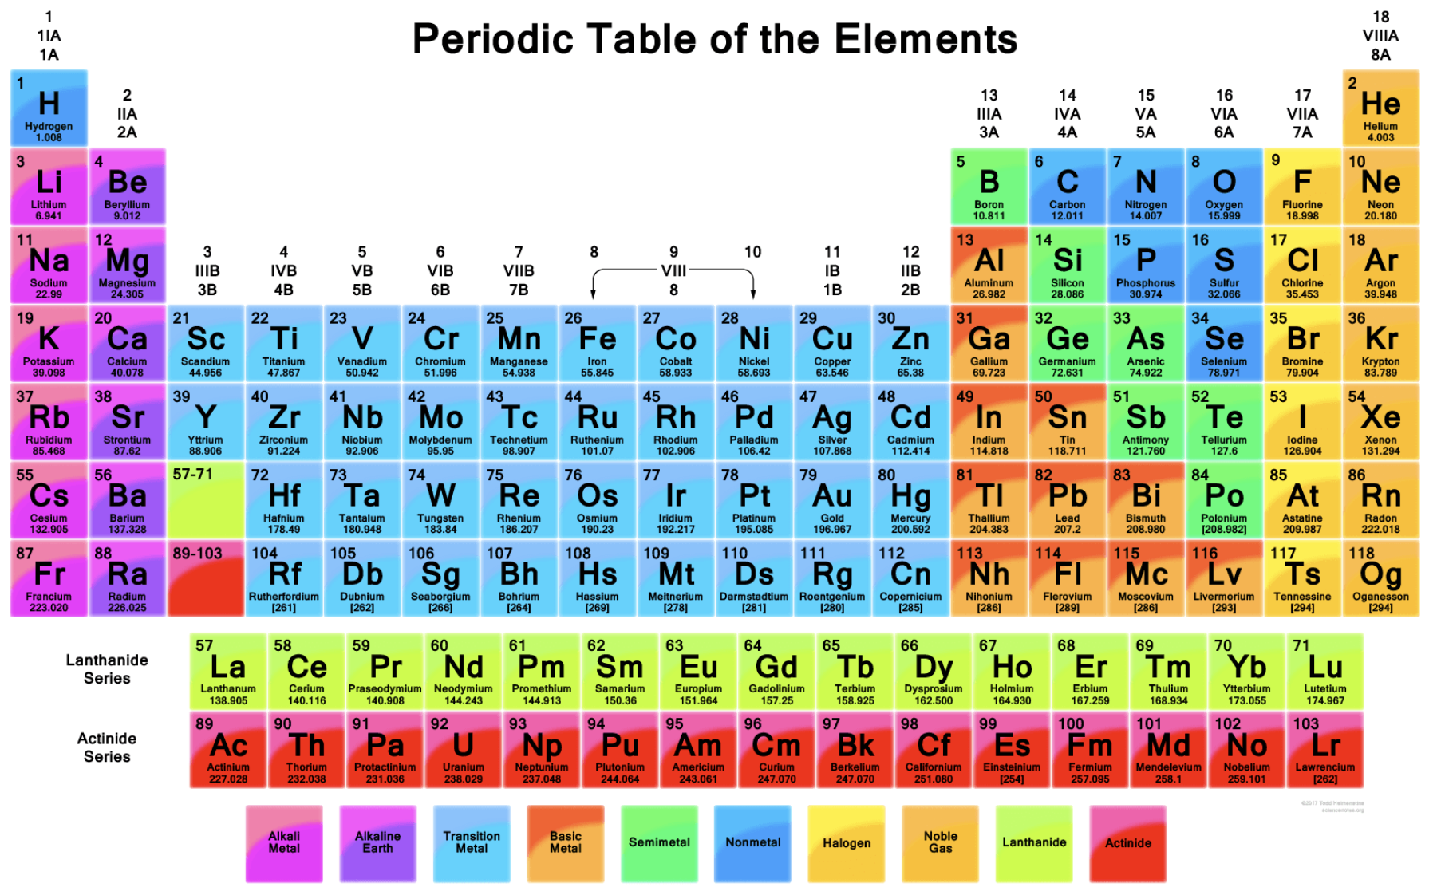

Slide 9
What are some issues in HEP?
Why is the mass range so large (0.1m_{p} – 175 m_{p})?
Is the particle discovered at the LHC really the Higgs particle?
Why is the matter in the universe made only of particles?
Neutrinos have mass!! (OMG!! The SM is broken!!! )
What are the mixing parameters, particle-anti particle asymmetry and the neutrino mass ordering?
Why are there only four apparent forces?
Were they all unified at the Big Bang?
Me!
Notes:
----- Meeting Notes (2/12/14 10:16) -----

Slide 10
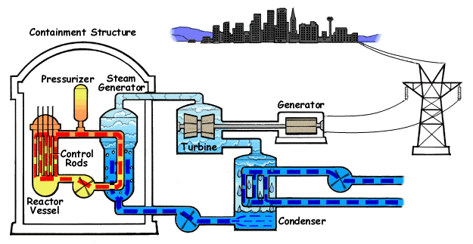
How does a nuclear power plant work?
Duke Energy
My 1000 year dream: Skip the whole thing!
Make electricity directly from nuclear force!

Slide 11
So what’s the problem?
Why is the mass range so large (0.1m_{p} – 175 m_{p})?
Is the particle we discovered really the Higgs particle?
Why is the matter in the universe made only of particles?
Neutrinos have mass!! What are the mixing parameters, particle-anti particle asymmetry and mass ordering?
Why are there only four apparent forces?
Were they all unified at the Big Bang?
Is the picture we present the real thing?
Notes:
----- Meeting Notes (2/12/14 10:16) -----

Slide 12
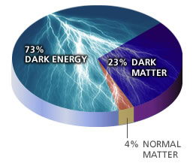
What makes up the universe?
~95% unknown!!
Notes:
----- Meeting Notes (2/12/14 10:16) -----

Slide 13
So what’s the problem?
Why is the mass range so large (0.1m_{p} – 175 m_{p})?
Is the particle we discovered really the Higgs particle?
Why is the matter in the universe made only of particles?
Neutrinos have mass!! What are the mixing parameters, particle-anti particle asymmetry and mass ordering?
Why are there only four apparent forces?
Were they all unified at the Big Bang?
Is the picture we present the real thing?
What makes up the remaining ~95% of the universe?
Are there any other particles we don’t know of?
Big deal for the new LHC Run!
Where do we all come from?
How can we live well in the universe as an integral partner?
Notes:
----- Meeting Notes (2/12/14 10:16) -----

Slide 14
Accelerators are Powerful Microscopes.
They make high energy particle beams
that allow us to see small things.
seen by
low energy beam
(poorer resolution)
seen by
high energy beam
(better resolution)

Slide 15
Accelerators are also Time Machines.
They make particles last seen
in the earliest moments of the universe.
Energy
particle beam
energy
anti-particle beam
energy
Particle and anti-particle annihilate.
E = mc²

Slide 16
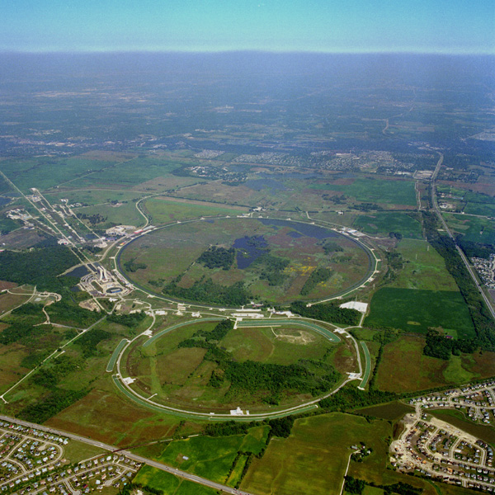
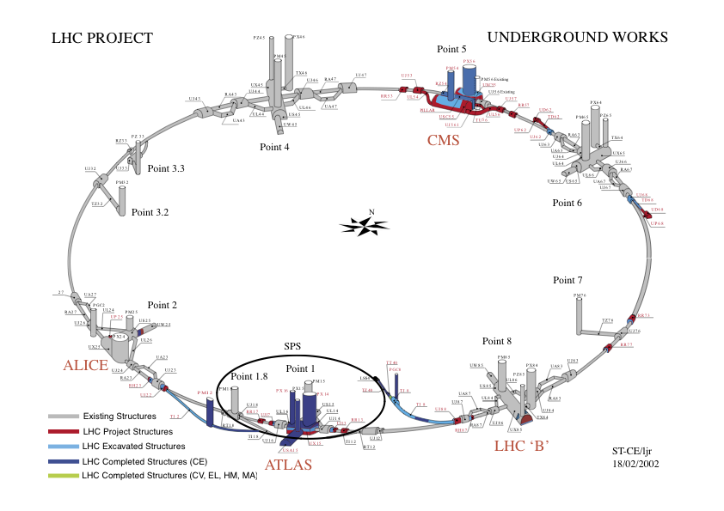
Fermilab Tevatron and LHC at CERN
World’s Highest Energy proton-anti-proton collider
4km (2.5mi) circumference
E_{cm}=1.96 TeV (=6.3x10⁻⁷J/p➔ 13M Joules on the area smaller than 10⁻⁴m²)
Equivalent to the kinetic energy of a 20t truck at the speed 130km/hr
~100,000 times the energy density at the ground 0 of the Hiroshima atom bomb
Tevatron was shut down in 2011
New frontiers with high intensity proton beams including the search for dark matter with beams!!
World’s Highest Energy p-p collider
27km (17mi) circumference, 100m (300ft) underground
Design E_{cm}=14 TeV (=44x10⁻⁷J/p➔ 362M Joules on the area smaller than 10⁻⁴m²)
Equivalent to the kinetic energy of a B727 (80tons) at the speed 310km/hr
~3M times the energy density at the ground 0 of the Hiroshima atom bomb
Discovered a new heavy particle that looks Higgs in 2012
Search for new particles has been ongoing!!
Shut down for two years begun for high stat. upgrade!
Chicago
CDF
p
DØ
Tevatron
p

Slide 17
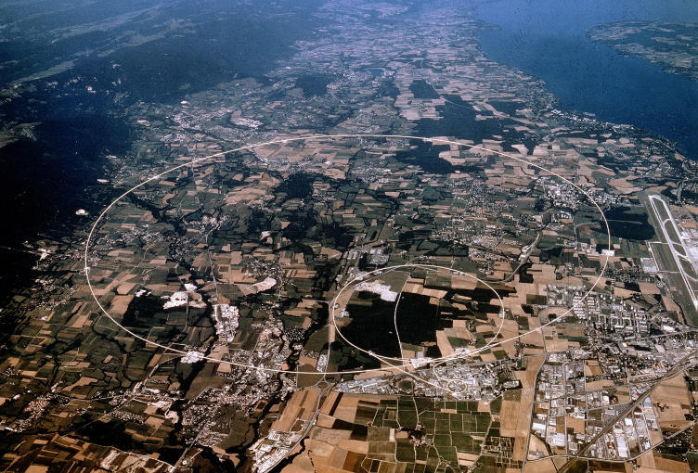
LHC @ CERN Aerial View
CMS
France
Geneva Airport
ATLAS
Swizerland

Slide 18
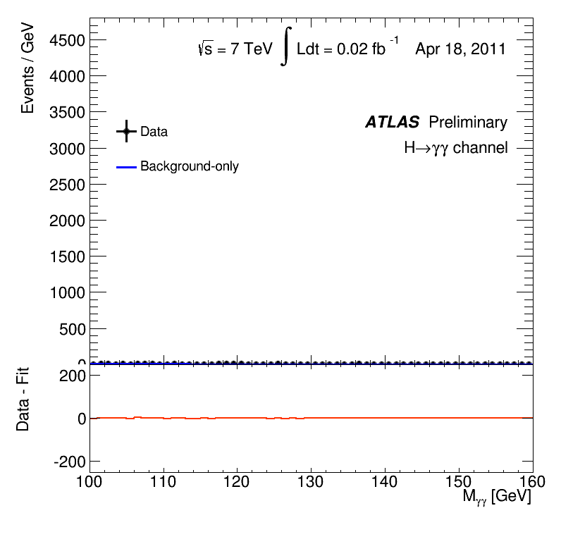
What did statistics do for Higgs?

Slide 19
Fermilab Neutrino Program
Fermilab is building high intensity proton beam based neutrino physics facility (LBNF – Long Baseline Neutrino Facility)
Precision neutrino oscillation properties
Mass Hierarchy, CP phase, etc
Supernova detection
Physics beyond Standard Model
Search for sterile neutrinos, dark matter, etc
Require capable ND and large mass underground FD w/ a capability for low energy detection, good position resolution, timing resolution and good particle ID
Also a short-baseline neutrino program

Slide 20
Light DM Production at High Intensity Accelerator
The Higgs particle, a part of only 5% of the universe, may’ve been seen
The remaining 95% of the universe must explored further!!

Slide 21
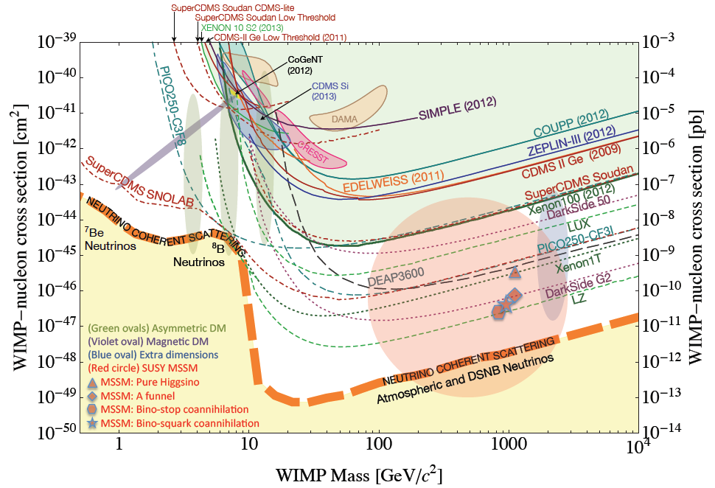
Dark Matter Search Motivation
No DM

Slide 22
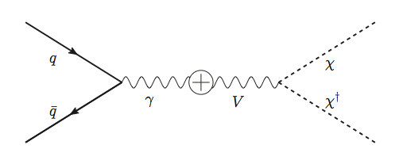
Light DM Production at High Intensity Accelerator
The Higgs particle, a part of only 5% of the universe, may’ve been seen
The remaining 95% of the universe must be explored further!
Detection of DM (elastic):
How does a DM event look in an experiment?:
Minimal model w/ kinetic mixing
Battell et al., PRD80, 095024
Higher E_{P} @ DUNE
Lower E_{P} @ MiniBooNE
High Intensity Proton Beam

Slide 23
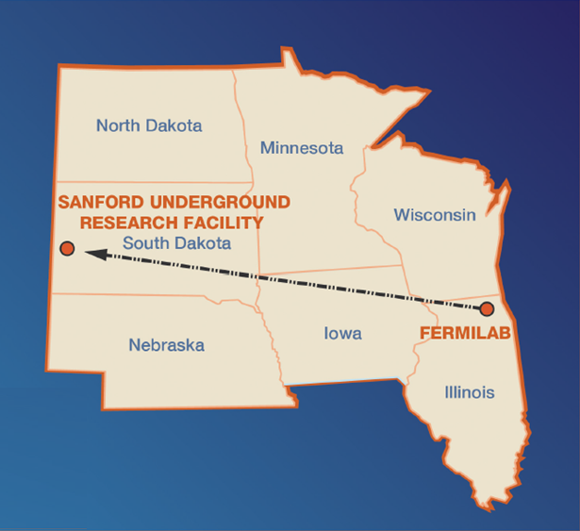
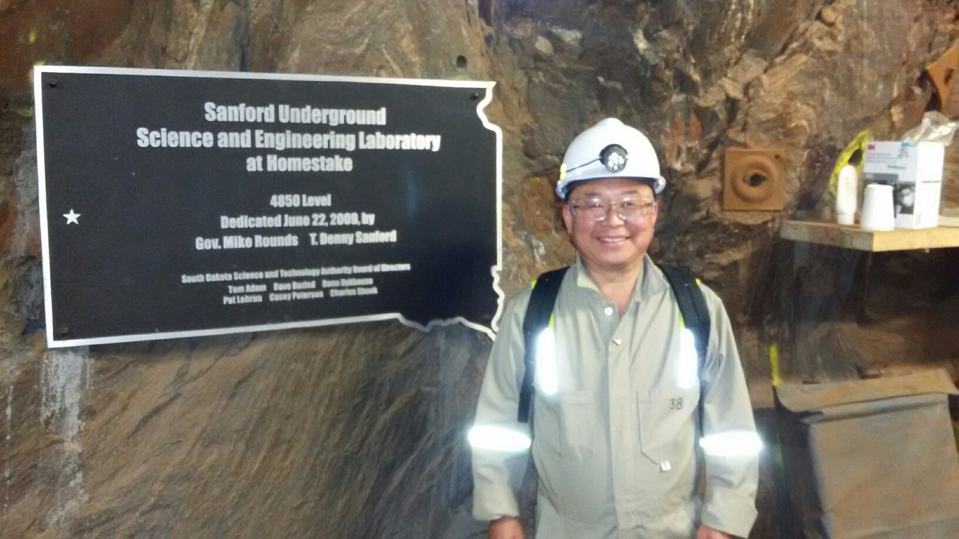
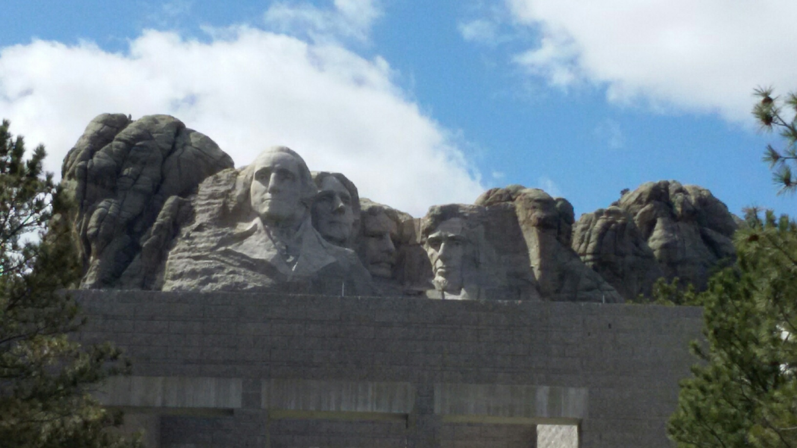
The Next Big Thing - DUNE Experiment
Stands for Deep Under Ground Neutrino Experiment
The flagship long baseline (1300km) ν experiment
1500m underground in South Dakota
Yes, you are right! Mount Rushmore!!
Nobel Winning Neutrino Discovery by Ray Davis in 1960’s
Many Dark Matter experiments in progress
New DUNE area to be excavated shortly

Slide 24
The Next Big Thing - DUNE Experiment
Stands for Deep Under Ground Neutrino Experiment
The flagship long baseline (1300km) ν experiment
1500m underground in an old South Dakota gold mine
With very high intensity proton beams (1.2MW → 2.4MW!)
Result in large number of neutrinos
A great potential for DM & other physics beyond the Standard Model
Food for thoughts! How many 100GeV protons per second do these beam powers correspond to?
Large mass (~80kt! total) LAr TPC at SURF
Powerful near detector
Was born in March 2015! A four year old toddler!
Combination of two large proposals – LBNE (US) and LBNO (EU)
1132 collaborators from ~179 institutes in 32 countries

Slide 25
The Map of the DUNE Experiment
1132 collaborators
179 institutions
32 countries

Slide 26
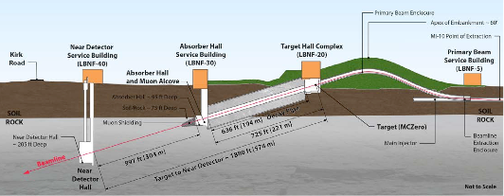
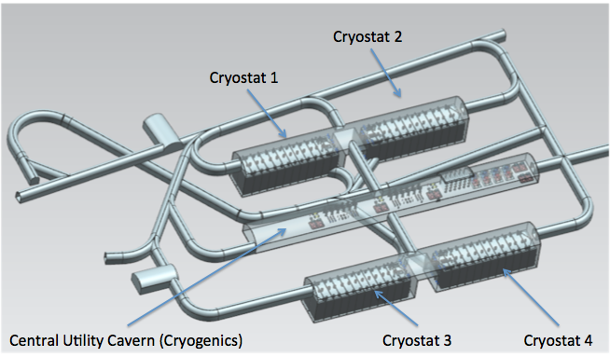
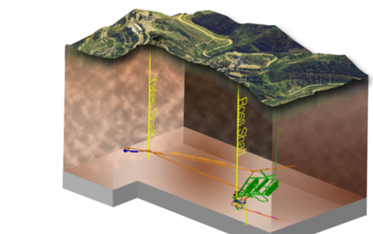
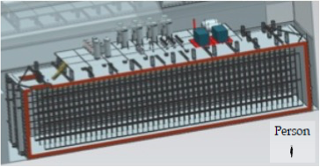
The Components of the DUNE Experiment
1300km (800 miles)
4 caverns with ~20kt total each
1500m underground
15m
66m
15m

Slide 27
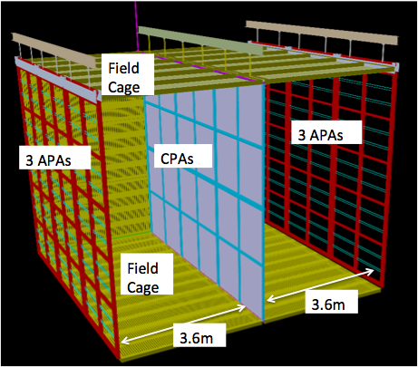
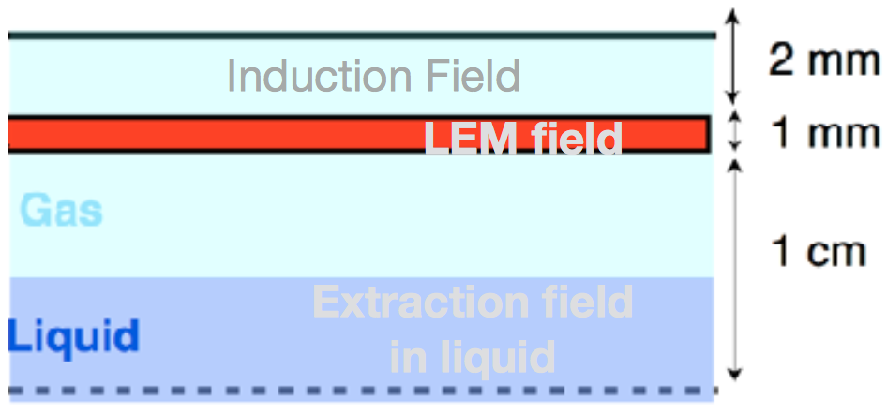
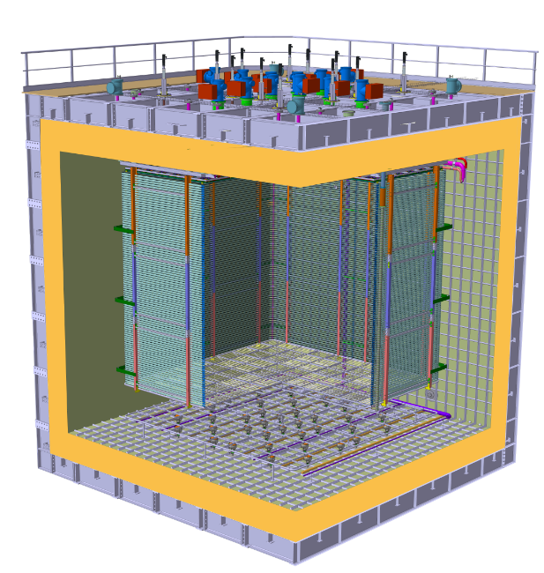
Prototyping the DUNE Experiment
Building four 10kt active volume LAr Detectors very challenging!
Need to understand many aspects of the detector technology
Two full scale prototype detectors under construction at CERN – SP and DP
35T @ FNAL
single phase technology: Interaction & detection in LAr
protoDUNE SP@CERN
6mx6mx6m Active
WA105 3x1x1@CERN
600t
Dual Phase: Interaction in LAr & detection in GAr
6 m
protoDUNE DP@CERN
6mx6mx6m Active
6 m
6 m

Slide 28
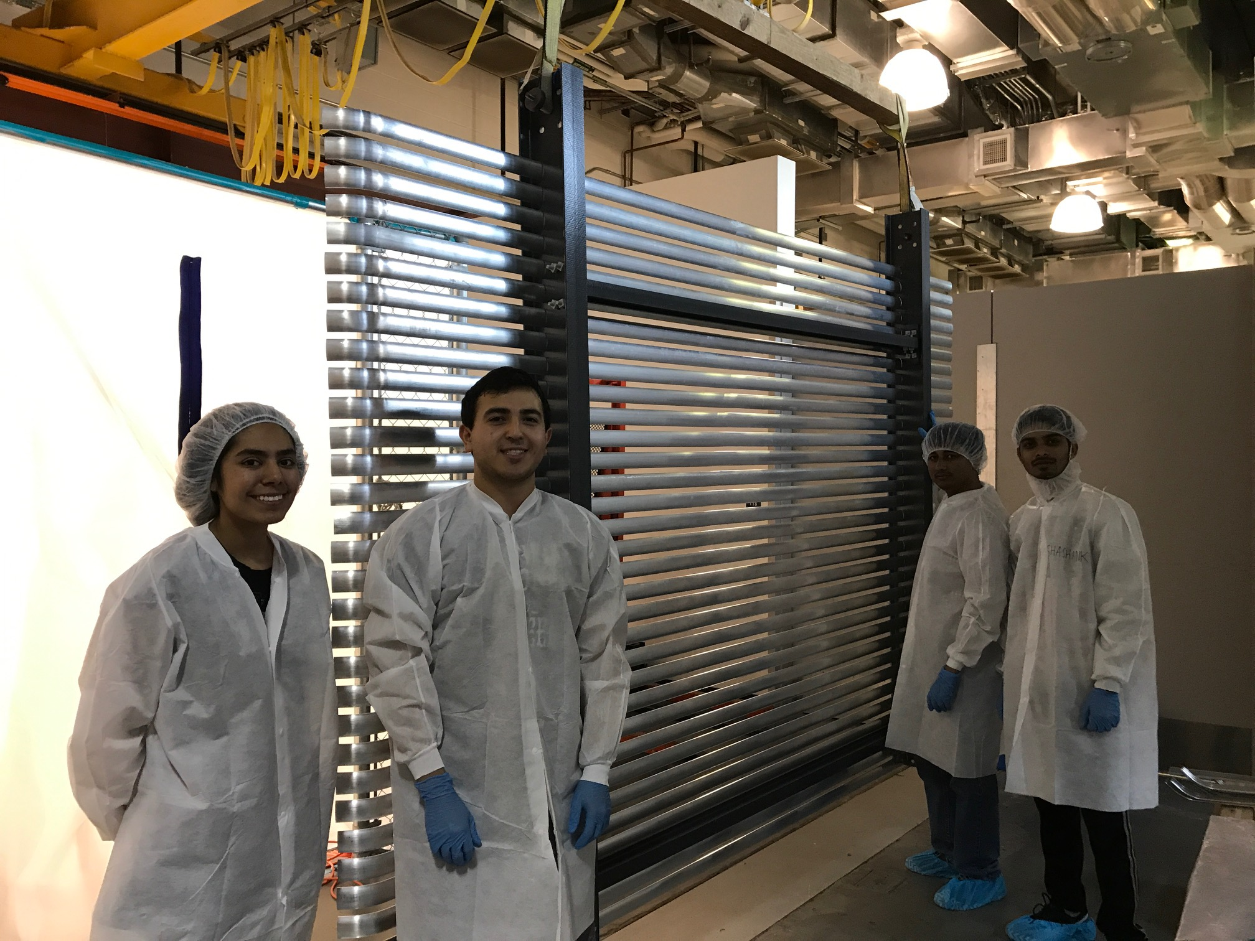
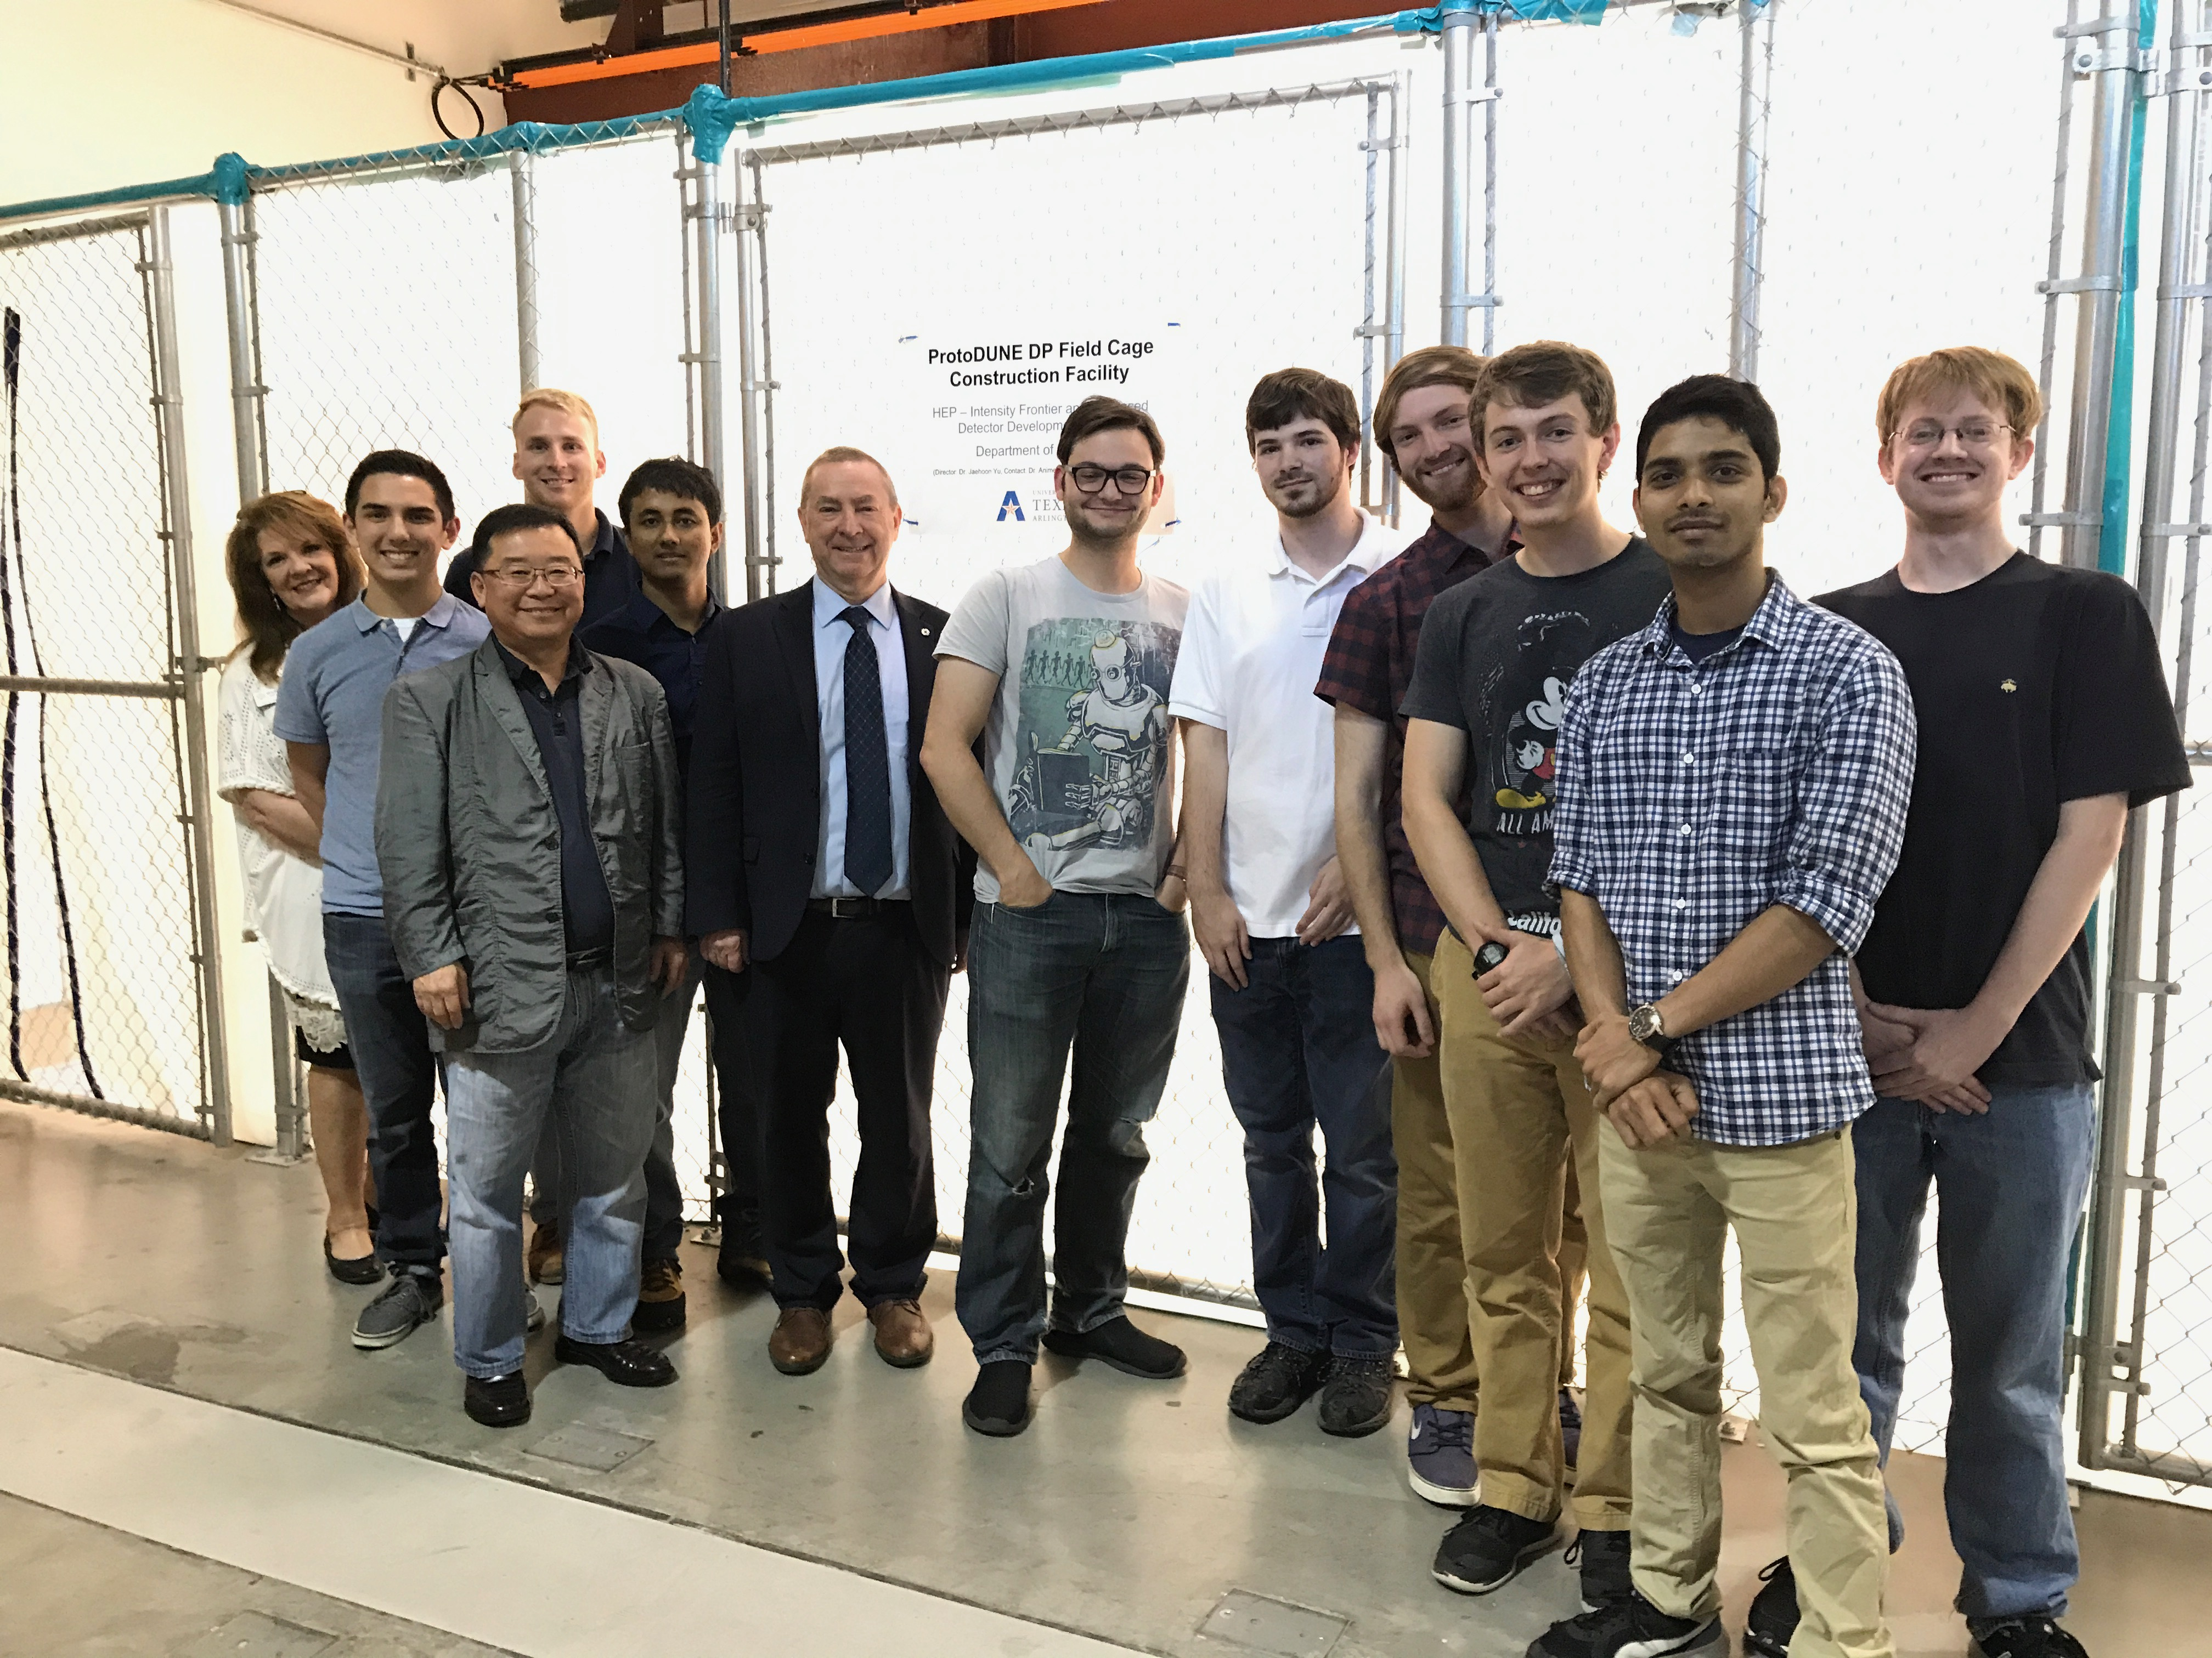
The UTA Field Cage Team

Slide 29
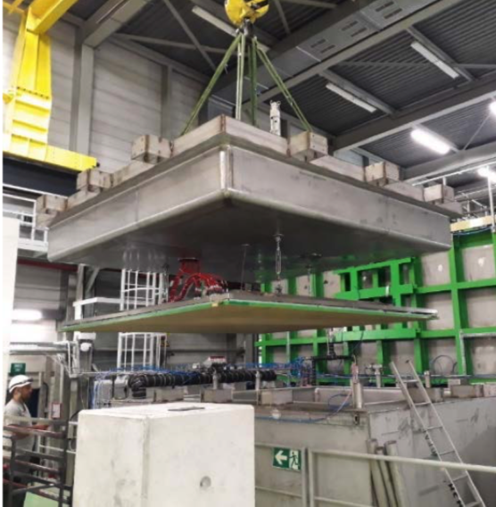
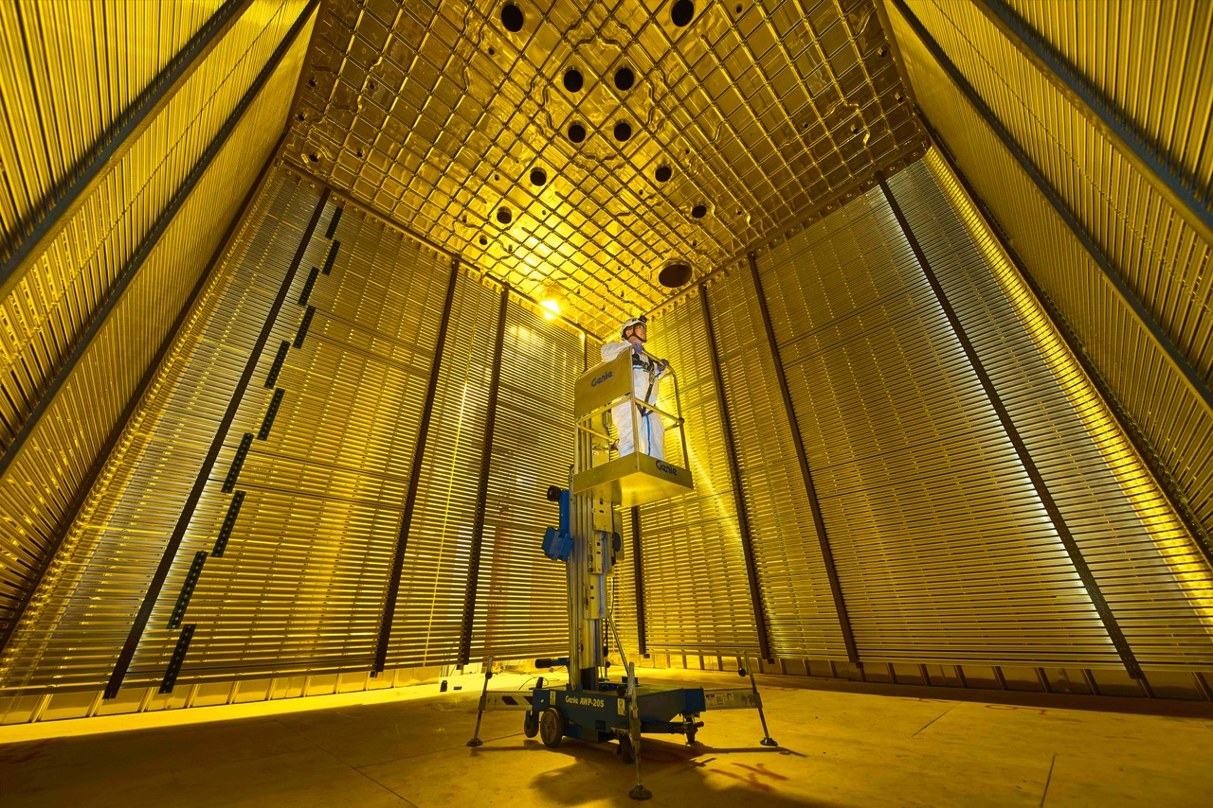
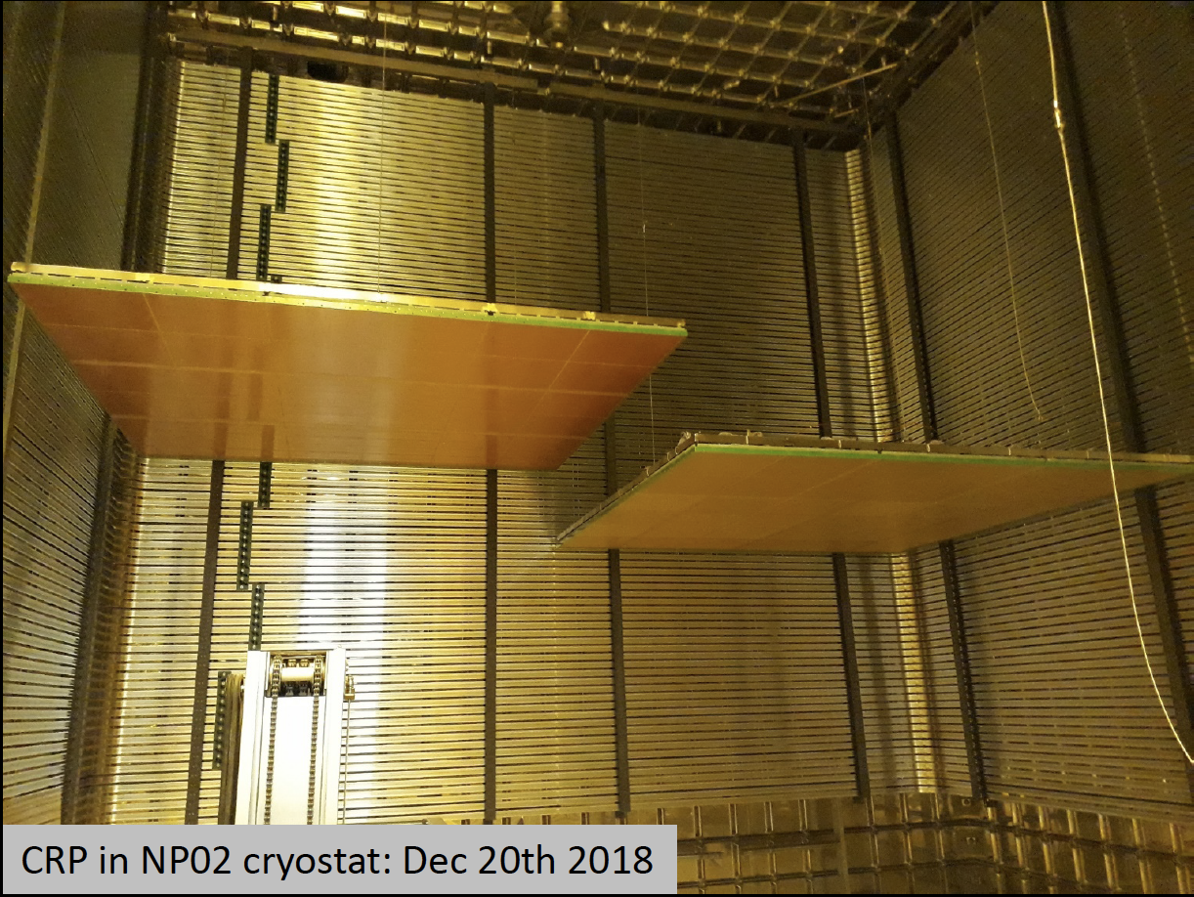
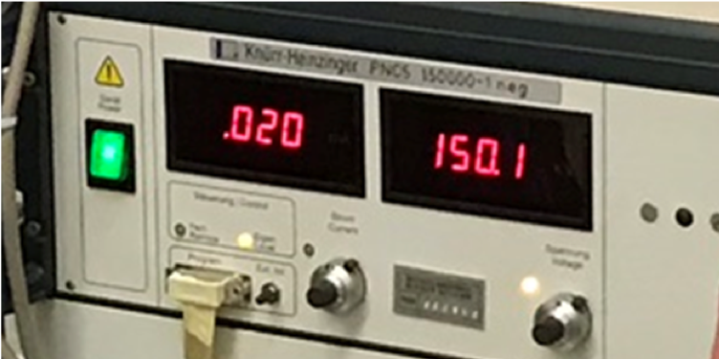
Status of ProtoDUNE Dual Phase
Field cage completed and tested at 150kV in air & the charge readout plane (CRP) assembly and installation in progress (3 ready, 2 installed)
Complete the installation of the 3mx3m CRP’s, cathode and PDS and close the cryostat Spring 2019
Complete purge and fill by July 2019
Ready for cosmic data summer 2019
CRP#1 cold testing
6m
CRP#3
CRP#1

Slide 30
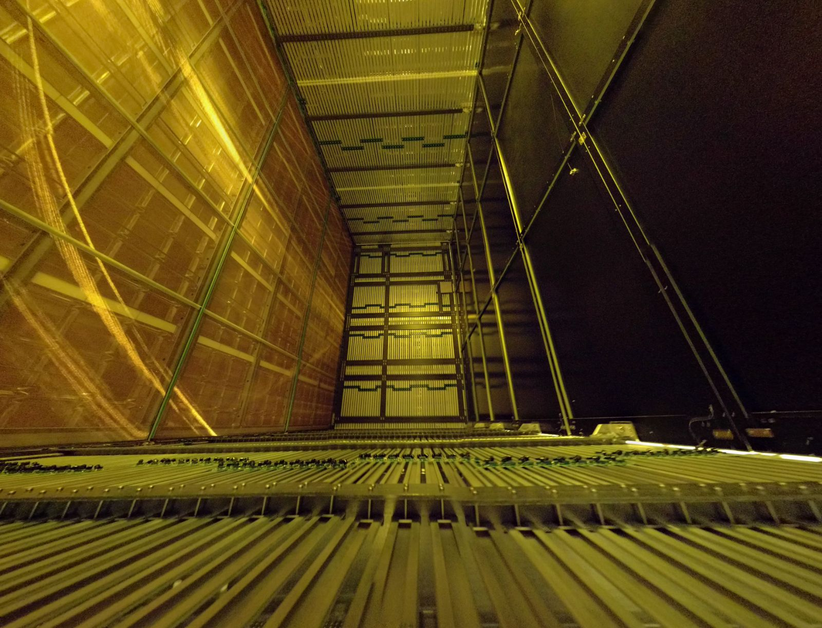
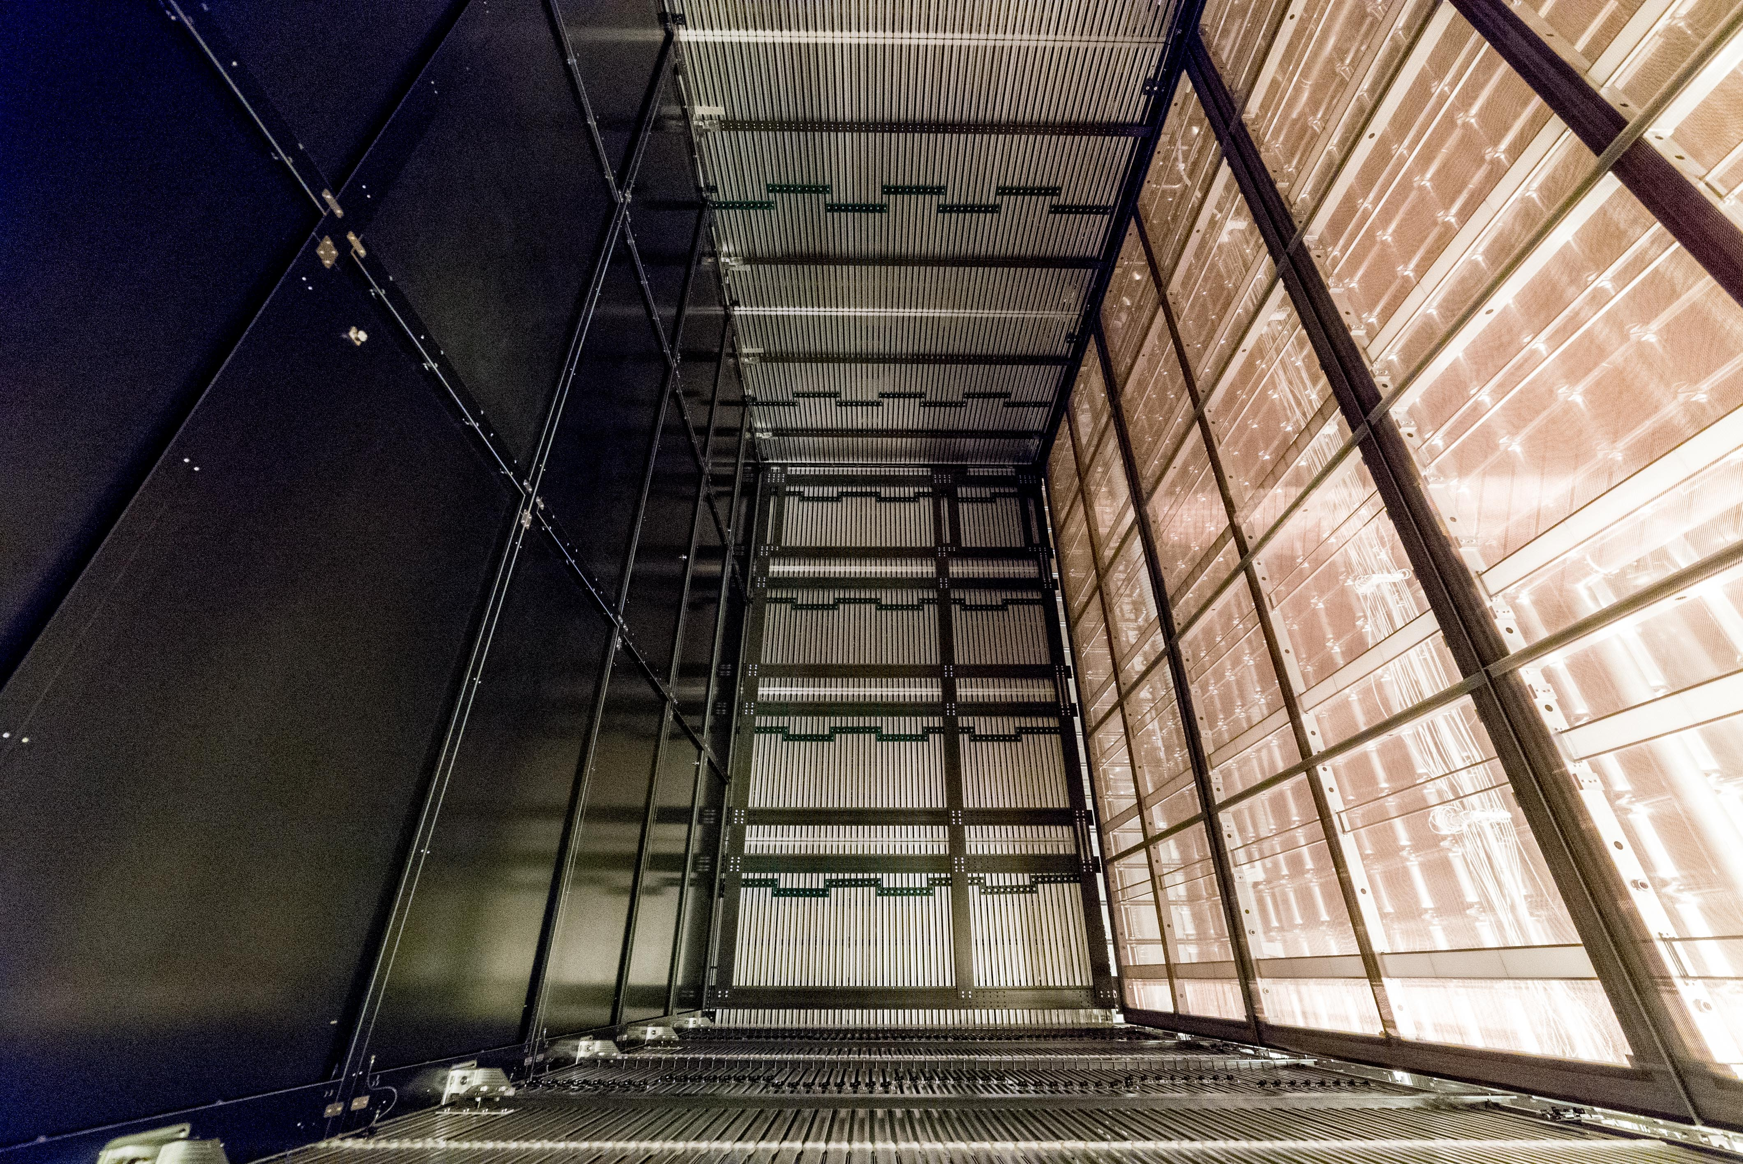
Status of ProtoDUNE Single Phase
Detector completed and the cryostat shut end of June
LAr filling completed on Sept. 13
TPC’s activated and taking data since Sept. 21
Observed cosmic tracks as soon as the TPC turned on close to the operational HV
LAr purity is >6ms, 99.7% of the channels alive!, gain uniform within 5% across
Beam data taking stopped on Nov. 15
Cosmic data taking continues throughout the 2 year CERN beam shutdown
Shared Cathode Plane
6m
6m
3.6m Drift
3.6m Drift

Slide 31
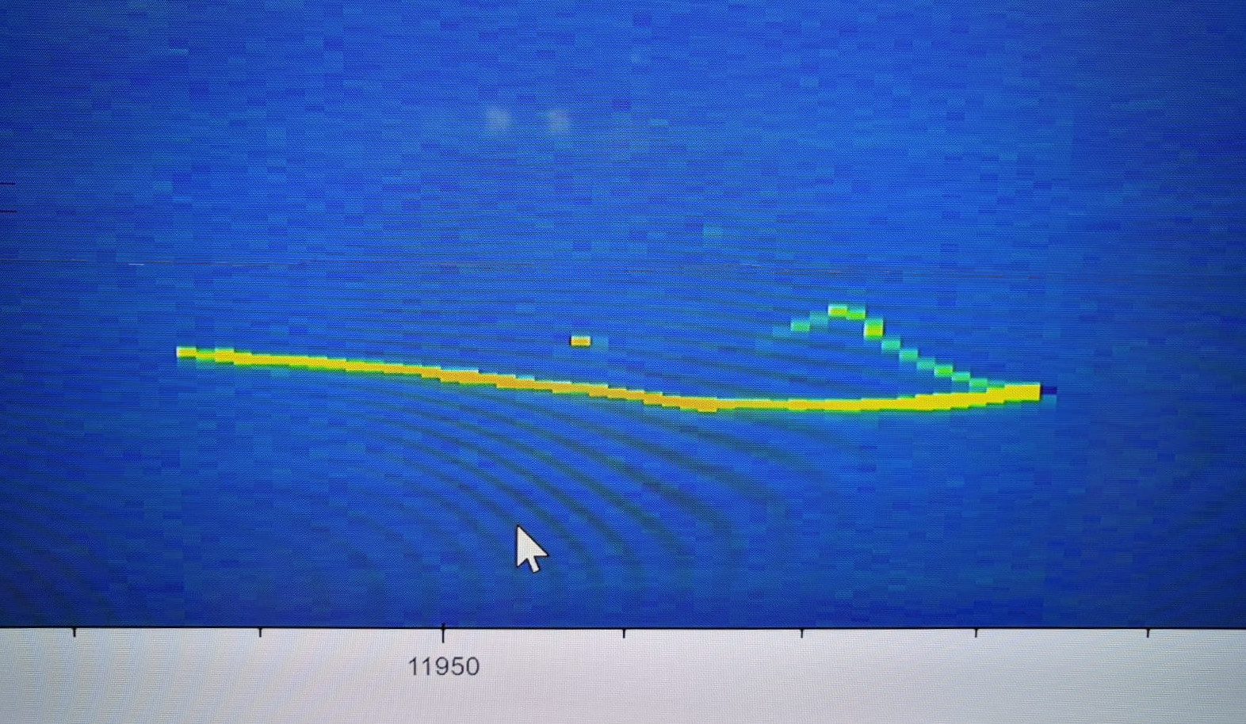
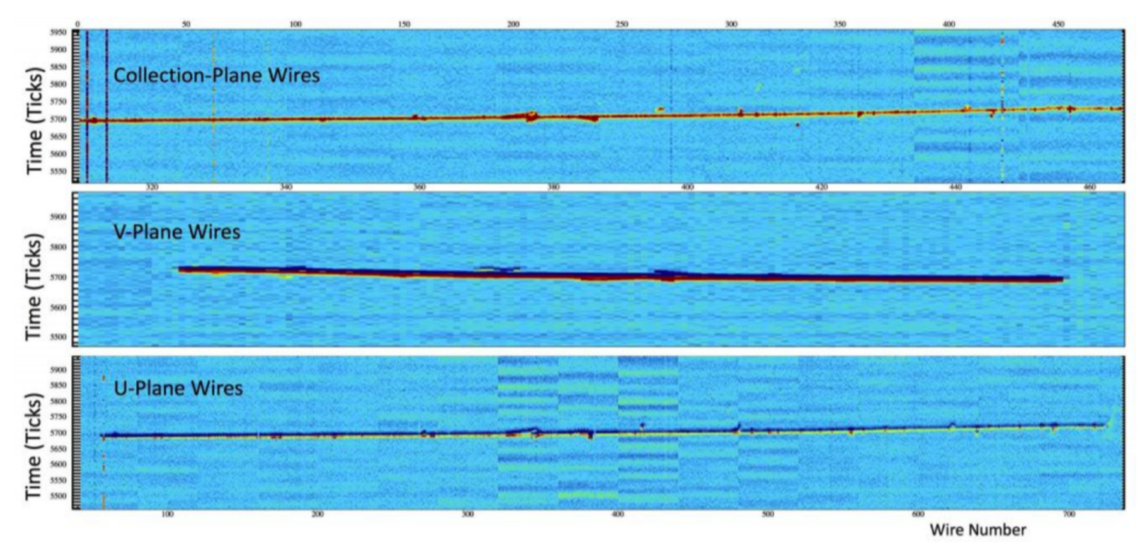
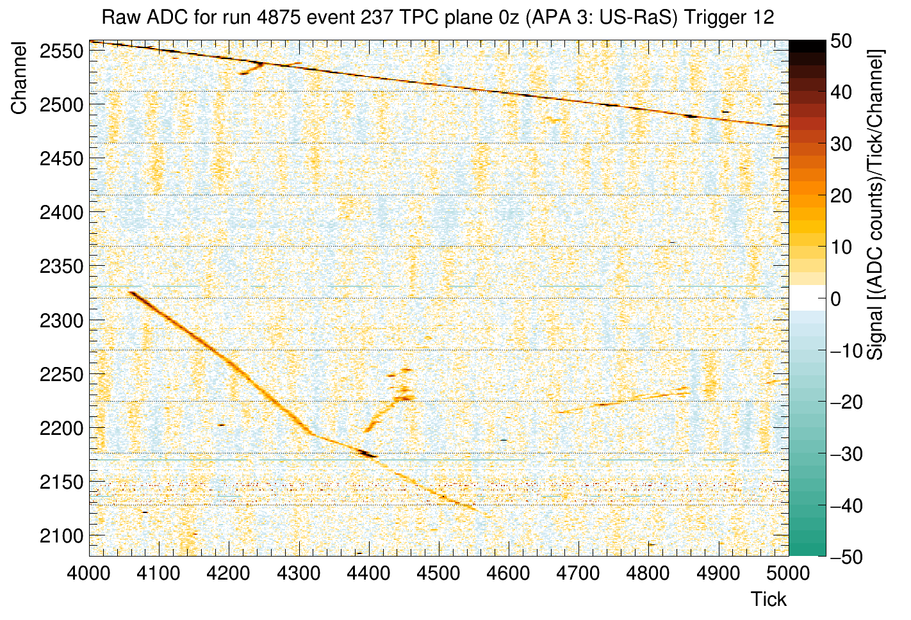
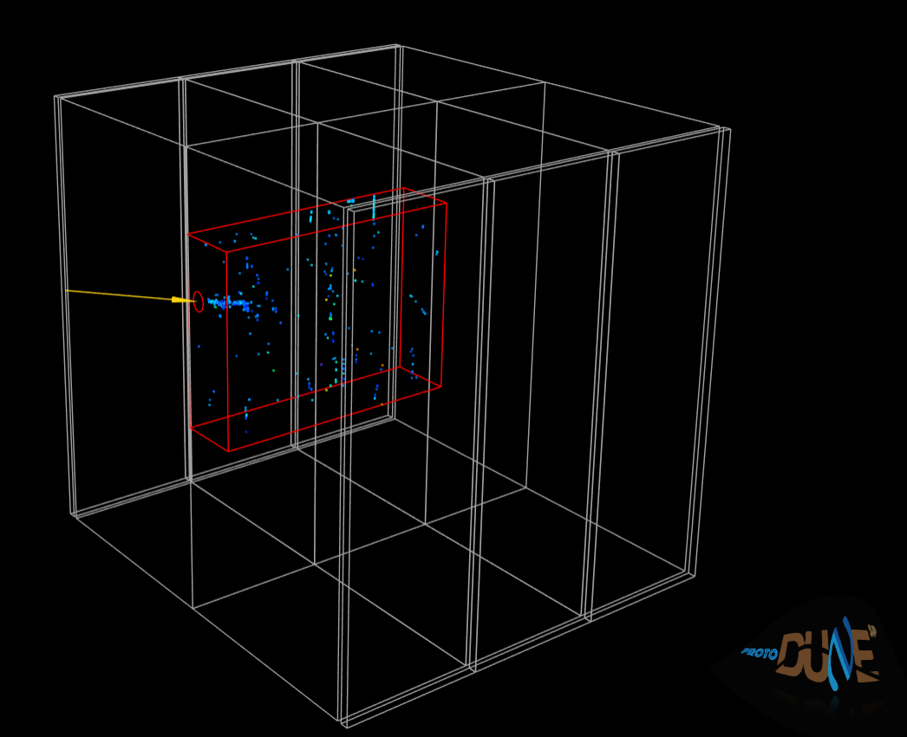
ProtoDUNE SP First Events
9/21/2018: First track seen at nominal E Field!
Off-line Event Display
On-line Event Display
10/2/2018: First event seen from beam!
(1 GeV electron)
10/2/18 1st e
3D “near”-line Event Display
10/2/2018: First pion interaction from beam!
(1 GeV pion)

Slide 32
ProtoDUNE SP First Event
Beam halo (high energy) muon with bremsstrahlung initiated E.M. shower
Collection plane view

Slide 33
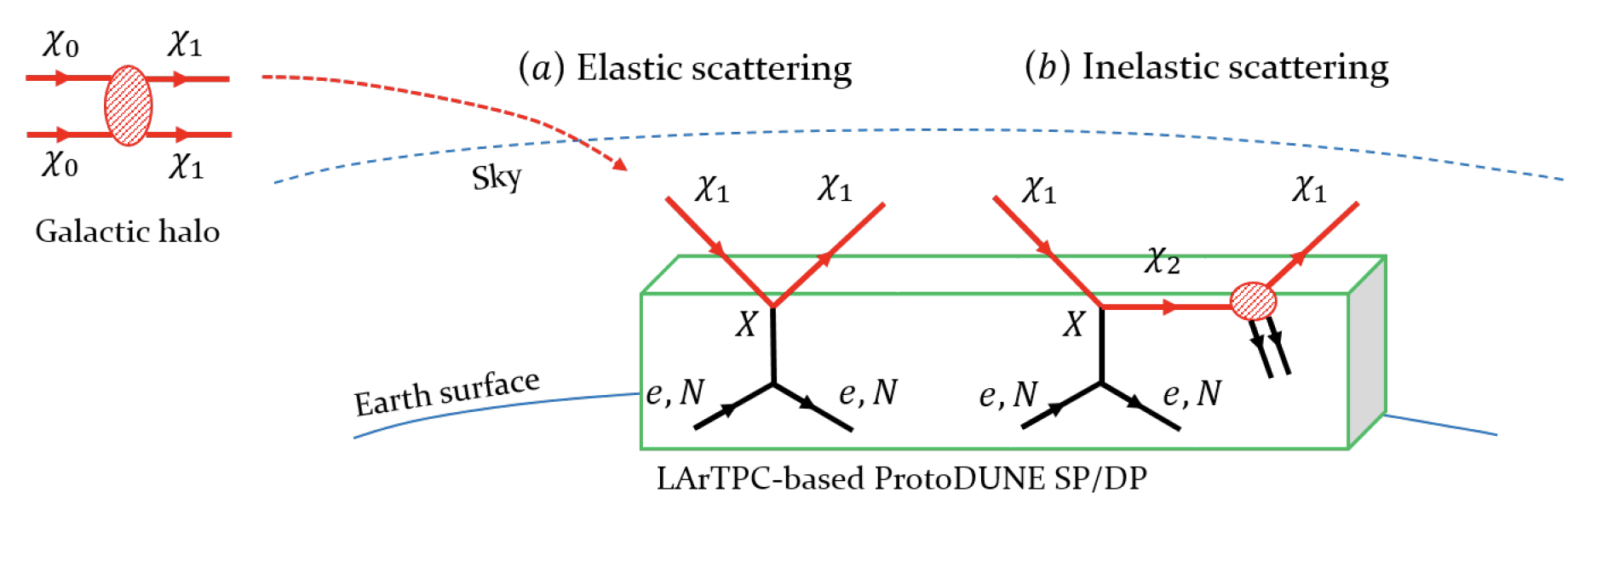
Intermediate Physics w/ ProtoDUNE?
ProtoDUNE detectors have active volume of over 600t total
Potential for searching for relativistic Boosted Dark Matter in its inelastic scattering in the detector ➔ Distinct signature of 3 lepton + missing energy final states helps over the anticipated large background on the surface

Slide 34
Dark Matter Search Motivation
No DM
LHC
DUNE potential

Slide 35
Smart Dark Matter Beam Line!!
A system that uses a string of magnets
We can have a beamline that separates neutrinos and anti-neutrinos from DM’s
Give parent particles of ν’s a magnetic kick to do this separation
Add a dipole after the mesons are fully focused with the 2nd horn
dipole
High Precision Detector
Dark Matter Experiments
p
p, π⁰, χ
Beam Dump
ν target
π⁺⁽⁻⁾, charged mesons
Focusing
horns
Precision Neutrino Experiments
Decay pipe
DUNE detector system

Slide 36
Dark Matter Searches at Fermilab
Fermilab is turning into a lab with very high intensity accelerator program
UTA group is part of three experiments
Deep Underground Neutrino Experiment (DUNE), a $1.3B US flagship experiment, with data expected in 2026
UTA playing very significant role in this experiment
A rich physics program for the next 20 – 30 years!!
If we see DM, we could use this to make DM Beam??

Slide 37
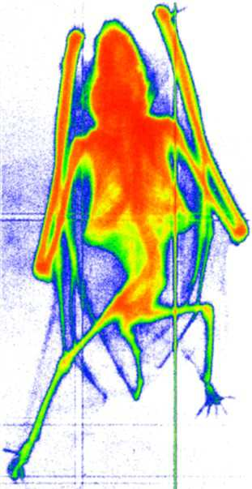
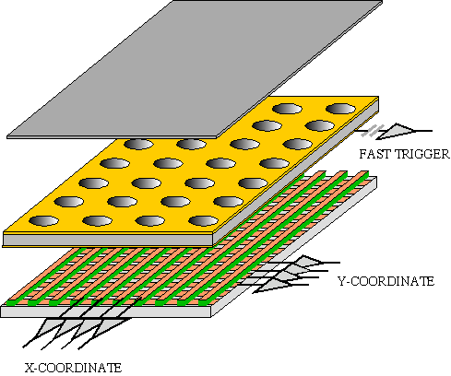
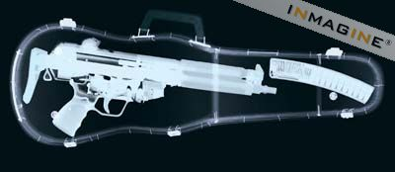
GEM Application Potential
FAST X-RAY IMAGING
Using the lower GEM signal, the readout can be self-triggered with energy discrimination:
9 keV absorption radiography of a small mammal (image size ~ 60 x 30 mm²)
A. Bressan et al,
Nucl. Instr. and Meth. A 425(1999)254
F. Sauli, Nucl. Instr. and Meth.A 461(2001)47

Slide 38
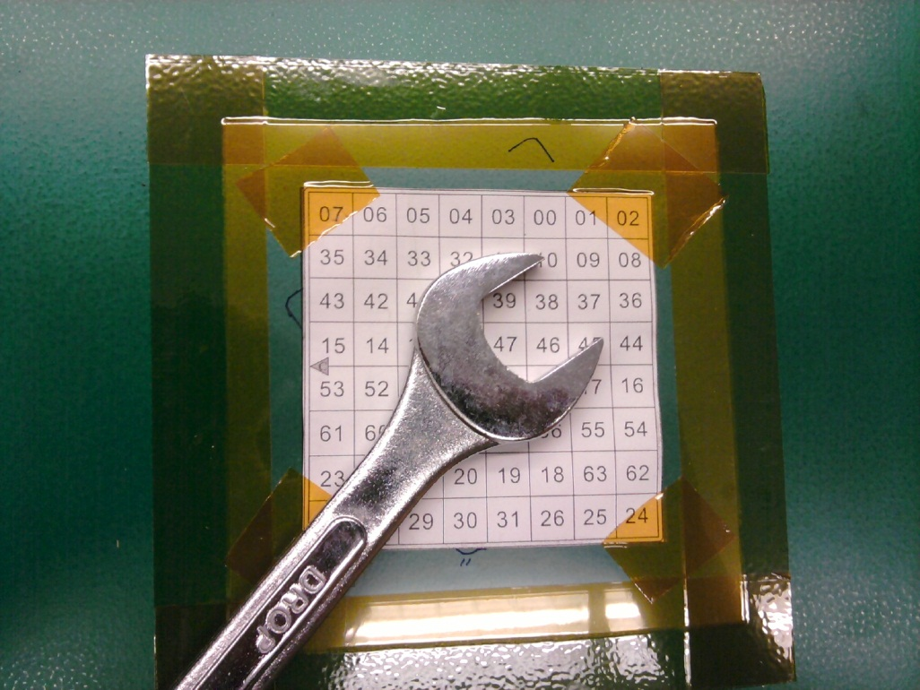
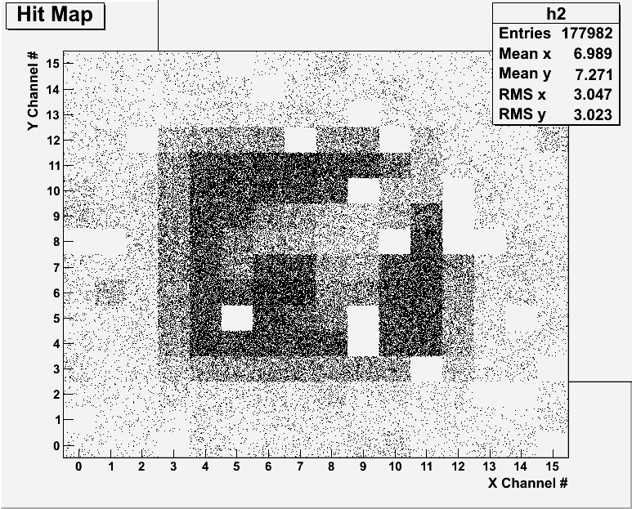
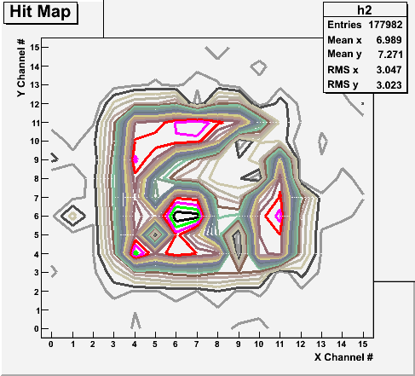
Bi-product of High Energy Physics Research
Can you see what the object is?
(GEM Detector X-ray Image)

Slide 39
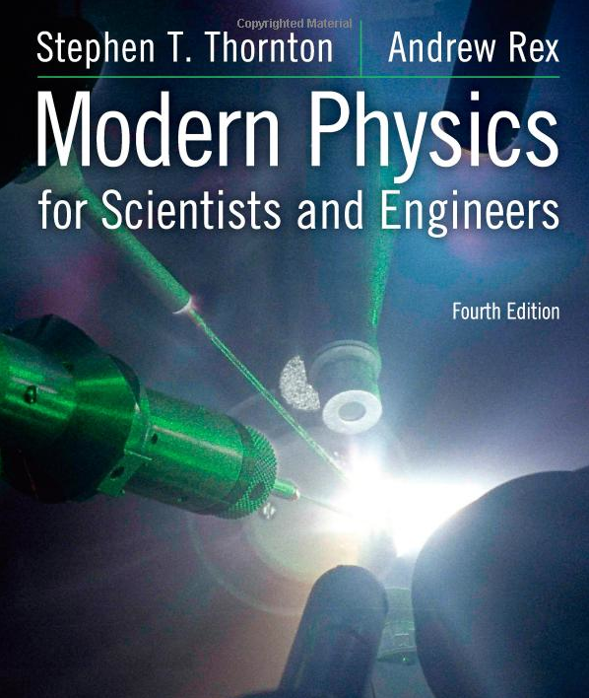
Textbook
Title: Modern Physics for Scientists and Engineers
4th edition
Authors: S.T. Thornton and A. Rex
ISBN: 978-1-133-10372-1

