Slide 1
PHYS 3313 – Section 001 Lecture #3
Wednesday, Jan. 23, 2019
Dr. Jaehoon Yu
Classical Physics
Concept of Waves and Particles
Conservation Laws and Fundamental Forces Atomic
Theory of Matter
Unresolved Questions of 1895 and the New Horizon
Unsolved Questions Today

Slide 2
Announcements
Office hours: 2:30 – 3:30pm Mon. and Wed.
Or by appointment
My office is CPB342

Slide 3
Reminder: Special Project #1
Compute the electric force between the two protons separate the farthest in an intact U²³⁸ nucleus. Use the actual size of the U²³⁸ nucleus. (10 points)
Compute the gravitational force between the two protons separate the farthest in an intact U²³⁸ nucleus. (10 points)
Express the electric force in #1 above in terms of the gravitational force in #2. (5 points)
You must look up the mass of the proton, actual size of the U²³⁸ nucleus, etc, and clearly write them on your project report
You MUST have your own, independent answers to the above three questions even if you worked together with others. All those who share the answers will get 0 credit if copied. Must be handwritten!
Due for the submission Monday, Feb. 4!

Slide 4
Special Project #2
Compute the value of the speed of light using the formula (5 points):
Derive the unit of speed from the units specified in the back-side of the front cover of the text book. (5 points)
Be sure to write down the values and units taken from the back-side of the front cover of the text book.
You MUST have your own, independent answers to the above three questions even if you worked together with others. All those who share the answers will get 0 credit if copied. Must be handwritten!
Due for the submission is Wednesday, Feb. 6!

Slide 5
The Kinetic Theory of Gases
Contributions made by:
Robert Boyle (1627-1691) ➔ PV = constant (fixed T)
Jacques Charles (1746-1823) & Joseph Louis Gay-Lussac (1778-1823) ➔ V/T=constant (fixed P)
Culminates in the ideal gas equation for n moles of a “simple” gas:
(where R is the ideal gas constant, 8.31 J/mol · K)
We now know that gas consists of rapidly moving molecules bouncing off each other and the wall!!

Slide 6
Primary Results of Statistical Interpretation
Average molecular kinetic energy is directly related to the absolute temperature
Internal energy U is directly proportional to the average molecular kinetic energy
Internal energy is equally distributed among the number of degrees of freedom (f ) of the system
(N_{A} = Avogadro’s Number)
And many others

Slide 7
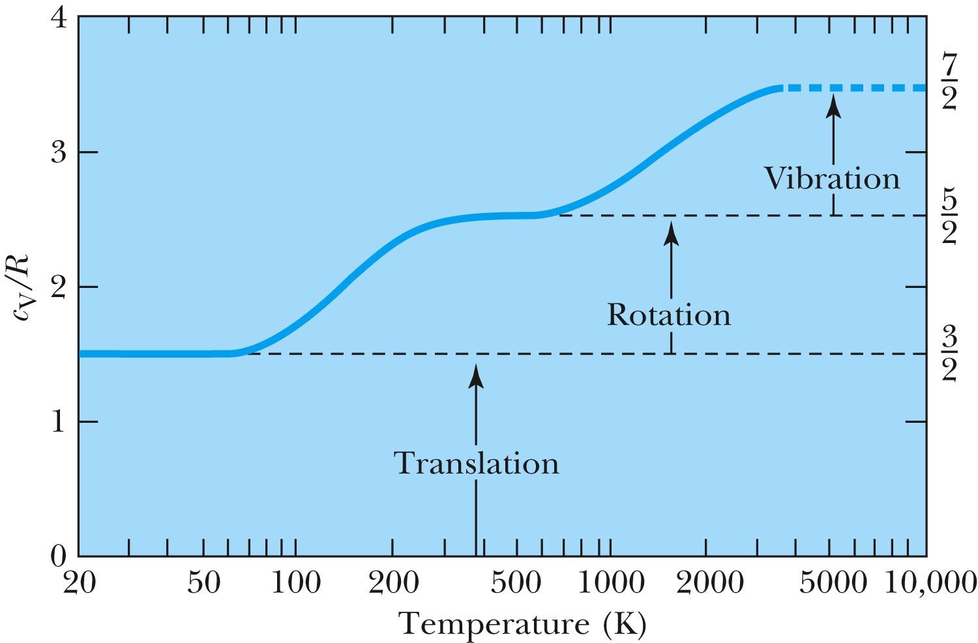
Experimental Demonstration of Equi-Partition Principle
Molar heat capacity vs T
For hydrogen
=f/2

Slide 8
Primary Results of Thermodynamics
Introduced thermal equilibrium concept
The first law establishes heat as energy
Introduces the concept of internal energy
Interprets temperature as a measure of the internal energy
Generates limitations of the energy processes that cannot take place

Slide 9
Concept of Waves and Particles
Two ways in which energy is transported:
Point mass interaction – transfers of momentum and kinetic energy: particles
Extended regions wherein energy transfers by way of vibrations and rotations – waves

Slide 10
Particles vs. Waves
Two distinct phenomena describing physical interactions
Both require Newtonian mass
Particles in the form of point masses and waves in the form of perturbation in a mass distribution, i.e., a material medium
The distinctions are observationally quite clear
although, not so obvious for the case of visible light
Thus as the 17th century begins the major disagreement arose concerning the nature of light

Slide 11
The Nature of Light
Isaac Newton promoted the corpuscular (particle) theory
Published a book “Optiks” in 1704
Particles of light travel in straight lines or rays
Explained “sharp” shadows
Explained reflection and refraction
Christian Huygens (1629 -1695) promoted the wave theory
Presented the theory in 1678
Light propagates as a wave of concentric circles from the point of origin
Explained reflection and refraction
Could not explain the “sharp” edges of the shadow
Thomas Young (1773 -1829) & Augustine Fresnel (1788 – 1829) ➔ Showed in 1802 and afterward that light clearly behaves as wave through two slit interference and other experiments
In 1850 Foucault showed that light travel slowly in water than air, the final blow to the corpuscular theory in explaining refraction

Slide 12
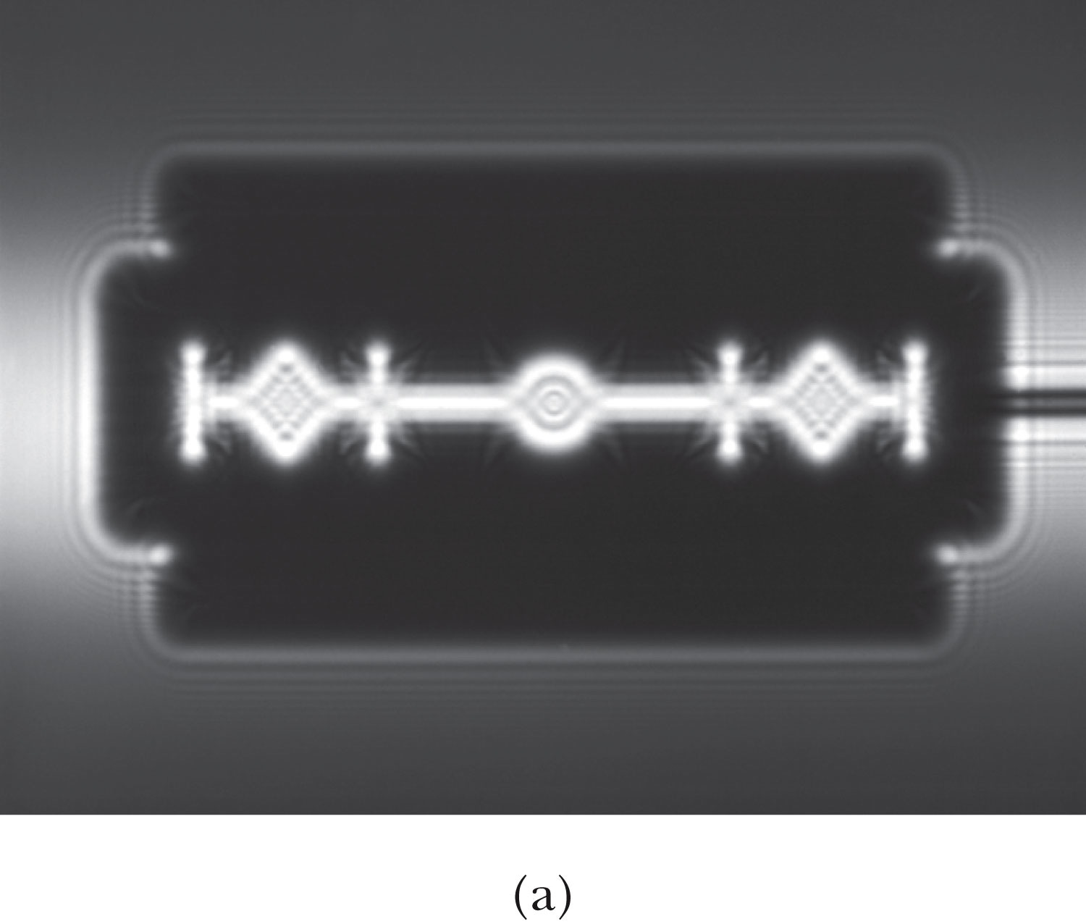
The Wave Theory Advances…
Contributions by Huygens, Young, Fresnel and Maxwell
Double-slit interference patterns
Refraction of light from the vacuum to a medium
Light was an electromagnetic phenomenon
Shadows are not as sharp as once thought with the advancement of experimental precision
Establishes the idea that light propagates as a wave

Slide 13
The Electromagnetic Spectrum
Visible light covers only a small range of the total electromagnetic spectrum

Slide 14
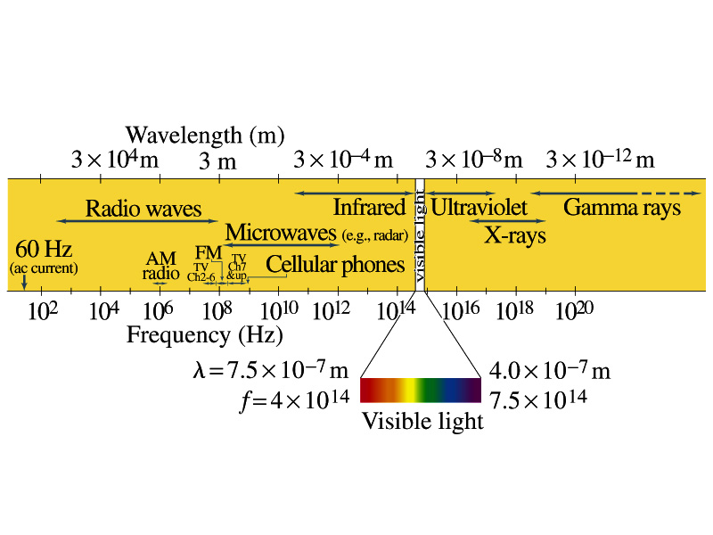
Electromagnetic Spectrum
Low frequency waves, such as radio waves or microwaves can be easily produced using electronic devices
Higher frequency waves are produced natural processes, such as emission from atoms, molecules or nuclei
Or they can be produced from acceleration of charged particles
Infrared radiation (IR) is mainly responsible for the heating effect of the Sun
The Sun emits visible lights, IR and UV
The molecules of our skin resonate at infrared frequencies so IR is preferentially absorbed and thus warm up

Slide 15
The Electromagnetic Spectrum
Visible light covers only a small range of the total electromagnetic spectrum
All electromagnetic waves travel in vacuum with the speed c given by:
(where μ₀ and ε₀ are the respective permeability and permittivity of “free” space)

Slide 16
Conservation Laws and Fundamental Forces
Conservations laws are the guiding principles of physics
Recall the fundamental conservation laws:
Conservation of energy
Conservation of linear momentum
Conservation of angular momentum
Conservation of electric charge
In addition to the classical conservation laws, two modern results include:
The conservation of baryons and leptons
The fundamental invariance principles for time reversal, distance, and parity

Slide 17
Also in the Modern Context…
The three fundamental forces are introduced
Gravitational:
Responsible for planetary motions, holding things on the ground, etc
Electroweak (unified at high energies)
Weak: Responsible for nuclear beta decay and effective only over distances of ~10⁻¹⁵ m
Electromagnetic: Responsible for all non-gravitational interactions, such as all chemical reactions, friction, tension….
(Coulomb force)
Strong: Responsible for “holding” the nucleus together and effective in the distance less than ~10⁻¹⁵ m

Slide 18
Relative Strength of Fundamental Forces

Slide 19
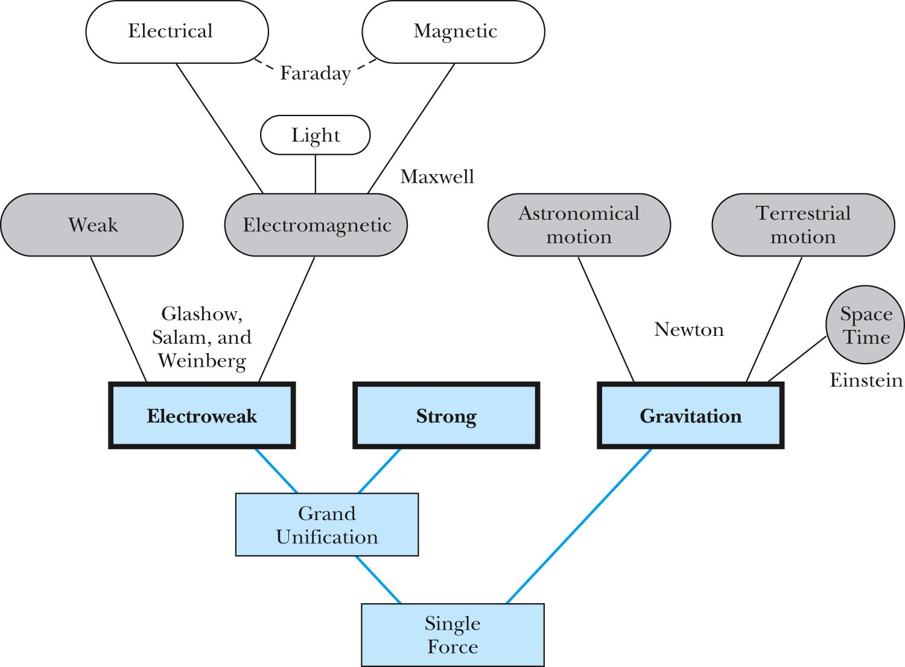
Unification of Forces
GUT, String theory
Not yet experimentally verified: p decays, magnetic monopole

