Slide 1
PHYS 3313 – Section 001
Lecture #4
Monday, Jan. 28, 2019
Dr. Amir Farbin
Theory of Matter
Unresolved Questions of 1895
Unsolved Questions Today
Gelilean Transformation
Do we need Ether?
Michelson-Morley Experiment

Slide 2
Announcements
Reading assignments: CH 2.10 (special topic), 2.13 and 2.14
  Please go through eq. 2.45 through eq. 2.49 and example 2.9
Homework #1
  chapter 2 end of the chapter problems
  17, 21, 23, 24, 32, 59, 61, 66, 68, 81 and 96
  Due is by the beginning of the class, Monday, Feb. 11
  Work in study groups together with other students but PLEASE do write your handwritten answer in your own way!
  DO NOT COPY! All copies will get 0 whether you are the original or not.

Slide 3
Reminder: Special Project #1
Compute the electric force between the two protons separate the farthest in an intact U²³⁸ nucleus. Use the actual size of the U²³⁸ nucleus. (10 points)
Compute the gravitational force between the two protons separate the farthest in an intact U²³⁸ nucleus. (10 points)
Express the electric force in #1 above in terms of the gravitational force in #2. (5 points)
You must look up the mass of the proton, actual size of the U²³⁸ nucleus, etc, and clearly write them on your project report
You MUST have your own, independent answers to the above three questions even if you worked together with others. All those who share the answers will get 0 credit if copied. Must be handwritten!
Due for the submission Monday, Feb. 4!

Slide 4
Reminder: Special Project #2
Compute the value of the speed of light using the formula (5 points):
Derive the unit of speed from the units specified in the back-side of the front cover of the text book. (5 points)
Be sure to write down the values and units taken from the back-side of the front cover of the text book.
You MUST have your own, independent answers to the above three questions even if you worked together with others. All those who share the answers will get 0 credit if copied. Must be handwritten!
Due for the submission is Wednesday, Feb. 6!

Slide 5
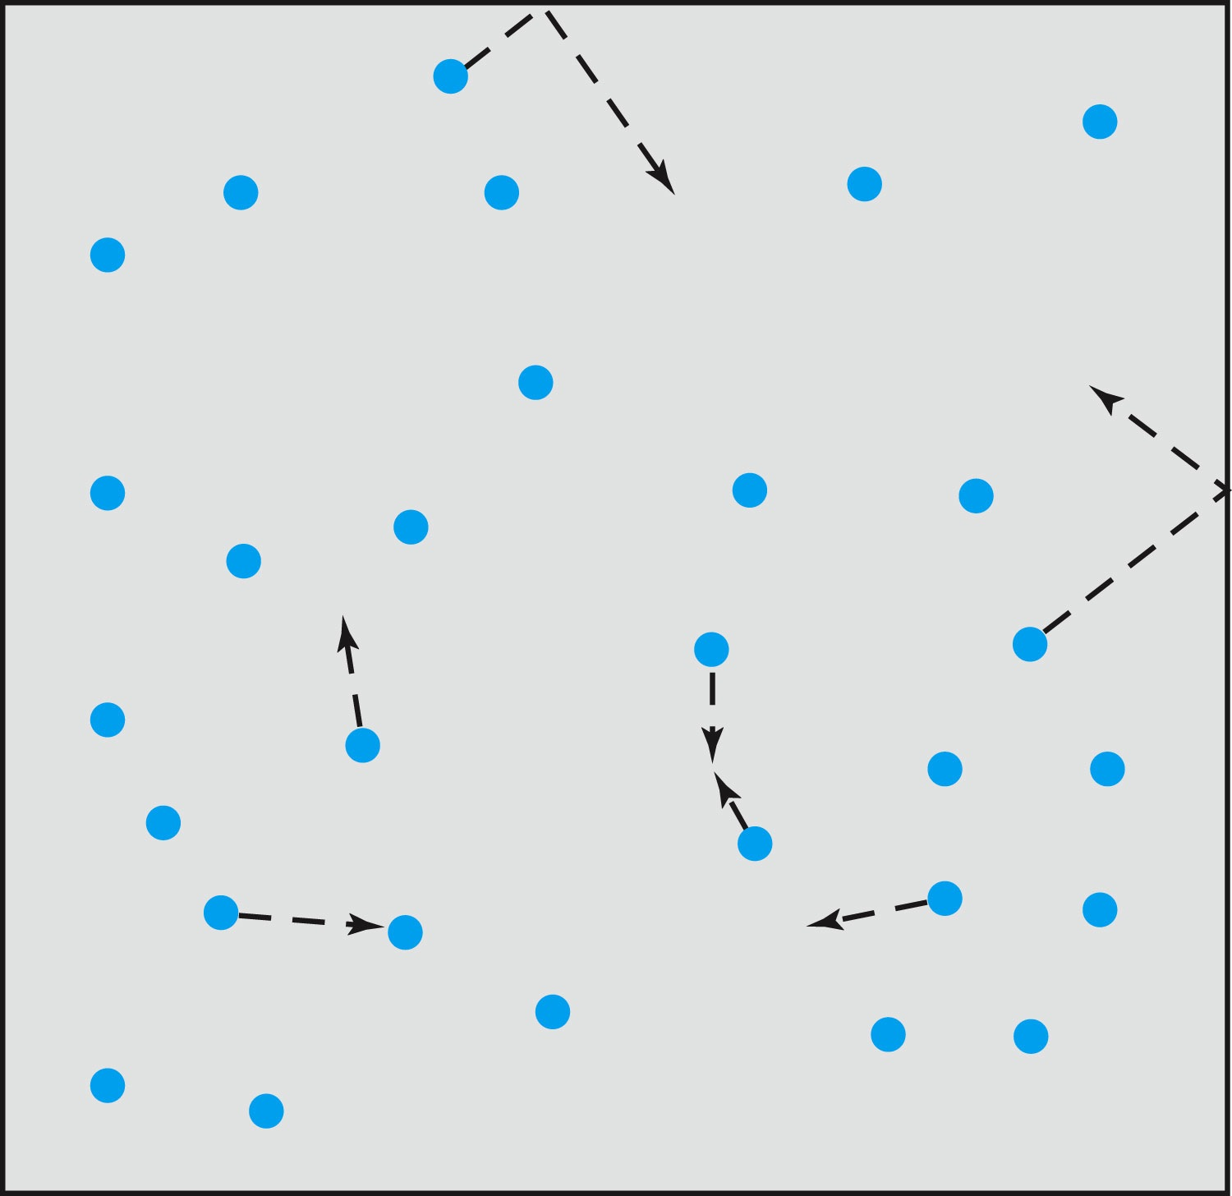
Relevance of Gas Concept to Atoms
The idea of gas (17th century) as a collection of small particles bouncing around with kinetic energy enabled the concept of small, unseen objects
This concept formed the bases of existence of something small that makes up matter

Slide 6
The Atomic Theory of Matter
Concept initiated by Democritus and Leucippus (~450 B.C.) (first to use the Greek atomos, meaning “indivisible”)
In addition to fundamental contributions by Boyle, Charles, and Gay-Lussac, Proust (1754 – 1826) proposes the law of definite proportions➔ For a compound of 2 or more elements, the weight proportion of the elements is always the same
Dalton advances the atomic theory of matter to explain the law of definite proportions
Avogadro proposed that all gases at the same temperature, pressure, and volume contain the same number of molecules (atoms); viz. 6.02 × 10²³ atoms
Cannizzaro (1826 – 1910) makes a distinction between atoms and molecules advancing the ideas of Avogadro.

Slide 7
Further Advances in Atomic Theory
Maxwell derives the speed distribution of atoms in a gas
Robert Brown (1753 – 1858), a botanist, observes microscopic “random” motion of suspended grains of pollen in water in 1811 (Brownian motion)
Einstein in the 20th century explains this random motion using atomic theory (~100 year later!)

Slide 8
Opposition to the Atomic Theory
Ernst Mach (1838 – 1916) opposes the theory on the basis of logical positivism, i.e., atoms being “unseen” questions their reality
Wilhelm Ostwald (1853 – 1932) supports Mach’s premise and called atoms hypothetical structures for bookkeeping based on experimental results of radioactivity, discrete spectral lines, and the formation of molecular structures

Slide 9
Overwhelming Evidence for Existence of Atoms
Max Planck (1858 – 1947) advances the concept to explain blackbody radiation, using submicroscopic “quanta”
Boltzmann requires existence of atoms for advances in statistical mechanics
Albert Einstein (1879 – 1955) uses molecules to explain Brownian motion and determines the approximate value of their sizes and masses
Jean Perrin (1870 – 1942) experimentally verifies Einstein’s predictions

Slide 10
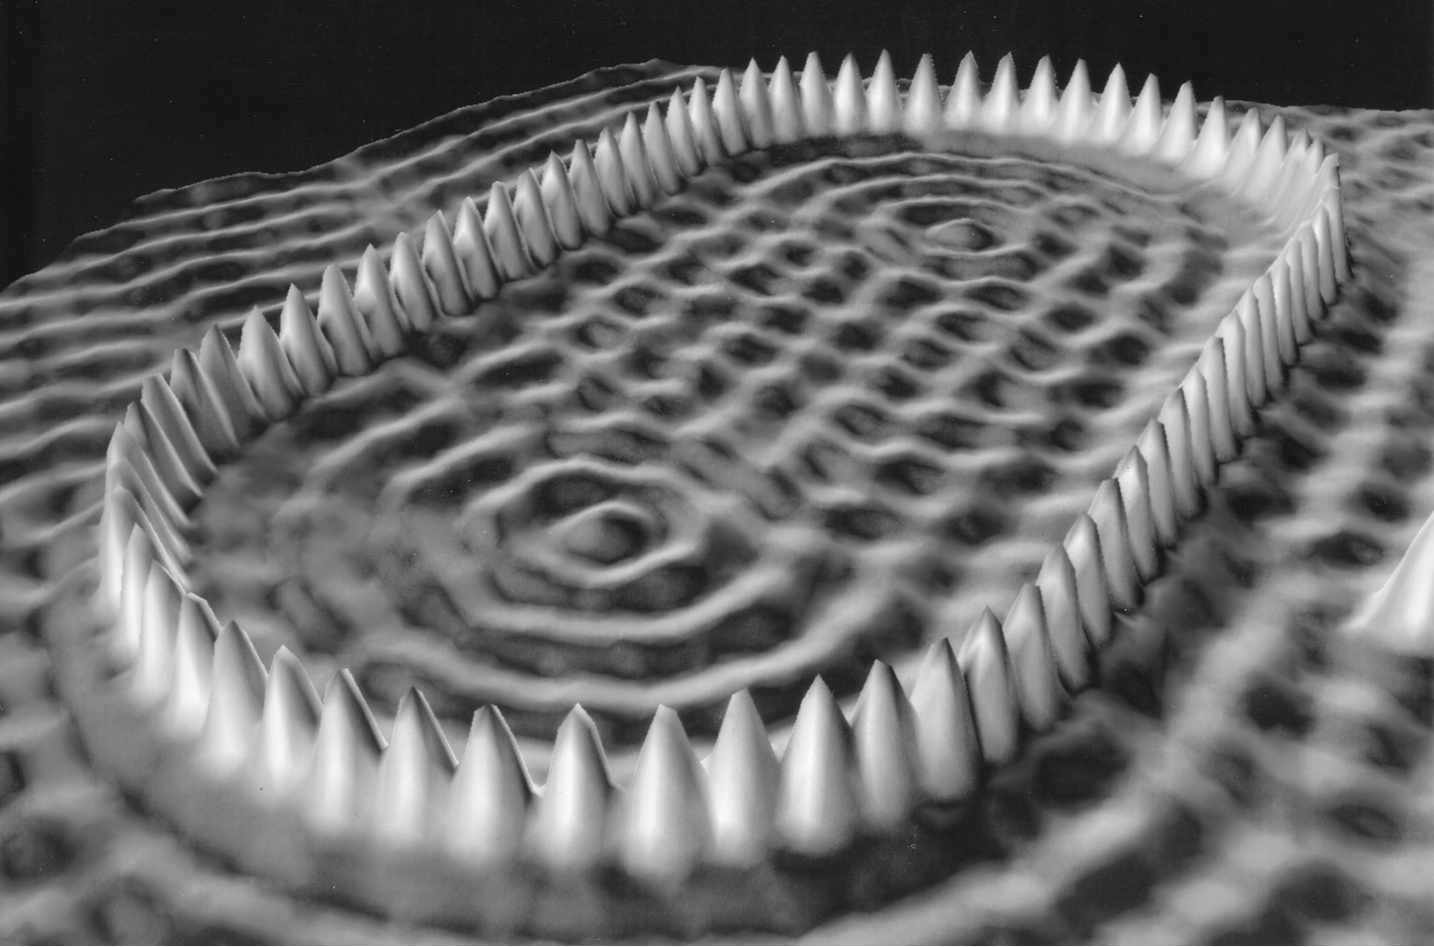
Unresolved Questions and New Horizons
The atomic theory controversy raises fundamental questions
  It was not universally accepted
  The constituents (if any) of atoms became a significant question
  The structure of matter remained unknown with certainty
  Experimental precisions were insufficient to discern this level of small scale

Slide 11
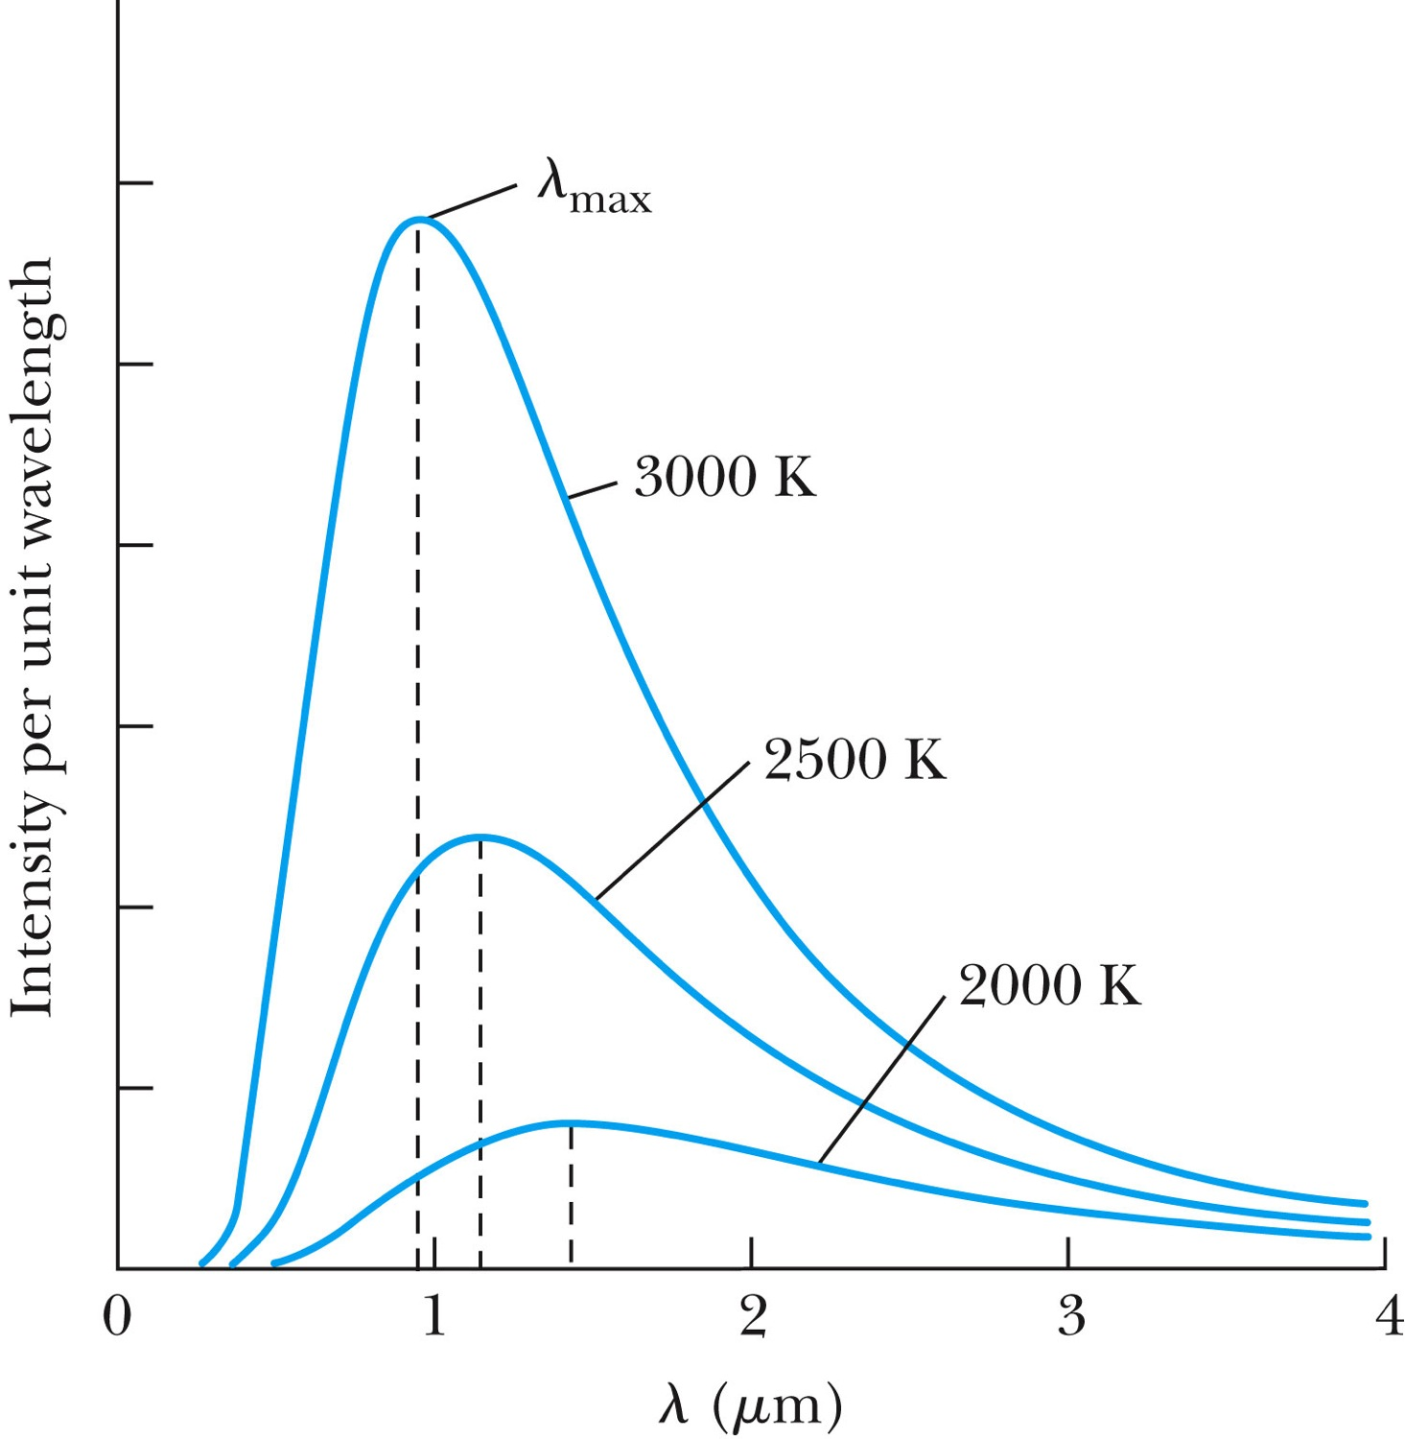
Further Complications
Three fundamental problems:
The (non) existence of a medium that transmits light waves from the sun – the electromagnetic medium
The observed differences in the electric and magnetic fields between stationary and moving reference systems
The failure of classical physics to explain blackbody radiation in which characteristic spectra of radiation that cover the entire EM wavelengths were observed depending on temperature not on the body itself!!
  Max Planck energy quantization

Slide 12
Additional Experimental Discoveries Contribute to the Complications
Discovery of x-rays (1895, Röntgen)
Discovery of radioactivity (1896, Becquerel)
Discovery of the electron (1897, Thompson)
Discovery of the Zeeman effect (1896, Zeeman), the dependence of spectral frequency on magnetic field

Slide 13
The Beginnings of Modern Physics
These new discoveries and the many resulting complications required a revision of the fundamental physical assumptions culminated on the successes of the classical foundations
To this end, the introduction of the modern theory of relativity and quantum mechanics becomes the starting point of this most fascinating revision
  1900 Max Planck’s Radiation Law
  1905 Einstein’s three papers: Brownian Motion, the Photo-electric effect, and the Special Relativity
  Broadened the horizon of physics!!

Slide 14
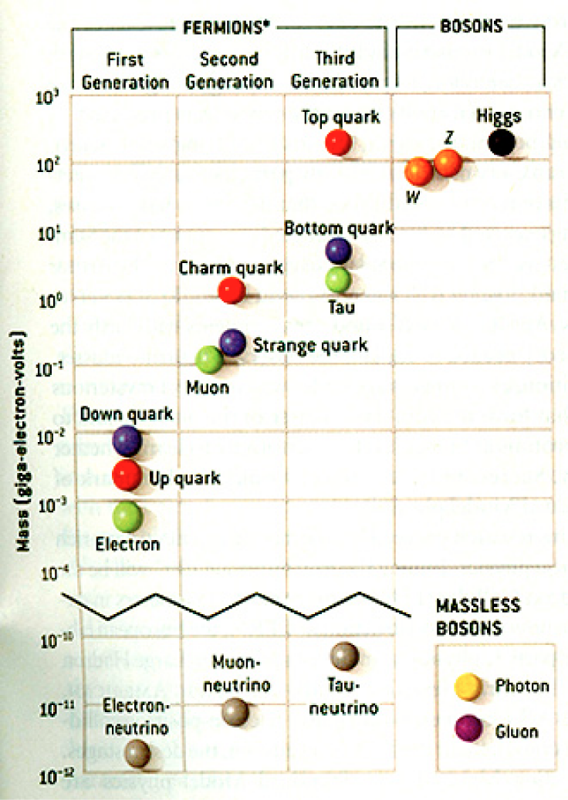
HEP and the Standard Model
Discovered in 1995, ~175m_{p}
Discovered in 2012, ~125m_{p}
Make up most ordinary matters ~0.1m_{p}
Total of 16 particles (12+4 force mediators) make up all the visible matter in the universe! ➔ Simple and elegant!!!
Tested to a precision of 1 part per million!

Slide 15
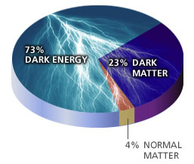
So what’s the problem?
Why is the mass range so large (0.1m_{p} – 175 m_{p})?
Is the particle we discovered really the Higgs particle?
Why is the matter in the universe made only of particles?
Neutrinos have mass!! What are the mixing parameters, particle-anti particle asymmetry and mass ordering?
Why are there only four apparent forces?
  Were they all unified at the Big Bang?
Is the picture we present the real thing?
  What makes up the remaining ~95% of the universe?
Are there any other particles we don’t know of?
  Big deal for the new LHC Run!
Notes:
----- Meeting Notes (2/12/14 10:16) -----

Slide 16
Newtonian (Classical) Relativity
It is assumed that Newton’s laws of motion must be measured with respect to (relative to) some reference frame.
A reference frame is called an inertial frame if Newton’s laws are valid in that frame.
Such a frame is established when a body, not subjected to a net external force, is observed to move in rectilinear motion at constant velocity
➔ Newtonian Principle of Relativity (Galilean Invariance): If Newton’s laws are valid in one reference frame, then they are also valid in another reference frame moving at a uniform velocity relative to the first system.

Slide 17
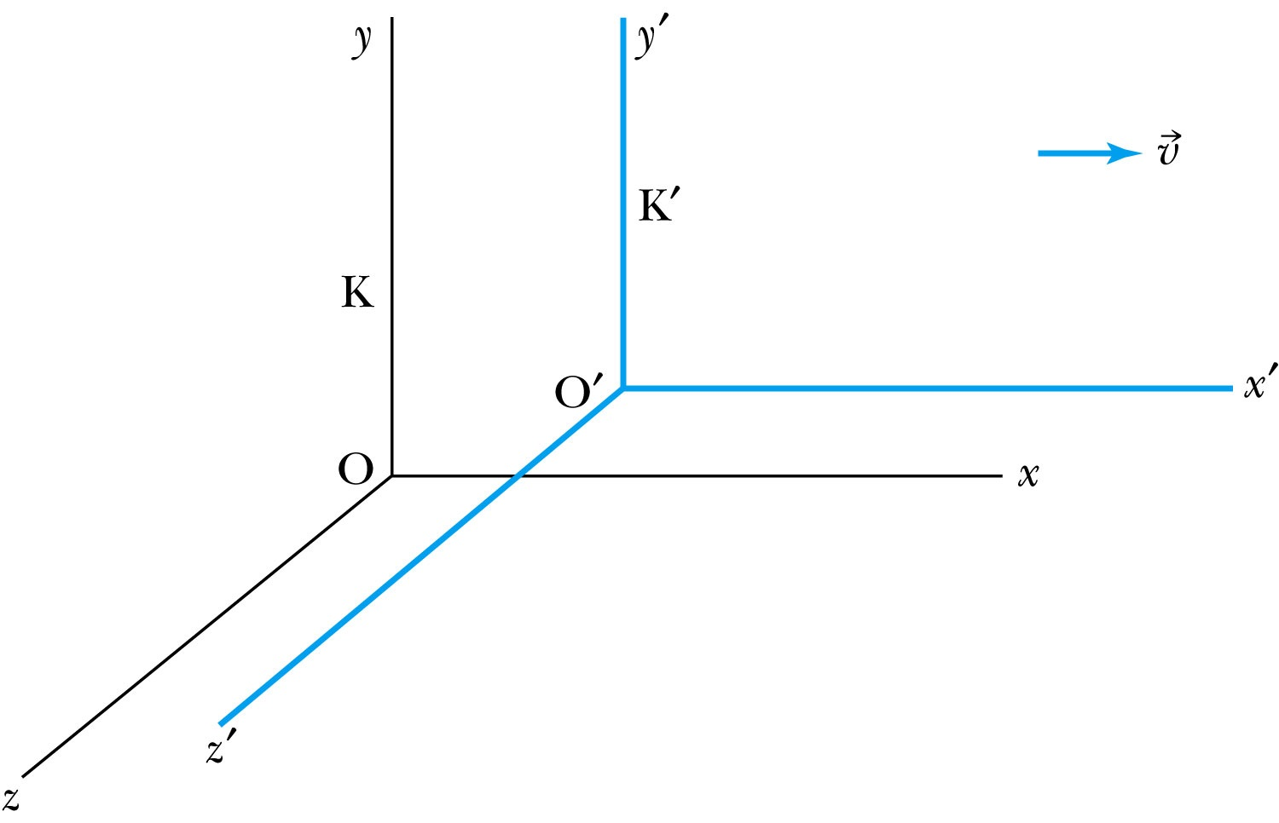
Inertial Frames K and K’
K is at rest and K’ is moving with a constant velocity
Axes are parallel
K and K’ are said to be INERTIAL COORDINATE SYSTEMS

Slide 18
The Galilean Transformation
For a point P
  In system K: P = (x, y, z, t)
  In system K’: P = (x’, y’, z’, t’)
P
x
K
K’
x’-axis
x-axis

Slide 19
Conditions of the Galilean Transformation
Parallel axes between the two inertial reference frames
K’ has a constant relative velocity in the x-direction with respect to K
Time (t) for all observers is a Fundamental invariant, i.e., the same for all inertial observers
  Space and time are separate!!

Slide 20
The Inverse Relations
Step 1. Replace with
Step 2. Replace “primed” quantities with
“unprimed” and “unprimed” with “primed”

Slide 21
The Transition to Modern Relativity
Although Newton’s laws of motion had the same form under the Galilean transformation, Maxwell’s equations did not.
In 1905, Albert Einstein proposed a fundamental connection between space and time and that Newton’s laws are only an approximation.

Slide 22
They Needed Ether!!
The wave nature of light suggested that there existed a propagation medium called the luminiferous ether or just ether.
  Provides an inertial reference frame
The properties of ether
  Very low density for planets to move through it without the loss of energy
  Sufficiently high elasticity to support the high velocity of light waves (c=?)

Slide 23
Ether as the Absolute Reference System
In Maxwell’s theory, the speed of light is given by
  The velocity of light between the moving systems must be a constant.
    Can you see why?
  Needed a system of medium that keeps this constant!
Ether proposed as the absolute reference system in which the speed of light is constant and from which other measurements could be made.
The Michelson-Morley experiment was an attempt to show the existence of ether.

Slide 24
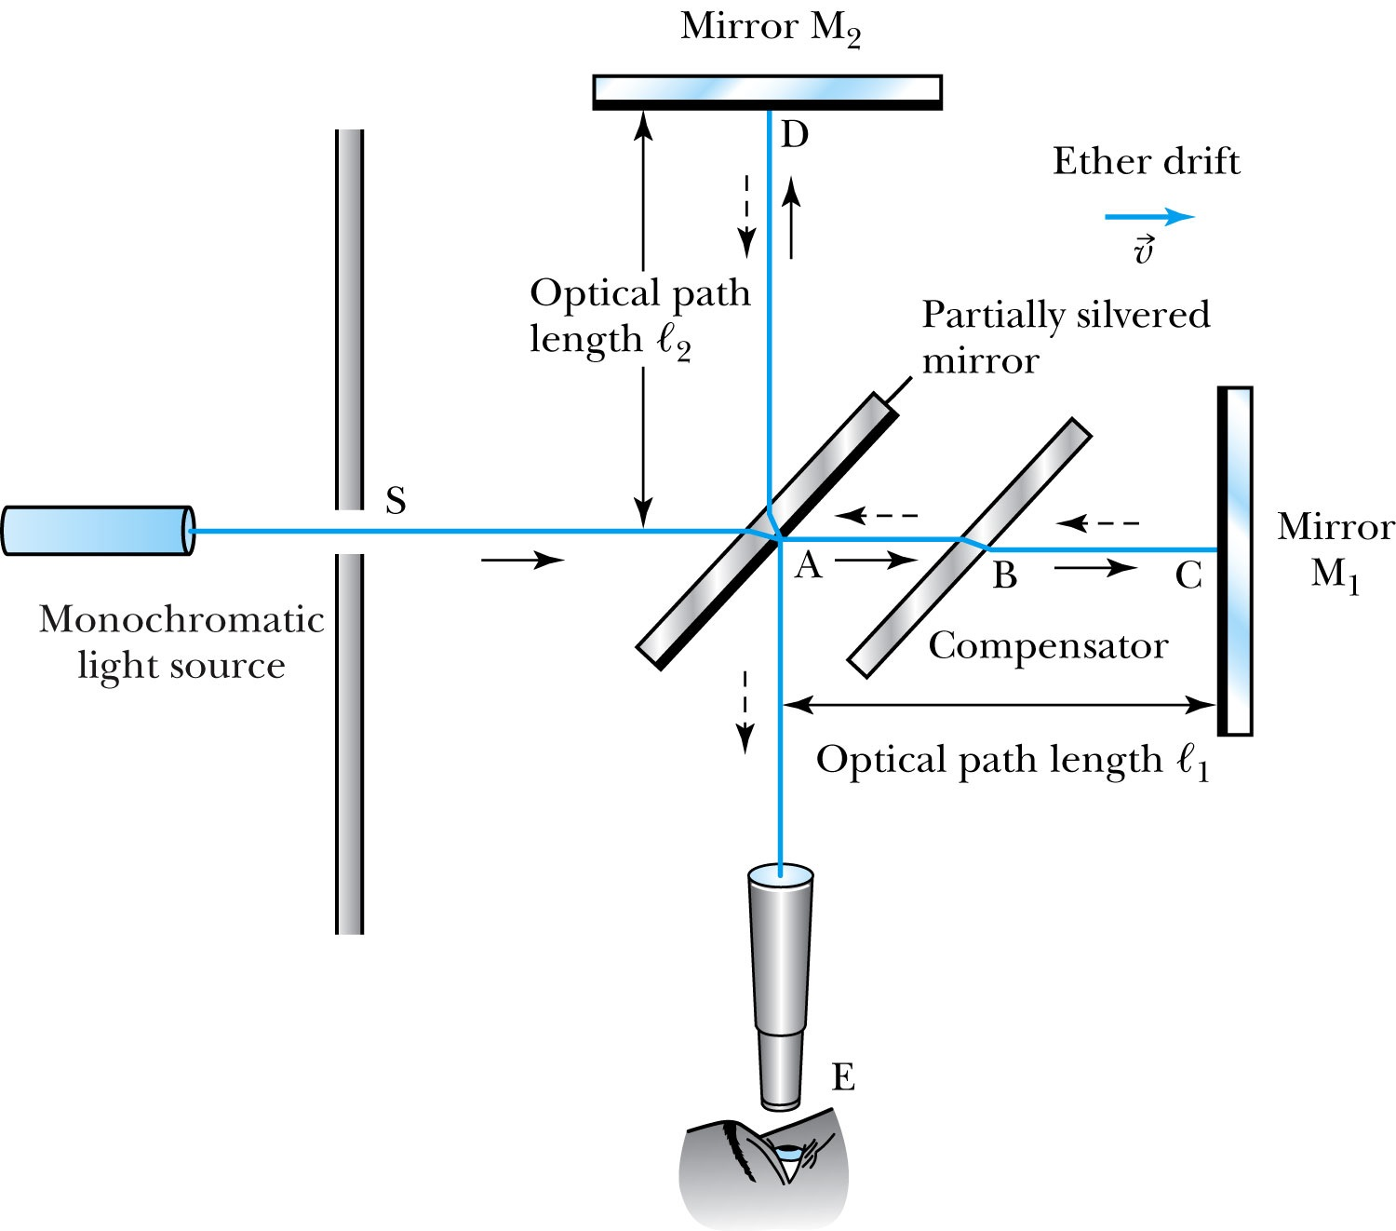
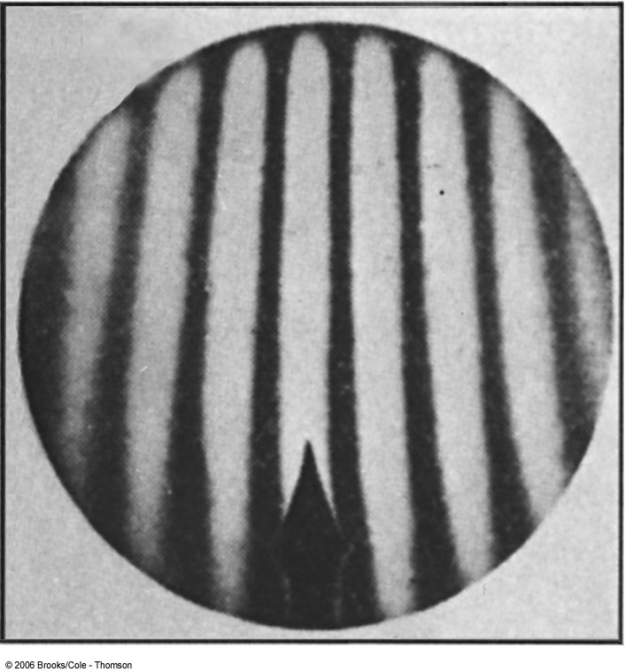
The Michelson-Morley Experiment
Albert Michelson (1852–1931) built an extremely precise device called the interferometer to measure the phase difference between two light waves traveling in orthogonal directions.

Slide 25
How does Michelson Interferometer work?
AC is parallel to the motion of the Earth inducing an “ether wind”
Light from source S is split by mirror A and travels to mirrors C and D in mutually perpendicular directions
After reflection the beams recombine at A slightly out of phase due to the “ether wind” as viewed by telescope E.
Ether

Slide 26
The analysis – Galilean X-formation
Travel time t₁ for a round trip over AC (the ether direction) is
Travel time t₂ for a round trip over AD (perpendicular direction to ether) is
The time difference is
c
v

Slide 27
The analysis
After rotating the machine by 90º, the time difference becomes
The difference of the time differences
Since v (the Earth’s speed) is 10⁻⁴ of c, we can do binomial expansion of the above

Slide 28
The Results
Using the Earth’s orbital speed as:
V = 3 × 10⁴ m/s
together with
ℓ₁ ≈ ℓ₂ = 1.2 m
So that the time difference becomes
Δt’ − Δt ≈ v²(ℓ₁ + ℓ₂)/c³ = 8 × 10⁻¹⁷ s
Although a very small number, it was within the experimental range of measurement for light waves.
Later with Morley, they increased the path lengths to 11m and improved precision better than a factor of 10
Yet, Michelson FAILED to “see” the expected interference pattern

Slide 29
Conclusions of Michelson Experiment
Michelson noted that he should be able to detect a phase shift of light due to the time difference between path lengths but found none.
He thus concluded that the hypothesis of the stationary ether must be incorrect.
After several repeats and refinements with assistance from Edward Morley (1893-1923), again a null result.
Thus, ether does not seem to exist!
Many explanations ensued afterward but none worked out!
This experiment shattered the popular belief of light being waves

