Slide 1
PHYS 3313 – Section 001
Lecture #5
Wednesday, Jan. 30, 2019
Dr. Amir Farbin
Michelson-Morley Experiment
Einstein’s postulates
Lorentz Transformations
Time Dilation
Length Contraction
Relativistic Velocity Addition

Slide 2
Announcements
Reminder: Homework #1
  chapter 2 end of the chapter problems
  17, 21, 23, 24, 32, 59, 61, 66, 68, 81 and 96
  Due is by the beginning of the class, Wednesday, Feb. 8
  Work in study groups together with other students but PLEASE do write your answer in your own way!

Slide 3
Reminder: Special Project #1
Compute the electric force between the two protons separate the farthest in an intact U²³⁸ nucleus. Use the actual size of the U²³⁸ nucleus. (10 points)
Compute the gravitational force between the two protons separate the farthest in an intact U²³⁸ nucleus. (10 points)
Express the electric force in #1 above in terms of the gravitational force in #2. (5 points)
You must look up the mass of the proton, actual size of the U²³⁸ nucleus, etc, and clearly write them on your project report
You MUST have your own, independent answers to the above three questions even if you worked together with others. All those who share the answers will get 0 credit if copied. Must be handwritten!
Due for the submission Monday, Feb. 4!

Slide 4
Reminder: Special Project #2
Compute the value of the speed of light using the formula (5 points):
Derive the unit of speed from the units specified in the back-side of the front cover of the text book. (5 points)
Be sure to write down the values and units taken from the back-side of the front cover of the text book.
You MUST have your own, independent answers to the above three questions even if you worked together with others. All those who share the answers will get 0 credit if copied. Must be handwritten!
Due for the submission is Wednesday, Feb. 6!

Slide 5
Special Project #3
Derive the three Lorentz velocity transformation equations, starting from Lorentz coordinate transformation equations. (10 points)
Derive the three reverse Lorentz velocity transformation equations, starting from Lorentz coordinate transformation equations. (10 points)
Prove that the space-time invariant quantity s²=x²-(ct)² is indeed invariant, i.e. s²=s’², in Lorentz Transformation. (5 points)
You must derive each one separately starting from the Lorentz spatial coordinate transformation equations to obtain any credit.
  Just simply switching the signs and primes will NOT be sufficient!
  Must take the simplest form of the equations, using β and γ.
You MUST have your own, independent handwritten answers to the above three questions even if you worked together with others. All those who share the answers will get 0 credit if copied.
Due for the submission is Wednesday, Feb. 13!

Slide 6
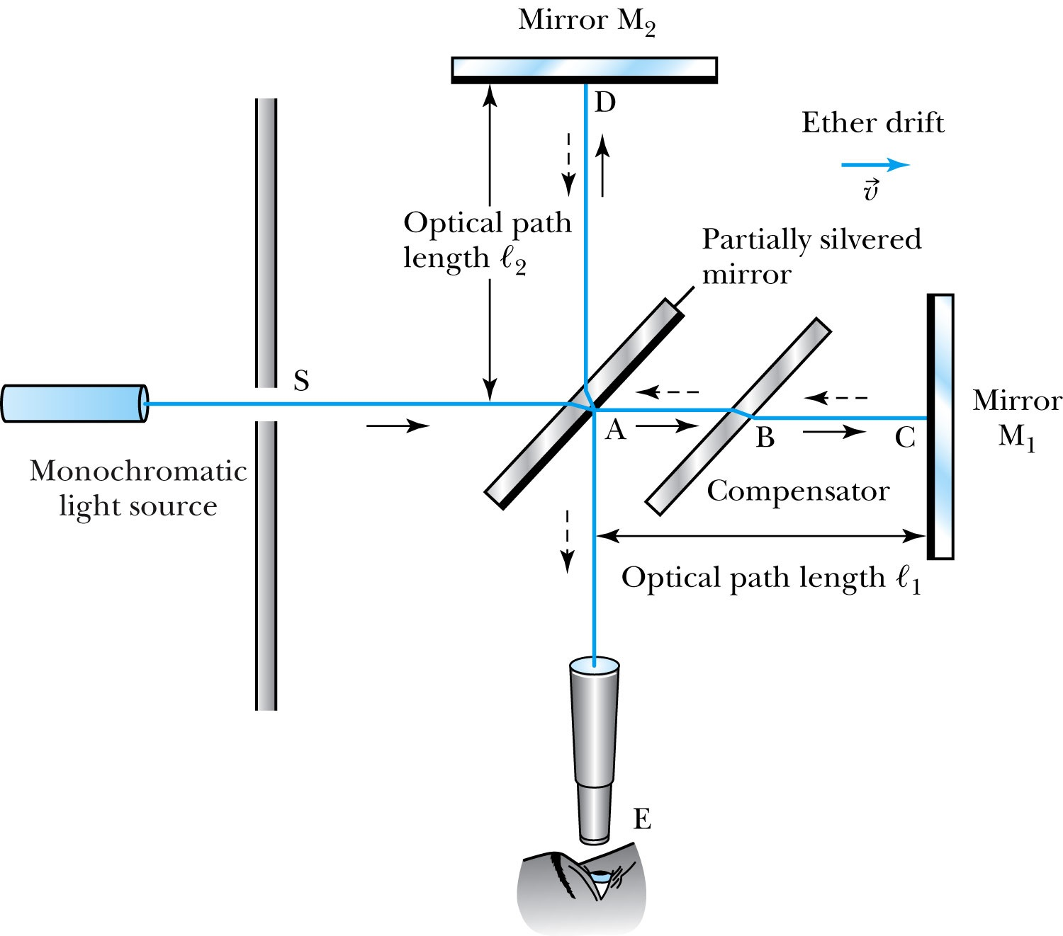
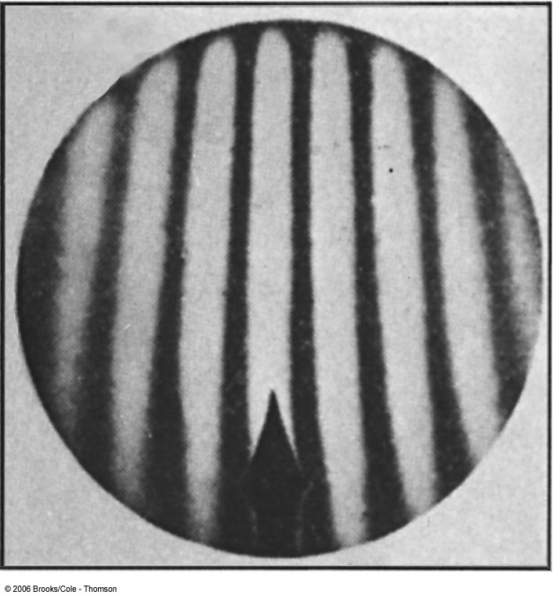
The Michelson-Morley Experiment
Albert Michelson (1852–1931) built an extremely precise device called the interferometer to measure the phase difference between two light waves traveling in orthogonal directions.

Slide 7
How does Michelson Interferometer work?
AC is parallel to the motion of the Earth inducing an “ether wind”
Light from source S is split by mirror A and travels to mirrors C and D in mutually perpendicular directions
After reflection the beams recombine at A slightly out of phase due to the “ether wind” as viewed by telescope E.
Ether

Slide 8
The analysis – Galilean X-formation
Travel time t₁ for a round trip over AC (the ether direction) is
Travel time t₂ for a round trip over AD (perpendicular direction to ether) is
The time difference is
c
v

Slide 9
The analysis
After rotating the machine by 90º, the time difference becomes
The difference of the time differences
Since v (the Earth’s speed) is 10⁻⁴ of c, we can do binomial expansion of the above

Slide 10
The Results
Using the Earth’s orbital speed as:
V = 3 × 10⁴ m/s
together with
ℓ₁ ≈ ℓ₂ = 1.2 m
So that the time difference becomes
Δt’ − Δt ≈ v²(ℓ₁ + ℓ₂)/c³ = 8 × 10⁻¹⁷ s
Although a very small number, it was within the experimental range of measurement for light waves.
Later with Morley, they increased the path lengths to 11m and improved precision better than a factor of 10
Yet, Michelson FAILED to “see” the expected interference pattern

Slide 11
Conclusions of Michelson Experiment
Michelson noted that he should be able to detect a phase shift of light due to the time difference between path lengths but found none.
He thus concluded that the hypothesis of the stationary ether must be incorrect.
After several repeats and refinements with assistance from Edward Morley (1893-1923), again a null result.
Thus, ether does not seem to exist!
Many explanations ensued afterward but none worked out!
This experiment shattered the popular belief of light being waves

Slide 12
The Lorentz-FitzGerald Contraction
Another hypothesis proposed independently by both H. A. Lorentz and G. F. FitzGerald suggested that the length ℓ₁, in the direction of the motion was contracted by a factor of
Thus making the path lengths equal to account for the zero phase shift.
  This, however, was an ad hoc assumption that could not be experimentally tested.

Slide 13
Einstein’s Postulates
Fundamental assumption: Maxwell’s equations must be valid in all inertial frames
The principle of relativity: The laws of physics are the same in all inertial systems. There is no way to detect absolute motion, and no preferred inertial system exists
  Published a paper in 1905 at the age 26
  Believed the principle of relativity to be fundamental
The constancy of the speed of light: Observers in all inertial systems measure the same value for the speed of light in a vacuum.

Slide 14
The Lorentz Transformations
General linear transformation relationship between P=(x, y, z, t) in frame S and P’=(x’,y’,z’,t’) in frame S’ ➔ these assume measurements are made in S frame and transferred to S’ frame
preserve the constancy of the speed of light between inertial observers
account for the problem of simultaneity between these observers
With the definitions and

Slide 15
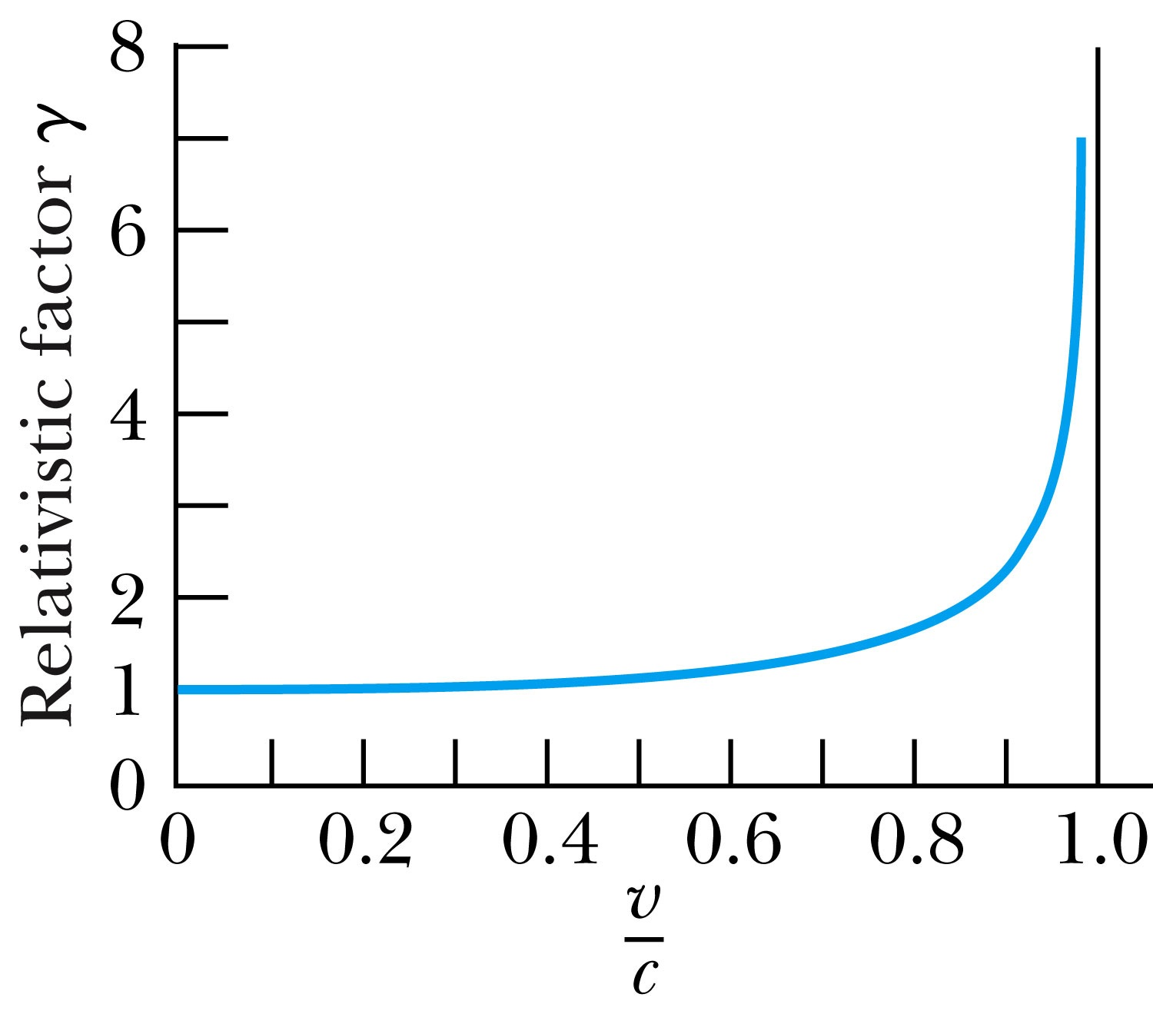
Properties of the Relativistic Factor γ
What is the property of the relativistic factor, γ?
Is it bigger or smaller than 1?
Recall Einstein’s postulate, β = v/c < 1 for all observers
γ = 1 only when v = 0

Slide 16
The complete Lorentz Transformations
Some things to note
  What happens when β~0 (or v~0)?
    The Lorentz x-formation becomes Galilean x-formation
  Space-time are not separated
  For non-imaginary transformations, the frame speed cannot exceed c!

Slide 17
Time Dilation and Length Contraction
Direct consequences of the Lorentz Transformation:
Time Dilation:
The clock in a moving inertial reference frame K’ run slower with respect to the stationary clock in K.
Length Contraction:
Lengths measured in a moving inertial reference frame K’ are shorter with respect to the same lengths stationary in K.

Slide 18
Time Dilation
To understand time dilation the idea of proper time must be understood:
proper time,T₀, is the time difference between two events occurring at the same position in a system as measured by a clock at that position.
Same location (spark “on” then off”)

Slide 19
Time Dilation
Is this a Proper Time?
spark “on” then spark “off”
Beginning and ending of the event occur at different positions

Slide 20
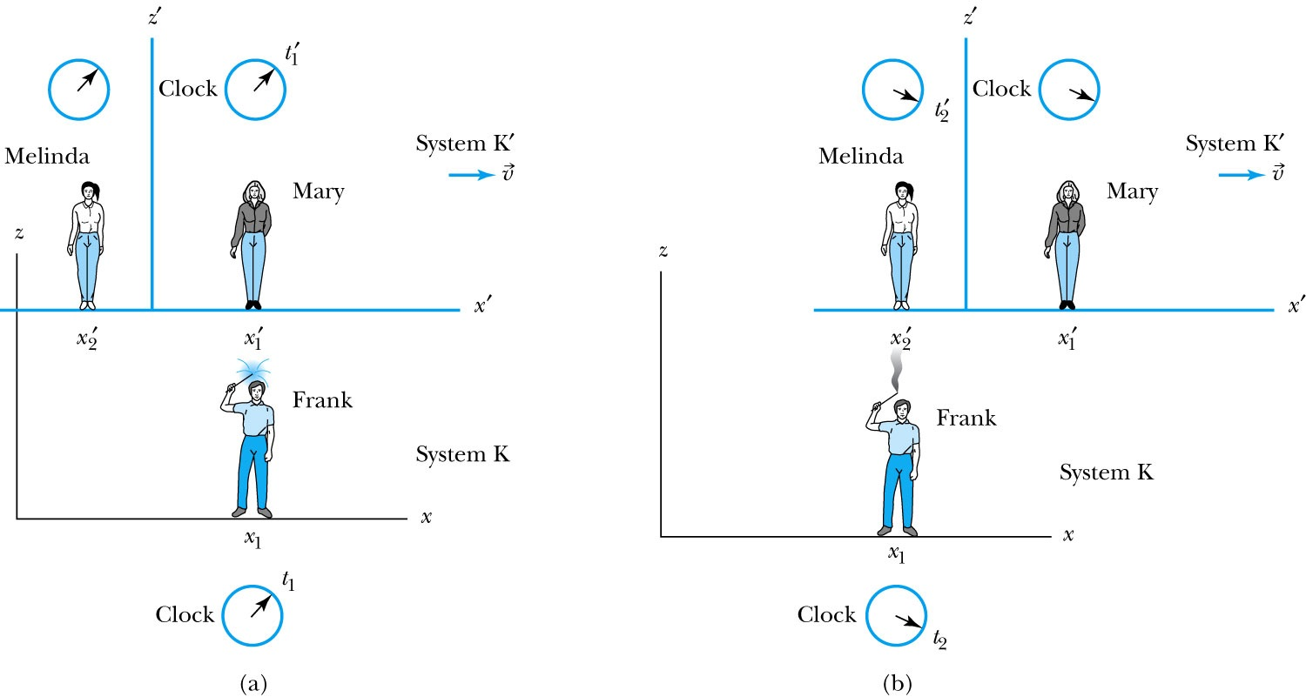
Time Dilation with Mary, Frank, and Melinda
Frank’s clock is at the same position in system K when the sparkler is lit in (a) (t=t₁) and when it goes out in (b) (t=t₂). ➔ The proper time T₀=t₂-t₁
Mary, in the moving system K’, is beside the sparkler when it was lit (t=t₁’)
Melinda then moves into the position where and when the sparkler extinguishes (t=t₂’)
Thus, Melinda, at the new position, measures the time in system K’ when the sparkler goes out in (b).

Slide 21
According to Mary and Melinda…
Mary and Melinda measure the two times for the sparkler to be lit and to go out in system K’ as times t₁’and t₂’ so that by the Lorentz transformation:
  Note here that Frank records x₂ – x₁ = 0 in K with a proper time: T₀ = t₂ – t₁ or

Slide 22
Time Dilation: Moving Clocks Run Slow
1) T ‘> T₀ or the time measured between two events at different positions is greater than the time between the same events at one position: time dilation.
The proper time is always the shortest time!!
2) The events do not occur at the same space and time coordinates in the two systems
3) System K requires 1 clock and K’ requires 2 clocks.

Slide 23
Time Dilation Example: muon lifetime
Muons are essentially heavy electrons (~200 times heavier)
Muons are typically generated in collisions of cosmic rays in upper atmosphere and, unlike electrons, decay ( μsec)
For a muon incident on Earth with v=0.998c, an observer on Earth would see what lifetime of the muon?
2.2 μsec?
t=35 μsec
Moving clocks run slow so when an outside observer measures, they see a longer lifetime than the muon itself sees.

Slide 24
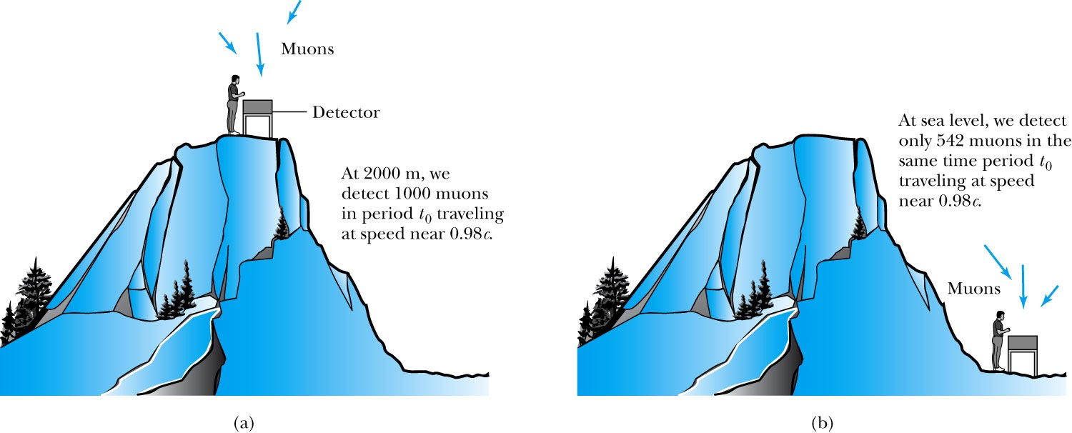
Experimental Verification of Time Dilation
Arrival of Muons on the Earth’s Surface
The number of muons detected with speeds near 0.98c is much different (a) on top of a mountain than
(b) at sea level, because of the muon’s decay. The experimental result agrees with our time dilation equation.

Slide 25
Length Contraction
To understand length contraction the idea of proper length must be understood:
Let an observer in each system K and K’ have a meter stick at rest in their own system such that each measures the same length at rest.
The length as measured at rest at the same time is called the proper length.
Notes:
Added “their own system”; changed measure to measures

Slide 26
Length Contraction cont’d
Each observer lays a stick down along his or her respective x axis, putting the left end at x_{ℓ} (or x’_{ℓ}) and the right end at x_{r} (or x’_{r}).
  Thus, in the rest frame K, Frank measures his stick to be:
  Similarly, in the moving frame K’, Mary measures her stick at rest to be:
Frank in his rest frame measures the length of the stick in Mary’s frame which is moving with speed v.
Thus using the Lorentz transformations Frank measures the length of the stick in K’ as:
Where both ends of the stick must be measured simultaneously, i.e, t_{r} = t_{ℓ}
Here Mary’s proper length is L’₀ = x’_{r} – x’_{ℓ}
and Frank’s measured length of Mary’s stick is L = x_{r} – x_{ℓ}

Slide 27
Measurement in Rest Frame
The observer in the rest frame measures the moving length as L given by
but since both Mary and Frank in their respective frames measure L’₀ = L₀
and L₀ > L, i.e. the moving stick shrinks

Slide 28
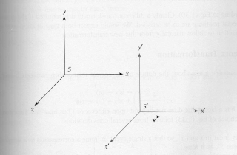
Length Contraction Summary
Proper length (length of object in its own frame:
Length of the object in observer’s frame:
Since γ>1, the length is shorter in the direction of motion (length contraction!)

Slide 29
More about Muons
Rate: 1/cm²/minute at Earth’s surface (so for a person with 600 cm² surface area, the rate would be 600/60=10 muons/sec passing through the body!)
They are typically produced in atmosphere about 6 km above surface of Earth and often have velocities that are a substantial fraction of speed of light, v=.998 c for example and lifetime of 2.2 μsec
How do they reach the Earth if they only go 660 m and not 6000 m?
The time dilation stretches life time to t=35 μsec not 2.2 μsec, thus they can travel 16 times further, or about 10 km, implying they easily reach the ground
But riding on a muon, the trip takes only 2.2 μsec, so how do they reach the ground???
Muon-rider sees the ground moving towards him, so the length he has to travel contracts and is only
At 1000 km/sec, it would take 5 seconds to cross U.S., pretty fast, but does it give length contraction? {not much contraction}
(for v=0.9c, the length is reduced by 66%)

Slide 30
The Complete Lorentz Transformations

Slide 31
Addition of Velocities
How do we add velocities in a relativistic case?
Taking differentials of the Lorentz transformation, relative velocities may be calculated:

