Slide 1
PHYS 3313 – Section 001
Lecture #7
Wednesday, Feb. 6, 2019
Dr. Jaehoon Yu
The Twin Paradox
Space-time Diagram
Invariant Quantities
The Relativistic Doppler Effect
Relativistic Momentum and Energy

Slide 2
Announcements
Reading assignments: CH 3.3 (special topic – the discovery of Helium) and CH3.7
Reminder: Homework #1
  chapter 2 end of the chapter problems
  17, 21, 23, 24, 32, 59, 61, 66, 68, 81 and 96
  Due is by the beginning of the class, Monday, Feb. 11
  Work in study groups together with other students but PLEASE do write your answer in your own way!

Slide 3
Reminder: Special Project #3
Derive the three Lorentz velocity transformation equations, starting from Lorentz coordinate transformation equations. (10 points)
Derive the three reverse Lorentz velocity transformation equations, starting from Lorentz coordinate transformation equations. (10 points)
Prove that the space-time invariant quantity s²=x²-(ct)² is indeed invariant, i.e. s²=s’², in Lorentz Transformation. (5 points)
You must derive each one separately starting from the Lorentz spatial coordinate transformation equations to obtain any credit.
  Just simply switching the signs and primes will NOT be sufficient!
  Must take the simplest form of the equations, using β and γ.
You MUST have your own, independent handwritten answers to the above three questions even if you worked together with others. All those who share the answers will get 0 credit if copied.
Due for the submission is Wednesday, Feb. 13!

Slide 4
Twin Paradox
The Set-up: Twins Mary and Frank at age 30 decide on two career paths: Mary (the Moving twin) decides to become an astronaut and to leave on a trip 8 light-years (ly) from the Earth at a great speed and to return; Frank (the Fixed twin) decides to stay on the Earth.
The Problem: Upon Mary’s return, Frank reasons, that her clocks measuring her age must run slow. As such, she will return younger. However, Mary claims that it is Frank who is moving and consequently his clocks must run slow.
The Paradox: Who is younger upon Mary’s return?

Slide 5
Twin Paradox cont’d
Let’s say, Mary is traveling at the speed of 0.8c
Frank will measure Mary’s total travel time as
  T=8ly/0.8c=10yrs
Mary’s clock will run slower due to relativity:
Thus, Frank claims that Mary will be 42 years old while he is 50 years old
Who is correct?

Slide 6
The Resolution
Frank’s clock is in an inertial system during the entire trip; however, Mary’s clock is not. As long as Mary is traveling at constant speed away from Frank, both of them can argue that the other twin is aging slower.
When Mary slows down to turn around, she leaves her original inertial system and eventually returns in a completely different inertial system.
Mary’s claim is no longer valid, because she does not remain in the same inertial system. There is also no doubt as to who is in the inertial system. Frank feels no acceleration during Mary’s entire trip, but Mary does.
So Frank is correct! Mary is younger!

Slide 7
Space-time
When describing events in relativity, it is convenient to represent events on a space-time diagram.
In this diagram one spatial coordinate x specifies the position, and instead of time t, ct is used as the other coordinate so that both coordinates have the same dimensions of length.
Space-time diagrams were first used by H. Minkowski in 1908 and are often called Minkowski diagrams. Paths on Minkowski space-time diagram are called worldlines.

Slide 8
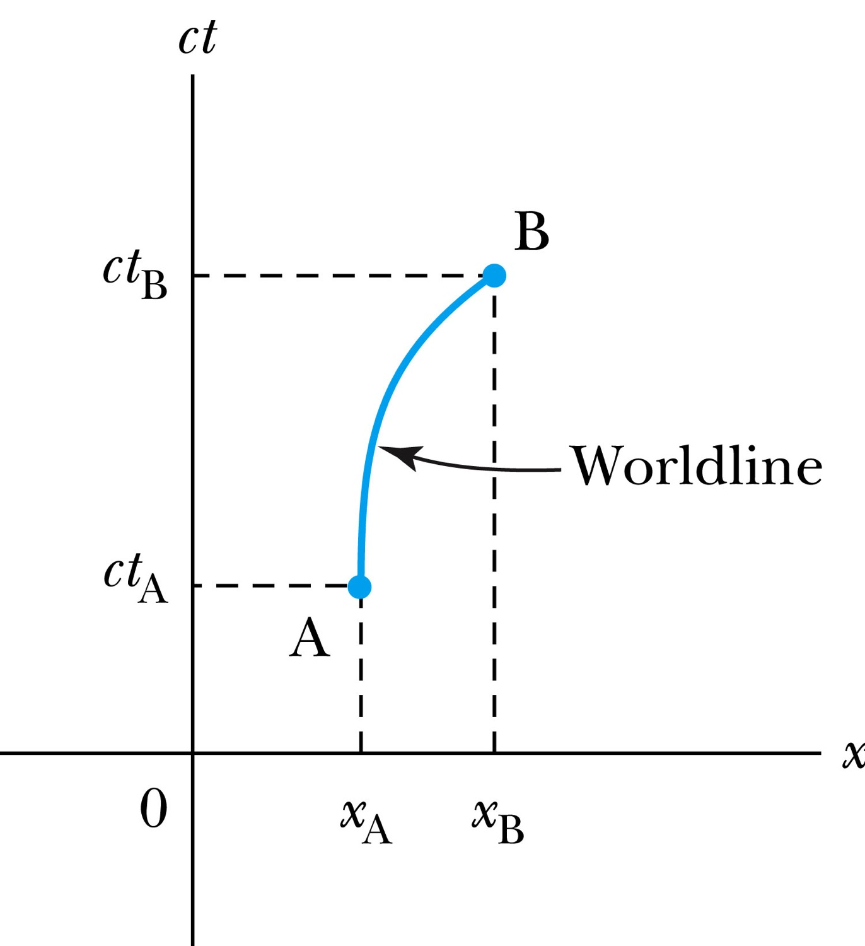
The Space-time Diagram
Notes:
Add the paragraph for Figure 2.21

Slide 9
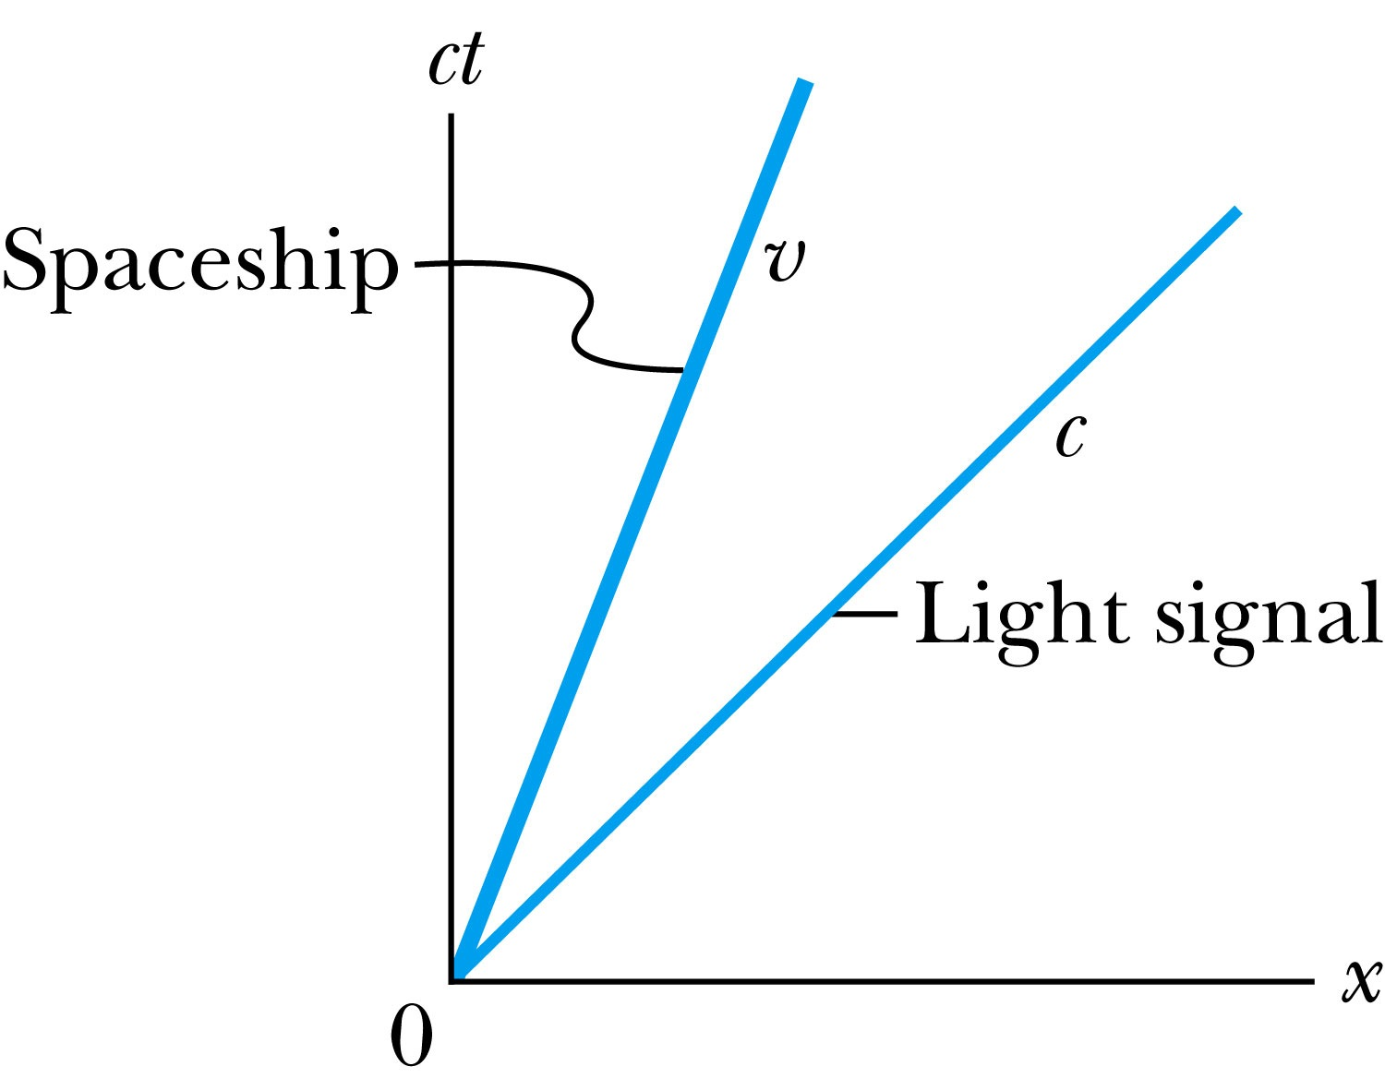
Particular Worldlines
How does the worldline for a spaceship running at the speed v(<c) look?
How does the worldline for a light signal look?
Notes:
Add the paragraph from Fig. 2.22

Slide 10
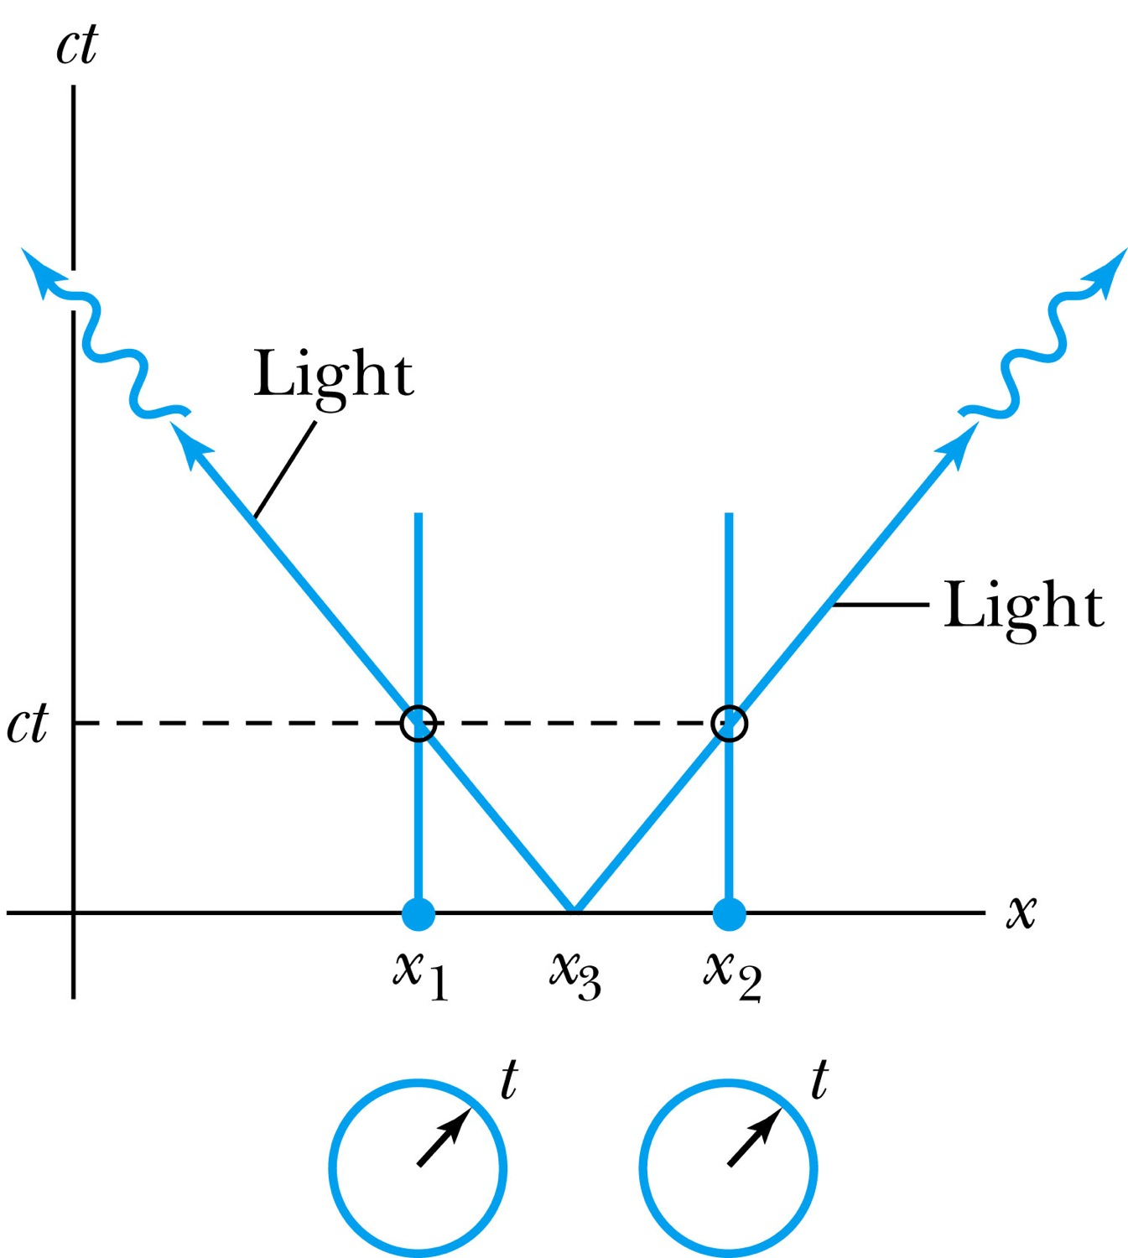
How about the time measured by two stationary clocks?
Notes:
Add paragraph from figure 2.23

Slide 11
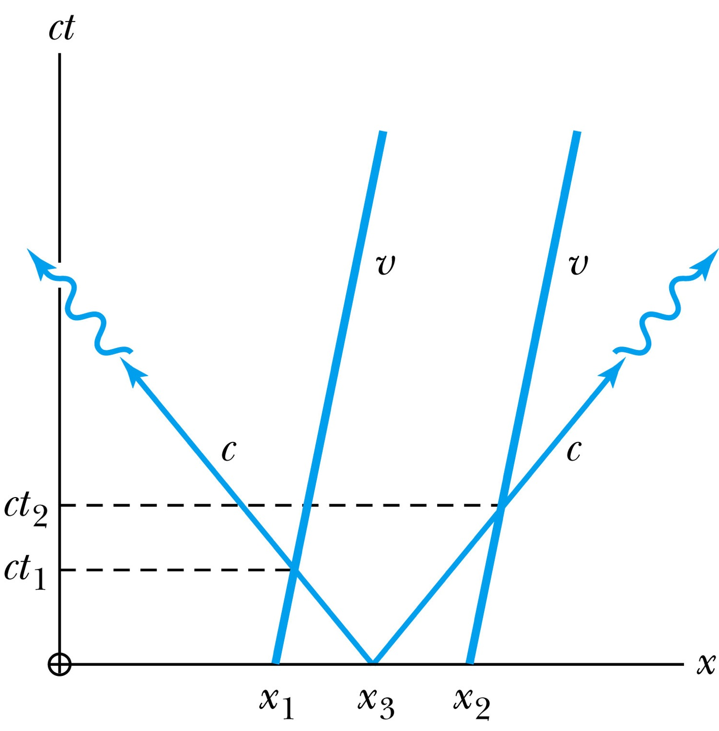
How about the time measured by two moving clocks?
Notes:
Add paragraph from figure 2.24

Slide 12
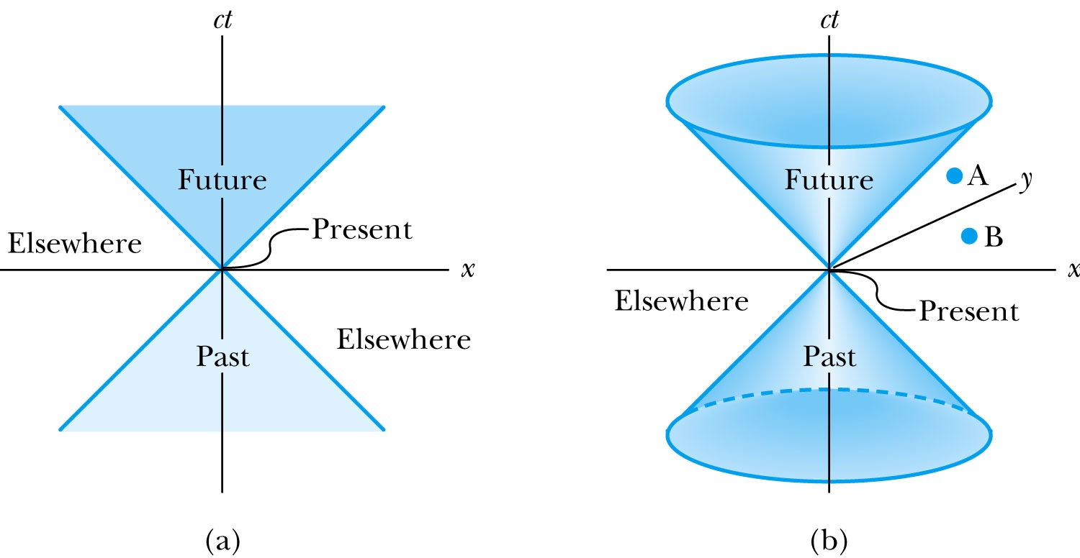
The Light Cone
Notes:
Add paragraph from Figure 2.25

Slide 13
Space-time Invariance
There are three possibilities for the invariant quantity Δs² (Space-Time Interval):

Slide 14
The Complete Lorentz Transformations

Slide 15
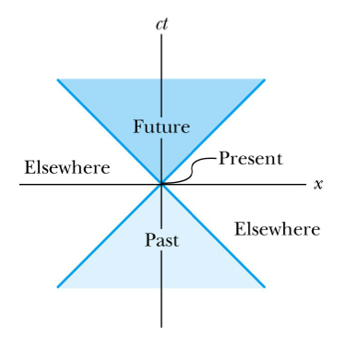
Space-time Invariance
There are three possibilities for the invariant quantity s² (Space-Time Interval):
s² = 0: x² = c² t²: light-like separation
  Two events can be connected only by a light signal.
s² > 0: x² > c² t²: space-like separation
  No signal can travel fast enough to connect the two events. The events are not causally connected!!
s² < 0: x² < c² t²: time-like separation
  Two events can be causally connected.
  These two events cannot occur simultaneously!
1
3
2

