Slide 1
PHYS 3313 – Section 001
Lecture #8
Monday, Feb. 11, 2019
Dr. Jaehoon Yu
The Relativistic Doppler Effect
Relativistic Momentum and Energy
Relationship Between Relativistic Quantities
Binding Energy

Slide 2
Announcements
Homework #2
  CH3 end of the chapter problems: 2, 19, 27, 36, 41, 47 and 57
  Due Wednesday, Feb. 22
Reminder: Quiz #2 Monday, Feb. 18
  Beginning of the class
  Covers CH1.1 – what we finish this Wednesday, Feb. 13
  You can bring your calculator but it must not have any relevant formula pre-input
  BYOF: You may bring a one 8.5x11.5 sheet (front and back) of handwritten formulae and values of constants for the exam
  No derivations, word definitions, or solutions of any problems !
    Lorentz velocity addition NOT allowed!!
    Maxwell’s equations NOT allowed!!
  No additional formulae or values of constants will be provided!

Slide 3
Reminder: Special Project #3
Derive the three Lorentz velocity transformation equations, starting from Lorentz coordinate transformation equations. (10 points)
Derive the three reverse Lorentz velocity transformation equations, starting from Lorentz coordinate transformation equations. (10 points)
Prove that the space-time invariant quantity s²=x²-(ct)² is indeed invariant, i.e. s²=s’², in Lorentz Transformation. (5 points)
You must derive each one separately starting from the Lorentz spatial coordinate transformation equations to obtain any credit.
  Just simply switching the signs and primes will NOT be sufficient!
  Must take the simplest form of the equations, using β and γ.
You MUST have your own, independent handwritten answers to the above three questions even if you worked together with others. All those who share the answers will get 0 credit if copied.
Due for the submission is this Wednesday, Feb. 13!

Slide 4
The Doppler Effect
The Doppler effect of sound
  Increased frequency of sound as the source approaches the receiver
  Decreased frequency as the source recedes.
The same change in sound frequency occurs when the source is fixed and the receiver is moving.
  The change in frequency of the sound wave depends on whether the source or the receiver is moving.
Does this violate the principle of relativity?
  No
  Why not?
  Sound wave is in a special frame of media such as air, water, or a steel plate in order to propagate;
Light does not need a medium to propagate!

Slide 5
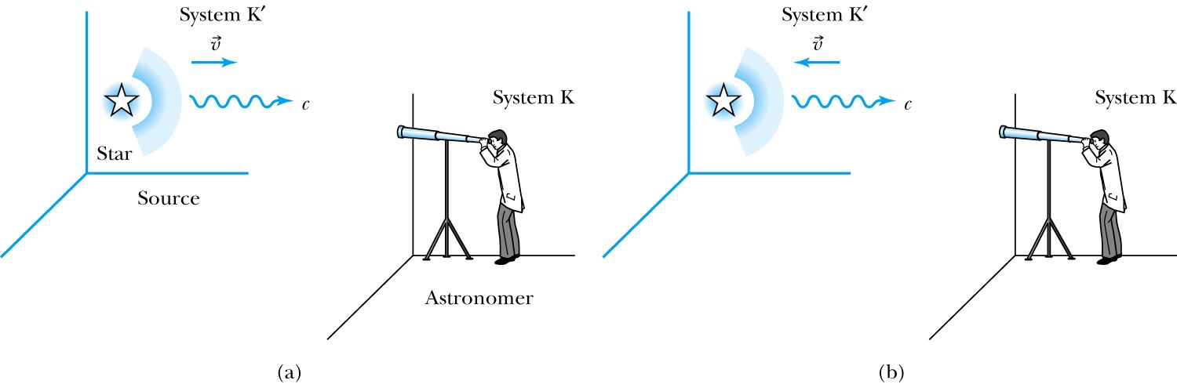
Recall the Doppler Effect
Notes:
Add p
aragraph from figure 2.27

Slide 6
The Relativistic Doppler Effect
Consider a source of light (a star) and a receiver (an astronomer) approaching one another with a relative velocity v.
Consider the receiver in system K and the light source in system K’ moving toward the receiver with velocity v.
The source emits n waves throughout the time interval T.
Because the speed of light is always c and the source is moving with velocity v, the total distance between the front and rear of the wave emitted during the time interval T is:
Length of the wave train = cT − vT

Slide 7
The Relativistic Doppler Effect (con’t)
Because there are n waves emitted by the source in time period T, the wavelength measured by the stationary receiver is
And the resulting frequency measured by the receiver is
The number of waves emitted in the moving frame of the source is n=f₀T ‘₀ with the proper time T’₀=T/γ we obtain the measured frequency by the receiver as

Slide 8
Results of Relativistic Doppler Effect
When source/receiver is approaching with β = v/c the resulting frequency is
Higher than the actual source’s frequency, blue shift!!
When source/receiver is receding with β = v/c the resulting frequency is
Lower than the actual source’s frequency, red shift!!
If we use +β for approaching source/receiver and -β for receding source/receiver, relativistic Doppler Effect can be expressed
For more generalized case

Slide 9
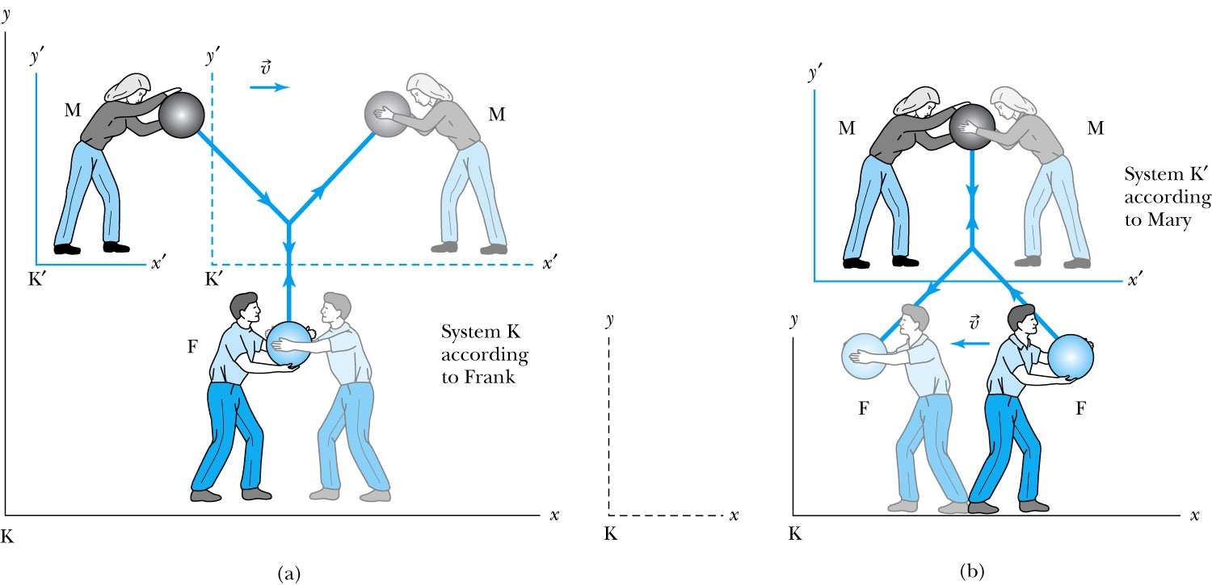
Relativistic Momentum
The most fundamental principle used here is the momentum conservation!
Frank is at rest in system K holding a ball of mass m.
Mary holds a similar ball in system K’ that is moving in the x direction with velocity v with respect to system K.
At one point they threw the ball at each other with exactly the same speed
Notes:
Add paragraph from figure 2.29

Slide 10
Relativistic Momentum
If we use the definition of momentum, the momentum of the ball thrown by Frank is entirely in the y direction
p_{Fy} = mu₀
The change of momentum as observed by Frank is
Δp_{F} = Δp_{Fy} = −2mu₀
Mary measures the initial velocity of her own ball to be
u’_{Mx} = 0 and u’_{My} = −u₀.
In order to determine the velocity of Mary’s ball as measured by Frank we use the velocity transformation equations:

Slide 11
Reminder: Lorentz Velocity Transformations
In addition to the previous relations, the Lorentz velocity transformations for v’_{x}, v’_{y} , and v’_{z} can be obtained by switching primed and unprimed and changing v to –v.(the velocity of the moving frame!!)

Slide 12
Relativistic Momentum
If we use the definition of momentum, the momentum of the ball thrown by Frank is entirely in the y direction
p_{Fy} = mu₀
The change of momentum as observed by Frank is
Δp_{F} = Δp_{Fy} = −2mu₀
Mary measures the initial velocity of her own ball to be
u’_{Mx} = 0 and u’_{My} = −u₀.
In order to determine the velocity of Mary’s ball as measured by Frank we use the velocity transformation equations:

Slide 13
Relativistic Momentum
Before the collision, the momentum of Mary’s ball as measured by Frank (in the Fixed frame) with the Lorentz velocity transformation becomes
For a perfectly elastic collision, the momentum after the collision is
Thus the change in momentum of Mary’s ball according to Frank is
OMG! The linear momentum is not conserved even w/o an external force!!
What do we do?
Redefine the momentum in a fashion
Something has changed. Mass is now, mγ!! The relativistic mass!!
Mass as the fundamental property of matter is called the “rest mass”, m₀!
Notes:
Spaced a bit more evenly

Slide 14
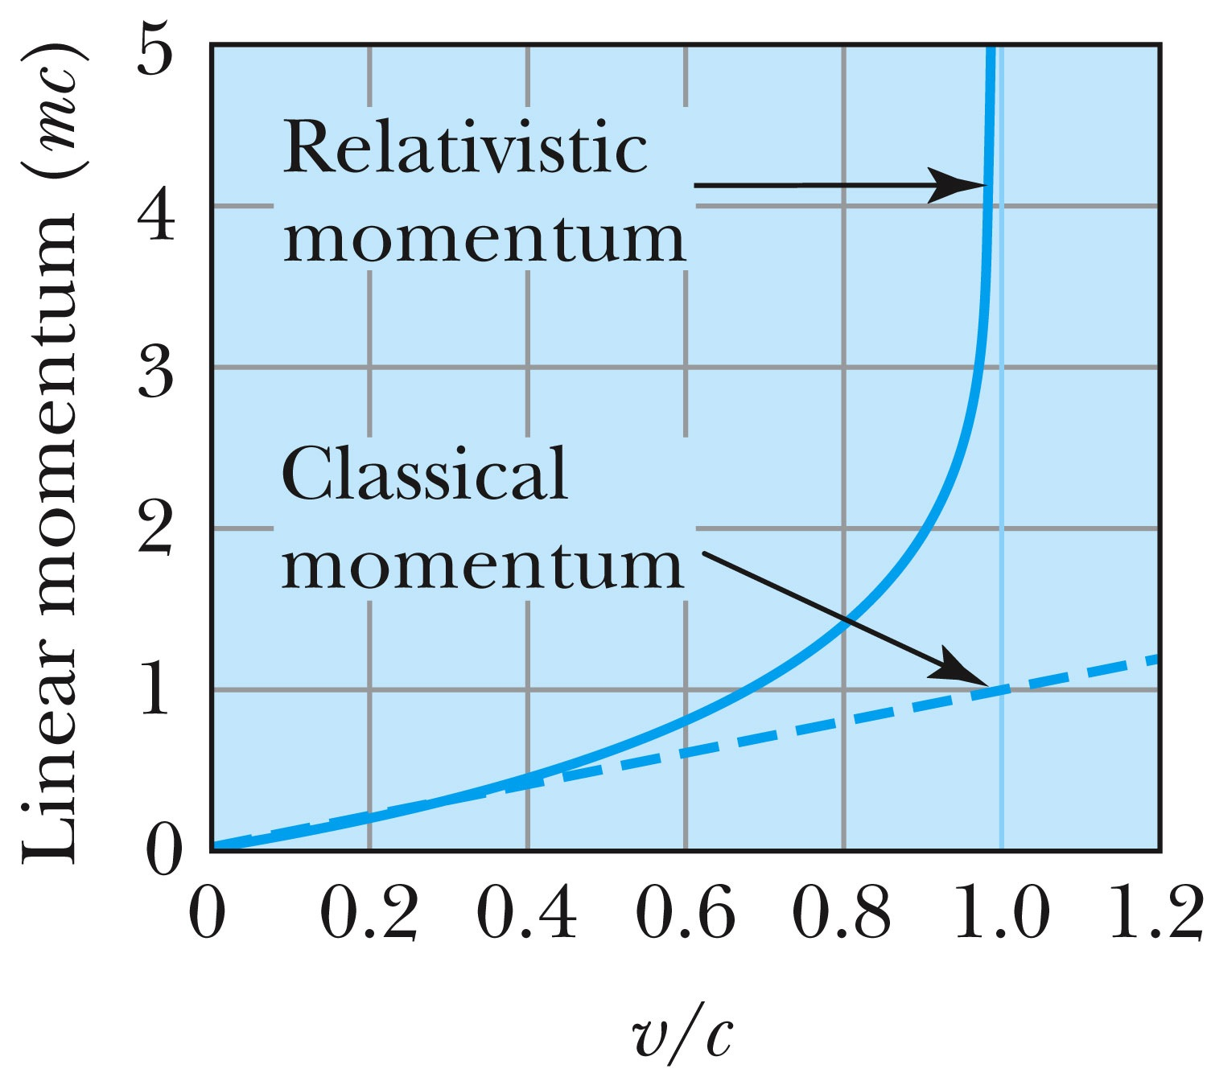
Relativistic and Classical Linear Momentum
Notes:
Add arrow head to the line from “Relativistic” to the graph
Possibly make the line from the “Classical” straight (as in figure 2.310
rather than curved, also add arrow head to this line pointing to the curve.

Slide 15
How do we keep momentum conserved in a relativistic case?
Redefine the classical momentum in the form:
This Γ(u) is different than the γ factor since it uses the particle’s speed u
➔ What? How does this make sense?
➔ Well the particle itself is moving at a relativistic speed, thus that must impact the measurements by the observer in the rest frame!!
Now, the agreed form of the momentum in all frames is (τ is the proper time):
Resulting in the new relativistic definition of the momentum:
When u→0, this formula becomes that of the classical.
What can the speed u be to maintain the relativistic momentum to 1% of classical momentum?
Notes:
Spaced a bit more evenly

Slide 16
Relativistic Energy
Due to the new idea of relativistic mass, we must now redefine the concepts of work and energy.
  Modify Newton’s second law to include our new definition of linear momentum, and the force becomes:
The work W done by a force F to move a particle from rest to a certain kinetic energy is
Resulting relativistic kinetic energy becomes
Why doesn’t this look anything like the classical KE?

Slide 17
Relativistic KE at u<<c
All relativistic quantities must become that of classical quantity at very low speed, u<<c
How does become ?
When u<<c, one can expand γ factor as follows
Thus,

Slide 18
Big note on Relativistic KE
Only is RIGHT!
and are WRONG!

Slide 19
Total Energy and Rest Energy
Rewriting the relativistic kinetic energy, we obtain:
The term mc² is called the rest energy and is denoted by E₀.
The sum of the kinetic energy and rest energy is interpreted as the total energy of the particle. (note that u is the speed of the particle)

Slide 20
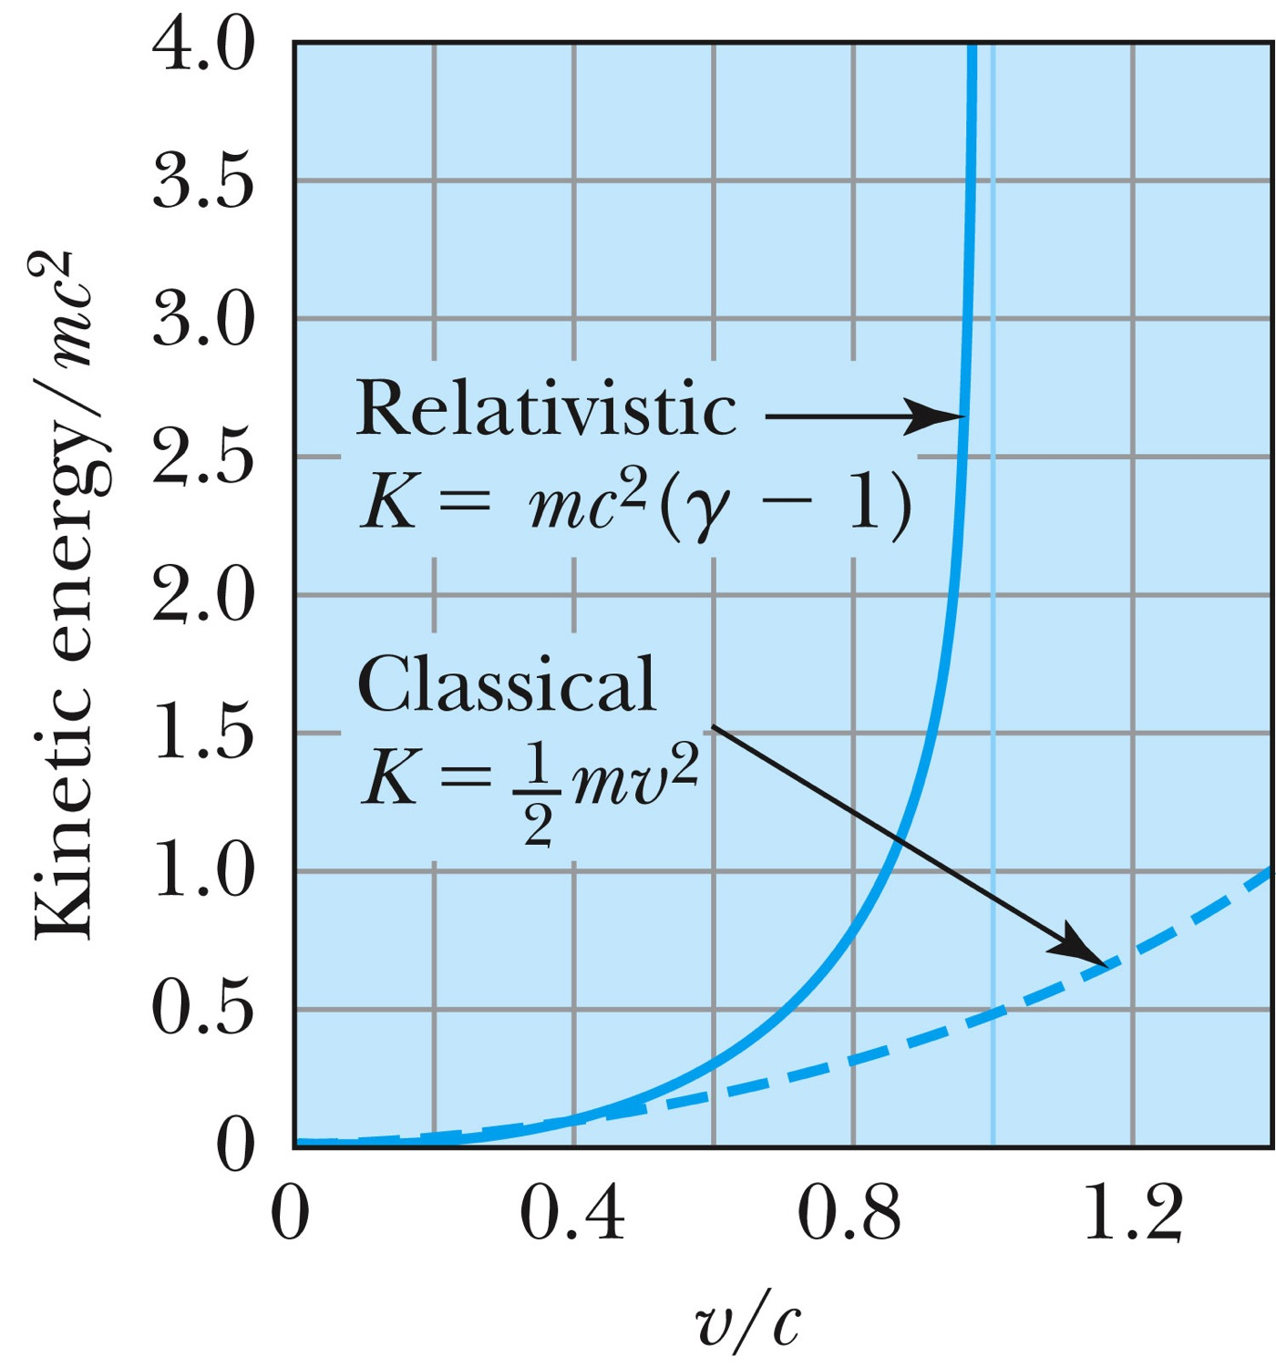
Relativistic and Classical Kinetic Energies
Notes:
Add arrow head to the line from “Relativistic” to the graph
Possibly make the line from the “Classical” straight (as in figure 2.310
rather than curved, also add arrow head to this line pointing to the curve.

Slide 21
Relationship of Energy and Momentum
We square this formula, multiply by c², and rearrange the terms.
Rewrite
Rewrite
Notes:
Title rewritten

Slide 22
Massless Particles have a speed equal to the speed of light c
Recall that a photon has “zero” rest mass and the equation from the last slide reduces to: E = pc and we may conclude that:
Thus the speed, u, of a massless particle must be c since, as 0, and it follows that: u = c.
Notes:
Add this slide

Slide 23
Units of Work, Energy and Mass
The work done in accelerating a charge through a potential difference V is W = qV.
  For a proton, with the charge e = 1.602 × 10⁻¹⁹ C being accelerated across a potential difference of 1 V, the work done is
  1 eV = 1.602 × 10⁻¹⁹ J
  W = (1.602 × 10⁻¹⁹)(1 V) = 1.602 × 10⁻¹⁹ J
eV is also used as a unit of energy.

Slide 24
Other Units
Rest energy of a particle:
Example: Rest energy, E₀, of proton
Atomic mass unit (amu): Example: carbon-12
What is 1u in eV?

Slide 25
Binding Energy
The potential energy associated with the force keeping a system together ➔ E_{B}.
The difference between the rest energy of the individual particles and the rest energy of the combined bound system.

Slide 26
Examples 2.13 and 2.15
Ex. 2.13: A proton with 2-GeV kinetic energy hits another proton with 2 GeV KE in a head on collision. (proton rest mass = 938MeV/c²)
  Compute v, β, p, K and E for each of the initial protons
  What happens to the kinetic energy?
Ex. 2.15: What is the minimum kinetic energy the protons must have in the head-on collision in the reaction p+p→π⁺+d, in order to produce the positively charged pion (139.6MeV/c² ) and a deuteron.(1875.6MeV/c²).

