Slide 1
PHYS 3313 – Section 001
Lecture #10
Monday, Feb. 18, 2019
Dr. Jaehoon Yu
Line Spectra
Blackbody Radiation
The Photoelectric Effect
Compton Effect
Pair production/Pair annihilation

Slide 2
Announcements
Reminder: Homework #2
  CH3 end of the chapter problems: 2, 19, 27, 36, 41, 47 and 57
  Due Wednesday, Feb. 20

Slide 3
Special Project #4
A total of N_{i} incident projectile particle of atomic number Z₁ kinetic energy KE scatter on a target of thickness t and atomic number Z₂ and has n atoms per volume. What is the total number of scattered projectile particles at an angle θ? (20 points)
Please be sure to clearly define all the variables used in your derivation! Points will be deducted for missing variable definitions.
This derivation must be done on your own. Please do not copy the book, internet or your friends’.
Due net Wednesday, Feb. 27

Slide 4
Line Spectra
Chemical elements produce unique wavelengths of light when burned or excited in an electrical discharge.
When collimated light is passed through a diffraction grating with thousands of ruling lines per centimeter,
  The diffracted light is separated at an angle θ according to its wavelength λ by the equation:
where d is the distance between the rulings and n is an integer called the order number (n=1 strongest)
Diffraction maxima

Slide 5
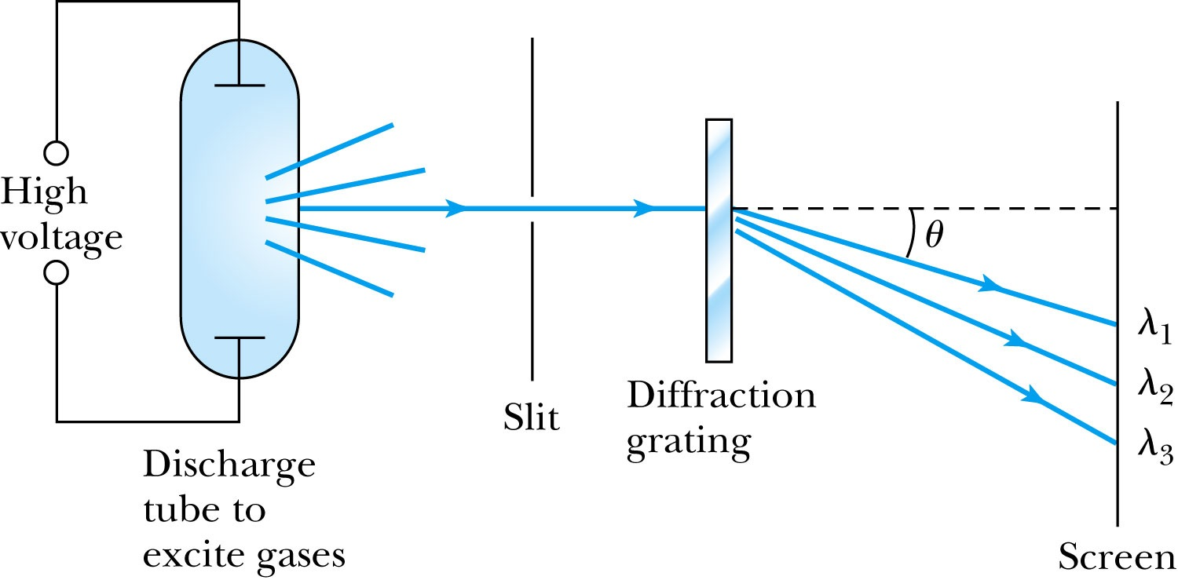
Optical Spectrometer
Diffraction creates a line spectrum pattern of light bands and dark areas on the screen.
Chemical elements and the composition of materials can be identified through the wavelengths of these line spectra

Slide 6
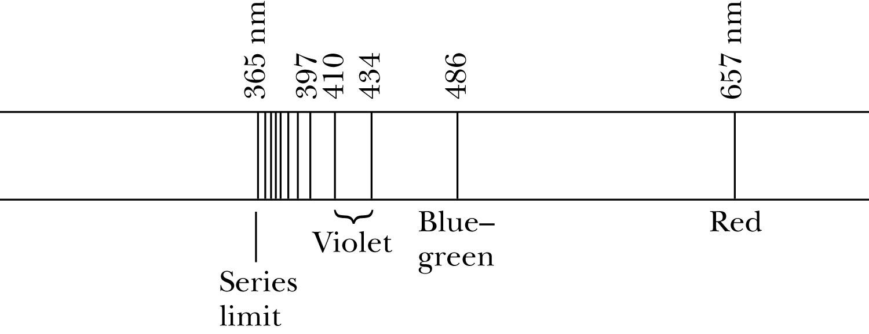
Balmer Series
In 1885, Johann Balmer found an empirical formula for wavelength of the visible hydrogen line spectra in nm:
(where k = 3,4,5… and k > 2)

Slide 7
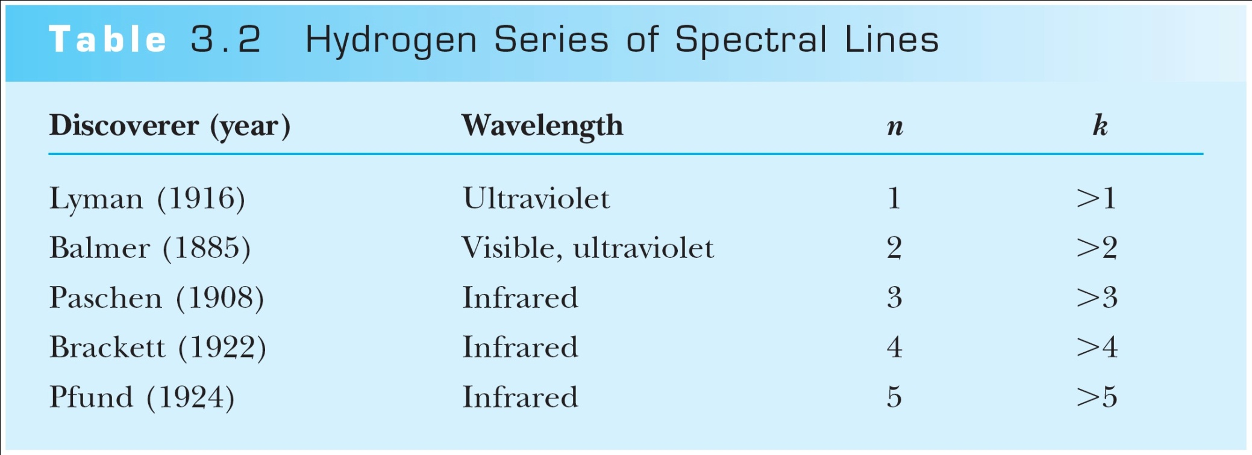
Rydberg Equation
Several more series of hydrogen emission lines at infrared and ultraviolet wavelengths were discovered, the Balmer series equation was extended to the Rydberg equation:
(n = 2, n>K)

Slide 8
More Quantization
Current theories predict that charges are quantized in units (quarks) of ±e/3 and ±2e/3, but quarks are not directly observed experimentally.
The charges of particles that have been directly observed are always quantized in units of ±e.
The measured atomic weights are not continuous—they have only discrete values, which are close to integral multiples of a unit mass.

Slide 9
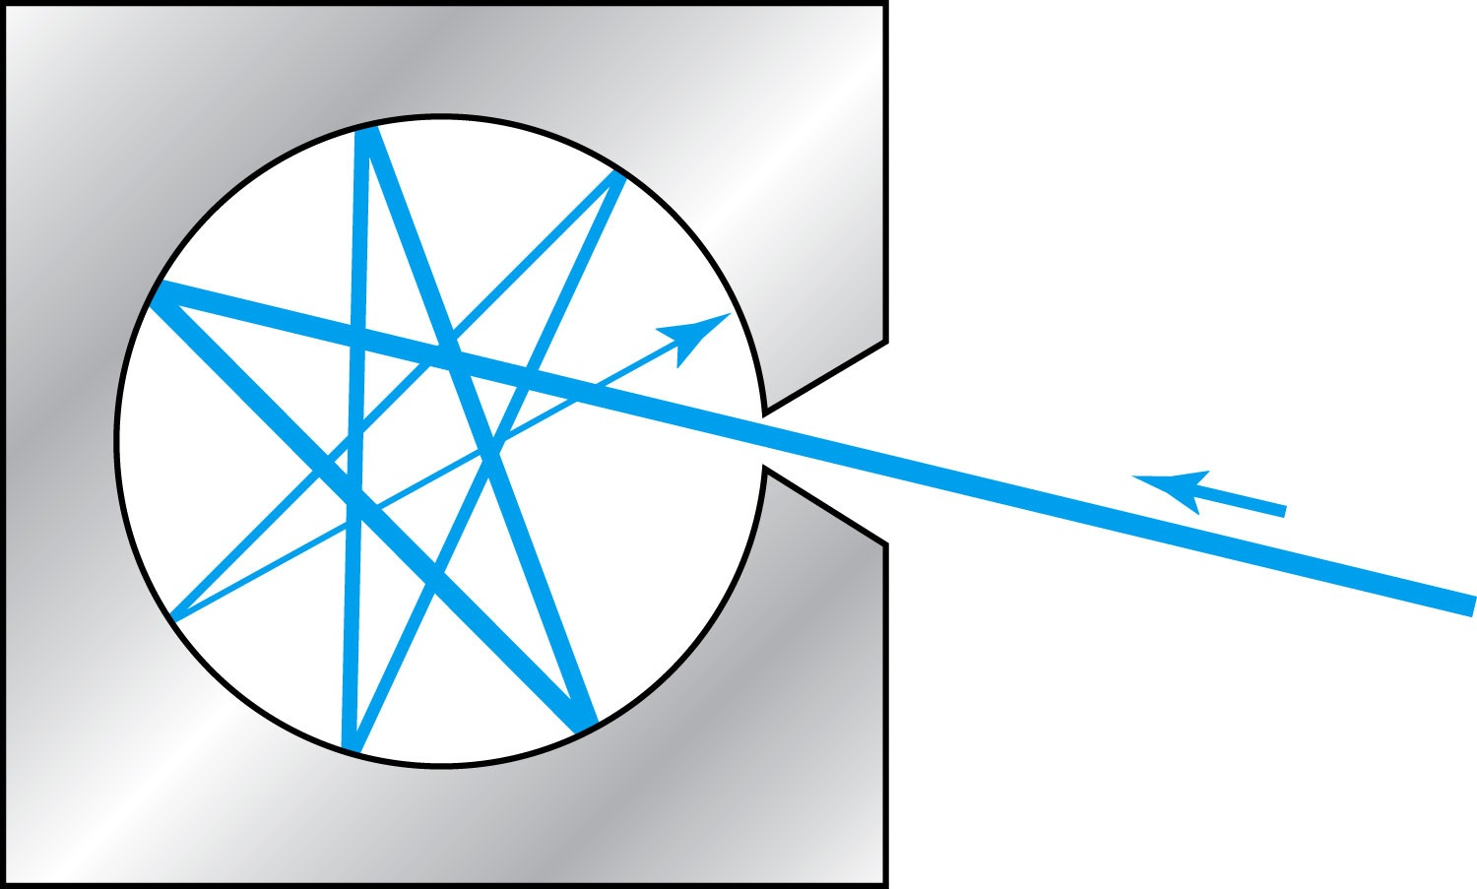
Blackbody Radiation
When a matter is heated, it emits radiation.
A blackbody is an ideal object that has 100% absorption and 100% emission without loss of energy
A cavity in a material that only emits thermal radiation can be considered as a blackbody. Incoming radiation is fully absorbed in the cavity.
Blackbody radiation is theoretically interesting because
  Radiation properties are independent of the particular material.
  Properties of intensity versus wavelength at fixed temperatures can be studied

Slide 10
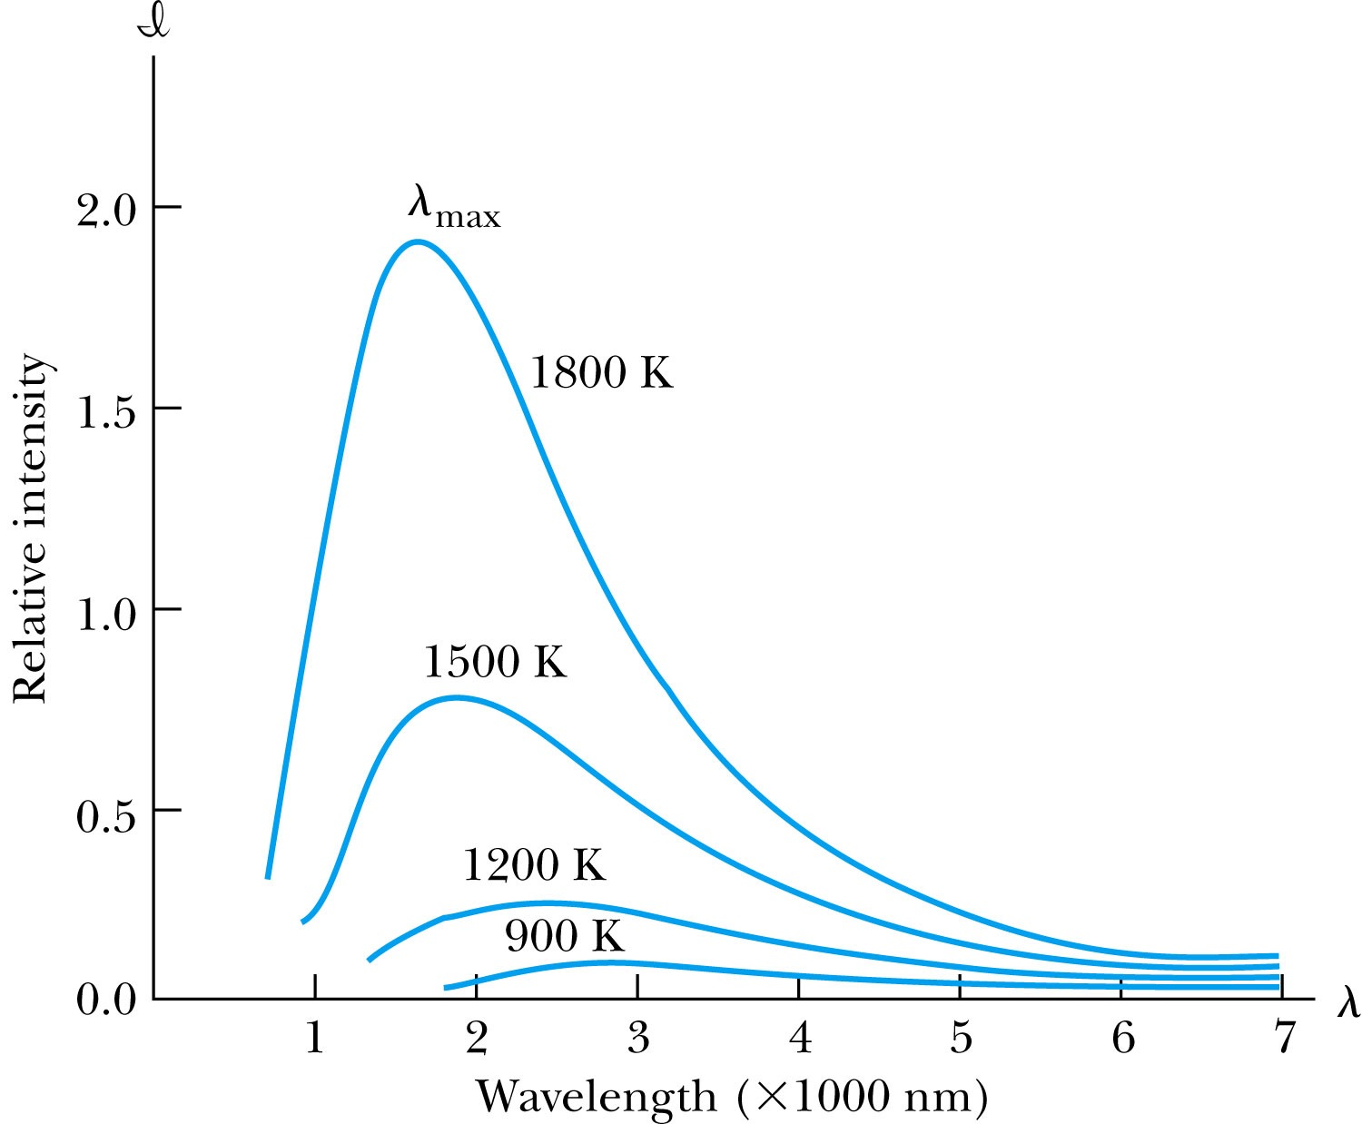
Wien’s Displacement Law
The intensity I(λ, T) is the total power radiated per unit area per unit wavelength at the given temperature. (Nobel 1911)
Wien’s displacement law: The peak of I(λ, T) distribution shifts to smaller wavelengths as the temperature increases.
(where λ_{max} = wavelength of the peak)

Slide 11
Ex 3.4: Using the Wien’s Law
A furnace has a wall of temperature 1600 ºC. What is the wavelength of maximum intensity emitted when a small door is opened?
Since it has a small door open, we treat the furnace as if it is a blackbody.
Using Wien’s displacement law, we obtain

Slide 12
Stefan-Boltzmann Law
The total power per unit area radiated from a blackbody increases with the temperature:
This is known as the Stefan-Boltzmann law, with the constant value of σ experimentally measured to be
  σ =5.6705×10⁻⁸ W / (m² · K⁴).
The emissivity ε (ε = 1 for an idealized blackbody) is the ratio of the emissive power of an object to that of an ideal blackbody and is always less than 1.

Slide 13
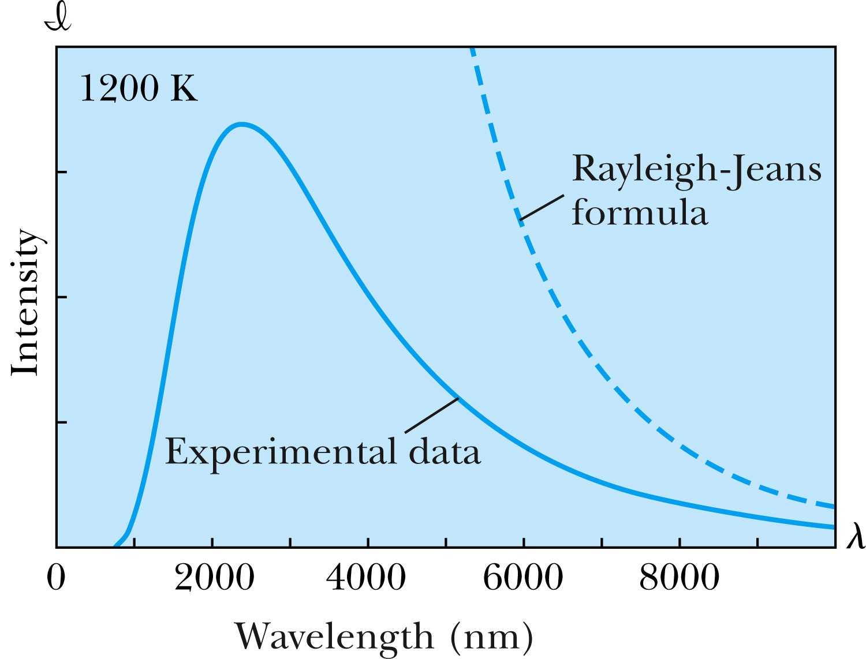
Rayleigh-Jeans Formula
Lord Rayleigh used the classical theories of electromagnetism and thermodynamics to show that the blackbody spectral distribution should be
Worked reasonably well at longer wavelengths but..
it deviates badly at short wavelengths.
➔ “the ultraviolet catastrophe” a serious issue that couldn’t be explained

Slide 14
Planck’s Radiation Law
Planck assumed that the radiation in the cavity was emitted (and absorbed) by some sort of “oscillators” that were contained in the walls. He used Boltzman’s statistical methods to arrive at the following formula that fit the blackbody radiation data.
Planck made two important modifications to the classical theory:
    The oscillators (of electromagnetic origin) can only have certain discrete energies determined by E_{n} = nhf, where n is an integer, f is the frequency, and h is called Planck’s constant, h = 6.6261 × 10⁻³⁴ J·s.
    The oscillators can absorb or emit energy ONLY in discrete multiples of the fundamental quantum of energy given by
Planck’s radiation law

