Slide 1
PHYS 3313 – Section 001
Lecture #11
Wednesday, Feb. 20, 2019
Dr. Jaehoon Yu
The Photoelectric Effect
Compton Effect
Pair production/Pair annihilation
Rutherford Scattering Experiment and Rutherford Atomic Model

Slide 2
Announcements
Midterm Exam
  In class Wednesday, March. 6
  Covers from CH1.1 through what we learn March 4 plus the math refresher in the appendices
  Mid-term exam constitutes 20% of the total
  Please do NOT miss the exam! You will get an F if you miss it.
  BYOF: You may bring a one 8.5x11.5 sheet (front and back) of handwritten formulae and values of constants for the exam
  No derivations, word definitions or setups or solutions of any problems!
    No Lorentz velocity addition formula!
    No Maxwell’s equations!
  No additional formulae or values of constants will be provided!
Colloquium today
  Dr. C. Liu of UTA Math Dept.

Slide 3
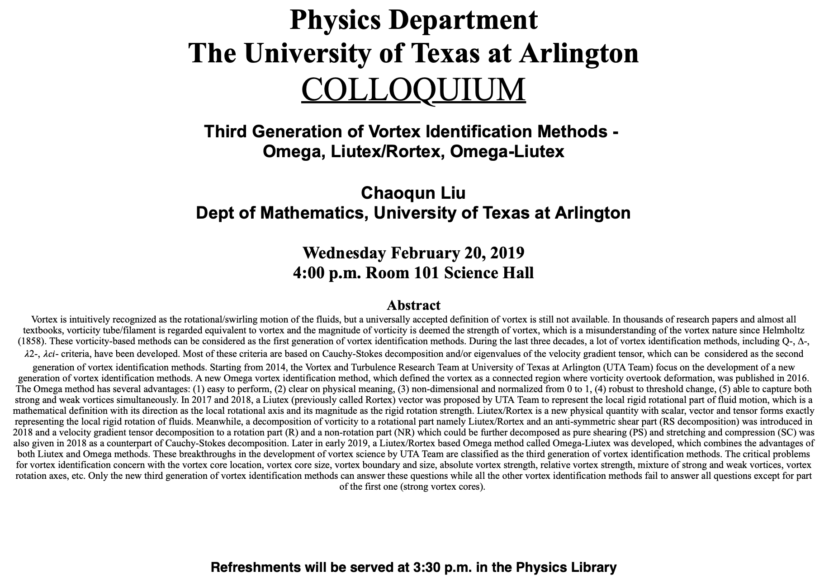

Slide 4
Reminder: Special Project #4
A total of N_{i} incident projectile particle of atomic number Z₁ kinetic energy KE scatter on a target of thickness t and atomic number Z₂ and has n atoms per volume. What is the total number of scattered projectile particles at an angle θ? (20 points)
Please be sure to clearly define all the variables used in your derivation! Points will be deducted for missing variable definitions.
This derivation must be done on your own. Please do not copy the book, internet or your friends’.
Due next Wednesday, Feb. 27

Slide 5
Photoelectric Effect
Definition: Incident electromagnetic radiation shining on a metal transfers energy to the electrons in the metal, allowing them to escape the surface of the metal. Ejected electrons are called photoelectrons.
Heinrich Hertz noticed during his experiment in 1887 that when ultraviolet light falls on metal surface charge gets ejected ➔ Left it to Philip Lenard to study further (1905 Nobel for photoelectric effect)
Other methods of electron emission:
Thermionic emission: Application of heat allows electrons to gain enough energy to escape.
Secondary emission: The electron gains enough energy by transfer from another high-speed particle that strikes the material from outside.
Field emission: A strong external electric field pulls the electron out of the material. (an example?)

Slide 6
Classical Interpretation of Photoelectric Effect
Classical theory allows EM radiation to eject photoelectrons from matter
Classical theory predicts the energy of the photoelectrons increase in proportion to the radiation intensity
Thus, the KE of the photoelectrons must be proportional to the intensity of light not the electric current
Time for an experiment!

Slide 7
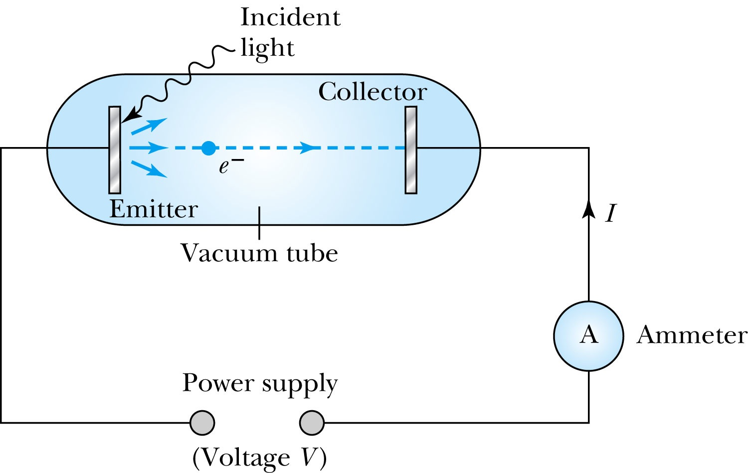
Photoelectric Effect Experimental Setup
Hmm.. Something does not make sense!!
Anode
Photocathode
V increased in reverse direction stops current independent of light intensity

Slide 8
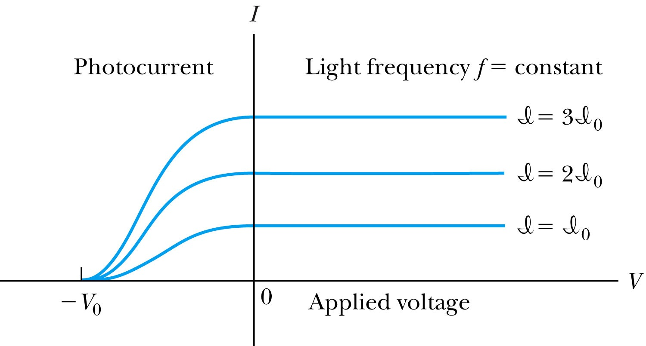
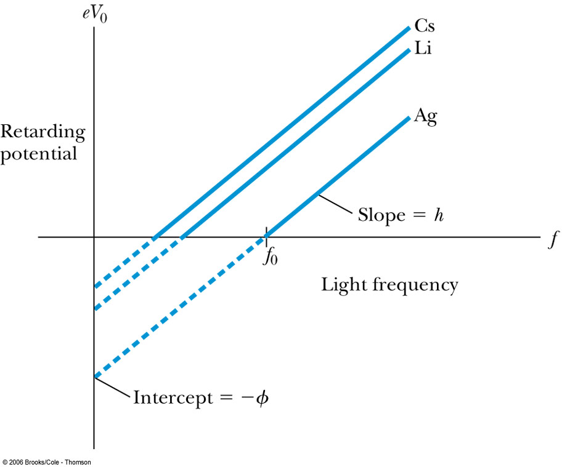
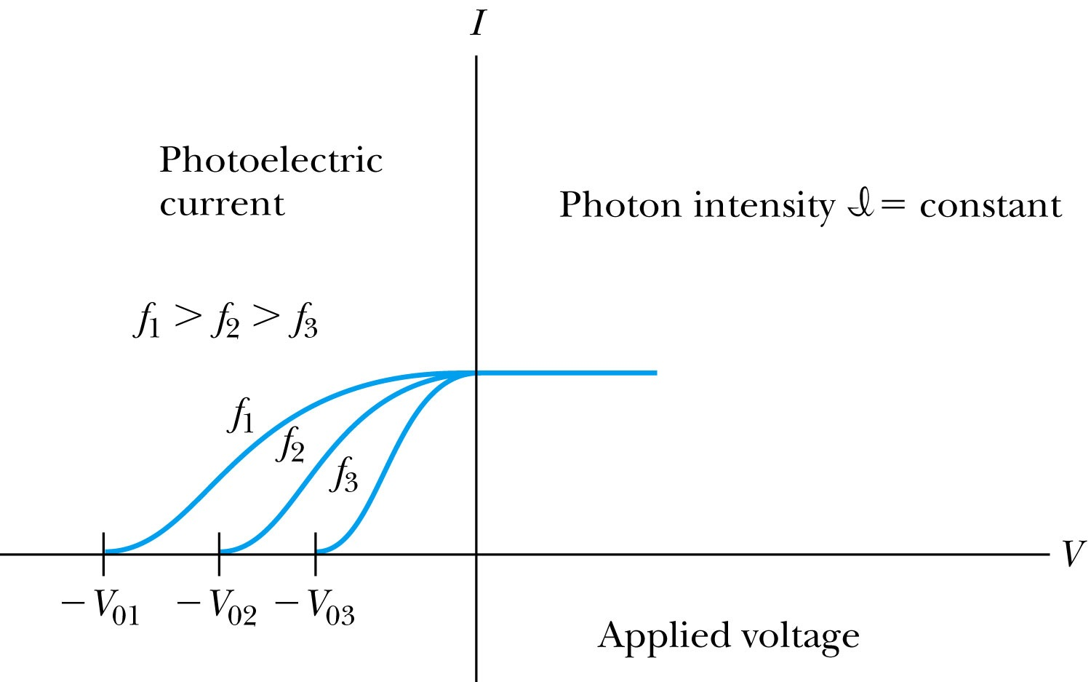
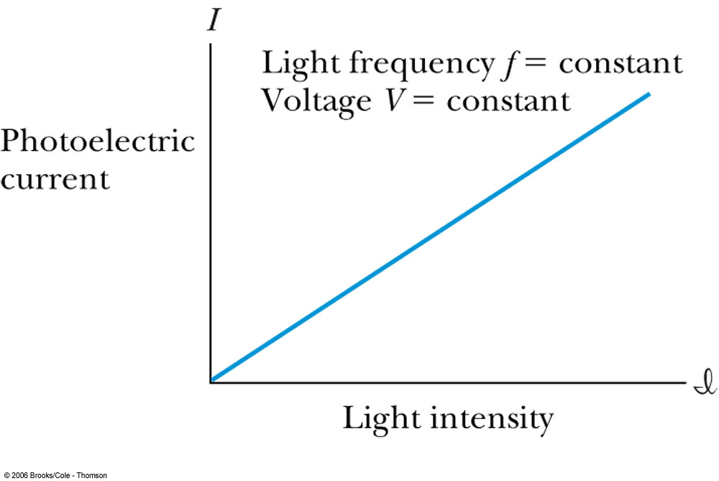
Experimental Observations
KE proportional to frequency!!
The same V₀ but higher current
The same current!!
Number of photoelectrons proportional to light intensity!!

Slide 9
Summary of Experimental Observations
Light intensity does not affect the KE of the photoelectrons
The max KE of the photoelectrons for a given emitter material depends only on the frequency of the light
The smaller the work function φ of the emitter material, the smaller is the threshold frequency of the light that can eject photoelectrons.
When the photoelectrons are produced, their number is proportional to the intensity of light.
The photoelectrons are emitted almost instantly following the illumination of the photocathode, independent of the intensity of the light. ➔ Totally unexplained by classical physics

Slide 10
Einstein’s Theory of Photoelectric Effect
Einstein suggested that the electromagnetic radiation field of the light is quantized into particles called photons. Each photon has the energy quantum:
where f is the frequency of the light and h is Planck’s constant.
The photon travels at the speed of light in vacuum, and its wavelength is given by

Slide 11
Einstein’s Theory
Conservation of energy yields:
where φ is the work function of the metal
The photon energy can then be written
The retarding potentials measure the KE of the most energetic photoelectrons.

Slide 12
Quantum Interpretation
The KE of the electron depends only on the light frequency and the work function φ of the material not the light intensity at all
Einstein in 1905 predicted that the stopping potential was linearly proportional to the light frequency, with a slope h, the same constant found by Planck.
From this, Einstein concluded that light is a particle with energy:
Was he already thinking about particle/wave duality?

Slide 13
Ex 3.11: Photoelectric Effect
Light of wavelength 400nm is incident upon lithium (φ=2.93eV). Calculate (a) the photon energy (eV) and (b) the stopping potential V₀.
Since the wavelength is known, we use plank’s formula:
The stopping potential can be obtained using Einstein’s formula for photoelectron energy

Slide 14
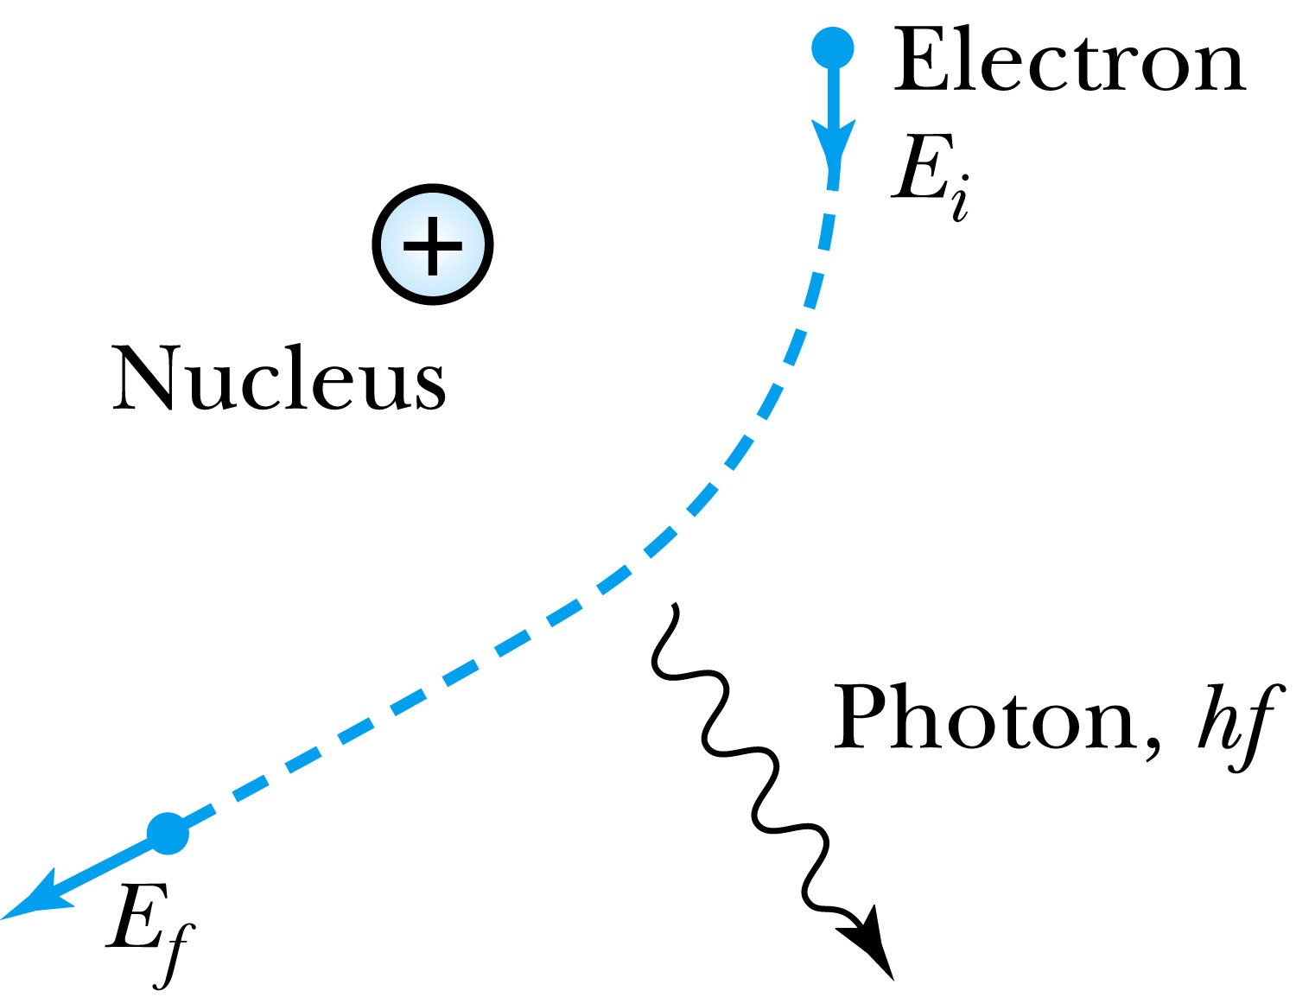
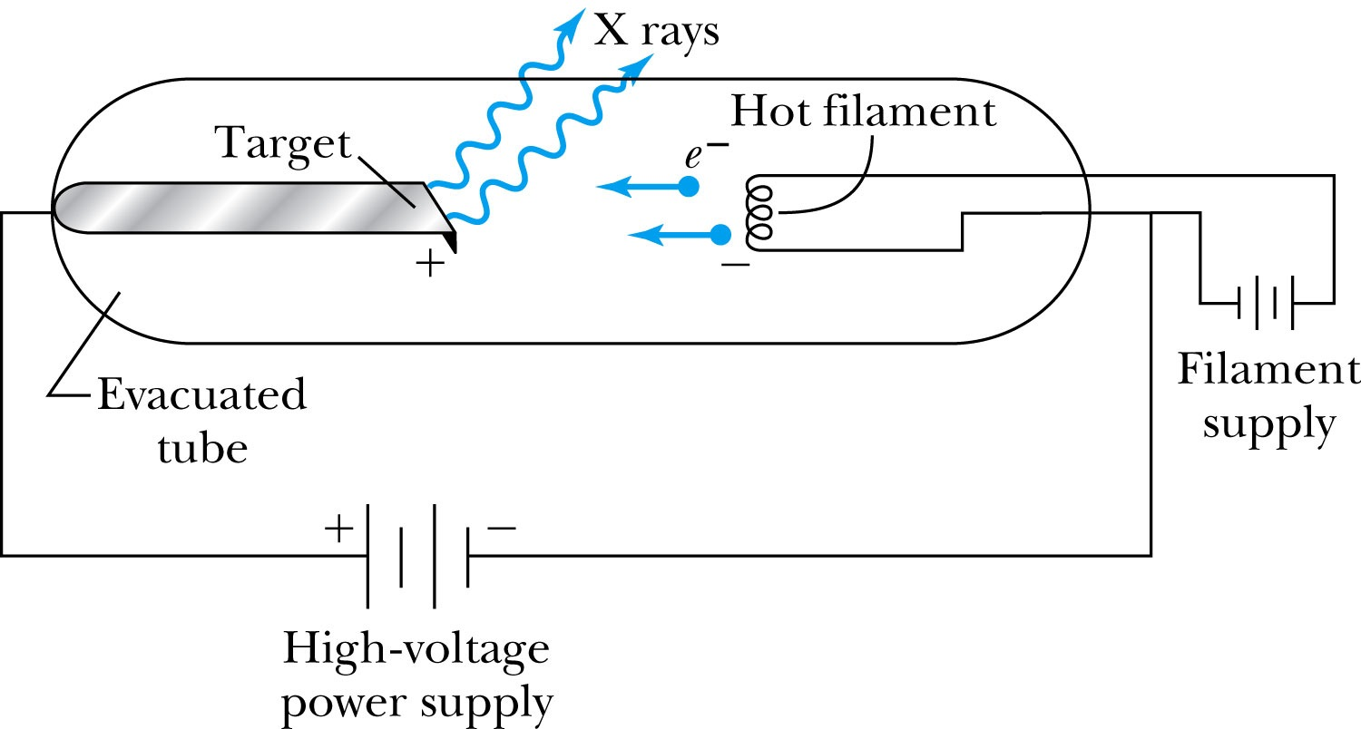
X-Ray Production
Bremsstrahlung (German word for braking radiation): Radiation of a photon from an energetic electron passing through matter due to an acceleration
Since linear momentum must be conserved, the nucleus absorbs very little energy, and it is ignored. The final energy of the electron is determined from the conservation of energy
An electron that loses a large amount of energy will produce an X-ray photon.
  Current passing through a filament produces copious numbers of electrons by thermionic emission.
  These electrons are focused by the cathode structure into a beam and are accelerated by potential differences of thousands of volts until they impinge on a metal anode surface, producing x rays by bremsstrahlung as they stop in the anode material
  X-ray wavelengths range 0.01 – 10nm. What is the minimum energy of an electron to produce X-ray?

Slide 15
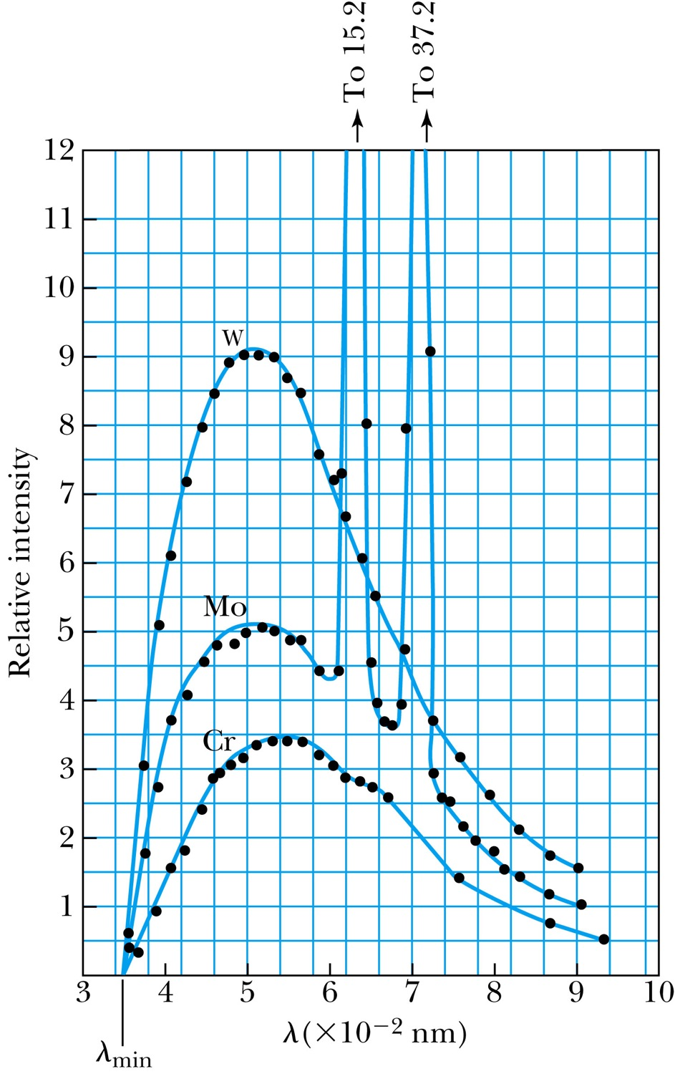
Inverse Photoelectric Effect.
Conservation of energy requires that the electron KE equals the maximum photon energy
  Work function neglected since it’s small compared to the potential energy of the electron.
This is the Duane-Hunt limit
  The minimum photon wavelength depends only on the accelerating voltage
  It is the same for all targets.
  Intensity of x-ray depends on the square of the target atomic number and V₀

Slide 16
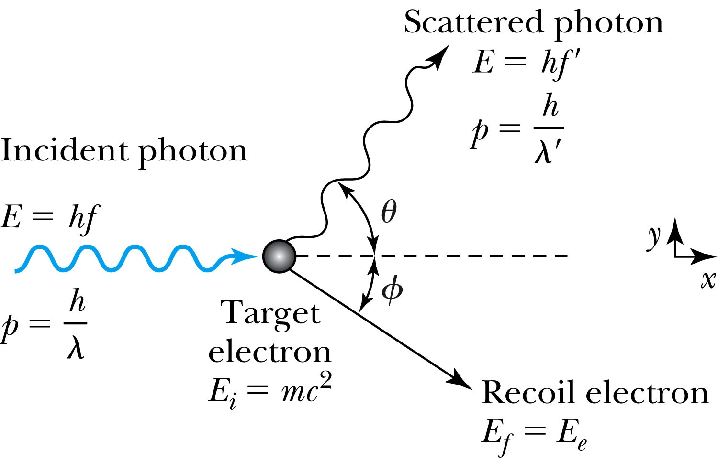
Compton Effect
When a photon enters matter, it is likely to interact with one of the atomic electrons.
The photon is scattered from only one electron
The laws of conservation of energy and momentum apply as in any elastic collision between two particles. The momentum of a particle moving at the speed of light is
The electron energy can be written as
Change of the scattered photon wavelength is known as the Compton effect:

Slide 17
Pair Production and Annihilation
If a photon can create an electron, it must also create a positive charge to balance charge conservation.
In 1932, C. D. Anderson observed a positively charged electron (e⁺) in cosmic radiation. This particle, called the positron, had been predicted to exist several years earlier by P. A. M. Dirac.
A photon’s energy can be converted entirely into an electron and a positron in a process called the pair production.
  Can only happen inside a material
  How much energy do you think is needed?

Slide 18
Pair Production in Empty Space?
Energy conservation for pair production in empty space
Momentum conservation yields
Thus max momentum exchange
Recall that the total energy for a particle can be written as
However this yields a contradiction:
Hence the conversion of energy in empty space is impossible and thus pair production cannot happen in empty space

Slide 19
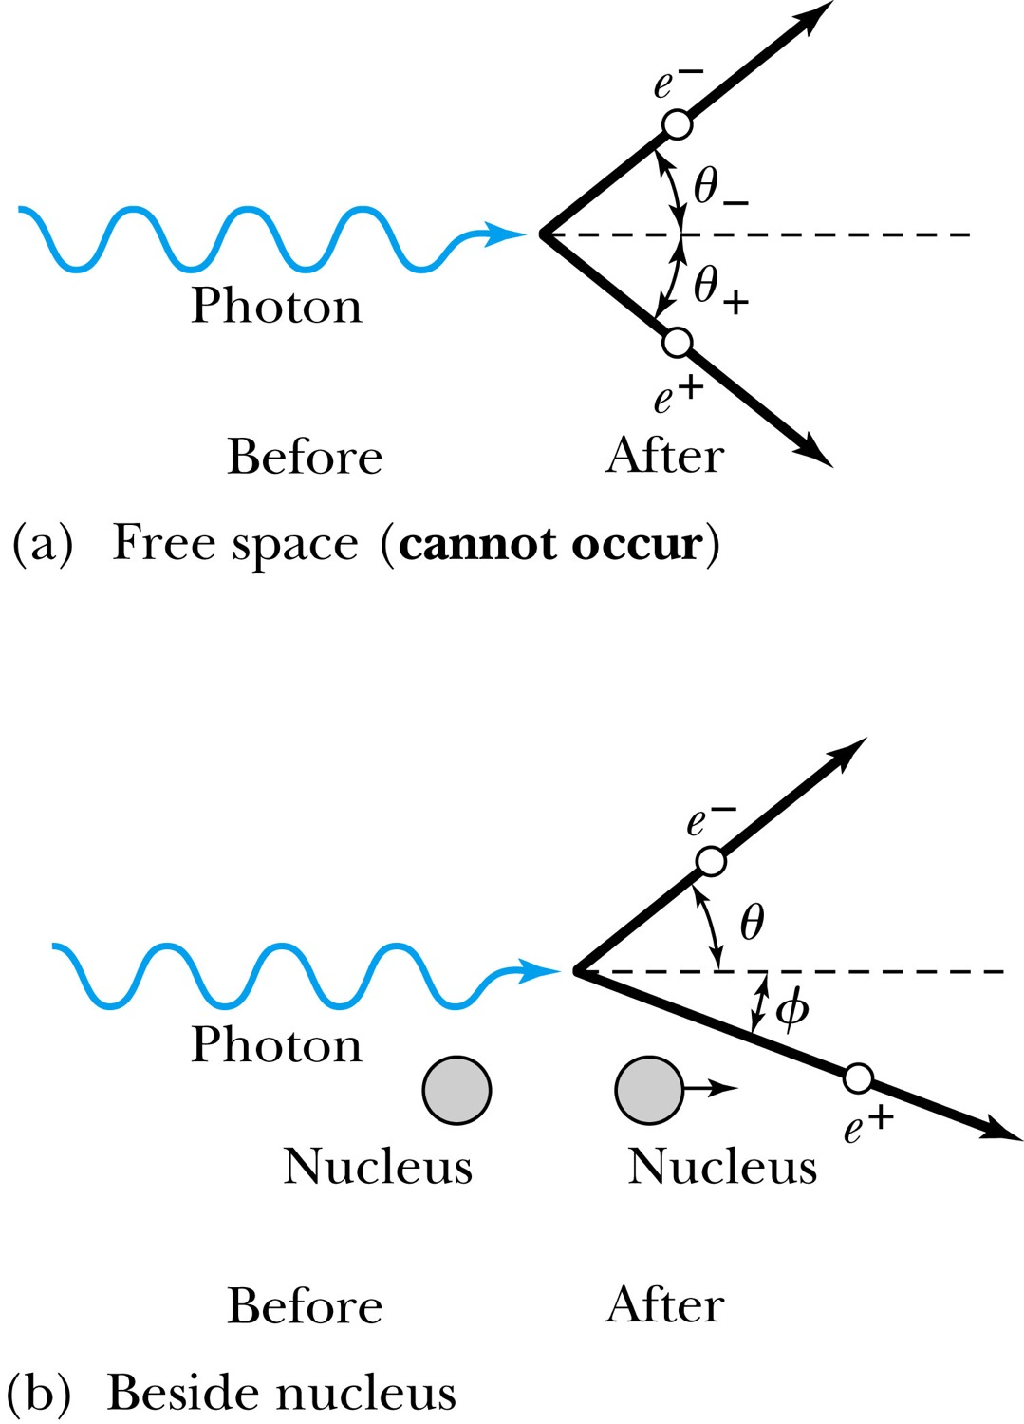
Pair Production in Matter
Since the relations and contradict each other, a photon can not produce an electron and a positron in empty space.
In the presence of matter, however, the nucleus absorbs some energy and momentum.
The photon energy required for pair production in the presence of matter is

Slide 20
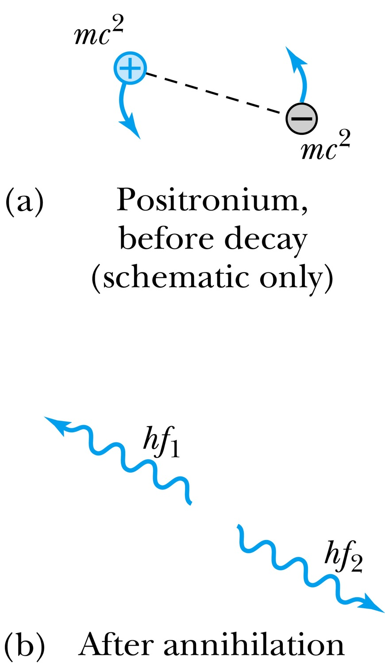
Pair Annihilation
A positron going through matter will likely annihilate with an electron.
A positron is drawn to an electron and form an atom-like configuration called positronium.
Pair annihilation in empty space will produce two photons to conserve momentum. Annihilation near a nucleus can result in a single photon.
Conservation of energy:
Conservation of momentum:
The two photons will be almost identical, so that
The two photons from a positronium annihilation will move in the opposite directions with an energy of:

