Slide 1
PHYS 3313 – Section 001
Lecture #12
Monday, Feb. 25, 2019
Dr. Jaehoon Yu
Rutherford Scattering Experiment and Rutherford Atomic Model
The Classic Atomic Model
Bohr Radius
Bohr’s Hydrogen Model and Its Limitations

Slide 2
Announcements
Reminder: Midterm Exam
  In class Wednesday, March. 6
  Covers from CH1.1 through what we learn March 4 plus the math refresher in the appendices
  Mid-term exam constitutes 20% of the total
  Please do NOT miss the exam! You will get an F if you miss it.
  BYOF: You may bring a one 8.5x11.5 sheet (front and back) of handwritten formulae and values of constants for the exam
  No derivations, word definitions or setups or solutions of any problems!
    No Lorentz velocity addition formula!
    No Maxwell’s equations!
  No additional formulae or values of constants will be provided!
Quiz 2 results
  Class average: 33.7/60
    Equivalent to 56.2/100
    Previous quiz: 37.2/100
  Top score: 58/60

Slide 3
Reminder: Special Project #4
A total of N_{i} incident projectile particle of atomic number Z₁ kinetic energy KE scatter on a target of thickness t and atomic number Z₂ and has n atoms per volume. What is the total number of scattered projectile particles at an angle θ? (20 points)
Please be sure to clearly define all the variables used in your derivation! Points will be deducted for missing variable definitions.
This derivation must be done on your own. Please do not copy the book, internet or your friends’.
Due this Wednesday, Feb. 27

Slide 4
Prefixes, expressions and their meanings
deca (da): 10¹
hecto (h): 10²
kilo (k): 10³
mega (M): 10⁶
giga (G): 10⁹
tera (T): 10¹²
peta (P): 10¹⁵
exa (E): 10¹⁸
deci (d): 10⁻¹
centi (c): 10⁻²
milli (m): 10⁻³
micro (μ): 10⁻⁶
nano (n): 10⁻⁹
pico (p): 10⁻¹²
femto (f): 10⁻¹⁵
atto (a): 10⁻¹⁸

Slide 5
The Atomic Models of Thomson and Rutherford
Without seeing it, 19th century scientists believed atoms have structure.
Pieces of evidence that scientists had in 1900 to indicate that the atom was not a fundamental unit
There are simply too many kinds of atoms (~70 known at that time), belonging to a distinct chemical element
  Too many to be fundamental!!
Atoms and electromagnetic phenomena seem to be intimately related
The issue of valence ➔ Why certain elements combine with some elements but not with others?
  Is there a characteristic internal atomic structure?
The discoveries of radioactivity, x rays, and the electron

Slide 6
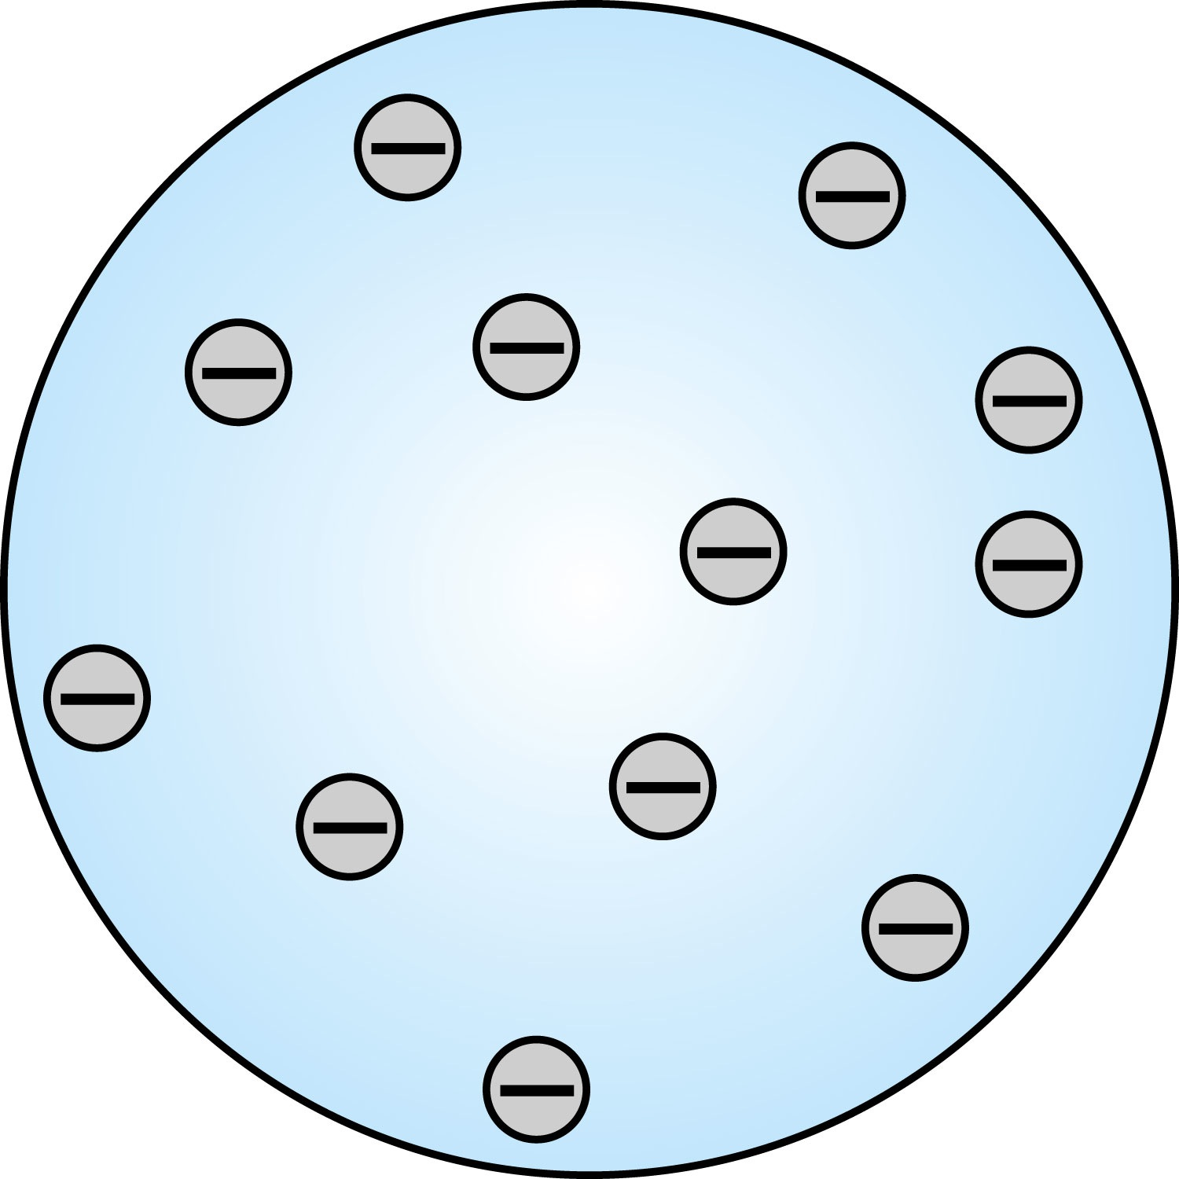
Thomson’s Atomic Model
Thomson’s “plum-pudding” model
  Atoms are electrically neutral and have electrons in them
  Atoms must have an equal amount of positive charges in it to balance electron negative charges
  So how about positive charges spread uniformly throughout a sphere the size of the atom with the newly discovered “negative” electrons embedded in a uniform background.
Thomson thought when the atom was heated the electrons could vibrate about their equilibrium positions and thus produce electromagnetic radiation.

Slide 7
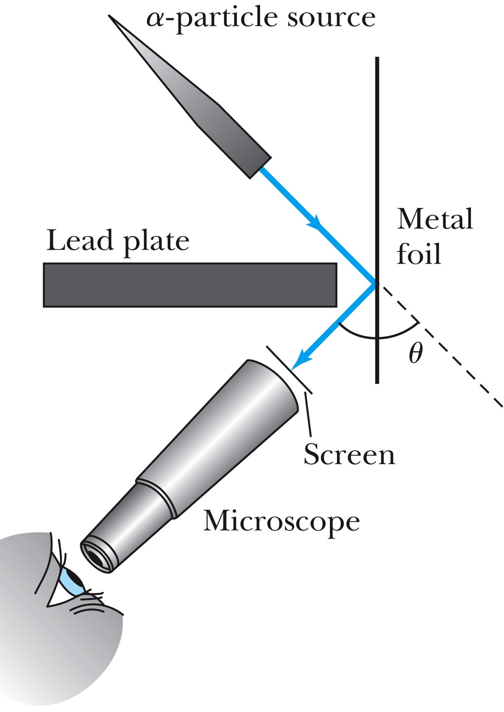
Experiments of Geiger and Marsden
Rutherford, Geiger, and Marsden conceived a new technique for investigating the structure of matter by scattering a particle off atoms.
Geiger showed that many particles were scattered from thin gold-leaf targets at backward angles greater than 90°.
Time to do some calculations!

Slide 8
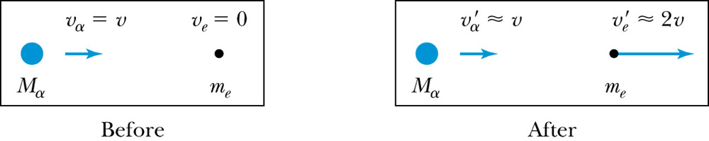
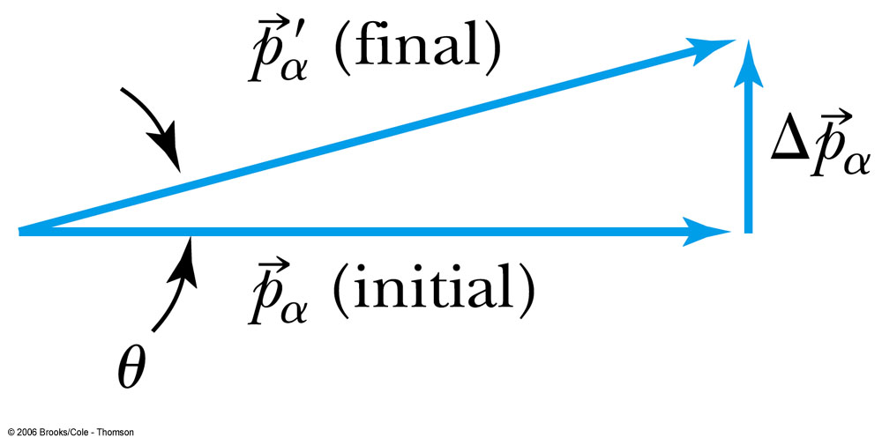
Ex 4.1: Maximum Scattering Angle
Geiger and Marsden (1909) observed backward-scattered (θ>=90º) α particles when a beam of energetic α particles was directed at a piece of gold foil as thin as 6.0x10⁻⁷m. Assuming an α particle scatters from an electron in the foil, what is the maximum scattering angle?
The maximum scattering angle corresponds to the maximum momentum change
Using the momentum conservation and the KE conservation for an elastic collision, the maximum momentum change of the α particle is in a head-on collision
Determine θ by letting Δp_{max} be perpendicular to the direction of motion.

Slide 9
Multiple Scattering from Electrons
If an α particle were scattered by many electrons, then N electrons results in <θ>_{total} ~
The number of atoms across a thin gold layer of 6 × 10⁻⁷ m:
Assume the distance between atoms is
and there are
This gives

Slide 10

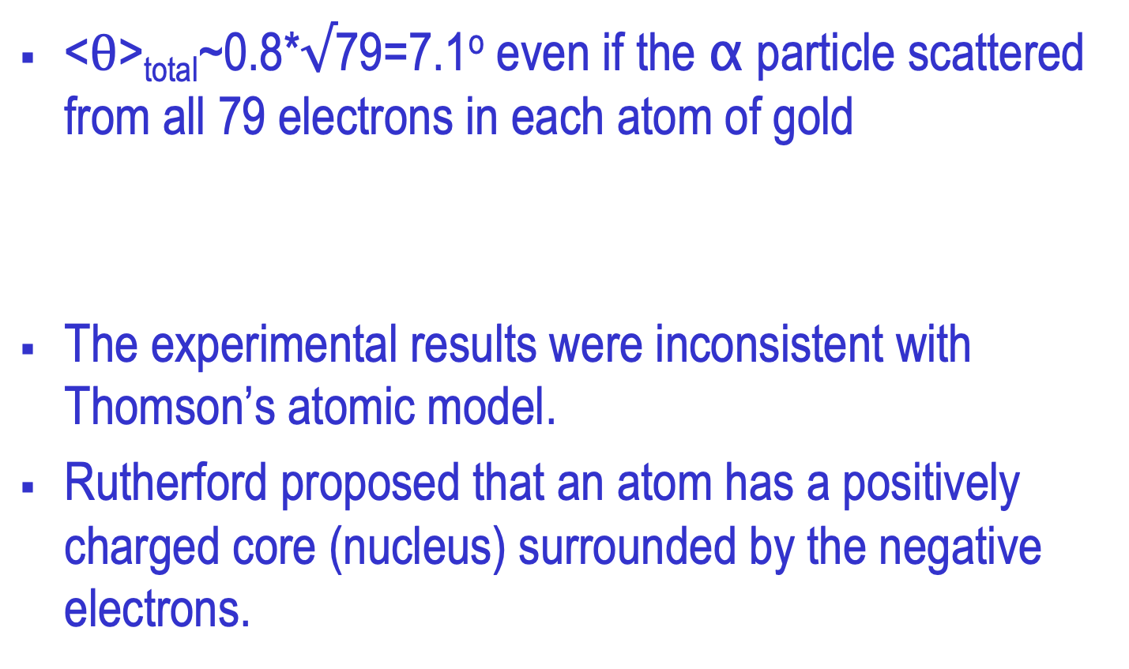
Rutherford’s Atomic Model
<θ>_{total}~0.8*$√$79=7.1º even if the α particle scattered from all 79 electrons in each atom of gold
The experimental results were inconsistent with Thomson’s atomic model.
Rutherford proposed that an atom has a positively charged core (nucleus) surrounded by the negative electrons.

Slide 11
Assumptions of Rutherford Scattering
The scatterer is so massive that it does not recoil significantly; therefore the initial and final KE of the α particle are practically equal.
The target is so thin that only a single scattering occurs.
The bombarding particle and target scatterer are so small that they may be treated as point masses with electrical charges.
Only the Coulomb force is effective.

Slide 12
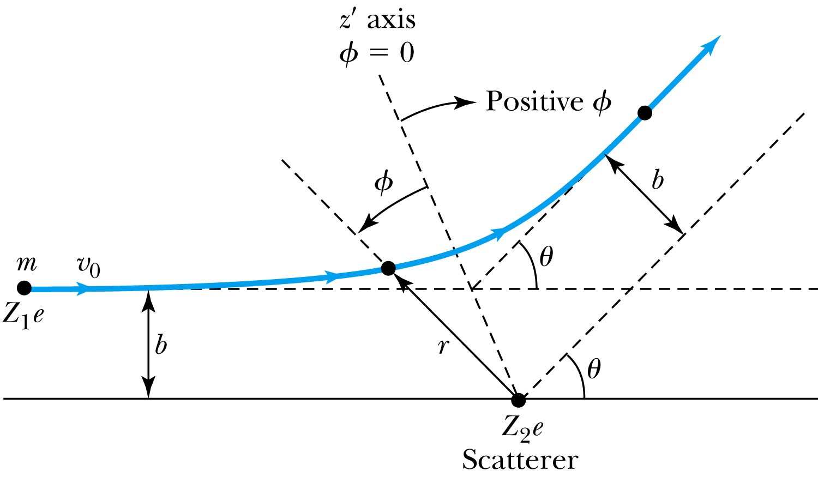
Rutherford Scattering
Scattering experiments help us study matter too small to be observed directly by measuring the angular distributions of the scattered particles
  What is the force acting in this scattering?
There is a relationship between the impact parameter b and the scattering angle θ.
When b is small,
r gets small.
Coulomb force gets large.
θ can be large and the particle can be repelled backward.

Slide 13
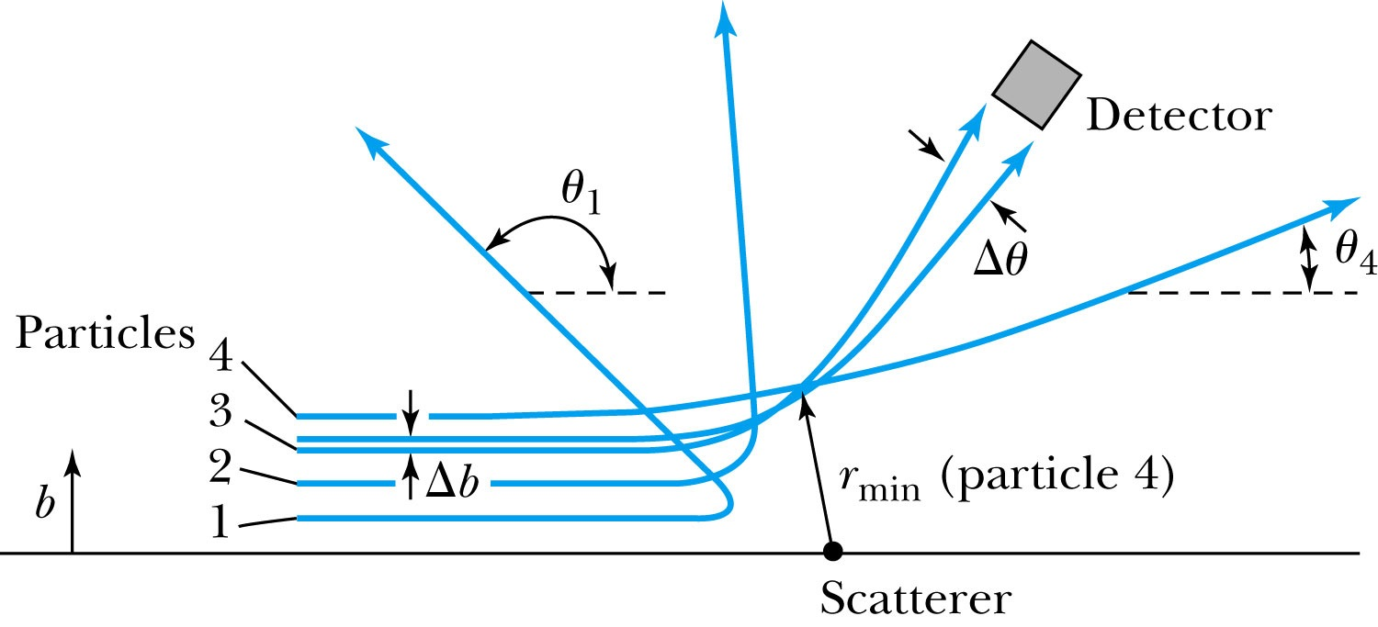
The Relationship Between the Impact Parameter b and the Scattering Angle
The relationship between the impact parameter b and scattering angle θ: Particles with small impact parameters approach the nucleus most closely (r_{min}) and scatter to the largest angles. Particles within a certain range of impact parameters b will be scattered within the window Δθ.

Slide 14
Rutherford Scattering
What are the quantities that can affect the scattering?
  What was the force again?
    The Coulomb force
  The charge of the incoming particle (Z₁e)
  The charge of the target particle (Z₂e)
  The minimum distance the projectile approaches the target (r)
Using the fact that this is a totally elastic scattering under a central force, we know that
  Linear momentum is conserved
  KE is conserved
  Angular momentum is conserved
From this, impact parameter

Slide 15
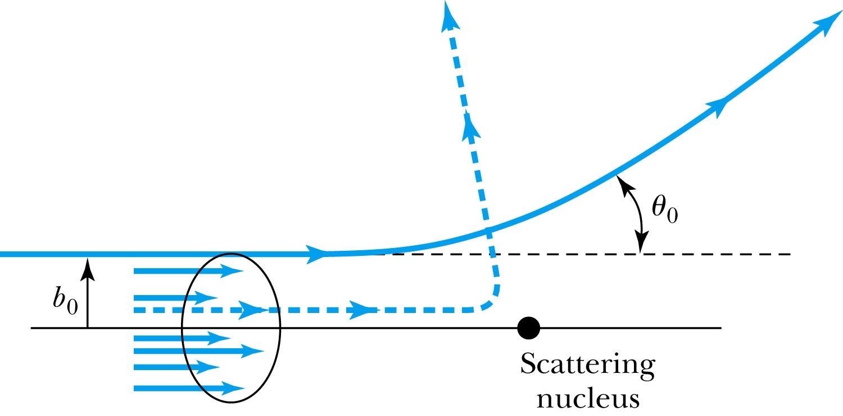
Rutherford Scattering - probability
Any particle inside the circle of area πb₀² will be similarly scattered.
The cross section σ = πb² is related to the probability for a particle being scattered by a nucleus.
The fraction of the incident particles scattered is
The number of scattering nuclei per unit area .
t: target thickness
n: atomic number density

Slide 16
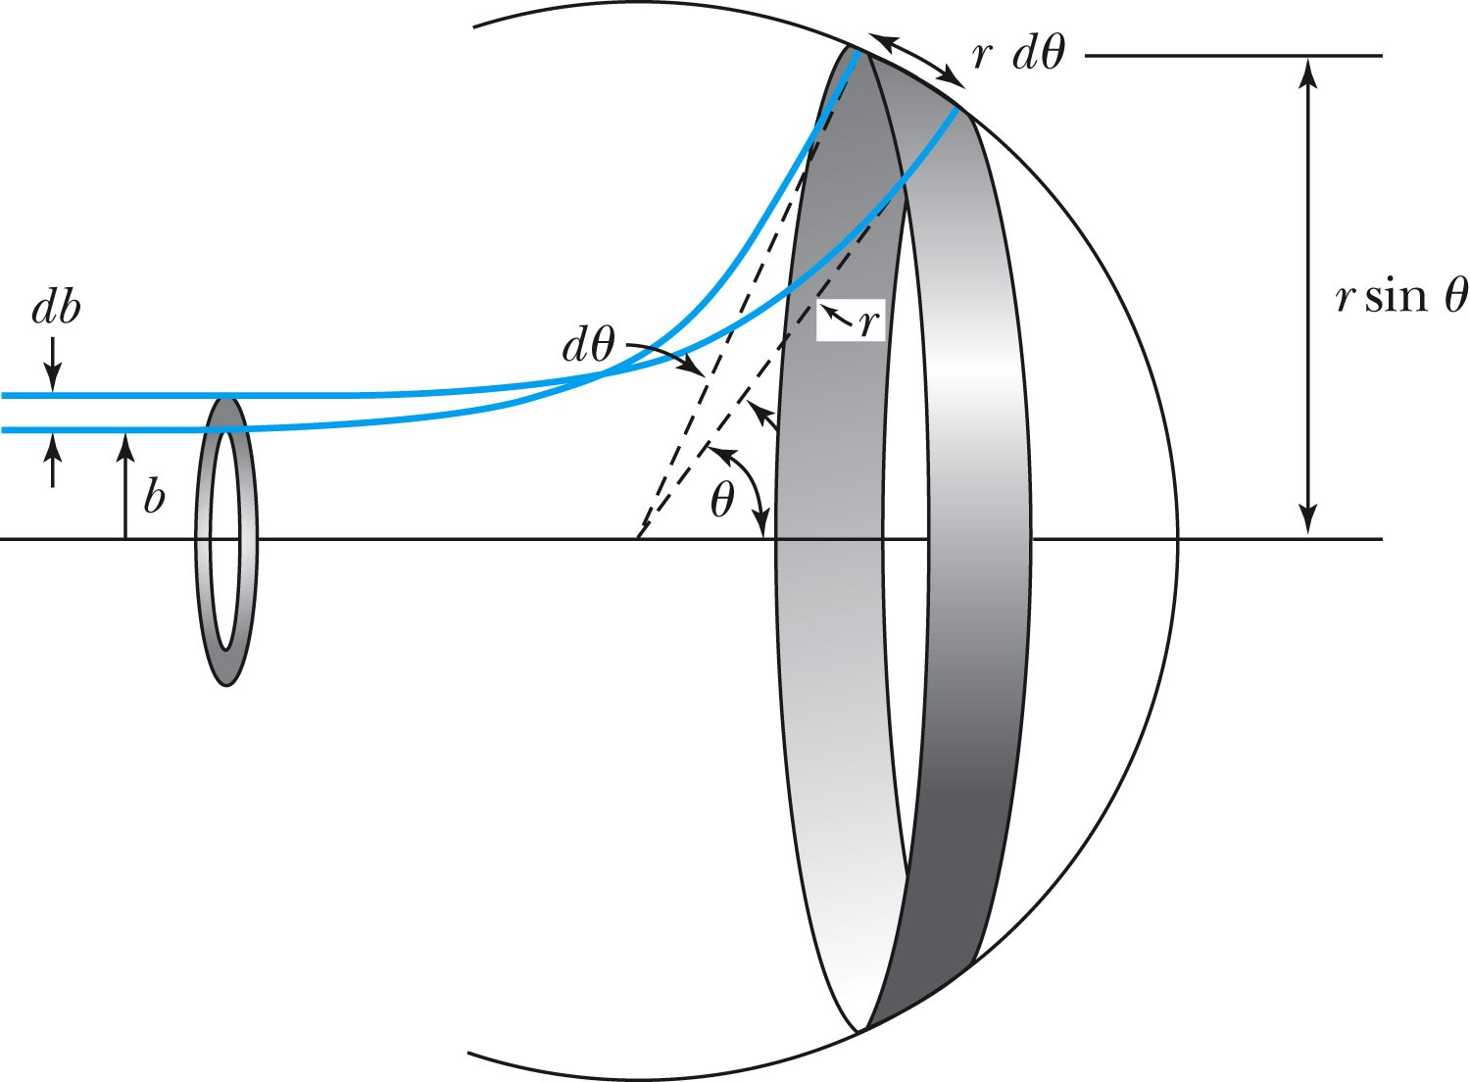
Rutherford Scattering Equation
In an actual experiment, a detector is positioned from θ to θ + dθ that corresponds to incident particles between b and b + db.
The number of particles scattered into the the angular coverage per unit area is

Slide 17
The Important Points
The scattering is proportional to the square of the atomic numbers of both the incident particle (Z₁) and the target scatterer (Z₂).
The number of scattered particles is inversely proportional to the square of the kinetic energy of the incident particle.
For a scattering angle θ, the scattering is proportional to the 4th power of sin(θ/2).
The Scattering is proportional to the target thickness for thin targets.

Slide 18
The Classical Atomic Model
As suggested by the Rutherford Model, an atom consists of a small, massive, positively charged nucleus surrounded by moving electrons. This then suggested consideration of a planetary model of the atom.
Let’s consider atoms in a planetary model.
The force of attraction on the electron by the nucleus and Newton’s 2nd law give
where v is the tangential speed of an electron.
The total energy is

Slide 19
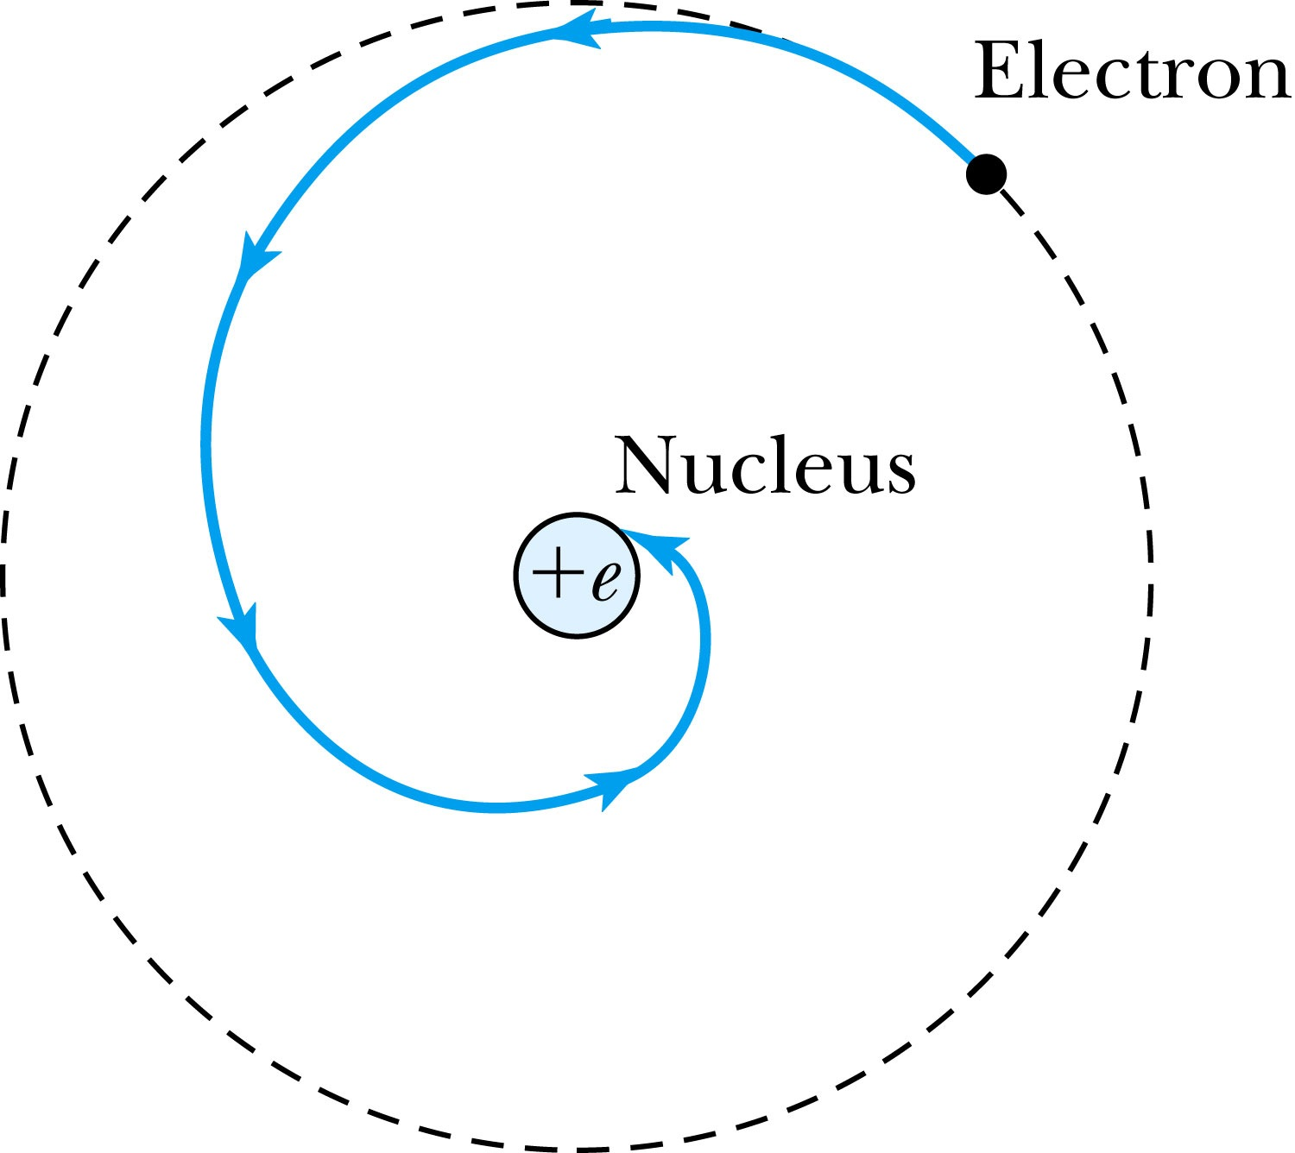
The Planetary Model is Doomed
From the classical E&M theory, an accelerated electric charge radiates energy (electromagnetic radiation) which means total energy must decrease. ➔Radius r must decrease!!
Electron crashes into the nucleus!?
Physics had reached a turning point in 1900 with Planck’s hypothesis of the quantum behavior of radiation.

