Slide 1
PHYS 3313 – Section 001
Lecture #13
Wednesday, Feb. 27, 2019
Dr. Jaehoon Yu
Bohr Radius
Bohr’s Hydrogen Model
The Correspondence Principle
Importance of Bohr’s Hydrogen Model
Success and Failure of Bohr’s Model
Characteristic X-ray Spectra

Slide 2
Announcements
Homework #3
  End of chapter problems on CH4: 5, 14, 17, 21, 23 and 45
  Due: Monday, March 18
Reminder: Midterm Exam
  In class next Wednesday, March. 6
  Covers from CH1.1 through what we learn March 4 plus the math refresher in the appendices
  Mid-term exam constitutes 20% of the total
  Please do NOT miss the exam! You will get an F if you miss it.
  BYOF: You may bring a one 8.5x11.5 sheet (front and back) of handwritten formulae and values of constants for the exam
  No derivations, word definitions or setups or solutions of any problems!
    No Lorentz velocity addition formula!
    No Maxwell’s equations!
  No additional formulae or values of constants will be provided!
Special Colloquium this Friday
  4pm, Friday, Mar. 1, SH101
  Mr. Steve Battel, Battel Engineering, member of National Academy of Engineering

Slide 3


Slide 4
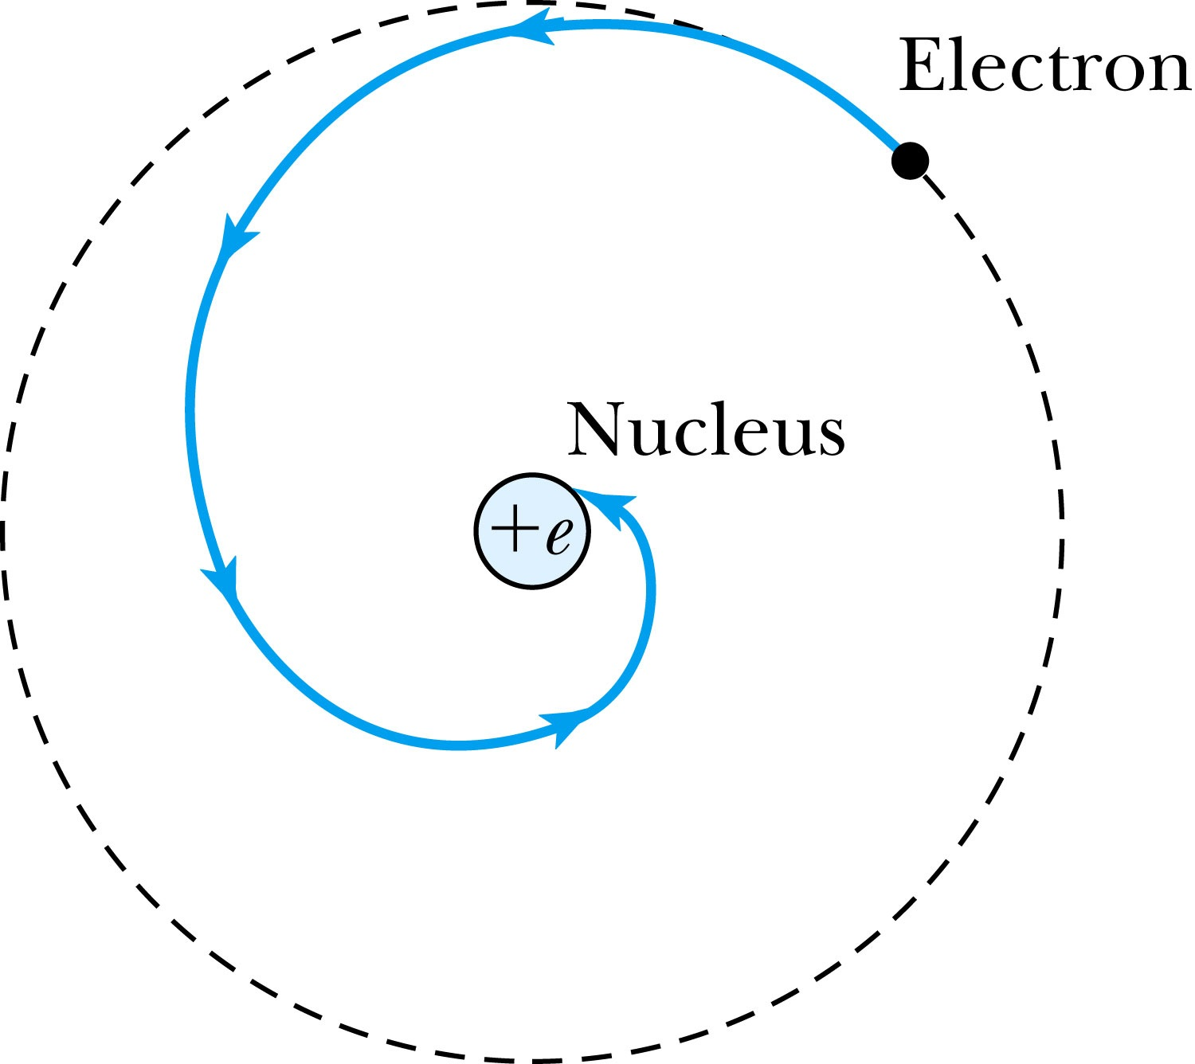
The Planetary Model is Doomed
From the classical E&M theory, an accelerated electric charge radiates energy (electromagnetic radiation) which means total energy must decrease. ➔Radius r must decrease!!
Electron crashes into the nucleus!?
Physics had reached a turning point in 1900 with Planck’s hypothesis of the quantum behavior of radiation.

Slide 5
The Bohr Model of the Hydrogen Atom – The assumptions
“Stationary” states or orbits must exist in atoms, i.e., orbiting electrons do not radiate energy in these orbits. These orbits or stationary states are of a fixed definite energy E. (Niels Bohr was awarded Nobel in 1922 for this!)
The emission or absorption of electromagnetic radiation can occur only in conjunction with a transition between two stationary states. The frequency, f, of this radiation is proportional to the difference in the energies of the two stationary states:
E = E₁ − E₂ = hf
where h is Planck’s Constant
  Bohr thought this has to do with the fundamental length of order ~10⁻¹⁰m
Classical laws of physics govern the dynamic equilibrium of the stationary state but they do not apply to the transitions between stationary states.
The mean kinetic energy of the electron-nucleus system is quantized as
K = nhf_{orb}/2, where f_{orb} is the frequency of rotation. This is equivalent to the angular momentum of a stationary state to be an integral multiple of

Slide 6
How did Bohr Arrived at the angular momentum quantization?
The mean kinetic energy of the electron-nucleus system is quantized as
K = nhf_{orb}/2, where f_{orb} is the frequency of rotation in the given orbit. This is equivalent to the angular momentum of a stationary state to be an integral multiple of h/2π.
Kinetic energy can be written
Angular momentum is defined as
The relationship between linear and angular quantifies
Thus, we can rewrite

Slide 7
Bohr’s Quantized Radius of Hydrogen
The angular momentum is
So the speed of an orbiting e can be written
From the Newton’s law for a circular motion
So from the above two equations, we can get

Slide 8
Bohr Radius
The radius of the hydrogen atom for the n^{th} stationary state is
Where the Bohr radius for a given stationary state is:
The smallest diameter of the hydrogen atom is
  OMG!! The fundamental length!!
n = 1 gives its lowest energy state (called the “ground” state)

Slide 9
Ex. 4.6 Justification for non-relativistic treatment of orbital e
Are we justified for the non-relativistic treatment of the orbital electrons?
  When do we apply relativistic treatment?
    When v/c>0.1
Orbital speed:
Thus

Slide 10
Uncertainties
Statistical Uncertainty: A naturally occurring uncertainty due to the number of measurements
  Usually estimated by taking the square root of the number of measurements or samples, √N
Systematic Uncertainty: Uncertainty due to unintended biases or unknown sources
  Biases made by personal measurement habits
  Some sources that could impact the measurements
In any measurement, the uncertainties provide the significance to the measurement

Slide 11
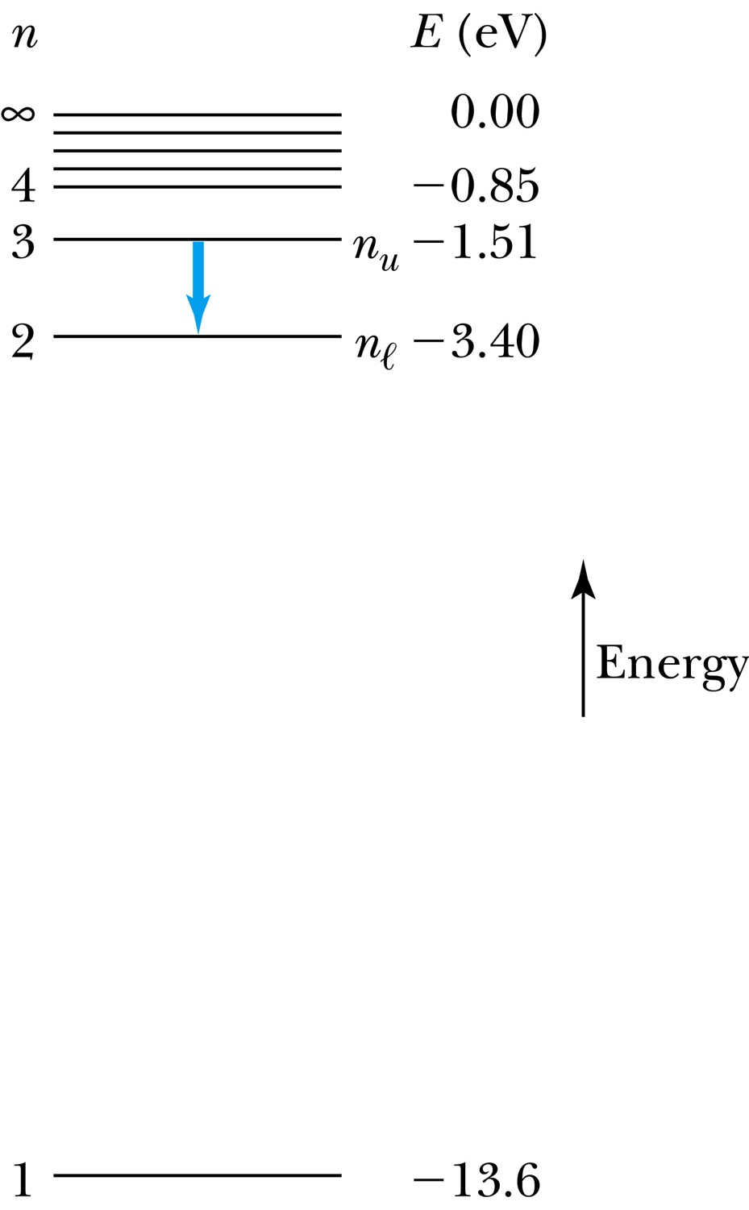
The Hydrogen Atom – Rydberg Equation
Recalling the total E of an e in an atom, the n^{th} stationary states, E_{n}
where E₁ is the lowest energy or ground state energy
Emission of light occurs when the atom is in an excited state and decays to a lower energy state (n_{u} → n_{ℓ}).
where f is the frequency of a photon.
R∞ is the Rydberg constant.

Slide 12
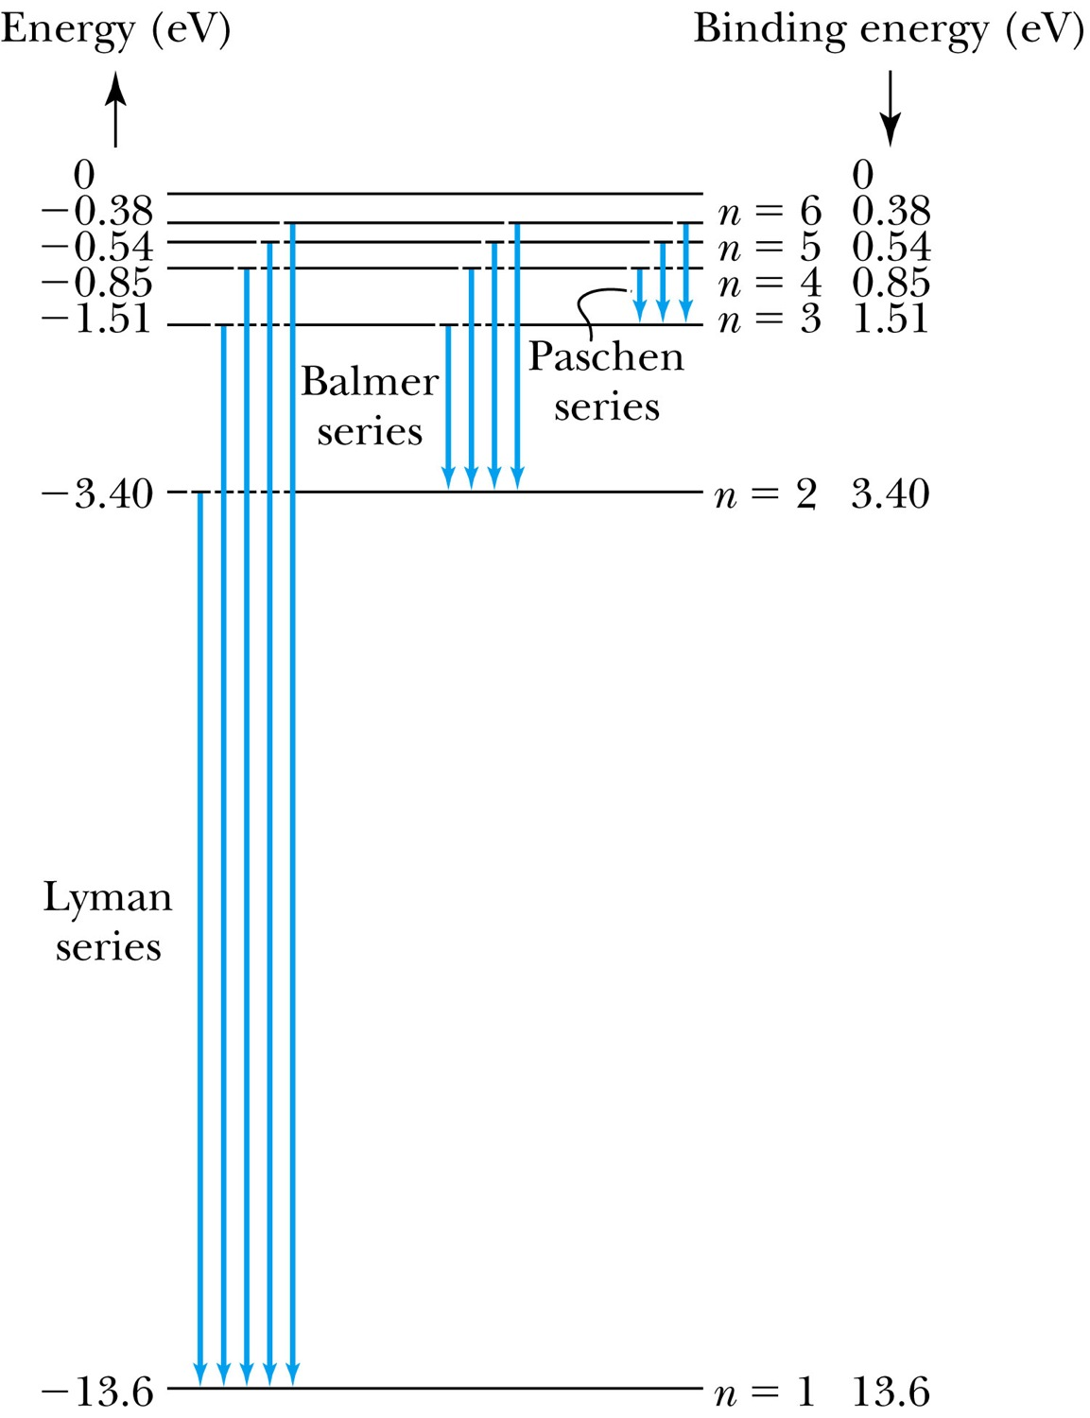
Transitions in the Hydrogen Atom
Lyman series (n=1): The atom will remain in the excited state for a short time before emitting a photon and returning to a lower stationary state. All hydrogen atoms exist in n = 1 (invisible).
Balmer series (n=2): When sunlight passes through the atmosphere, hydrogen atoms in water vapor absorb the wavelengths (visible).

Slide 13
Fine Structure Constant
The electron’s speed on an orbit in the Bohr model:
On the ground state, v₁ = 2.2 × 10⁶ m/s ~ less than 1% of the speed of light
The ratio of v₁ to c is the fine structure constant, α.

Slide 14
Ex. 4.7: Determine the longest and shortest wavelengths observed in Paschen Series (n=3)
We use the equation

