Slide 1
PHYS 3313 – Section 001
Lecture #14
Monday, March 4, 2019
Dr. Jaehoon Yu
The Correspondence Principle
Importance of Bohr’s Hydrogen Model
Success and Failure of Bohr’s Model
Characteristic X-ray Spectra
X-ray scattering
Bragg’s Law

Slide 2
Announcements
Reminder: Homework #3
  End of chapter problems on CH4: 5, 14, 17, 21, 23 and 45; Due: Monday, March 18
Reminder: Midterm Exam
  Covers from CH1.1 through CH4.7 plus the math refresher in the appendices
  Mid-term exam constitutes 20% of the total
  Please do NOT miss the exam! You will get an F if you miss it.
  BYOF: You may bring a one 8.5x11.5 sheet (front and back) of handwritten formulae and values of constants for the exam
  No derivations, word definitions or setups or solutions of any problems!
    No Lorentz velocity addition formula!
    No Maxwell’s equations!
  No additional formulae or values of constants will be provided!
Mid-term grade discussions in my office CPB342
  Monday, March 18 class for the first 45min, from 1:50 – 2:30: Last name starts A – C
  Wednesday, March 20: 12:30 – 1:00: Last name starts D – K; 1 – 1:30: L – P: 1:30 – 2:00: P - Z
  Extremely important for you to come and talk to me about the prospect of your grade
Colloquium this week; 4:00pm Wed. Mar. 6 in SH101
  Dr. A. Naumov of TCU

Slide 3
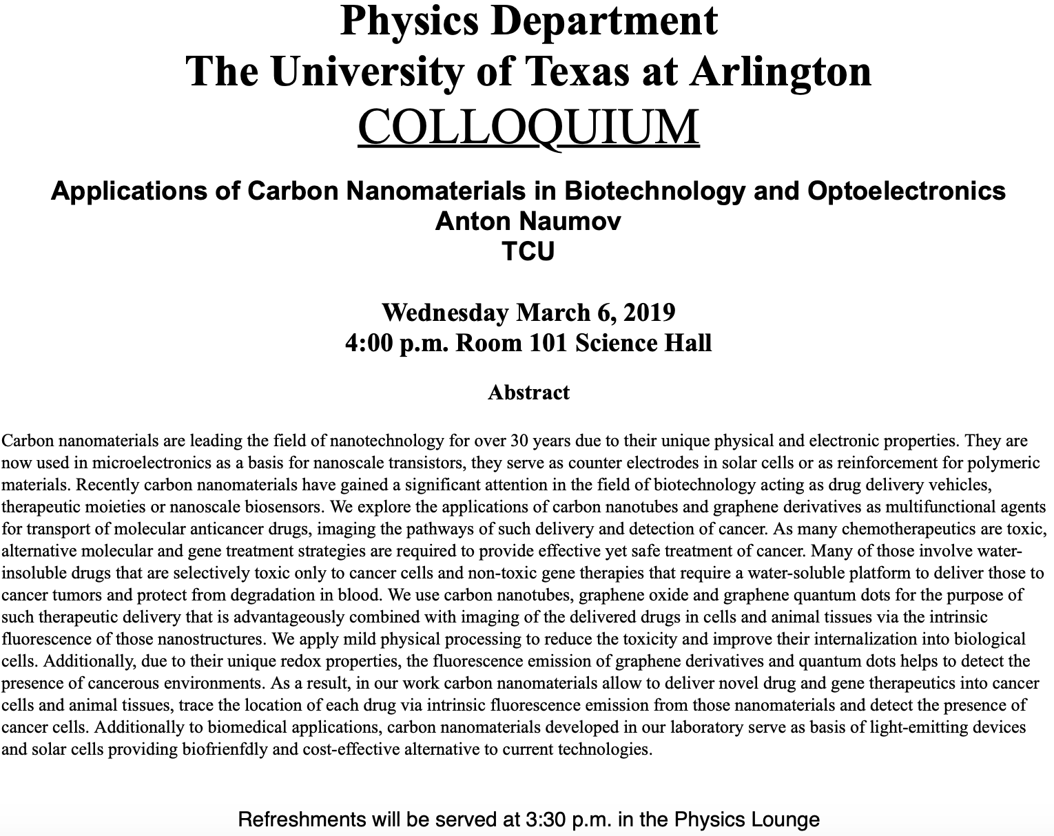

Slide 4
Group Research Projects
Detailed studies on important discoveries and theories that set the foundation of modern physics
Final project consists of
  A 5 – 10 page paper each : 10% of the total
  A 10+2 minute power point presentation for each group: 5% of total
Report Due and Presentation Dates
  Reference cannot have more than 20% direct web link!
  Presentation: Monday, Apr. 22 and Wednesday, Apr. 24
  Report Due: At the beginning of the class on Wed. Apr. 24

Slide 5
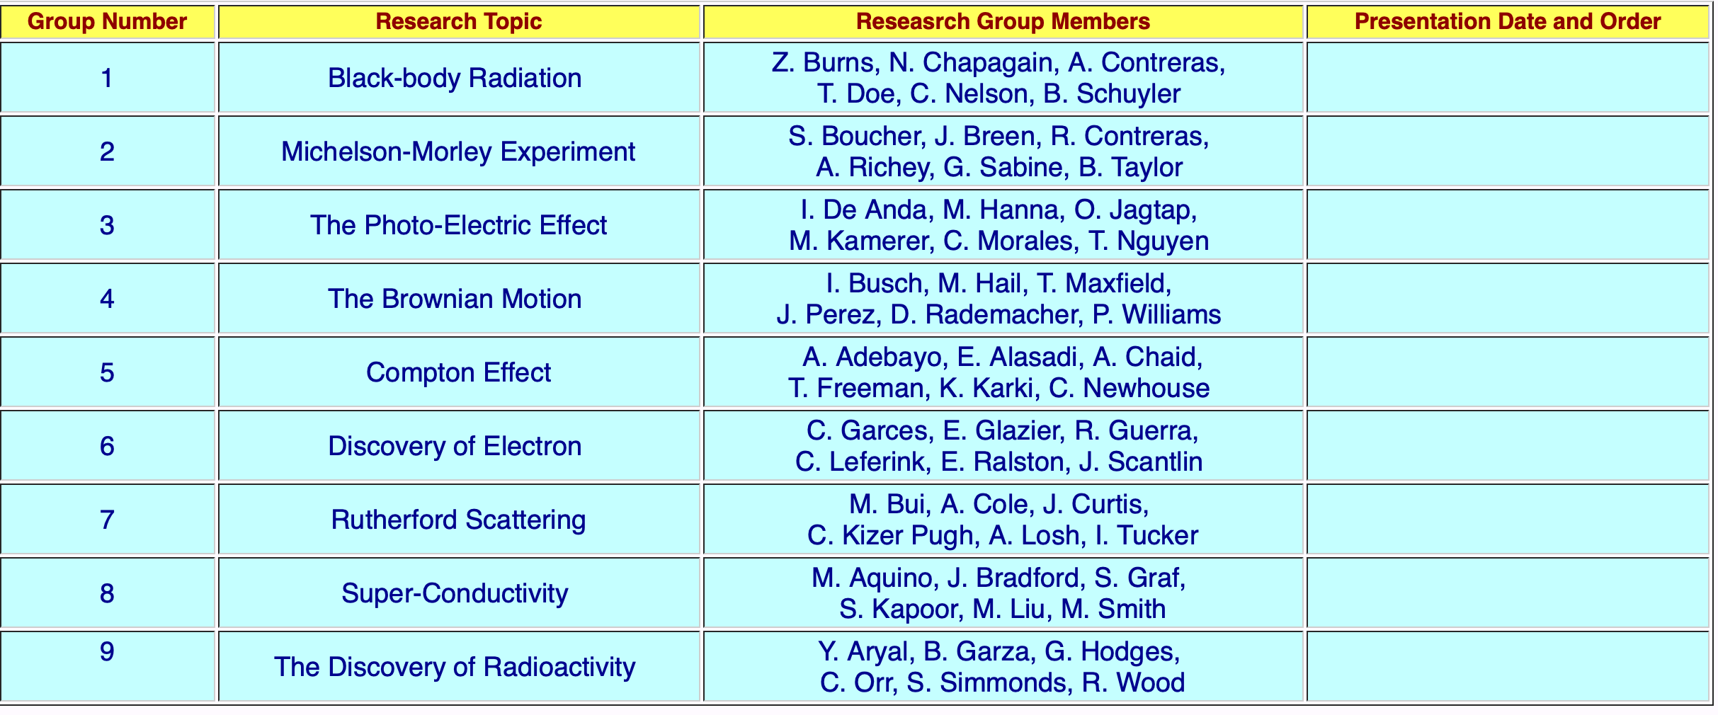

Slide 6
The Correspondence Principle
Classical electrodynamics
Bohr’s atomic model
+
Determine the properties
of radiation
Need a principle to relate the new modern results with the classical ones.
Bohr’s correspondence
principle
In the limits where classical and quantum theories should agree, the quantum theory must produce the classical results.

Slide 7
The Correspondence Principle
The frequency of the radiation emitted f_{classical} is equal to the orbital frequency f_{orb} of the electron around the nucleus.
The frequency of the photon in the transition from n + 1 to n is
For a large n the classical limit,
Substitute E₀:
So the frequency of the radiated E between classical theory and Bohr model agrees in large n case!!

Slide 8
The Importance of Bohr’s Model
Demonstrated the need for Plank’s constant in understanding the atomic structure
Assumption of quantized angular momentum which led to quantization of other quantities, r, v and E as follows
Orbital Radius:
Orbital Speed:
Energy levels:

Slide 9
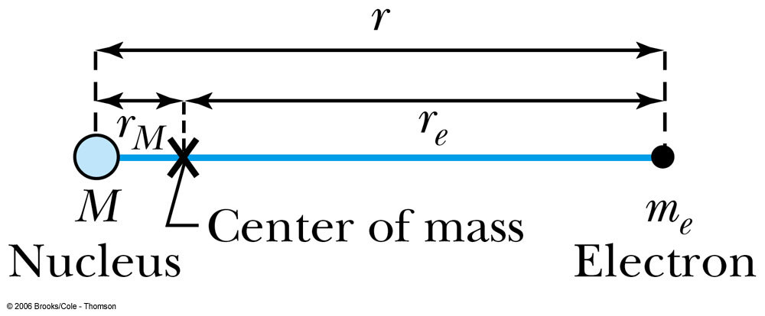
Successes and Failures of the Bohr Model
The electron and hydrogen nucleus actually revolve about their mutual center of mass ➔ reduced mass correction!!
All we need is to replace m_{e} with atom’s reduced mass.
The Rydberg constant for infinite nuclear mass, R∞ is replaced by R.

Slide 10
Limitations of the Bohr Model
The Bohr model was a great step of the new quantum theory, but it had its limitations.
Works only to single-electron atoms (H, He+, Li++..)
  Works even for ions ➔ What would change?
  The charge of the nucleus
Could not account for the intensities or the fine structure of the spectral lines
  Fine structure is caused by the electron spin
  Under a magnetic field, the spectrum splits by the spin
Could not explain the binding of atoms into molecules

Slide 11
Characteristic X-Ray Spectra and Atomic Number
Shells have letter names:
K shell for n = 1
L shell for n = 2
The atom is most stable in its ground state.
When a transition occurs in a heavy atom, the radiation emitted is an x ray.
It has the energy E (x ray) = E_{u} − E_{ℓ}.
An electron from higher shells will fill the inner-shell vacancy at lower energy.

Slide 12
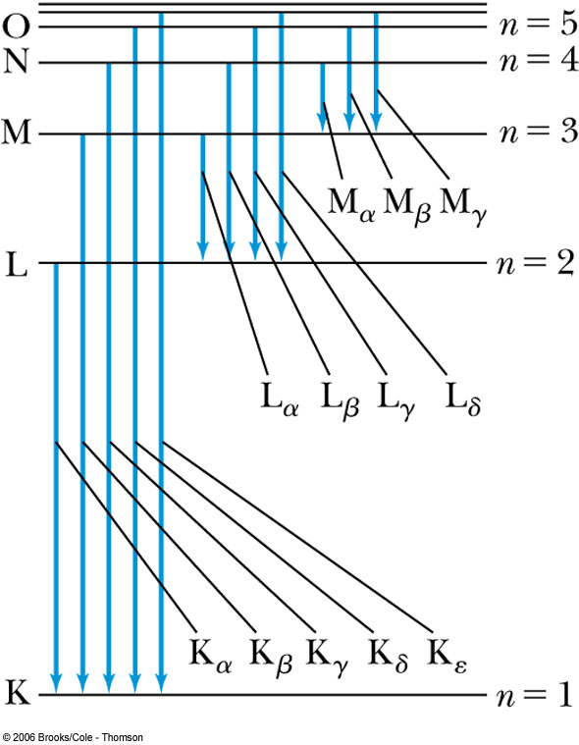
Atomic Number
L shell to K shell K_{α} x ray
M shell to K shell K_{β} x ray
Atomic number Z = number of protons in the nucleus
Moseley found a relationship between the frequencies of the characteristic x ray and Z.
This holds for the K_{α} x ray

Slide 13
Moseley’s Empirical Results
The x ray is produced from n = 2 to n = 1 transition.
In general, the K series of x ray wavelengths are
Moseley’s research clarified the importance of the electron shells for all the elements, not just for hydrogen
  Concluded correctly that atomic number Z, rather than the atomic weight, is the determining factor in ordering of the periodic table

Slide 14
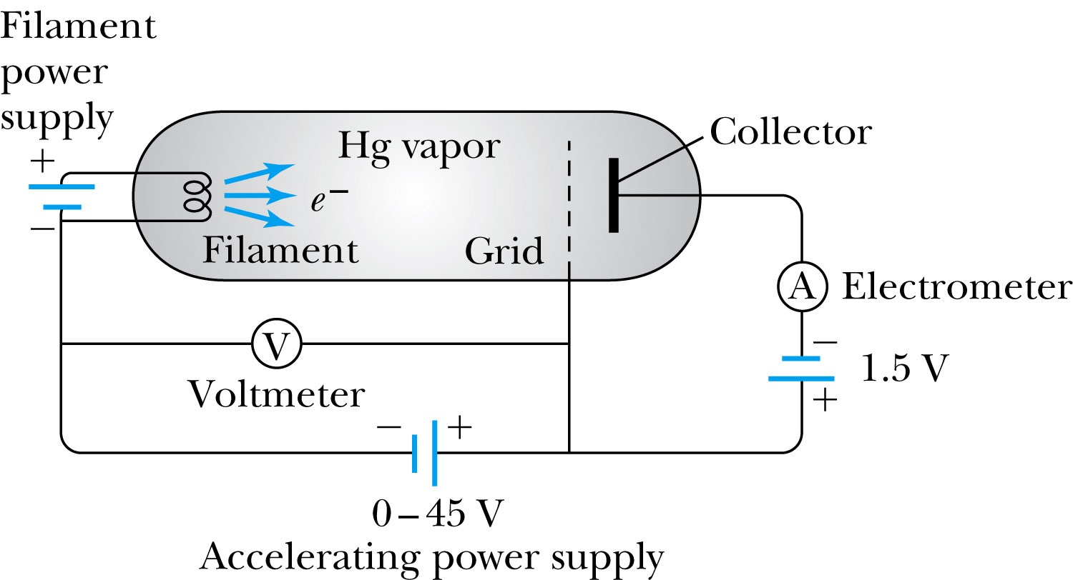
Atomic Excitation by Electrons
Franck and Hertz studied the phenomenon of ionization KE transfer from electrons to atoms.
When the accelerating voltage is below 5 V
electrons did not lose energy going through the mercury vapor
When the accelerating voltage is above 5 V, 10V, etc..
sudden drop in the current
Min. e KE

Slide 15
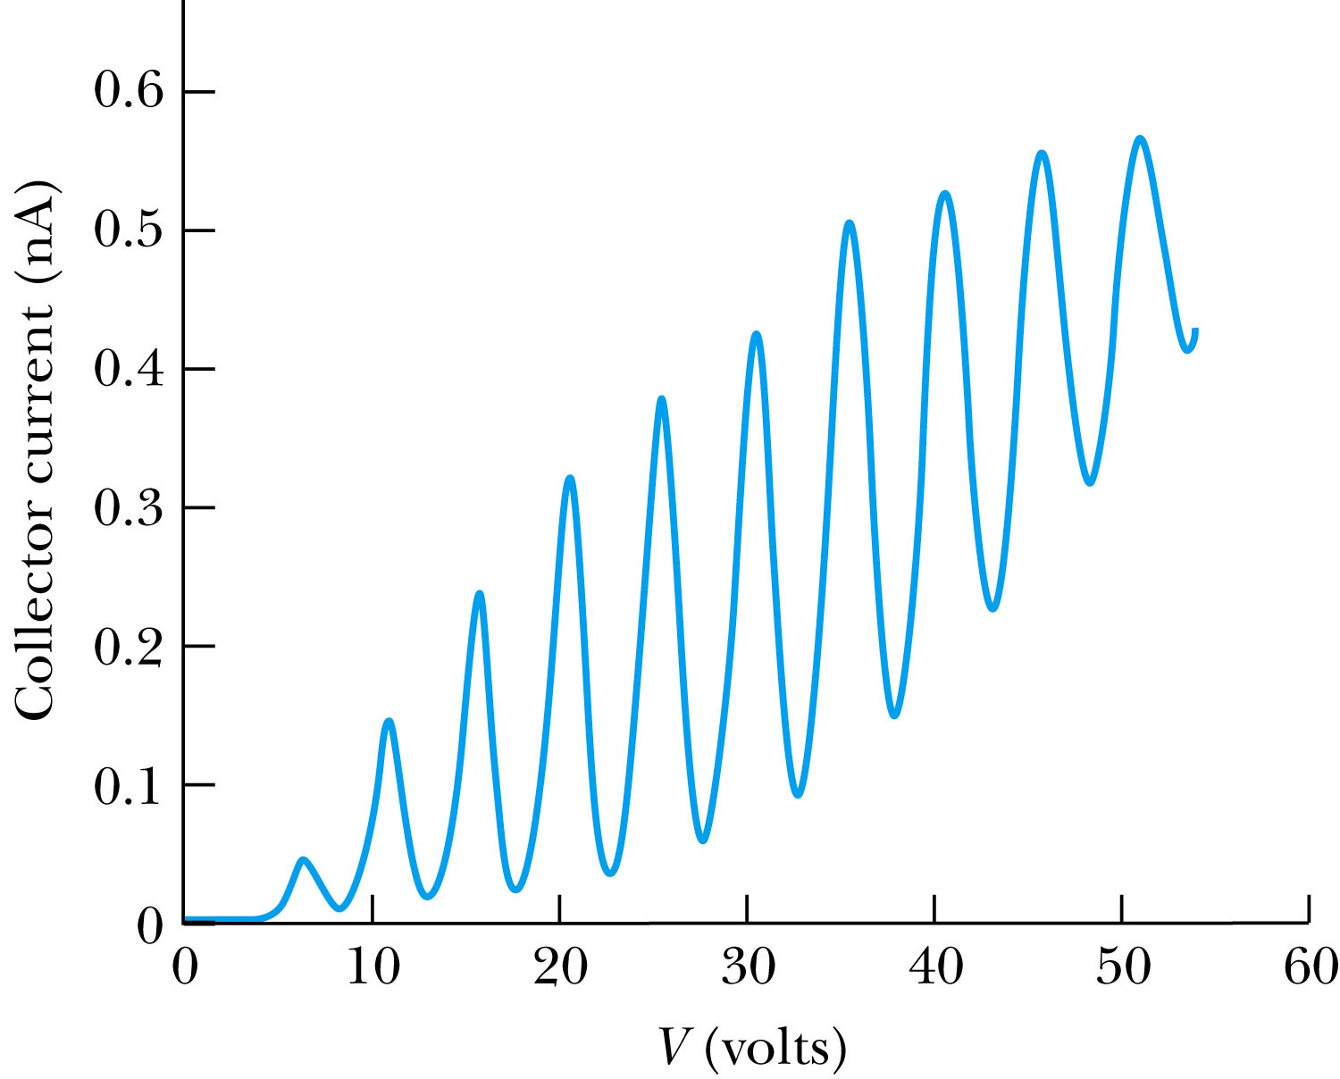
Atomic Excitation by Electrons
Ground state has E₀ which can be considered as 0.
First excited state has E₁.
The energy difference E₁ − 0 = E₁ is the excitation energy.
Hg (mercury) has an excitation energy of 4.88 eV in the first excited state
No energy can be transferred to Hg below 4.88 eV because not enough energy is available to excite an electron to the next energy level
Above 4.88 eV, the current drops because scattered electrons no longer reach the collector until the accelerating voltage reaches 9.76 eV and so on.

Slide 16
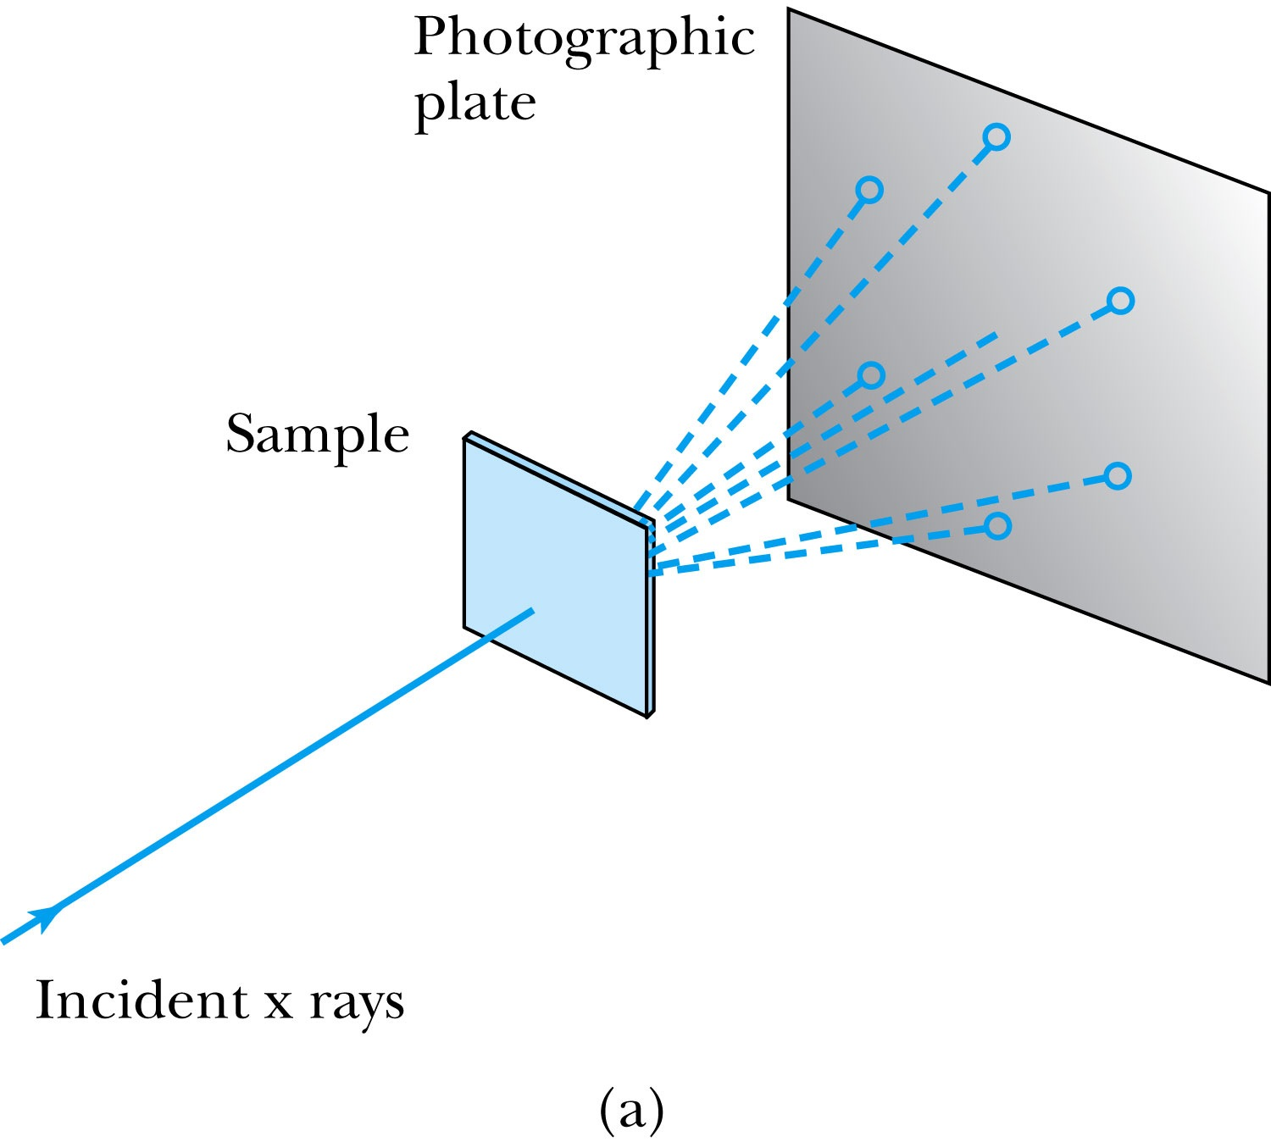
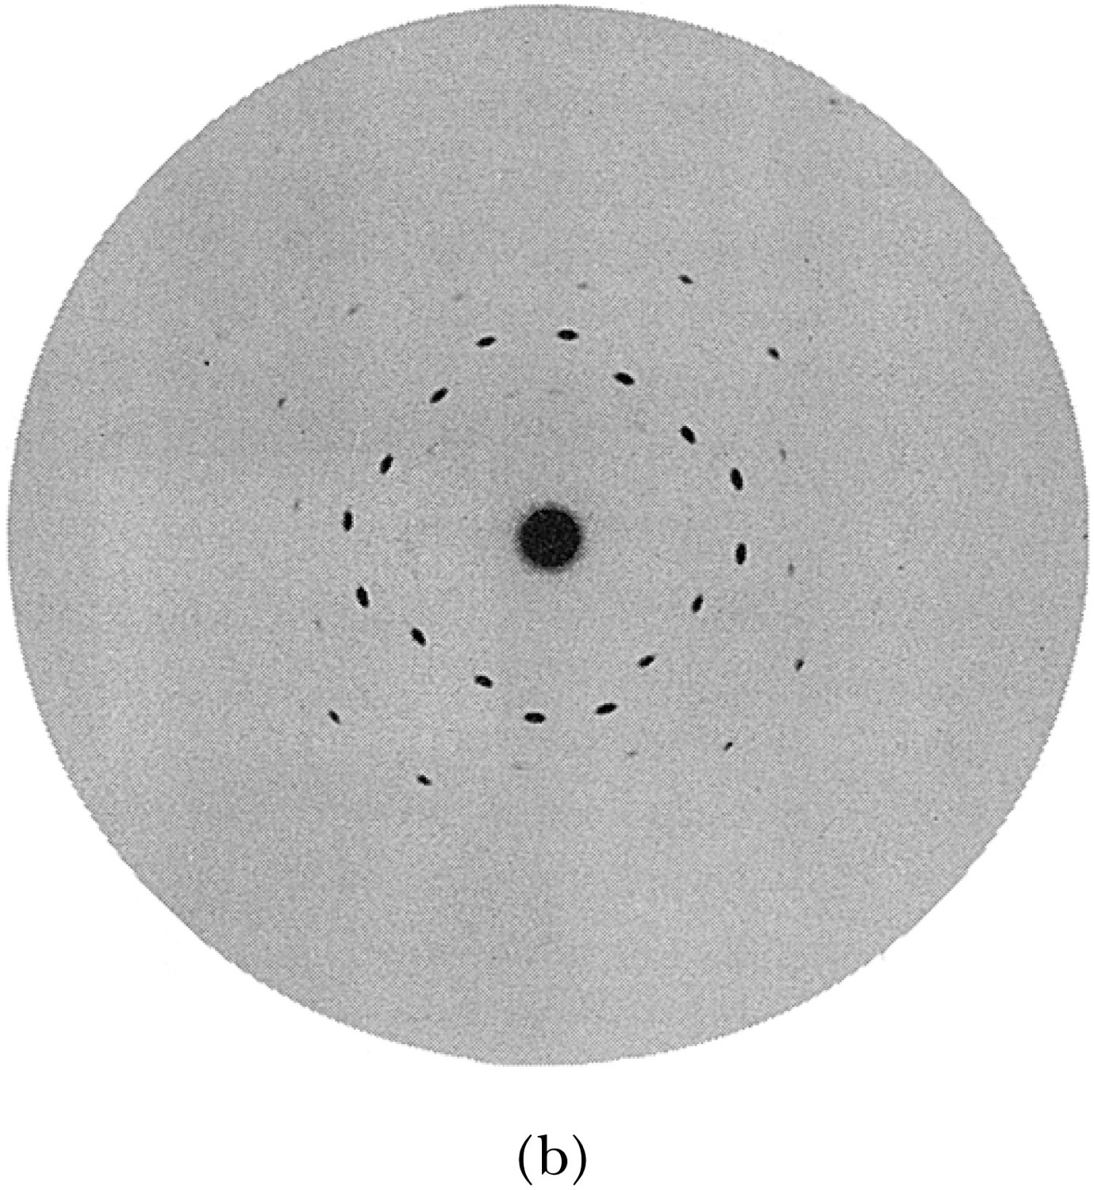
X-Ray Scattering
Max von Laue suggested that if X rays were a form of electromagnetic radiation, interference effects should be observed. (Wave property!!)
Crystals act as three-dimensional gratings, scattering the waves and producing observable interference effects.

