Slide 1
PHYS 3313 – Section 001
Lecture #15
Monday, March 18, 2019
Dr. Jaehoon Yu
X-ray scattering
Bragg’s Law
de Broglie Waves
Bohr’s Quantization Conditions

Slide 2
Announcements
Mid-term grade discussions in my office CPB342
  Today: Class for the first 45min, from 1:50 – 2:30: Last name starts A – C
  Wednesday, March 20: 12:30 – 1:00: Last name starts D – K; 1 – 1:30: L – P: 1:30 – 2:00: P - Z
  Extremely important for you to come and talk to me about the prospect of your grade
Mid-term exam results
  Class average: 50.4/105
    Equivalent to 48/100
  Top score: 84

Slide 3
Evaluation Policy
Homework: 30%
Exams
  Mid-term Exam (Wed., Mar. 6): 20%
  Final Comprehensive Exam (11 – 1:30pm, Fri, May. 10): 25%
  Missing an exam is not permissible unless pre-approved
    No makeup test
    You will get an F if you miss any of the exams without a prior approval
Group Research Project: 15%
Pop-quizzes: 10%
Extra credits: 10% of the total
Grading will be done on a sliding scale
55% of the grade is in your hand!!
100%

Slide 4
Announcements
Mid-term grade discussions in my office CPB342
  Today: Class for the first 45min, from 1:50 – 2:30: Last name starts A – C
  Wednesday, March 20: 12:30 – 1:00: Last name starts D – K; 1 – 1:30: L – P: 1:30 – 2:00: P - Z
  Extremely important for you to come and talk to me about the prospect of your grade
Mid-term exam results
  Class average: 50.4/105
    Equivalent to 48/100
  Top score: 84
Volunteers needed for two physics workshop at UTA
  4/12 and 13: New Opportunities at the Next Generation Neutrino Experiments
    A few students to help registration on 4/12 and 2 throughout the day to help the session
  4/18 and 19: US DUNE Near Detector Workshop
    Two students in the morning of 4/18 for help with registration
    Several students to help 4 breakout sessions – 2 each, total 8 for both days

Slide 5
Special Project #5
Prove that the wave function Ψ=A[sin(kx-ωt)+icos(kx-ωt)] is a good solution for the time-dependent Schrödinger wave equation. Do NOT use the exponential expression of the wave function. (10 points)
Determine whether or not the wave function Ψ=Ae^{-α|x|} satisfy the time-dependent Schrödinger wave equation. (10 points)
Due for this special project is Wednesday, Apr. 5.
You MUST have your own answers!

Slide 6
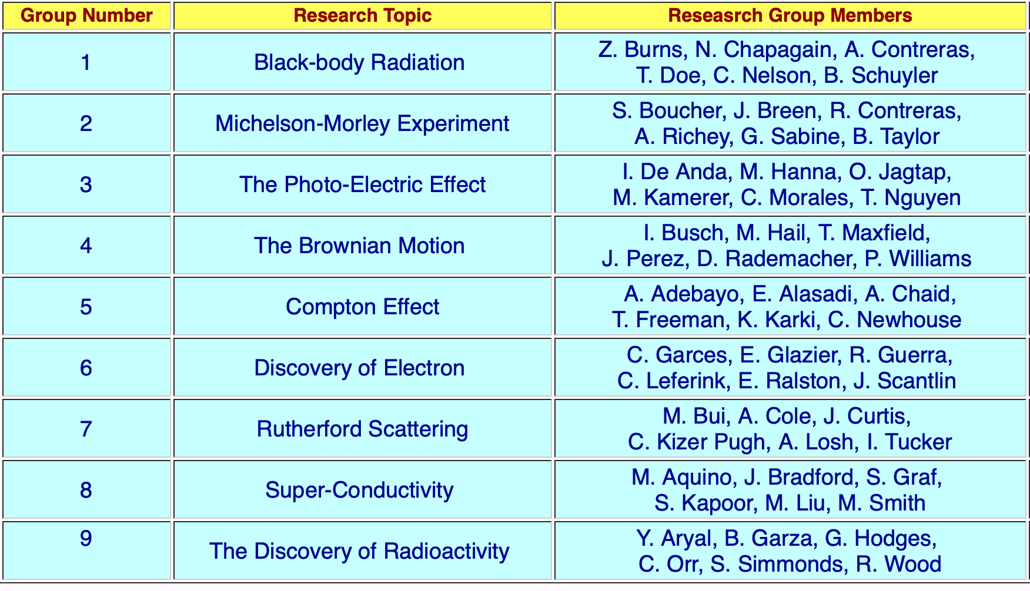
Research Projects
Each of the 9 research groups has an assigned research topic

Slide 7
Research Projects
Each of the 9 research groups has an assigned research topic
Study the topic as a group, looking up references
  The original theory or the original observation
  Experimental proofs or Theoretical prediction + subsequent experimental proofs
  Importance and the impact of the theory/experiment
Each member of the group writes a 5 – 7 page report, including figures
  10% of the total grade
  Can share the theme and facts but you must write your own!
  Due beginning of the class Wed. Apr. 24, 2019
  DO NOT Copy! Both the copies and the one allowed it will get F grade!
Each group presents a 10+2min power point talk
  5% of the total grade
  Date and the order of presentations have been chosen today!

Slide 8
Reminder: Research Project Report
Must contain the following at the minimum
  Original theory or Original observation
  Experimental proofs or Theoretical prediction + subsequent experimental proofs
  Importance and the impact of the theory/experiment
  Conclusions and future prospects
  The reference to the original paper must be included!
  Bibliography referring to web site must be minimized (<20%)

Slide 9
Project Report Template

Slide 10
Research Presentations
Each of the 9 research groups makes a 10+2min presentation
  10min presentation + 2min Q&A
  All presentations must be in power point
  I must receive all final presentation files by 8pm, Sunday, Apr. 21, 2019
    No changes are allowed afterward
  The representative of the group makes the presentation followed by all group members’ participation in the Q&A session
Date and time:
  In class Monday and Wednesday, Apr. 22 and 24, 2019
Important metrics
  Contents of the presentation: 55%
    Inclusion of all important points as mentioned in the report
    The quality of the research and making the right points
  Quality of the presentation itself: 15%
  Presentation manner: 10%
  Q&A handling: 10%
  Staying in the allotted presentation time: 5%
  Judging participation and sincerity: 5%

