Slide 1
PHYS 3313 – Section 001
Lecture #16
Monday, March 25, 2019
Dr. Jaehoon Yu
X-ray scattering & Bragg’s Law
de Broglie Waves
Bohr’s Quantization Conditions
Electron Scattering
Wave Motion and Properties
Wave Packets and Packet Envelops
The Uncertainty Principle

Slide 2
Announcements
Homework #4: CH5 end of the chapter problems
  8, 10, 16, 24, 26, 37 and 47
  Due: Monday Apr. 1, 2019
Reading Assignments: CH5.1 and CH5.3
The workshop volunteers needed
  Two workshops in April
    April 12 and 13, Friday and Saturday: New Opportunities at the Next Generation Neutrino Experiments
      8:30am – noon, Friday, Apr. 12 in front of CPB303: four for registration desk help through 9am then two at the registration desk and two in the room
      Noon, Friday, Apr. 12 – 4pm Saturday, Apr. 13: Need help of one person in the room at all times
    April 18 and 19, Thursday and Friday: US DUNE Near Detector Workshop
      8:30am – noon, Thursday, Apr. 18 in front of CPB303: four for registration desk help through 9am then two at the registration desk and two in the room
      2pm, Thursday, Apr. 18 – 11:30am Friday, Apr. 19: Need help of two persons in each of the four breakout rooms\
      11:30am – 1:30pm, Friday, Apr. 19: One person in CPB303
  Eman Alasadi will coordinate this with Dr. Jonathan Asaadi

Slide 3
Special Project #6
Derive the following using trigonometric identities
10 points total for this derivation
Due for this special project is Wednesday, Apr. 5.
You MUST have your own answers!

Slide 4
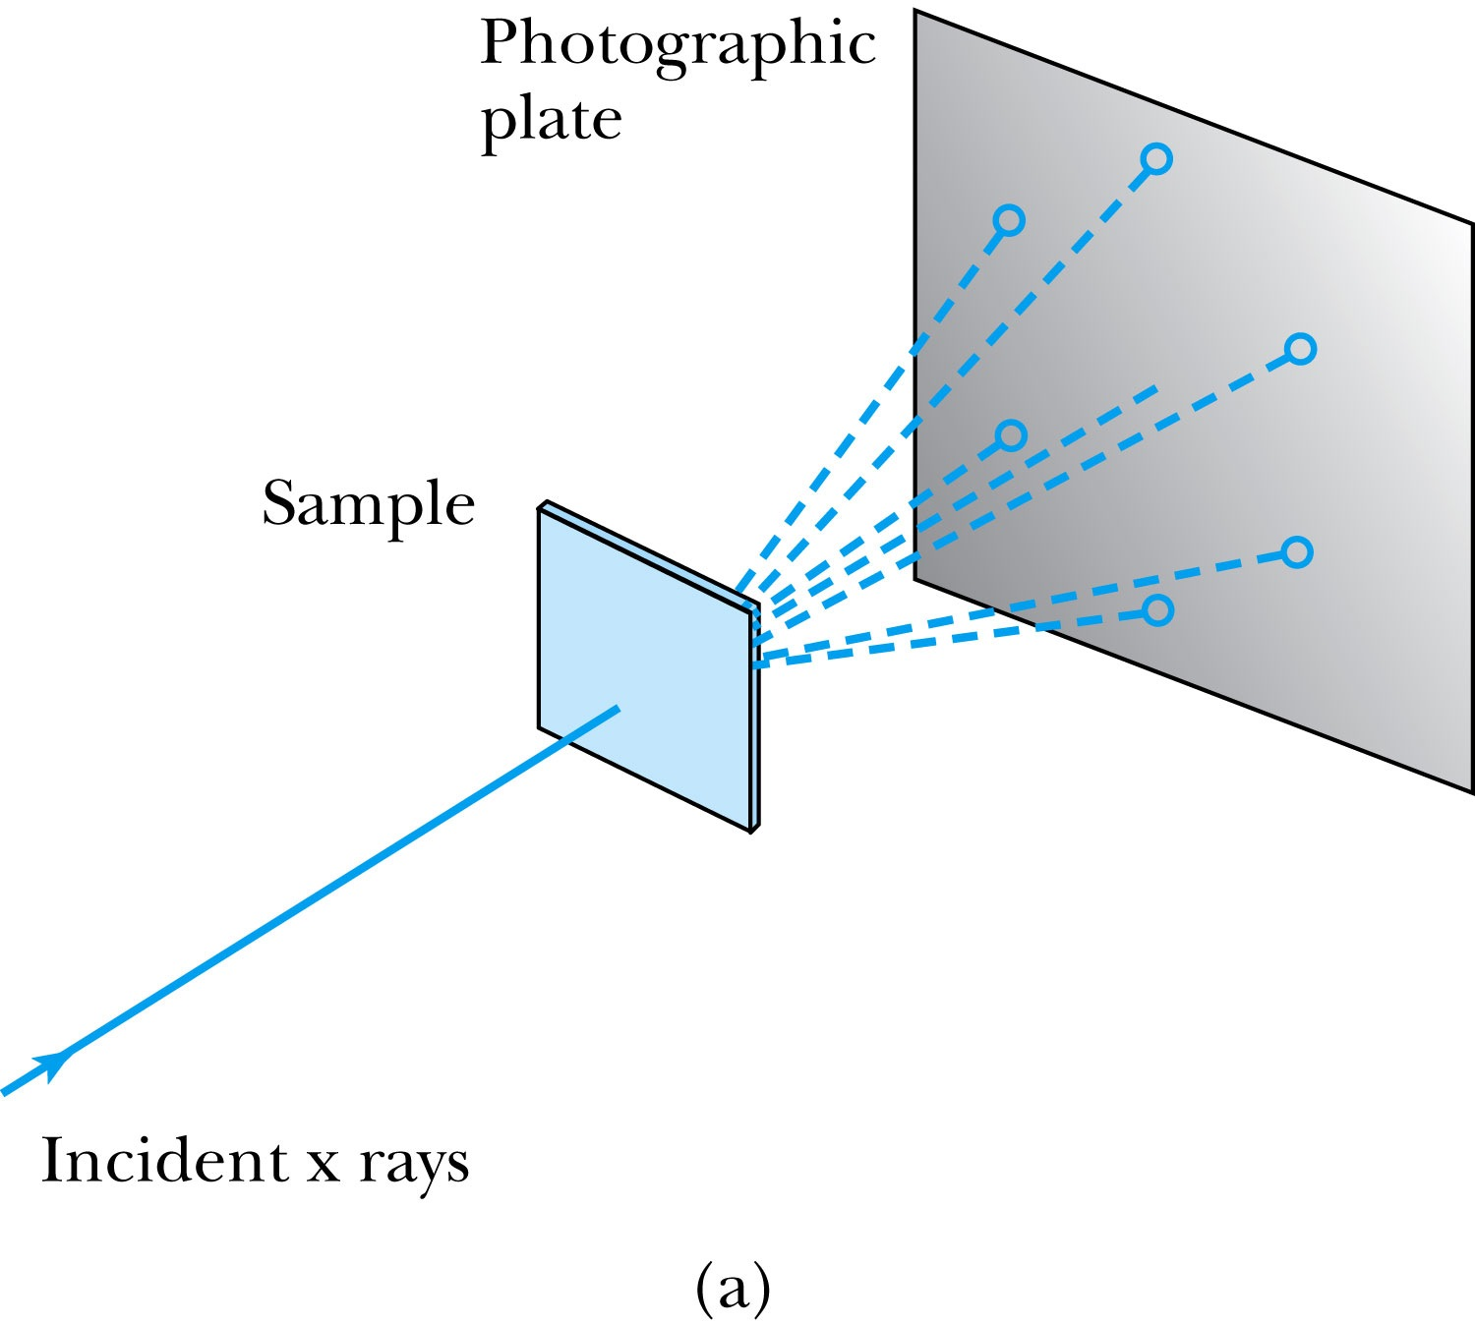
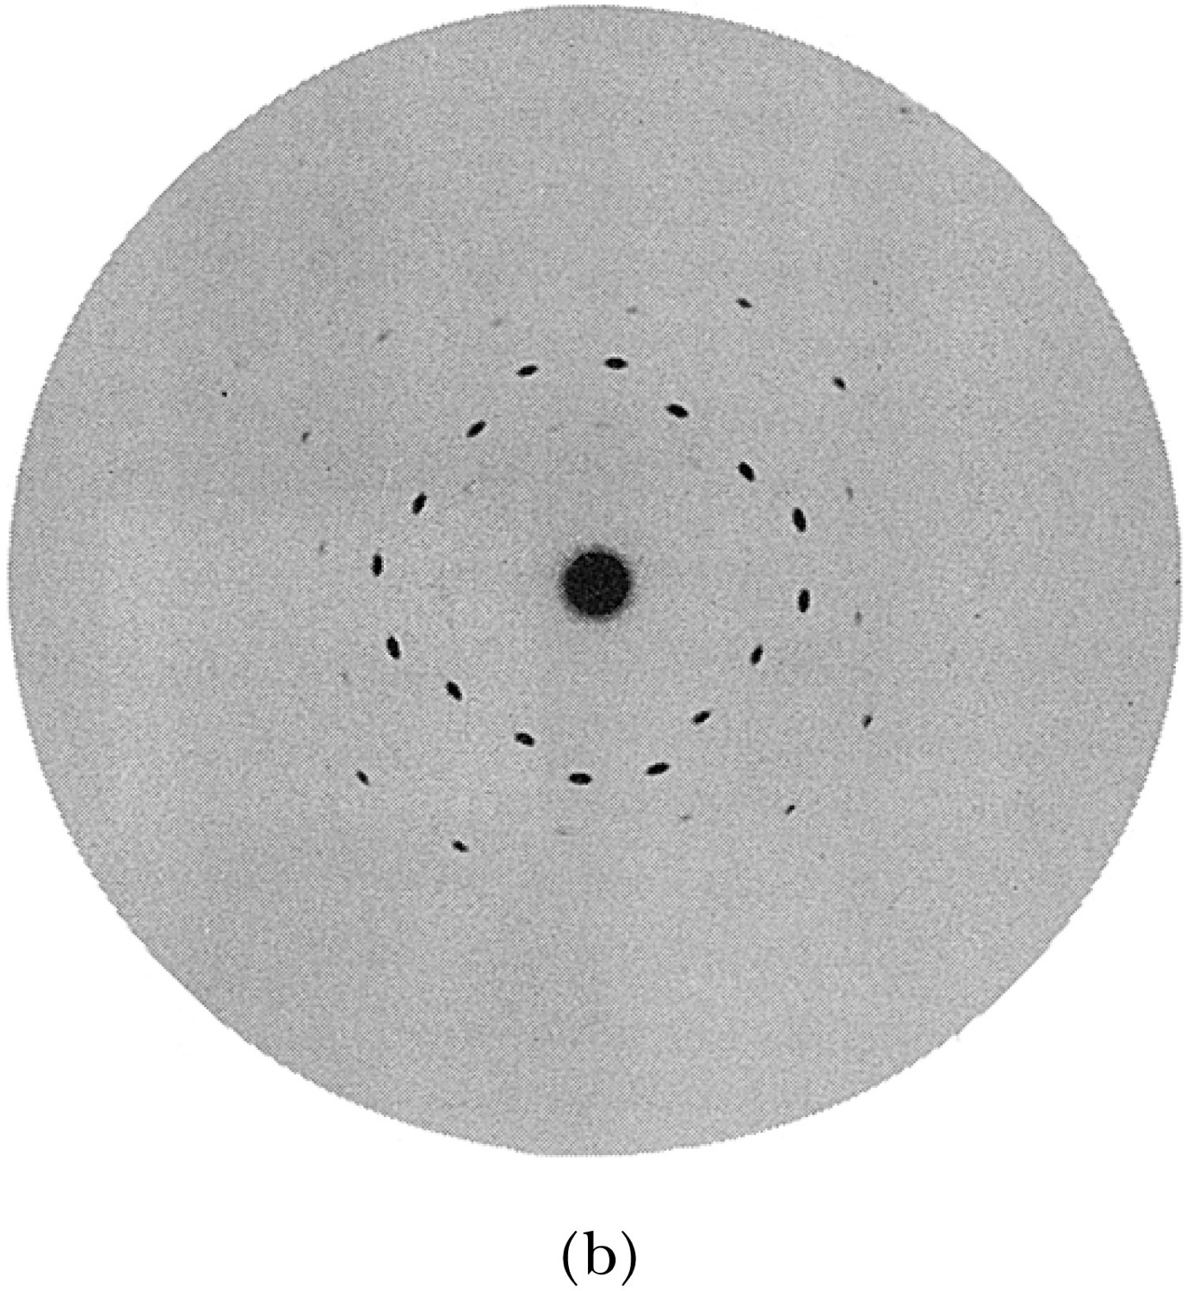
X-Ray Scattering
Max von Laue (1914 Nobel) suggested that if X rays were a form of electromagnetic radiation, interference effects should be observed. (Wave property!!)
Crystals act as three-dimensional gratings, scattering the waves and producing observable interference effects.

Slide 5
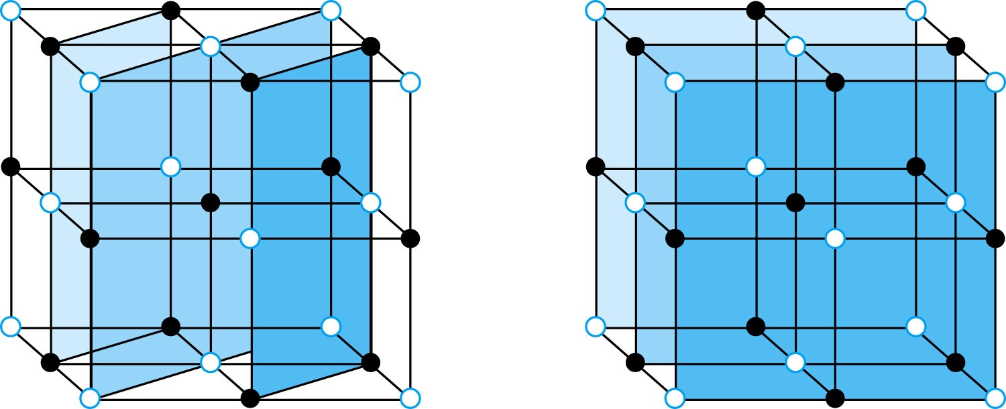
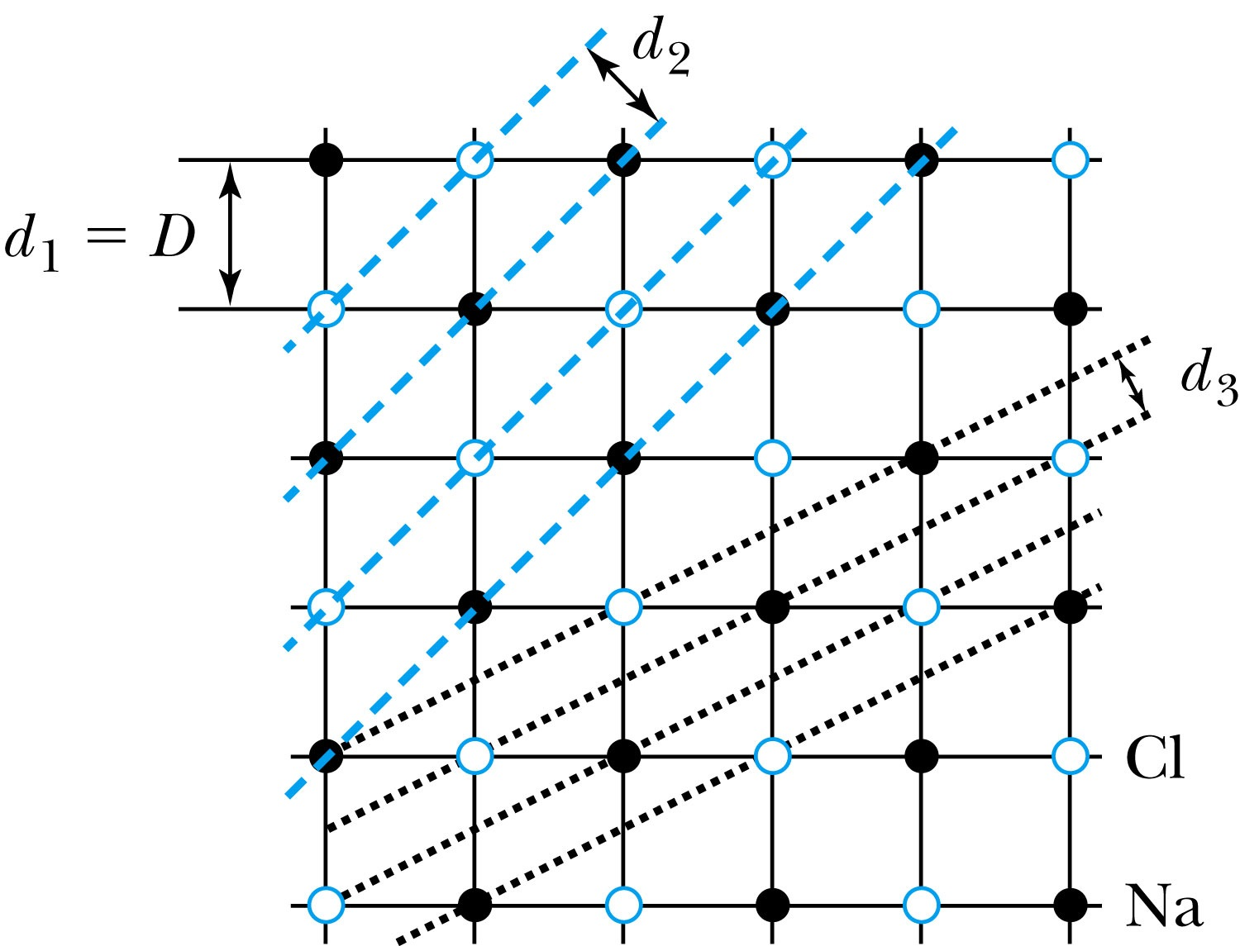
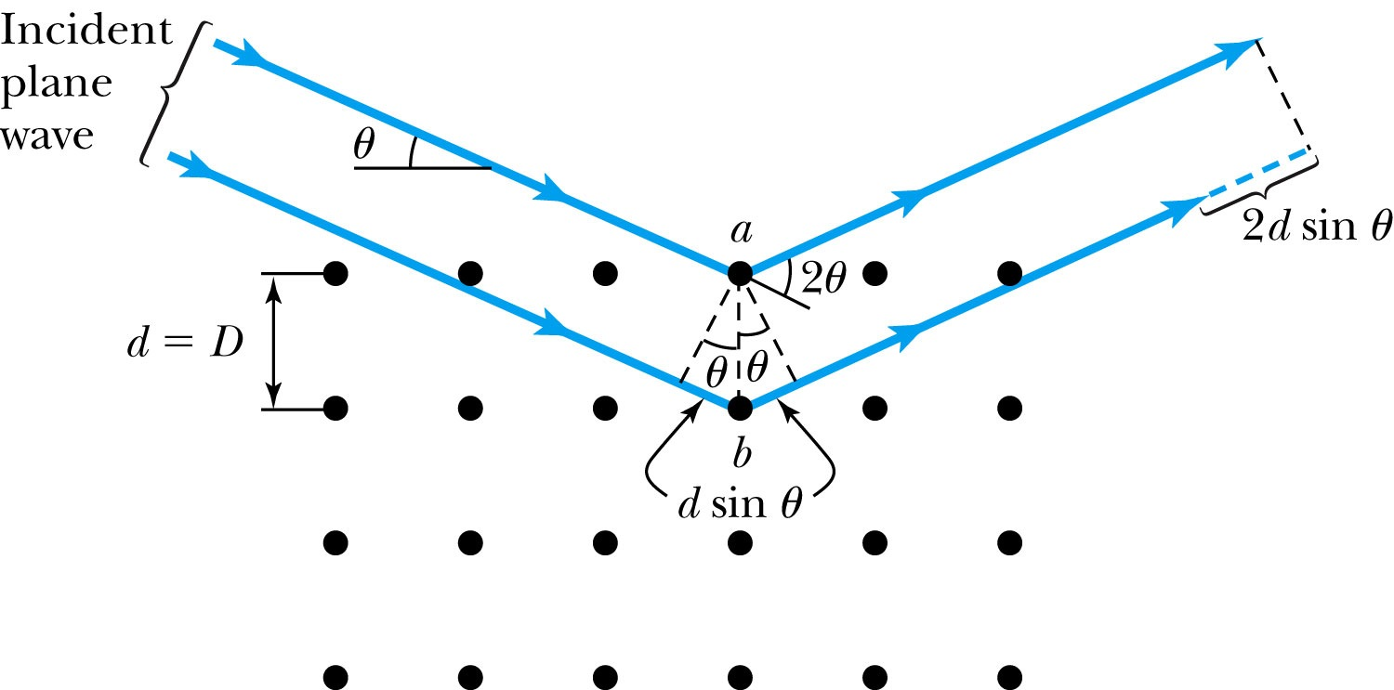
Bragg’s Law
William Lawrence Bragg (1915 Nobel) interpreted the x-ray scattering as the reflection of the incident X-ray beam from a unique set of planes of atoms within the crystal.
There are two conditions for constructive interference of the scattered X rays:
The angle of incidence must equal the angle of reflection of the outgoing wave. (total reflection)
The difference in path lengths between two rays must be an integral number of wavelengths.
Bragg’s Law:
nλ = 2d sin θ
(n = integer, order of reflection)

Slide 6
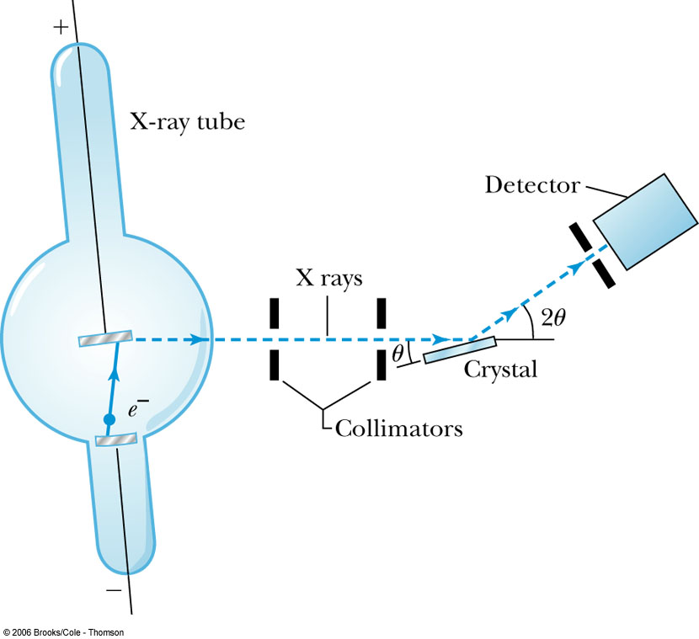
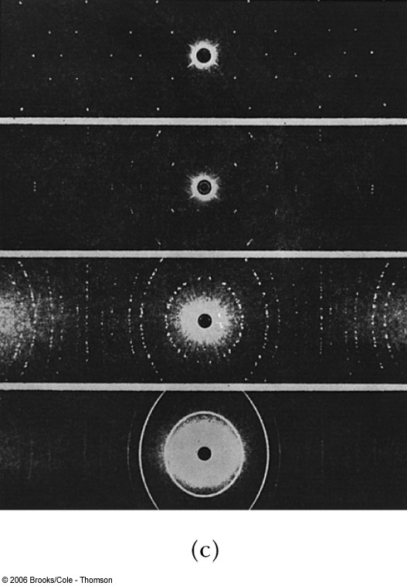
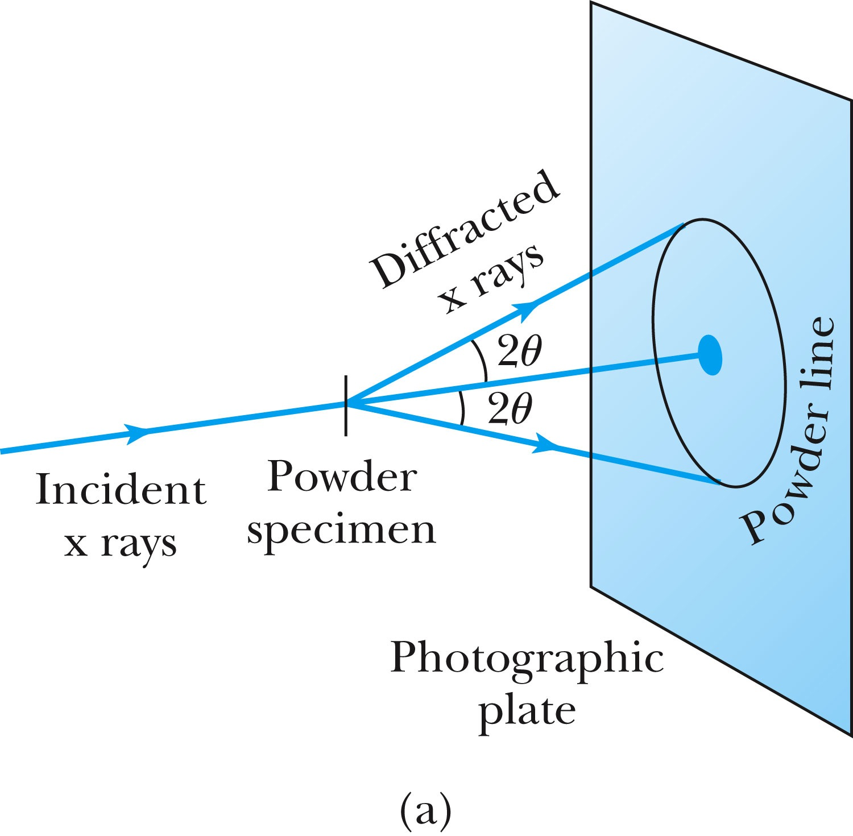
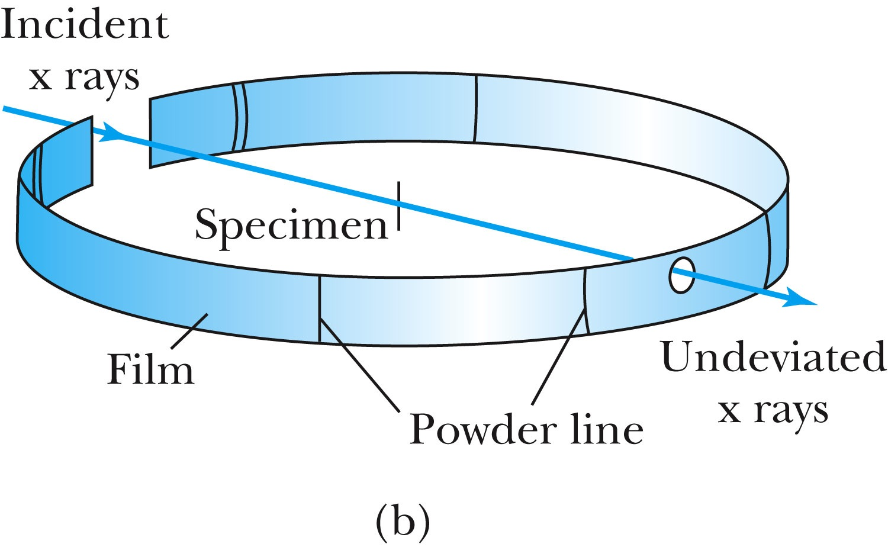
The Bragg Spectrometer
A Bragg spectrometer scatters X rays from several crystals. The intensity of the diffracted beam is determined as a function of scattering angle by rotating the crystal and the detector.
When a beam of X rays passes through the powdered crystal, the dots become a series of rings due to random arrangement.

Slide 7
Ex 5.1: Bragg’s Law
X rays scattered from rock salt (NaCl) are observed to have an intense maximum at an angle of 20º from the incident direction. Assuming n=1 (from the intensity), what must be the wavelength of the incident radiation? NaCl density is 2.16g/cm³ and the atomic mass is 58.5g/mol.
Bragg’s law: nλ = 2d sin θ
What do we need to know to use this? The lattice spacing d!
We know n=1 and 2θ=20º.
We use the density of NaCl to find out what d is.

Slide 8
De Broglie Waves
Louis V. de Broglie suggested that mass particles should have wave properties similar to electromagnetic radiation, matter waves (1929 Nobel) ➔ many experiments supported this!
Thus the wavelength of a matter wave is called the de Broglie wavelength:
This can be considered as the probing beam length scale
Since for a photon, E = pc and E = hf, the energy can be written as

Slide 9
Ex 5.2: De Broglie Wavelength
Calculate the De Broglie wavelength of (a) a tennis ball of mass 57g traveling 25m/s (about 56mph) and (b) an electron with kinetic energy 50eV.
What is the formula for De Broglie Wavelength?
(a) for a tennis ball, m=0.057kg.
(b) for electron with 50eV KE, since KE is small, we can use non-relativistic expression of electron momentum!
What are the wavelengths of you running at the speed of 2m/s? What about your car of 2 metric tons at 100mph? How about the proton with 14TeV kinetic energy?
What is the momentum of the photon from a green laser (λ=532nm)?
This is why we don’t observe a wave-like properties for a macroscopic objects.

Slide 10
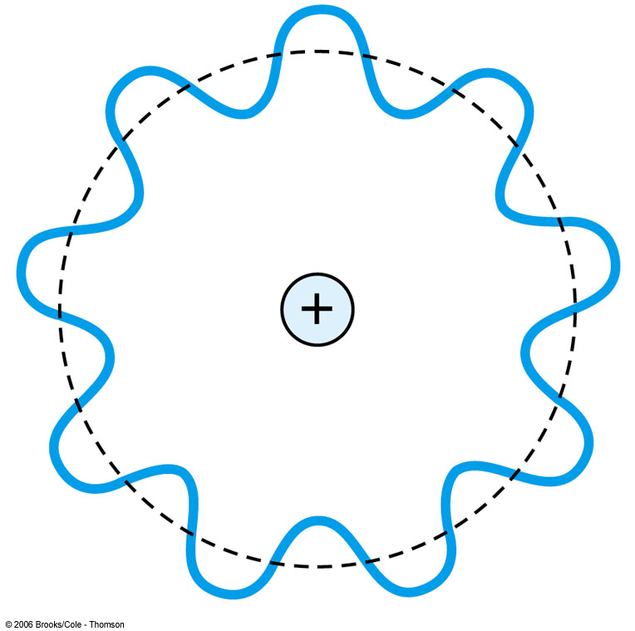
Bohr’s Quantization Condition
One of Bohr’s assumptions concerning his hydrogen atom model was that the angular momentum of the electron-nucleus system in a stationary state is an integral multiple of h/2π.
The electron is a standing wave in an orbit around the proton. This standing wave will have nodes, and an integral number of wavelengths fit into the orbit!
The angular momentum becomes:

Slide 11
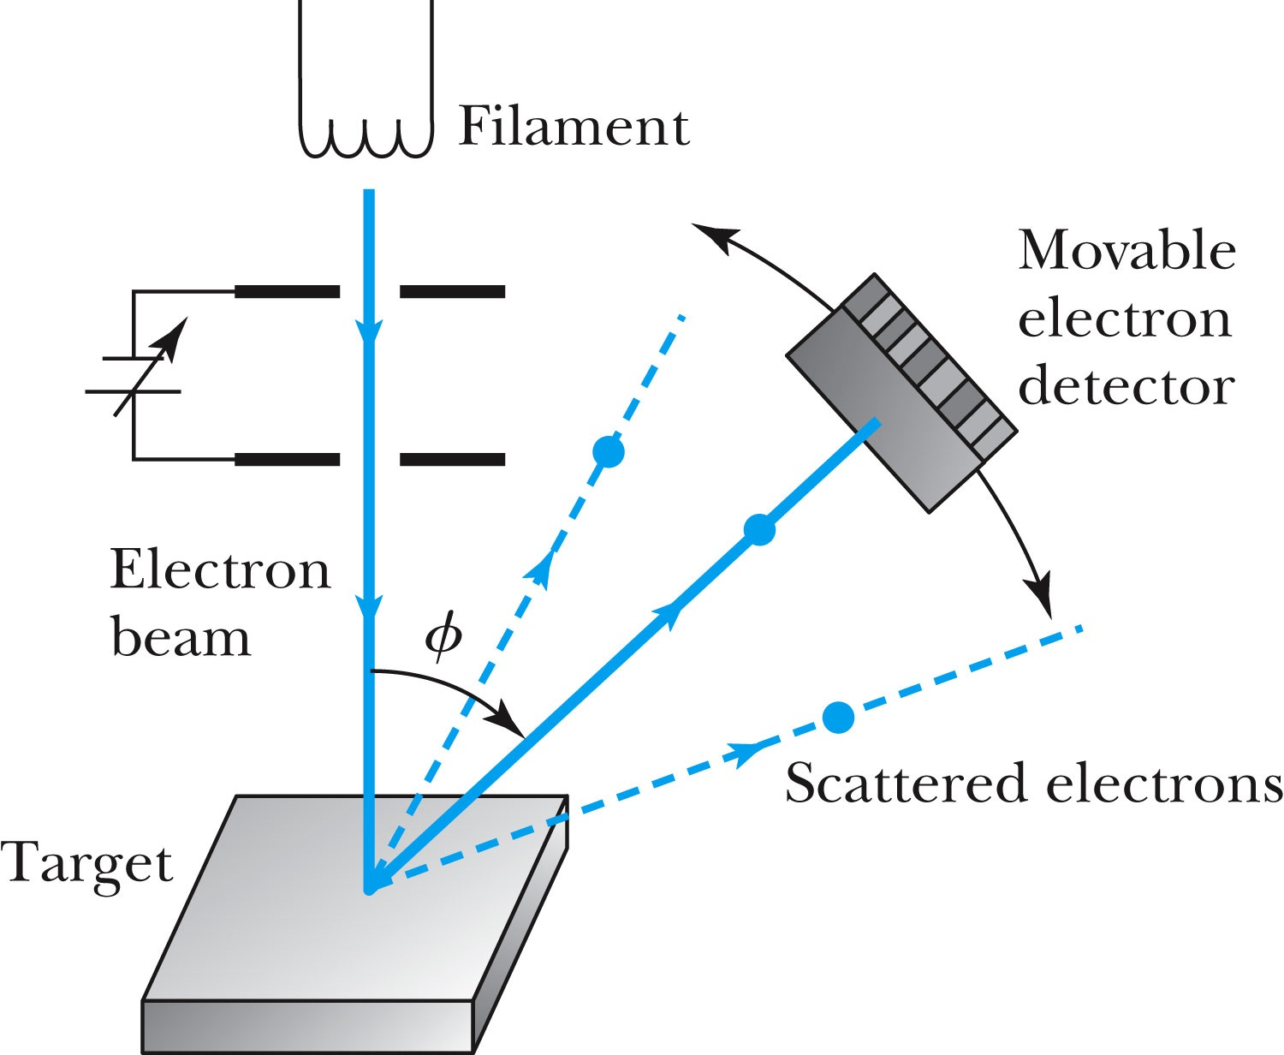
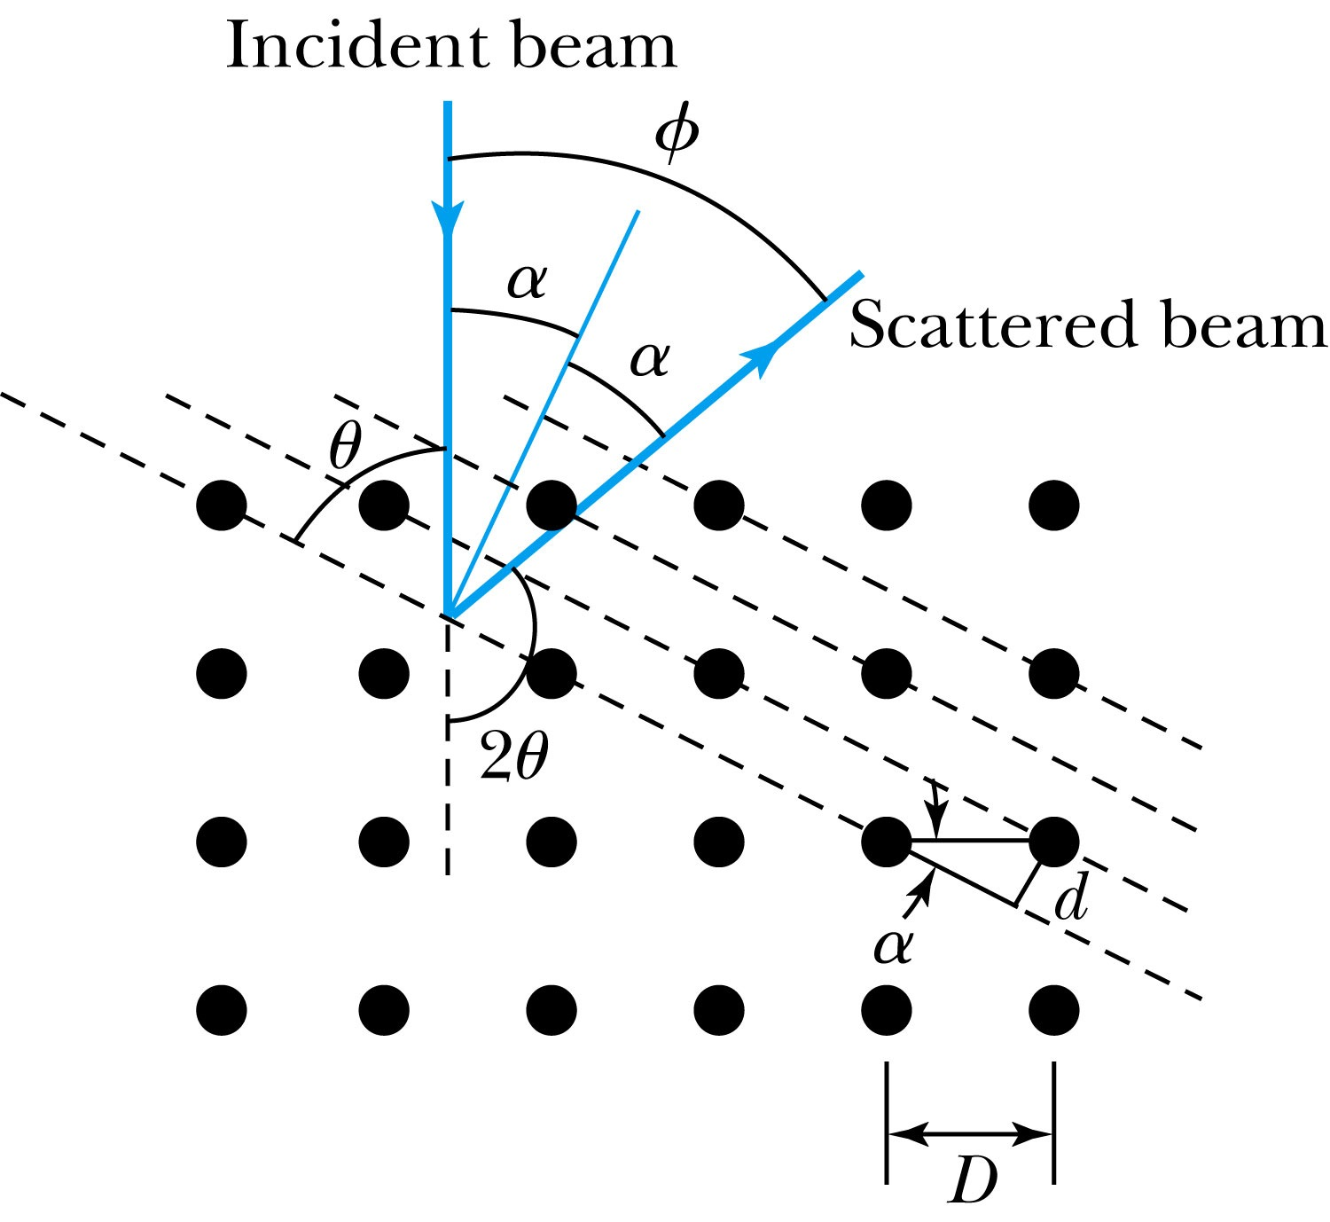
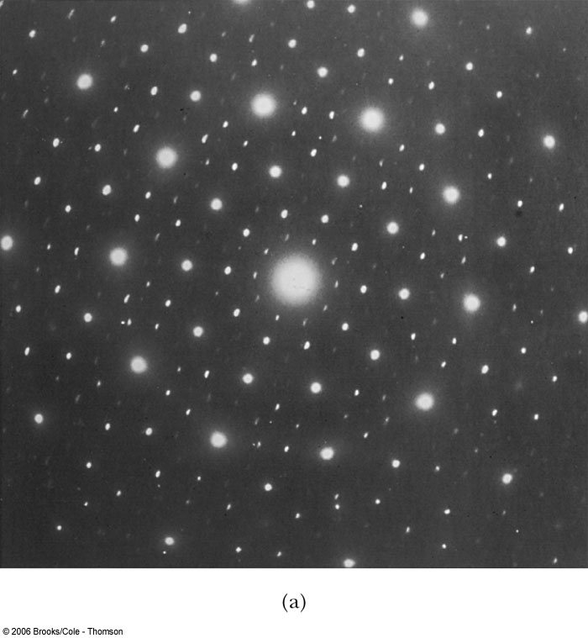
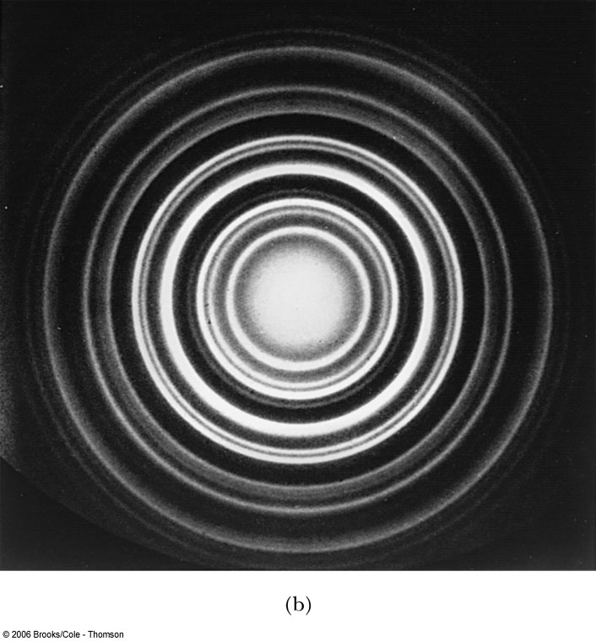
Electron Scattering
Davisson* and Germer experimentally observed that electrons were diffracted much like X rays in nickel crystals. ➔ direct proof of the de Broglie wave!
George P. Thomson* (1892–1975, 1937 Nobel), the son of J. J. Thomson (1906 Nobel), reported seeing the effects of electron diffraction in transmission experiments. The first target was celluloid, and soon after that gold, aluminum, and platinum were used.
The randomly oriented polycrystalline sample of SnO₂ produces rings as shown in the figure right.
Crystal
Powder

Slide 12
Photons, which we thought were waves, act particle like (eg Photoelectric effect or Compton Scattering)
Electrons, which we thought were particles, act wave like (e.g. electron scattering)
de Broglie: All matter has intrinsic wavelength.
  Wavelength is inversely proportional to momentum
  The more massive… the smaller the wavelength… the harder to observe the wavelike properties
  So while photons appear mostly wavelike, electrons (next lightest particle!) appear mostly particle like.
How can we reconcile the wave/particle views?

Slide 13
Wave Motion
de Broglie matter waves suggest a further description of particles in wave. The displacement of a typical traveling wave is
This is a solution to the wave equation
Define the wave number k and the angular frequency ω as:
The wave function can be rewritten:

Slide 14
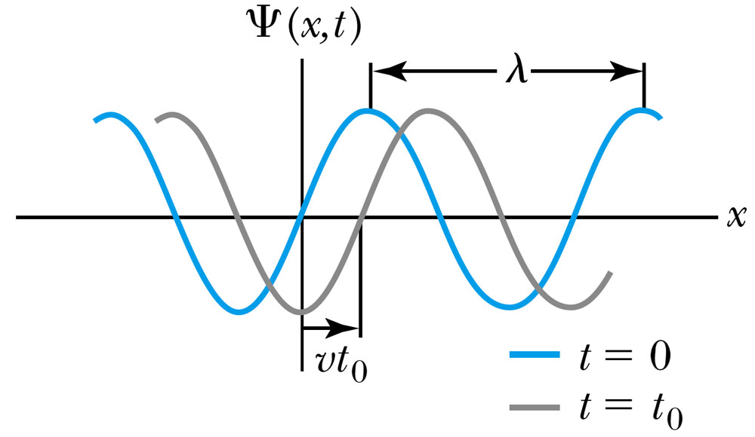
Wave Properties
The phase velocity is the velocity of a point on the wave that has a given phase (for example, the crest) and is given by
The phase constant φ shifts the wave:
.
(When φ=π/2)

Slide 15
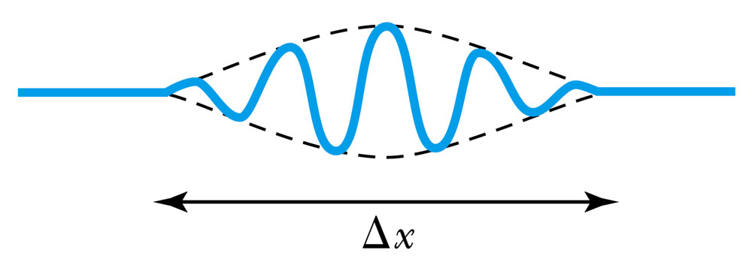
Principle of Superposition
When two or more waves traverse in the same region, they act independently of each other.
Combining two waves of the same amplitude yields:
The combined wave oscillates within an envelope that denotes the maximum displacement of the combined waves.
When combining many waves with different amplitudes and frequencies, a pulse, or wave packet w/ localized amplitude, can be formed and can move with a group velocity:

Slide 16
Fourier Series
The sum of many waves that form a wave packet is called a Fourier series:
Summing an infinite number of waves yields the Fourier integral:

Slide 17
Wave Packet Envelope
The superposition of two waves yields the wave number and angular frequency of the wave packet envelope.
The range of wave numbers and angular frequencies that produce the wave packet have the following relations:
A Gaussian wave packet has similar relations:
The localization of the wave packet over a small region to describe a particle position precisely requires a large range of wave numbers. Conversely, a small range of wave numbers cannot produce a wave packet localized within a small distance.

Slide 18
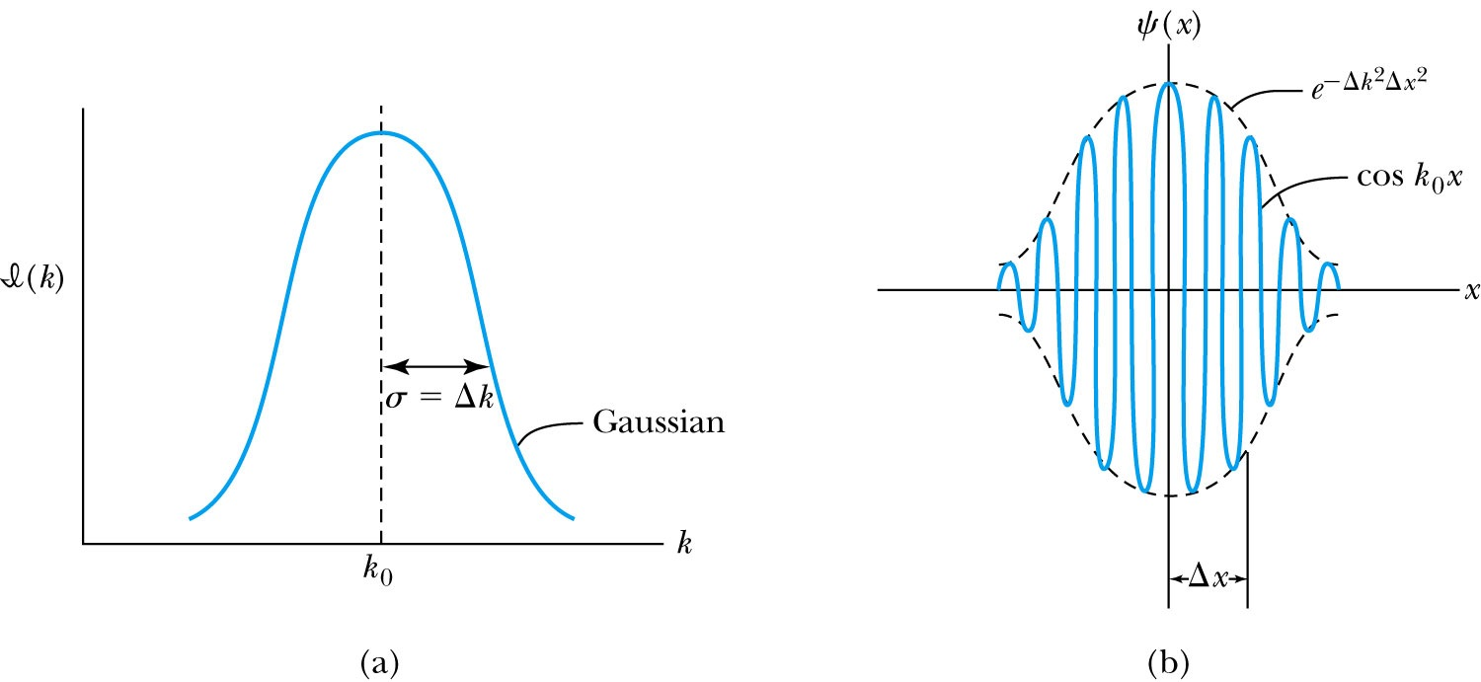
Gaussian Function
A Gaussian wave packet describes the envelope of a pulse wave.
The group velocity is

Slide 19
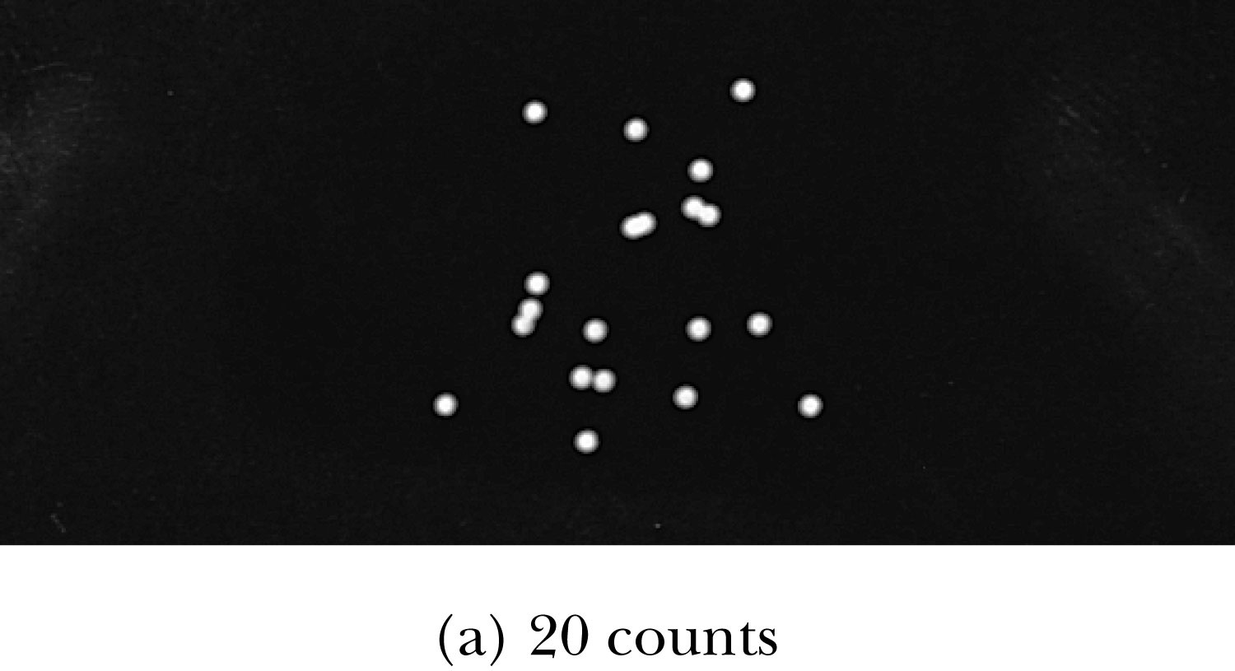
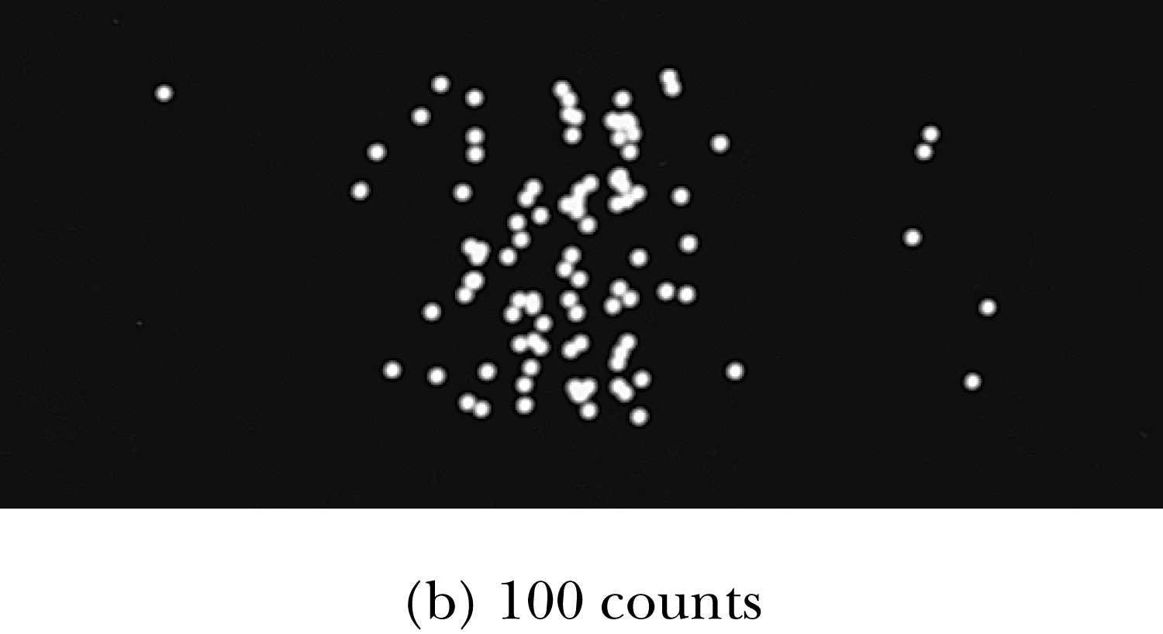
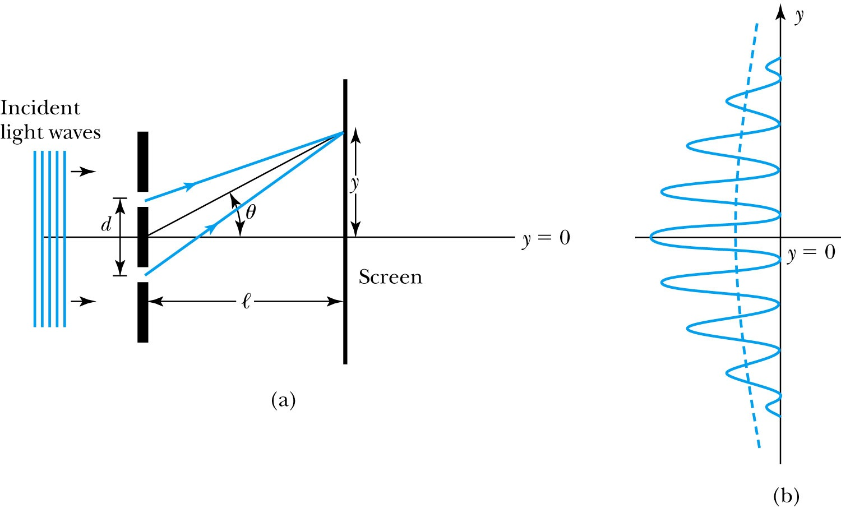
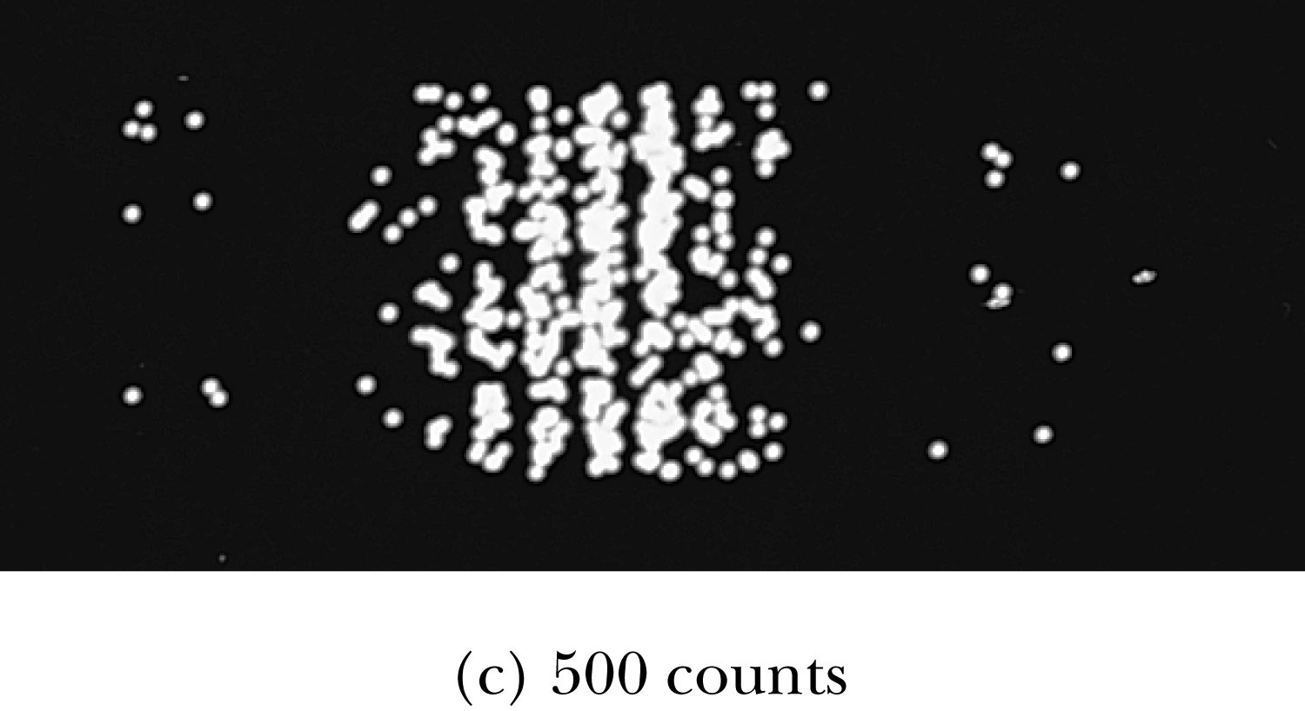
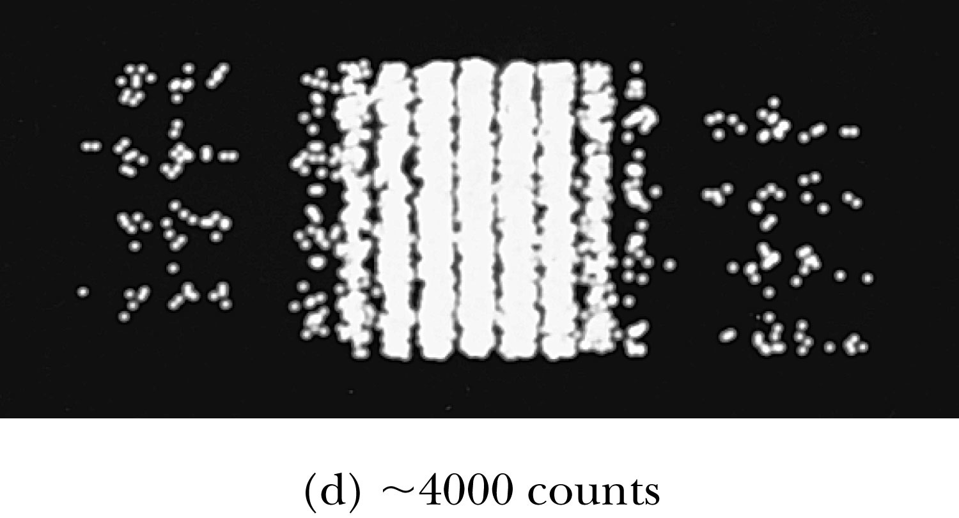
Waves or Particles?
Young’s double-slit diffraction experiment demonstrates the wave property of the light.
However, dimming the light results in single flashes on the screen representative of particles.

Slide 20
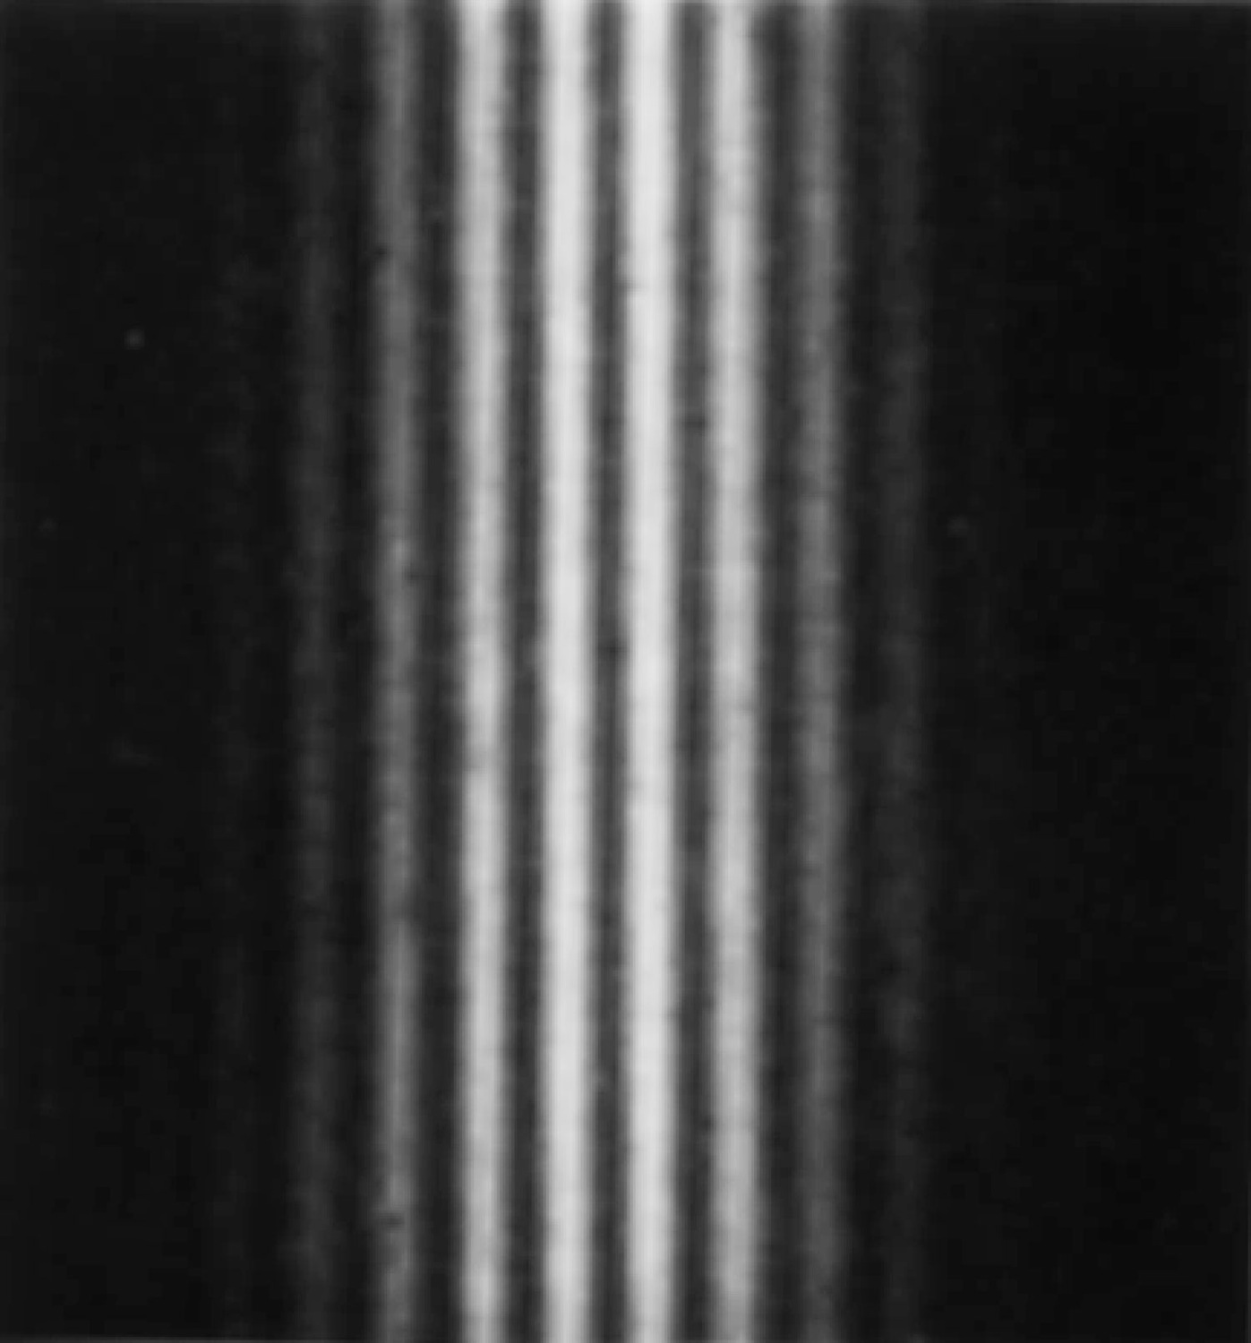
Electron Double-Slit Experiment
C. Jönsson of Tübingen, Germany, succeeded in 1961 in showing double-slit interference effects for electrons by constructing very narrow slits and using relatively large distances between the slits and the observation screen.
This experiment demonstrated that precisely the same behavior occurs for both light (waves) and electrons (particles).

Slide 21
Wave particle duality solution
The solution to the wave particle duality of an event is given by the following principle.
Bohr’s principle of complementarity: It is not possible to describe physical observables simultaneously in terms of both particles and waves.
Physical observables are the quantities such as position, velocity, momentum, and energy that can be experimentally measured. In any given instance we must use either the particle description or the wave description.

Slide 22
Uncertainty Principles
It is impossible to measure simultaneously, with no uncertainty, the precise values of k and x for the same particle. The wave number k may be rewritten as
For the case of a Gaussian wave packet we can write
Thus for a single particle, the Heisenberg’s uncertainty principle:
Momentum-position
Energy- time

Slide 23
Probability, Wave Functions, and the Copenhagen Interpretation
The wave function determines the likelihood (or probability) of finding a particle at a particular position in space at a given time.
The total probability of finding the particle is 1. Forcing this condition on the wave function is called the normalization.

Slide 24
The Copenhagen Interpretation
Bohr’s interpretation of the wave function consisted of 3 principles:
    The uncertainty principle of Heisenberg
    The complementarity principle of Bohr
    The statistical interpretation of Born, based on probabilities determined by the wave function
Together, these three concepts form a logical interpretation of the physical meaning of quantum theory. According to the Copenhagen interpretation, physics depends on the outcomes of measurement.

