Slide 1
PHYS 3313 – Section 001
Lecture #17
Wednesday, March 27, 2019
Dr. Jaehoon Yu
Probability of Particle
Schrodinger Wave Equation and Solutions
Normalization and Probability
Time Independent Schrodinger Equation
Expectation Values
Momentum, Position and Energy Operators

Slide 2
Announcements
Reminder for Homework #4: CH5 end of the chapter problems
  8, 10, 16, 24, 26, 37 and 47
  Due: Monday Apr. 1, 2019
Quiz #3
  Beginning of the class, Wednesday, Apr. 3
  Covers: CH4.8 through what we finish Monday, Apr. 1
  BYOF: You may bring a one 8.5x11.5 sheet (front and back) of handwritten formulae and values of constants for the exam
  No derivations, word definitions or setups or solutions of any problems!
    No Maxwell’s equations!
  No additional formulae or values of constants will be provided!
Colloquium at 4pm today in SH101
  Dr. Kevin Pham of National Center for Atmospheric Research

Slide 3


Slide 4
Special Project #6
Derive the following using trigonometric identities
10 points total for this derivation
Due for this special project is Wednesday, Apr. 3.
You MUST have your own answers!

Slide 5
The Copenhagen Interpretation
Bohr’s interpretation of the wave function consisted of 3 principles:
    The uncertainty principle of Heisenberg
    The complementarity principle of Bohr
    The statistical interpretation of Born, based on probabilities determined by the wave function
Together, these three concepts form a logical interpretation of the physical meaning of quantum theory. According to the Copenhagen interpretation, physics depends on the outcomes of measurement.

Slide 6
Particle in a Box
A particle of mass m is trapped in a one-dimensional box of width l.
The particle is treated as a wave.
The box puts boundary conditions on the wave. The wave function must be zero at the walls of the box and the outside of the box.
In order for the probability to vanish at the walls, we must have an integral number of half wavelengths in the box.
  or
The energy of the particle is .
The possible wavelengths are quantized and thus yields the energy:
The possible energies of the particle are quantized.
Find the quantized energy level of an electron constrained to move in a 1-D atom of size 0.1nm.

Slide 7
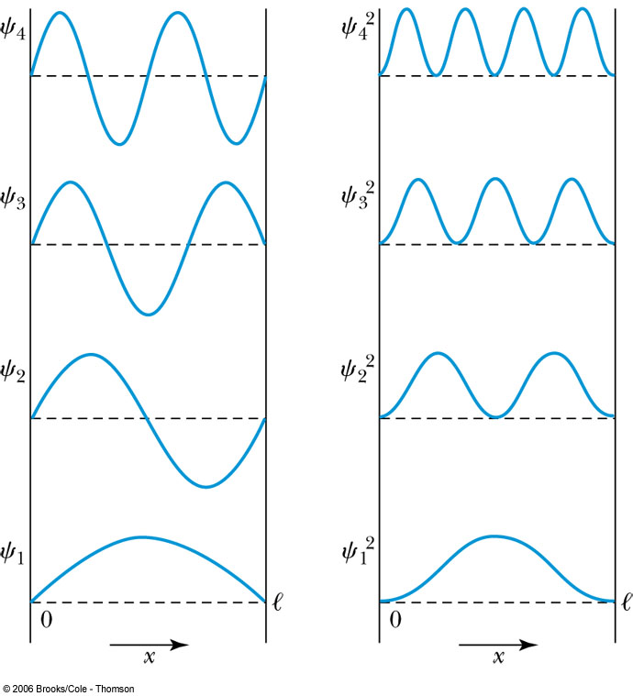
Probability of the Particle
The probability of observing a particle between x and x + dx in each state is
Note that E₀ = 0 is not a possible energy level.
The concept of energy levels, as first discussed in the Bohr model, has surfaced in a natural way by using waves.

Slide 8
The Schrödinger Wave Equation
Erwin Schrödinger and Werner Heisenberg (1932 Nobel) proposed quantum theory in 1920
  The two proposed very different forms of equations
  Heisenberg: Matrix based framework
  Schrödinger: Wave mechanics, similar to the classical wave equation
Paul Dirac and Schrödinger (1933 Nobel jointly) later proved that the two give identical results
The probabilistic nature of quantum theory is contradictory to the direct cause and effect seen in classical physics and makes it difficult to grasp!

Slide 9
The Time-dependent Schrödinger Wave Equation
The Schrödinger wave equation in its time-dependent form for a particle of energy E moving in a potential V in one dimension is
The extension into three dimensions is
where is an imaginary number

Slide 10
Ex 6.1: Wave equation and Superposition
The wave equation must be linear so that the superposition principle can be used to form a wave packet. Prove that the wave function in Schrödinger equation is linear by showing that it is satisfied by the wave equation Ψ (x,t)=aΨ₁ (x,t)+bΨ₂ (x,t) where a and b are constants and Ψ₁ (x,t) and Ψ₂ (x,t) describe two waves each satisfying the Schrödinger Eq.
Rearrange terms

Slide 11
General Solution of the Schrödinger Wave Equation
The general form of the solution of the Schrödinger wave equation is given by:
which also describes a wave propagating in the x direction. In general the amplitude may also be complex. This is called the wave function of the particle.
The wave function is also not restricted to being real. Only the physically measurable quantities (or observables) must be real. These include the probability, momentum and energy.

Slide 12
Ex 6.2: Solution for Wave Equation
Show that Ae^{i(kx-ωt)} satisfies the time-dependent Schrödinger wave Eq.
So Ae^{i(kx-ωt)} is a good solution and satisfies the Schrödinger Eq.

Slide 13
Ex 6.3: Bad Solution for Wave Equation
Determine whether Ψ (x,t)=Asin(kx-ωt) is an acceptable solution for the time-dependent Schrödinger wave Eq.
This is not true in all x and t. So Ψ (x,t)=Asin(kx-ωt) is not an acceptable solution for the Schrödinger Eq. Is it for the classical wave eq. ?

Slide 14
Normalization and Probability
The probability P(x) dx of a particle being between x and X + dx was given by the equation
Here Ψ* denotes the complex conjugate of Ψ
The probability of the particle being between x₁ and x₂ is given by
The wave function must also be normalized so that the probability of the particle being somewhere on the x axis is 1.

Slide 15
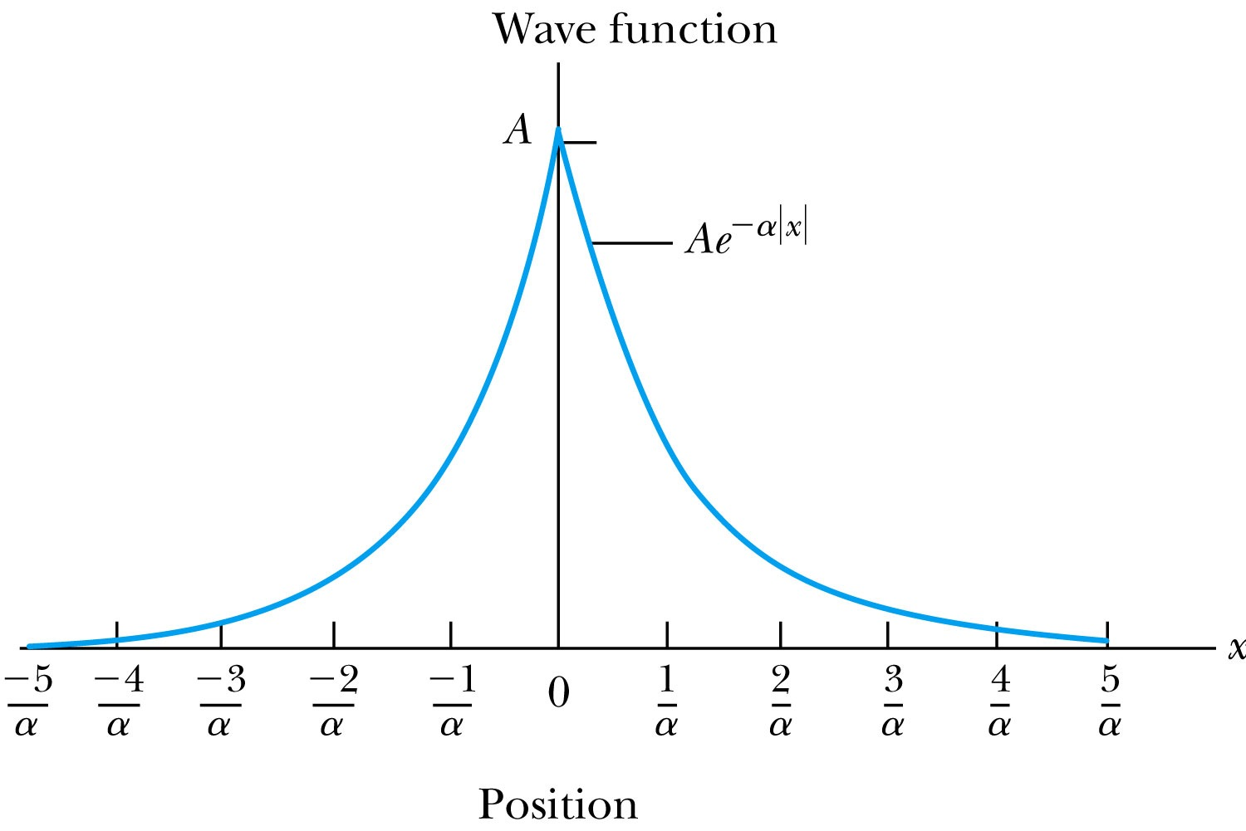
Ex 6.4: Normalization
Consider a wave packet formed by using the wave function that Ae^{-α|x|}, where A is a constant to be determined by normalization. Normalize this wave function and find the probabilities of the particle being between 0 and 1/α, and between 1/α and 2/α.
Probability density
Normalized Wave Function

Slide 16
Ex 6.4: Normalization, cont’d
Using the wave function, we can compute the probability for a particle to be in 0 to 1/α and 1/α to 2/α.
For 0 to 1/α:
For 1/α to 2/α:
How about 2/α:to ∞?

