Slide 1
PHYS 3313 – Section 001
Lecture #18
Monday, April 1, 2019
Dr. Jaehoon Yu
Time Independent Schrodinger Equation
Expectation Values
Momentum Operator
Position and Energy Operators
Infinite Square-well Potential

Slide 2
Announcements
Bring out HW#4
Quiz #3
  Beginning of the class, Wednesday, Apr. 3
  Covers: CH4.8 through what we finish Monday, Apr. 1
  BYOF: You may bring a one 8.5x11.5 sheet (front and back) of handwritten formulae and values of constants for the exam
  No derivations, word definitions or setups or solutions of any problems!
    No Maxwell’s equations!
  No additional formulae or values of constants will be provided!
A special colloquium at 4pm today in SH101
  Dr. Dora Muesielak of UTA

Slide 3


Slide 4
Reminder: Special Project #5
Prove that the wave function Ψ=A[sin(kx-ωt)+icos(kx-ωt)] is a good solution for the time-dependent Schrödinger wave equation. Do NOT use the exponential expression of the wave function. (10 points)
Determine whether or not the wave function Ψ=Ae^{-α|x|} satisfy the time-dependent Schrödinger wave equation. (10 points)
Due for this special project is Wednesday, Apr. 3.
You MUST have your own answers!

Slide 5
Reminder: Special Project #6
Derive the following using trigonometric identities
10 points total for this derivation
Due for this special project is Monday, Apr. 8.
You MUST have your own answers!

Slide 6
Normalization and Probability
The probability P(x) dx of a particle being between x and X + dx was given by the equation
Here Ψ* denotes the complex conjugate of Ψ
The probability of the particle being between x₁ and x₂ is given by
The wave function must also be normalized so that the probability of the particle being somewhere on the x axis is 1.

Slide 7
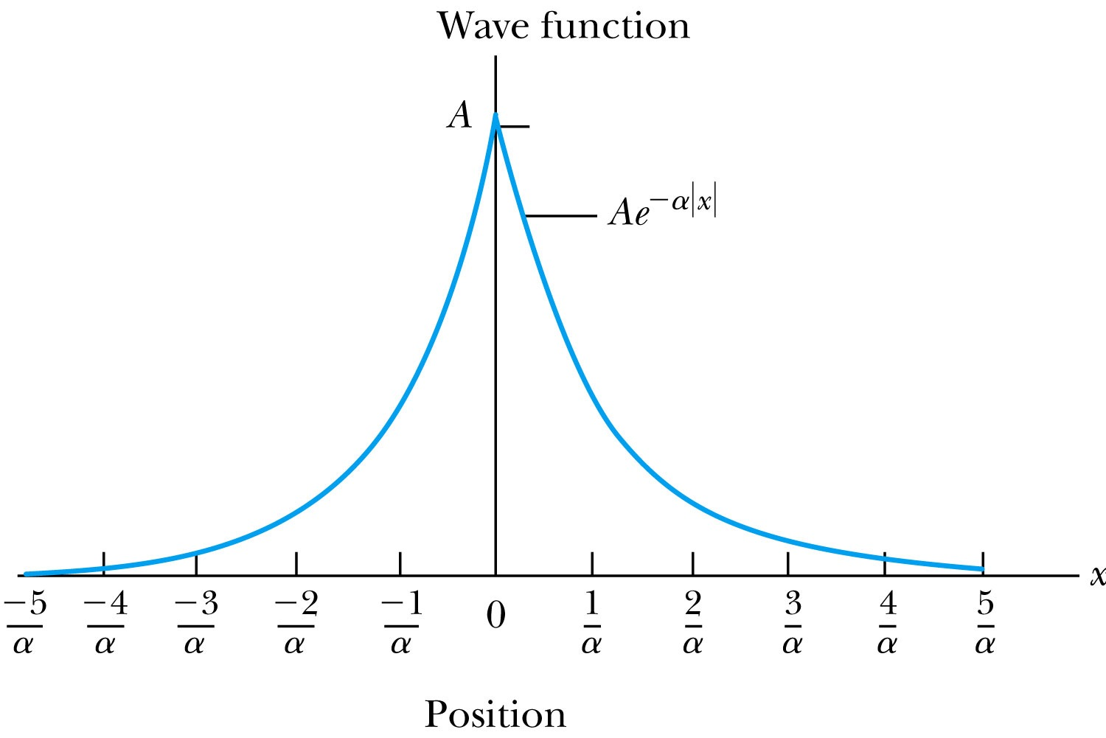
Ex 6.4: Normalization
Consider a wave packet formed by using the wave function that Ae^{-α|x|}, where A is a constant to be determined by normalization. Normalize this wave function and find the probabilities of the particle being between 0 and 1/α, and between 1/α and 2/α.
Probability density
Normalized Wave Function

Slide 8
Ex 6.4: Normalization, cont’d
Using the wave function, we can compute the probability for a particle to be with 0 to 1/α and 1/α to 2/α.
For 0 to 1/α:
For 1/α to 2/α:
How about 2/α:to ∞?

Slide 9
Properties of a Valid Wave Function
Boundary conditions
To avoid infinite probabilities, the wave function must be finite everywhere.
To avoid multiple values of the probability, the wave function must be single valued.
For a finite potential, the wave function and its derivatives must be continuous. This is required because the second-order derivative term in the wave equation must be single valued. (There are exceptions to this rule when V is infinite.)
In order to normalize the wave functions, they must approach zero as x approaches infinity.
Solutions that do not satisfy these properties do not generally correspond to physically realizable circumstances.

Slide 10
Time-Independent Schrödinger Wave Equation
The potential in many cases will not depend explicitly on time.
The dependence on time and position can then be separated in the Schrödinger wave equation. Let,
which yields:
Now divide by the wave function:
The left side of this last equation depends only on time, and the right side depends only on spatial coordinates. Hence each side must be equal to a constant. The time dependent side is

Slide 11
Time-Independent Schrödinger Wave Equation(con’t)
We integrate both sides and find:
where C is an integration constant that we may choose to be 0. Therefore
This determines f to be . Comparing this to the time dependent portion of the free particle wave function
This is known as the time-independent Schrödinger wave equation, and it is a fundamental equation in quantum mechanics.

Slide 12
Stationary State
Recalling the separation of variables:
and with the wave function can be written as:
The probability density becomes:
The probability distributions are constant in time. This is a standing wave phenomena that is called the stationary state.

Slide 13
Comparison of Classical and Quantum Mechanics
Newton’s second law and Schrödinger’s wave equation are both differential equations.
Newton’s second law can be derived from the Schrödinger wave equation, so the latter is the more fundamental.
Classical mechanics only appears to be more precise because it deals with macroscopic phenomena. The underlying uncertainties in macroscopic measurements are just too small to be significant.

Slide 14
Expectation Values
The expectation value is the expected result of the average of many measurements of a given quantity. The expectation value of x is denoted by <x>.
Any measurable quantity for which we can calculate the expectation value is called the physical observable. The expectation values of physical observables (for example, position, linear momentum, angular momentum, and energy) must be real, because the experimental results of measurements are real.
The average value of x is

Slide 15
Continuous Expectation Values
We can change from discrete to continuous variables by using the probability P(x,t) of observing the particle at the particular x.
Using the wave function, the expectation value is:
The expectation value of any function g(x) for a normalized wave function:

Slide 16
Momentum Operator
To find the expectation value of p, we first need to represent p in terms of x and t. Consider the derivative of the wave function of a free particle with respect to x:
With k = p / ħ we have
This yields
This suggests we define the momentum operator as .
The expectation value of the momentum is

Slide 17
Position and Energy Operators
The position x is its own operator as seen above.
The time derivative of the free-particle wave function is
Substituting ω = E / ħ yields
So the energy operator is
The expectation value of the energy is

