Slide 1
PHYS 3313 – Section 001
Lecture #19
Wednesday, April 3, 2019
Dr. Jaehoon Yu
Momentum Operator
Position and Energy Operators
Infinite Square-well Potential
Quantized Energy
Finite Square-well Potential
Penetration Depth
3D Infinite Potential

Slide 2
Announcements
Bring out SP#5
Homework #5
  CH6 end of chapter problems: 34, 46 and 65
  CH7 end of chapter problems: 7, 9, 17 and 29
  Due Monday, Apr. 15
Colloquium at 4pm today in SH101
  Dr. Antonia Hubbard of Northwestern University

Slide 3
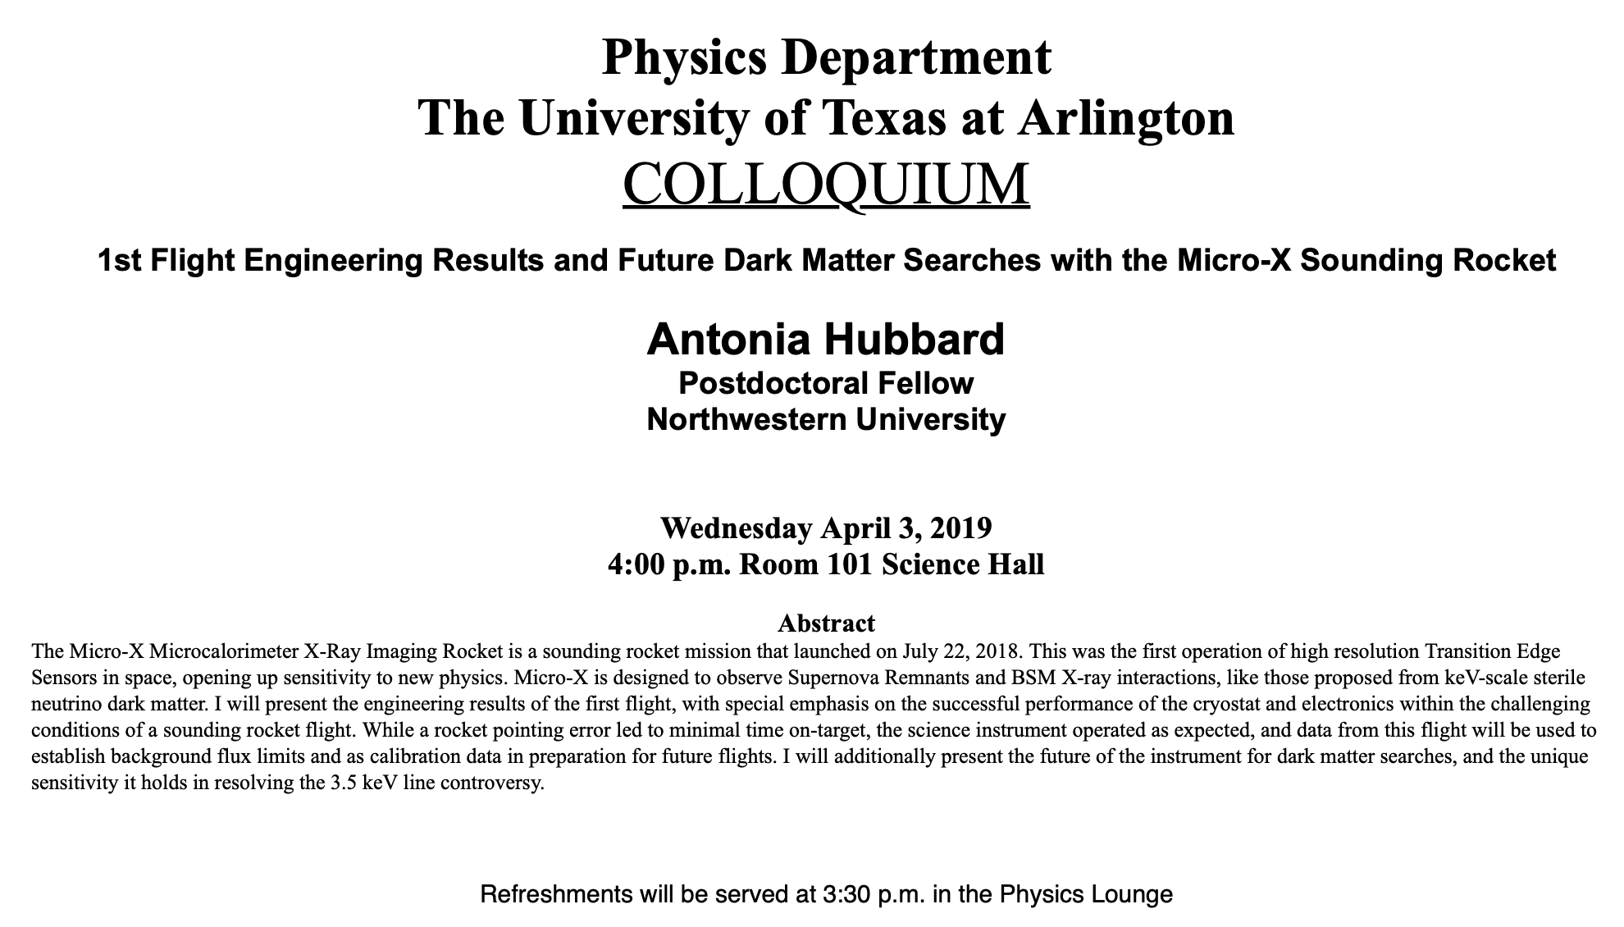

Slide 4
Reminder: Special Project #6
Derive the following using trigonometric identities
10 points total for this derivation
Due for this special project is Monday, Apr. 8.
You MUST have your own answers!

Slide 5
Special Project #7
Show that the Schrodinger wave equation becomes Newton’s second law in the classical limit. (15 points)
Deadline Wednesday, Apr. 17
You MUST have your own answers!

Slide 6
Momentum Operator
To find the expectation value of p, we first need to represent p in terms of x and t. Consider the derivative of the wave function of a free particle with respect to x:
With k = p / ħ we have
This yields
This suggests we define the momentum operator as .
The expectation value of the momentum is

Slide 7
Position and Energy Operators
The position x is its own operator as seen above.
The time derivative of the free-particle wave function is
Substituting ω = E / ħ yields
So the energy operator is
The expectation value of the energy is

Slide 8
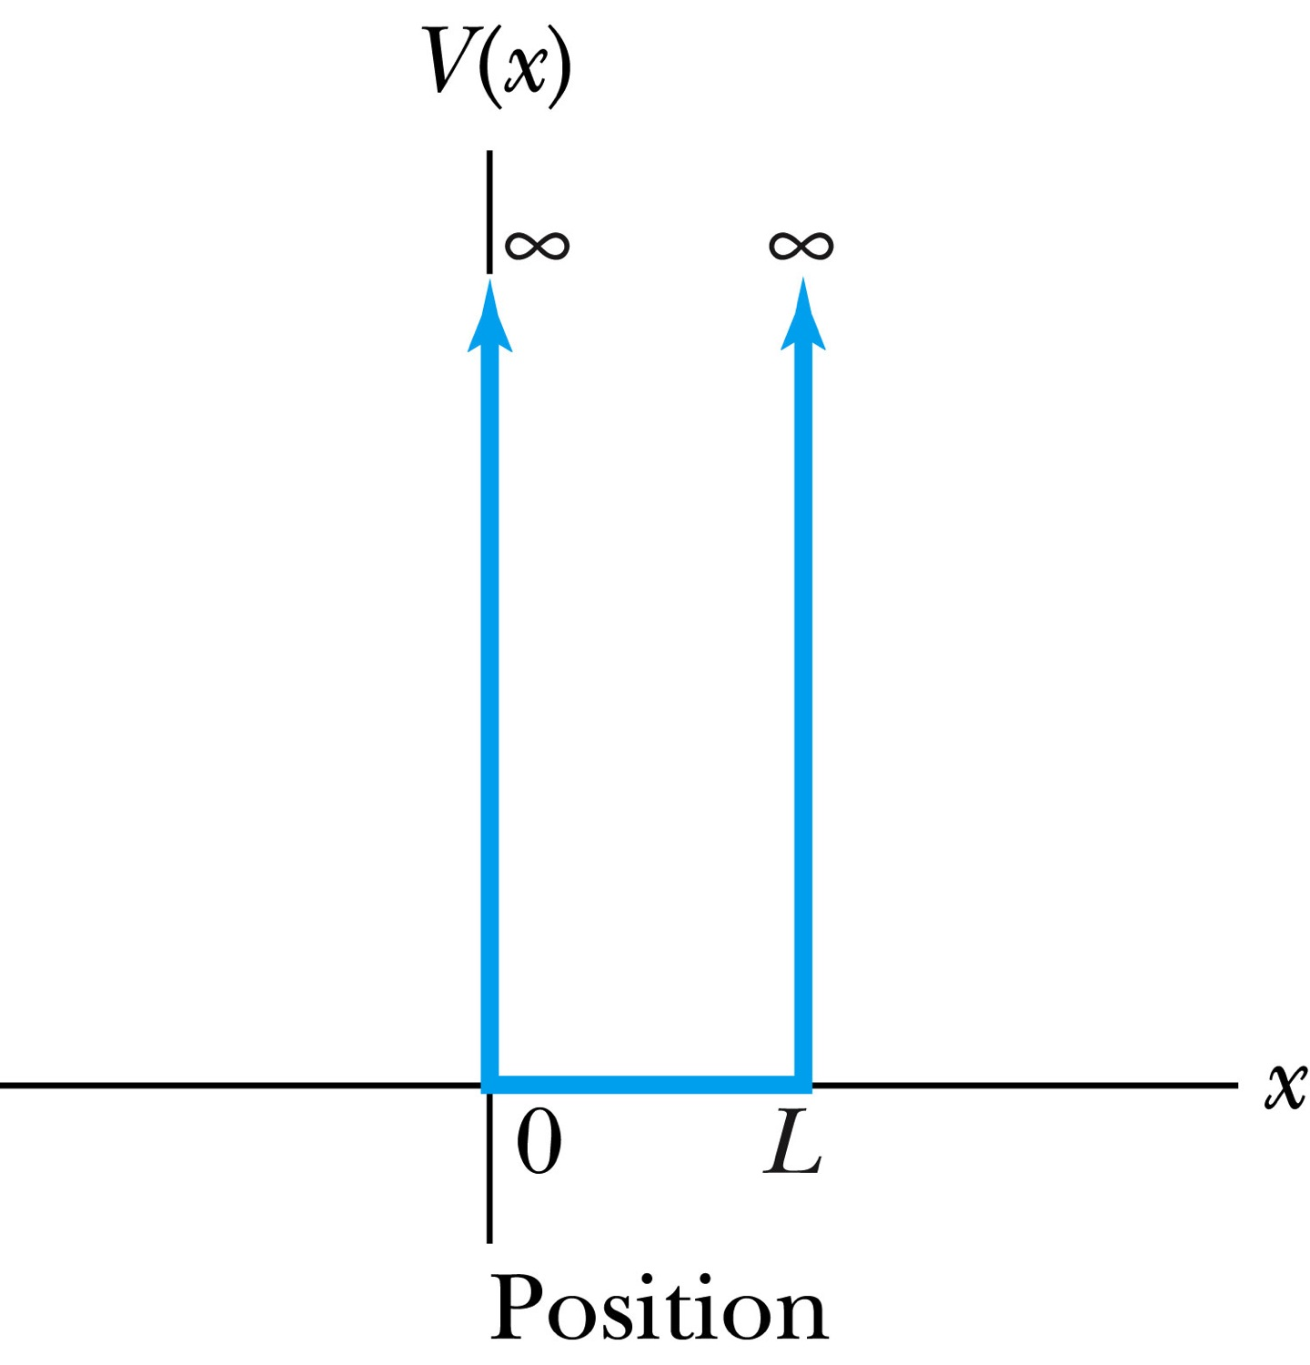
Infinite Square-Well Potential
The simplest such system is that of a particle trapped in a box with infinitely hard walls that the particle cannot penetrate. This potential is called an infinite square well potential and is given by
The wave function must be zero where the potential is infinite.
Where the potential is zero inside the box, the time independent Schrödinger wave equation becomes where .
The general solution is .

Slide 9
Quantization
Since the wave function must be continuous, the boundary conditions of the potential dictate that the wave function must be zero at x = 0 and x = L. These yield B=0 for valid solutions for, and for integer values of n such that kL = nπ ➔ k=nπ/L
The wave function is now
We normalize the wave function

Slide 10
Details of the computation

Slide 11
Quantization, cnt’d
Since the wave function must be continuous, the boundary conditions of the potential dictate that the wave function must be zero at x = 0 and x = L. These yield B=0 for valid solutions for, and for integer values of n such that kL = nπ ➔ k=nπ/L
The wave function is now
We normalize the wave function
The normalized wave function becomes
These functions are identical to those obtained for a vibrating string with fixed ends (a standing wave!!)

Slide 12
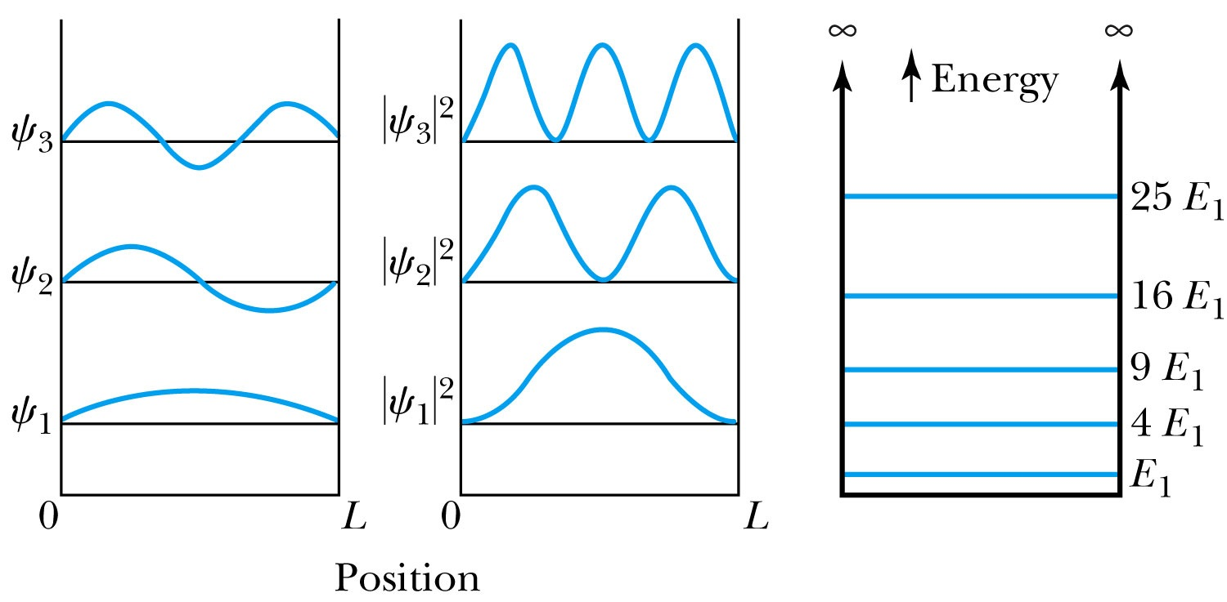
Quantized Energy
The quantized wave number now becomes
Solving for the energy yields
Note that the energy depends on the integer values of n. Hence the energy is quantized and nonzero.
The special case of n = 1 is called the ground state energy.

Slide 13
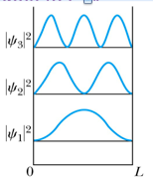
How does this correspond to Classical Mech.?
What is the probability of finding a particle in a box of length L?
Bohr’s correspondence principle says that QM and CM must correspond to each other! When?
  When n becomes large, the QM approaches to CM
So when n→∞, the probability of finding a particle in a box of length L is
Which is identical to the CM probability!!
One can also see this from the plot of P!

