Slide 1
PHYS 3313 – Section 001 Lecture #20
Monday, April 8, 2019
Dr. Jaehoon Yu
Finite Square-well Potential
Penetration Depth
3D Infinite Potential
Simple Harmonic Oscillator
Barriers and Tunneling
Alpha Particle Decay

Slide 2
Announcements
Bring out SP#6
Reminder: Homework #5
CH6 end of chapter problems: 34, 46 and 65
CH7 end of chapter problems: 7, 9, 17 and 29
Due Monday, Apr. 15
There will be a quiz coming Monday, Apr. 15
Beginning of the class
Covers: CH 6.2 to what we finish this Wednesday
BOYF: You may bring a one 8.5x11.5 sheet (front and back) of handwritten formulae and values of constants for the exam
No derivations, word definitions or setups or solutions of any problems!
No Maxwell’s equations!
No additional formulae or values of constants will be provided!

Slide 3
Reminder: Special Project #7
Show that the Schrodinger wave equation becomes Newton’s second law in the classical limit. (15 points)
Deadline Wednesday, Apr. 17
You MUST have your own answers!

Slide 4
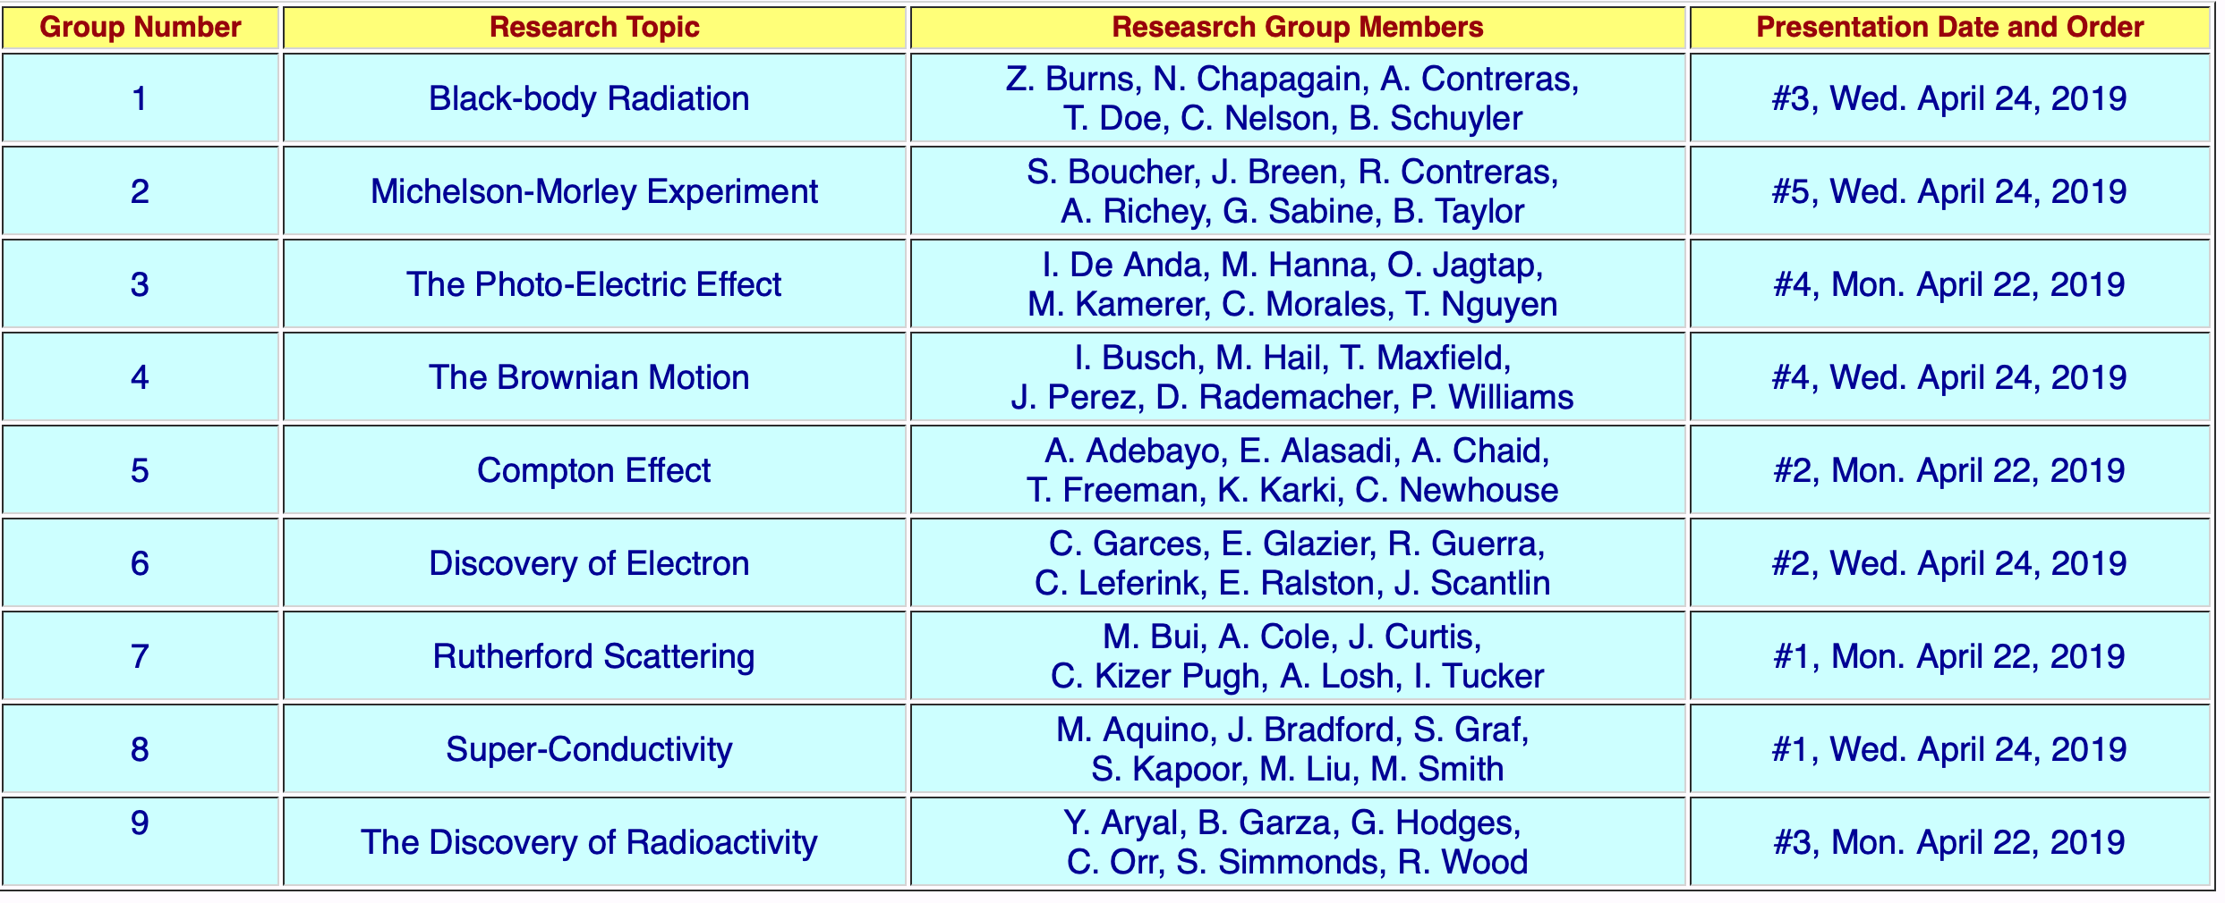
Research Projects
Each of the 9 research groups has an assigned research topic and the date and sequence of the presentations

Slide 5
Research Presentations
Each of the 9 research groups makes a 10+2min presentation
10min presentation + 2min Q&A
All presentations must be in power point
I must receive all final presentation files by 8pm, Sunday, Apr. 21, 2019
No changes are allowed afterward
The representative of the group makes the presentation followed by all group members’ participation in the Q&A session
Date and time:
In class Monday and Wednesday, Apr. 22 and 24, 2019
Important metrics
Contents of the presentation: 60%
Inclusion of all important points as mentioned in the report
The quality of the research and making the right points
Quality of the presentation itself: 15%
Presentation manner: 10%
Q&A handling: 10%
Staying in the allotted presentation time: 5%
Judging participation and sincerity: 5%

Slide 6
Expectation Values & Operators
Expectation value for any function g(x)
Position operator is the same as itself, x
Momentum Operator
Energy Operator

Slide 7
Ex 6.8: Expectation values inside a box
Determine the expectation values for x, x², p and p² of a particle in an infinite square well of width L for the first excited state.
What is the wave function of the first excited state?
n=?
2
See Appendix 3

Slide 8
Ex 6.9: Proton Transition Energy
A typical diameter of a nucleus is about 10⁻¹⁴m. Use the infinite square-well potential to calculate the transition energy from the first excited state to the ground state for a proton confined to the nucleus.
The energy of the state n is
What is n for the ground state?
n=1
What is n for the 1st excited state?
n=2
So the proton transition energy is

Slide 9
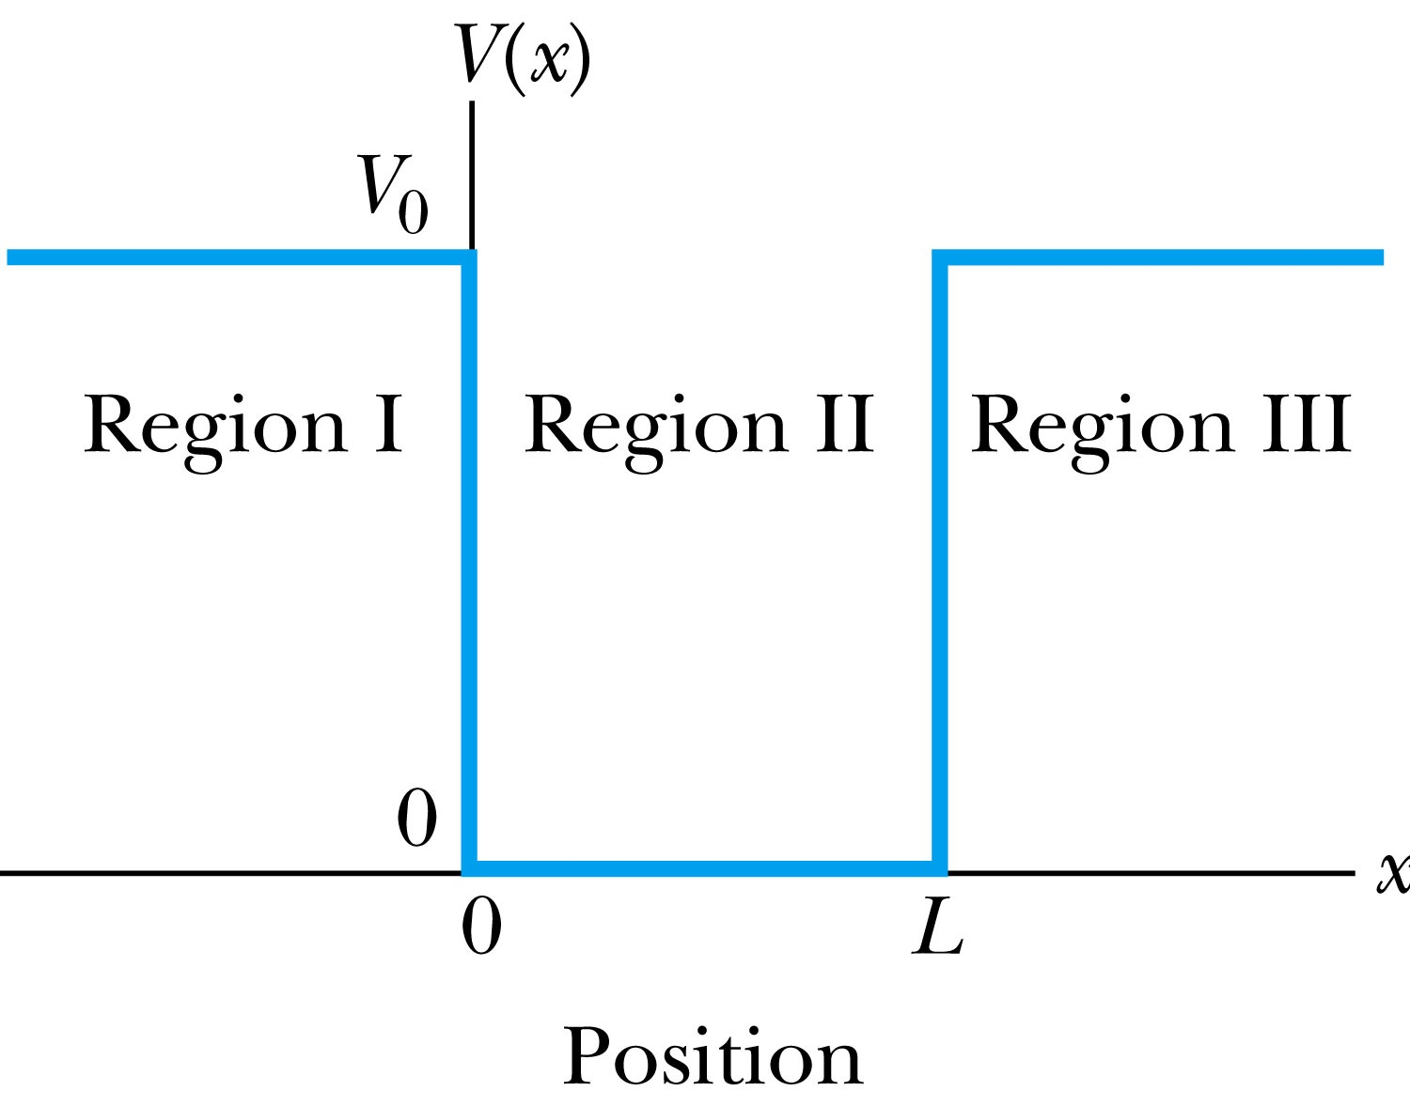
Finite Square-Well Potential
The finite square-well potential is
The Schrödinger equation outside the finite well in regions I and III is
for regions I and III, or using
yields . The solution to this differential eq. has exponentials of the form e^{αx} and e^{-αx}. In the region x > L, we reject the positive exponential and in the region x < 0, we reject the negative exponential. Why?
This is because the wave function should be 0 as x→±infinity.

Slide 10
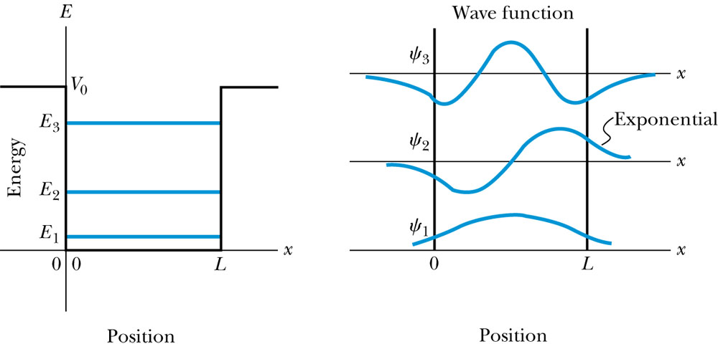
Finite Square-Well Solution
Inside the square well, where the potential V is zero and the particle is free, the wave equation becomes where
Instead of a sinusoidal solution we can write
The boundary conditions require that
and the wave function must be smooth where the regions meet.
Note that the wave function is nonzero outside of the box.
Non-zero at the boundary either..
What would the energy look like?

Slide 11
Penetration Depth
The penetration depth is the distance outside the potential well where the probability significantly decreases. It is given by
It should not be surprising to find that the penetration distance that violates classical physics is proportional to Planck’s constant.

Slide 12
Three-Dimensional Infinite-Potential Well
The wave function must be a function of all three spatial coordinates.
We begin with the conservation of energy
Multiply this by the wave function to get
Now consider momentum as an operator acting on the wave function. In this case, the operator must act twice on each dimension. Given:
The three dimensional Schrödinger wave equation is
Rewrite

Slide 13
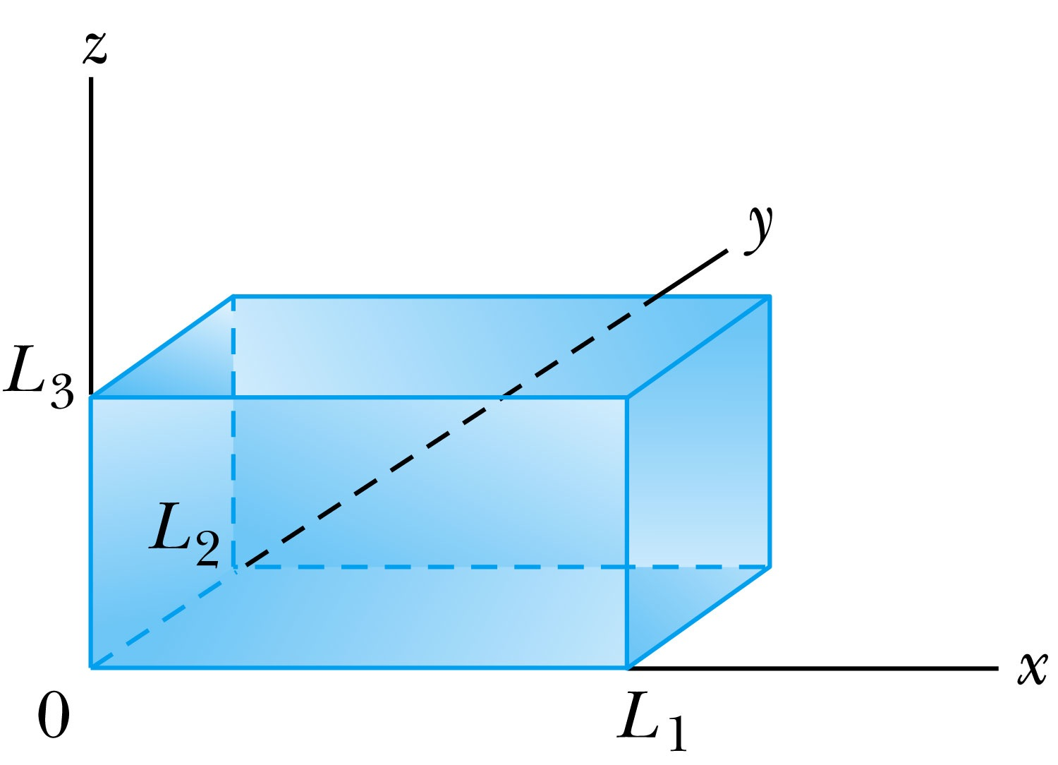
Ex 6.10: Expectation values inside a box
Consider a free particle inside a box with lengths L₁, L₂ and L₃ along the x, y, and z axes, respectively, as shown in the figure. The particle is constrained to be inside the box. Find the wave functions and energies. Then find the ground energy and wave function and the energy of the first excited state for a cube of sides L.
What are the boundary conditions for this situation?
Particle is free, so x, y and z wave functions are independent from each other!
Each wave function must be 0 at the wall!
Inside the box, potential V is 0.
A reasonable solution is
Using the boundary conditions
So the wave numbers are

Slide 14
Ex 6.10: Expectation values inside a box
Consider a free particle inside a box with lengths L₁, L₂ and L₃ along the x, y, and z axes, respectively, as shown in figure. The particle is constrained to be inside the box. Find the wave functions and energies. Then find the ground energy and wave function and the energy of the first excited state for a cube of sides L.
The energy can be obtained through the Schrödinger equation
What is the ground state energy?
E_{1,1,1} when n₁=n₂=n₃=1, how much?
When are the energies the same for different combinations of n_{i}?

Slide 15
Degeneracy*
Analysis of the Schrödinger wave equation in three dimensions introduces three quantum numbers that quantize the energy.
A quantum state is degenerate when there is more than one wave function for a given energy.
Degeneracy results from particular properties of the potential energy function that describes the system. A perturbation of the potential energy, such as the spin under a B field, can remove the degeneracy.
*Mirriam-webster: having two or more states or subdivisions

