Slide 1
PHYS 3313 – Section 001 Lecture #21
Wednesday, April 10, 2019
Dr. Jaehoon Yu
Simple Harmonic Oscillator
Reflection and Transmission
Barriers and Tunneling
Alpha Particle Decay
Schrodinger Equations applied on Hydrogen Atom

Slide 2
Announcements
Reminder: Homework #5
CH6 end of chapter problems: 34, 46 and 65
CH7 end of chapter problems: 7, 9, 17 and 29
Due Monday, Apr. 15
Quiz #4 coming Monday, Apr. 15
Beginning of the class; Covers CH6.2 to the end of CH 6
BYOF: You may bring a one 8.5x11.5 sheet (front and back) of handwritten formulae and values of constants for the exam
Quiz 3 results
Class average: 34.3/50
Equivalent to 68.6/100
Previous results: 37.2 and 56.2
Class top score: 50/50
Colloquium 4pm today in SH101
Dr. V. Chirayath of UTA

Slide 3
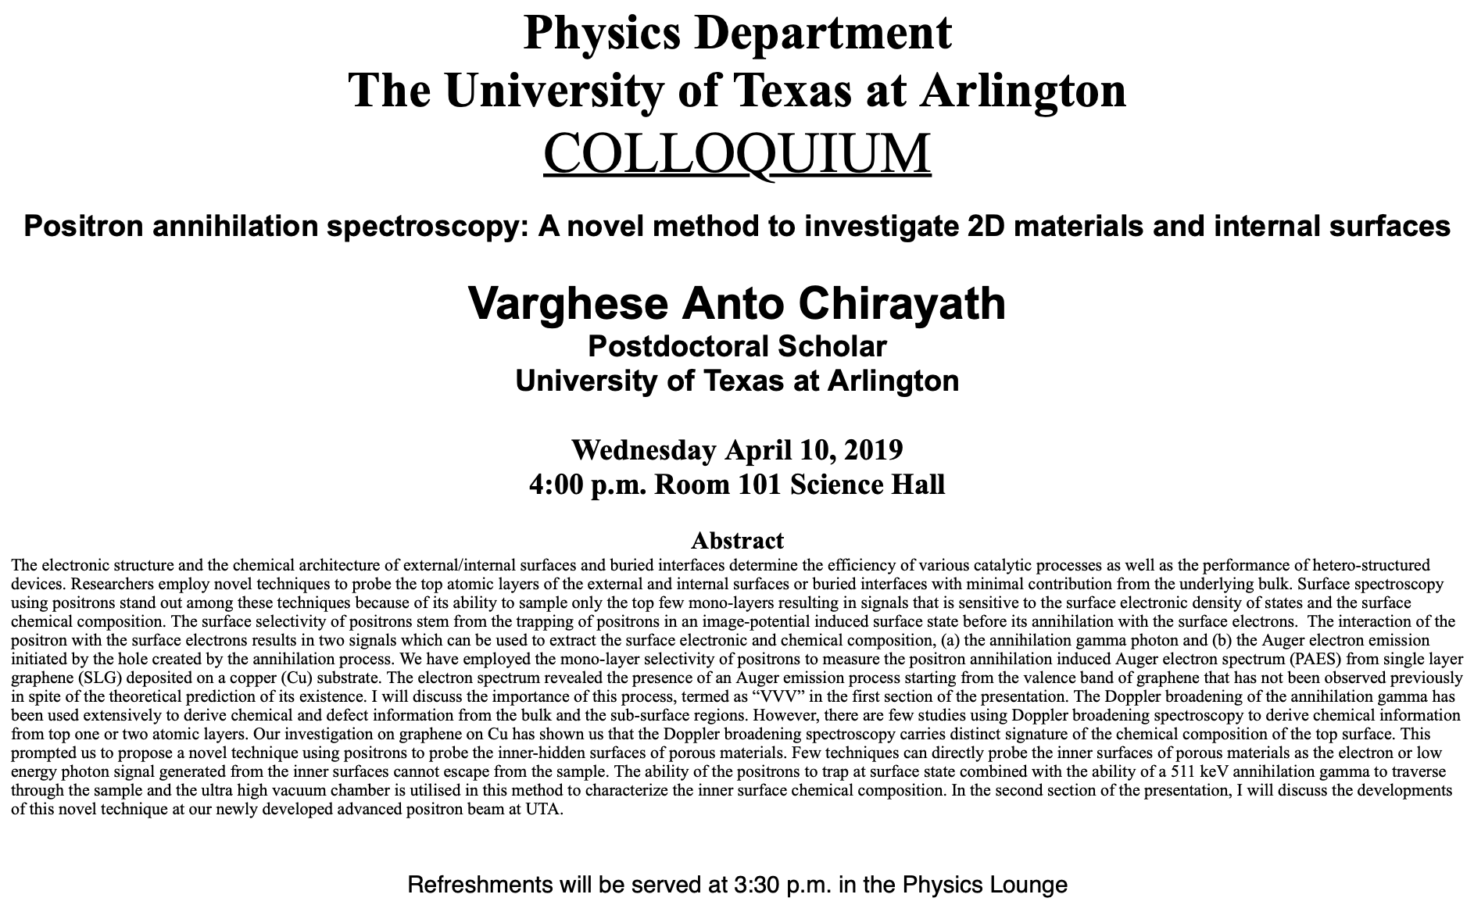

Slide 4
Reminder: Special Project #7
Show that the Schrodinger wave equation becomes Newton’s second law in the classical limit. (15 points)
Deadline Wednesday, Apr. 17
You MUST have your own answers!

Slide 5
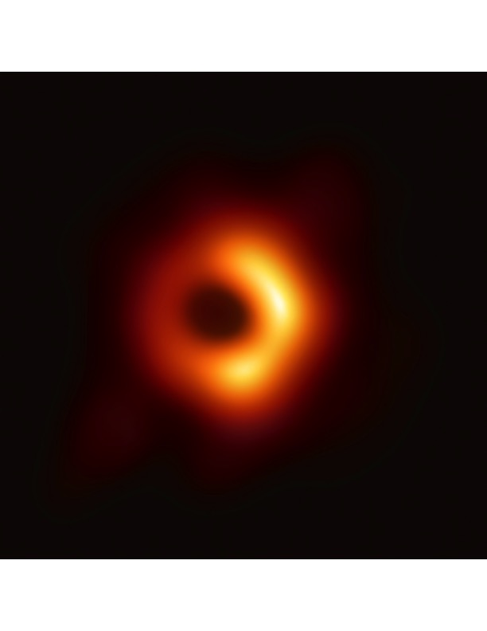
The Black Hole Observation
Announced today by the Event Horizon Telescope (EHT) Collaboration
First positive confirmation of the existence of the Black Hole predicted by Einstein’s general relativity in 1915

Slide 6
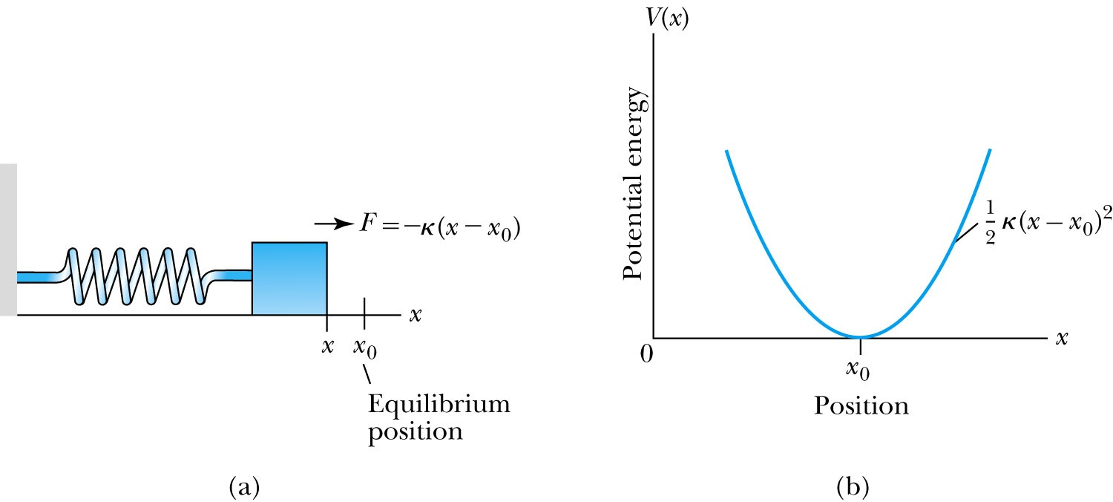
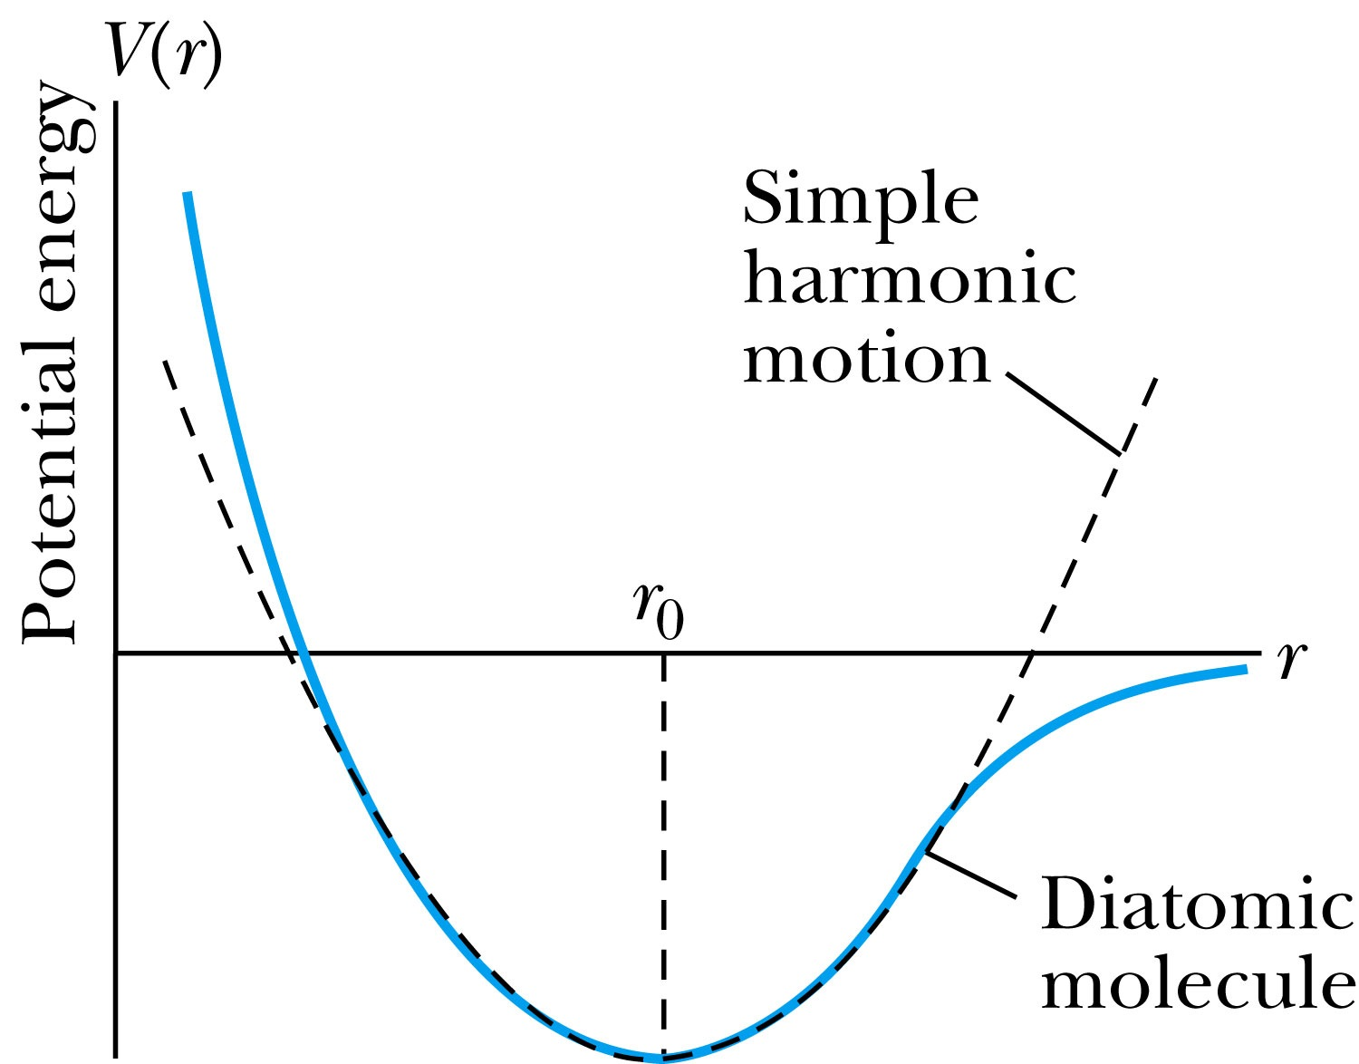
The Simple Harmonic Oscillator
Simple harmonic oscillators describe many physical situations: springs, diatomic molecules and atomic lattices.
Consider the Taylor expansion of a potential function:
The minimum potential at x=x₀, dV/dx=0 ➔ V₁=0 and the zero potential V₀=0, then we have the potential of the form
Substituting this into the wave equation (make x₀=0):
Let and which yields .

Slide 7
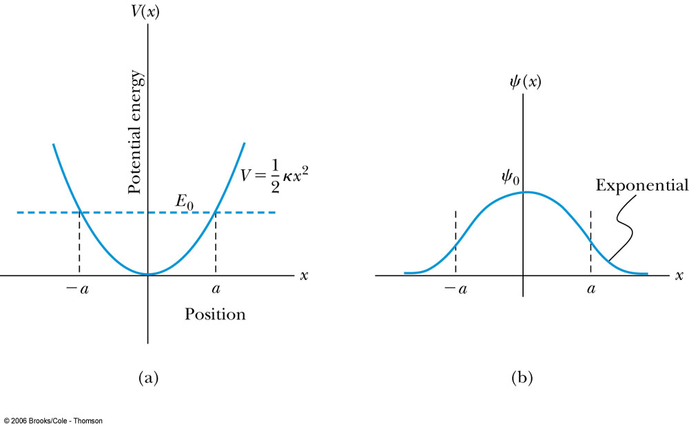
Parabolic Potential Well
If the lowest energy level is zero, this violates the uncertainty principle since both x and p must be 0 at the same time.➔ So E cannot be 0!
The wave function solutions are where H_{n}(x) are Hermite polynomial function of order n.
In contrast to the particle in a box, where the oscillatory wave function is a sinusoidal curve, in this case the oscillatory behavior is due to the polynomial (H_{n}) which dominates at small x. The exponential tail is provided by the Gaussian function, which dominates at large x.

Slide 8
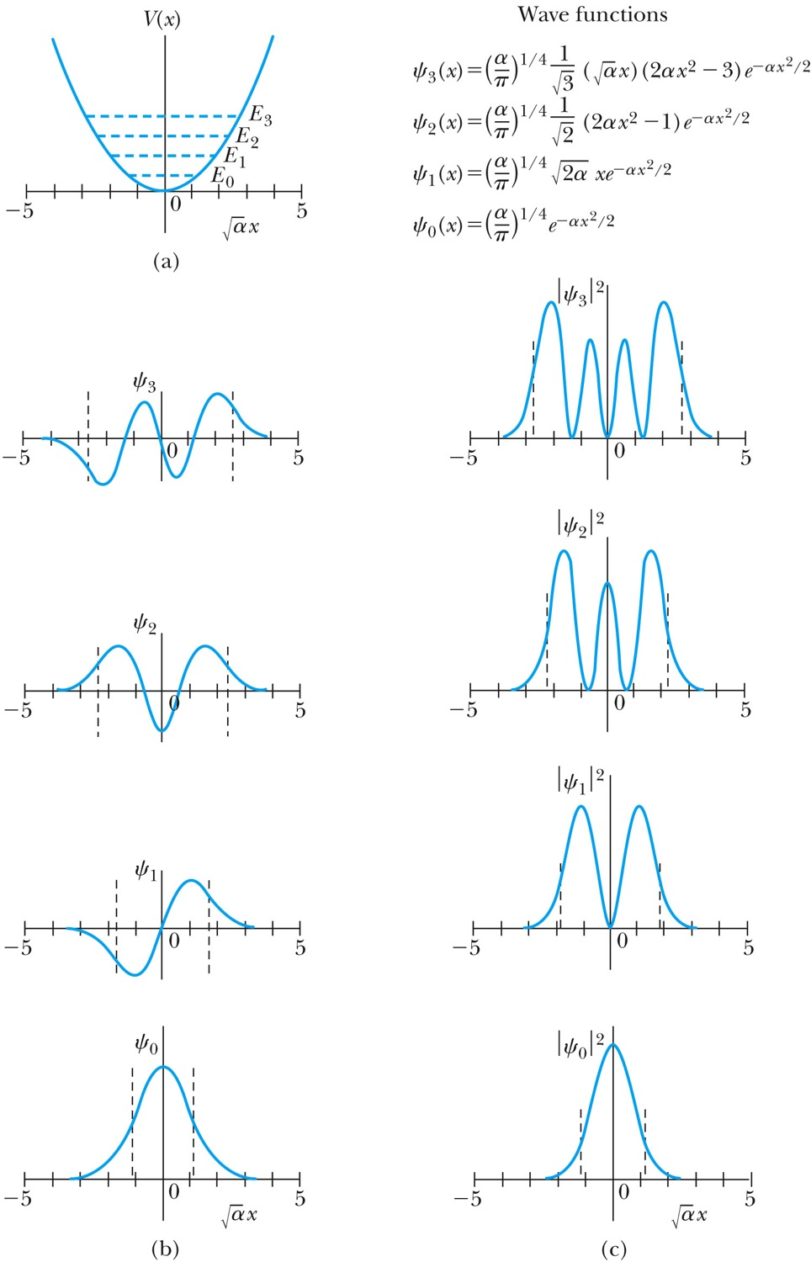
Analysis of the Parabolic Potential Well
The energy levels are given by
The zero point energy is called the Heisenberg limit:
Classically, the probability of finding the mass is greatest at the ends of motion’s range and smallest at the center (that is, proportional to the amount of time the mass spends at each position).
Contrary to the classical one, the largest probability for this lowest energy state is for the particle to be at the center.

Slide 9
Ex. 6.12: Harmonic Oscillator stuff
Normalize the ground state wave function ψ₀ for the simple harmonic oscillator and find the expectation values <x> and <x²>.

Slide 10
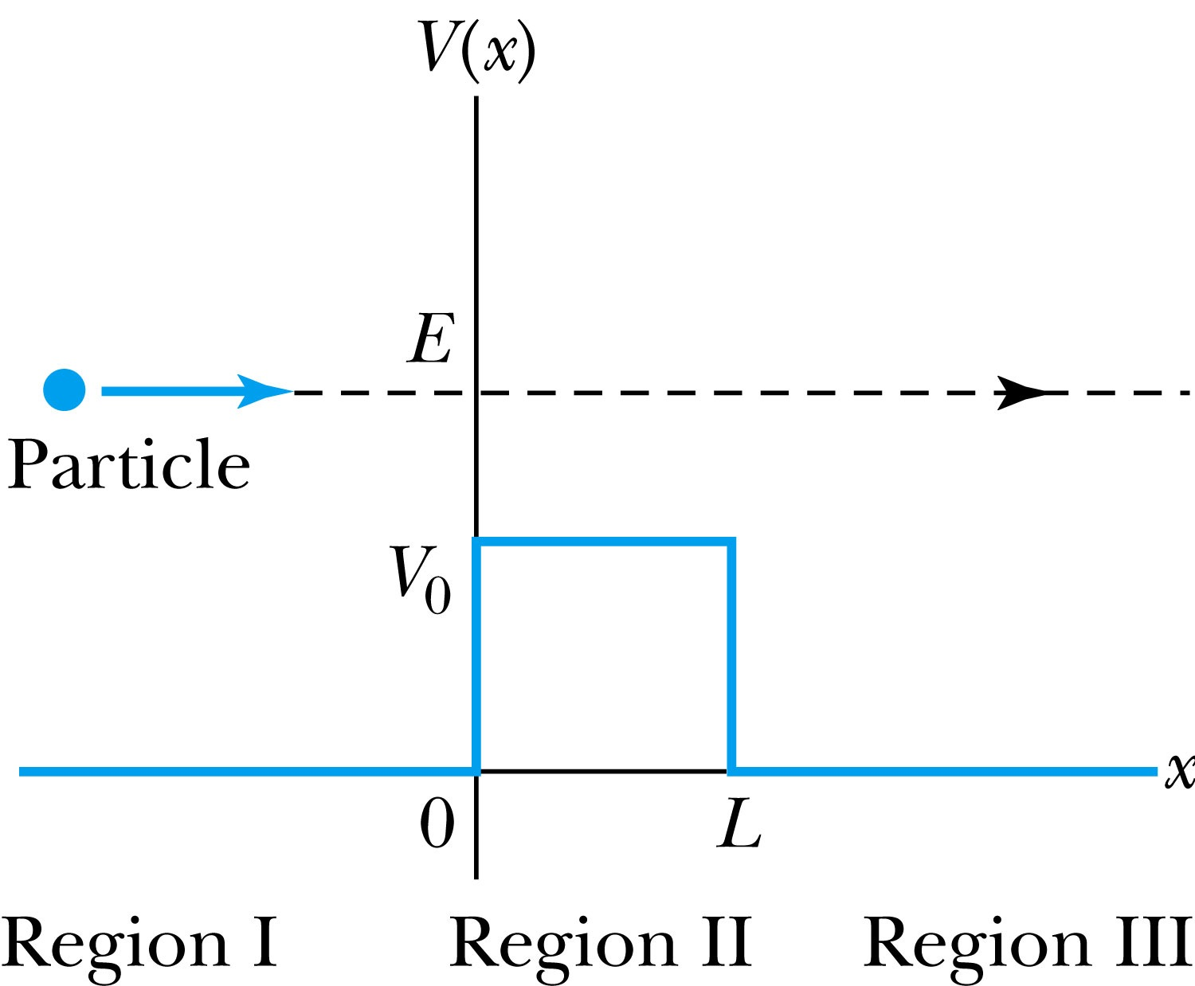
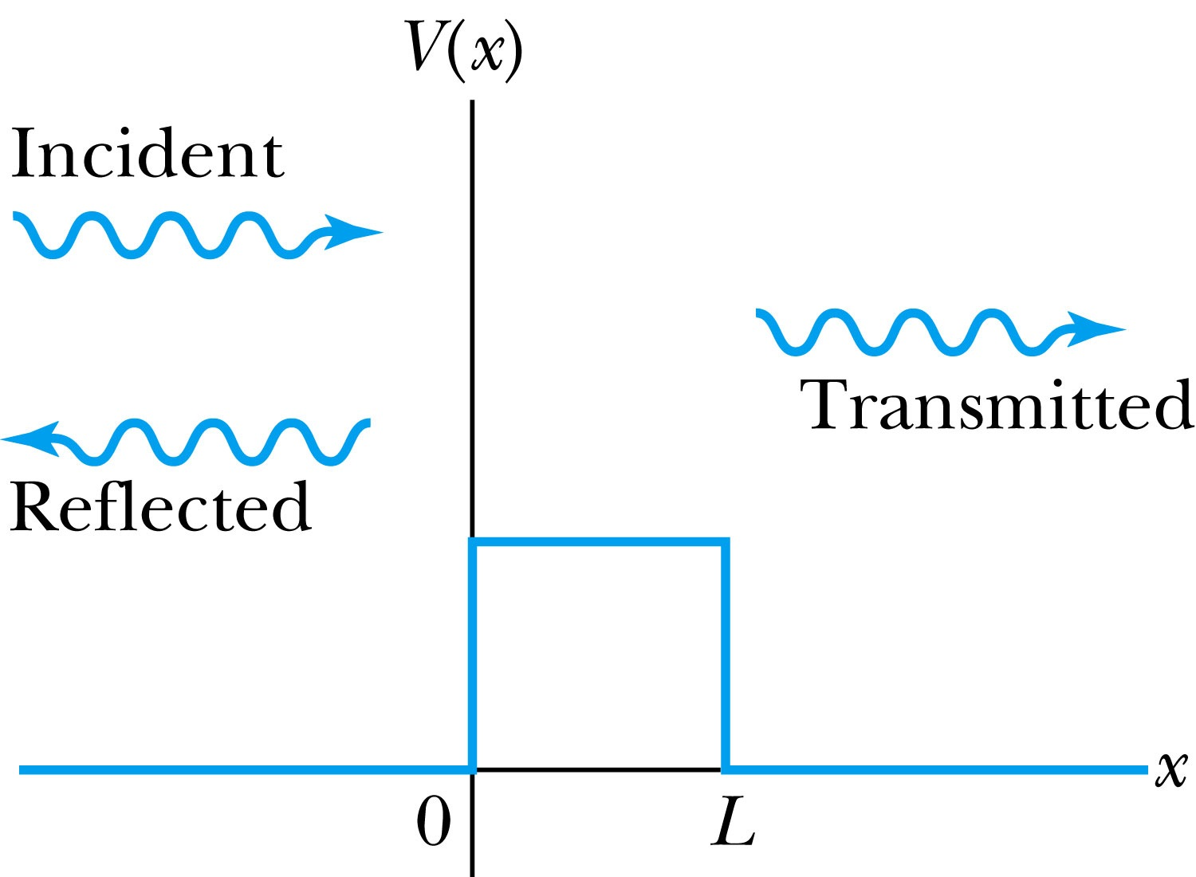
Barriers and Tunneling
Consider a particle of energy E approaching a potential barrier of height V₀ and the potential everywhere else is zero.
We will first consider the case when the energy is greater than the potential barrier.
In regions I and III the wave numbers are:
In the barrier region we have

Slide 11
Reflection and Transmission
The wave function will consist of an incident wave, a reflected wave, and a transmitted wave.
The potentials and the Schrödinger wave equation for the three regions are as follows:
The corresponding solutions are:
As the wave moves from left to right, we can simplify the wave functions to:

Slide 12
Probability of Reflection and Transmission
The probability of the particles being reflected R or transmitted T is:
The maximum kinetic energy of the photoelectrons depends on the value of the light frequency f and not on the intensity.
Because the particles must be either reflected or transmitted we have: R + T = 1
By applying the boundary conditions x → ±∞, x = 0, and x = L, we arrive at the transmission probability:
When does the transmission probability become 1?

Slide 13
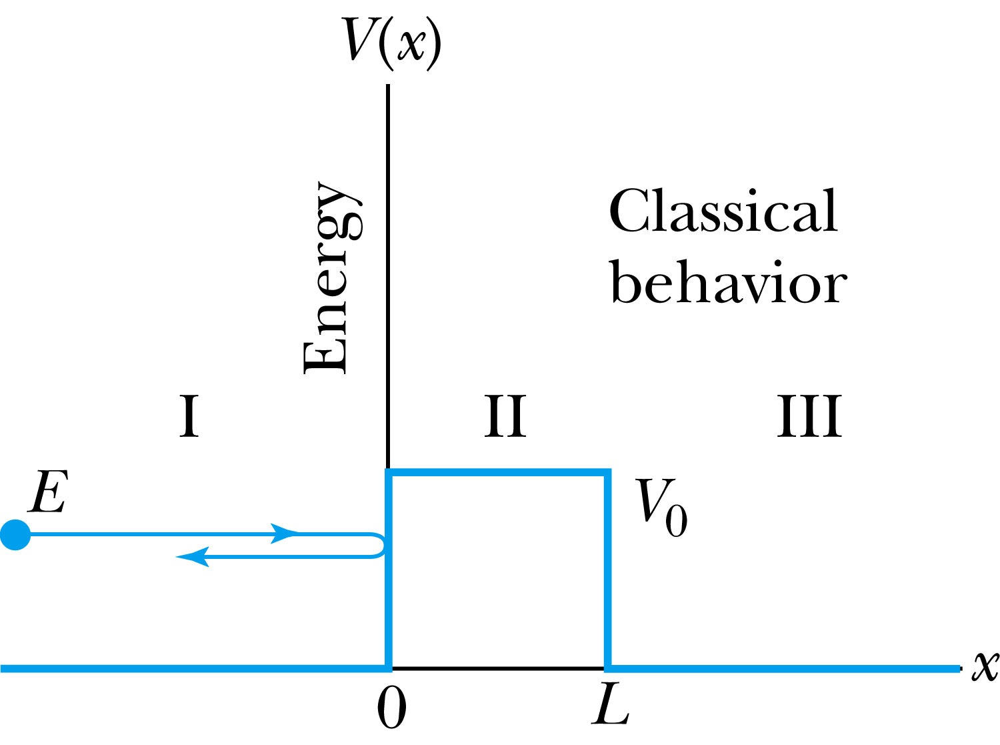
Tunneling
Now we consider the situation where classically the particle does not have enough energy to surmount the potential barrier, E < V₀.
The quantum mechanical result, however, is one of the most remarkable features of modern physics, and there is ample experimental proof of its existence. There is a small, but finite, probability that the particle can penetrate the barrier and even emerge on the other side.
The wave function in region II becomes
The transmission probability that describes the phenomenon of tunneling is

Slide 14
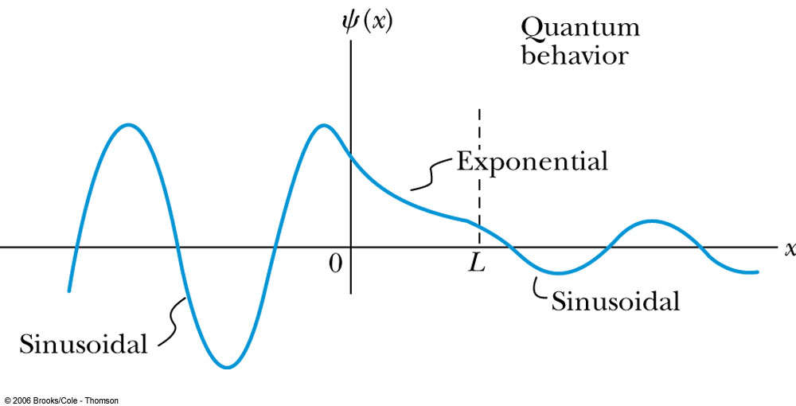
Uncertainty Explanation
Consider when κL >> 1 then the transmission probability becomes:
This violation allowed by the uncertainty principle is equal to the negative kinetic energy required! The particle is allowed by quantum mechanics and the uncertainty principle to penetrate into a classically forbidden region. The minimum such kinetic energy is:

Slide 15
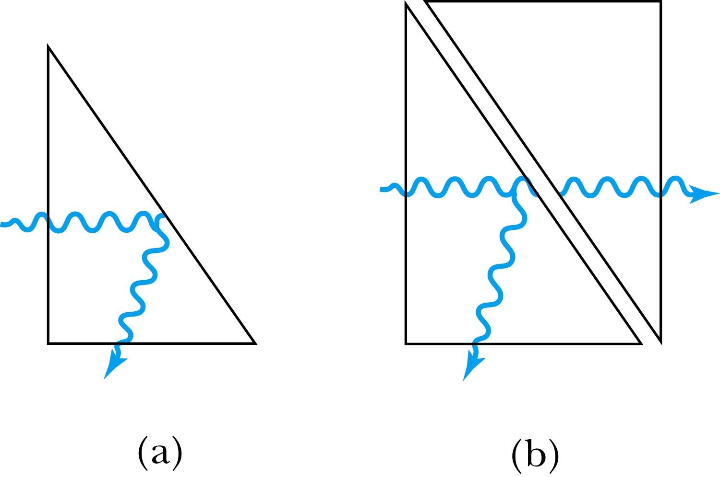
Analogy with Wave Optics
If light passing through a glass prism reflects from an internal surface with an angle greater than the critical angle, total internal reflection occurs. The electromagnetic field, however, is not exactly zero just outside the prism. Thus, if we bring another prism very close to the first one, experiments show that the electromagnetic wave (light) appears in the second prism.
The situation is analogous to the tunneling described here. This effect was observed by Newton and can be demonstrated with two prisms and a laser. The intensity of the second light beam decreases exponentially as the distance between the two prisms increases.

Slide 16
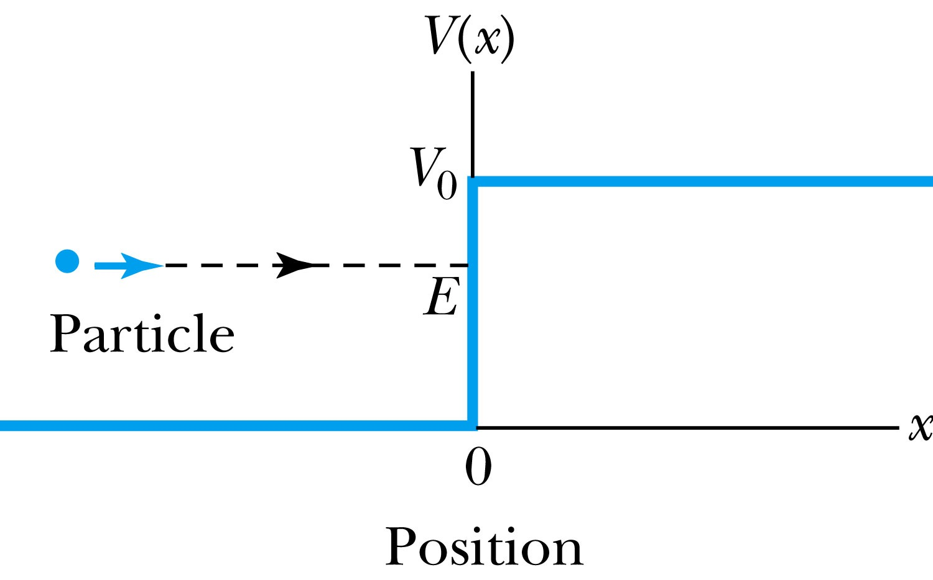
Potential Well
Consider a particle passing through a potential well region rather than through a potential barrier.
Classically, the particle would speed up passing the well region, because K = mv² / 2 = E - V₀.
According to quantum mechanics, reflection and transmission may occur, but the wavelength inside the potential well is shorter than outside. When the width of the potential well is precisely equal to half-integral or integral units of the wavelength, the reflected waves may be out of phase or in phase with the original wave, and cancellations or resonances may occur. The reflection/cancellation effects can lead to almost pure transmission or pure reflection for certain wavelengths. For example, at the second boundary (x = L) for a wave passing to the right, the wave may reflect and be out of phase with the incident wave. The effect would be a cancellation inside the well.

Slide 17
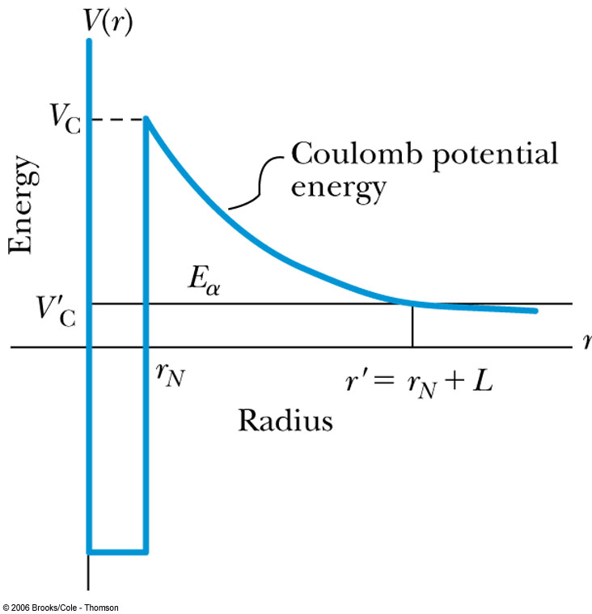
Alpha-Particle Decay
Many nuclei heavier than Pb emits alpha particles (nucleus of He)! The phenomenon of tunneling explains the alpha-particle decay of heavy, radioactive nuclei.
Inside the nucleus, an alpha particle feels the strong, short-range attractive nuclear force as well as the repulsive Coulomb force.
The nuclear force dominates inside the nuclear radius where the potential is approximately a square well.
The Coulomb force dominates outside the nuclear radius.
The potential barrier at the nuclear radius is several times greater than the energy of an alpha particle (~5MeV).
According to quantum mechanics, however, the alpha particle can “tunnel” through the barrier. Hence this is observed as radioactive decay.

