Slide 1
PHYS 3313 – Section 001
Lecture #23
Wednesday, April 17, 2019
Dr. Jaehoon Yu
Solution for Angular and Azimuthal Equations
Angular Momentum Quantum Numbers
Magnetic Quantum Numbers
Zeeman Effects
Intrinsic Spin

Slide 2
Announcements
Bring out SP#7
Reminder: Reading assignments
  CH7.2, CH7.6 and the entire CH8
Presentations coming Monday and Wednesday
Research presentation PPT files due 8pm, this Sunday, April 21
Research paper deadline is Wednesday, 4/24

Slide 3
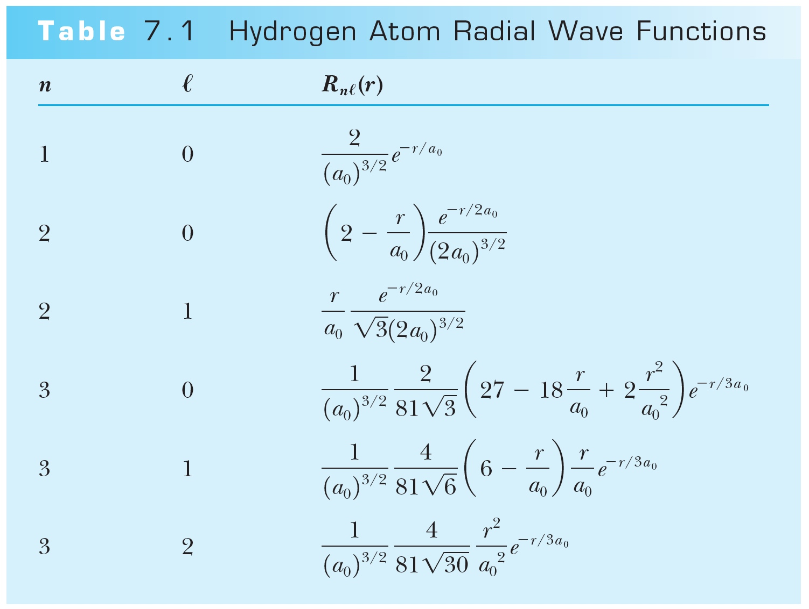
Hydrogen Atom Radial Wave Functions
The radial solution is specified by the values of n and ℓ
First few radial wave functions R_{nℓ}

Slide 4
Solution of the Angular and Azimuthal Equations
The solutions for azimuthal eq. are or
Solutions to the angular and azimuthal equations are linked because both have m_{ℓ}
Group these solutions together into functions
-------- angular equation
-------- azimuthal equation
---- spherical harmonics

Slide 5
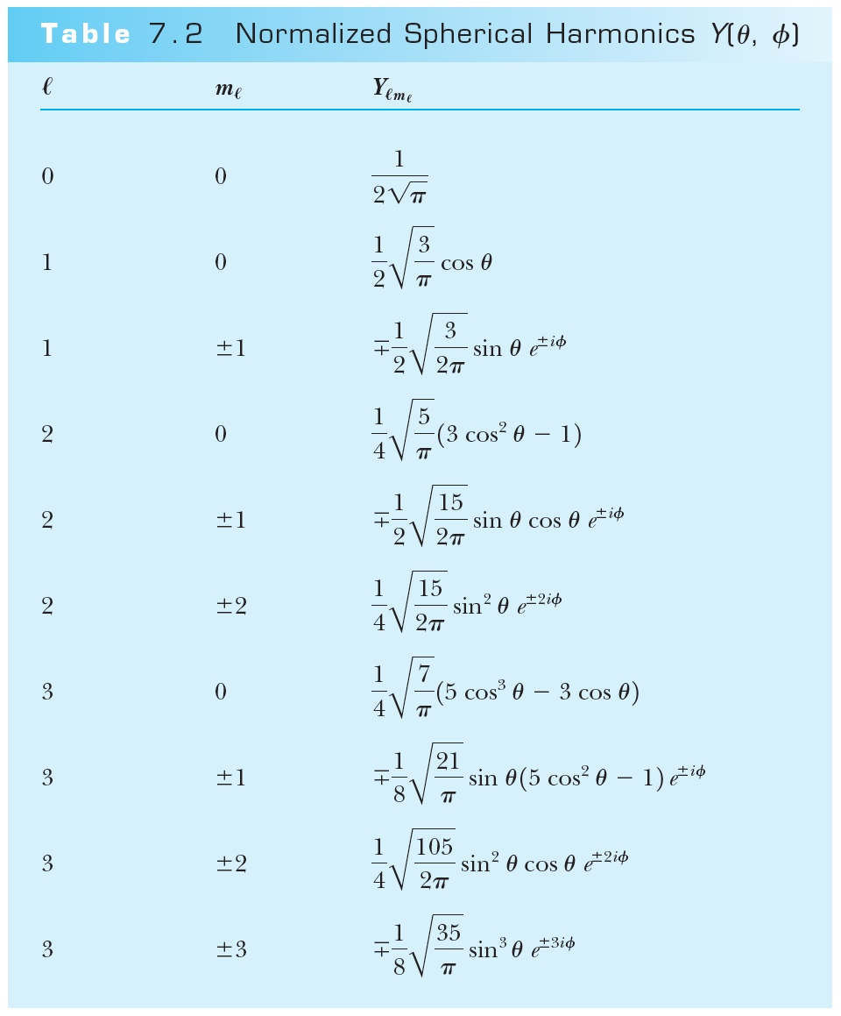
Normalized Spherical Harmonics

Slide 6
Ex 7.1: Spherical Harmonic Function
Show that the spherical harmonic function Y₁₁(θ,φ) satisfies the angular Schrodinger equation.

Slide 7
Solutions for the Angular and Azimuthal Equations
The radial wave function R and the spherical harmonics Y determine the probability density for the various quantum states.
Thus the total wave function ψ(r,θ,φ) depends on n, ℓ, and m_{ℓ}. The wave function can be written as

Slide 8
Orbital Angular Momentum Quantum Number ℓ
Orbital Angular Momentum Quantum Number ℓ is associated with the R(r) and f(θ) parts of the wave function.
Classically, the orbital angular momentum with L = mv_{orbital}r.
ℓ is related to the magnitude of L by .
In an ℓ = 0 state, .
It disagrees with Bohr’s semi-classical “planetary” model of electrons orbiting a nucleus L = nħ.

Slide 9
Orbital Angular Momentum Quantum Number ℓ
Certain energy level is degenerate with respect to ℓ when the energy is independent of ℓ.
Use letter names for the various ℓ values
  ℓ = 0 1 2 3 4 5 . . .
  Letter = s p d f g h . . .
Atomic states are referred by their n and ℓ
  s=sharp, p=principal, d=diffuse, f =fundamental, then in alphabetical order afterward
A state with n = 2 and ℓ = 1 is called the 2p state
  Is 2d state possible?
The boundary conditions require n > ℓ

Slide 10
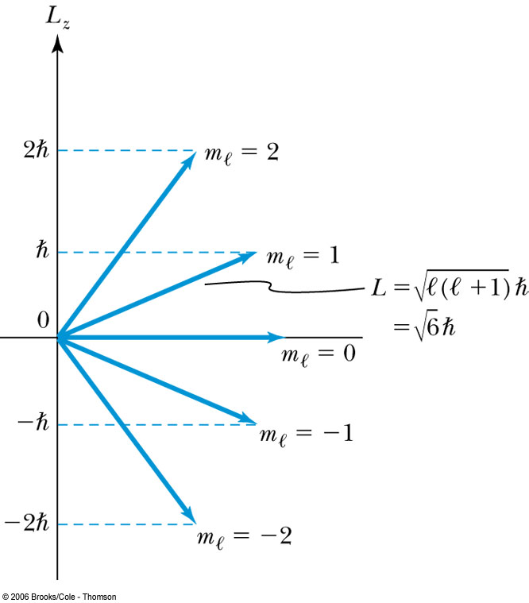
Magnetic Quantum Number m_{ℓ}
The angle φ is a measure of the rotation about the z axis.
The solution for specifies that m_{ℓ} is an integer and related to the z component of L.
The relationship of L, L_{z}, ℓ, and m_{ℓ} for ℓ = 2.
is fixed.
Because L_{z} is quantized, only certain orientations of are possible and this is called space quantization.
m_{ℓ} is called the magnetic moment since z axis is chosen customarily along the direction of magnetic field.

Slide 11
Magnetic Quantum Number m_{ℓ}
Quantum mechanics allows to be quantized along only one direction in space and because of the relationship L² = L_{x}² + L_{y}² + L_{z}², once a second component is known, the third component will also be known. ➔ violation of uncertainty principle
  One of the three components, such as L_{z}, can be known clearly but the other components will not be precisely known
Now, since we know there is no preferred direction,
We expect the average of the angular momentum components squared to be:

Slide 12
Magnetic Effects on Atomic Spectra—The Normal Zeeman Effect
A Dutch physicist Pieter Zeeman showed as early as 1896 that the spectral lines emitted by atoms in a magnetic field split into multiple energy levels. It is called the Zeeman effect.
The Normal Zeeman effect:
A spectral line of an atom is split into three lines.
Consider the atom to behave like a small magnet.
The current loop has a magnetic moment μ = IA and the period T = 2πr / v. If an electron can be considered as orbiting a circular current loop of I = dq / dt around the nucleus, we obtain
where L = mvr is the magnitude of the orbital
angular momentum

Slide 13
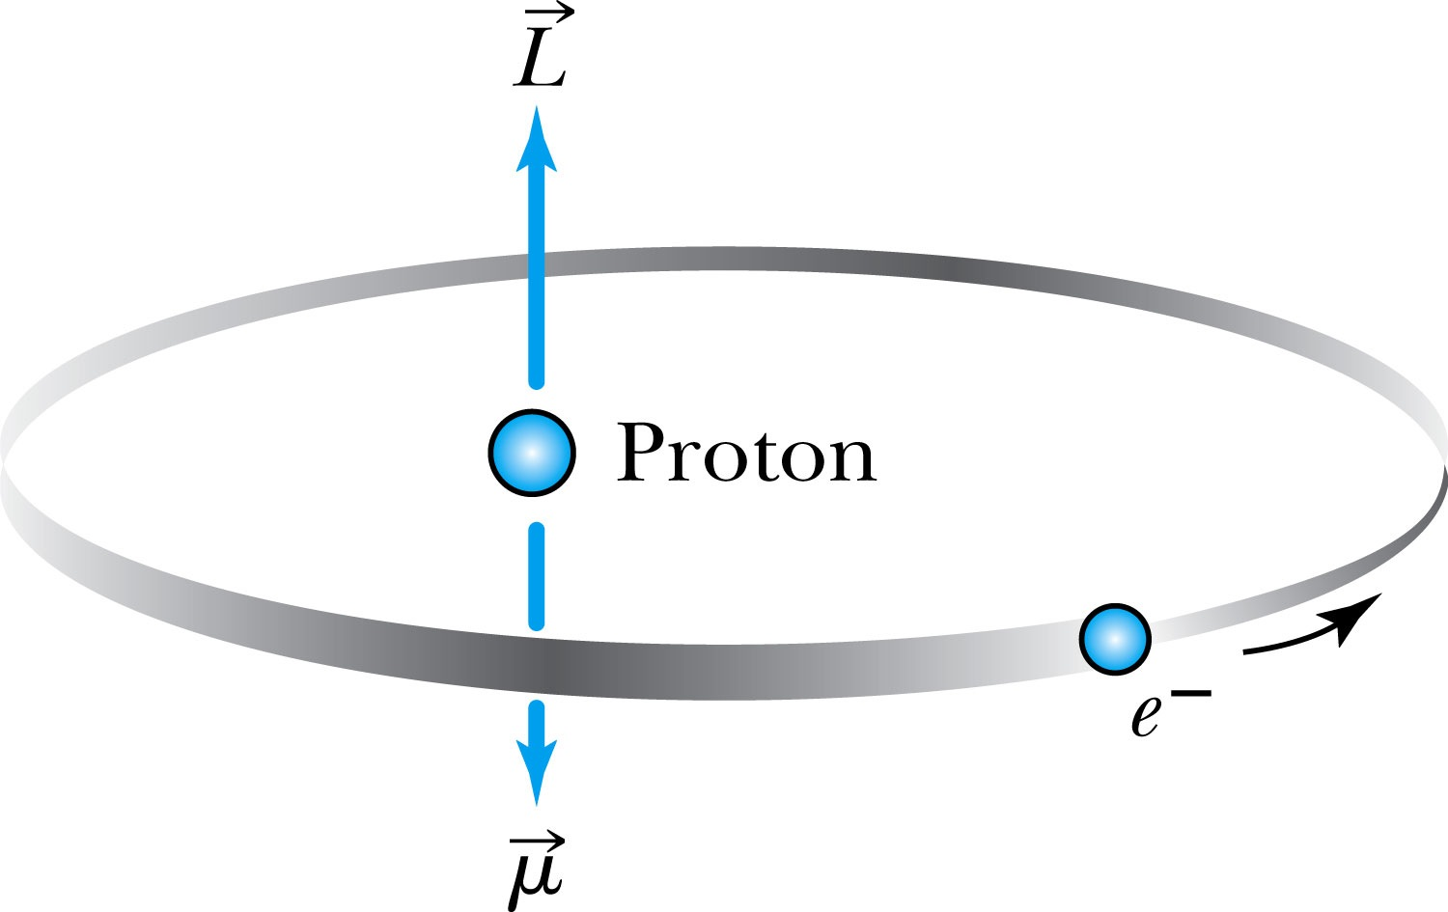
The Normal Zeeman Effect
In the absence of an external magnetic field to align them, points random directions.
The dipole has a potential energy
The angular momentum is aligned with the magnetic moment, and the torque between and causes a precession of .
Where μ_{B} = eħ / 2m is called the Bohr magneton.
cannot align exactly in the z direction and
has only certain allowed quantized orientations.

Slide 14
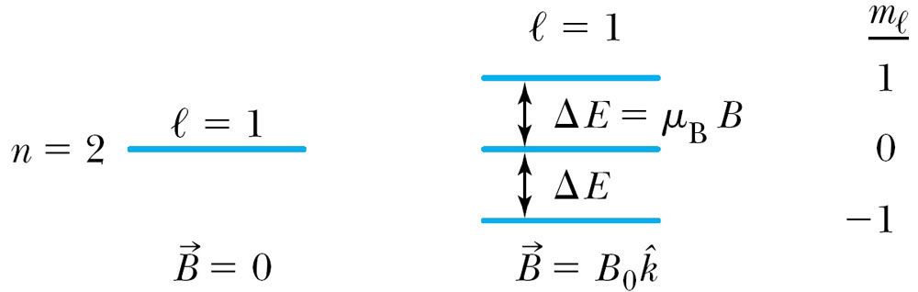
The Normal Zeeman Effect
The potential energy is quantized due to the magnetic quantum number m_{ℓ}.
When a magnetic field is applied, the 2p level of atomic hydrogen is split into three different energy states with the electron energy difference of ΔE = μ_{B}B Δm_{ℓ}.
So split is into a total of 2ℓ+1 energy states
m_{ℓ} | Energy
1 | E₀ + μ_{B}B
0 | E₀
−1 | E₀ − μ_{B}B

Slide 15
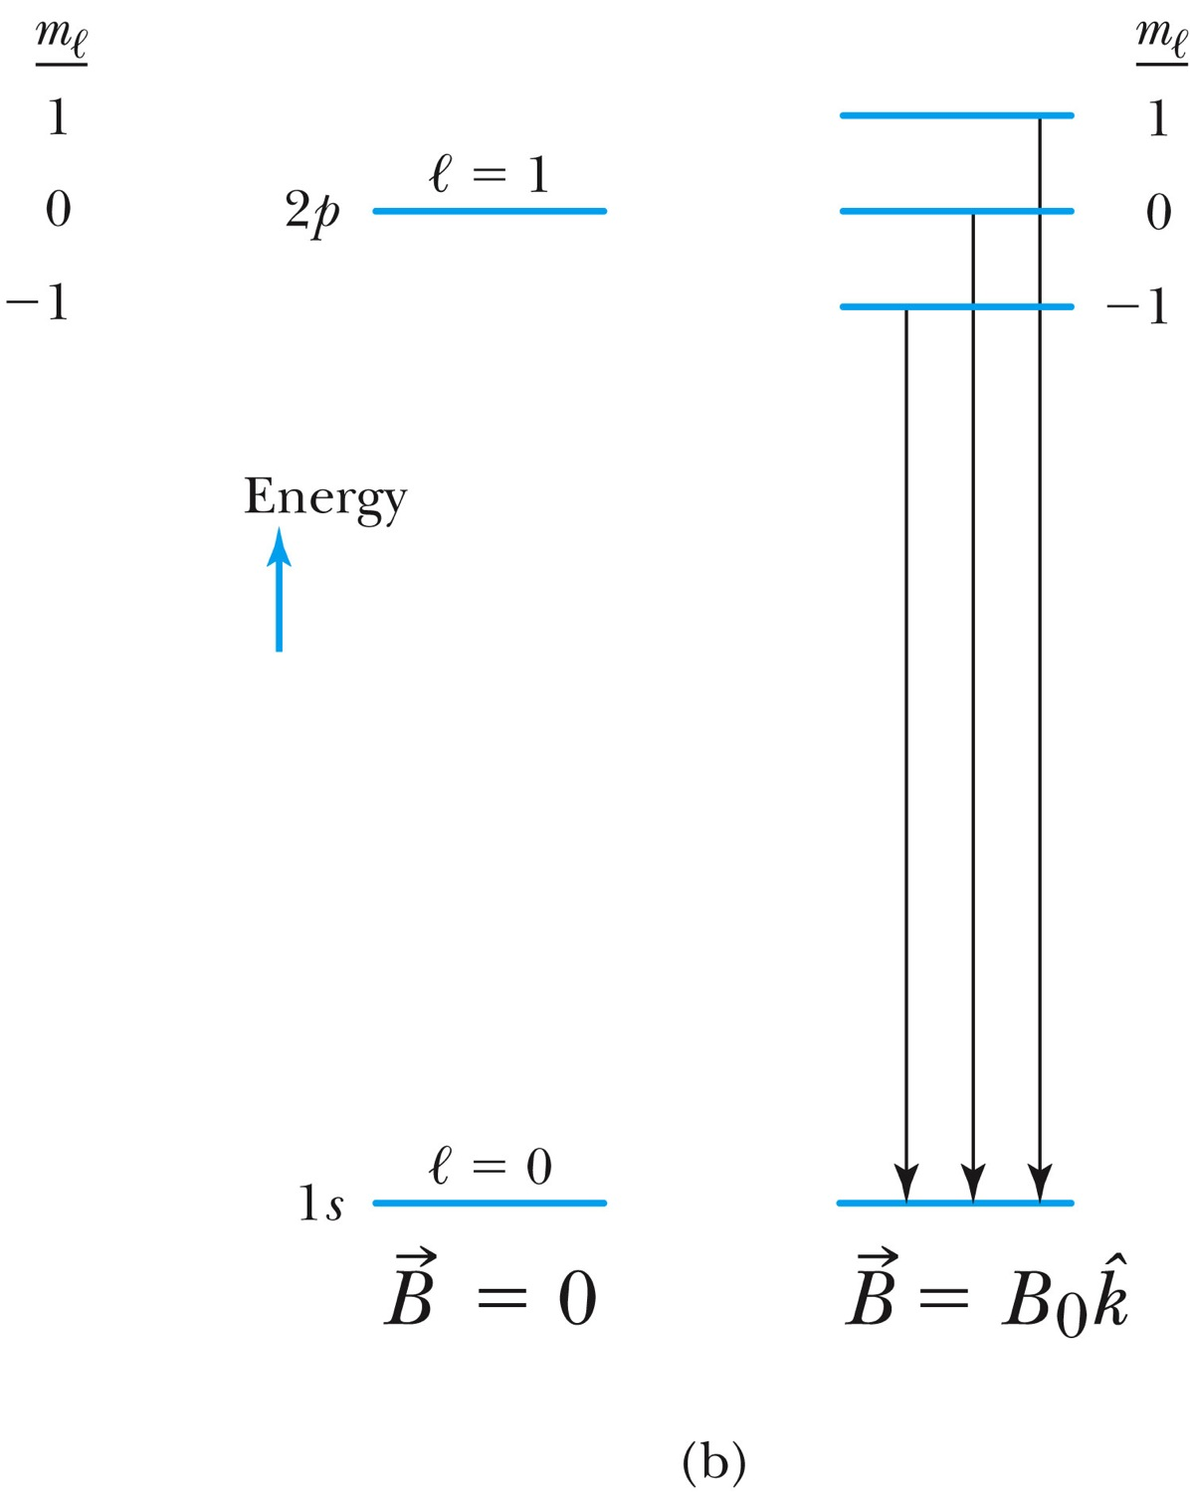
The Normal Zeeman Effect
A transition from 1s to 2p
A transition from 2p to 1s

Slide 16
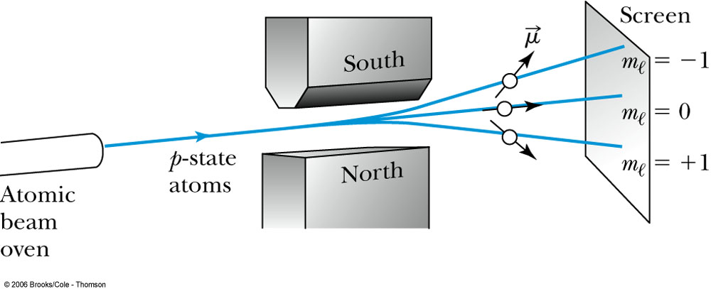
The Normal Zeeman Effect
An atomic beam of particles in the ℓ = 1 state pass through a magnetic field along the z direction. (Stern-Gerlach experiment)
The m_{ℓ} = +1 state will be deflected down, the m_{ℓ} = −1 state up, and the m_{ℓ} = 0 state will be undeflected. ➔ saw only 2 with silver atom
If the space quantization were due to the magnetic quantum number m_{ℓ}, the number of m_{ℓ} states is always odd at (2ℓ + 1) and should have produced an odd number of lines.

Slide 17
Intrinsic Spin
In 1920, to explain spectral line splitting of Stern-Gerlach experiment, Wolfgang Pauli proposed the forth quantum number assigned to electrons
In 1925, Samuel Goudsmit and George Uhlenbeck (graduate students!!) in Holland proposed that the electron must have an intrinsic angular momentum and therefore a magnetic moment.
Paul Ehrenfest showed that the surface of the spinning electron should be moving faster than the speed of light to obtain the needed angular momentum!!
In order to explain experimental data, Goudsmit and Uhlenbeck proposed that the electron must have an intrinsic spin quantum number s = ½.

Slide 18
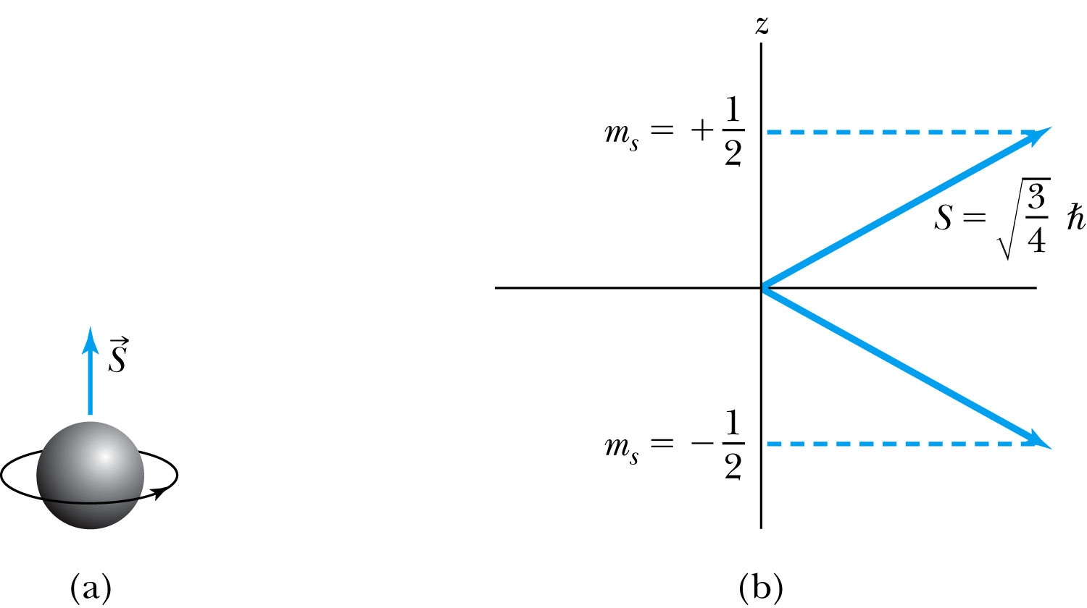
Intrinsic Spin
The spinning electron reacts similarly to the orbiting electron in a magnetic field. (Dirac showed that this is necessary due to special relativity.)
We should try to find L, L_{z}, ℓ, and m_{ℓ}.
The magnetic spin quantum number m_{s} has only two values, m_{s} = ±½.
The electron’s spin will be either “up” or “down” and can never be spinning with its magnetic moment μ_{s} exactly along the z axis.
For each state of the other quantum numbers, there are two spin values
The intrinsic spin angular momentum vector .

Slide 19
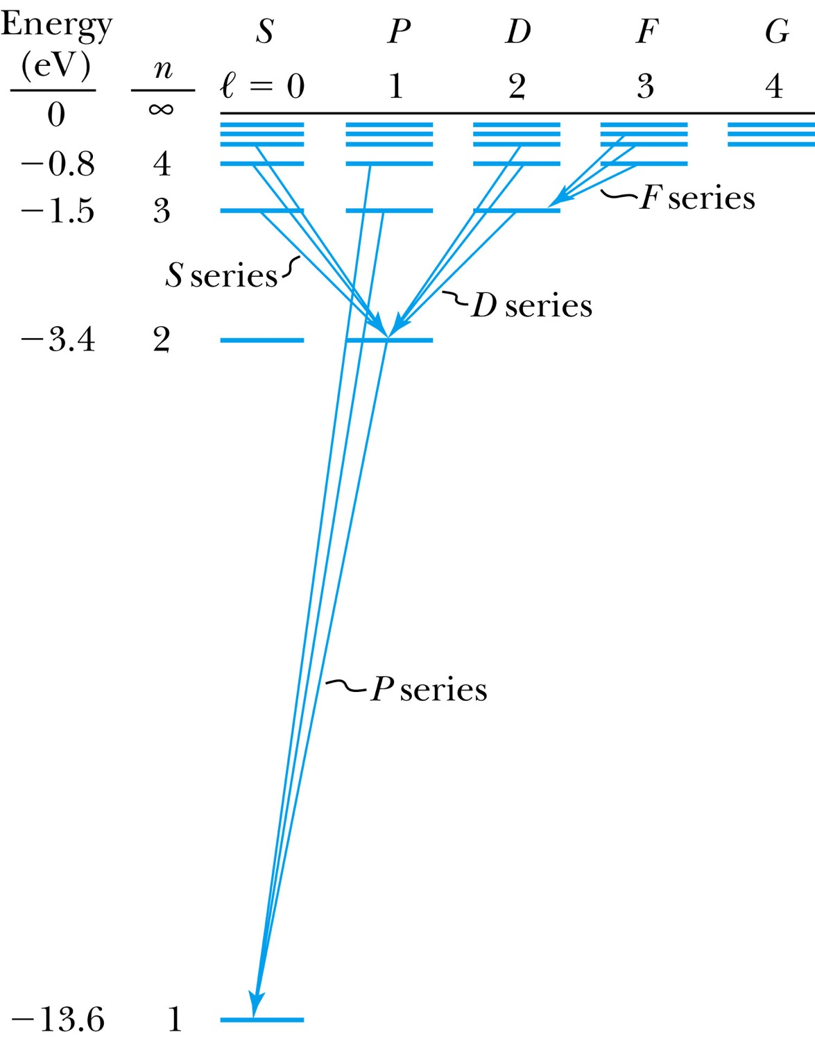
Energy Levels and Electron Probabilities
For hydrogen, the energy level depends on the principle quantum number n.
In ground state an atom cannot emit radiation. It can absorb electromagnetic radiation, or gain energy through inelastic bombardment by particles.

Slide 20
Selection Rules
We can use the wave functions to calculate transition probabilities for the electron to change from one state to another.
Allowed transitions: Electrons absorbing or emitting photons can change states when Δℓ = ±1. (Evidence for the photon carrying one unit of angular momentum!)
Δn=anything
Δℓ = ±1
Δm_{ℓ} = 0, ±1
Forbidden transitions: Other transitions possible but occur with much smaller probabilities when Δℓ ≠ ±1.

