Slide 1
PHYS 3313 – Section 001
Lecture #26
Monday, April 29, 2019
Dr. Jaehoon Yu
Introduction to Particle Physics
Elementary Particles and Their Interactions
The Standard Model of Particle Physics
Particle Accelerators
Particle Detectors
Hot Issues in Physics Frontier
Where Does the Future Lie?

Slide 2
Announcements
Final exam is 11am – 1:30pm, Friday, May 10
  Location: CRB114
  Comprehensive exam covering from CH1 – CH8 + what we’ve learned today (some in CH14) + appendices 3 – 7
  Bring your calculator but DO NOT input formula into it!
  BYOF: You can prepare a one 8.5x11.5 sheet (front and back) of handwritten formulae and values of constants for the exam
    No additional formulae or values of constants will be provided!
    No Maxwell’s equations allowed!
Planetarium extra credit
  Tape one side of your ticket stubs on a sheet of paper with your name on it
  Submit the sheet in the morning of May 10

Slide 3
Introduction to Particle Physics
What are the elementary particles?
  Particles that make up all matters in the universe
What are the requirements for elementary particles?
  Cannot be broken into smaller pieces
  Cannot have sizes
The notion of “elementary particles” have changed from early 1900’s through present
  In the past, people thought protons, neutrons, pions, kaons, ρ-mesons, etc, as elementary particles
Why?
  Due to the increasing energies of accelerators that allowed us to probe smaller distance scales
What is the energy needed to probe 0.1–fm?
  From de Broglie Wavelength, we obtain

Slide 4
Interaction Time
The ranges of forces also affect interaction time
  Typical time for Strong interaction ~10⁻²⁴sec
    What is this time scale?
    A time that takes light to traverse the size of a proton (~1 fm)
  Typical time for EM force ~10⁻²⁰ – 10⁻¹⁶ sec
  Typical time for Weak force ~10⁻¹³ – 10⁻⁶ sec
In GeV energy scale, the four forces (now three since EM and Weak forces are unified!) are different
These are used to classify elementary particles

Slide 5
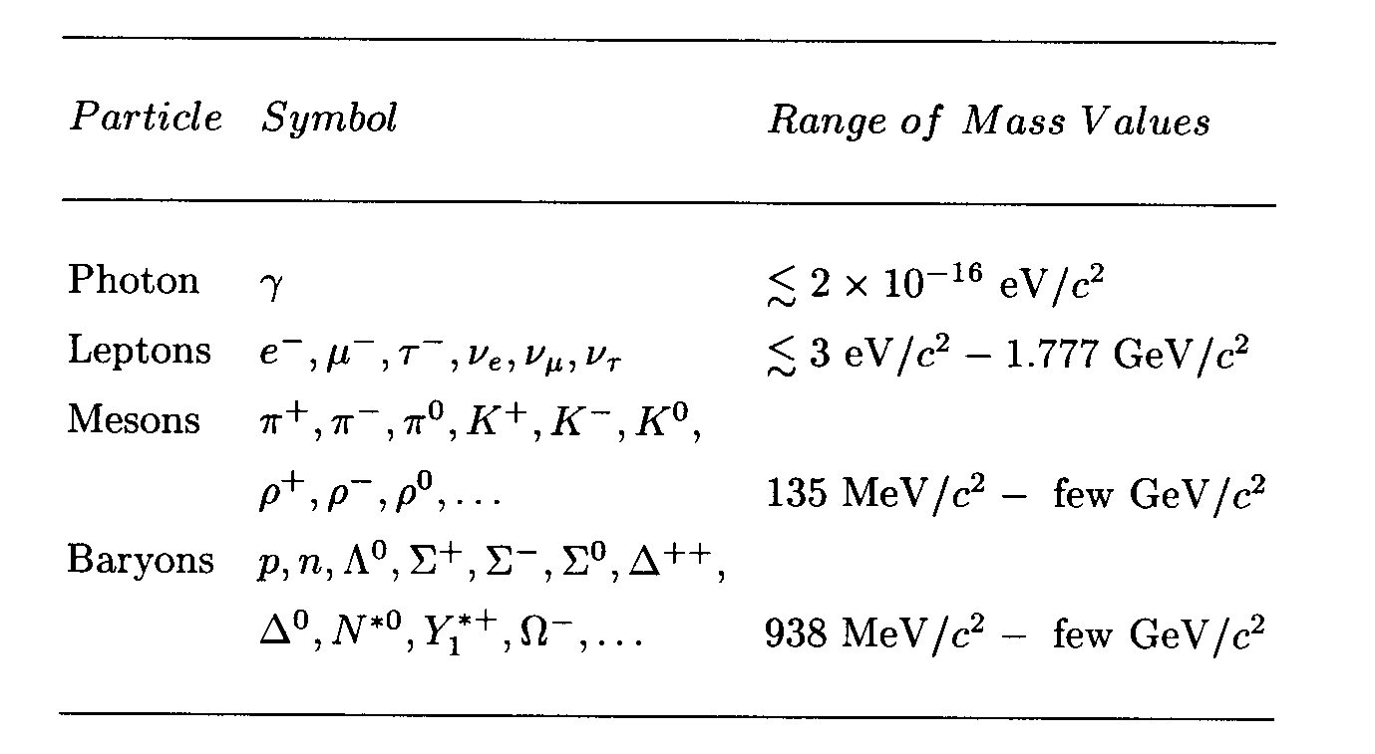
Elementary Particles
Before the quark concept in the 70’s, all known elementary particles were grouped in four depending on the nature of their interactions
Hadrons {

Slide 6
Elementary Particle Interactions
How do the elementary particles interact??
  All particles, including photons and neutrinos, participate in gravitational interactions
  Photons can interact electromagnetically with any particles with electric charge
  All charged leptons participate in both EM and weak interactions
  Neutral leptons do not have EM couplings
  All hadrons (Mesons and baryons) respond to the strong force and appears to participate in all interactions

Slide 7
Bosons, Fermions, Particles and Antiparticles
Bosons
  All have integer spin angular momentum, follow BE statistics
  All mesons (consists of two quarks) are bosons
Fermions
  All have half integer spin angular momentum follow FD statistics
  All leptons and baryons (consist of three quarks) are fermions
All particles have anti-particles
  What are anti-particles?
    Particles that have the same mass as particles but with opposite quantum numbers
  What is the anti-particle of
    A π⁰?
    A neutron?
    A K⁰?
    A Neutrino?

Slide 8
Allowed Interactions
When can an interaction occur?
  If it is kinematically allowed
  If it does not violate any recognized conservation laws
    Eg. A reaction that violates charge conservation will not occur
  In order to deduce conservation laws, a full theoretical understanding of forces are necessary
Since we do not have full theory for all the forces
  Many of general conservation rules for particles are based on experiments (or empirical)
One of the clearest conservation is the lepton number conservation
  While photon and meson numbers are not conserved

Slide 9
The Standard Model of Particle Physics
In late 60’s, Jerome Friedman, Henry Kendall and Rich Taylor designed an experiment with electron beam scattering off of hadrons and deuterium at SLAC (Stanford Linear Accelerator Center)
  Data could be easily understood if protons and neutrons are composed of point-like objects with charges -1/3e and +2/3e.
  A point-like electrons scattering off of point-like quark partons inside the nucleons and hadrons
    Corresponds to modern day Rutherford scattering
    Higher energies of the incident electrons could break apart the target particles, revealing the internal structure

Slide 10
The Standard Model of Particle Physics
By early 70’s, it was clear that hadrons (baryons and mesons) are not fundamental point-like objects
But leptons did not show any evidence of internal structure
  Even at high energies they still do not show any structure
  Can be regarded as elementary particles
The phenomenological understanding along with observations from electron scattering (Deep Inelastic Scattering, DIS) and the quark model
Resulted in the Standard Model that can describe three of the four known forces along with quarks, leptons and gauge bosons as the fundamental particles

Slide 11
Quarks and Leptons
In SM, there are three families of leptons
  ➔ Increasing order of lepton masses
And three families of quark constituents
All these fundamental particles are fermions w/ spin
Q
0
-1
Q
+2/3
-1/3

Slide 12
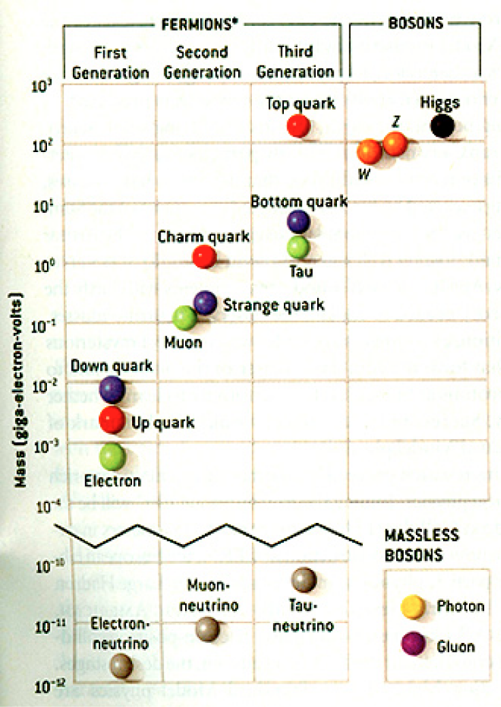
HEP and the Standard Model
Discovered in 1995, ~175m_{p}
Make up most ordinary matters ~0.1m_{p}
Total of 16 particles (12+4 force mediators) make up all the visible matter in the universe! ➔ Simple and elegant!!!
Tested to a precision of 1 part per million!

Slide 13
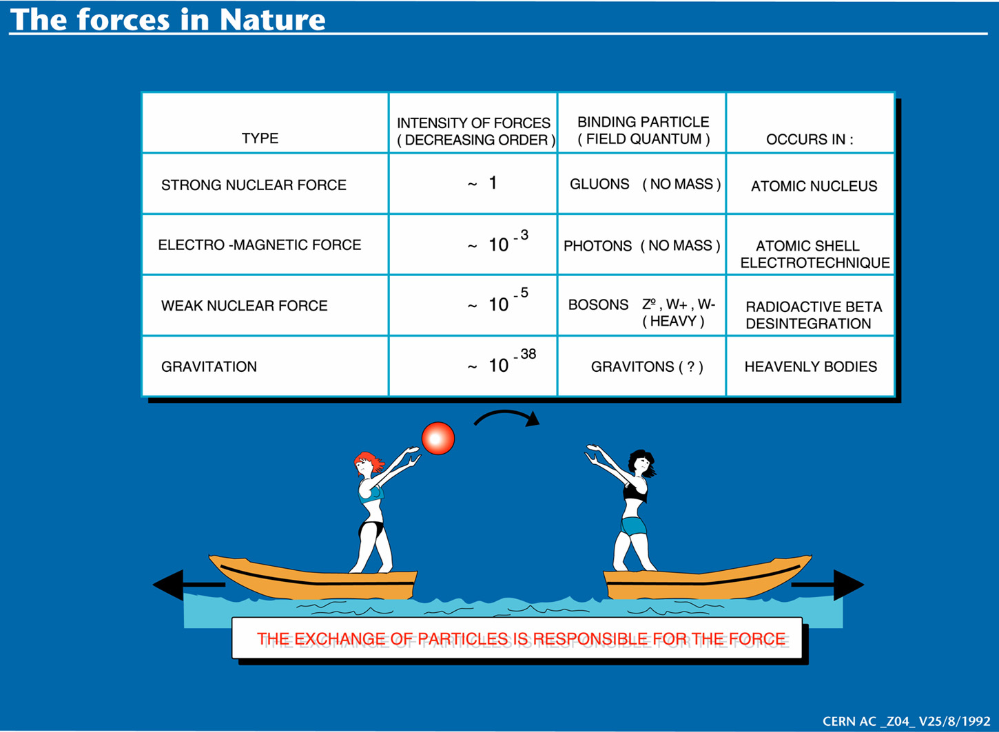

Slide 14
Particle Accelerators
How can one obtain high energy particles?
  Cosmic ray ➔ Sometimes we observe 1000TeV cosmic rays
    Low flux and cannot control energies well
Need to look into small distances to probe the fundamental constituents with full control of particle energies and fluxes
  Particle accelerators
Accelerators need not only to accelerate particles but also to
  Track them
  Maneuver them
  Constrain their motions to the order of 1μm or better
Why?
  Must correct particle paths and momenta to increase fluxes and precisely control momenta

Slide 15
Particle Accelerators
Depending on what the main goals of physics are, one needs different kinds of accelerator experiments
Fixed target experiments: Probe the nature of the nucleons ➔ Nucleon structure functions
  Results also can be used for producing secondary particles for further accelerations ➔ Tevatron anti-proton production
Colliders: Probes the interactions between fundamental constituents
  Hadron colliders: Wide kinematic ranges and high discovery potential
    Proton-anti-proton: TeVatron at Fermilab, at CERN
    Proton-Proton: Large Hadron Collider at CERN (turned on early 2010)
  Lepton colliders: Very narrow and focused kinematic reach, so it is used for precision measurements
    Electron-positron: LEP at CERN, Petra at DESY, PEP at SLAC, Tristan at KEK, ILC in the mid-range future
    Muon-anti-muon: Conceptual accelerator in the far future
  Lepton-hadron colliders: HERA at DESY

Slide 16
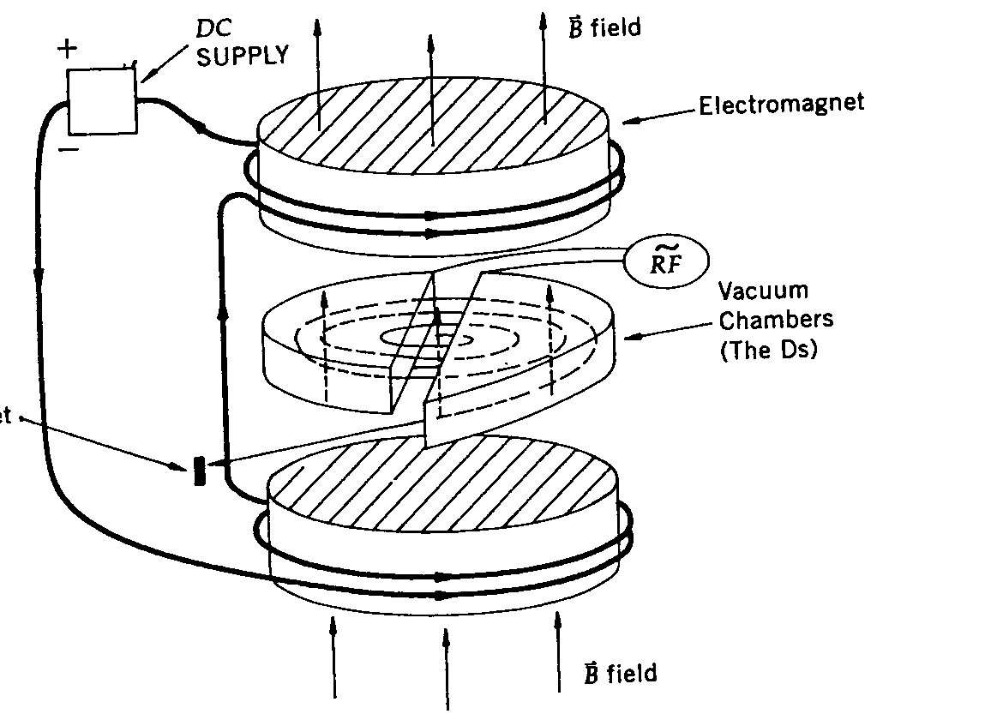
Resonance Accelerators: Cyclotron
Invented by E. Lawrence at Berkeley in 1930’s
While the two D shaped vacuum chambers are connected to HV sources, there is no electric field inside them due to Faraday effect
Strong electric field exists only in the gap between the two D’s
An ion source is placed in the gap
The path is circular due to the perpendicular magnetic field
The ions do not feel any acceleration inside the D but gets bent due to magnetic field
When the particle exits one D, the direction of voltage can be changed and the ion gets accelerated before entering into the D on the other side
If the frequency of the alternating voltage is just right (cyclotron frequency), the charged particle gets accelerated continuously until it is extracted
The maximum energy is determined by the accelerator radius and the magnetic field strength

Slide 17
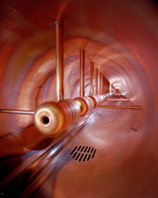
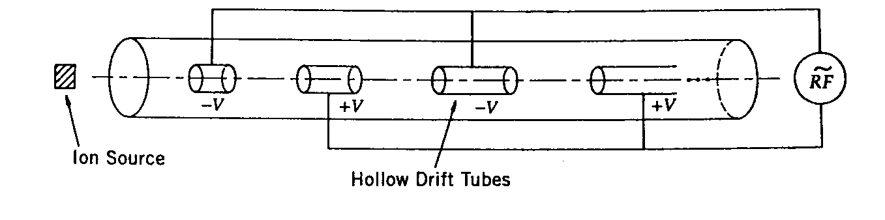
Resonance Accelerators: Linear Accelerator
Accelerates particles along the linear path using the resonance principle
A series of metal tubes are located in a vacuum vessel and connected successively to alternating terminals of radio frequency oscillator
The direction of the electric field changes before the particles exit the given tube
The tube length needs to get longer as the particle gets accelerated to keep up with the phase
These accelerators are used for accelerating low mass particles to very high energies

Slide 18
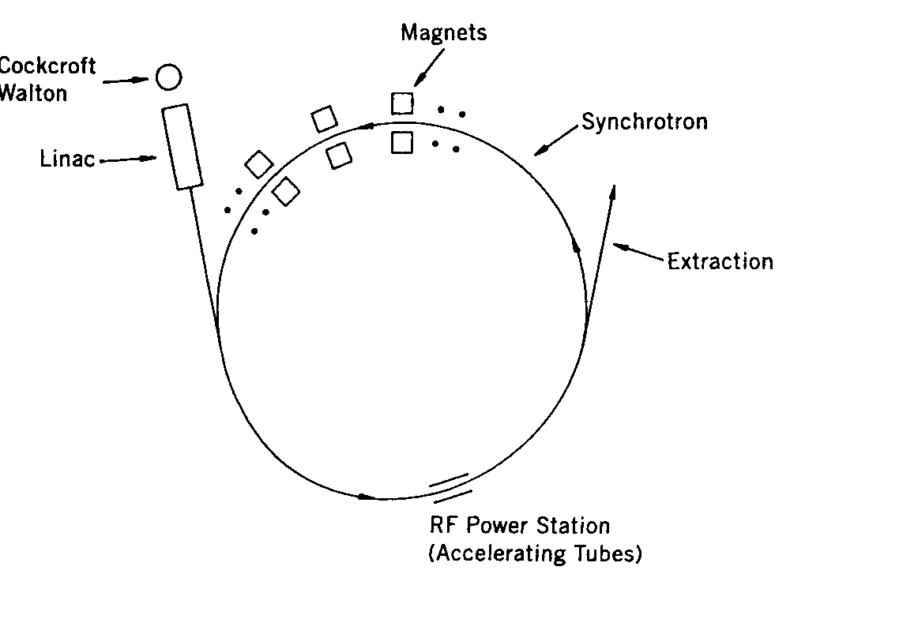
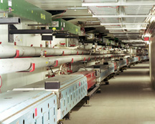
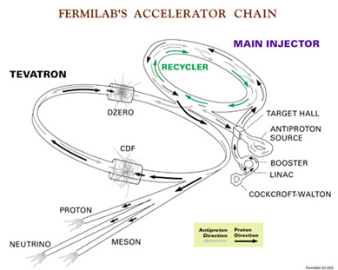
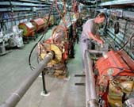
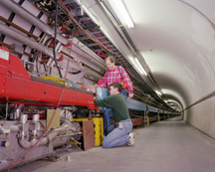
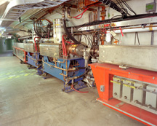
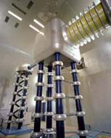
Synchroton Accelerators
Synchrotons use magnets arranged in a ring-like fashion with varying magnetic field and frequency
Multiple stages of accelerations are needed before reaching over GeV ranges of energies
RF power stations are located throughout the ring to pump electric energies into the particles

Slide 19
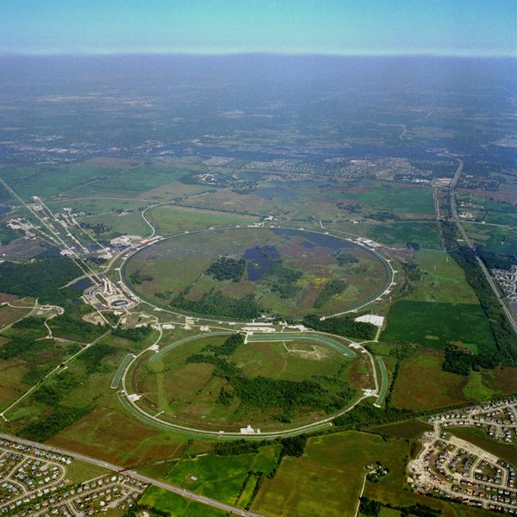
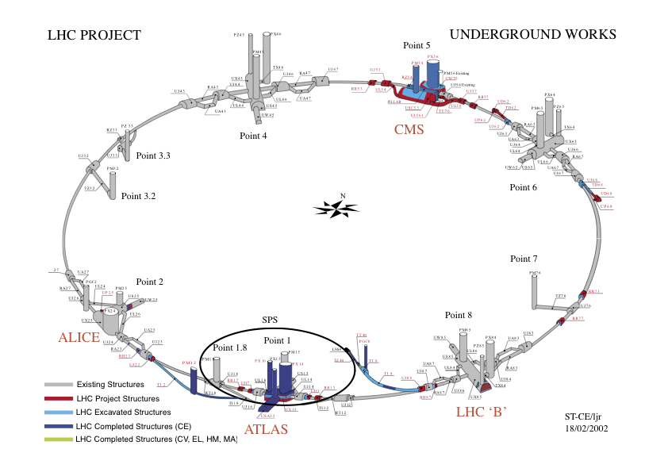
Fermilab Tevatron and LHC at CERN
World’s Highest Energy proton-anti-proton collider
  4km (2.5mi) circumference
  E_{cm}=1.96 TeV (=6.3x10⁻⁷J/p➔ 13M Joules on the area smaller than 10⁻⁴m²)
  Equivalent to the kinetic energy of a 20t truck at the speed 130km/hr
    ~100,000 times the energy density at the ground 0 of the Hiroshima atom bomb
  Tevatron was shut down in 2011
  New frontiers with high intensity proton beams including the search for dark matter with beams!!
World’s Highest Energy p-p collider
  27km (17mi) circumference, 100m (300ft) underground
  Design E_{cm}=14 TeV (=44x10⁻⁷J/p➔ 362M Joules on the area smaller than 10⁻⁴m²)
  Equivalent to the kinetic energy of a B727 (80tons) at the speed 310km/hr
    ~3M times the energy density at the ground 0 of the Hiroshima atom bomb
Discovered a new heavy particle that looks Higgs in 2012
Search for new particles had been ongoing!!
Shut down for two years for high stat. upgrade!
Chicago
CDF
p
DØ
Tevatron
p

Slide 20
Comparisons between Tevatron and the LHC
Tevatron: A proton-anti proton collider at 2TeV
  Need to produce anti-protons using accelerated protons at 120GeV
  Takes time to store a sufficient number of anti-protons
    Need a storage accelerator for anti-protons
  Can use the same magnet and acceleration ring to circulate and accelerate the particles
LHC: A proton-proton collier at 14TeV design energy
  Protons are easy to harvest
  Takes virtually no time to between a fresh fill of particles into the accelerator
  Must use two separate magnet and acceleration rings

Slide 21
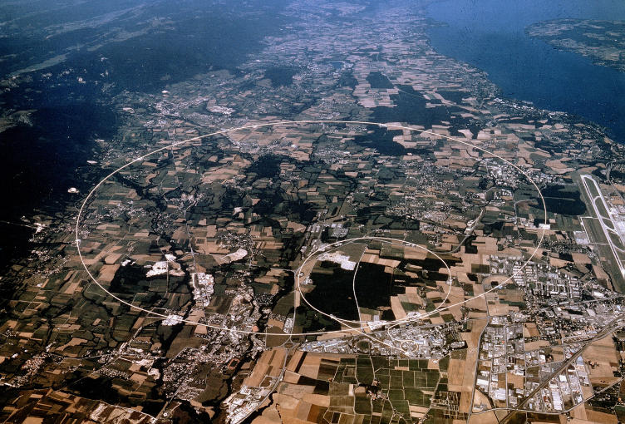
LHC @ CERN Aerial View
CMS
France
Geneva Airport
ATLAS
Swizerland

Slide 22
Particle Detectors
Subatomic particles cannot be seen by naked eyes but can be detected through their interactions within matter
What do you think we need to know first to construct a detector?
  What kind of particles do we want to detect for the given physics?
    Charged particles and neutral particles
  What do we want to measure?
    Their momenta measured by tracking detectors and magnetic field
    Trajectories measured by tracking detectors (like the cloud chamber)
    Energies measured by the calorimeter
    Origin of interaction (interaction vertex) measured by a precision tracking det.
    Etc
  To what precision do we want to measure?
Depending on the answers to the above questions we use different detection techniques

Slide 23
Particle Detection Techniques
Charged Particle Tracks
Energy
Muon Tracks
Scintillating Fiber
Silicon Tracking
Calorimeter (dense)
Interaction
Point
B
EM
hadronic
Magnet
electron
photon
Wire Chambers
jet
muon
neutrino -- or any non-interacting particle missing transverse momentum
We know x,y starting momenta is zero, but
along the z axis it is not, so many of our measurements are in the xy plane, or transverse
Notes:
The Run 2 detector. Schematically how it works.
SVX and the like.

Slide 24
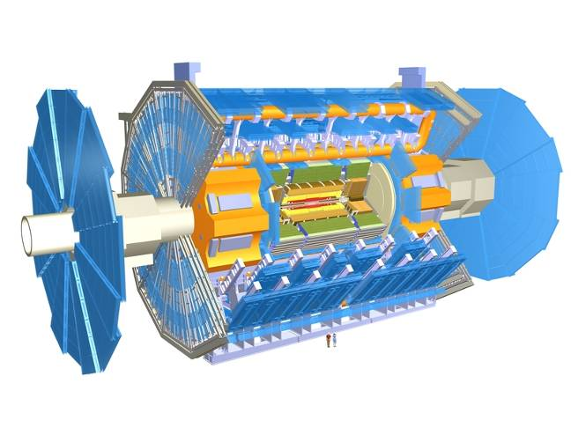
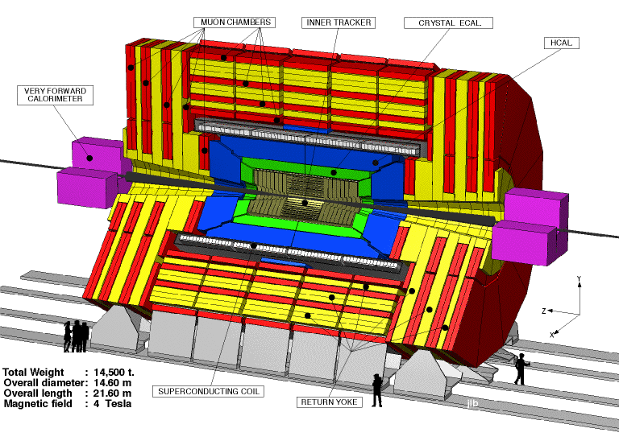
The ATLAS and CMS Detectors
Fully multi-purpose detectors with emphasis on lepton ID & precision E & P
Weighs 7000 tons and 10 story tall
Records 200 – 400 collisions/second
Records approximately 350 MB/second
Record over 2 PB per year ➔ 200*Printed material of the US Lib. of Congress

Slide 25
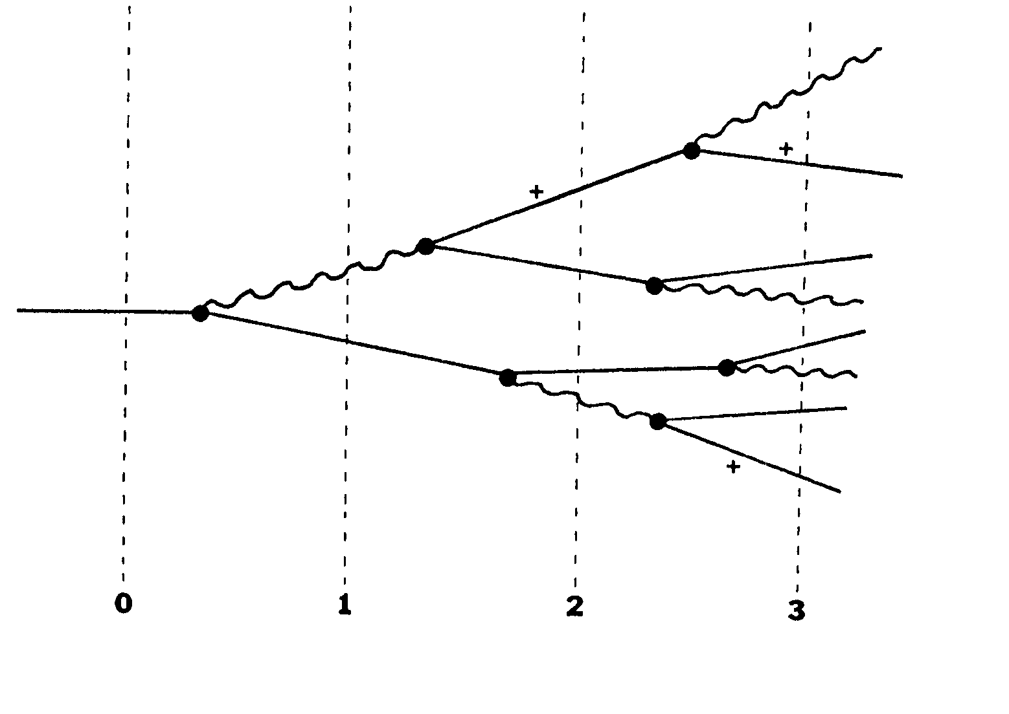
Electron Interactions in material (showering)
Photon, γ
Method of measuring the particle energy in a calorimeter!!

Slide 26
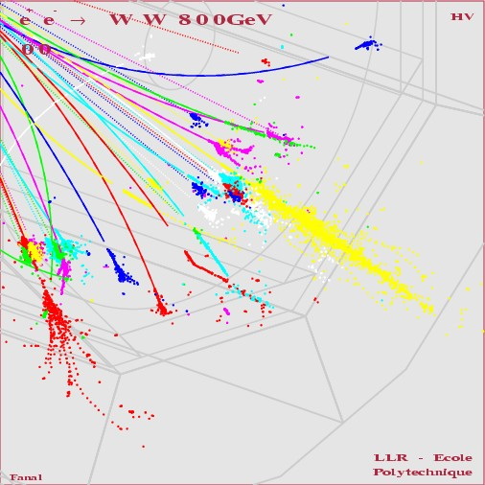
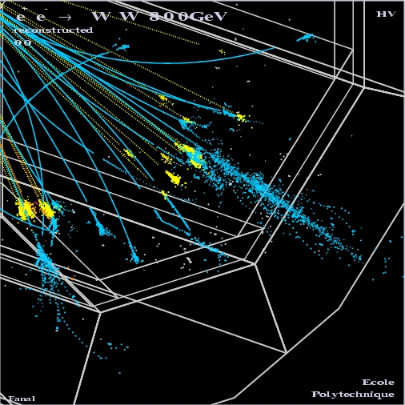
How particle showers look in detectors
Hadron
EM

Slide 27
Example Hadronic Shower (20GeV)

Slide 28
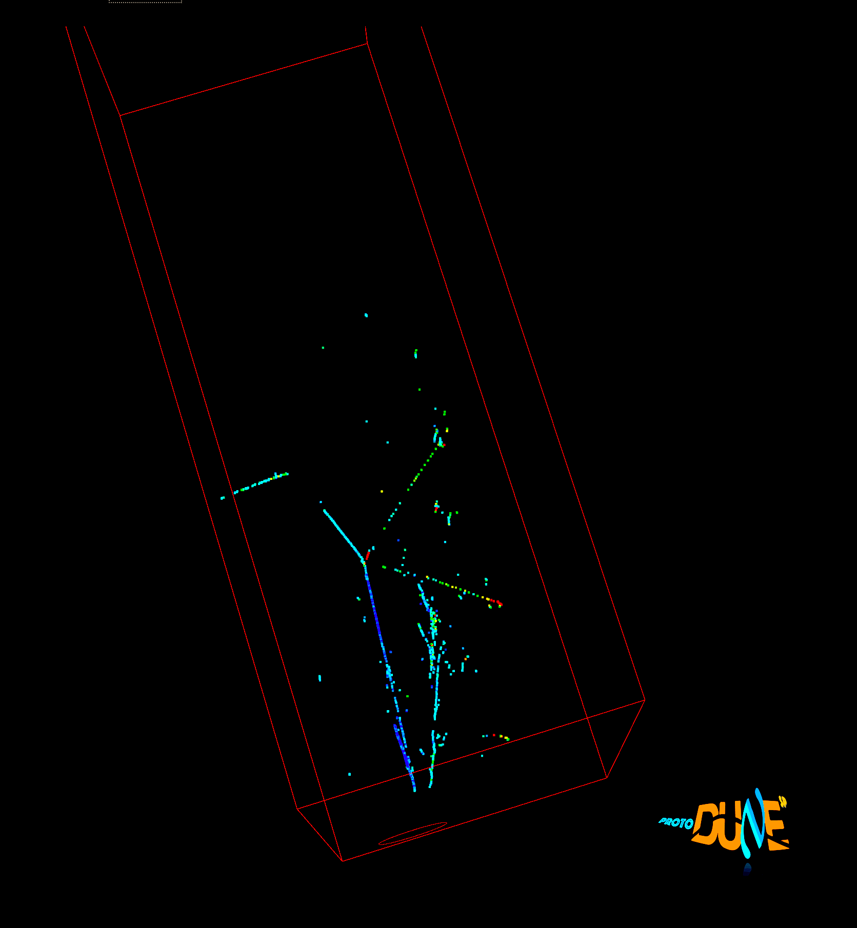

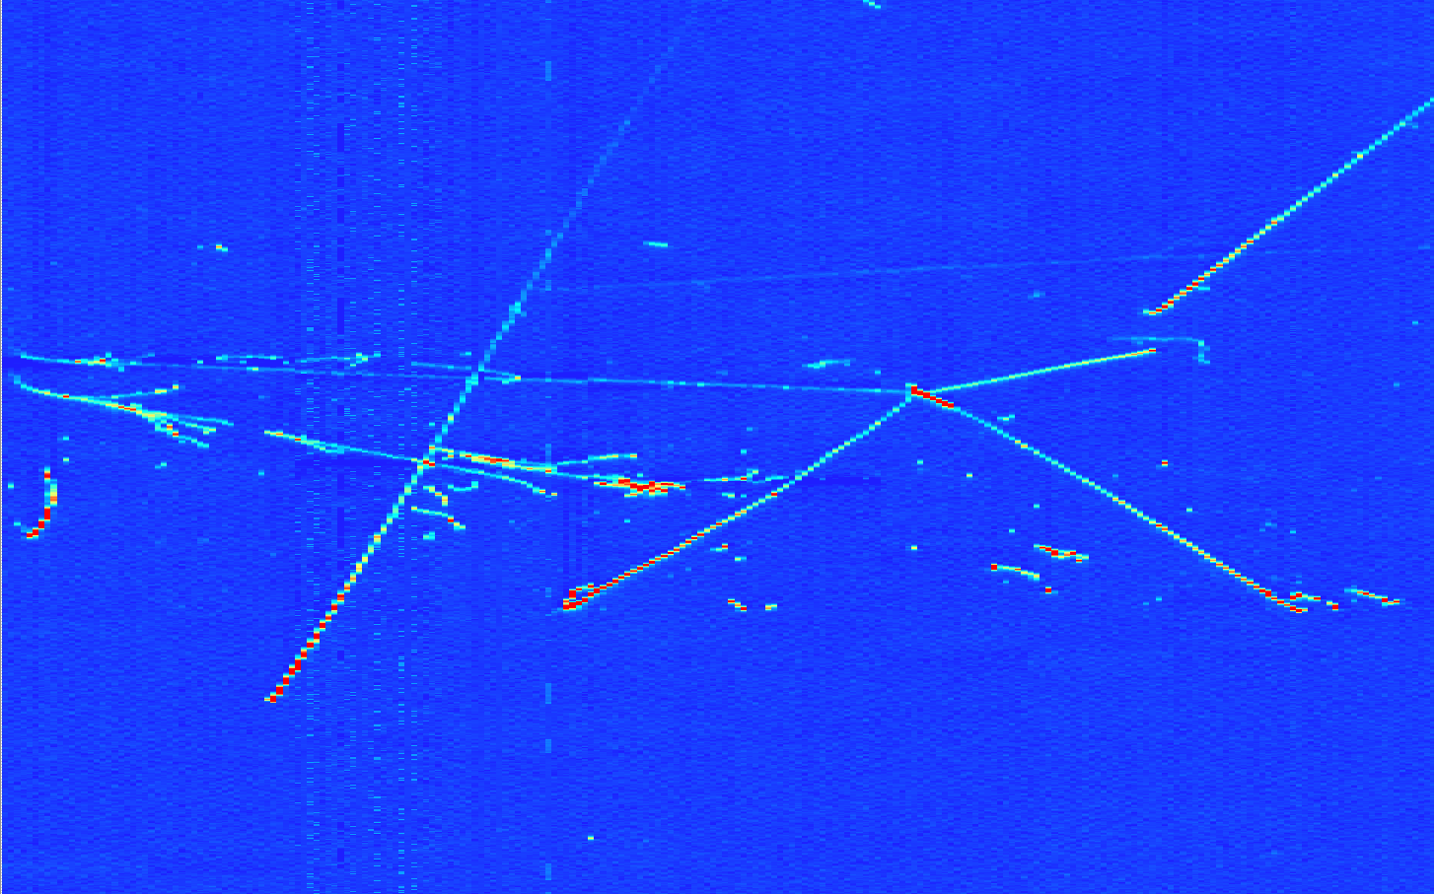
ProtoDUNE SP Beam Pile-up
Collection plane view
Run 4696, Ev 103:
2 EM showers and a pion interaction with 4 outcoming particles
3D view

Slide 29
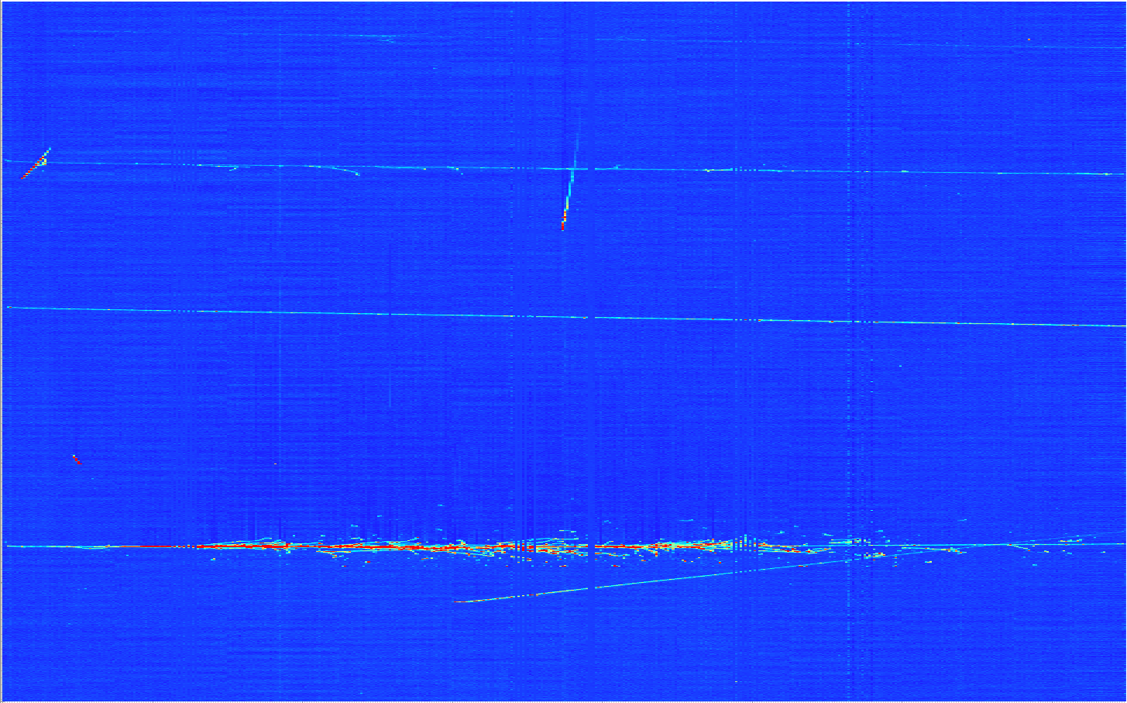
ProtoDUNE SP First Event
Beam halo (high energy) muon with bremsstrahlung initiated E.M. shower
Collection plane view

Slide 30
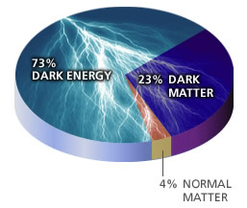
What are the current hot issues?
Why is the mass range so large (0.1m_{p} – 175 m_{p})?
How do matters acquire mass?
  Higgs mechanism but where is the Higgs?
Why is the matter in the universe made only of particles?
Neutrinos have mass!! What are the mixing parameters, particle-anti particle asymmetry and mass ordering?
Why are there only three apparent forces?
Is the picture we present the real thing?
  What makes up the ~95% of the universe?
  How about extra-dimensions?
Are there any other theories that describe the universe better?
  Does the super-symmetry exist?
Where is new physics?
How can we live well in the universe as an integral partner?
  - Higgs mechanism, did we find the Higgs?
Notes:
----- Meeting Notes (2/12/14 10:16) -----

Slide 31
What is the Higgs and What does it do?
When there is perfect symmetry, one cannot tell directions!

Slide 32

What? What’s the symmetry?
Where is the head of the table?
Without a broken symmetry, one cannot tell directional information!!

Slide 33

A broken symmetry

Slide 34
What is the Higgs and What does it do?
When there is perfect symmetry, one cannot tell directions!
Only when symmetry is broken, can one tell directions
Higgs field works to break the perfect symmetry and gives mass to all fundamental particles
Sometimes, this field spontaneously generates a particle, the Higgs particle
So the Higgs particle is the evidence of the existence of the Higgs field!

Slide 35



So how does Higgs Field work again?
Person in space ➔ no symmetry breaking
Person in air ➔ symmetry can be broken
Sometimes, you get
Just like a tornado is a piece of evidence of the existence of air, Higgs particle is a piece of evidence of Higgs mechanism

Slide 36
How do we look for the Higgs?
Higgs particle is so heavy they decay into other lighter particles instantaneously
When one searches for new particles, one looks for the easiest way to get at them
Of many signatures of the Higgs, some are much easier to find, if it were the Standard Model Higgs
  H→ γγ
  H → ZZ* → 4e, 4μ, 2e2μ, 2e2ν and 2μ2ν
  H→ WW*→2e2ν and 2μ2ν
  And many more complicated signatures

Slide 37
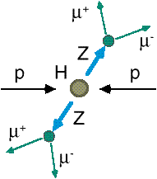
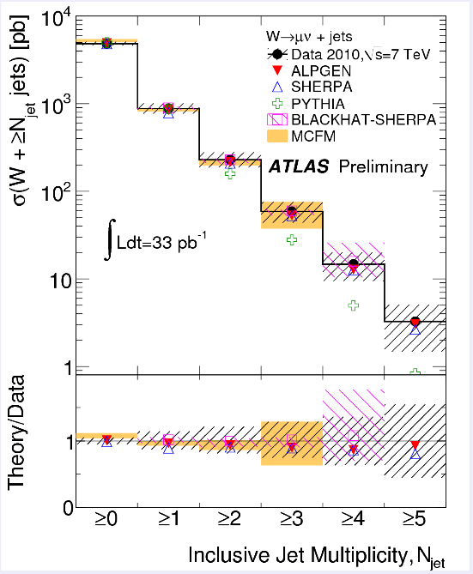
How do we look for the Higgs?
Identify Higgs candidate events
Understand fakes (backgrounds)
Look for a bump!!
  Large amount of data absolutely critical
e⁺ (μ⁺)
e⁻ (μ⁻)
e⁺
e⁻

Slide 38
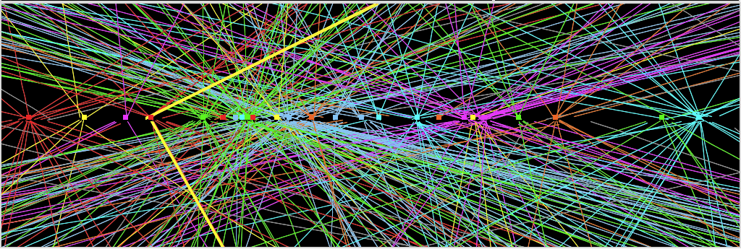
Challenges? No problem!
An interesting collision event with 25 collisions at once!!
Here it is!!

Slide 39

What did statistics do for Higgs?

Slide 40

How about this?

Slide 41
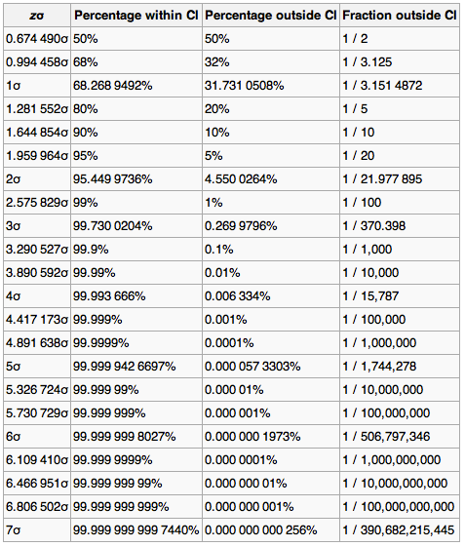
Statistical Significance Table

Slide 42
So have we seen the Higgs particle?
The statistical significance of the finding is much bigger than seven standard deviations
  Level of significance: much better than 99.999 999 999 7% (eleven 9s!!)
  We could be wrong once if we do the same experiment 391,000,000,000 times (will take ~12,500 years even if each experiment takes 1s!!)
    Probability of winning the $0.5B Power Ball Jackpot was 175,233,510
So did we find the Higgs particle?
  We have discovered the heaviest new boson we’ve seen thus far
  It has many properties consistent with the Standard Model Higgs particle
    It quacks like a duck and walks like a duck but…
  We do not have enough data to precisely measure all the properties – mass, lifetime, the rate at which this particle decays to certain other particles, etc – to definitively determine its nature
Precision measurements and searches in new channels ongoing

Slide 43
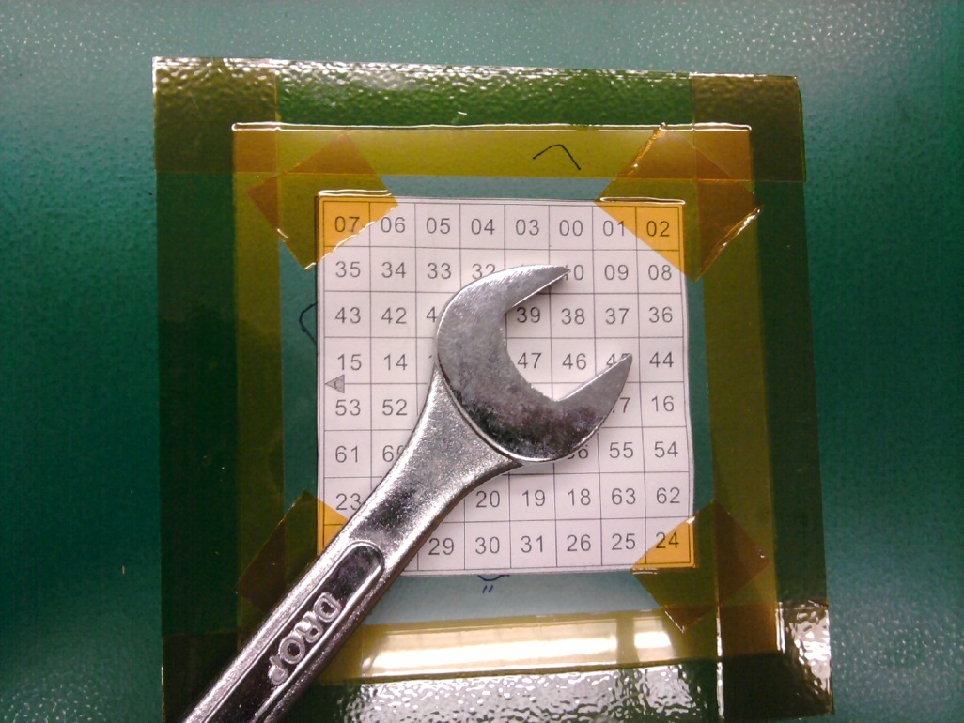
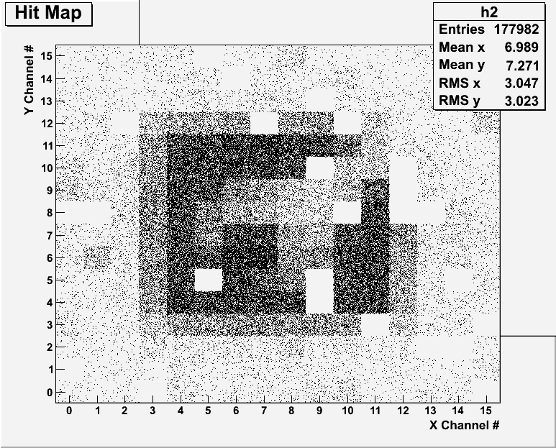
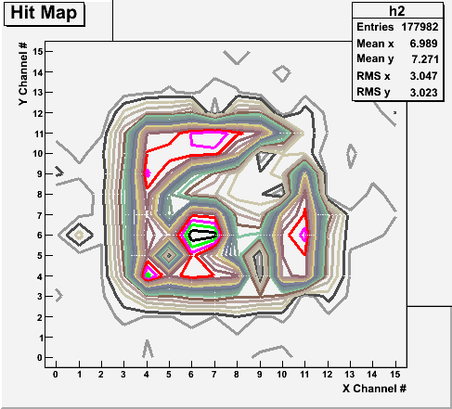
Bi-product of High Energy Physics Research
Can you see what the object is?
(GEM Detector X-ray Image)

Slide 44
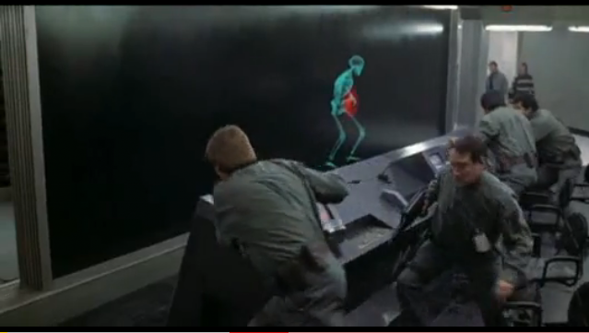
And in not too distant future, we could do …

Slide 45
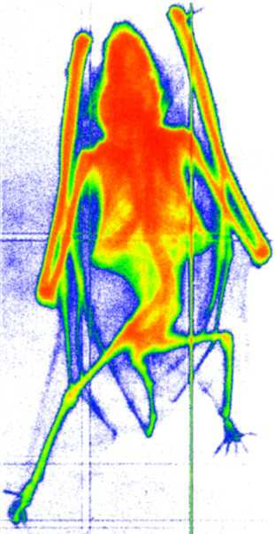
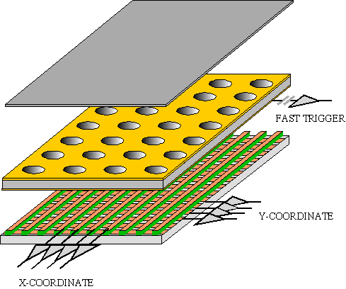
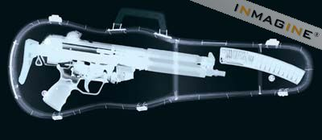
GEM Application Potential
FAST X-RAY IMAGING
Using the lower GEM signal, the readout can be self-triggered with energy discrimination:
9 keV absorption radiography of a small mammal (image size ~ 60 x 30 mm²)
A. Bressan et al,
Nucl. Instr. and Meth. A 425(1999)254
F. Sauli, Nucl. Instr. and Meth.A 461(2001)47

Slide 46
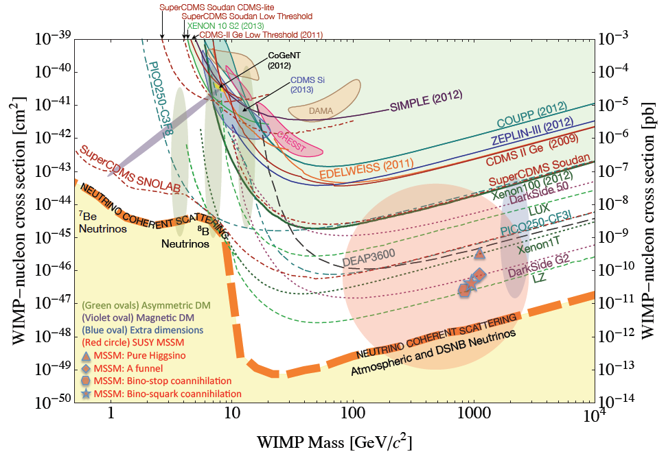
Dark Matter Search Motivation
LHC@CERN
No DM

Slide 47
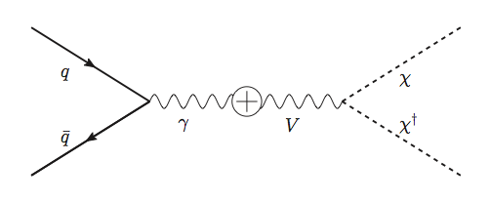
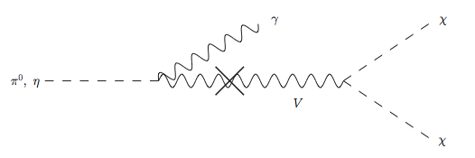
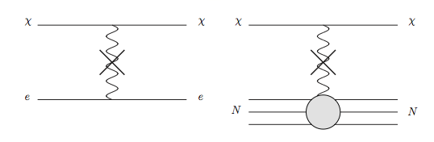
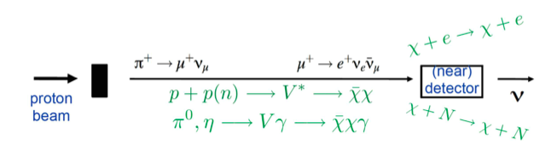
Light DM Production at High Intensity Accelerator
Now the Higgs particle, a part of only 5% of the universe, may’ve been seen
It is time for us to look into the 95% of the universe!!
Detection of DM:
How does a DM event look in an experiment?:
Higher E_{P} @ LBNE
Lower E_{P} @ MiniBooNE
High Intensity Proton Beam

Slide 48
So What?
The LHC opened up a whole new world!!
Discovered one new charge neutral particle that couples to vector force carriers and whose measured mass is 125 times the proton mass
  The discovery is no longer a matter of significance
Properties of the discovered particle being intensely studied
  Confirmed that some properties are like the Standard Model Higgs Particle ➔ Walks like the Higgs and Quacks like the Higgs
  Still not enough though…
Linear collider and advanced detectors are being developed for future precision measurements of Higgs and other newly discovered particles

Slide 49
So What?
The new frontier at Fermilab will give us a chance to look for dark matter at an accelerator and possibly making DM beams, Yeah!!
Outcome and the bi-product of HEP research improves our daily lives directly and indirectly
  WWW came from HEP
  GEM will make a large screen low dosage X-ray imaging possible
Many technological advances happened through the last 100 years & will happen through the coming 100 yrs
UTA is a big contributor in this endeavor!
Continued and sufficient investments to forefront scientific endeavor is essential for the future!

Slide 50
Congratulations!!!!
You all are impressive and have done very well!!!
I certainly had a lot of fun with ya’ll and am truly proud of you!
Good luck with your exam!!!
Have a safe summer!!

