Slide 1
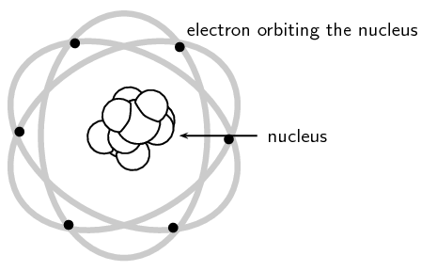
Rutherford Scattering
Group #7: M. Bui, A. Cole, J. Curtis, C. Kizer-Pugh, A. Losh, I. Tucker

Slide 2
Timeline
Prior to Rutherford: Thomson model of the atom
“Plum Pudding model” i.e. overall positively charged atom with evenly scattered electrons
Rutherford Scattering proves a variance in density of atoms
Initial discovery: Gold Foil Experiment conducted by Hans Geiger and Ernest Marsden under Ernest Rutherford's lab (1909)
Rutherford would go on to publish “The Scattering of Alpha and Beta Particles by Matter and the Structure of the Atom” (1911).
Materials Analysis Method: Rubin et. Al would go on to publish “Chemical Analysis of Surfaces by Nuclear Methods” (1957)

Slide 3
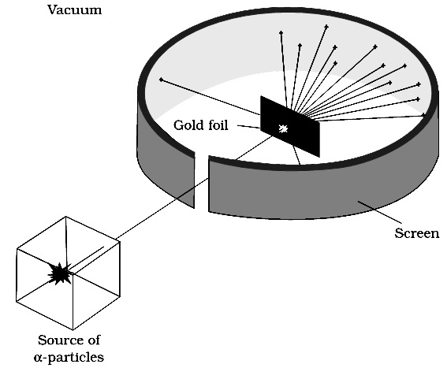
Gold Foil Experiment
1909: Geiger and Marsden carried out the following experiment under Rutherford’s lab and published results
Methodology: Projecting alpha particles through thin metal foil and measuring the angle of scattering
Notes:
Geiger and Marsden are undergraduate students under Rutherford’s lab at the time

Slide 4
Assumptions Due to Thomson Model
Deflection of negatively charged particles were due to:
(1) repulsion of evenly distributed negative charges
(2) attraction of evenly distributed positive charges
Deflection would be SMALL due to even distributions of positive and negative
+
−
−
−
−
−
−
−
−
−
−
−
−
−
−
−
−
−
−
−
−
−
−
−
−
−
−
Proven wrong! Gold Foil Experiment showed varied deflections, including large deflections (greater than 90º)
Rutherford would then propose an atom with a dense positive core with surrounding negative charges
−
−
−
+
+
+
−
+
−
−
+
−
−
−
−
−

Slide 5
Assumptions made by Rutherford
${KE}_{initial}≈{KE}_{final}$Since the scattering agent is massive, it does not recoil significantly.
The target is so thin that only a single scattering occur
The incoming particle and target scattering agent can be treated as point masses and point charge
Only Coulomb’s force is effective

Slide 6
Rutherford Scattering

Slide 7
Rutherford Scattering

Slide 8
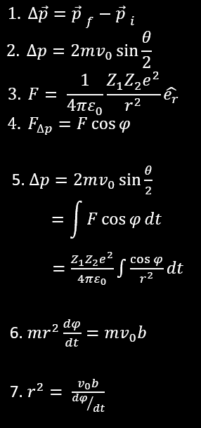
Derivation for Impact Parameter
2 Change in momentum is equal to
3 Coulomb force equation
4 Force along p direction
5 Set equations 2, 4, and 5 equal to each other
6 & 7 Instantaneous angular momentum must therefore be conserved

Slide 9
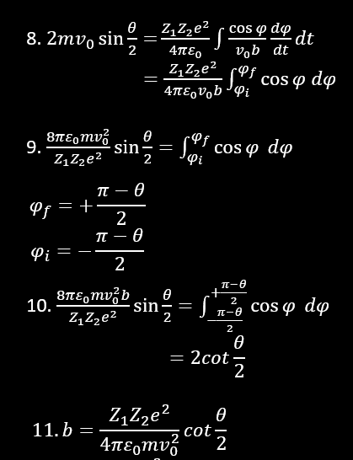
Derivation for Impact Parameter (cont.)
8 Equations 6 and 7 are now plugged into 5
9 Rearrange the so that the integral is by itself
10 Plug in the bounds and solve for b
11 The Impact parameter is obtained

Slide 10
Impact Parameter
$b=\frac{Z_{1}Z_{2}e^{2}}{8πε_{0}K}\cot\left(\frac{θ}{2}\right)$

Slide 11
Derivation for Scattering
13 Number of scattering nuclei per unit area
14 Number of target nuclei
15 Target area exposed to scattering over area
σ = πb²
16 Plugging the impact parameter for B
17 The derivative of f is taken, shows particles scattered between θ+dθ
18 Plug df in to the equation 18

Slide 12
Rutherford Scattering Equation

Slide 13
Key Points
$N\left(θ\right)=\frac{N_{i}nt}{16}{\left(\frac{e^{2}}{4πε_{0}}\right)}^{2}\frac{Z_{1}^{2}Z_{2}^{2}}{r^{2}K^{2}\sin^{4}\left(\frac{θ}{2}\right)}$
Scattering is proportional to square of incident particle atomic number (Z₁) and target scattering agent’s atomic number (Z₂) i.e. $N(θ)∝Z_{1}^{2}Z_{2}^{2}$
Number of scattered particles is inversely proportional to the square of kinetic energy (K) of the incident particle i.e. $N\left(θ\right)∝\frac{1}{K^{2}}$
Scattering is inversely proportional to the fourth power of $sin\left(\frac{θ}{2}\right)$i.e. $N\left(θ\right)∝{\frac{1}{\sin^{4}\left(\frac{θ}{2}\right)}}$
Scattering is proportional to target thickness for thin targets i.e. $N\left(θ\right)∝$ t

Slide 14
Application: Rutherford Backscattering Spectroscopy
Used in Materials Science: analytical technique known as “Rutherford backscattering spectroscopy” (RBS) published in 1957 Analytical Chemistry journal article
Three components: ion source, linear particle accelerator, energy detector
Characteristics of RBS:
Depth range between 0-1mm
Depth resolution about 2 nm
Non-destructive analysis (no need for sample preparation)
High precision (± 3% error)
Applications:
Absolute thickness of films, coatings, surface layers
Surface contaminant detection
Elemental composition of complex materials
Interdiffusion kinetics of thin films

Slide 15
Bibliography
E. Rutherford, “The Scattering of Alpha and Beta Particles by Matter and the Structure of the Atom.” Phil. Mag. 21, 669-688 (1911).
F. Ernst. “Rutherford Backscattering Spectrometry.” Lund University. EMSE-515, 13-15 (2005).
H. Geiger, E. Marsden, et. al. “On Diffuse Reflection of the a-Particles.” Proc. R. Soc. A82, 495-500 (1909).
S. Rubin et. al. “Chemical Analysis of Surfaces by Nuclear Methods.” Anal. Chem. 29, 736 (1957).
S. Thornton and A. Rex. “Rutherford Scattering.” Modern Physics for Scientists and Engineers, 4th ed., 131-139 (2013, 2006).

