Slide 1
The Compton effect
By: Eman Alasadi,
Akolade Adebayo, Anfal Chaid, Charleston Newhouse, Kiran Karki, Tyler Freeman
PHYS 3313

Slide 2
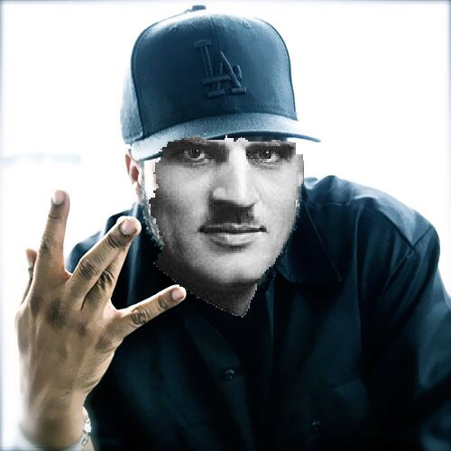
Outline of Presentation
Timeline of Discoveries
What is Compton Scattering?
Difference between the Compton effect, the Photoelectric effect, and Pair production
The Compton Experiment + Some Cool Math
Importance and Impact

Slide 3
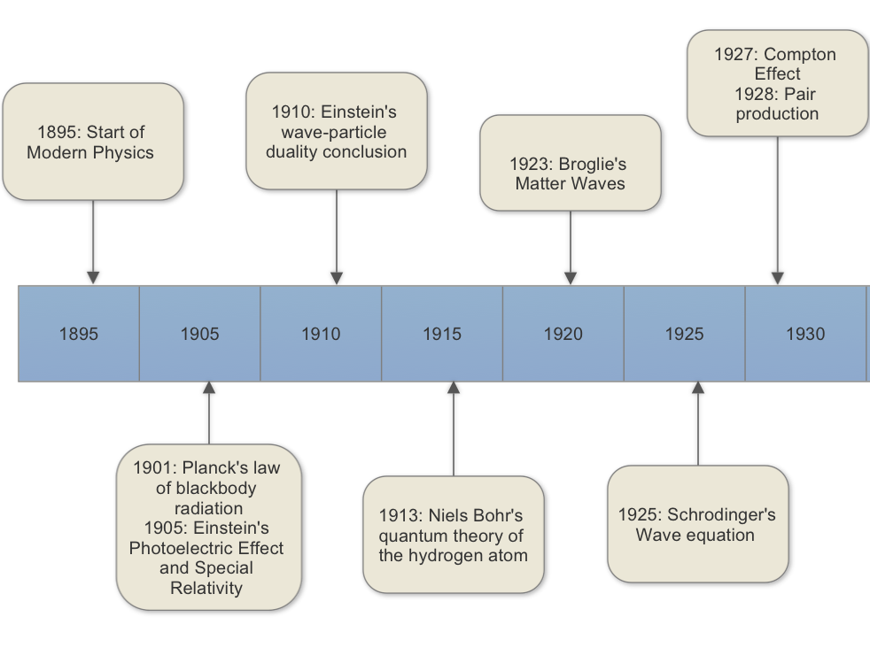
Notes:
Some of the early and arguably most important discoveries that rushed in the era of modern physics revolve around understanding how to properly describe particle behavior: are they just particle are they waves? What's going on? (Thomas Young did his double slit experiment in 1801)
Although it is common sense to us now, the duality nature wasn’t something so easily accepted. Wave–particle duality is the concept in quantum mechanics that every particle or quantum entity may be partly described in terms not only of particles, but also of waves. And it is important bc it expresses the inability of the classical concepts "particle" or "wave" to fully describe the behaviour of quantum-scale objects
Einstein paved the way in 1905 by embracing wave-particle duality. He talked about light (photon) as particles in his paper about the photoelectric effect and as waves in special relativity. Now fast forward a couple of years to 1927, when Compton was working with his ideas, he also had to turn to this idea that of duality In order to make sense of his results, Compton had to utilize the photon particle concept explored in Einstein’s paper about the photoelectric effect.

Slide 4
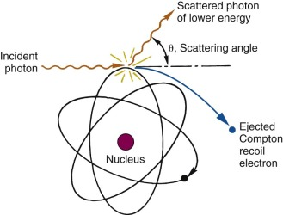
Compton Effect
The collision between a photon and a charged particle, such as an electron, results in a scattered photon with a different wavelength.
Describes changes in:
Energy
Momentum
Wavelength
Notes:
So now, what is the Compton effect?
Arthur Compton proved that Thomson scattering, the classical theory that had attempted to explain scattering of charged particles, was incomplete because of its inconsistency in explaining shifts in wavelengths at low intensity [3]. According to classical theory, when a photon interacts with a charged particle, that charged particle oscillates at the photons frequency and then reemits a photon with the same frequency as the incident photon
The physical process of the Compton effect constitutes the collision of photons into charged particles PROPERLY[1]. Energy and momentum are transferred to the charged particle and photons scatter with changed wavelengths, energy, and momentum. The setup for Compton scattering utilizes relativistic mechanics when expressing the laws of conservation of energy and momentum for the elastic collision between the two particles. Kinetic energy, scattering angle, and change in wavelength can all also be calculated. From the laws of the conservation of energy and momentum, the energy of the incident photon and the rest energy of the target electron must equal the scattered photon and recoiled electron [2].

Slide 5
When high energy photons interact with matter:
Photoelectric Effect
Electron completely absorbs photons energy and gets ejected
Compton Effect
Pair Production
Photons with energy more than 1.022 MeV, photon is converted to mass giving a pair of particles
Electron absorbs some of photon energy = free electron + photon with different wavelength
Notes:
Now we learn about the photoelectric effect, Compton effect, and pair production and usually what happens is that:
We don’t connect the dots between how related these concepts are.
Alongside the work of Einstein, Planck, and Paul Dirac, twentieth century physics was able to explain that when high energy photons interact with matter, there are three primary means of energy transfer between the photon and particles of material: Photoelectric effect (electron completely absorbs photons energy and gets ejected), Compton scattering (electron absorbs some of the photon’s energy and you get a free electron and a photon with a different wavelength), and pair production (Photons with energy more than 1.022 MeV, photon is converted to mass giving a pair of particles).

Slide 6
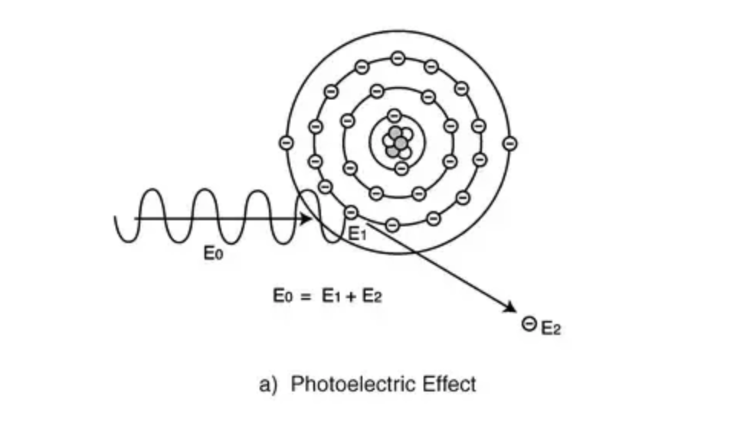
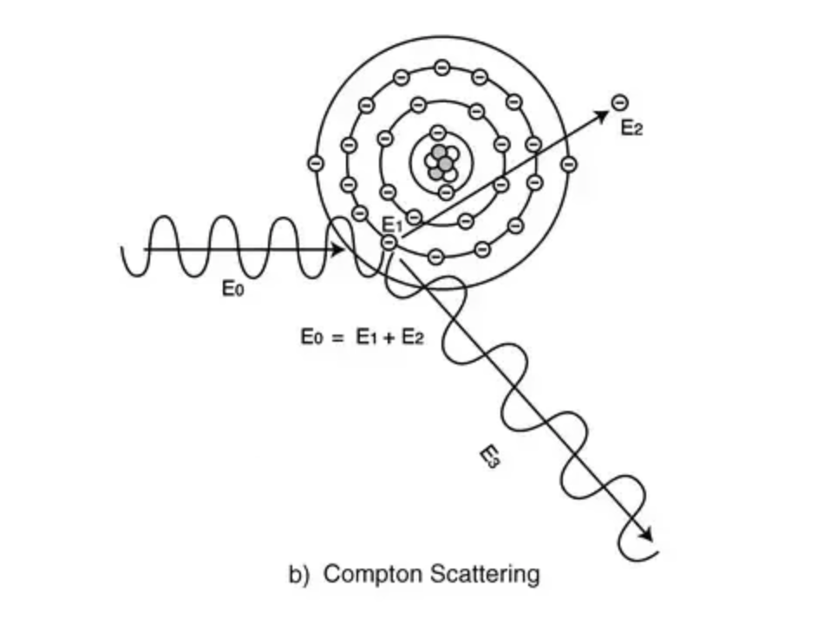
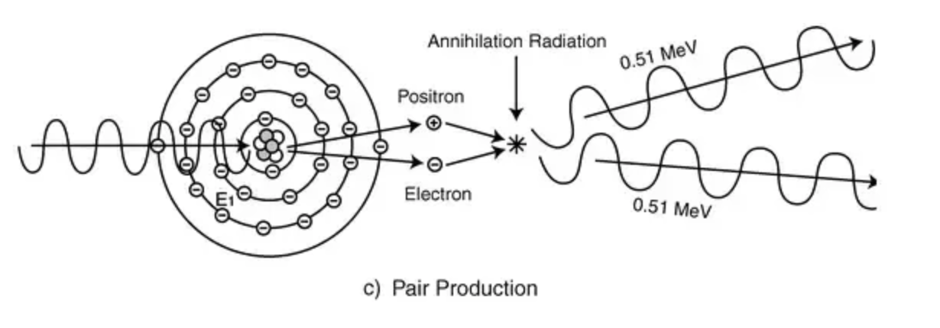
Notes:
And here you can visualize those differences even more profoundly and you see exactly what we discussed before. Of course, our focus is the Compton effect but it is important to see the how you get different effect depending on how high of an energy your photon possess.

Slide 7
COMPTON EXPERIMENT
Arthur Compton’s Original Experiment:
X-ray tube
Targeted X-rays at carbon target
Passed through crystal
Crystal systems
Reached ionization chamber that measured energy
X-Ray tube
Graphite target
Ionization Chamber
Calcite Crystal
Notes:
Now, lets dive into the experimental setup that led to the Compton effect conclusions.
Compton first worked with X-rays when studying the arrangement of atoms and electrons in crystals. He then expanded into studies involving X-ray scattering. Initially, Compton perfected the apparatus that he used in studying X-ray scattering to be able to measure shifts in wavelengths and scattering angles. He then conducted experiments where X-rays were targeted at a carbon, specifically graphite, target [3]. It then passed through a crystal system. Compton scattering is observed because the emitted radiation had a longer wavelength then the primary wave. Longer wavelength means lower energy. The energy of the scattered photon was measured using bragg scattering on a calcite crystal (has a trigonal crystal class) and an ionization chamber to measure energy over time.

Slide 8
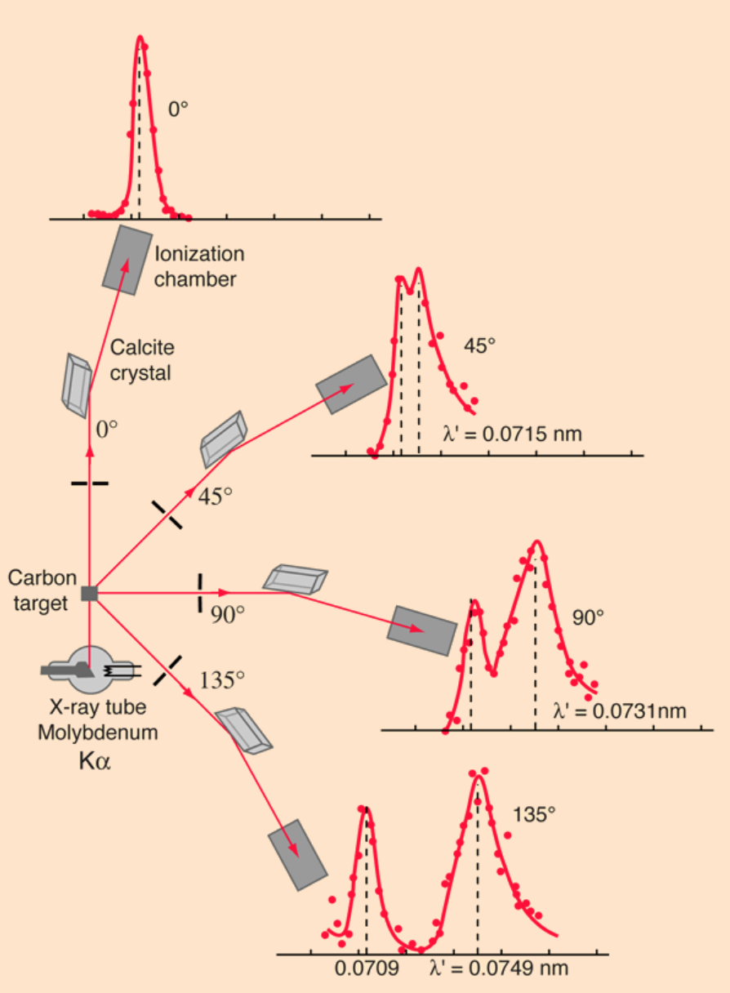
Notes:
The energy of the scattered photon was measured using bragg scattering on a calcite crystal (has a trigonal crystal class) and an ionization chamber to measure energy over time.
Compton's original experiment made use of molybdenum K-alpha x-rays, which have a wavelength of 0.0709 nm. These were scattered from a block of carbon and observed at different angles with a Bragg spectrometer. The spectrometer consists of a rotating framework with a calcite crystal to diffract the x-rays and an ionization chamber for detection of the x-rays. Since the spacing of the crystal planes in calcite is known, the angle of diffraction gives an accurate measure of the wavelength.

Slide 9
X DIRECTION
$$\frac{h}{λ}= \frac{h}{λ^{′}}cosθ+p_{e}cosφ$$
Y DIRECTION
0 $=p_{e}sinφ −\frac{h}{λ^{′}}sinθ$
Conservation of Energy
$$hf+ mc^{2}=hf^{′}+E_{e}$$
PHOTON
PHOTON
ELECTRON
INITIAL
FINAL
ELECTRON
Compton Effect
$$∆λ=\frac{h}{mc}(1−cosθ)$$

Slide 10
Momentum of photon $p= \frac{h}{λ}$
Electron’s total energy ${E_{e}}^{2}=(mc^{2})^{2}+{p_{e}}^{2}c^{2}$
Energy Conservation $hf+ mc^{2}=hf^{′}+E_{e}$
Momentum Conservation:
x-direction $\frac{h}{λ}= \frac{h}{λ^{′}}cosθ+p_{e}cosφ$
y-direction $\frac{h}{λ^{′}}sinθ=p_{e}sinφ$
In order to relate change in wavelength to scattering angle, we define $E_{e}$ and $p_{e}$ (from previous definitions) and then substitute into the total energy formula
$[h\left(f−f^{′}\right)+mc^{2}]^{2}=m^{2}c^{4}+(hf)^{2}+(hf^{′})^{2}$-2$(hf)(hf{′)}^{2}cosθ$
$$mc^{2}\left(f−f^{′}\right)=hff′(1−cosθ)$$
$$∆λ=\frac{h}{mc}(1−cosθ)$$

Slide 11
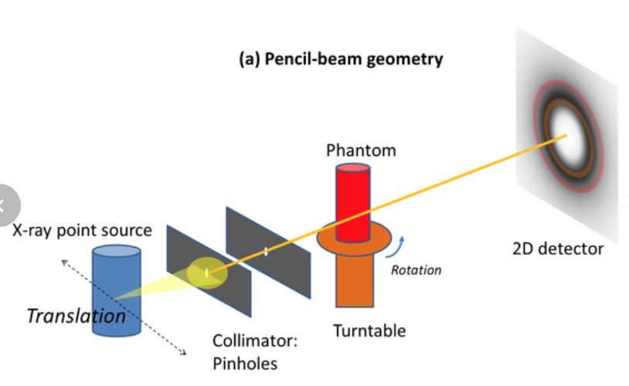
The IMPORTANCE OF THE COMPTON EFFECT IN MEDICINE
Treatment and Diagnoses of Cancer
Radiobiology
Coherent scatter computed tomography
Notes:
Schematic illustration of the equipment used to acquire scatter diffraction patterns. The coherent scatter CT projections are generated using pencil-beam geometry with translation and rotation motions of the sample
Compton scattering is of great importance to the development and understanding of radiation therapy since it involves the interaction of high energy electromagnetic radiation such as gamma and X-rays with living cells. In addition, coherent scatter computed tomography (CSCT) is a reconstructive X-ray imaging that uses scattered x-rays at different scattering angles to reconstruct images of the tissue at question. This sort of technology is still under investigation but will be extremely useful for cancer diagnoses when perfected.
The Compton effect has a lot of useful applications in radiobiology, coherent scatter computed tomography, gamma spectroscopy, and other instrumentation. Radiobiology is based on studying the effects and benefits of ionized radiation as a potential treatment for cancer and diseases of the thyroid [9]. Compton scattering is of great importance to the development and understanding of radiation therapy since it involves the interaction of high energy electromagnetic radiation such as gamma and X-rays with living cells. In addition, coherent scatter computed tomography (CSCT) is a reconstructive X-ray imaging that uses scattered x-rays at different scattering angles to reconstruct images of the tissue at question. This sort of technology is still under investigation but will be extremely useful for cancer diagnoses when perfected.

Slide 12
Bibliography
Ghammraoui, Bahaa & Badal, Andreu & Popescu, Lucretiu. (2016). Maximum-likelihood estimation of scatter components algorithm for x-ray coherent scatter computed tomography of the breast. Physics in medicine and biology. 61. 3164-3179. 10.1088/0031-9155/61/8/3164.
Scannavino, Francisco A., and Paulo E. Cruvinel. 2012. “A Graphical Tool for an Analytical Approach of Scattering Photons by the Compton Effect.” Nuclear Instruments and Methods in Physics Research Section A: Accelerators, Spectrometers, Detectors and Associated Equipment674: 28–38. doi:10.1016/j.nima.2011.12.120.
Bartlett, A. A. Compton Effect: Historical Background. American Journal of Physics 1–9 (1963).

Slide 13
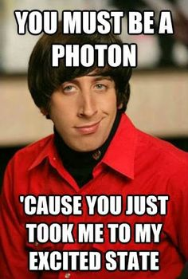
QUESTIONS???

