Slide 1
The Discovery of Radioactivity
Group #9
Phys 3313-001
Y. Aryal, B. Garza, G. Hodges, S. Simmonds, R. Wood

Slide 2
Overview
History
Original Theory of Experiment
Experimental Results
Importance of Impact
Future works and Applications
Conclusion

Slide 3
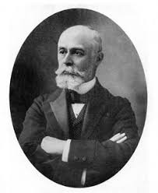
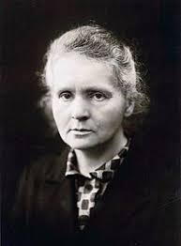
History / Contributors
Antoine Henri Becquerel
French engineer
Known for: discovery of radioactivity
Wilhelm Roentgen discovered X-rays when he noticed that his photographic plates were darkened, even when wrapped with black paper while conducting experiments with electricity and vacuum tubes in 1895.
A year later Henri Becquerel found similar rays were produced in his experiments with uranium salts.
Marie Curie, together with her husband Pierre, then began investigating the phenomenon discovered by Henri using pitchblende (uranium-rich ore), coined the term radioactivity and discovered radium and polonium from the ore.
Marie Curie
French-Polish physicist
Known for: radioactive decay, Polonium, Radium

Slide 4
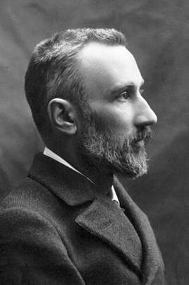
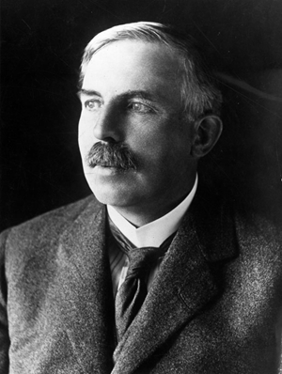
History / Contributors
Pierre Curie
French physicist
Known for: magnetism, piezoelectricity, radioactivity
Ernest Rutherford expanded upon the research of the Curies and later found that there were two types of radiation. Readily absorbed radiation and penetrating radiation, which are alpha and beta rays respectively.
While Pierre Curie was not initially a major contributor to the research of radioactivity, he did use his status to help Marie Curie gain access to the equipment needed as well as the materials needed, to perform her tests which lead to the discovery of polonium and radium.
Upon Marie Curie’s discoveries, he ceased his own work and began working with her. Pierre and Albert Laborde found that alpha particles are strongly ionizing.
Ernest Rutherford
New Zealand - British physicist
Known for: the father of nuclear physics

Slide 5
Theory of Radioactivity
Certain materials emit radiation without an external source of energy.
Different radioactive substances put in the magnetic field, deflect in different directions or not at all, proving three classes of radioactivity: negative, positive, and electrically neutral.
Radioactive Decay Mechanism

Slide 6
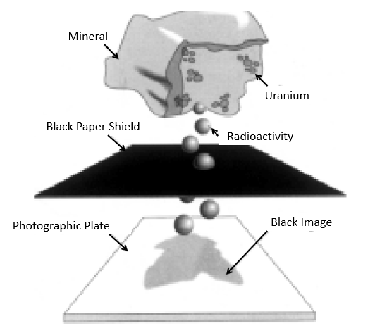
Becquerel’s Experiment
Henri Becquerel took these procedures in his experiment:
Wrap photographic plates in black paper to prevent sunlight from reaching the plates.
Place uranium salt rocks on black paper.
Expose uranium salt rocks to sunlight.
Wait for outlined image to appear on photographic plate.
Henri Becquerel’s experimental setup.

Slide 7
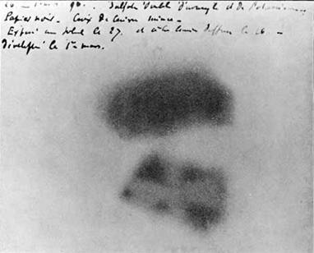
Experiment Results
The uranium salts left an outline on the paper.
One day later, Becquerel attempted to reproduce the results but was unable to due to overcast weather.
He placed the rocks, and paper wrapped photogenic plates in a draw and came back to it at a later date.
Upon receiving his materials for his next experiment, he found that even without sunlight, the uranium salts emitted radiation and caused an outline on the plates.
Henri Becquerel’s Experimental Results

Slide 8
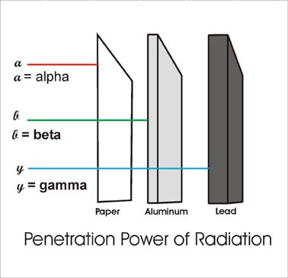
Rutherford’s Experiment and Results
Rutherford found different types of rays by using varying sizes of aluminum.
As the aluminum thickness increased, he saw that there were multiple types of rays.
Rutherford concluded that rays that the two types of rays were either readily absorbable, or penetrating. He named these alpha and beta rays respectively.
Rutherford based radiation test

Slide 9
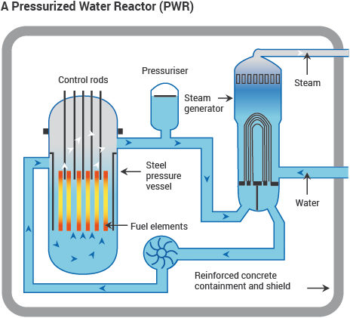
Impact of the Discovery
Built the foundation of modern science:
Discovery of the Nucleus
Discovery of Polonium and Radium
Discovery of Alpha and Beta particles and Gamma rays
The invention of radiochemistry and nuclear physics
Medical advancement
Treat cancer, detect illnesses
Nuclear Reactor
Notes:
Image: http://www.world-nuclear.org/information-library/nuclear-fuel-cycle/nuclear-power-reactors/nuclear-power-reactors.aspx

Slide 10
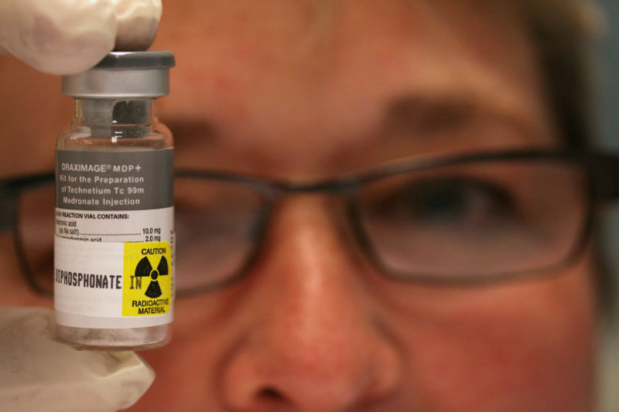
Future works and Application
Nuclear power and weapons: Uranium and other radioactive material are used to generate power and nuclear weapons.
Medical application: locate and cure cancer, detecting diseases and glands.
Sterilization: of foods and medical instruments.
Carbon-14 dating: Used to determine the ages of rocks and chronological sequence of past events.

Slide 11
Conclusion
In conclusion the discovery of radioactivity has impacted science greatly. The utilization of X-rays and radioactive materials is extensive in medicine and industry. It not only provides sterilization of medical instruments and food; radiation sources are also fundamental to the manufacturing industries around the world. There are plenty of industrial applications that rely on radioactivity, to determine if the product is internally fit for its application.

Slide 12
References
https://www.rsc.org/images/essay1_tcm18-17763.pdf
https://www.aps.org/publications/apsnews/200803/physicshistory.cfm
https://www.sciencedirect.com/science/article/pii/S1631070517300786
Reed, A. B. (n.d.). The History of Radiation Use in Medicne. Journal of Vascular Surgery,53(1), 3S-5S. Retrieved April 20, 2019.
https://www.nde-ed.org/EducationResources/HighSchool/Radiography/usesradioactivity.htm

