Slide 1
The Photoelectric Effect
Ivan De Anda, Tommy Nguyen, Micah Hanna, Oshina Jagtap, Chris Morales, Mark Kamerer

Slide 2
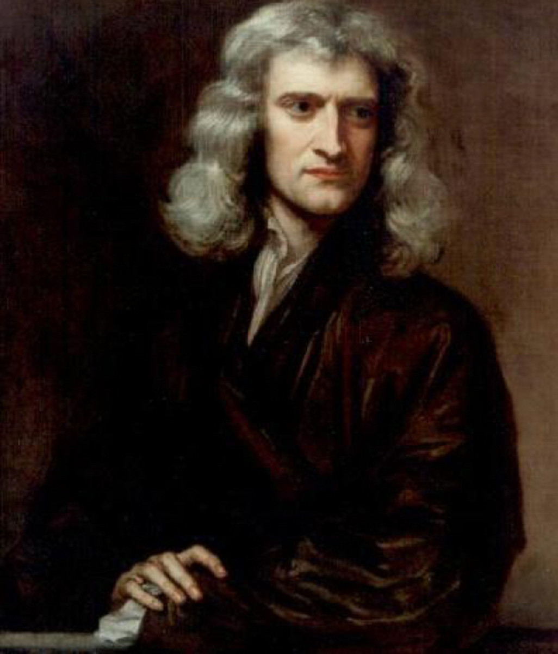
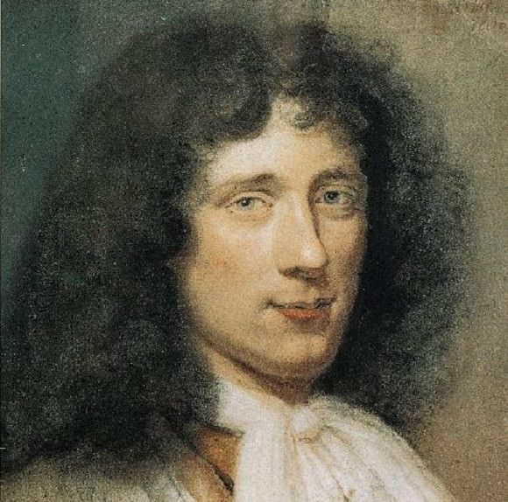
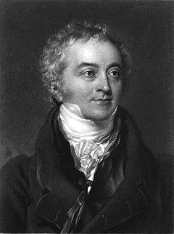
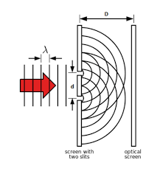
Introduction to light: Waves or Particles?
Light viewed as particles Isaac Newton:
• Corpuscular theory
• Wrote Optiks
• Accepted view for a while
Christiaan Huygens claims light is a wave:
• Wrote The Wave Theory of Light
• Accepted over Newton because of Thomas Young’s double slit experiment
Notes:
Mention newton’s corpuscular theory. Mention the victory of Huygens wave theory which was “proven” by thomas young’s double slit experiment. Transition to the photoelectric effect.

Slide 3
A challenge to the Wave Theory of Light: The Photoelectric Effect
Notes:
Give a brief explanation of the photoelectric effect. Something like, “ the photoelectric effect is a phenomenon where electrons are omitted from a material when light is shone into that material.”

Slide 4
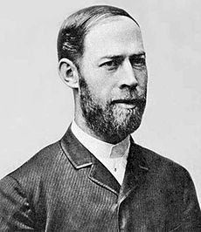
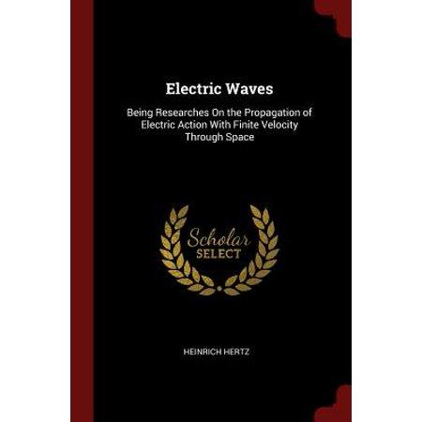
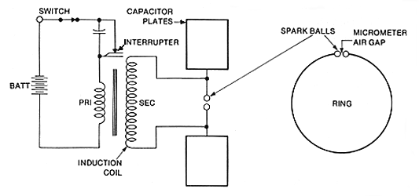
The Classical Photoelectric Effect:
Heinrich Hertz
1887 Heinrich Hertz discovered the photoelectric effect.
Spark gap experiment to prove Maxwell’s equations
Encasing the spark gap in container (eliminating incident UV light) decreased spark length.
Refused to make theory from the results.
Notes:
First time photoelectric effect is viewed. Hertz viewed the photoelectric effect when he was trying to prove maxwell’s theory. One day while working on a spark gap experiment he decided to encase one of the gaps in a container to make the gap more visible. This affected the results of the experiment. Hertz dint make a theory as he did not know what made this phenomena.

Slide 5
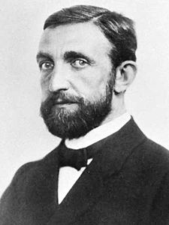
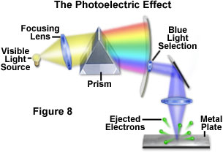
The Classical Photoelectric Effect: Phillip Leonard
1902 Phillip Leonard; assistant to Heinrich Hertz
Experimented using a prism (right)
velocity of the ejected electrons were independent of the intensity of light
Electron energy increase with frequency of incident light
His studies led to the addition of the Photoelectric effect being added to the list of ways that an electron can be emitted. Sharing space with Thermionic emission, Secondary emission, and Field emission.
Notes:
Leonard was an assistant to Heinrich Hertz. He attempted to find out what the photoelectric effect was. To do so he made the experiment as shown. He passed visible light through a prism to break up the light and experimented to see what the different light colors did to a metal plate. Leonard listed a few properties (as shown).

Slide 6
How It’s Made: classical results
Experiment used to detect photons. Five major points:
https://images.app.goo.gl/zr2KNEHedgNtFAjs6
Notes:
Explain the model. Black bar represents a photocathode which acts as the emitter when light falls on it and ejects the electrons. The electrons travel across the tube toward the anode which collects these electrons. Where a voltage from the power supply accelerates it or slows it down depending on what is applied. What we measure is the current which is gathered from the flow from cathode to anode.

Slide 7
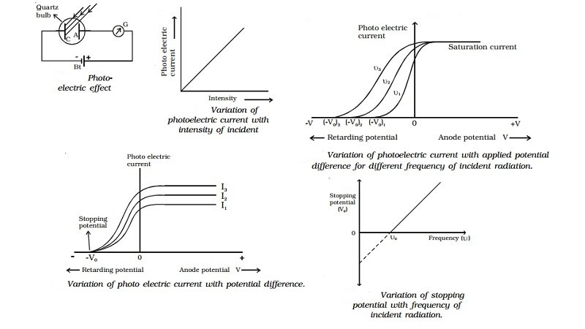
Summary of classical experiment
Notes:
They found that the kinetic energy is completely independent of the intensity. So basically the retarding voltage as mentioned before can stop any photoelectrons from flowing at any given light intensity. Which means that there is a maximum current that is allowed when the voltage adds to it and not slows it.
The maximum kinetic energy only relies on the frequency of the light. For different frequencies there are different stopping potentials and it does not rely on the intensity whatsoever.
The smaller the work function for the metal emitter the lower the frequency needs to be to start ejecting photoelectrons. Same as before intensity doesnt’t matter its the frequency of the light.
What intensity does influence is how many photoelectrons are produced. A low intensity is like a pee shooter, while a huge intensity is a rapidfire machine gun. So the calculations thus show that light intensity and photocurrent are linearly related.
The time it takes to emmit photo electrons is instantly, and doesnt rely on intensity.
All of this goes completely against the classical theory of light wave energy. So what does it all mean.

Slide 8
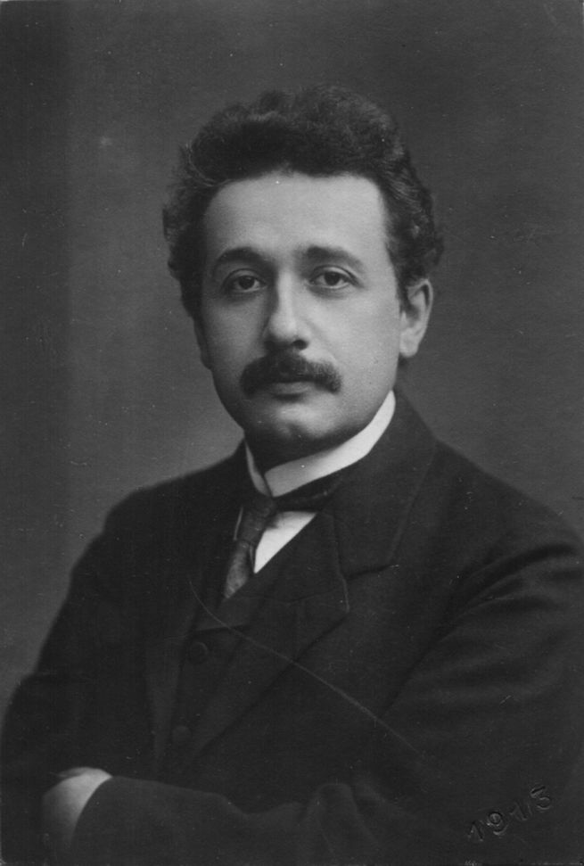
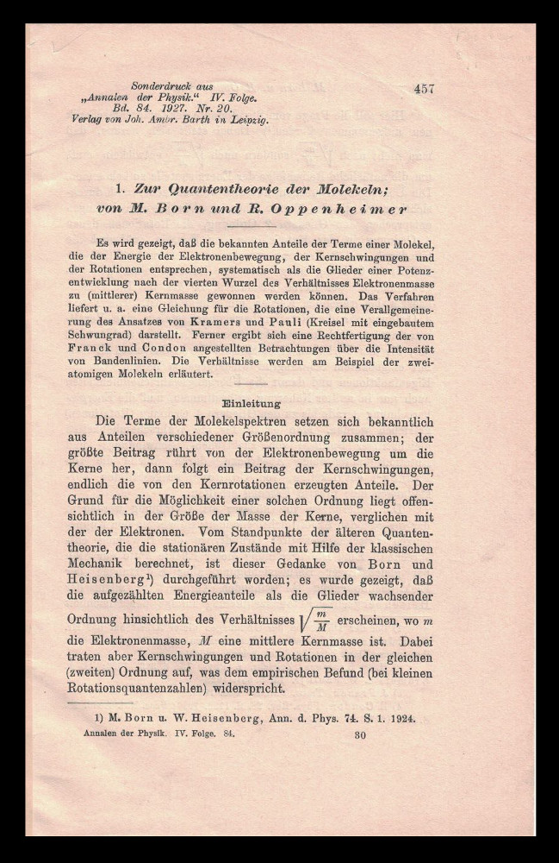
The Man, The Myth, The Legend
Albert Einstein comes into this when he took interest in Planck’s hypothesis, the electromagnetic field is quantized.
He wrote in “Annalen der Physik” which is the oldest scientific journal from the 1970’s.
What he proposed was that the light particles behave as both waves and particles. [9]
Notes:
Explain who albert Einstein is, what the annalen der physik is, mention the phenomena that made einstein think about light (photoelectric, blackbody radiation) as quantum “packets” called photons.
The issue with fluorescence is that the frequency of fluorescent light cannot be greater than the frequency of light inducing it. Fluorescence is the emission of light when light hits a substance, this is how some corals glow. Blackbody and photoelectric should be known from lecture.

Slide 9
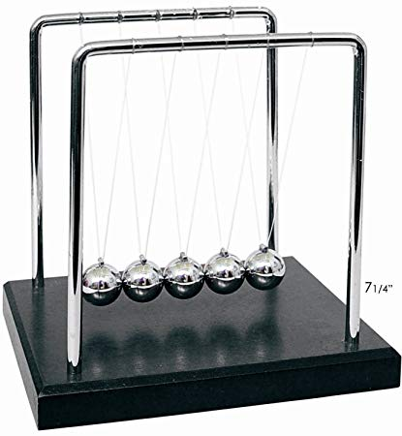
Modern Interpretation: Photoelectric Effect Revisited
Einstein started his dive into the Photoelectric effect by stating that the energy quantum of a photon is: E = hf
These photons need to overcome the work of the material and the resulting energy is what the electrons have as they escape. This is represented by
E = Φ + K = hf
Now we can represent the energy (eV) of these photons by the function
hf = Φ + ½ mv^2
Notes:
Explain the conservation of energy in this scenario i.e. a photon of energy E will strike an electron. The electron must use potential energy (work function) to escape and will emit with a kinetic energy; the conservation requires that potential energy and kinetic energy to sum into the photon’s total energy. Then the kinetic energy can be found. Φ

Slide 10
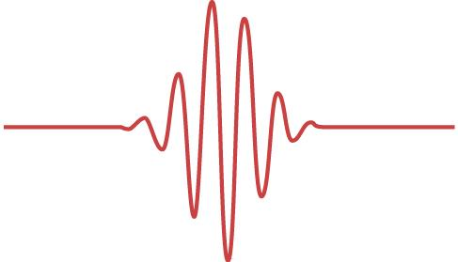
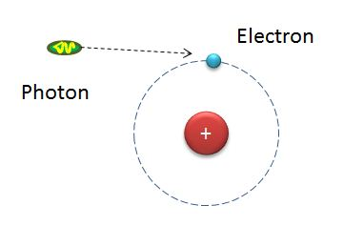
Modern Interpretation: Photons
The modern interpretation follows Einstein’s findings regarding wave-particle duality where the light behaves in both ways.
It also follows Planck’s quantum wave packet theory, and we use Einstein’s energy formula for wave packets
Energy (photon) = hf
This formula also allows us to determine the energy with the wavelength of the photons by replacing the frequency with
f= c/λ
Notes:
Explain photons, what wave-particle duality is, they come in wave packets as shewn, energy of a photon, frequency of the photon,

Slide 11
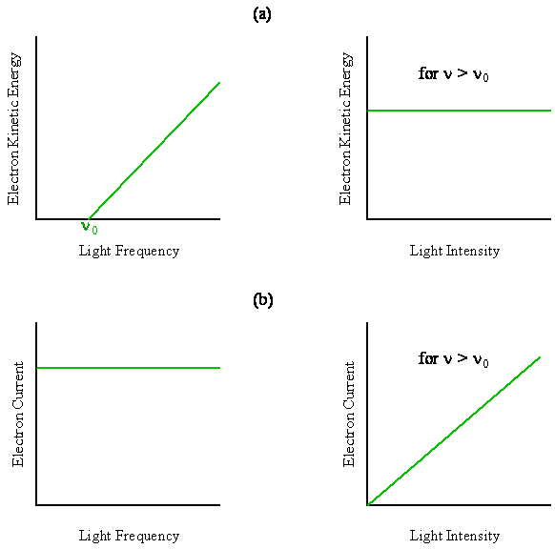
Modern Interpretation: Experimental Results
Needs a threshold frequency (f₀) to begin electron ejection
Higher frequency above threshold increases electron kinetic energy
More light intensity (greater than f₀) increases the amount of ejected electrons [7]
https://chem.libretexts.org/Bookshelves/Physical_and_Theoretical_Chemistry_Textbook_Maps/Book%3A_Quantum_States_of_Atoms_and_Molecules_(Zielinksi_et_al.)/02._Foundations_of_Quantum_Mechanics/2.2%3A_Photoelectric_Effect

Slide 12
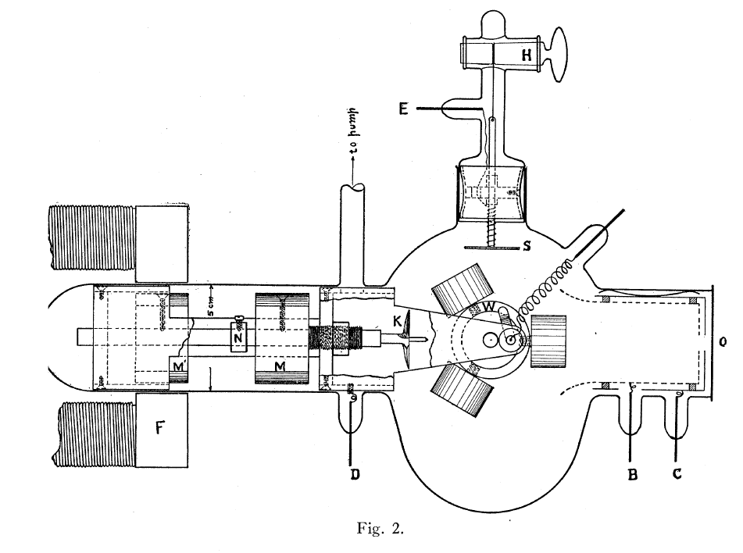
Modern Interpretation: Other Experimental Confirmation
Then along came Robert Millikan who was determined to prove Einstein’s conclusions wrong but… in 1916 his experiment not only confirmed the photoelectric effect and Einstein’s findings, but also was able to determine Planck’s constant to be
h = 4.1x10⁻¹⁵ eV s
His experiment involved a light of different frequencies on a sodium electrode and measured the Kinetic energy hoping to find a nonlinear relationship. However it was linear and the slope was indeed planck’s constant. [12]

Slide 13
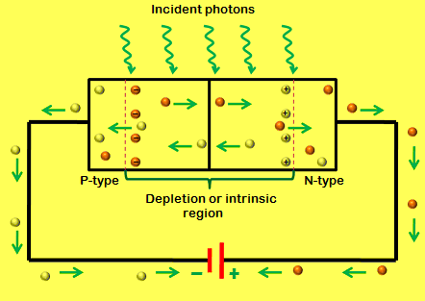
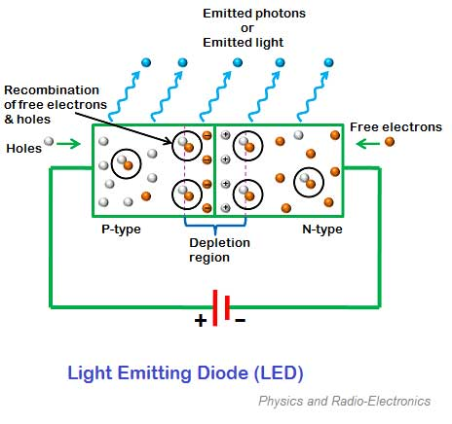
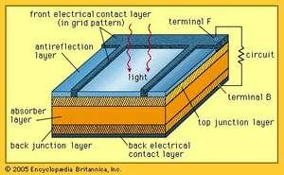
Applications of the Photoelectric Effect: Diodes
Photodiodes
Light shone at reverse bias diode.
Made out of compound semiconductor (gallium and arsenide)
Memory, signal processing, transmission
Solar Cell
Light shone at forward bias diode
Cause flow of electrons
Light Emitting Diode
Recombination causes emittance of light
Notes:
Photodiodes are diodes that have a current through them when light is shone at them. Solar cells are what is used for solar power; they work like photodiodes but are much bigger and operate in forward bias while photodiodes operate in reverse bias. Light emitting diodes are diodes where recombination (the combination of electrons and holes) emits light.

Slide 14
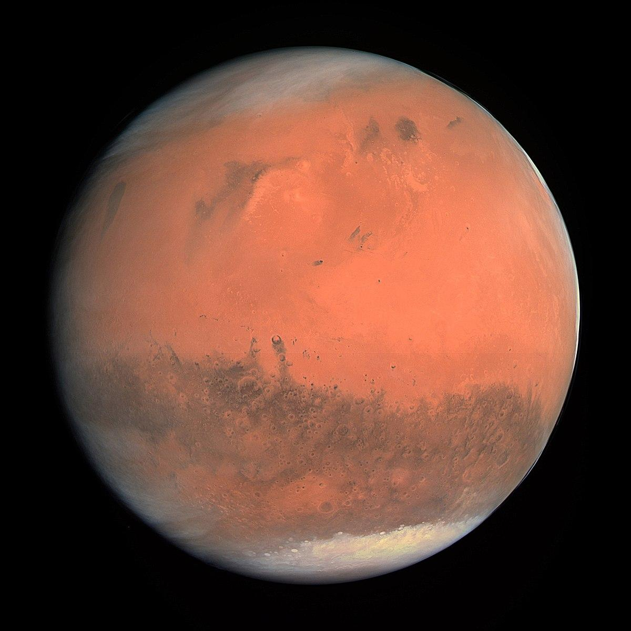
Futurology
The photoelectric effect has to be considered in space travel.
• Space shuttles are subject to discharge because of the sun’s rays
• Ongoing Questions: Martian atmosphere is thinner, more sunlight reaches the ground. How would this affect metals in mars? Moon?
Notes:
Due to the photoelectric effect, a space shuttle has to take into account possible discharge. This is because if one side of the shuttle is facing the sun then by the photoelectric effect it will have a bigger charge than the side of the shuttle not facing the sun. This discharge can damage components.

Slide 15
References
1. Hawkins, Stephen. A stubbornly persistent illusion: the essential scientific works of Albert Einstein. Philadelphia, Running Press Book Publishers, 2007
2. Newton, Isaac. Opticks, Translated by Bernard Cohen, New York, Dover Publications Inc, 1952
3. Huygens, Christiaan. Silvanus P. Thompson. Treatise on Light: In which are Explained the Causes of that which Occurs in Reflexion &amp; in Refraction, and Particularly in the Strange Refraction of Iceland Crystal. Dover Publications, New York, 1962.
4. Hertz, Heinrich Rudolf. Miscellaneous Papers. with an Introduction by. P. Lenard. Authorized English Translation by D. E. Jones and G. A. Schott., 1896.
5. Hertz, Heinrich. Untersuchungen über die Ausbreitung der elektrischen Kraft; Electric Waves, Being Researches on the Propagation of Electric Action with Finite Velocity through Space. New York: Dover Publications, 1962. Print.
6. Fowler, Michael. “The Photoelectric Effect.” Photoelectric Effect, galileo.phys.virginia.edu/classes/252/photoelectric_effect.html.
7. Thornton, Stephen. Rex, Andrew. Modern Physics For Scientists and Engineers. Fourth Edition. Cengage Learning, 2006.
8. Wheaton, Bruce R. &quot;Philipp Lenard and the Photoelectric Effect, 1889-1911.&quot; Historical Studies in the Physical Sciences, vol. 9, 1978, pp. 299-322.
9. Annalen Der Physik (1900: Online). Leipzig: [J.A. Barth], 1900. Print.
10. Sedra, Adel. Smith, Kenneth. Microelectronic Circuits. Seventh Edition. New York,
Oxford University Press, 2014.
11. Encyclopedia Britannica, “Photoelectric Effect.” Encyclopedia Britannica, Inc., 19 Jan. 2018, www.britannica.com/science/photoelectric-effect.
12. Millikan, Robert. “A Direct Photoelectric Determination of Planck&#39;s &#39;h&#39;&quot;. vol. 2,, 2004.

Slide 16
Questions and Answers

