Slide 1
Super-Conductivity
Madeline Smith, Jennifer Bradford,
Muye Liu, Sidharth Kapoor

Slide 2
Below a certain temperature, materials enter a superconducting state and offer no resistance to the passage of electrical current
CERN [3]

Slide 3
What is Superconductivity?

Slide 4
Super-conductivity can be defined as a material’s ability to conduct an electrical current with little to no resistance. When a critical temperature is hit (usually an extremely low temperature) the material will enter the transition into the super-conducting state.

Slide 5
The super-conductivite state can be characterized by two properties:
The material offers no resistance to electrical current passing through it
If a material is super weak, any external magnetic fields cannot pass through the super-conductor. Instead it will remain at the surface. This is known as the Meissner effect.
Super-conductors can be categorized into two different states: Type-I and Type-II.

Slide 6
Type-I
A type-I material can only remain in the super-conductivity state if the applied magnetic field is weak. Once the given threshold is exceeded, the magnetic field will pass through the material and break the superconducting state

Slide 7
Type-II
Type-II materials are able to handle the local passing of the magnetic field due to the mixed state of superconducting and non superconducting areas coexisting. This allows for a super-conductive state to be present with a strong magnetic field.

Slide 8
The Early Stages of Superconductivity

Slide 9
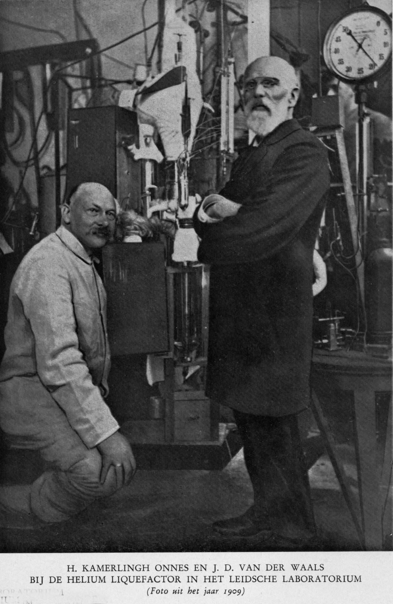
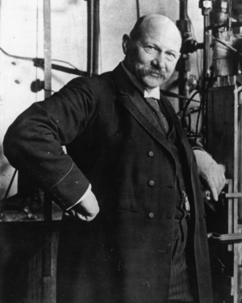
Heike Kamerlingh Onnes
University of Leiden in Holland
Known for the initial discovery of superconductivity through the use of Mercury and Hydrogen.
Heike Kamerlingh-Onnes (left) and J. D. Van Der Waals (right) 1909.
Heike Kamerlingh-Onnes 1913
https://photos.aip.org/history-programs/niels-bohr-library/photos/nobel-gallery/heike-kamerlingh-onnes

Slide 10
H. Kamerlingh Onnes Cont..
A Test of Mercury
During a mercury electrical resistance test, he cooled the temperature to 4K, where he noticed a strange disappearance of resistance.
Einstein Applied to be Onnes assistant
He was rejected.
1908
1913
1901
1911
Discovered the boiling point of helium
Won nobel prize for his research

Slide 11
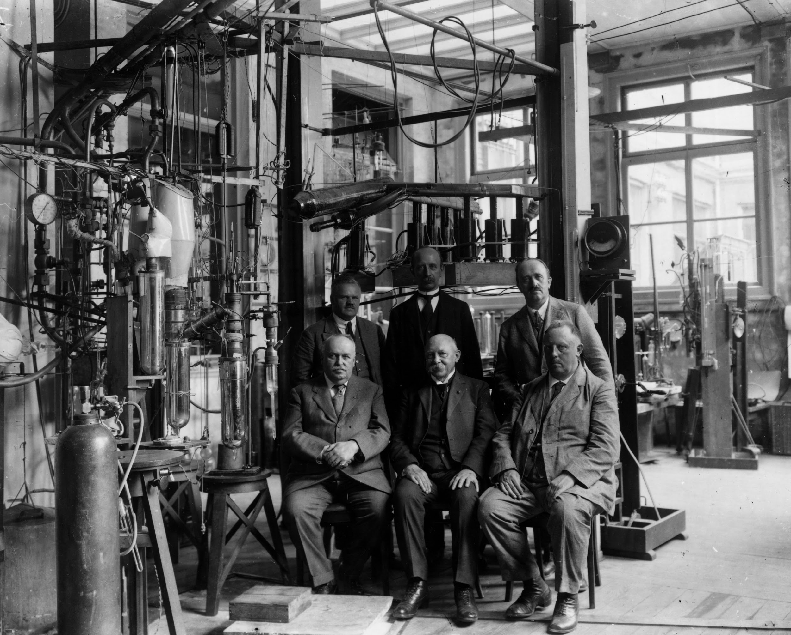
(Left to Right) Sitting: Heike Kamerlingh-Onnes, Willem Keesom, and Kowalsky. Standing: Wolfke, Vegard, and Flim.
https://photos.aip.org/history-programs/niels-bohr-library/photos/nobel-gallery/heike-kamerlingh-onnes

Slide 12
1927
1924
[4]
[4]

Slide 13
Meissner and Ochsenfeld
Meissner Effect
Fritz and Heinz London
London equations
Bern Matthias- Bell Laboratories
Raised Tc ceiling to 17.86 K
1950
1933
1935
1953
Kharkov group (L. V. Shubnikov)
Type II Superconductors
Vitalii Ginzburg and Lev Landau’s
Modified London’s equations Under Type I and II behavior
John Hulm- University of Chicago
17K Superconductor of a new crystal structure

Slide 14
The Science Behind it and Important Theories

Slide 15
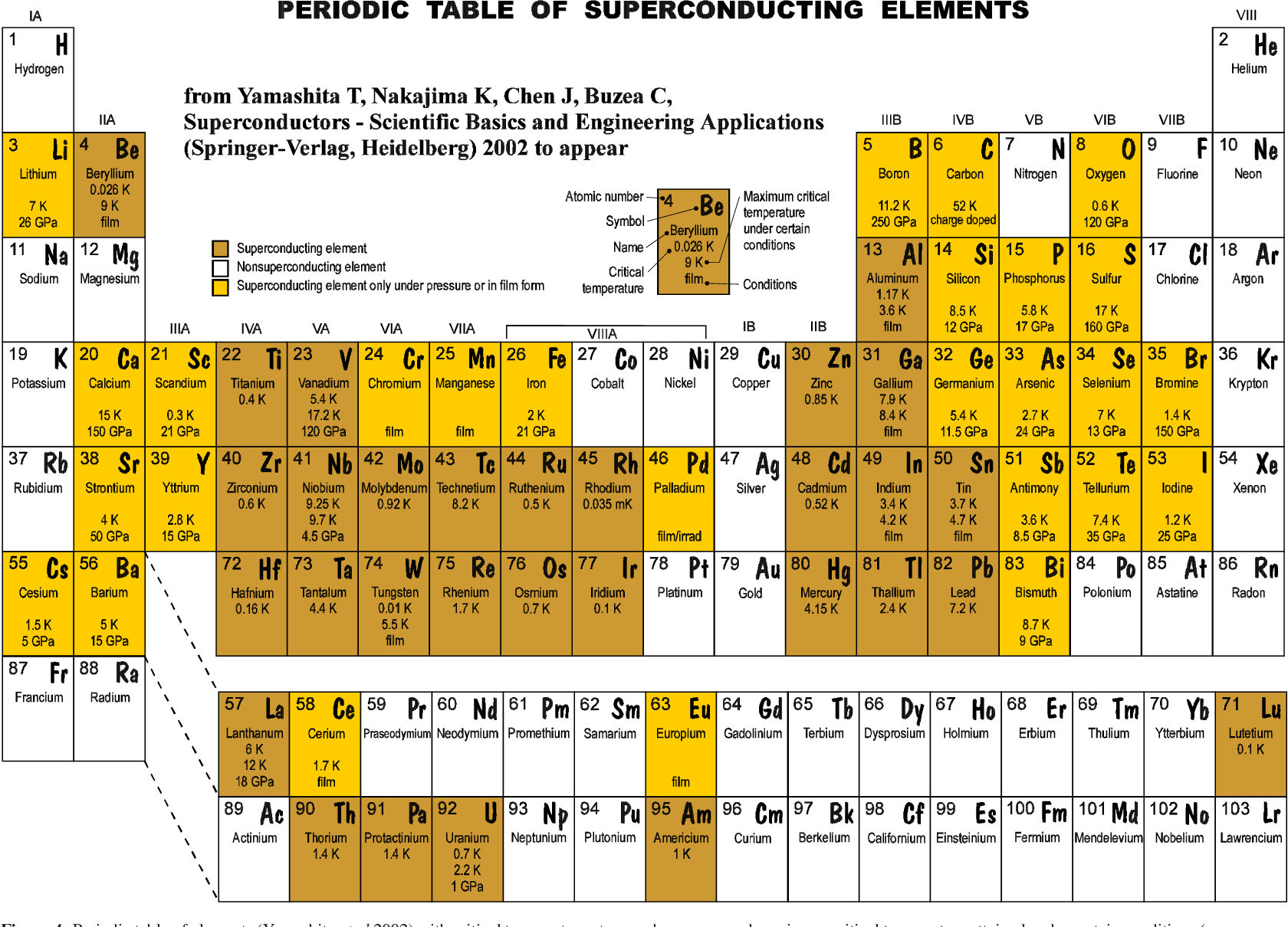
https://www.semanticscholar.org/paper/Review-of-the-superconducting-properties-of-MgB2-Buzea-Yamashita/eda1c669431462738ef9ba687cde45c03b2666bb

Slide 16
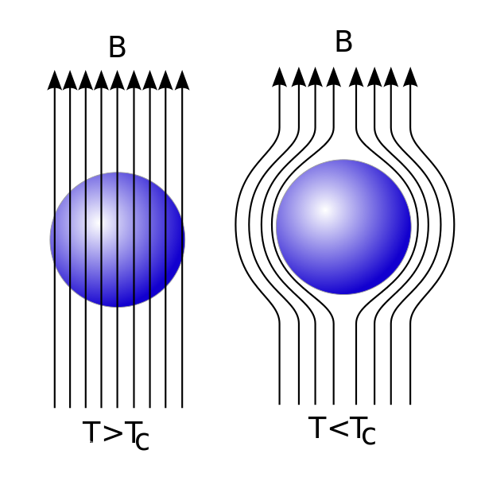
Meissner Effect
Discovered by German physicists Walther Meissner and Robert Ochsenfeld in 1933;
Expulsion of a magnetic field from a superconductor during its transition to the superconducting state.
https://eng.libretexts.org/Bookshelves/Materials_Science/Supplemental_Modules_(Materials_Science)/Magnetic_Properties/Meissner_Effect

Slide 17
London Equation
Developed by brothers Fritz and Heinz London in 1935;
Related current to electromagnetic fields in and around a superconductor;
Explain the Meissner effect;
Two London Equation:

Slide 18
Ginzburg–Landau Theory
Named after Vitaly Lazarevich Ginzburg and Lev Landau in 1950;
As a mathematical physical theory used to describe superconductivity;
Could describe type-I superconductors without examining their microscopic properties;
Also appears in some limit of microscopic theory.

Slide 19
BCS Theory
Named after John Bardeen, Leon Cooper, and John Robert Schrieffer in 1957;
The first microscopic theory of superconductivity;
Describe superconductivity as a microscopic effect caused by a condensation of Cooper pairs into a boson-like state;
Also used in nuclear physics to describe the pairing interaction between nucleons in an atomic nucleus.

Slide 20
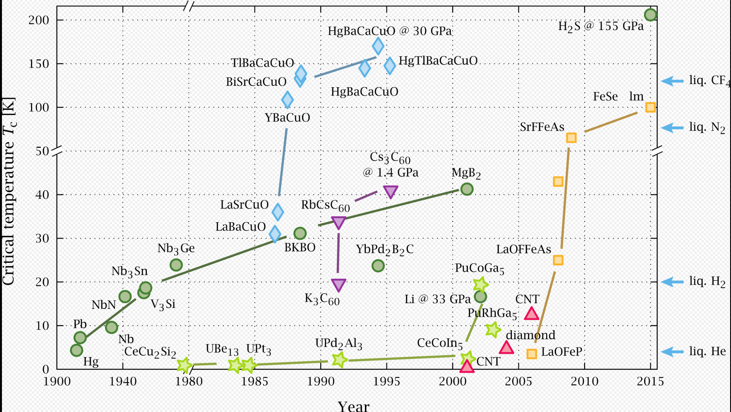
Timeline of superconducting materials
https://amitray.com/quantum-computing-with-superconductivity-at-room-temperature/

Slide 21
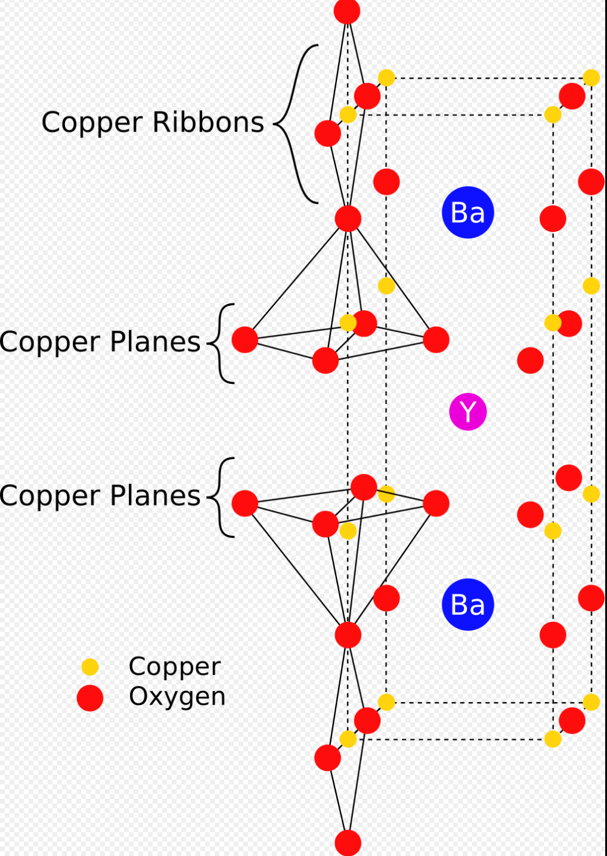
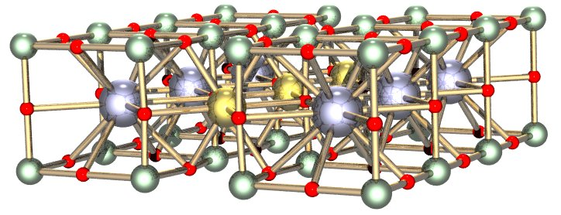
Y-Ba-Cu-O Superconductor (1987)
https://www.kisspng.com/png-yttrium-barium-copper-oxide-crystal-structure-supe-3638998/download-png.html

Slide 22
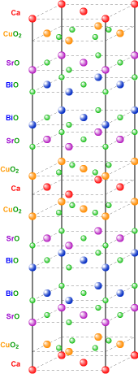
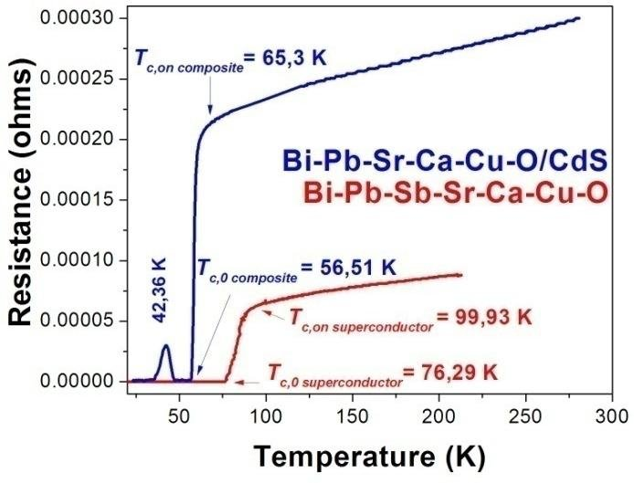
Bi-Sr-Ca-Cu-O Superconductor (1988)
https://www.researchgate.net/figure/Bi-Pb-Sr-Ca-Cu-O-superconductor-and-CdS-Bi-Pb-Sr-Ca-Cu-O-composite-electrical-behaviour_fig4_48176707

Slide 23
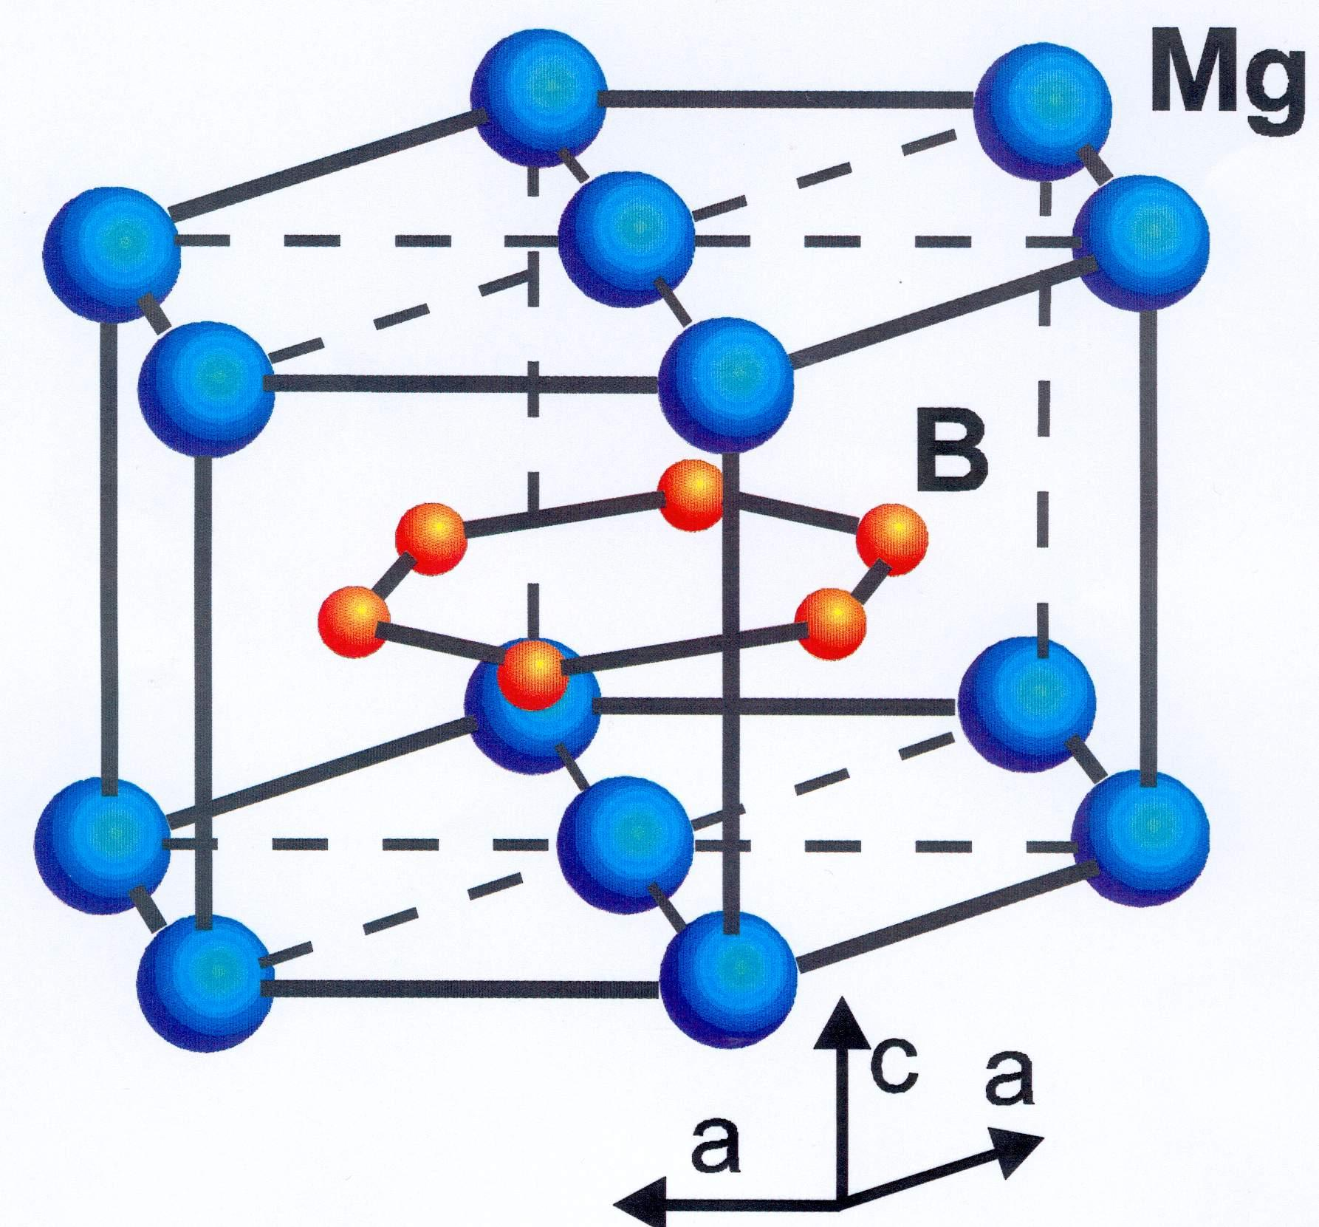
MgB2 Superconductor (2001)
https://www.phy.cam.ac.uk/research/research-groups/qm/novelsc

Slide 24
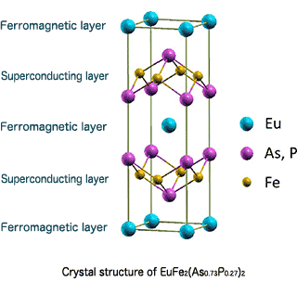
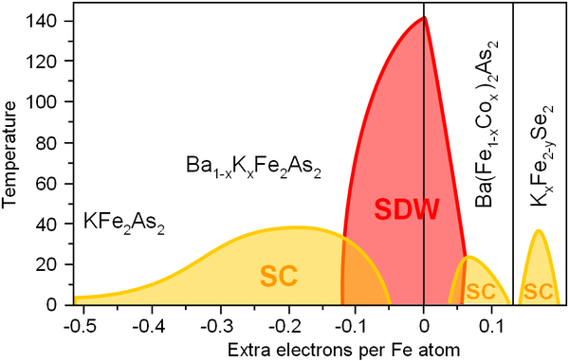
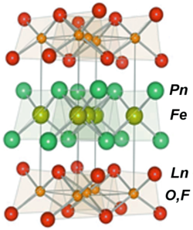
Iron-based Superconductors (2006-2008)
https://www.researchgate.net/figure/Phase-diagram-of-the-122-family-of-ferro-pnictides-complemented-by-the-122Se-family-as_fig6_230779462

Slide 25
Why is this relevant?

Slide 26
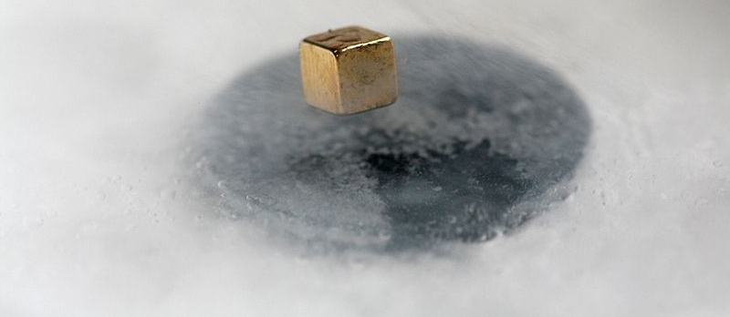
Applications in the modern world
Two major subgroups-
LTS (Low temperature superconductor)
Accounts for the vast majority of superconductor applications today.
Made from Niobium-Titanium alloy, typically operates at cryogenic temperatures, well below 20 K (-253℃).
Nb-Ti Alloy low temperature superconductor
https://physicsworld.com/a/metamaterials-offer-route-to-room-temperature-superconductivity/
Notes:
2 major types of superconductors in use-
Low temps (most common)
High temps(niche applications)

Slide 27
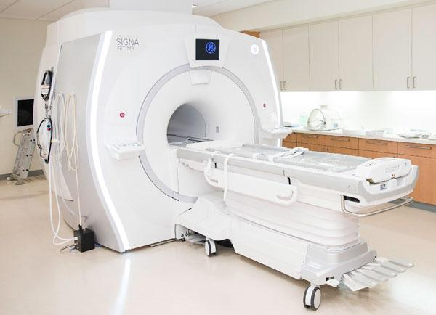
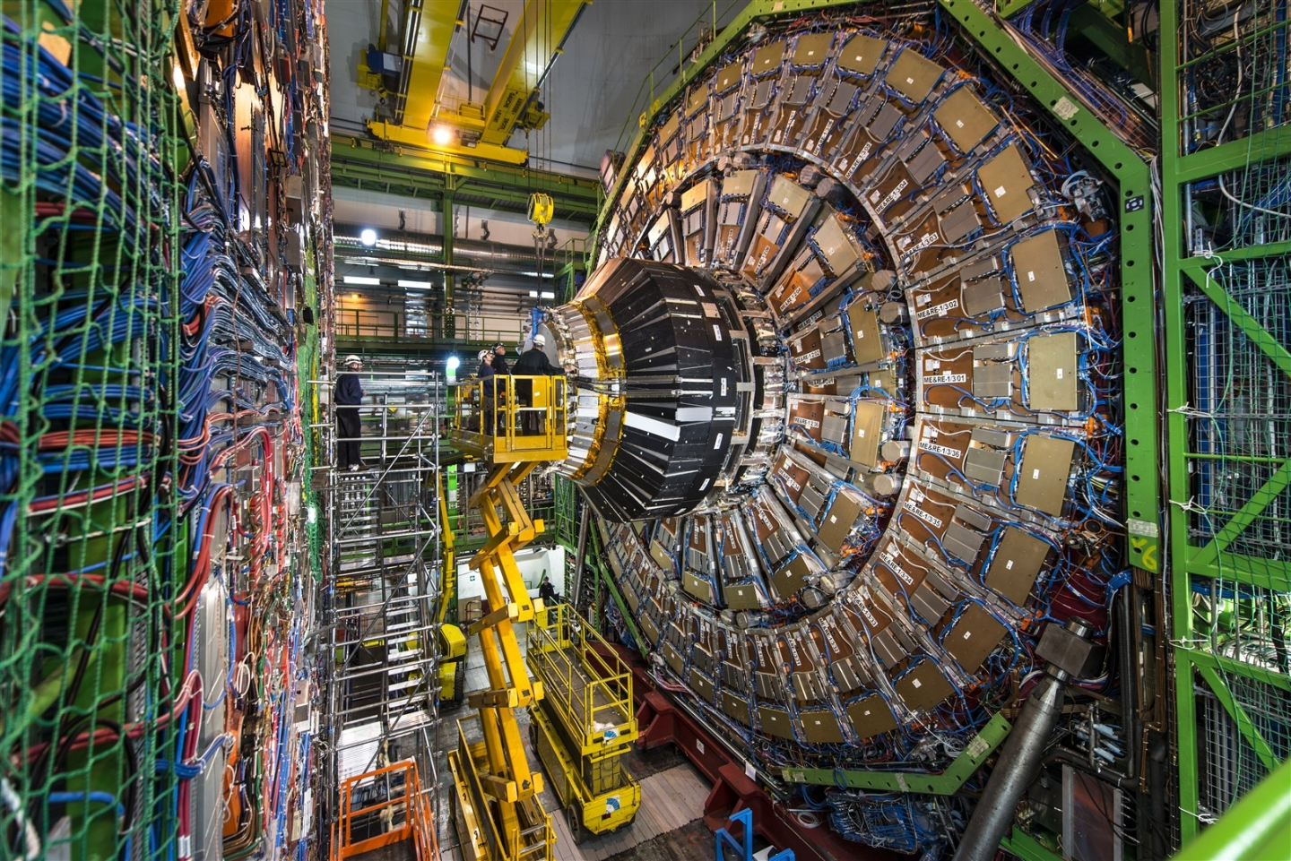
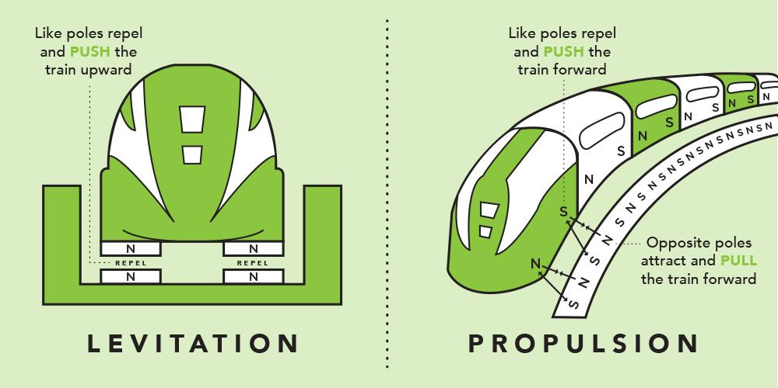
Low Temperature Superconductors
Applications related to magnet technology, including MRI and medical imaging, particle accelerators, maglev trains are significant.
https://home.cern/news/news/accelerators/lhc-rocks-seesaw-model
Notes:
Low temp superconductors used for magnetic technology, makes super powerful and efficient magnets, has vast applications mentioned above.

Slide 28
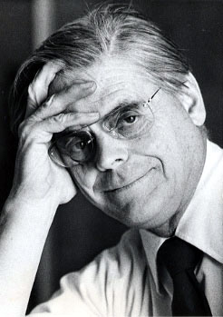
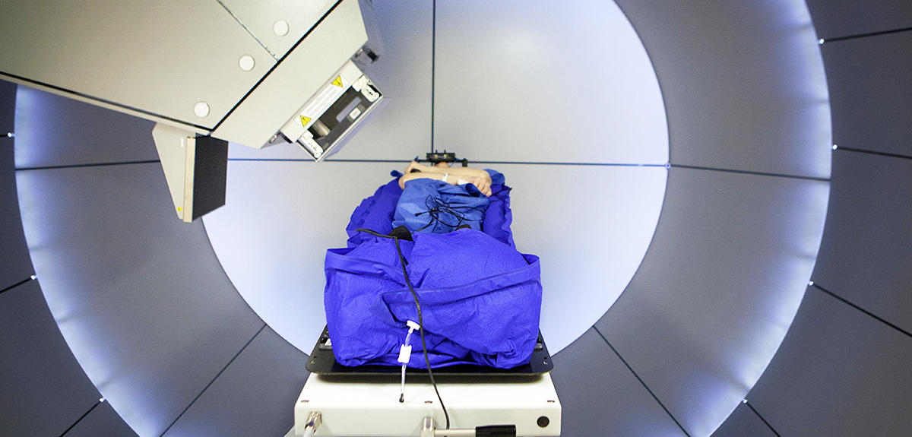
Low temperature superconductors in medicine
Hadrontherapy-
The idea of using protons for cancer treatment was first proposed in 1946 by the physicist Robert Wilson, who later became the founder and first director of the Fermi National Accelerator Laboratory.
https://history.fnal.gov/wilson.html
https://ieeexplore.ieee.org/abstract/document/1018566
Notes:
Better and more precise than existing therapy.
Lower collateral damage to body, but ways to go because of existing traditional infrastructure.

Slide 29
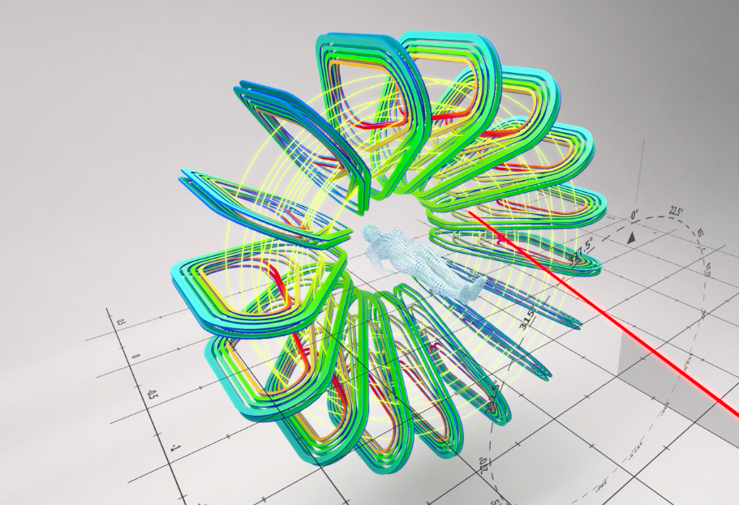
Use of low temperature superconducting magnets to direct carbon ion beam to irradiate malignant tumors.
Offers lower operating cost and lower footprint, especially significant in pediatric cancer research.
https://home.cern/news/news/knowledge-sharing/using-cern-magnet-technology-innovative-cancer-treatment
https://www.cdc.gov/cancer/dcpc/research/articles/rates-children-teens-state-region.htm
Notes:
More child friendly, lower death rates from treatment.

Slide 30
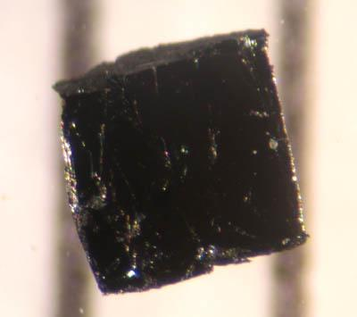
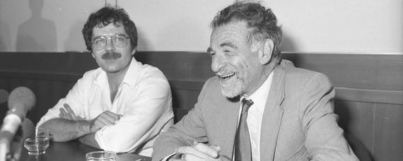
HTS (High temperature superconductors)
Ceramic oxides able to display superconductivity at unusually high temperatures ( over 138 K).
1987 Nobel prize awarded To IBM researchers Karl Muller and Johannes Bednorz.
Bismuth strontium calcium copper oxide
Karl Muller and Johannes Bednorz at the IBM research laboratory
https://www.library.ethz.ch/en/Resources/Digital-library/Short-portraits/Karl-Alexander-Mueller-1927-Georg-Bednorz-1950
Notes:
Less common, relatively high working temps compared to low temp superconductors.
YBCO (yttrium barium copper oxide) superconductors
super-conducts at higher temps than boiling point of liquid nitrogen, more than 203 K (-70 °C).

Slide 31
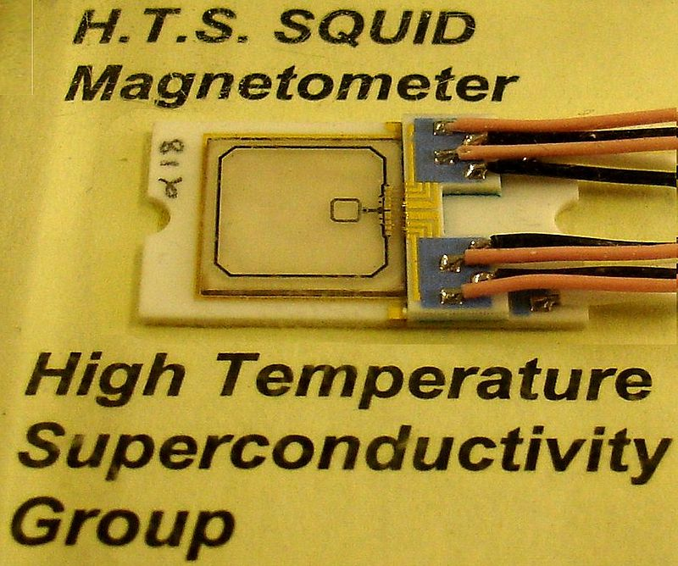
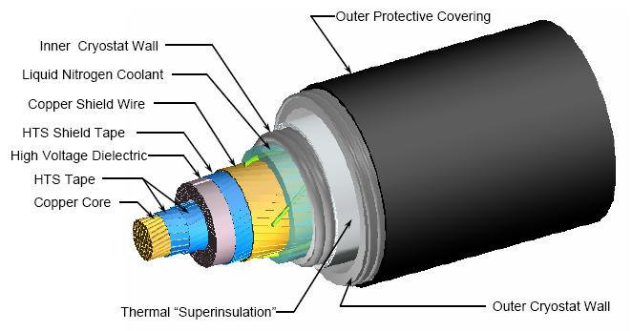
High Temperature Superconductors
Costly to operate and maintain, niche applications. Mostly small scale applications such as high efficiency power transmitters, magnetometers, ultra fast response digital circuits.
SQUID device- Superconducting QUantum Interface Device
Extremely sensitive magnetometer used to detect very subtle magnetic fields(5x⏨-18 tesla).
http://hyperphysics.phy-astr.gsu.edu/hbase/Solids/Squid.html
Notes:
Squid device is a significant application of high temp superconductors.
Unprecedented levels of magnetic field detection without cryogenic treatment.
Advanced SQUIDS called near quantum-limited SQUID amplifiers- used to detect Axions. Axions are a prime candidate for cold dark matter.

Slide 32
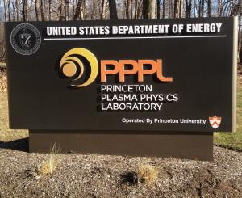
High Temperature Superconductors for Fusion Nuclear
Princeton Plasma Physics Laboratory (PPPL) is currently leading the design study of Fusion Nuclear Science Facility(FNSF).
High performance superconducting magnets are being used in the highfield fusion reactors such as the FNSF which was completed in 2015, in the South of France.
https://www.pppl.gov/research/experimental-fusion-research
Notes:
Superconducting magnets used to control and retain plasma generated from nuclear fusion.
Has potential to replace fission with fusion; working prototypes exist on small scale.

Slide 33
What Next?

Slide 34
What We Don't Know
The BCS theory is considered incomplete. It offers no explanation for the existence of HTS
Why are there not any room-temperature super-conductors?

Slide 35
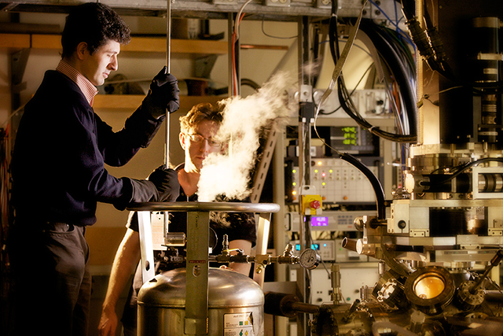
High temperature… but not really
HTC are still relatively low temperatures, with the record super-conductor being patented in 1996 at 138K (-135 C).
Currently scientists are attempting to discover a way to create a room temperature superconductor.
https://d2r55xnwy6nx47.cloudfront.net/uploads/2014/04/superconductivity-main_web.jpg
Notes:
If scientists can figure out a way it could change technology forever. Things like levitating trains or power grids that never lose energy could finally be possible.

Slide 36
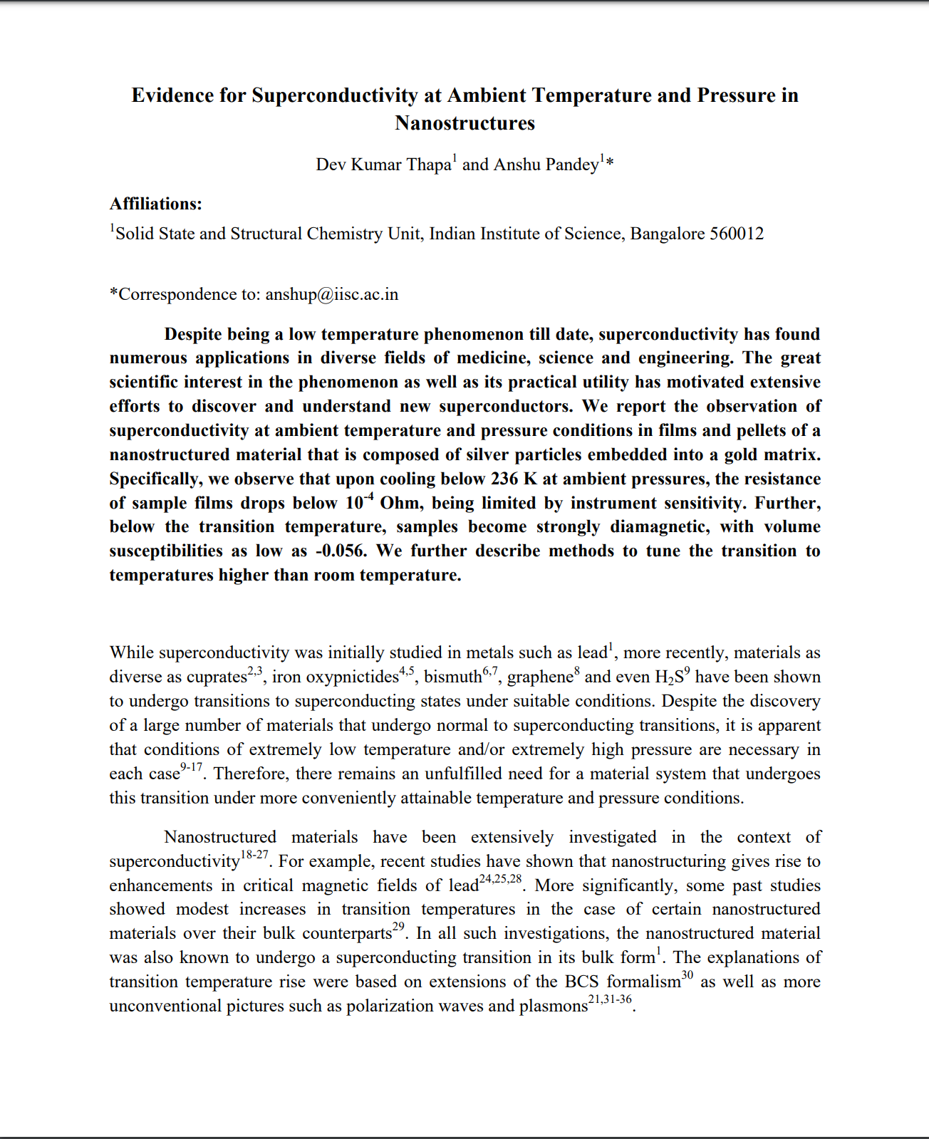
FAKE NEWS?

Slide 37
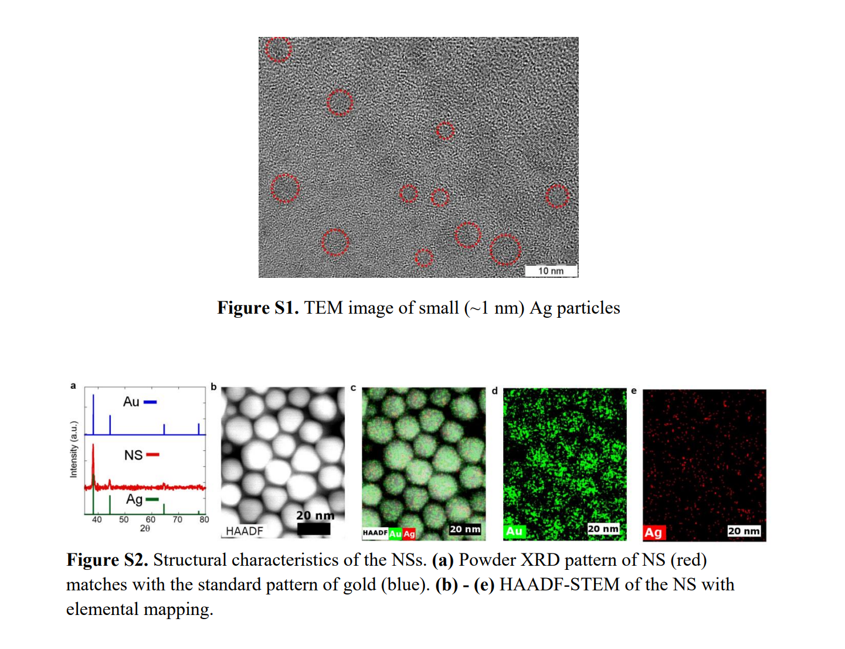
Room temperature Superconductor discovered?
On 7-23-18 two physicists published a paper claiming that they have found a way to create a room temperature superconductor. This would be a Nobel worthy accomplishment.
5
Notes:
a combination of silver and gold nanoparticles is the materials they used

Slide 38
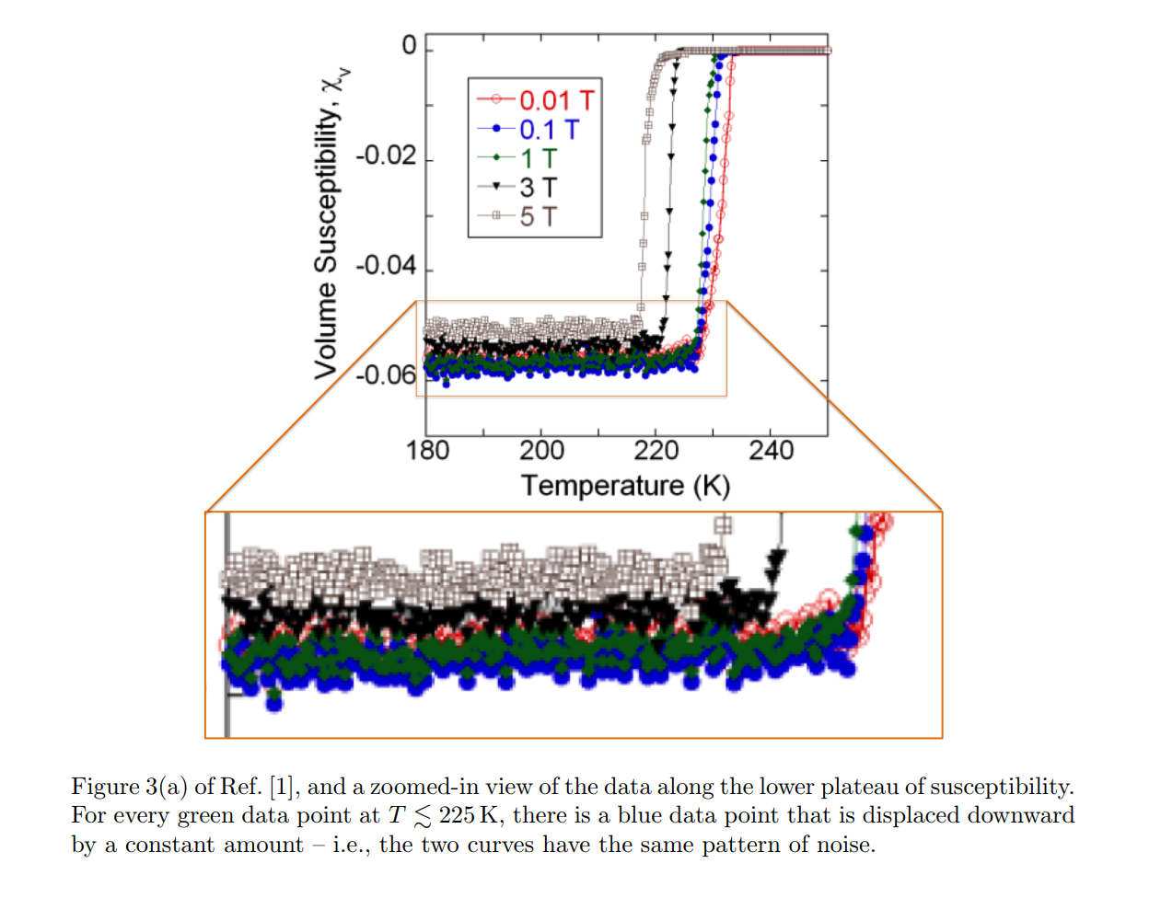
Discrepancies found
MIT Physicist, Brian Skinner, found a concerning correlation of the original paper’s data.
Two of the values for the magnetic field were found to have the same pattern of noise, only slightly offset.
The authors of the original paper have remained silent on the issue, despite requests for them to share their samples so independent studies can be done.
6
Notes:
Noise should be random, and should not repeat on different trials completed with different magnetic fields.

Slide 39
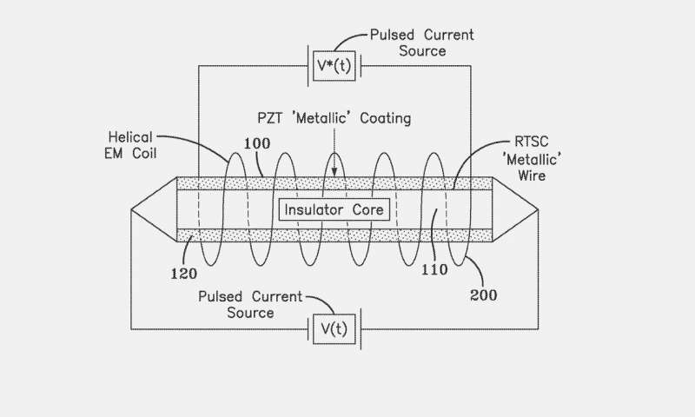
The Search Continues
On February 21st 2019, a Navy scientist published a patent for a room temperature superconductor.
But there is no data published with the patent
8
Notes:
This super-conductor would be built using a wire that has an insulator core, as well as an aluminum led zirconate titanate (PZT) coating.

Slide 40
Bibliography
“The History of Superconductors.” Superconductor History, Feb. 2019, superconductors.org/history.htm.
Lee, Peter J, The Applied Superconductivity Center. “Brief History of Superconductivity”. Superconductivity Florida
State University, fs.magnet.fsu.edu/~lee/lee-superconductor-history.htm.
“Superconductivity.” CERN, home.cern/science/engineering/superconductivity.
Hamburgisches Welt-Wirtschafts-Archiv. “Bilder Aus Dem Kaltelaboratorium Der Physikalish-Technishen Reichsanstalt in
Berlin-Charlottenburg.” V.D.I Nachrichten, 14 Dec. 1927, http://webopac.hwwa.de/PresseMappe20E/Digiview_MID.cfm?mid=F045342.
D. Thapa, A. Pandey, “Evidence for Superconductivity at Ambient Temperature and Pressure in
Nanostructures”, arXiv:1807.08572, Cornell University, 23 Jul. 2018
B.Skinner, “Repeated noise pattern in the data of arXiv:1807.08572, ‘Evidence for Superconductivity at Ambient Temperature
and Pressure in Nanostructures’”, arXiv:1808.02929, Cornell University, 8 Aug. 2018
S.Hall, “A Superconductor Scandal? Scientists Question a Nobel Prize–Worthy Claim”, Scientific American, 20 Aug. 2018
C. Salvatore, “Piezoelectricity-induced room temperature superconductor”, US2019/0058105 A1, 21 Feb, 2019
Johnston, H. Metamaterials offer route to room-temperature superconductivity. PhysicsWorld (2013).
Chalmers, M. CMS experiment delves into the mystery of neutrino masses. CERN (2017).
Wilson, R. R. Fermilab History and Archives Project. Robert Rathbun Wilson
Priano, C. A superconducting magnet for a beam delivery system for carbon ion cancer therapy. IEEE Xplore (2002).
Tvede, L. & Porcellana, G. Using CERN magnet technology in innovative cancer treatment. CERN (2017).

