Slide 1
J.J. Thomson’s Discovery of Electron
C. Garces, R. Guerra, C. Leferink, J. Scantlin

Slide 2
Cathode Rays
Many respected scientists thought cathode rays were some type of wave phenomena.
It was also believed that atoms were the fundamental building blocks of matter and were not divisible.
However, Thomson believed they were particles.
Thomson set out to prove that cathode rays were negatively charged particles he called “corpuscles” with his experiments.

Slide 3
Do Cathode Ray’s Have a Negative Charge?
Two Leading Theories:
Ethereal Theory / Electrified-Particle Theory
Jean Perrin, French Physicist, conducted experiment using a very simplified C.R. Tube.
When the C.R. hit the ”target” (an electrometer) a negative charge was found.
When the C.R. was deflected by a magnet as to not hit the “target” no charge was shown.
Ethereal Theorist thought was not enough to prove direct relation between the C.R. and Negative Charge.
As Thompson stated in The Electrician (1897) ”…while they did not deny that electrified particles might be shot off from the cathode, these particles were, in their opinion, merely accidental accompaniments of the rays, and were no more to do with the rays than the bullet has with the flash of a rifle” (p.106).

Slide 4
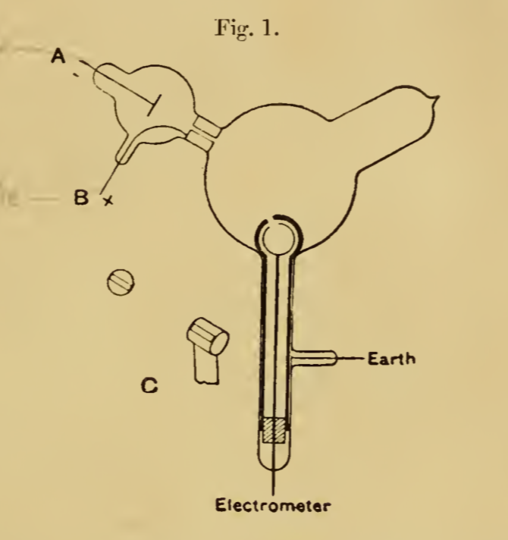
Enter Thomson (the first time)
Thomson redesigned Perrin’s Experiment
Thomson found that only when a magnetic field was
applied in just the right fashion, as to where it hit the
electrometer, did he get a negative charge to show.
Showing the negative charge follows the Cathode Ray
and they must be in some way connected.
Pg.295, Philosophical Magazine

Slide 5
Hertz’s Experiment
Hertz showed that when a strong electric field was applied to a cathode ray it would deflect.
Could not get this to happen with a small electric field (i.e. a battery).
Ethereal Theorist thought no connection proven. Proposed the rays move due to discharge passing between the electrodes, not the electric field.
As if the rays are being “pushed.”
Failed because the cathode rays had interacted with and ionized the residual gas in the tube.
Thomson (entering again a second time) proposes redoing Hertz’s experiment under a vacuum upon results that gas in the C.R. tube becomes conductive.
Pg.296, Phil. Mag.

Slide 6
Thomson’s Results
After redoing Hertz’s experiment under a vacuum Thomson found:
The higher the vacuum he used on the tube, He could pull off using only a battery to achieve ‘deflexion’ of the cathode ray.
Thomson found as the battery slowly diminished the cathode ray would slowly deflect less and less until it returned to the zero mark.
Showing it interacts with the electric field just as they would suspect an electric particle to interact.
Thomson then proceeded to see how the cathode rays interacted with magnetic fields in different conductive gases, and found that regardless of the gas he saw the same ‘deflexion.’

Slide 7
What did Thomson conclude from all this?
Quoted by Thomson from the Philosophical Magazine (1897) “As the cathode rays carry a charge of negative electricity, are deflected by an electrostatic force as if they were negatively electrified, and are acted on by a magnetic force in just the way in which this force would act on a negatively electrified body moving along the path of these rays, I can see no escape from the conclusion that they are charges of negative electricity carried by particles of matter” (p.302).
Thomson then asked what these particles are?
To try an answer this question, “I made a series of measurements of the ratio of the mass of these particles to the charge carried by it” (p.302, Phil. Mag.).

Slide 8
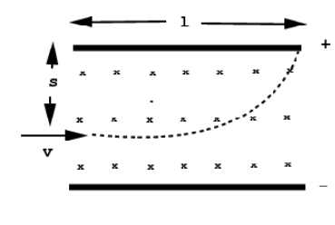
Results/Conclusions of Thomson’s Experiment Summary
Cathode Rays are composed of negatively charged particles
Observed that cathode rays were deflected in an evacuated glass tube
Charge of the electron was determined by Millikan’s Oil Drop Experiment
Mass of electron is $\sim \frac{1}{1700}$ the mass of a Hydrogen atom
~9.8235E-31 kg which is very close to the actual known value
Electrons are present in atoms of all known elements

Slide 9
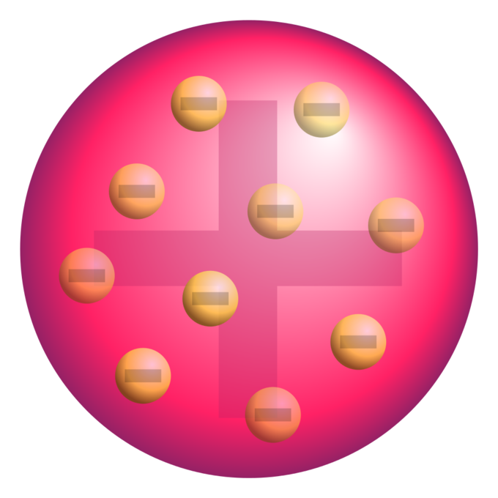
Thomson’s Atomic Model
Thomson proposed the “Plum Pudding” Model to satisfy his findings.
Atom is composed of negatively charged particles surrounded by a positive charge.
Later disproven by Hans Geiger’s and Ernest Marsden’s Gold Foil Experiment interpreted by Rutherford.

Slide 10
Applications and Usefulness
Solid state devices
Transistors
Semi-conductors
Cathode ray tubes
Computer monitors and television sets
Imaging
Electron transmission and scanning microscopes
Low energy electron diffraction uses a collimated beam of electrons and observes diffraction patterns to determine the structure of the material.
Particle beams
Particle accelerators propel electrons and their antiparticles using electric fields.
Line particle accelerators which generate electron beams for radiation therapy of superficial tumors.
Electron beam processing is used to irradiate materials or sterilize medical and food products.
Electron beams used for welding.
Electron beam lithography which is used for etching semiconductors.

Slide 11
Q/A

