Slide 1
BLACK BODY RADIATION
Explained by Zach Burns
Research and Developmental Assistance:
Tyche Doe,
April Contreras,
Nabin Champagain,
Chelsi Nealson

Slide 2
GOOD AFTERNOON!!

Slide 3
INTROduction

Slide 4
INTRO(cont.)
Perfect absorber/emitter
Light-source in TE
All objects above absolute zero

Slide 5
INTRO

Slide 6
INTRO

Slide 7
Term used by Gustav Kirchhof first in 1860
Also called thermal, cavity, complete, or temperature radiation
Blackbodies are bodies “which, for infinitely small thickness, completely absorb all incident rays, and neither reflect nor transmit any”

Slide 8
ORIGINAL THEORY/EXPERIMENT
Color depends on temperature only

Slide 9
ORIGINAL THEORY
1859 Kichhoff-
“Large box with hole”

Slide 10
ORIGINAL EXPERIMENT
Wien and Lummer finally did it! (1895)

Slide 11
Theoretical predictions and experimental proofs
E plot INSIDE over: ρ(f,T)
Frequency interval: f,f+Δf
Energy density: ρ(f,T)Δf
Radiation power from hole area:
A=14Acρ(f,T).

Slide 12
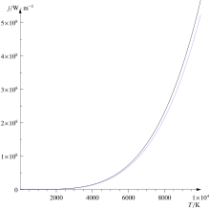
THEORETICAL PREDICTIONS AND EXPERIMENTAL PROOFS
Stefan-Boltzmann Law
Wien’s Displacement Law

Slide 13
Theoretical predictions and experimental proofs
Ultraviolet Catastrophe
Rayleigh and Jeans calculated energy density inside a cavity

Slide 14
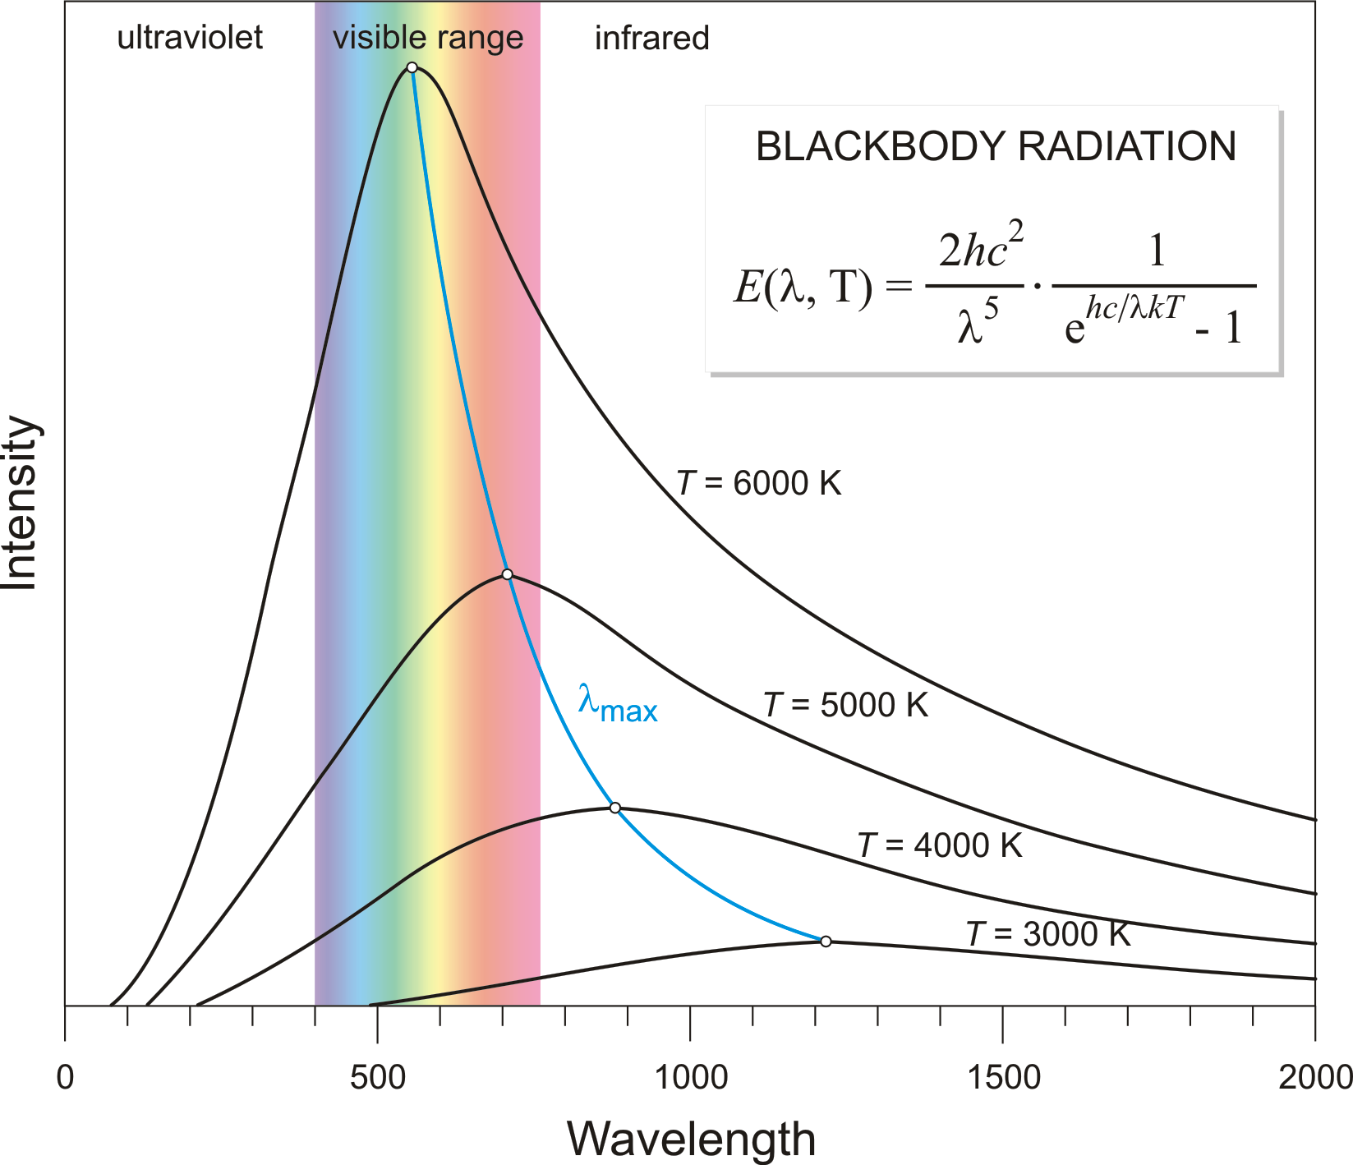
Theoretical predictions and experimental proofs
PLANCKS LAW OF BLACK BODY RADIATION
EINSTEIN- AVERAGE ENERGY IN AN OSCILLATOR OF FREQUENCY f AT TEMPERATURE T IS:

Slide 15
IMPORTANCE AND IMPACT OF THE THEORY

Slide 16
IMPORTANCE AND IMPACT OF THE THEORY

Slide 17
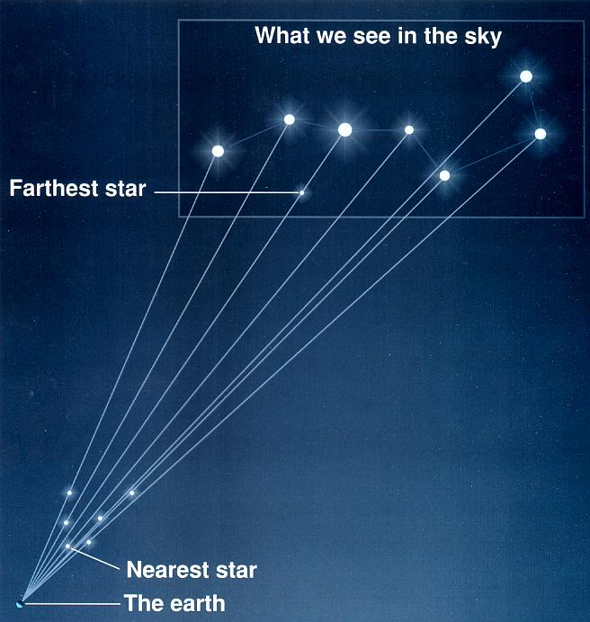
IMPORTANCE AND IMPACT OF THE THEORY

Slide 18
FUTURE WORK
DYSON SPHERE

Slide 19
bibliography
Hollandt Jörg, “ PTB Mitteilungen.”, “The Black Body and the Quantization of the World”, issue 2, June 2012, Germany
Kirchhoff, G.; [27 October 1859] (1860a). "Über die Fraunhofer'schen Linien" [On Fraunhofer's lines]. Monatsberichte der Königlich Preussischen Akademie der Wissenschaften zu Berlin: 662–665.
Kirchhoff, G.; [11 December 1859] (1860b). "Über den Zusammenhang zwischen Emission und Absorption von Licht und Wärme" [On the relation between emission and absorption of light and heat]. Monatsberichte der Königlich Preussischen Akademie der Wissenschaften zu Berlin: 783–787.
Kirchhoff, G. (1860c). "Ueber das Verhältniss zwischen dem Emissionsvermögen und dem Absorptionsvermögen der Körper für Wärme and Licht" [On the relation between bodies' emission capacity and absorption capacity for heat and light]. Annalen der Physik und Chemie. 109 (2): 275–301. Bibcode:1860AnP...185..275K. doi:10.1002/andp.18601850205. Translated by Guthrie, F. as Kirchhoff, G. (1860). "On the relation between the radiating and absorbing powers of different bodies for light and heat". Philosophical Magazine. Series 4, volume 20: 1–21.
Kirchhoff, G. (1882) [1862], "Ueber das Verhältniss zwischen dem Emissionsvermögen und dem Absorptionsvermögen der Körper für Wärme und Licht", Gessamelte Abhandlungen, Leipzig: Johann Ambrosius Barth, pp. 571–598
Kogure Tomokazu (2007), The Astrophysics of Emission Line Stars, “Thermodynamic equilibrium and black body radiation”, pp: 41-49
Stewart, B. (1858). "An account of some experiments on radiant heat". Transactions of the Royal Society of Edinburgh. 22: 1–20.
Weblinks:
http://astronomy.swin.edu.au/cosmos/b/blackbody+radiation
http://galileo.phys.virginia.edu/classes/252/black_body_radiation.html
https://quantummechanics.ucsd.edu/ph130a/130_notes/node48.html
https://www.pitt.edu/~jdnorton/teaching/HPS_0410/chapters/quantum_theory_origins/

Slide 20
Q & a?!?

