Slide 1
Brownian Motion
Joshua Perez, Matthew Hail, Ian Busch, Prince Williams, and David Rademacher

Slide 2
Before Einstein
Greeks assumed discrete matter (Lucretius 50 BCE)
Daniel Bernoulli explained heat (1738)
Dalton’s law of multiple proportions (1808)

Slide 3
Robert brown
Scottish botanist
Spent a lot of time classifying plant species
Believed pollen properties could aid in classification

Slide 4
The observation (1827)

Slide 5
Possible explanations
Animalcules
Microcurrents
Electrical affects

Slide 6
Classical attempt
Kinetic energy calculations off by 10^6
Could not measure velocity of 1 particle

Slide 7
What they knew by 1905
Trajectory has no tangent
Size matters
Particles independent of each other
Motion never stops

Slide 8
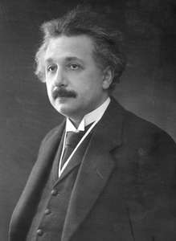
Einstein
Made some assumptions:
Osmotic pressure experiment
Dynamic equilibrium
Diffusion process
Stokes Law
Unaware of brown’s observations

Slide 9
Theory
Osmotic pressure forces balance action force
<x²>=2Dt
Switch from “ensemble” and single particle
D=μk_{b}T=$\frac{μRT}{N}$
- Diffusivity related to physical observables

Slide 10
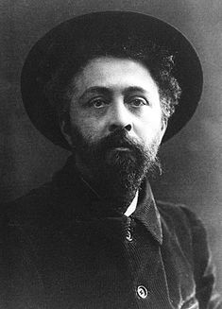
Perrin
French physicist
Devised experiment with students to test Einstein’s theory
First time determination of N=7.05x10²³

Slide 11
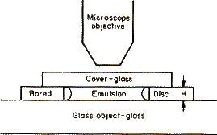
Perrin’s Experiment
Took 1000+ measurements
Performed 2 times
Average value of N=7.01x10²³

Slide 12
Perrin’s Observation

Slide 13
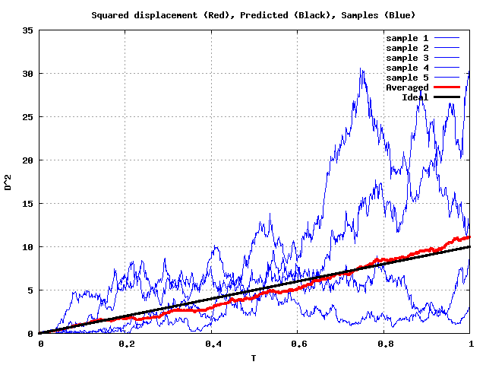
Applications

Slide 14
Sources
Einstein, A (1905) Investigations on the Theory of, The Brownian Movement
Perrin, J (1909) Brownian Movement and Molecular Reality
Brown R, (1827) A Brief Account of Microscopical Observations Made in the Months of June, July and August, 1827, on the Particles Contained in the Pollen of Plants; and on the General Existence of Active Molecules in Organic and Inorganic Bodies
Chowdhury, D (2008) 100 Years of Einstein’s Theory of Brownian Motion: From Pollen Grains to Protein Chains
Alamy.com

