Slide 1
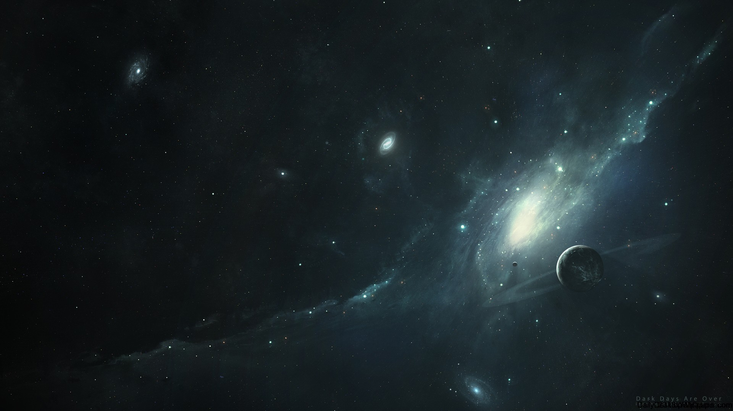
The Michelson-Morley Experiment:
Ether a Failure or a Success
S. Boucher, J. Breen, A. Richey, G. Sabine, B. Taylor, R. Zachary
Notes:
https://docs.google.com/presentation/d/14Y0h1c_BGOkj_2s6lEsmH8UF6hAgg4dJc8dxMA7Ip48/edit?usp=sharing

Slide 2
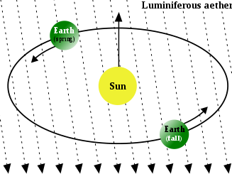
Introduction
Light was shown to have a finite velocity by Monsieur Romer in 1676¹.
Stellar aberration of light was discovered in 1727 by James Bradley².
Since the aberration of light is not constant through the year, Bradley theorized that the velocity of light would add to the velocity of moving objects.
Luminiferous Ether was the dominant theory for the propagation of light throughout the 18th and 19th centuries³
Credit: Cronholm144
Wed. April 24, 2019
PHYS-3313-001, Spring 2019
Undergraduates

Slide 3
Previous Work
1881 - Michelson performs original experiment⁴
Found stationary ether erroneous
1886 - Lorentz publishes critique⁵ stating that the apparatus had experimental errors, meaning the results were invalid
Although, the prototype demonstrated that the basic method was feasible (just need greater accuracy)
Credit: Debbie Choo
Wed. April 24, 2019
PHSY-3313-001, Spring 2019
Undergraduates
Notes:
1886 - In the original paper, the effect of the earth's motion on light moving at right angles was neglected. Lorentz's analysis pointed out that this can't be neglected.

Slide 4
Theoretical Predictions
Michelson was hoping that this experiment would prove the existence of ether in the universe.
The experiment was designed to show the effect of motion through the ether on the motion of light
e.g. Motion at right angles would cause light to move further
Wed. April 24, 2019
PHSY-3313-001, Spring 2019
Undergraduates
Notes:
Describe the subsequent experimental proof of the theory or of the paper.

Slide 5
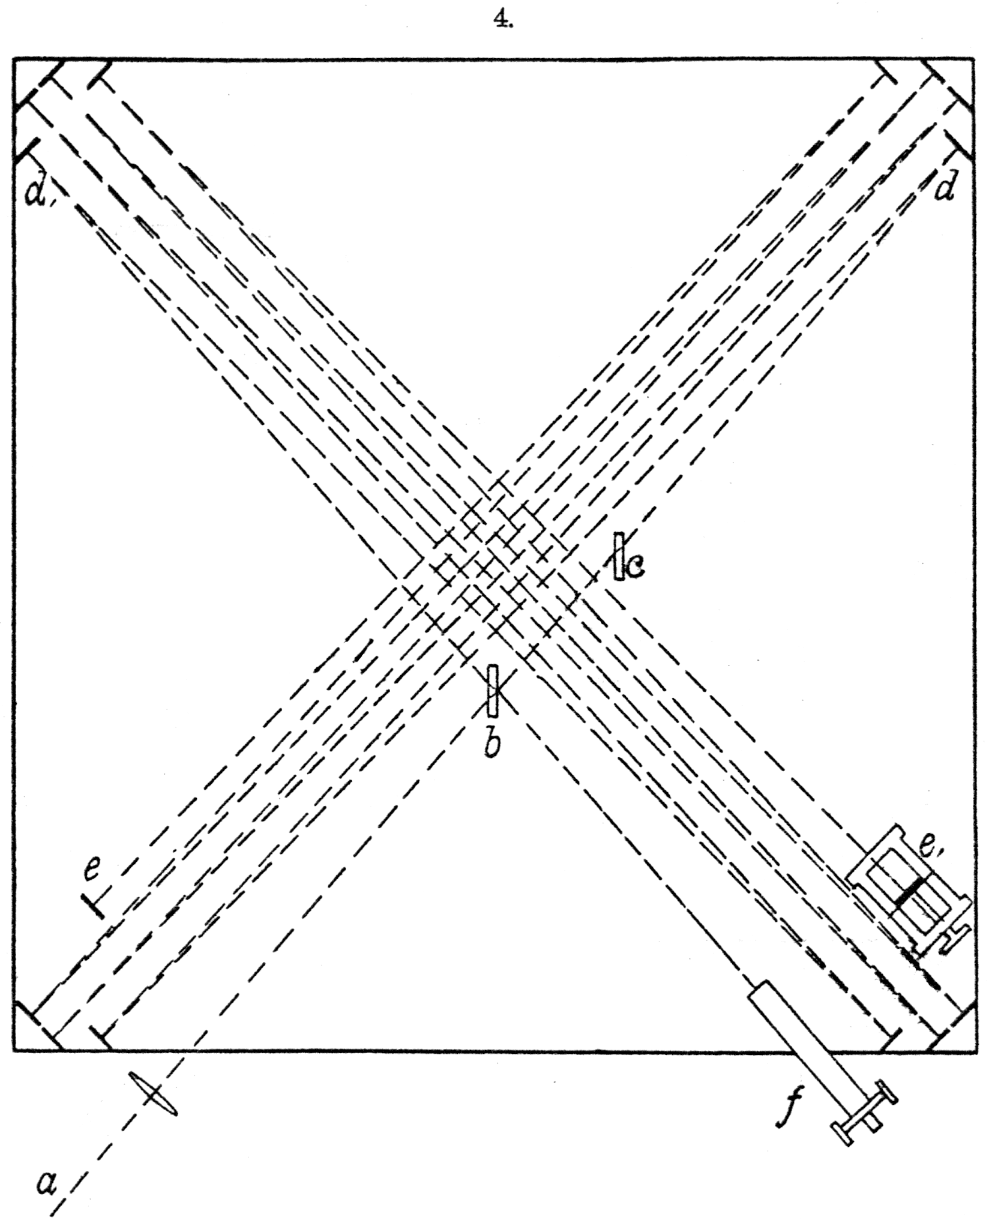
Experimental Predictions
Set out to correct errors in Michelson’s 1881 paper⁶
Interferometer mounted on a floating stone block atop mercury rather than an iron stand
Made rotation easier
Reduced effect of vibrations
Light reflected multiple times to give a longer path length
Reduced experimental error
Effect of earth's motion on rays moving at right angles taken into account in deriving formulæ
Measurements were taken twice per day
Once at noon, once at 6 P.M.
Credit: Michelson and Morley
Wed. April 24, 2019
PHSY-3313-001, Spring 2019
Undergraduates

Slide 6
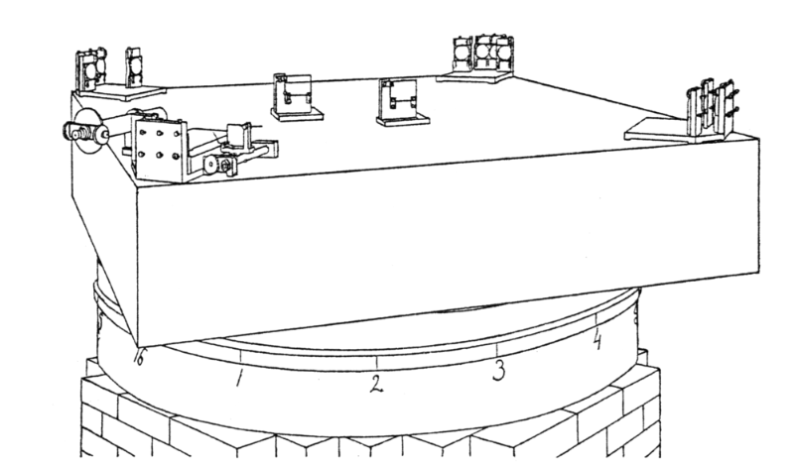
Experimental Setup
The experiment consisted of a rotating apparatus on which a light source, multiple mirrors, and a detector would rest
The light source would be turned on, then they would start rotating the apparatus at a rate of one revolution per 6 minutes
At noon, the apparatus would be rotated anticlockwise
At 6 P.M., the apparatus would be rotated clockwise
Interference patterns would be observed through a telescope at the final destination of the light
Credit: Michelson and Morley
Wed. April 24, 2019
PHSY-3313-001, Spring 2019
Undergraduates

Slide 7
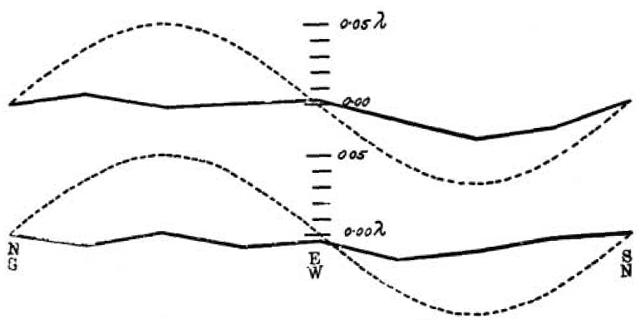
Experimental Results
The theory expected a displacement of 0.4λ
A displacement less than 0.01λ was found
NB: The dotted line represents one-eighth of the theoretical displacement
Credit: Michelson and Morley
Wed. April 24, 2019
PHSY-3313-001, Spring 2019
Undergraduates

Slide 8
Importance and Impact
Firmly disproved notion of stationary ether and ether wind
Forms the basis of the complete Lorentz transformation, along with the Kennedy-Thorndike and Ives-Stilwell experiments⁷
Led to the development of the Special Theory of Relativity
Wed. April 24, 2019
PHSY-3313-001, Spring 2019
Undergraduates
Notes:
Describe in detail the the importance and impact of the paper. What did we do with the knowledge of the paper?

Slide 9
Conclusions and Future Work
Morley, unconvinced of their results, went on to perform additional experiments in 1902 and 1904 with Dayton Miller.
Results were negative
Ether theories would be changed in future years, but in self-contradictory ways
Special relativity and, later, quantum mechanics would obviate the need for ether altogether
Multiple experiments were performed in years since, including as recently as 2009
All either found a null result or were inconclusive
Wed. April 24, 2019
PHSY-3313-001, Spring 2019
Undergraduates
Notes:
Describe what your conclusions are on this paper and what can be done more.
QM puts light as a particle with wave-like properties. Since a particle doesn't need a medium in which to move, the idea of photons gets rid of the need for ether

Slide 10
References
[1] M. Romer, “A Demonstration Concerning the Motion of Light”, Philosophical Transaction, 1676
[2] A. Stewart, “The Discovery of Stellar Aberration”, Scientific American, 1964
[3] E. Whittaker, "A history of the theories of aether and electricity: from the age of Descartes to the close of the nineteenth century", 1910
[4] A. Michelson, "The Relative Motion of the Earth and the Luminiferous Ether", The American Journal of Science, 1881
[5] H. Lorentz, "De l'Influence du Mouvement de la Terre sur les Phen. Lum.", Archives Néerlandaises, 1886
[6] A. Michelson, E. Morley, “On the Relative Motion of the Earth and the Luminiferous Ether”, The American Journal of Science, 1887
[7] H. P. Robertson, "Postulate versus Observation in the Special Theory of Relativity", Review of Modern Physics, 1949
Wed. April 24, 2019
PHSY-3313-001, Spring 2019
Undergraduates

