Slide 1
PHYS 1444 – Section 002 Lecture #3
Wednesday, Jan. 29, 2020
Dr. Jonathan Asaadi
CH 21
Charges in Atom, Insulators and Conductors & Induced Charge
Coulomb’s Law
Electric Fields and Conductors
Motion of a Charged Particle in an Electric Field

Slide 2
Announcements
Reading assignment: CH21 – 7
Quiz at the beginning of the class, Mon. Feb. 3
Appendix A1 – A8 and what we’ve learned this Wednesday
Beginning of the class, Monday, Feb. 3
You can bring your calculator but it must not have any relevant formula pre-input
No phone or computers can be used as a calculator!
BYOF: You may bring one 8.5x11.5 sheet (front and back) of handwritten formulae and values of constants for the exam
No derivations, word definitions, or solutions or setups of ANY problems!
No additional formulae or values of constants will be provided!

Slide 3
Announcements
Reading assignment: CH21 – 7
Quiz at the beginning of the class, Wed. Sept. 4
Appendix A1 – A8 and what we’ve learned this Wednesday
In class, this Wednesday, Sept. 4
You can bring your calculator but it must not have any relevant formula pre-input
No phone or computers can be used as a calculator!
BYOF: You may bring one 8.5x11.5 sheet (front and back) of handwritten formulae and values of constants for the exam
No derivations, word definitions, or solutions or setups of ANY problems!
No additional formulae or values of constants will be provided!
No class next Monday, Sept. 2, Labor Day

Slide 4
Announcements
Reading assignment: CH21 – 7
Quiz at the beginning of the class, Wed. Sept. 4
Appendix A1 – A8 and what we’ve learned this Wednesday
In class, this Wednesday, Sept. 4
You can bring your calculator but it must not have any relevant formula pre-input
No phone or computers can be used as a calculator!
BYOF: You may bring one 8.5x11.5 sheet (front and back) of handwritten formulae and values of constants for the exam
No derivations, word definitions, or solutions or setups of ANY problems!
No additional formulae or values of constants will be provided!
No class next Monday, Sept. 2, Labor Day

Slide 5
Reminder: Extra Credit Special Project #1
Compare the Coulomb force to the Gravitational force in the following cases by expressing Coulomb force (F_{C}) in terms of the gravitational force (F_{G})
Between two protons separated by 1m
Between two protons separated by an arbitrary distance R
Between two electrons separated by 1m
Between two electrons separated by an arbitrary distance R
Five points each, totaling 20 points
BE SURE to show all the details of your work, including all formulae, proper references to them and explanations
Please staple them before the submission
Due at the beginning of the class Wednesday, Sept. 4

Slide 6
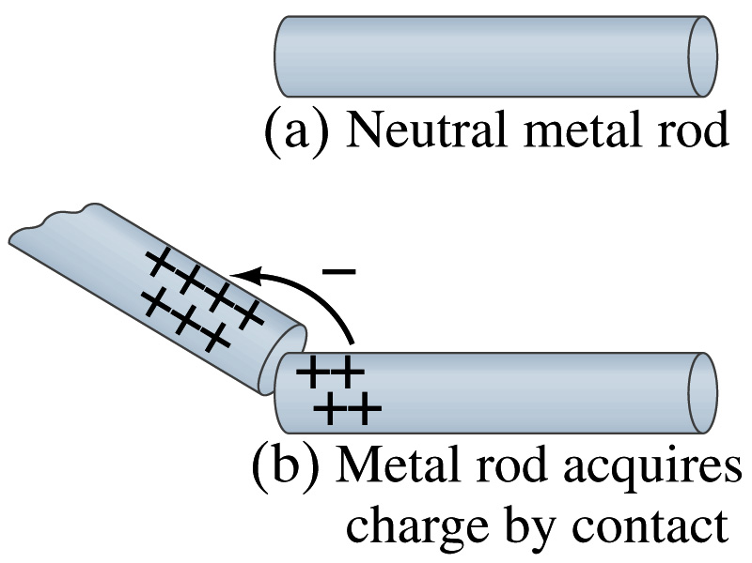
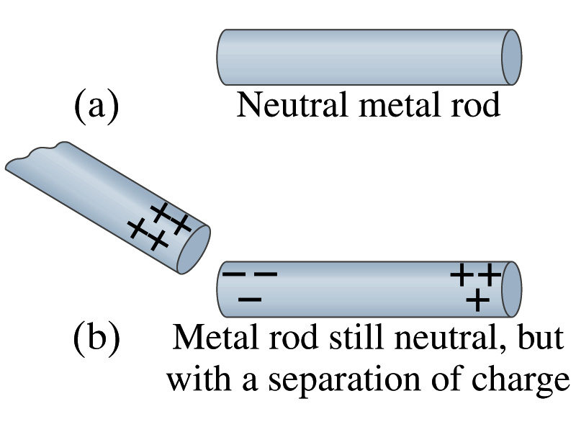
Induced Charge
When a positively charged metal object is brought close to an uncharged metal object
If two objects touch each other, the free electrons in the neutral one are attracted to the positively charged object and some will pass over to it, leaving the neutral object positively charged ➔ Charging by conduction
If the objects get close, the free electrons in the neutral one still move within the metal toward the charged object leaving the opposite side of the object positively charged.
The charges have been “induced” in the opposite ends of the object.

Slide 7
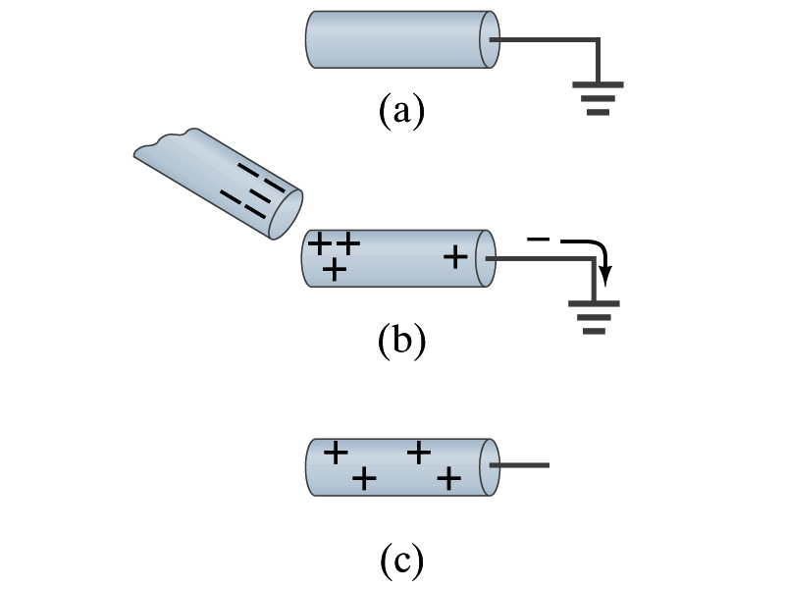
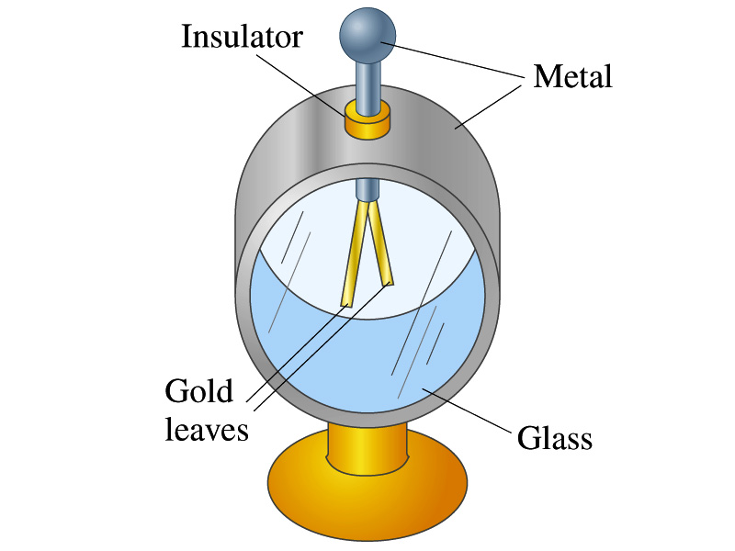
Induced Charge
ground
We can induce a net charge on a metal object by connecting a wire to the ground.
The object is “grounded” or “earthed”.
Since the Earth is so large and conducts, it can give or accept charge.
The Earth acts as a reservoir of electric charge.
If negative charge is brought close to a neutral metal
Positive charge will be induced toward the negatively charged metal.
The negative charges in the neutral metal will be gathered on the opposite side, transferring through the wire to the Earth.
If the wire is cut, the metal bar has net positive charge.
An electroscope is a device that can be used for detecting charge and signs.
How does this work?

Slide 8
Coulomb’s Law
Charges exert force to each other. What factors affect the magnitude of this force?
Any guesses?
Charles Coulomb figured this out in 1780’s.
Coulomb found that the electric force is
Proportional to the multiplication of the two charges
If one of the charges doubles, the force doubles.
If both the charges double, the force quadruples.
Inversely proportional to the square of the distances between them.
Electric charge is a fundamental property of matter, just like mass.
How would you put the above into a formula?

Slide 9
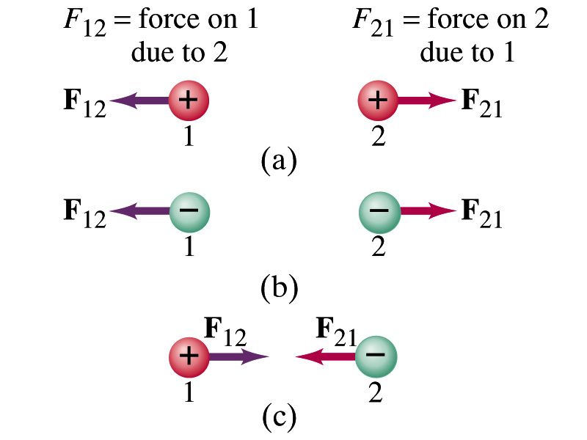
Coulomb’s Law – The Formula
Formula
Is Coulomb force a scalar quantity or a vector quantity? Unit?
A vector quantity. The unit is Newtons (N)!
The direction of electric (Coulomb) force is always along the line joining the two objects.
If the two charges are the same: forces are directed away from each other.
If the two charges are opposite: forces are directed toward each other.
Coulomb force is precise to 1 part in 10¹⁶.
Unit of charge is called Coulomb, C, in SI.
The value of the proportionality constant, k, in SI unit is
Thus, 1C is the charge that gives F~9x10⁹N of force when placed 1m apart from each other.

Slide 10
Electric Force
and Gravitational Force
Extremely
Similar
Does the electric force look similar to another force? What is it?
Gravitational Force
What are the sources of the forces?
Electric Force: Electric charges, fundamental properties of matter
Gravitational Force: Masses, fundamental properties of matter
What else is similar?
Inversely proportional to the square of the distance between the sources of the force ➔ What is this kind law called?
Inverse Square Law
What is the difference?
Gravitational force is always attractive.
Electric force depends on the type of the two charges. (must pay good attention to the signs due to the sign of the charge and the vector force directions!!)

Slide 11
The Elementary Charge and Permittivity
Elementary charge, the smallest charge, is that of an electron:
Since electron is a negatively charged particle, its charge is –e.
Object cannot gain or lose fraction of an electron.
Electric charge is quantized.
It changes always in integer multiples of e.
The proportionality constant k is often written in terms of another constant, ε₀, the permittivity* of free space. They are related and .
Thus the electric force can also be written as:
Note that this force is for “point” charges at rest.
*Mirriam-Webster, Permittivity: The ability of a material to store electric potential energy under the influence of an electric field

Slide 12
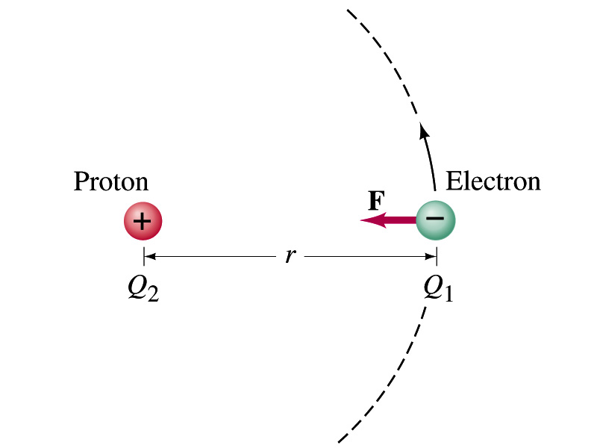
Example on Coulomb Force
Electric force on electron by proton. Determine the magnitude of the electric force on the electron of a hydrogen atom exerted by the single proton (Q₂=+e) that is its nucleus. Assume the electron “orbits” the proton at its average distance of r=0.53x10⁻¹⁰m.
Using Coulomb’s law
Each charge is
and
So the magnitude of the force is
Which direction?
Toward each other…

Slide 13
The Coulomb Force Refresher
Formula
Is Coulomb force a scalar quantity or a vector quantity? Unit?
A vector quantity. The unit is Newtons (N)!
The direction of electric (Coulomb) force is always along the line joining the two objects.
If the two charges are the same: forces are directed away from each other.
If the two charges are opposite: forces are directed toward each other.
Coulomb force is precise to 1 part in 10¹⁶.
Unit of charge is called Coulomb, C, in SI.
The value of the proportionality constant, k, in SI unit is
Thus, 1C is the charge that gives F~9x10⁹N of force when placed 1m apart from each other.
The Elementary Charge

Slide 14
Example on Coulomb Force
Electric force on electron by proton. Determine the magnitude of the electric force on the electron of a hydrogen atom exerted by the single proton (Q₂=+e) that is its nucleus. Assume the electron “orbits” the proton at its average distance of r=0.53x10⁻¹⁰m.
Using Coulomb’s law
Each charge is
and
So the magnitude of the force is
Which direction?
Toward each other…
What is the speed of the electron circling around the proton in a hydrogen atom?

Slide 15
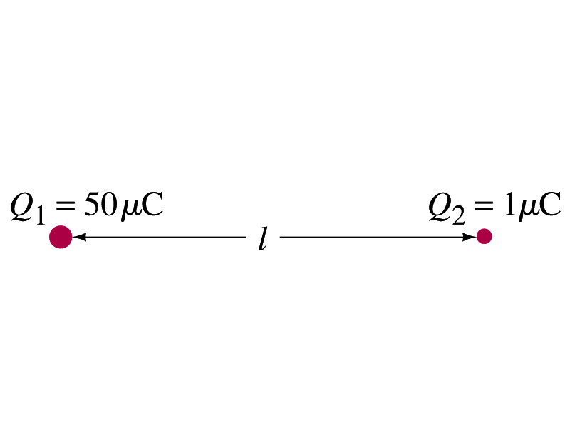
Example 21 – 1
Which charge exerts greater force? Two positive point charges, Q₁=50μC and Q₂=1μC, are separated by distance L. Which is larger in magnitude, the force that Q₁ exerts on Q₂ or the force that Q₂ exerts on Q₁?
What is the force that Q₁ exerts on Q₂?
What is the force that Q₂ exerts on Q₁?
Therefore the magnitudes of the two forces are identical!!
Well then what is different?
The direction.
Which direction?
Opposite to each other!
What is this law?
Newton’s third law, the law of action and reaction!!

Slide 16
Vector Additions and Subtractions
Addition:
Triangular Method: One can add vectors by connecting the head of one vector to the tail of the other (head-to-tail)
Parallelogram method: Connect the tails of the two vectors and extend
Addition is commutative: Changing order of operation does not affect the results A+B=B+A, A+B+C+D+E=E+C+A+B+D
A+B
A
A+B
B
=
OR
B
A+B
B
A
A
Subtraction:
The same as adding a negative vector:A - B = A + (-B)
A
-B
Since subtraction is the equivalent to adding a negative vector, subtraction is also commutative!!!
A-B
Multiplication by a scalar is increasing the magnitude A, B=2A
A
B=2A

Slide 17
Example for Vector Addition
A force of 20.0N applies to north while another force of 35.0N applies in the direction 60.0º west of north. Find the magnitude and direction of resultant force.
F₂sin60^{ο}
N
F₂
60^{ο}
F₂cos60^{ο}
20
F
θ
F₁
E
Find other ways to solve this problem…

Slide 18
Components and Unit Vectors
Coordinate systems are useful in expressing vectors in their components
y
(+,+)
F_{y}
(F_{x},F_{y})
}Components
F
(-,+)
θ
x
} Magnitude
(-,-)
(+,-)
F_{x}

Slide 19
Unit Vectors
Unit vectors are the ones that tells us the directions of the components
Dimensionless
Magnitudes are exactly 1
Unit vectors are usually expressed in i, j, k or
So the vector F can be re-written as

Slide 20
Examples of Vector Operations
Find the resultant force which is the sum of F1=(2.0i+2.0j)N and F2 =(2.0i-4.0j)N.
Find the resultant force of the sum of three forces: F₁=(15i+30j +12k)N, F₂=(23i+14j -5.0k)N, and F₃=(-13i+15j)N.
Magnitude

Slide 21
The Coulomb Force Refresher
Formula
Is Coulomb force a scalar quantity or a vector quantity? Unit?
A vector quantity. The unit is Newtons (N)!
The direction of electric (Coulomb) force is always along the line joining the two objects.
If the two charges are the same: forces are directed away from each other.
If the two charges are opposite: forces are directed toward each other.
Coulomb force is precise to 1 part in 10¹⁶.
Unit of charge is called Coulomb, C, in SI.
The value of the proportionality constant, k, in SI unit is
Thus, 1C is the charge that gives F~9x10⁹N of force when placed 1m apart from each other.
The Elementary Charge

Slide 22
Reminder: Components and Unit Vectors
Coordinate systems are useful in expressing vectors in their components
y
(+,+)
F_{y}
(F_{x},F_{y})
}Components
F
(-,+)
θ
x
} Magnitude
(-,-)
(+,-)
F_{x}

Slide 23
Reminder: Unit Vectors
Unit vectors are the ones that tells us the directions of the components
Dimensionless
Magnitudes are exactly 1
Unit vectors are usually expressed in i, j, k or
So the vector F can be re-written as

Slide 24
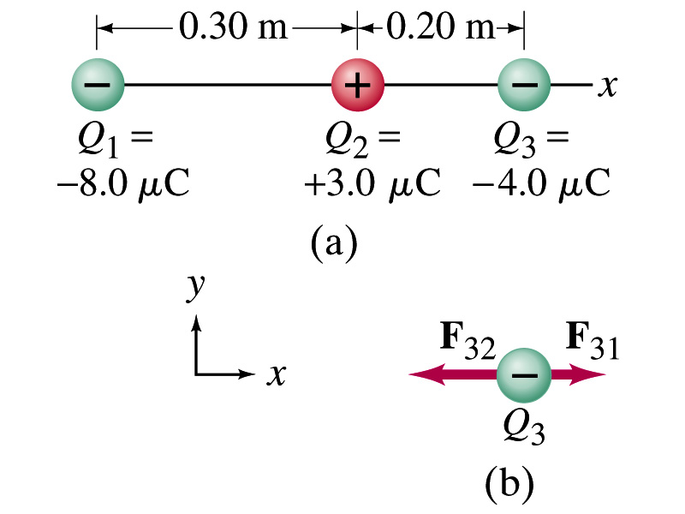
Example 21.2
Three charges on a line. Three charged particles are arranged in a line as shown in the figure. Calculate the net electrostatic force on particle 3 (the -4μC on the right) due to the other two charges.
What is the force that Q₁ exerts on Q₃?
What is the force that Q₂ exerts on Q₃?
Using the vector sum of the two forces

Slide 25
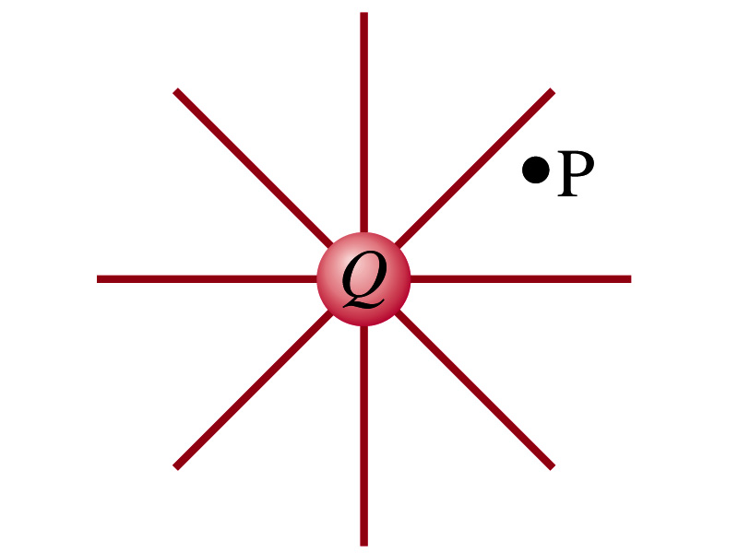
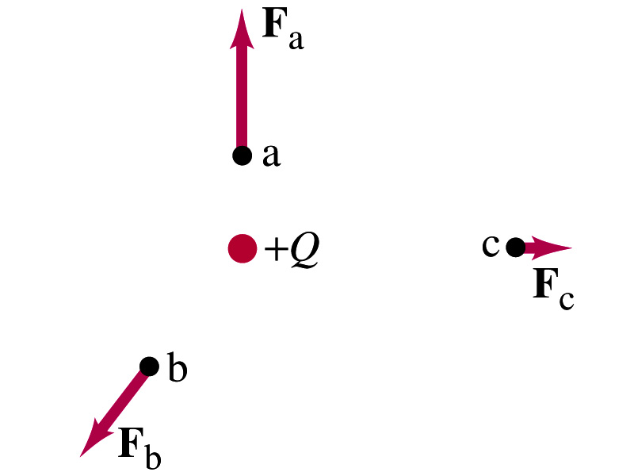
The Electric Field
Both gravitational and electrostatic forces act over a distance without contacting objects ➔ What kind of forces are these?
Field forces
Michael Faraday developed an idea of field.
Faraday (1791 – 1867) argued that the electric field extends outward from every charge and permeates through all of space.
Field by a charge or a group of charges can be inspected by placing a small positive test charge in the vicinity and measuring the force on it.

Slide 26
The Electric Field
The electric field at any point in space is defined as the force exerted on a tiny positive test charge (e.g., q) divide by the magnitude of the test charge
Electric force per unit charge
What kind of quantity is the electric field?
Vector quantity. Why?
What is the unit of the electric field?
N/C
What is the magnitude of the electric field by a single point charge Q at a distance r from it?

Slide 27
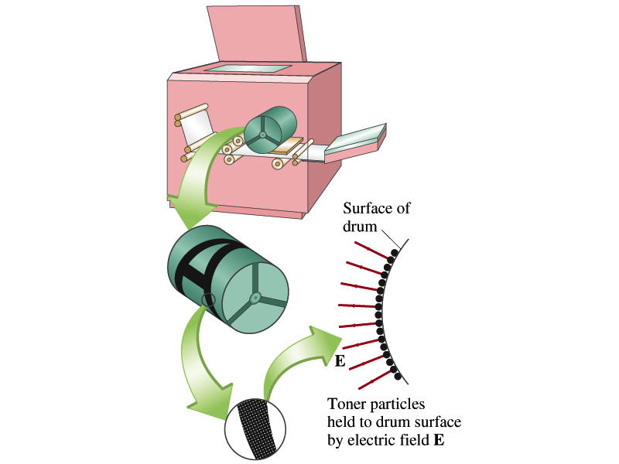
Example 21 – 5
Electrostatic copier. An electrostatic copier works by selectively arranging positive charges (in a pattern to be copied) on the surface of a non-conducting drum, then gently sprinkling negatively charged dry toner (ink) onto the drum. The toner particles temporarily stick to the pattern on the drum and are later transferred to paper and “melted” to produce the copy. Suppose each toner particle has a mass of 9.0x10⁻¹⁶kg and carries the average of 20 extra electrons to provide an electric charge. Assuming that the electric force on a toner particle must exceed twice its weight in order to ensure sufficient attraction, compute the required electric field strength near the surface of the drum.
The electric force must be the same as twice the gravitational force on the toner particle.
So we can write
Thus, the magnitude of the electric field is

