Slide 1
PHYS 1444 – Section 002 Lecture #4
Monday, Feb. 3, 2020
Dr. Jaehoon Yu
Ch 21
The Electric Field & Field Lines
Electric Fields and Conductors
Motion of a Charged Particle in an E Field
Electric Dipole and Dipole Moment
Today’s homework is homework #3, due 11pm, Tuesday, Feb. 11!!

Slide 2
Announcements
Homework #2: Deadline extended to 11pm, this Wed., Feb. 5
Special project #1 deadline at the beginning of the class this Wed., Feb. 5
Reading assignments
CH21.11, CH21.12 and CH21.13
1st Term Exam
In class, Wednesday, Feb. 19: DO NOT MISS THE EXAM!
CH1.1 to what we learn on Monday, Feb. 17 + Appendices A1 – A8
You can bring your calculator but it must not have any relevant formula pre-input
BYOF: You may bring a one 8.5x11.5 sheet (front and back) of handwritten formulae and values of constants for the exam
No derivations, word definitions, or solutions of any problems !
No additional formulae or values of constants will be provided!

Slide 3
Reminder: Extra Credit Special Project #1
Compare the Coulomb force to the Gravitational force in the following cases by expressing Coulomb force (F_{C}) in terms of the gravitational force (F_{G})
Between two protons separated by 1m
Between two protons separated by an arbitrary distance R
Between two electrons separated by 1m
Between two electrons separated by an arbitrary distance R
Five points each, totaling 20 points
BE SURE to show all the details of your work, including all formulae, proper references to them and explanations
Please staple them before the submission
Due at the beginning of the class Wednesday, Feb. 5

Slide 4
Special Project #2 – Angels & Demons
Compute the total possible energy released from an annihilation of xx-grams of anti-matter and the same quantity of matter, where xx is the last two digits of your SS#. (20 points)
Use the famous Einstein’s formula for mass-energy equivalence
Compute the power output of this annihilation when the energy is released in yy ns, where yy is the first two digits of your SS#. (10 points)
Compute how many cups of gasoline (8MJ) this energy corresponds to. (5 points)
Compute how many months of world electricity usage (3.6GJ/mo) this energy corresponds to. (5 points)
Due at the beginning of the class Monday, Feb. 24

Slide 5
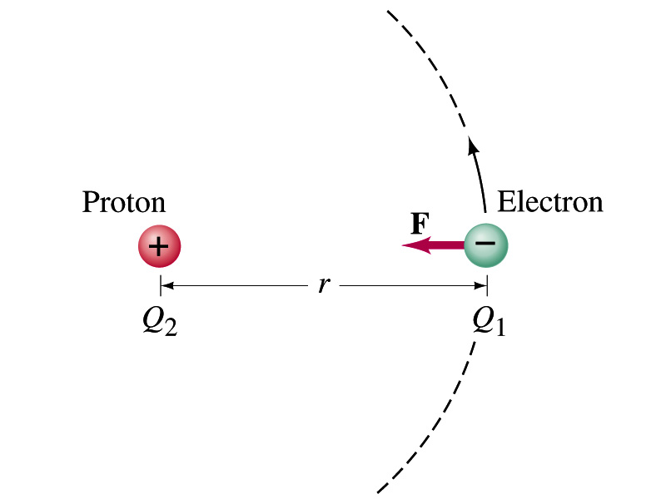
Example on Coulomb Force
Electric force on electron by proton. Determine the magnitude of the electric force on the electron of a hydrogen atom exerted by the single proton (Q₂=+e) that is its nucleus. Assume the electron “orbits” the proton at its average distance of r=0.53x10⁻¹⁰m.
Using Coulomb’s law
Each charge is
and
So the magnitude of the force is
Which direction?
Toward each other…
What is the speed of the electron circling around the proton in a hydrogen atom?

Slide 6
The Electric Field
The electric field at any point in space is defined as the force exerted on a tiny positive test charge (e.g., q) divide by the magnitude of the test charge
Electric force per unit charge
What kind of quantity is the electric field?
Vector quantity. Why?
What is the unit of the electric field?
N/C
What is the magnitude of the electric field by a single point charge Q at a distance r from it?

Slide 7
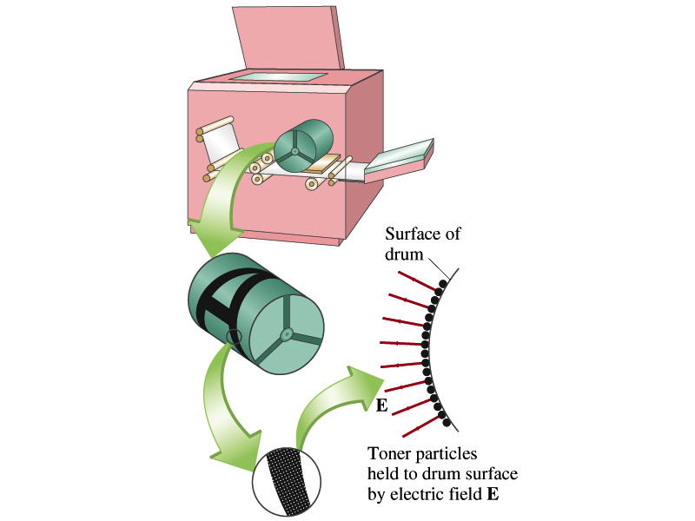
Example 21 – 5
Electrostatic copier. An electrostatic copier works by selectively arranging positive charges (in a pattern to be copied) on the surface of a non-conducting drum, then gently sprinkling negatively charged dry toner (ink) onto the drum. The toner particles temporarily stick to the pattern on the drum and are later transferred to paper and “melted” to produce the copy. Suppose each toner particle has a mass of 9.0x10⁻¹⁶kg and carries the average of 20 extra electrons to provide an electric charge. Assuming that the electric force on a toner particle must exceed twice its weight in order to ensure sufficient attraction, compute the required electric field strength near the surface of the drum.
The electric force must be the same as twice the gravitational force on the toner particle.
So we can write
Thus, the magnitude of the electric field is

