Slide 1
PHYS 1444 – Section 002 Lecture #5
Wednesday, Feb. 5, 2020
Dr. Jaehoon Yu
Ch 21
The Electric Field & Field Lines
Electric Fields and Conductors
Motion of a Charged Particle in an E Field
Electric Dipole and Dipole Moment

Slide 2
Announcements
Bring out special project #1
Reading assignments
CH21.11, CH21.12 and CH21.13
1st Term Exam
In class, Wednesday, Feb. 19: DO NOT MISS THE EXAM!
CH1.1 to what we learn on Monday, Feb. 17 + Appendices A1 – A8
You can bring your calculator but it must not have any relevant formula pre-input
BYOF: You may bring a one 8.5x11.5 sheet (front and back) of handwritten formulae and values of constants for the exam
No derivations, word definitions, or solutions of any problems !
No additional formulae or values of constants will be provided!

Slide 3
Reminder: Special Project #2 – Angels & Demons
Compute the total possible energy released from an annihilation of xx-grams of anti-matter and the same quantity of matter, where xx is the last two digits of your SS#. (20 points)
Use the famous Einstein’s formula for mass-energy equivalence
Compute the power output of this annihilation when the energy is released in yy ns, where yy is the first two digits of your SS#. (10 points)
Compute how many cups of gasoline (8MJ) this energy corresponds to. (5 points)
Compute how many months of world electricity usage (3.6GJ/mo) this energy corresponds to. (5 points)
Due at the beginning of the class Monday, Feb. 24

Slide 4
Direction of the Electric Field
If there are more than one charge present, the individual fields due to each charge are added vectorially to obtain the total field at any point in space
This superposition principle of electric field has been verified by experiments.
For a given electric field E at a given point in space, we can calculate the force F on any charge q, F=qE.
What is the direction of the force on the charge placed in the field and the field depending on the sign of the charge q?
The F and E are in the same directions if the sign of q is positive
The F and E are in the opposite directions if the sign of q is negative

Slide 5
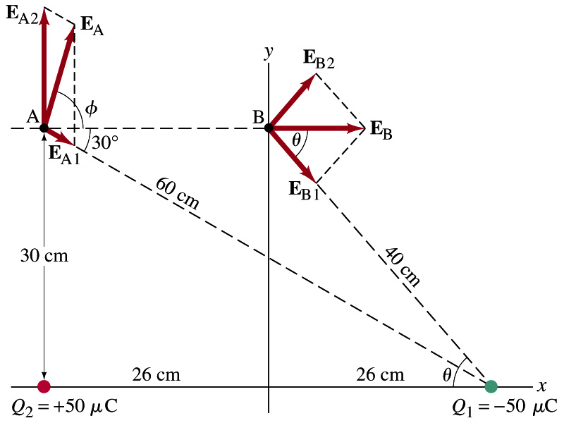
Example 21 – 8
E above two point charges: Calculate the total electric field (a) at point A and (b) at point B in the figure on the right due to both the charges Q₁ and Q₂.
How do we solve this problem?
First, compute the magnitude of the fields at each point due to each of the two charges.
Then add them at each point vectorially!
First, the electric field at point A by Q₁ and then Q₂.

Slide 6
Example 21 – 8, cnt’d
Now the components of the electric field vectors by the two charges at point A.
So the electric field at point A is
The magnitude of the electric field at point A is
Now onto the electric field at point B

Slide 7
Example 21 – 8, cnt’d
Electric field at point B is easier due to symmetry!
Since the magnitude of the charges are the same and the distance to point B from the two charges are the same, the magnitude of the electric field by the two charges at point B are the same!!
Now the components!
First, the y-component!
Now, the x-component!
So the electric field at point B is
The magnitude of the electric field at point B

Slide 8
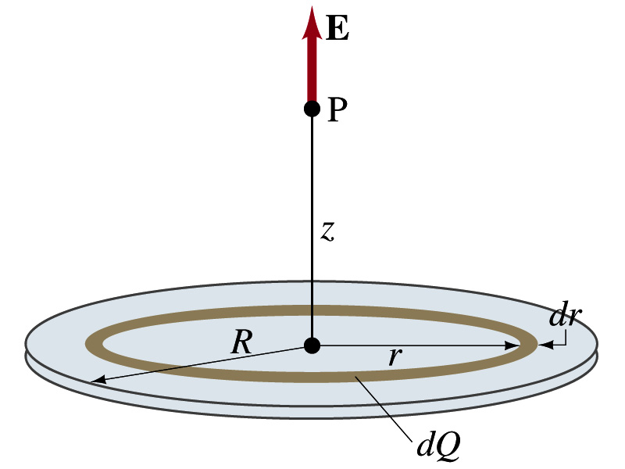
Example 21 – 12
Uniformly charged disk: Charge is distributed uniformly over a thin circular disk of radius R. The charge per unit area (C/m²) is σ. Calculate the electric field at a point P on the axis of the disk, a distance z above its center.
How do we solve this problem?
First, compute the magnitude of the field (dE) at point P due to the charge (dQ) on the ring of infinitesimal width dr.
From the result of example 21 – 11 (please do this problem yourself)
Since the surface charge density is constant, σ, and the ring has an area of 2πrdr, the infinitesimal charge of dQ is
So the infinitesimal field dE can be written

Slide 9
Example 21 – 12 cnt’d
Now integrating dE over 0 through R, we get
What happens if the disk has infinitely large area?
So the electric field due to an evenly distributed surface charge with density, σ, is

Slide 10
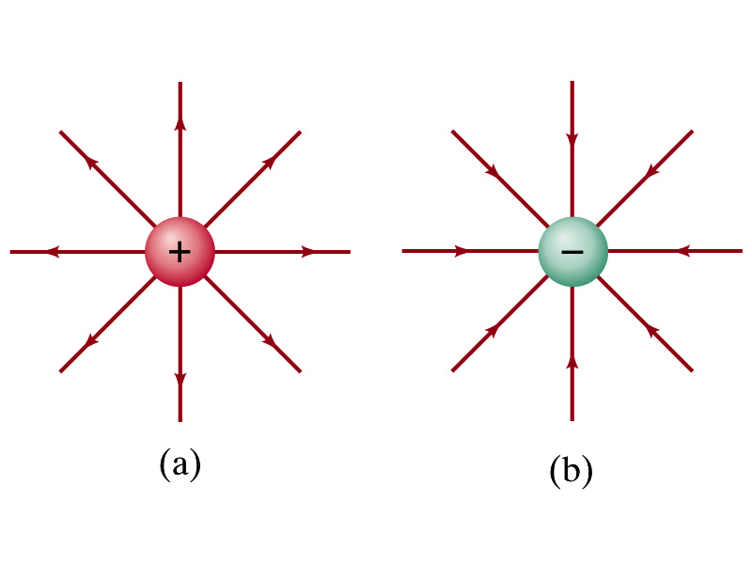
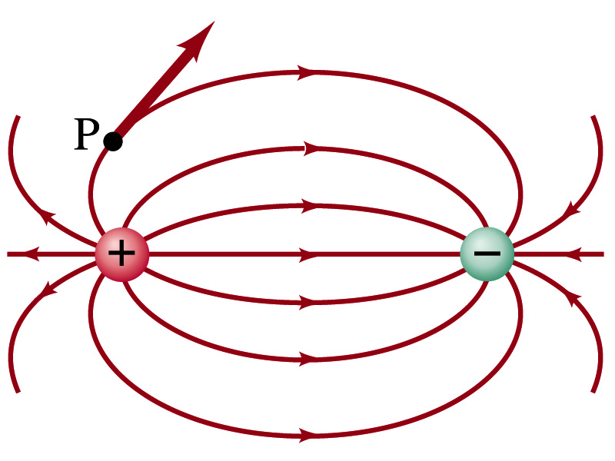
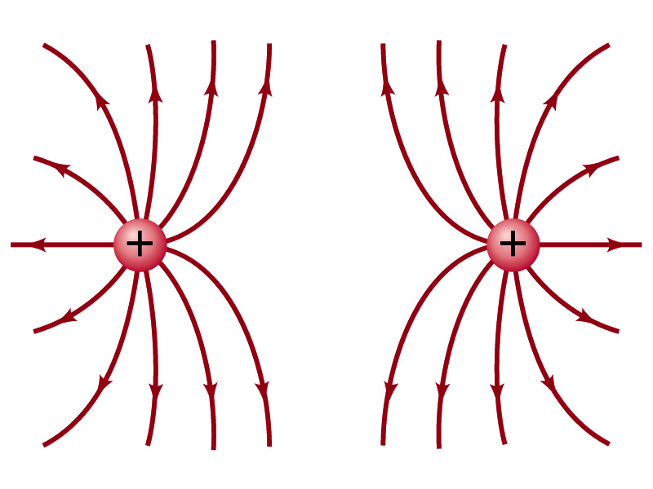
Field Lines
The electric field is a vector quantity. Thus, its magnitude can be expressed by the length of an arrow and the direction by the direction the arrowhead points.
Since the field permeates through the entire space, drawing vector arrows is not a good way of expressing the field.
Electric field lines are drawn to indicate the direction of the force due to the given field on a positive test charge.
The number of lines crossing unit area perpendicular to E is proportional to the magnitude of the electric field.
The closer the lines are together, the stronger the electric field in that region.
Starts on a positive charge and ends on a negative charge.
Earth’s G-field lines

Slide 11
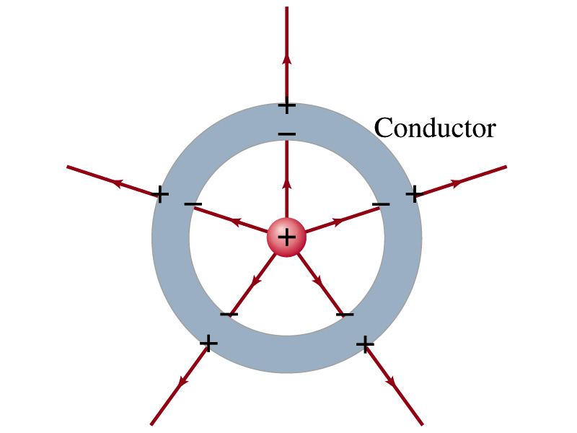
Electric Fields and Conductors
The electric field inside a conductor is ZERO in a static situation. (If the charge is at rest.) Why?
If there were an electric field within a conductor, there would be a force on its free electrons.
The electrons will move until they reach the position where the electric field becomes zero.
Electric field, however, can exist inside a non-conductor.
Consequences of the above
Any net charge on a conductor distributes itself on its surface.
Although no field exists inside a conductor, the fields can exist outside the conductor due to induced charges on either surface
The electric field is always perpendicular to the surface outside of a conductor.

Slide 12
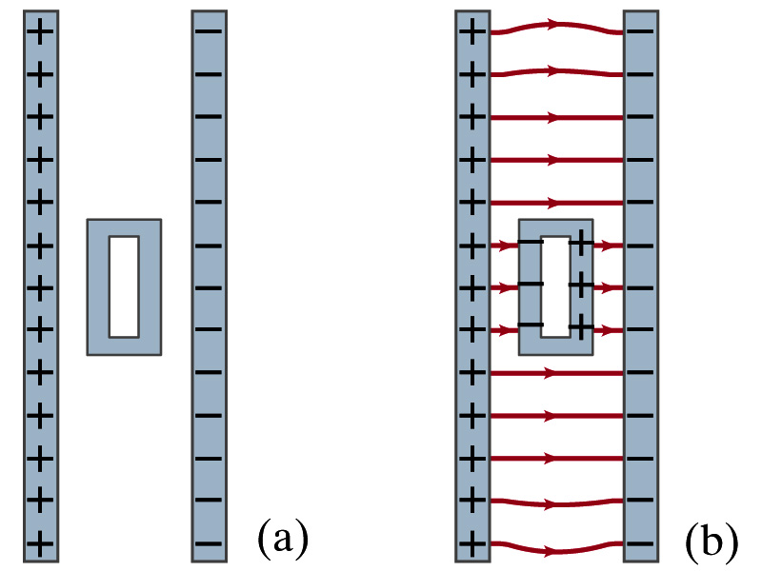
Example 21-13
Shielding, and safety in a storm. A hollow metal box is placed between two parallel charged plates. What is the field like in the box?
If the metal box were solid
The free electrons in the box would redistribute themselves along the surface so that the field lines would not penetrate into the metal.
The free electrons do the same in hollow metal boxes just as well as it did in a solid metal box.
Thus a conducting hollow box is an effective device for shielding. ➔ The Faraday cage
So what do you think will happen if you were inside a car when the car was struck by a lightening?

