Slide 1
PHYS 1444 – Section 002 Lecture #6
Monday, Feb. 10, 2020
Dr. Jaehoon Yu
Ch 21
Motion of a Charged Particle in an E Field
Electric Dipole and Dipole Moment
CH 22
Gauss’ Law
Electric Flux
Gauss’ Law with Multiple Charges
Today’s homework is homework #4, due 11pm, Monday, Feb. 17!!

Slide 2
Announcements – I
Please make sure you make the necessary payment for the homework
You and I both will lose access to your homework!
Quiz # 2
Beginning of the class this Wednesday, Feb. 12
Covers CH21.6 to what we finish today (CH22?)
You can bring your calculator w/o any relevant formula pre-input
BYOF: You may bring a one 8.5x11.5 sheet (front and back) of handwritten formulae and values of constants for the exam
No derivations, word definitions, or solutions of any problems !
No additional formulae or values of constants will be provided!

Slide 3
Announcements – II
1st Term Exam
In class, Wednesday, Feb. 19: DO NOT MISS THE EXAM!
CH21.1 to what we learn on Monday, Feb. 17 + Appendices A1 – A8
You can bring your calculator w/o any relevant formula pre-input
BYOF: You may bring a one 8.5x11.5 sheet (front and back) of handwritten formulae and values of constants for the exam
No derivations, word definitions, or solutions of any problems !
No additional formulae or values of constants will be provided!
Quiz 1 results
Class average: 38.7/80
Equivalent to 48.4/100
Top score: 73/80

Slide 4
Reminder: Special Project #2 – Angels & Demons
Compute the total possible energy released from an annihilation of xx-grams of anti-matter and the same quantity of matter, where xx is the last two digits of your SS#. (20 points)
Use the famous Einstein’s formula for mass-energy equivalence
Compute the power output of this annihilation when the energy is released in yy ns, where yy is the first two digits of your SS#. (10 points)
Compute how many cups of gasoline (8MJ) this energy corresponds to. (5 points)
Compute how many months of world electricity usage (3.6GJ/mo) this energy corresponds to. (5 points)
Due at the beginning of the class Monday, Feb. 24

Slide 5
What did we last weekend?
Built the first field cage module for DUNE!

Slide 6
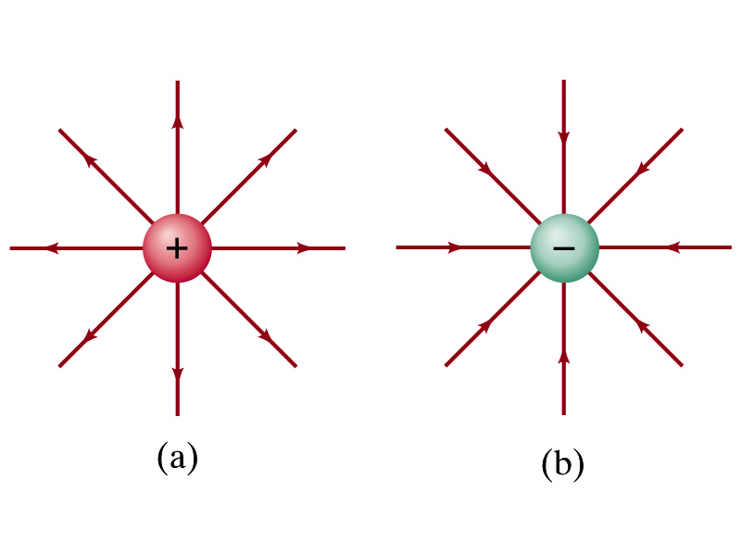
Motion of a Charged Particle in an Electric Field
If an object with an electric charge q is at a point in space where electric field is E, the force exerting on the object is .
What do you think will happen to the charge?
Let’s think about the cases like these on the right.
The object will move along the field line…Which way?
Depends on the sign of the charge
The charge gets accelerated under an electric field.

Slide 7
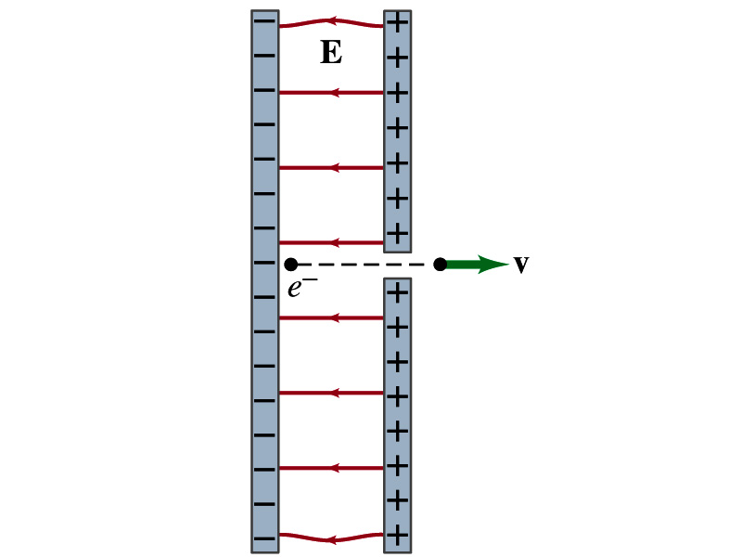
Example 21 – 14
Electron accelerated by electric field. An electron (mass m = 9.1x10⁻³¹kg) is accelerated in a uniform field E (E=2.0x10⁴N/C) between two parallel charged plates. The separation of the plates is 1.5cm. The electron is accelerated from rest near the negative plate and passes through a tiny hole in the positive plate. (a) With what speed does it leave the hole? (b) Show that the gravitational force can be ignored. Assume the hole is so small that it does not affect the uniform field between the plates.
The magnitude of the force on the electron is F=qE and is directed to the right. The equation to solve this problem is
The magnitude of the electron’s acceleration is
Between the plates the field E is uniform, thus the electron undergoes a uniform acceleration

Slide 8
Example 21 – 14
Since the travel distance is 1.5x10⁻²m, using one of the kinetic eq. of motions,
Since there is no electric field outside the conductor, the electron continues moving with this speed after passing through the hole.
(b) Show that the gravitational force can be ignored. Assume the hole is so small that it does not affect the uniform field between the plates.
The magnitude of the electric force on the electron is
The magnitude of the gravitational force on the electron is
Thus the gravitational force on the electron is negligible compared to the electromagnetic force.

Slide 9
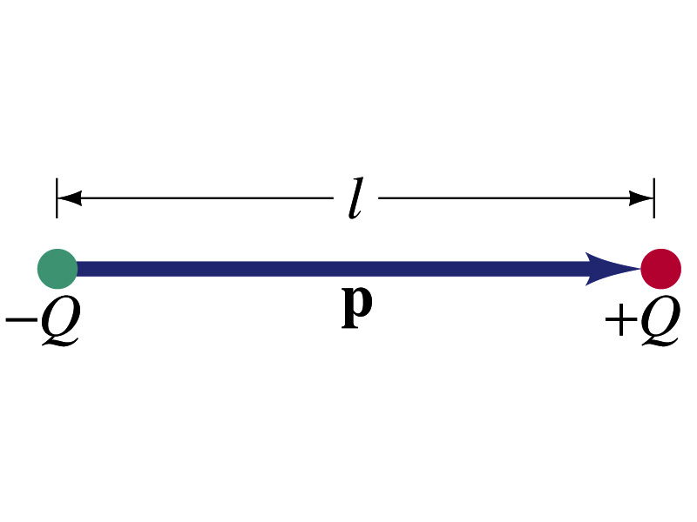
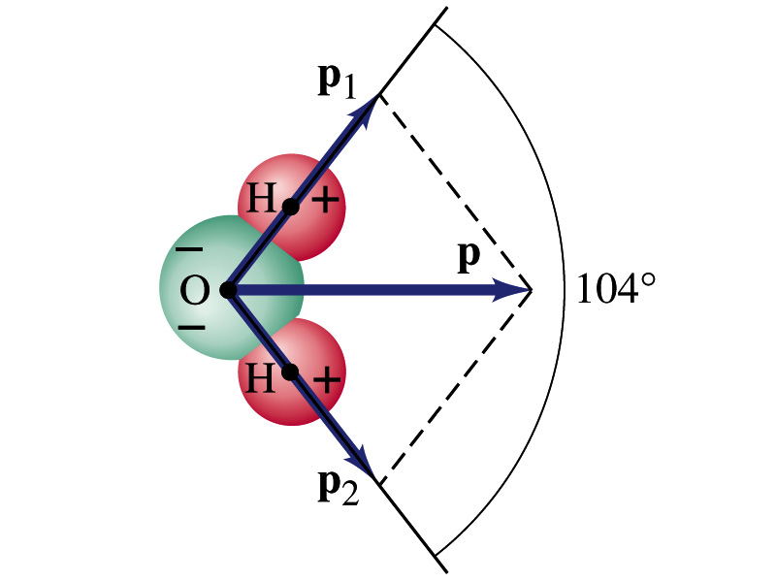
Electric Dipoles
An electric dipole is the combination of two equal charges of opposite signs, +Q and –Q, separated by a distance l, which behaves as one entity.
The quantity Ql is called the electric dipole moment and is represented by the symbol p.
The dipole moment is a vector quantity, p
The magnitude of the dipole moment is Ql. Unit?
Its direction is from the negative to the positive charge.
Many of diatomic molecules like CO have a dipole moment. ➔ These are referred as polar molecules.
Even if the molecule is electrically neutral, their sharing of electron causes separation of charges
Symmetric diatomic molecules, such as O₂, do not have a dipole moment
C-m
The water molecule also has a dipole moment which is the vector sum of two dipole moments between Oxygen and each of Hydrogen atoms.

Slide 10
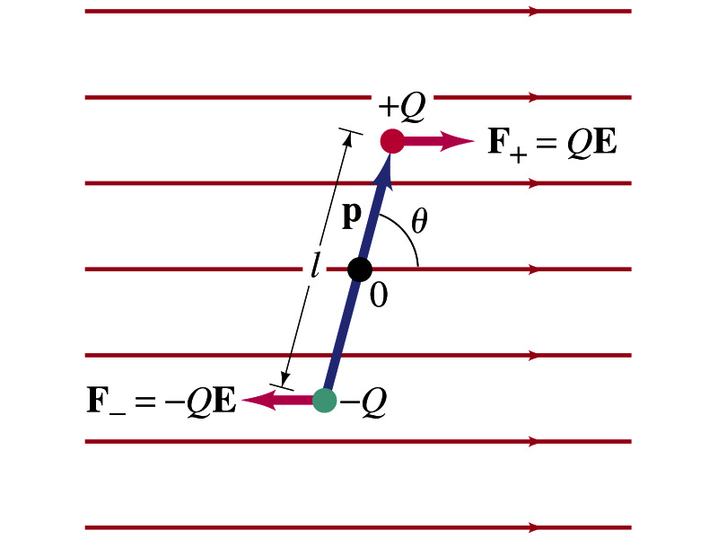
Dipoles in an External Field
Let’s consider a dipole placed in a uniform electric field E.
What do you think will happen to the dipole in the figure?
Forces will be exerted on the charges.
The positive charge will get pushed toward right while the negative charge will get pulled toward left.
What is the net force acting on the dipole?
Zero
So will the dipole not move?
Yes, it will.
Why?
There is a torque applied on the dipole.

Slide 11
Dipoles in an External Field, cnt’d
How much is the torque on the dipole?
Do you remember the formula for torque?
The magnitude of the torque exerting on each of the charges with respect to the rotational axis at the center is
Thus, the total torque is
So the torque on a dipole in vector notation is
The effect of the torque is to try to turn the dipole so that the dipole moment is parallel to E. Which direction?

Slide 12
Potential Energy of a Dipole in an External Field
What is the work done on the dipole by the electric field to change the angle from θ₁ to θ₂?
The torque is .
Thus the work done on the dipole by the field is
What happens to the dipole’s potential energy, U, when a positive work is done on it by the field?
It decreases.
We choose U=0 when θ₁=90 degrees, then the potential energy at θ₂=θ becomes
Why negative?
Because τ and θ are in opposite directions to each other.

Slide 13
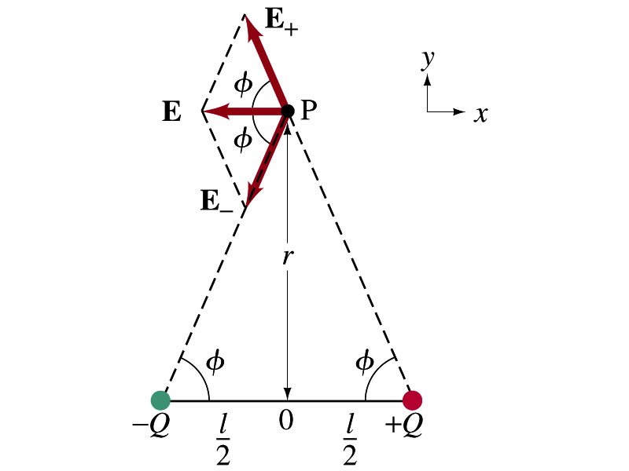
Electric Field by a Dipole
Let’s consider the case in the picture.
There are fields by both the charges. So the total electric field by the dipole is
The magnitudes of the two fields are equal
Now we must work out the x and y components of the total field.
Sum of the two y components is
Zero since they are the same but in opposite direction
So the magnitude of the total field is the same as the sum of the two x-components:

Slide 14
Dipole Electric Field from Afar
What happens when r>>l?.
Why does this make sense?
Since from a long distance, the two charges are very close so that the overall charge gets close to 0!!
This dependence works for the point not on the bisecting line as well

Slide 15
Example 21 – 17
Dipole in a field. The dipole moment of a water molecule is 6.1x10⁻³⁰C-m. A water molecule is placed in a uniform electric field with magnitude 2.0x10⁵N/C. (a) What is the magnitude of the maximum torque that the field can exert on the molecule? (b) What is the potential energy when the torque is at its maximum? (c) In what position will the potential energy take on its greatest value? Why is this different than the position where the torque is maximized?
(a) The torque is maximized when θ=90 degrees. Thus the magnitude of the maximum torque is
What is the distance between a hydrogen atom and the oxygen atom?

Slide 16
Example 21 – 17
(b) What is the potential energy when the torque is at its maximum?
Since the dipole potential energy is
And τ is at its maximum at θ=90 degrees, the potential energy, U, is
Is the potential energy at its minimum at θ=90 degrees?
No
Why not?
Because U will become negative as θ increases.
(c) In what position will the potential energy take on its greatest value?
The potential energy is maximum when cosθ= -1, θ=180 degrees.
Why is this different than the position where the torque is maximized?
The potential energy is maximized when the dipole is oriented so that it has to rotate through the largest angle against the direction of the field, to reach the equilibrium position at θ=0.
Torque is maximized when the field is perpendicular to the dipole, θ=90.

Slide 17
Gauss’ Law
Gauss’ law states the relationship between electric charge and the electric field.
More generalized and elegant form of Coulomb’s law.
The electric field by a distribution of charges can be obtained using Coulomb’s law by summing (or integrating) over the charge distributions vectorially.
Gauss’ law, however, gives an additional insight into the nature of the electrostatic field and a more general relationship between the charge and the field

Slide 18
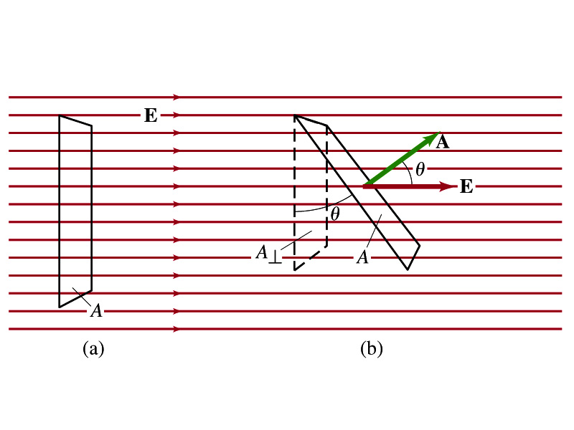
Electric Flux
Let’s imagine a surface of area A through which a uniform electric field E passes
The electric flux Φ_{E} is defined as
Φ_{E}=EA, if the field is perpendicular to the surface
Φ_{E}=EAcosθ, if the field makes an angle θ to the surface
So the electric flux is defined as .
How would you define the electric flux in words?
The total number of field lines passing through the unit area perpendicular to the field.
Unit?

Slide 19
Example 22 – 1
Electric flux. (a) Calculate the electric flux through the rectangle in the figure (a). The rectangle is 10cm by 20cm and the electric field is uniform with magnitude 200N/C. (b) What is the flux in figure if the angle is 30 degrees?
The electric flux is defined as
So when (a) θ=0, we obtain
And when (b) θ=30 degrees, we obtain

Slide 20
A Brain Teaser of Electric Flux
What would change the electric flux through a circle lying in the xz plane where the electric field is (10N/C)j?
Changing the magnitude of the electric field
Changing the surface area of the circle
Tipping the circle so that it is lying in the xy plane
All of the above
None of the above

Slide 21
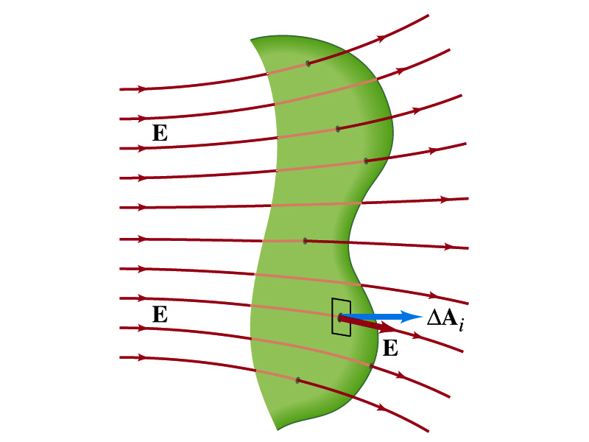
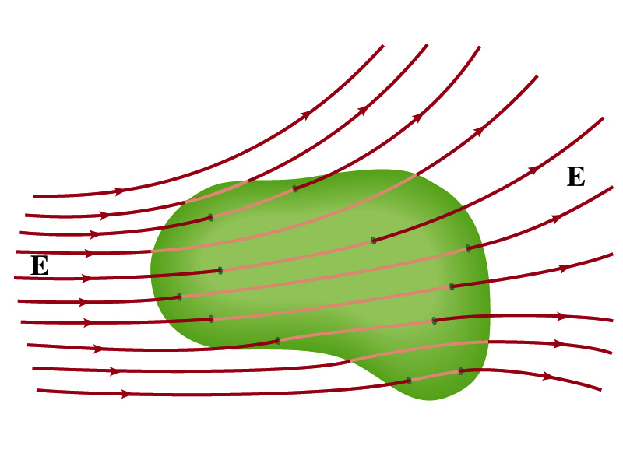
Generalization of the Electric Flux
Let’s consider a surface of area A that is not a square or flat but in some random shape, and that the field is not uniform.
The surface can be divided up into infinitesimally small areas of ΔA_{i} that can be considered flat.
And the electric field through this area can be considered uniform since the area is very small.
Then the electric flux through the entire surface is approximately
In the limit where ΔA_{i} → 0, the discrete summation becomes an integral.
open surface
enclosed surface

Slide 22
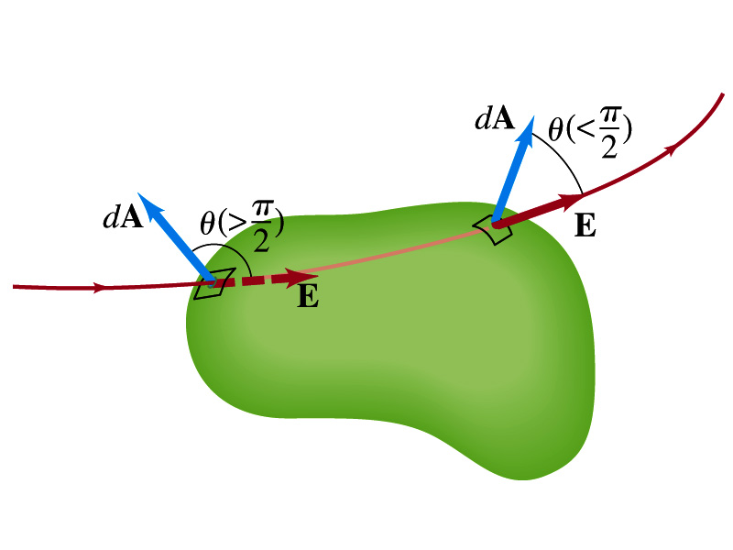
Generalization of the Electric Flux
We arbitrarily define that the area vector points outward from the enclosed volume.
For the line leaving the volume, θ<π/2 and cosθ>0. The flux is positive.
For the line coming into the volume, θ>π/2 and cosθ<0. The flux is negative.
If Φ_{E}>0, there is net flux out of the volume.
If Φ_{E}<0, there is flux into the volume.
In the above figures, each field that enters the volume also leaves the volume, so
The flux is non-zero only if one or more lines start or end inside the surface.

Slide 23
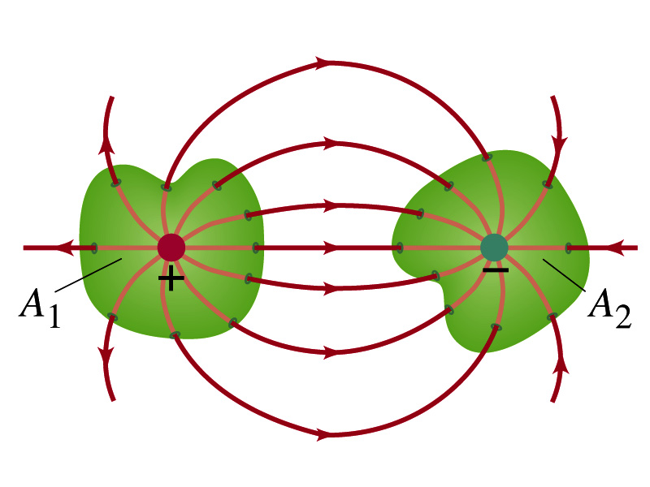
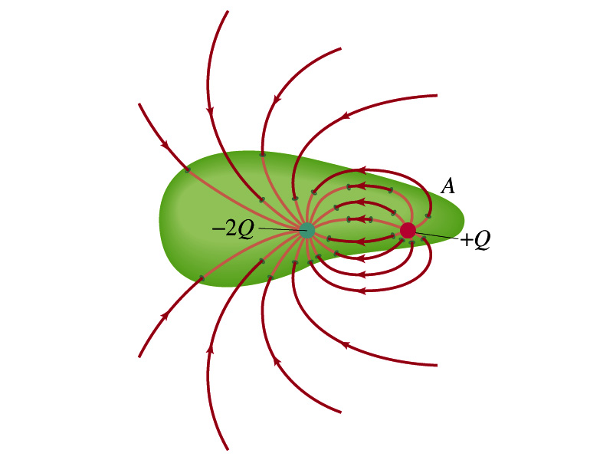
Generalization of the Electric Flux
The field line starts or ends only on a charge.
Sign of the net flux on the surface A₁?
The net outward flux (positive flux)
How about A₂?
Net inward flux (negative flux)
What is the flux in the bottom figure?
There should be a net inward flux (negative flux) since the total charge inside the volume is negative.
The net flux that crosses an enclosed surface is proportional to the total charge inside the surface. ➔ This is the crux of Gauss’ law.

Slide 24
Gauss’ Law
q
q’
Let’s consider the case in the above figure.
What are the results of the closed integral of the Gaussian surfaces A₁ and A₂?
For A₁
For A₂

Slide 25
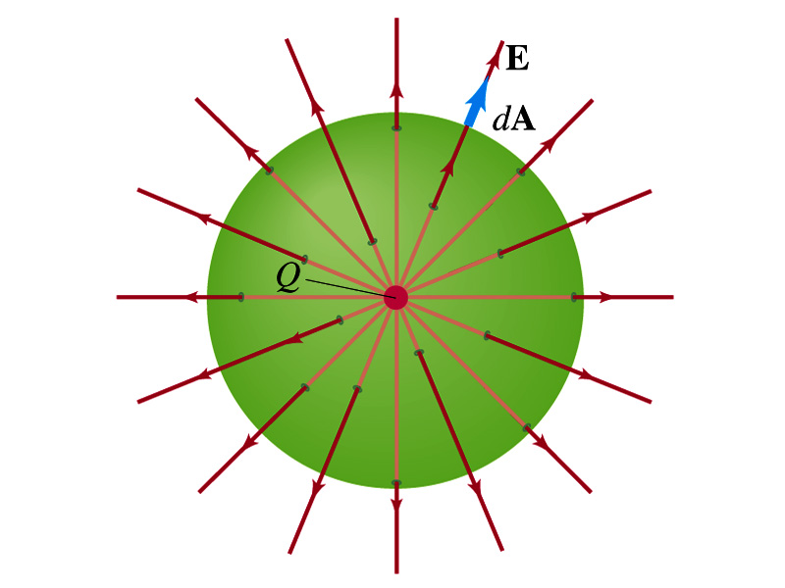
Coulomb’s Law from Gauss’ Law
Let’s consider a charge Q enclosed inside our imaginary Gaussian surface of sphere of radius r.
Since we can choose any shape of the surface enclosing the charge, we choose the simplest possible one! ☺
The surface is symmetric about the charge.
What does this tell us about the field E?
Must have the same magnitude (uniform) at any point on the surface
Points radially outward parallel to the surface vector dA.
The Gaussian integral can be written as
Solve
for E
Electric Field of
Coulomb’s Law

