Slide 1
PHYS 1444 – Section 002 Lecture #7
Wednesday, Feb. 12, 2020
Dr. Jaehoon Yu
CH 22
Gauss’ Law with Multiple Charges
CH 23
Electric Potential Energy
Electric Potential due to Point Charges
Shape of the Electric Potential
V due to Charge Distribution

Slide 2
Announcements
1st Term Exam
In class, Wednesday, Feb. 19: DO NOT MISS THE EXAM!
CH21.1 to what we learn on Monday, Feb. 17 + Appendices A1 – A8
You can bring your calculator w/o any relevant formula pre-input
BYOF: You may bring a one 8.5x11.5 sheet (front and back) of handwritten formulae and values of constants for the exam
No derivations, word definitions, or solutions of any problems !
No additional formulae or values of constants will be provided!
Physics department colloquia at 4pm Wednesdays in SH103!!
Special triple extra credit colloquium on Wed. Mar. 18
Dr. Pedro Machado from Fermilab
Mark your calendar!!

Slide 4
Reminder: Special Project #2 – Angels & Demons
Compute the total possible energy released from an annihilation of xx-grams of anti-matter and the same quantity of matter, where xx is the last two digits of your SS#. (20 points)
Use the famous Einstein’s formula for mass-energy equivalence
Compute the power output of this annihilation when the energy is released in yy ns, where yy is the first two digits of your SS#. (10 points)
Compute how many cups of gasoline (8MJ) this energy corresponds to. (5 points)
Compute how many months of world electricity usage (3.6GJ/mo) this energy corresponds to. (5 points)
Due at the beginning of the class Monday, Feb. 24

Slide 5
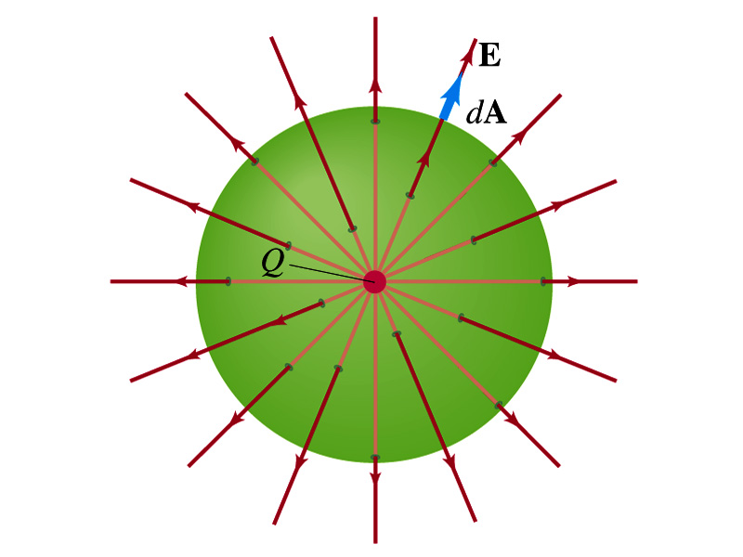
Gauss’ Law from Coulomb’s Law
Let’s consider a single static point charge Q surrounded by an imaginary spherical surface.
Coulomb’s law tells us that the electric field at a spherical surface of radius r is
Performing a closed integral over the surface, we obtain
Gauss’ Law

Slide 6
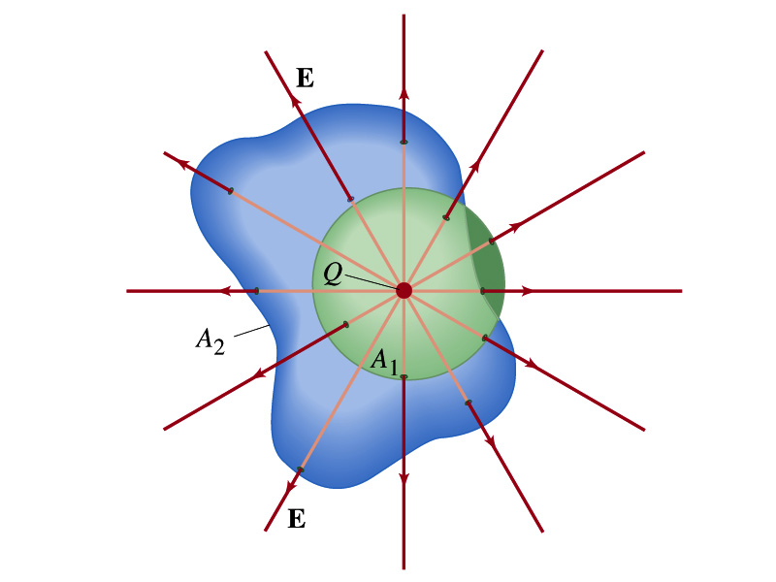
Gauss’ Law from Coulomb’s Law Irregular Surface
Let’s consider the same single static point charge Q surrounded by a symmetric spherical surface A₁ and a randomly shaped surface A₂.
What is the difference in the total number of field lines due to the charge Q, passing through the two surfaces?
None. What does this mean?
The total number of field lines passing through the surface is the same no matter what shape the enclosing surface has.
So we can write:
What does this mean?
The flux due to the given enclosed charge is the same no matter what the shape of the surface enclosing it is. ➔ Gauss’ law, , is valid for any surface surrounding a single point charge Q.

Slide 7
Gauss’ Law w/ more than one charge
Let’s consider several charges inside a closed surface.
For each charge, Q_{i} inside the chosen closed surface,
What is ?
The electric field produced by Q_{i} alone!
Since electric fields can be added vectorially, following the superposition principle, the total field E is equal to the sum of the fields due to each charge plus any external fields. So
The value of the flux depends only on the charge enclosed in the surface!! ➔ Gauss’ law.
What is Q_{encl}?
The total enclosed charge!

Slide 8
So what is Gauss’ Law good for?
Derivation of Gauss’ law from Coulomb’s law is only valid for static electric charge.
Electric field can also be produced by changing magnetic fields.
Coulomb’s law cannot describe this field while Gauss’ law is still valid
Gauss’ law is more general than Coulomb’s law.
Can be used to obtain electric field, forces or obtain charges
Gauss’ Law: Any differences between the input and output flux of the electric field over any enclosed surface is due to the charge inside that surface!!!

Slide 9
Solving problems with Gauss’ Law
Identify the symmetry of the charge distributions
Draw an appropriate Gaussian surface, making sure it pass through the point you want to know the electric field at
Use the symmetry of the charge distribution to determine the direction of E at the point of the Gaussian surface
Evaluate the flux
Calculate the charge enclosed by the Gaussian surface
Ignore all the charges outside the Gaussian surface
Equate the flux to the enclosed charge and solve for E

Slide 10
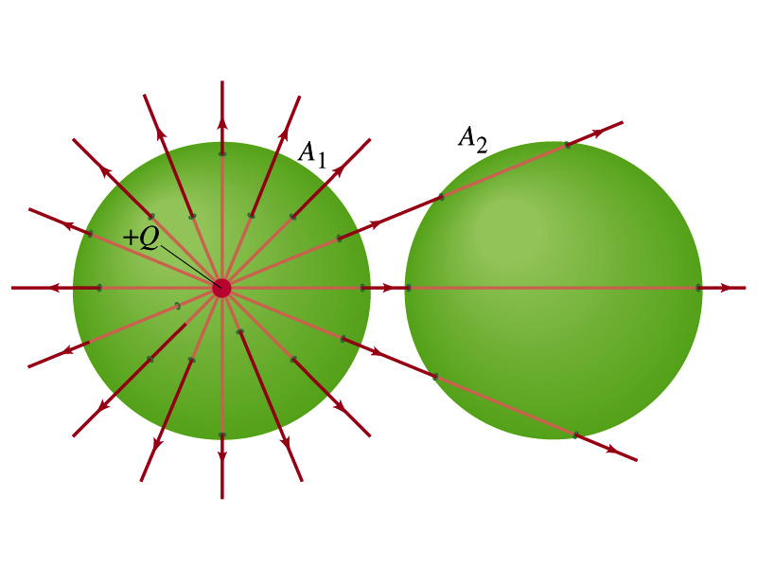
Example 22 – 2
Flux from Gauss’ Law: Consider two Gaussian surfaces, A₁ and A₂, shown in the figure. The only charge present is the charge +Q at the center of surface A₁. What is the net flux through each surface A₁ and A₂?
The surface A₁ encloses the charge +Q, so from Gauss’ law we obtain the total net flux
For the surface A₂, the charge, +Q, is outside the surface, so the total net flux is 0.

Slide 11
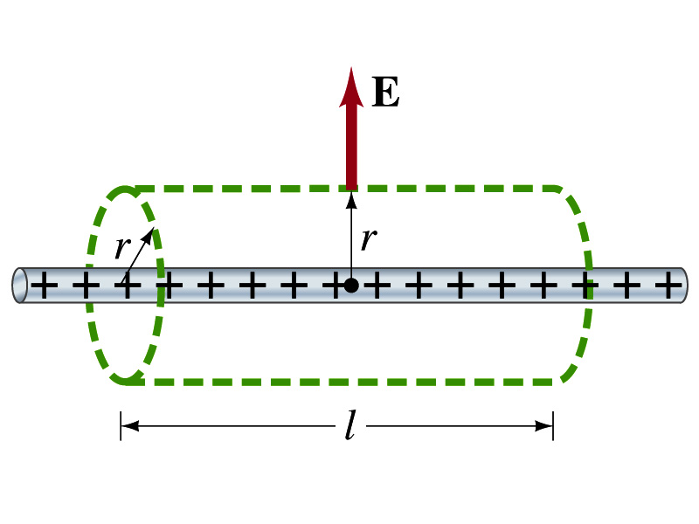
Example 22 – 6
Long uniform line of charge: A very long straight wire possesses a uniform positive charge per unit length, λ. Calculate the magnitude of the electric field at points near but outside the wire, far from the ends.
Which direction do you think the field due to the charge on the wire is?
Radially outward from the wire, the direction of the radial vector r.
Due to the cylindrical symmetry, the field is the same on the Gaussian surface of the cylinder surrounding the wire.
The end surfaces do not contribute to the flux at all. Why?
Because the field vector E is perpendicular to the surface vector dA.
From Gauss’ law
Solving for E

Slide 12
Gauss’ Law Summary
The precise relationship between flux and the enclosed charge is given by Gauss’ Law
ε₀ is the permittivity of free space in the Coulomb’s law
A few important points on Gauss’ Law
Freedom to choose!!
The integral is performed over the value of E on a closed surface of our choice in any given situation.
Test of existence of an electric charge!!
The charge Q_{encl} is the net charge enclosed by the arbitrary closed surface of our choice.
Universality of the law!
It does NOT matter where or how much charge is distributed inside the surface or in which way they are distributed.
The charge outside the surface does not contribute to Q_{encl}. Why?
The charge outside the surface might impact field lines but not the net total number of lines entering or leaving the surface

Slide 13
Electric Potential Energy
Concept of energy is very useful solving mechanical problems
Conservation of energy makes solving complex problems easier.
When can the potential energy be defined?
Only for a conservative force.
The work done by a conservative force is independent of the path. What does it only depend on??
The difference between the initial and final positions
Can you give me an example of a conservative force?
Gravitational force
Is the electrostatic force between two charges a conservative force?
Yes. Why?
The dependence of the force to the distance is identical to that of the gravitational force.
The only thing matters is the direct linear distance between the objects not the path.

Slide 14
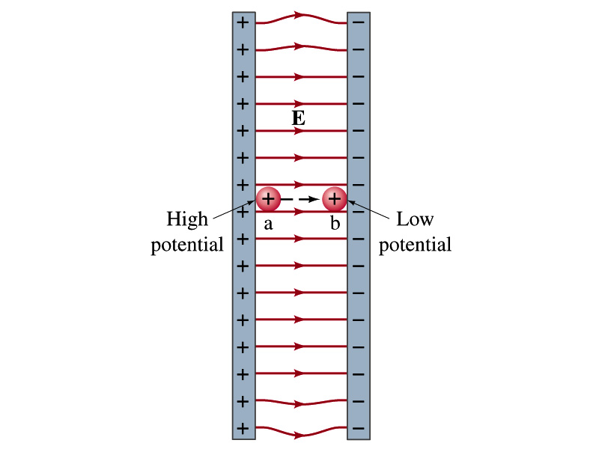
Electric Potential Energy
How would you define the change in electric potential energy U_{b} – U_{a}?
The potential energy gained by the charge as it moves from point a to point b.
The negative of the work done on the charge by the electric force to move it from a to b.
Let’s consider an electric field between two parallel plates w/ equal but opposite charges
The field between the plates is uniform since the gap is small and the plates are infinitely long…
What happens when we place a small charge, +q, on a point at the positive plate and let it go?
The electric force will accelerate the charge toward the negative plate.
What kind of energy does the charged particle gain?
Kinetic energy

Slide 15
Electric Potential Energy
What does this mean in terms of energies?
The electric force is a conservative force.
Thus, the mechanical energy (K+U) is conserved under this force.
The charged object has only the electric potential energy (no KE) at the positive plate.
The electric potential energy decreases and
Turns into kinetic energy as the electric force works on the charged object, and the charged object gains speed.
Point of greatest potential energy for
Positively charged object
Negatively charged object
PE=
U
0
KE=
0
K
ME=
U
K
U+K

