Slide 1
PHYS 1444 – Section 002
Lecture #8
Monday, Feb. 17, 2020
Dr. Jaehoon Yu
CH 23
  Electric Potential Energy
  Electric Potential
  Electric Potential and Electric Field
  Electric Potential due to Point Charges
  Shape of the Electric Potential
Today’s homework is homework #4, due 11pm, Monday, Feb. 24!!

Slide 2
Announcements
Reading assignments: CH23.9
1st Term Exam
  In class, this Wednesday, Feb. 19: DO NOT MISS THE EXAM!
  CH21.1 to what we finish today (CH23.2) + Appendices A1 – A8
  You can bring your calculator w/o any relevant formula pre-input
  BYOF: You may bring a one 8.5x11.5 sheet (front and back) of handwritten formulae and values of constants for the exam
  No derivations, word definitions, or solutions of any problems !
  No additional formulae or values of constants will be provided!
Quiz 2 results
  Class average: 33.7/70
    Equivalent to 48.1/100
    Previous results: 48.9/100
  Top score: 59/70

Slide 3
Reminder: Special Project #2 – Angels & Demons
Compute the total possible energy released from an annihilation of xx-grams of anti-matter and the same quantity of matter, where xx is the last two digits of your SS#. (20 points)
  Use the famous Einstein’s formula for mass-energy equivalence
Compute the power output of this annihilation when the energy is released in yy ns, where yy is the first two digits of your SS#. (10 points)
Compute how many cups of gasoline (8MJ) this energy corresponds to. (5 points)
Compute how many months of world electricity usage (3.6GJ/mo) this energy corresponds to. (5 points)
Due at the beginning of the class Monday, Feb. 24

Slide 4
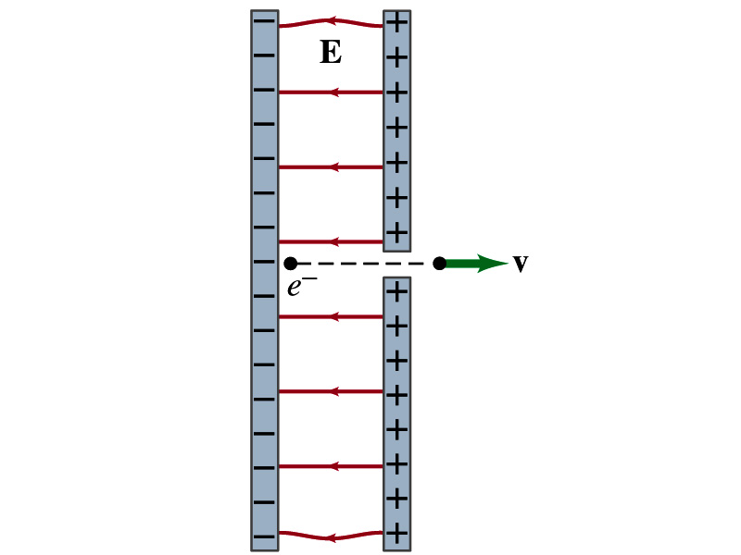
Special Project #3
Particle Accelerator. A charged particle of mass M with charge -Q is accelerated in the uniform field E between two parallel charged plates whose separation is D as shown in the figure on the right. The charged particle is accelerated from an initial speed v₀ near the negative plate and passes through a tiny hole in the positive plate.
  Derive the formula for the electric field E to accelerate the charged particle to a fraction f of the speed of light c. Express E in terms of M, Q, D, f, c and v₀.
  (a) Using the Coulomb force and the kinematic equations. (8 points)
  (b) Using the work-kinetic energy theorem. ( 8 points)
  (c) Using the formula above, evaluate the strength of the electric field E to accelerate an electron from 0.1% of the speed of light to 90% of the speed of light. You need to look up and write down the relevant constants, such as mass of the electron, charge of the electron and the speed of light. (5 points)
Must be handwritten and not copied from anyone else!
Due beginning of the class Monday, March 2

Slide 5
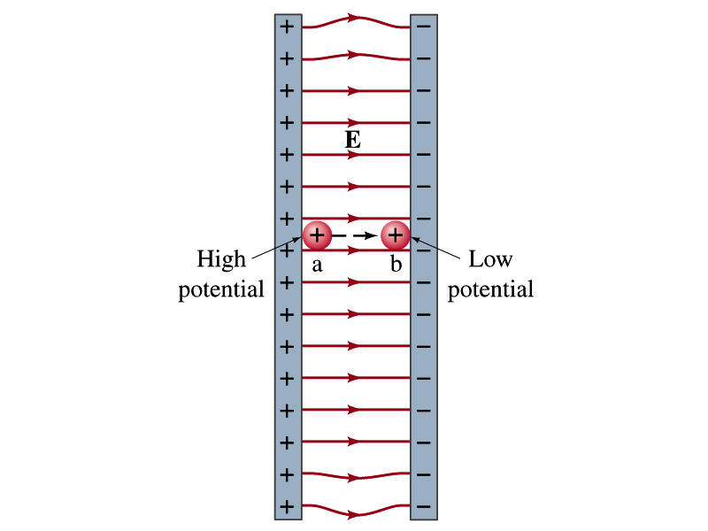
Electric Potential Energy
How would you define the change in electric potential energy U_{b} – U_{a}?
  The potential energy gained by the charge as it moves from point a to point b.
  The negative of the work done on the charge by the electric force to move it from a to b.
Let’s consider an electric field between two parallel plates w/ equal but opposite charges
  The field between the plates is uniform since the gap is small and the plates are infinitely long…
What happens when we place a small charge, +q, on a point at the positive plate and let it go?
  The electric force will accelerate the charge toward the negative plate.
  What kind of energy does the charged particle gain?
    Kinetic energy

Slide 6
Electric Potential Energy
What does this mean in terms of energies?
  The electric force is a conservative force.
  Thus, the mechanical energy (K+U) is conserved under this force.
  A positively charged object has only the electric potential energy (no KE) at the positive plate.
  The electric potential energy decreases and
  Turns into kinetic energy as the electric force works on the charged object, and the charged object gains speed.
Point of greatest potential energy for
  Positively charged object
  Negatively charged object
PE=
U
0
KE=
0
K
ME=
U
K
U+K

Slide 7
Electric Potential
How is the electric field defined?
  Electric force per unit charge: F/q
We can define the electric potential (potential) as
  The electric potential energy per unit charge
  This is like the voltage of a battery…
Electric potential is written with the symbol V
  If a positive test charge q has potential energy U_{a} at point a, the electric potential of the charge at that point is

Slide 8
Electric Potential
Since only the difference in potential energy is meaningful, only the potential difference between two points is measurable
What happens when the electric force does a “positive work”?
  The charge gains kinetic energy
  Electric potential energy of the charge decreases
Thus the difference in potential energy is the same as the negative of the work, W_{ba}, done on the charge by the electric field to move the charge from point a to b.
The potential difference V_{ba} is
  Electric potential is independent of the test charge!! Unit?
J/C

Slide 9
A Few Things about Electric Potential
What does the electric potential depend on?
  Other charges that create the field
  What about the test charge?
    No, the electric potential is independent of the test charge
    Test charge gains potential energy by simply existing in the potential created by other charges
Which plate is at a higher potential?
  Positive plate. Why?
    Since positive charge has the greatest potential energy on it.
  What happens to the positive charge if it is let go?
    It moves from higher potential to lower potential
  How about a negative charge?
    Its potential energy is higher on the negative plate. Thus, it moves from negative plate to positive. Potential difference is the same.
The unit of the electric potential is Volt (V).
From the definition, 1V = 1J/C.
Zero point of the electric potential can be chosen arbitrarily.
Often the ground, a conductor connected to Earth, is zero.

Slide 10
Example 23 – 1
A negative charge: Suppose a negative charge, such as an electron, is placed at point b in the figure. If the electron is free to move, will its electric potential energy increase or decrease? How will the electric potential change?
-
-
An electron placed at point b will move toward the positive plate since it was released at its highest potential energy point.
It will gain kinetic energy as it moves toward left, decreasing its potential energy.
The electron, however, moves from the point b at a lower potential to point a at a higher potential. ΔV=V_{a} – V_{b}>0.
This is because the potential is generated by the charges on the plates not by the electron.

Slide 11
Electric Potential and Potential Energy
What is the definition of the electric potential?
  The potential energy difference per unit charge
OK, then, how would you express the potential energy that a charge q would obtain when it is moved between point a and b with the potential difference V_{ba}?
  In other words, if an object with charge q moves through a potential difference V_{ba}, its potential energy changes by qV_{ba}.
So based on this, how differently would you describe the electric potential in words?
  A measure of how much potential energy an electric charge can acquire in a given situation
  A measure of how much work a given charge can do.

Slide 12
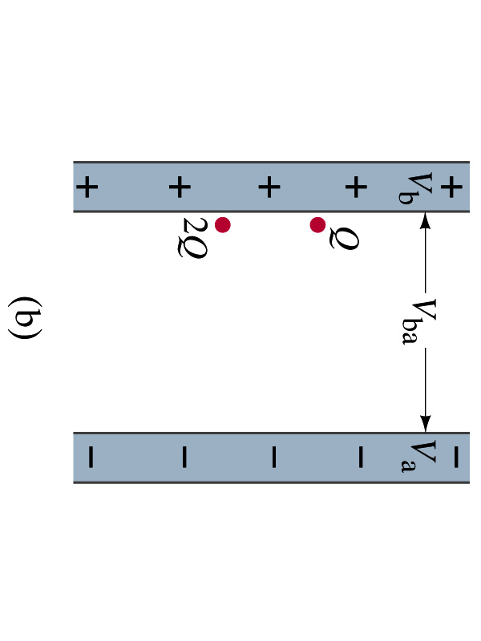
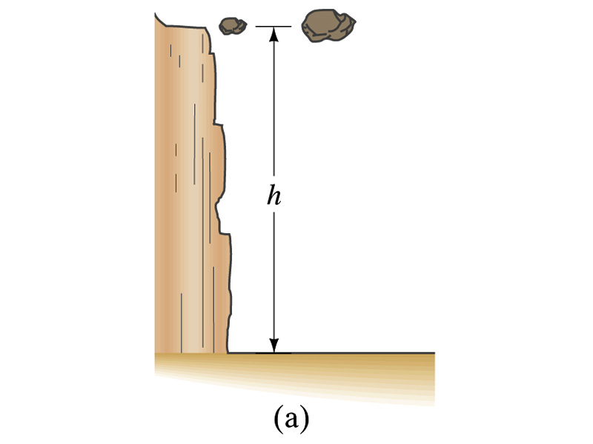
Comparisons of Potential Energies
Let’s compare gravitational and electric potential energies
m
2m
What are the potential energies of the rocks?
  mgh and 2mgh
Which rock has a bigger potential energy?
  The rock with a larger mass
Why?
  It’s got a bigger mass.
What are the potential energies of the charges?
  QV_{ba} and 2QV_{ba}
Which object has a bigger potential energy?
  The object with a larger charge.
Why?
  It’s got a bigger charge.
The potential is the same but the heavier rock or larger charge can do a greater work.

Slide 13
Electric Potential and Potential Energy
The electric potential difference gives potential energy or the possibility to perform work based on the charge of the object.
So what is happening in a battery or a generator?
  They maintain a potential difference.
  The actual amount of energy used or transformed depends on how much charge flows.
  How much is the potential difference maintained by a car battery?
    12Volts
  If for a given period, 5C charge flows through the headlight lamp, what is the total energy transformed?
    E_{tot}=5C*12V=60 Umm… What is the unit?
  If it is left on twice as long? E_{tot}=10C*12V=120J.
Joules

Slide 14
Some Typical Voltages
Sources | Approximate Voltage
Thundercloud to ground | 10⁸ V
High-Voltage Power Lines | 10⁶ V
Power supply for TV (cathode ray) tube | 10⁴ V
Automobile ignition | 10⁴ V
US household outlet | 10² V
Automobile battery | 12 V
Flashlight battery | 1.5 V
Resting potential across nerve membrane | 10⁻¹ V
Potential changes on skin (EKG and EEG) | 10⁻⁴ V
In a typical lightening strike, 15C of electrons are released in 500μs. What is the total kinetic energy of these electrons when they strike ground? What is the power released during this strike? What do you think will happen to a tree hit by this lightening?

Slide 15
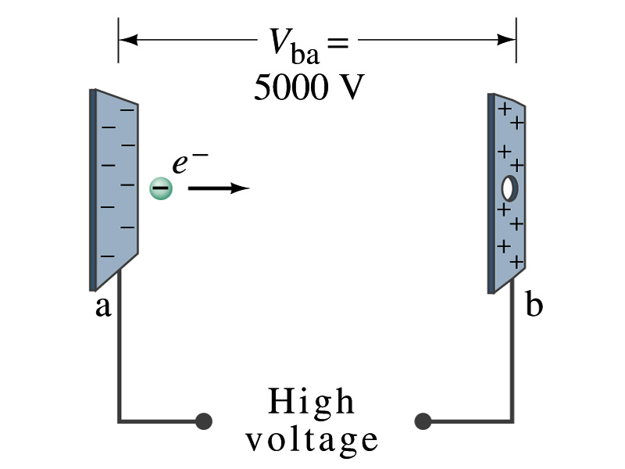
Example 23 – 2
Electrons in TV tube: Suppose an electron in the picture tube of a television set is accelerated from rest through a potential difference V_{ba}=+5000V. (a) What is the change in potential energy of the electron? (b) What is the speed of the electron (m=9.1x10⁻³¹kg) as a result of this acceleration? (c) Repeat for a proton (m=1.67x10⁻²⁷kg) that accelerates through a potential difference of V_{ba}= - 5000V.
(a) What is the charge of an electron?
So what is the change of its potential energy?

Slide 16
Example 23 – 2
(b) Speed of the electron?
  The entire potential energy of the electron turns to its kinetic energy. Thus the equation is
(C) Speed of a proton?

Slide 17
Electric Potential and Electric Field
The effect of the charge distribution can be described in terms of electric field or electric potential.
  What kind of quantities are the electric field and the electric potential?
    Electric Field:
    Electric Potential:
  Since electric potential is a scalar quantity, it is often easier to handle.
Well other than the above, how are these two quantities related?
Vector
Scalar

Slide 18
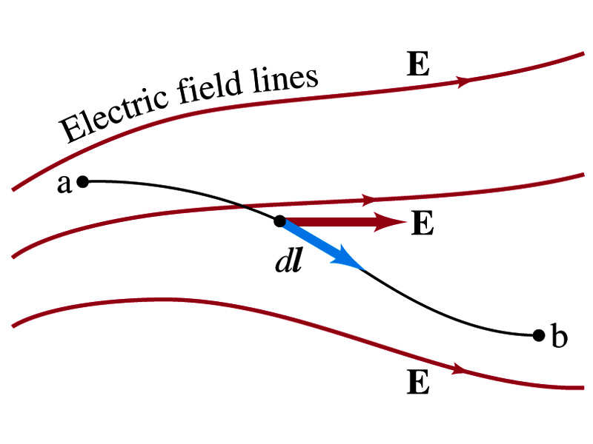
Electric Potential and Electric Field
Potential energy change is expressed in terms of a conservative force (point a at the higher potential)
For the electrical case, we are more interested in the potential difference:
  This formula can be used to determine V_{ba} when the electric field is given.
When the field is uniform
so
What does “-”sign mean?
The direction of E is along that of decreasing potential.
Unit of the electric field in terms of potential?
V/m
Can you derive this from N/C?

Slide 19
Example
Uniform electric field obtained from voltage: Two parallel plates are charged to a voltage of 50V. If the separation between the plates is 5.0cm, calculate the magnitude of the electric field between them, ignoring any fringe effect.
5cm
50V
What is the relationship between electric field and the potential for a uniform field?
Solving for E
Which direction is the field?
Direction of decreasing potential!

