Slide 1
PHYS 1444 – Section 002
Lecture #10
Wednesday, Feb. 26, 2020
Dr. Jaehoon Yu
CH 23
  Electrostatic Potential Energy
CH 24 Capacitance etc..
  Capacitors
  Capacitors in Series or Parallel
  Electric Energy Storage
  Effect of Dielectric

Slide 2
Announcements
Quiz #3
  Next Wednesday, Mar. 4 at the beginning of the class
  Covers CH23.2 through what we cover in class next Monday
  Bring your calculator but DO NOT input formula into it!
    Cell phones or any types of computers cannot replace a calculator!
  BYOF: You may bring a one 8.5x11.5 sheet (front and back) of handwritten formulae and values of constants for the quiz
  No derivations, word definitions or solutions of any problems!
  No additional formulae or values of constants will be provided!

Slide 3
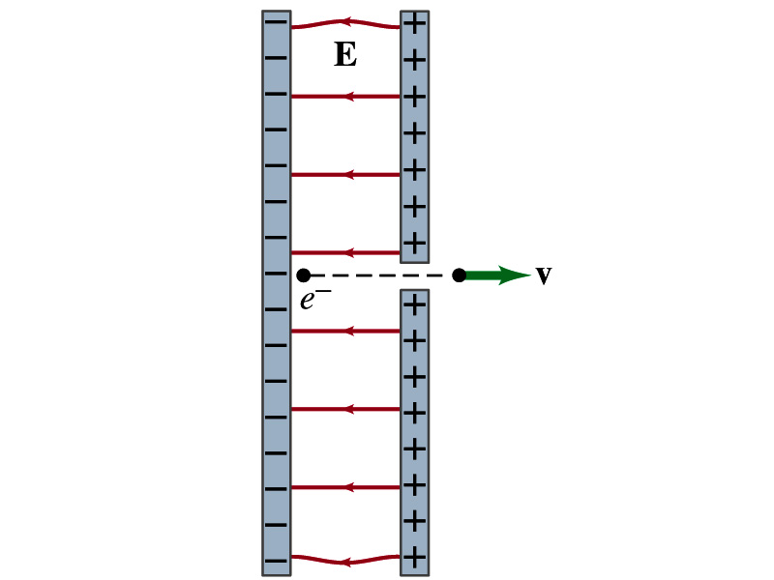
Reminder: Special Project #3
Particle Accelerator. A charged particle of mass M with charge -Q is accelerated in the uniform field E between two parallel charged plates whose separation is D as shown in the figure on the right. The charged particle is accelerated from an initial speed v₀ near the negative plate and passes through a tiny hole in the positive plate.
  Derive the formula for the electric field E to accelerate the charged particle to a fraction f of the speed of light c. Express E in terms of M, Q, D, f, c and v₀.
  (a) Using the Coulomb force and the kinematic equations. (8 points)
  (b) Using the work-kinetic energy theorem. ( 8 points)
  (c) Using the formula above, evaluate the strength of the electric field E to accelerate an electron from 0.1% of the speed of light to 90% of the speed of light. You need to look up and write down the relevant constants, such as mass of the electron, charge of the electron and the speed of light. (5 points)
Must be handwritten and not copied from anyone else! All of those involved in copying will get 0 credit!
Due beginning of the class next Monday, March 2

Slide 4
Electrostatic Potential Energy
Consider a case in which a point charge q is moved between points a and b where the electrostatic potential due to other charges in the system is V_{a} and V_{b}
The change in electrostatic potential energy of q in the field by other charges is
Now what is the electrostatic potential energy of a system of charges?
  Let’s choose V=0 at r=∞
  If there are no other charges around, single point charge Q₁ in isolation has no potential energy and is under no electric force

Slide 5
Electrostatic Potential Energy; Two charges
If the second point charge Q₂ is brought close to Q₁ at a distance r₁₂, the potential due to Q₁ at the position of Q₂ is
The potential energy of the two charges relative to V=0 at r= ∞ is
  This is the work that needs to be done by an external force to bring Q₂ from infinity to the distance r₁₂ from Q₁.
  It is also a negative of the work needed to separate them to infinity.

Slide 6
Electrostatic Potential Energy; Three Charges
So what do we do for three charges?
Work is needed to bring all three charges together
  Work needed to bring Q₁ to a certain location without the presence of any charge is 0.
  Work needed to bring Q₂ to a distance to Q₁ is
  Work need to bring Q₃ to certain distances to Q₁ and Q₂ is
So the total electrostatic potential energy of the three charge system is
  What about a four charge system or N charge system?

Slide 7
Electrostatic Potential Energy: electron Volt
What is the unit of the electrostatic potential energy?
  Joules
Joules is a very large unit in dealing with electrons, atoms, molecules or any atomic scale problems
For convenience a new unit, electron volt (eV), is defined
  1 eV is defined as the energy acquired by a particle carrying the magnitude of the charge equal to that of an electron (q=e) when it moves across a potential difference of 1V.
  How many Joules is 1 eV then?
eV, however, is NOT a standard SI unit. You must convert the energy to Joules for computations.
What is the speed of an electron with kinetic energy 5000eV?

Slide 8
Capacitors (or Condensers)
What is a capacitor?
  A device that can store electric charge
  But does not let them flow through
What does a capacitor consist of?
  Usually consists of two conducting objects (plates or sheets) placed near each other without touching
  Why can’t they touch each other?
    The charge will neutralize…
Can you give some examples?
  Camera flash, surge protectors, binary circuits, memory, etc…
How is the capacitor different than the battery?
  Battery provides potential difference by storing energy (usually chemical energy) while the capacitor stores charges but very little energy.

Slide 9
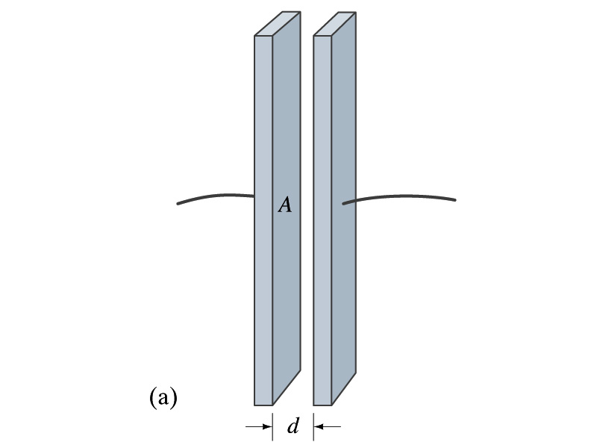
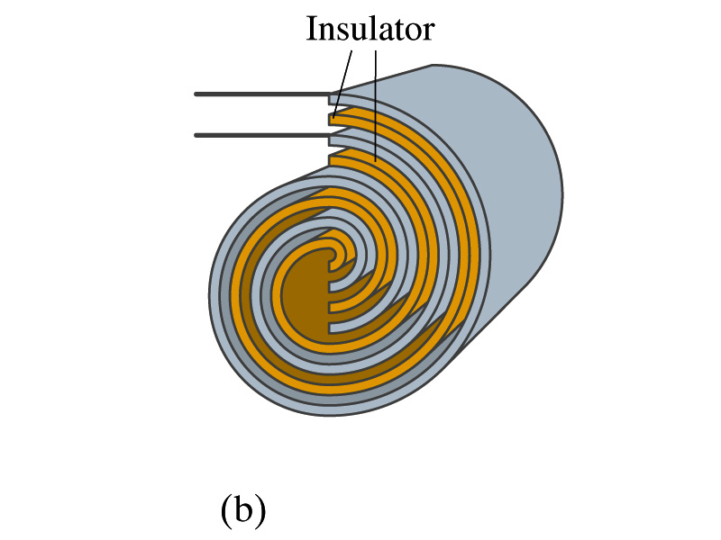
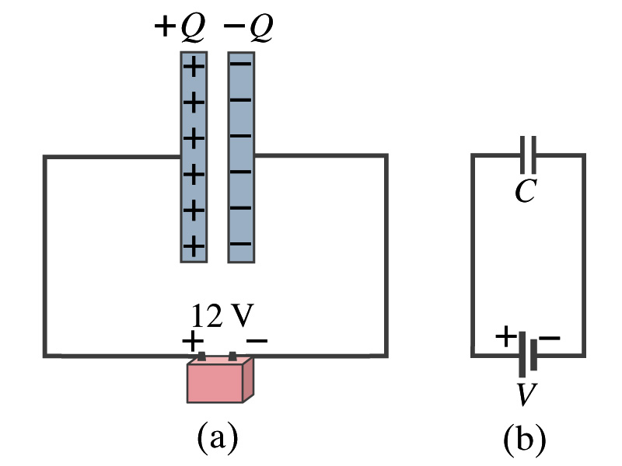
Capacitors
A simple capacitor consists of a pair of parallel plates of area A separated by a distance d.
  A cylindrical capacitor is essentially parallel plates wrapped around as a cylinder.
How do you draw symbols for a capacitor and a battery in a circuit diagram?
  Capacitor -||-
  Battery (+) -|i- (-)
Circuit
Diagram

Slide 10
Capacitors
What do you think will happen if a battery is connected ( or the voltage is applied) to a capacitor?
  The capacitor gets charged quickly, one plate positive and the other negative in equal amount.
The battery terminals, the wires and the plates are conductors. What does this mean?
  All conductors are at the same potential. And?
  So the full battery voltage is applied across the capacitor plates.
So for a given capacitor, the amount of charge stored on each capacitor plate is proportional to the potential difference V_{ba} between the plates. How would you write this formula?
  C is a proportionality constant, called the capacitance of the device.
  What is the unit?
C is the property of a capacitor so does not depend on Q or V.
C/V
or
Farad (F)
Normally use μF or pF.

Slide 11
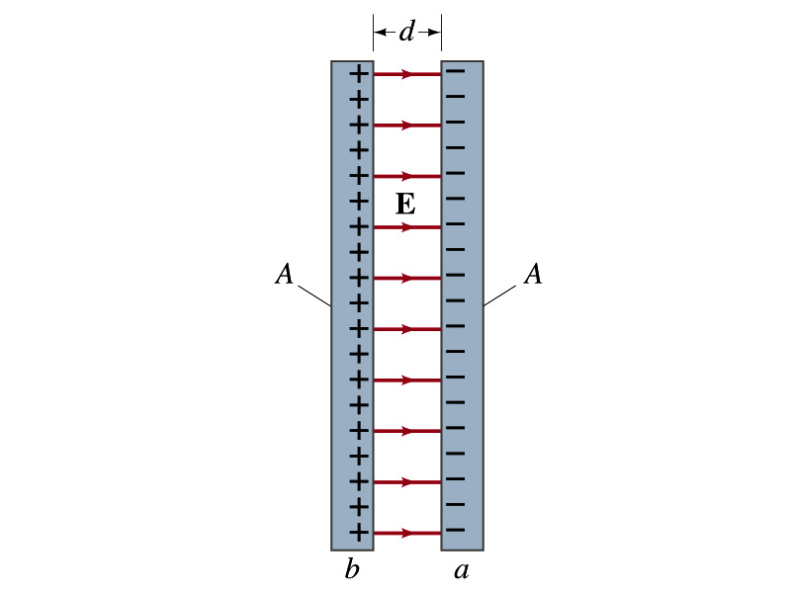
Determination of Capacitance
C, the capacitance can be determined analytically for a capacitor with a simple geometry and air in between.
Let’s consider a parallel plate capacitor.
  Plates have area A each and separated by d.
    d is smaller than the length, and so E is uniform.
  E for parallel plates is E=σ/ε₀, σ=Q/A is the surface charge density.
E and V are related
Since we take the integral from the lower potential (a) to the higher potential (b) along the field line, we obtain
So from the formula:
  What do you notice?
C only depends on the area and the distance of the plates and the permittivity of the medium between them.

Slide 12
Example 24 – 1
Capacitor calculations: (a) Calculate the capacitance of a capacitor whose plates are 20cmx3.0cm and are separated by a 1.0mm air gap. (b) What is the charge on each plate if the capacitor is connected to a 12-V battery? (c) What is the electric field between the plates? (d) Estimate the area of the plates needed to achieve a capacitance of 1F, given the same air gap.
(a) Using the formula for a parallel plate capacitor, we obtain
(b) From Q=CV, the charge on each plate is

Slide 13
Example 24 – 1
(C) Using the formula for the electric field in two parallel plates
Or, since
we can obtain
(d) Solving the capacitance formula for A, we obtain
Solve for A
About 40% the area of Arlington (256km²).

Slide 14
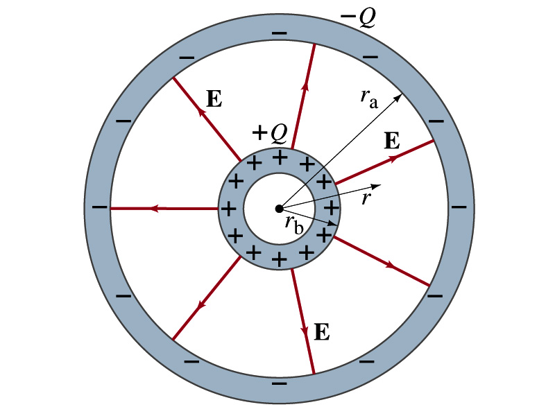
Example 24 – 3
Spherical capacitor: A spherical capacitor consists of two thin concentric spherical conducting shells, of radius r_{a} and r_{b}, as in the figure. The inner shell carries a uniformly distributed charge Q on its surface and the outer shell an equal but opposite charge –Q. Determine the capacitance of the two shells.
Using Gauss’ law, the electric field outside a uniformly charged conducting sphere is
So the potential difference between a and b is
Thus capacitance is

