Slide 1
PHYS 1444 – Section 002
Lecture #11
Monday, Mar. 2, 2020
Dr. Jaehoon Yu
CH 24 Capacitance etc..
  Single Conductor Capacitance
  Capacitors in Series or Parallel
  Electric Energy Storage
  Effect of Dielectric
CH 25
  Electric Current and Resistance
Today’s homework is homework #7, due 11pm, Monday, Mar. 16!!

Slide 2
Announcements
Bring out the special project #3
Reading Assignment: CH24.5
Quiz #3
  This Wednesday, Mar. 4 at the beginning of the class
  Covers CH23.2 through end of CH24
  Bring your calculator but DO NOT input formula into it!
    Cell phones or any types of computers cannot replace a calculator!
  BYOF: You may bring a one 8.5x11.5 sheet (front and back) of handwritten formulae and values of constants for the quiz
  No derivations, word definitions or solutions of any problems!
  No additional formulae or values of constants will be provided!
Exam 1 results
  Class average: 51.3/86
    Equivalent to: 59.7/100
  Top score: 82/86

Slide 3
Single Conductor Capacitance
A single isolated conductor can be said to have capacitance, C.
C can still be defined as the ratio of the charge to the absolute potential V on the conductor.
  So Q=CV.
The potential of a single conducting sphere of radius r_{b} can be obtained as
where
So its capacitance is

Slide 4
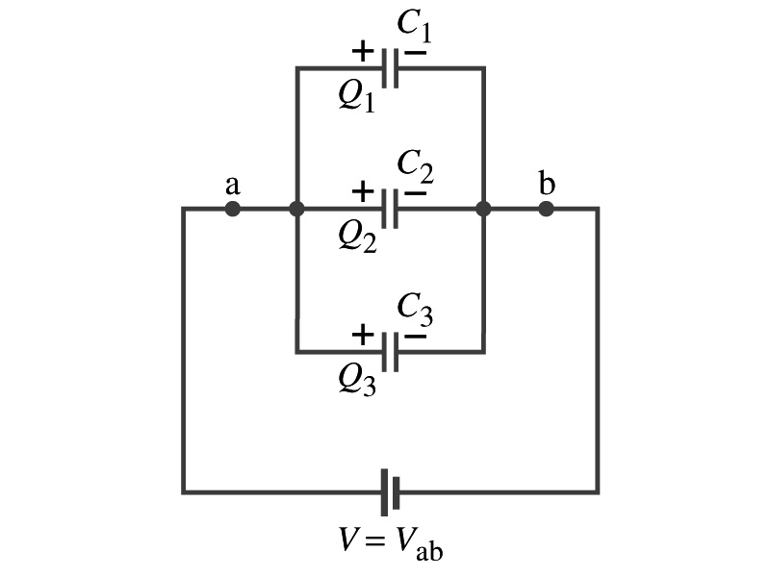
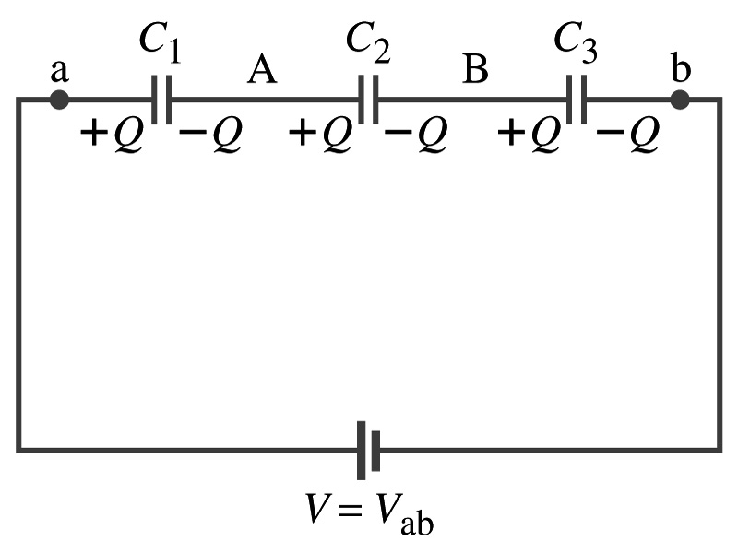
Capacitors in Series or Parallel
Capacitors may be used in an electric circuit
What is an electric circuit?
  A closed path of conductors, usually wires connecting capacitors and other electrical devices, in which
    charges can flow
    And includes a voltage source such as a battery
Capacitors can be connected in various ways.
  In parallel, in series or in combination

Slide 5
Capacitors in Parallel
Parallel arrangement provides the same voltage across all the capacitors.
  Lefthand plates are at V_{a}, while the righthand plates are at V_{b}
  So each capacitor plate acquires charges given by the formula
    Q₁=C₁V, Q₂=C₂V, and Q₃=C₃V
The total charge Q that must leave the battery is then
  Q=Q₁+Q₂+Q₃=V(C₁+C₂+C₃)
Consider that the three capacitors behave like an equivalent one
  Q=C_{eq}V= V(C₁+C₂+C₃)
Thus the equivalent capacitance in parallel is
What is the net effect?
The capacitance increases!!!

Slide 6
Capacitors in Series
Series arrangement is more interesting
  When battery is connected, +Q flows to the left plate of C₁ and –Q flows to the right plate of C₃.
  Since capacitors in between were originally neutral, charges get induced to neutralize the ones in the middle.
  So the charge on each capacitor plate is the same value, Q. (Same charge)
Consider that the three capacitors behave like an equivalent one
  Q=C_{eq}V
The total voltage V across the three capacitors in series must be equal to the sum of the voltage across each capacitor.
  V=V₁+V₂+V₃=Q/C₁+Q/C₂+Q/C₃
Putting all these together, we obtain:
V=Q/C_{eq}=Q(1/C₁+1/C₂+1/C₃)
Thus the equivalent capacitance is
What is the net effect?
The capacitance smaller than the smallest C!!!

Slide 7
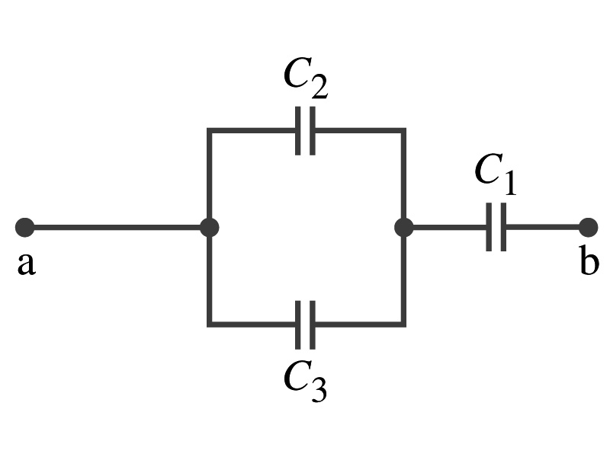
Example 24 – 5
Equivalent Capacitor: Determine the capacitance of a single capacitor that will have the same effect as the combination shown in the figure. Take C₁=C₂=C₃=C.
We should do these first!!
How?
These are in parallel so the equivalent capacitance is:
Now the equivalent capacitor is in series with C1.
Solve for C_{eq}

Slide 8
Electric Energy Storage
A charged capacitor stores energy.
  The stored energy is the same as the amount of the work done to charge it.
The net effect of charging a capacitor is removing one type of charge from one plate and put them on to the other.
  Battery does this when it is connected to a capacitor.
Capacitors do not get charged immediately.
  Initially when the capacitor is uncharged, no work is necessary to move the first bit of charge. Why?
    Since there is no charge, there is no field that the external force needs to work to overcome.
  When some charge is on each plate, it requires work to add more charges of the same sign due to the electric repulsion.

Slide 9
Electric Energy Storage
The work needed to add a small amount of charge, dq, when a potential difference across the plate is V: dW=Vdq.
Since V=q/C, the work needed to store total charge Q is
Thus, the energy stored in a capacitor when the capacitor carries the charges +Q and –Q is
Since Q=CV, we can rewrite

Slide 10
Example 24 – 8
Energy store in a capacitor: A camera flash unit stores energy in a 150μF capacitor at 200V. How much electric energy can be stored?
Using the formula for stored energy.
Umm.. Which one?
What do we know from the problem?
C and V
So we use the one with C and V:
How do we get J from FV²?

Slide 11
Electric Energy Density
The energy stored in a capacitor can be considered as being stored in the electric field between the two plates
For a uniform field E between two plates, V=Ed and C=ε₀A/d
Thus the stored energy is
Since Ad is the gap volume V, we can obtain the energy density, stored energy per unit volume, as
Valid for any space that is vacuum
Electric energy stored per unit volume in any region of space is proportional to the square of E in that region.

Slide 12
Dielectrics
Capacitors have an insulating sheet of material, called dielectric, between the plates to
  Increase breakdown voltage greater than that in air (3MV/m)
  Apply higher voltage to the gap without the charge passing across
  Allow the plates get closer together without touching
    Increases capacitance ( recall C=ε₀A/d)
  Increase the capacitance by the dielectric constant K
  Where C₀ is the intrinsic capacitance when the gap is vacuum

Slide 13
Dielectrics
The value of dielectric constant K varies depending on the material (Table 24 – 1)
  K for vacuum is 1.0000
  K for air is 1.0006 (this is why permittivity of air and vacuum are used interchangeably.)
  K for paper is 3.7
The maximum electric field before breakdown occurs is called the dielectric strength. What is its unit?
  V/m
The capacitance of a parallel plate capacitor with a dielectric (K) filling the gap is

Slide 14
Dielectrics
A new quantity of the permittivity of a dielectric material is defined as ε=Kε₀
The capacitance of a parallel plate capacitor with a dielectric medium filling the gap is
The energy density stored in an electric field E in a dielectric is
Valid for any space w/ dielectric w/ permittivity ε.
What is the stored energy in between ProtoDUNE cathode (-300kV) plate (6mx6m) and the cryostat wall (0V), d=1.5m, LAr K=1.6?

Slide 15
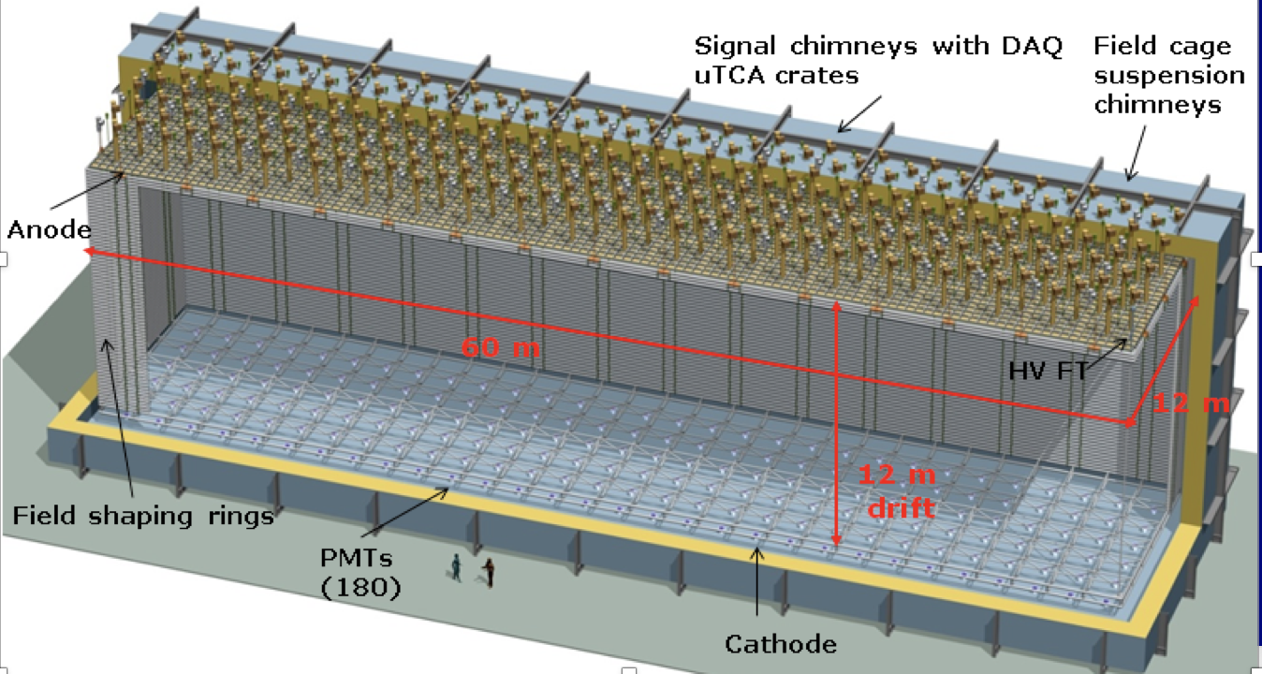
DUNE Dual Phase
Cathode

Slide 16
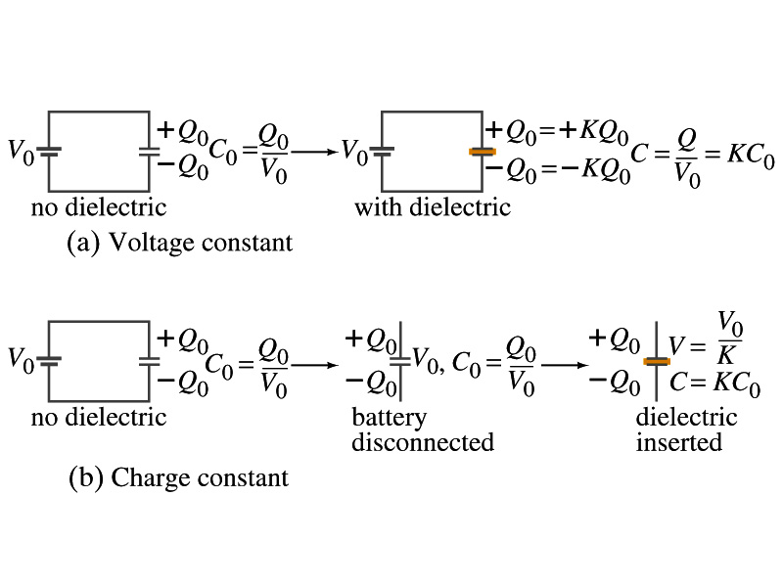
Effect of a Dielectric Material on Capacitance
Let’s consider the two cases below:
Case #1 : constant V
Case #2 : constant Q
Constant voltage: Experimentally observed that the total charge on each plate of the capacitor increases by K as a dielectric material is inserted between the gap ➔ Q=KQ₀
  The capacitance increased to C=Q/V₀=KQ₀/V₀=KC₀
Constant charge: Voltage found to drop by a factor K ➔ V=V₀/K
  The capacitance increased to C=Q₀/V=KQ₀/V₀=KC₀

Slide 17
Effect of a Dielectric Material on Field
What happens to the electric field within a dielectric?
Without a dielectric, the field is
  What are V₀ and d?
    V₀: Potential difference between the two plates
    d: separation between the two plates
For a constant voltage, the electric field remains the same
For the constant charge: the voltage drops to V=V₀/K, thus the field in the dielectric is
  The field in the dielectric is reduced.

Slide 18
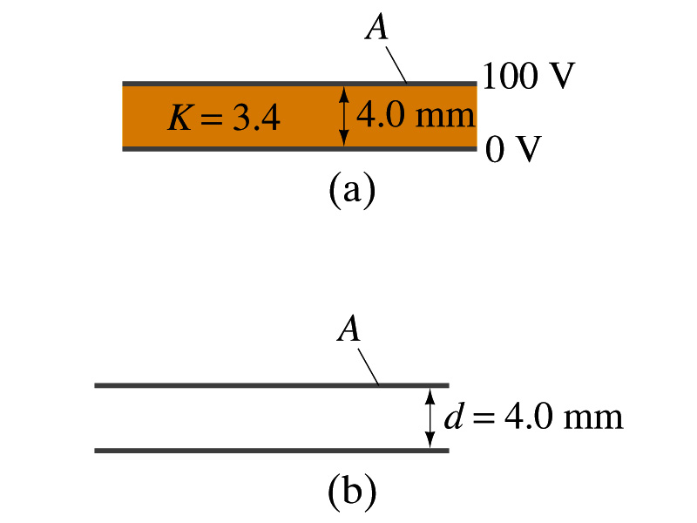
Example 24 – 11
Dielectric Removal: A parallel-plate capacitor, filled with the dielectric of K=3.4, is connected to a 100-V battery. After the capacitor is fully charged, the battery is disconnected. The plates have area A=4.0m² and are separated by d=4.0mm. (a) Find the capacitance, the charge on the capacitor, the electric field strength, and the energy stored in the capacitor. (b) The dielectric is carefully removed, without changing the plate separation nor does any charge leave the capacitor. Find the new value of capacitance, electric field strength, voltage between the plates and the energy stored in the capacitor.
(a)

Slide 19
Example 24 – 11 cont’d
(b)
Since the dielectric has been removed, the effect of dielectric constant must be removed as well.
Since charge is the same ( ) before and after the removal of the dielectric, we obtain
Wrong!
Where did the extra energy come from?
The energy conservation law is violated in electricity???
Wrong!
Wrong!
An external force has done the work of 3.6x10⁻⁴J on the system to remove dielectric!!

Slide 20
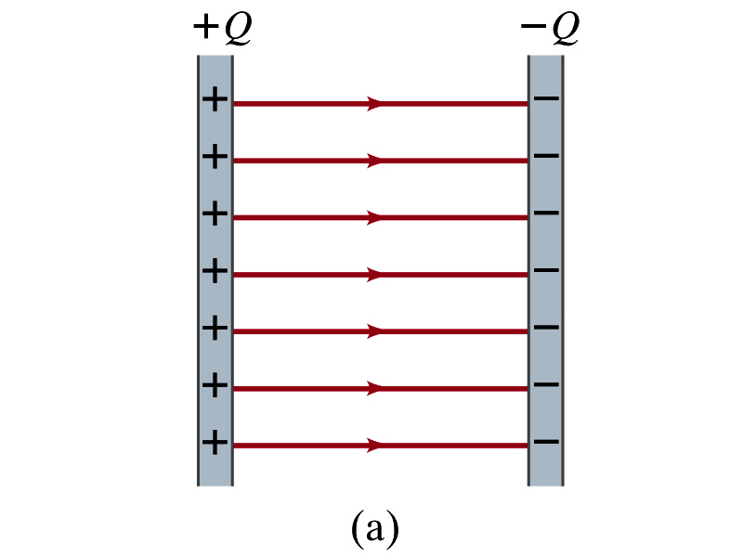
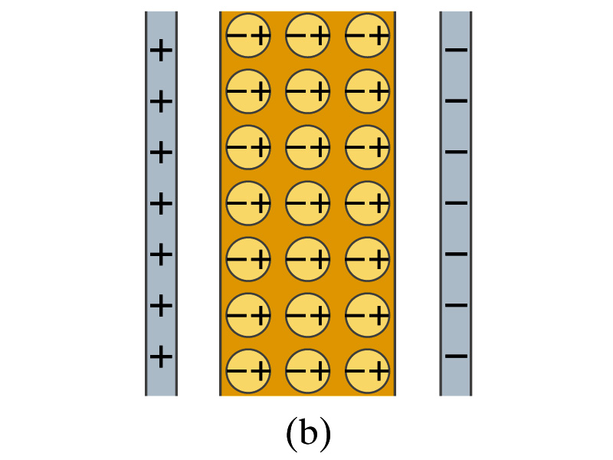
Molecular Description of Dielectric
So what in the world makes dielectrics behave the way they do?
We need to examine this in a microscopic scale.
Let’s consider a parallel plate capacitor that is charged up +Q(=C₀V₀) and –Q with air in between.
  Assume there is no way any charge can flow in or out
Now insert a dielectric
  Dielectric can be polar ➔ could have permanent dipole moment. What will happen?
Due to the electric field molecules will be aligned.

Slide 21
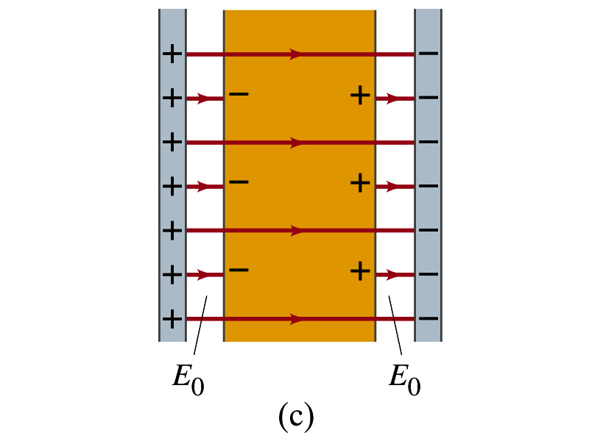
Molecular Description of Dielectric
OK. Then what happens?
Then effectively, there will be some negative charges close to the surface of the positive plate and positive charge on the negative plate
  Some electric field do not pass through the whole dielectric but stops at the negative charge
  So the field inside dielectric is smaller than the air
Since electric field is smaller, the force is smaller
  The work need to move a test charge inside the dielectric is smaller
  Thus the potential difference across the dielectric is smaller than across the air

