Slide 1
PHYS 1444 – Section 002 Lecture #13
Monday, Mar. 23, 2020
Dr. Jaehoon Yu
CH25
Electric Current and Resistance
Ohm’s Law: Resisters, Resistivity
Electric Power
Alternating Current
Microscopic View of Electric Current
Ohm’s Law in Microscopic View
Today’s homework is homework #8, due 11pm, Monday, Mar. 30!!

Slide 2
Basic Rules of the Online Classes
I will take attendance as if we are in the class room!
Turn on your mic when joining the class but then mute once you have answered to the roll call!
All mics must be muted unless you have a question
I will unmute all of you when I ask you a question for interactivity!
If you have a question, turn on your mic, pronounce your name and ask your question
Use appropriate languages on mic and on chat!
You can only chat with me
You will be assigned into random breakout rooms for example problem solving. Please discuss amongst yourselves to take advantage of the session!
No recording of the lecture is permitted!

Slide 3
Announcements
Reading Assignments: CH25.9 and 25.10
Mid-term Exam
Wednesday, Mar. 25 via Quest ➔ No free tries! Once submitted, you cannot change the answer! So be very careful!
First join in zoom class at 1pm and then move onto the exam on Quest at 1:05pm through 2:25pm ➔ Keep zoom on so that if you have any questions to me, type your questions in the chat window
Covers CH21.1 through what we finish today, Monday, Mar. 23 (CH25.7?) + the math refresher
You can use your calculator but DO NOT input formula into it!
Cell phones or any types of computers cannot replace a calculator!
Turn off your phones!!
BYOF: You may prepare a one 8.5x11.5 sheet (front and back) of handwritten formulae and values of constants
No derivations, word definitions or solutions of any problems!
Let’s be fair to other students and not cheat!
There will not be any department colloquia this semester

Slide 4
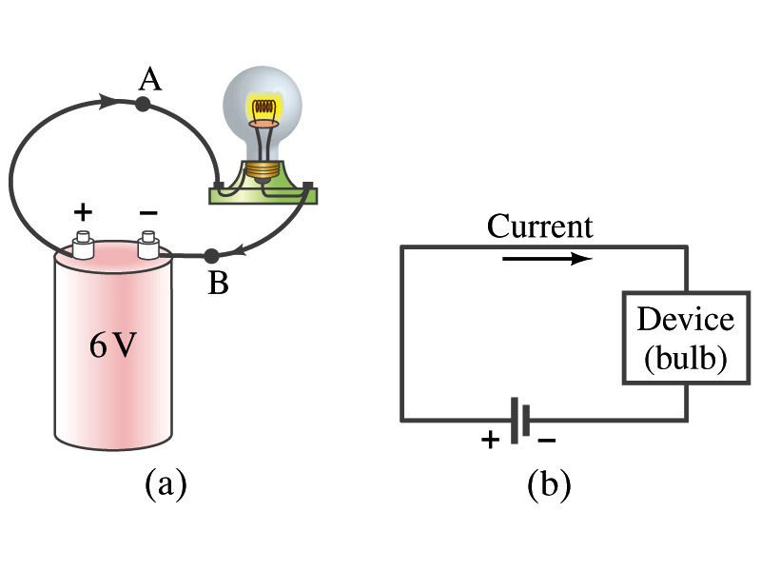
Refresher: Electric Current
When a circuit is powered by a battery (or a source of emf) the charge can flow through the circuit.
Electric Current: Any flow of charge
Current can flow whenever there is a potential difference between the ends of a conductor (or when the two ends have opposite charges)
The current can flow even through the empty space under certain conditions
Electric current in a wire can be defined as the net amount of charge that passes through the wire’s full cross section at any point per unit time (just like the flow of water through a conduit.)
Average current is defined as:
The instantaneous current is:
What kind of a quantity is the current?
Unit of the electric current?
C/s
1A=1C/s
Scalar
In a single circuit, the conservation of electric charge guarantees that the current at one point of the circuit is the same as any other points on the circuit.

Slide 5
Direction of the Electric Current
What do conductors have in abundance?
Free electrons
What happens if a continuous loop of conducting wire is connected to the terminals of a battery?
Electrons start flowing through the wire continuously as soon as both the terminals are connected to the wire. Why?
The potential difference between the battery terminals sets up an electric field inside the wire and in the direction parallel along the wire
Free electrons in the conducting wire get attracted to the positive terminal
The electrons leaving the negative terminal flow through the wire and arrive at the positive terminal
Electrons flow from negative to positive terminal
Due to historical convention, the direction of the current is opposite to the direction of flow of electrons ➔ Conventional Current

Slide 6
Ohm’s Law: Resistance and Resistors
What do we need to produce electric current?
Potential difference
Georg S. Ohm experimentally established that the current is proportional to the potential difference ( )
If we connect a wire to a 12V battery, the current flowing through the wire is twice that of 6V, three times that of 4V and four times that of 3V battery.
What happens if we reverse the sign of the voltage?
It changes the direction of the current flow
Does not change the size of the current
Just as in water flow case, if the height difference is large the flow rate is large ➔ If the potential difference is large, the current is large.

Slide 7
Ohm’s Law: Resistance
The exact amount of the current flow in a wire depends on
The voltage
The resistance of the wire to the flow of electrons
Just like the gunk in water pipe slows down water flow
Electrons are slowed down due to interactions with the atoms of the wire
The higher the resistance, the less the current for the given potential difference V
So how would you define resistance?
Such that current is inversely proportional to the resistance
Often it is rewritten as
What does this mean?
The metal conductor’s resistance R is a constant independent of V.
This linear relationship is not valid for some materials like diodes, vacuum tubes, transistors etc. ➔ These are called non-ohmic
Unit?
Ohm’s Law
ohms

Slide 8
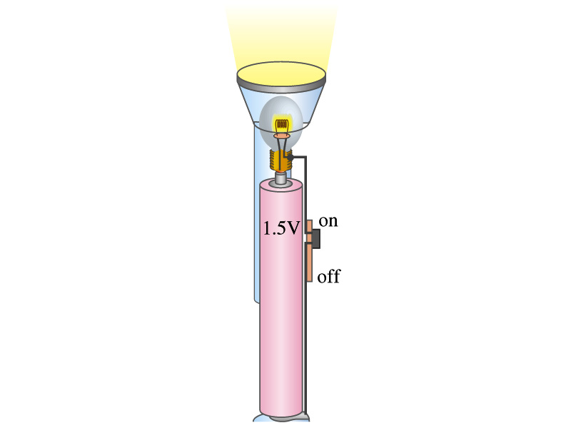
Example 25 – 4
Flashlight bulb resistance: A small flashlight bulb draws 300mA from its 1.5V battery. (a) What is the resistance of the bulb? (b) If the voltage drops to 1.2V, how would the current change?
From Ohm’s law, we obtain
Would the current increase or decrease, if the voltage reduces to 1.2V?
If the resistance did not change, the current is

Slide 9
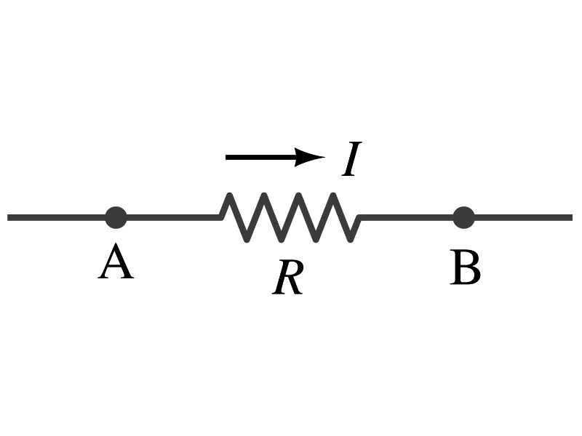
Ohm’s Law: Resistors
All electric devices offer resistance against the flow of current.
Filaments of light bulbs or heaters are wires with high resistance to cause electrons to lose their kinetic energy in the wire
In general connecting wires have lower resistance compared to other devices in the circuit
In a circuit, resistors are used to control the amount of current
Resistors offer resistance of less than one ohm to billions of ohms
Main types are
“wire-wound” resistors which consists of a coil of fine wire
“composition” resistors which are usually made of semiconductor carbon
thin metal films
When drawn in the circuit, the symbol for a resistor is:
Wires are drawn simply as straight lines

Slide 10
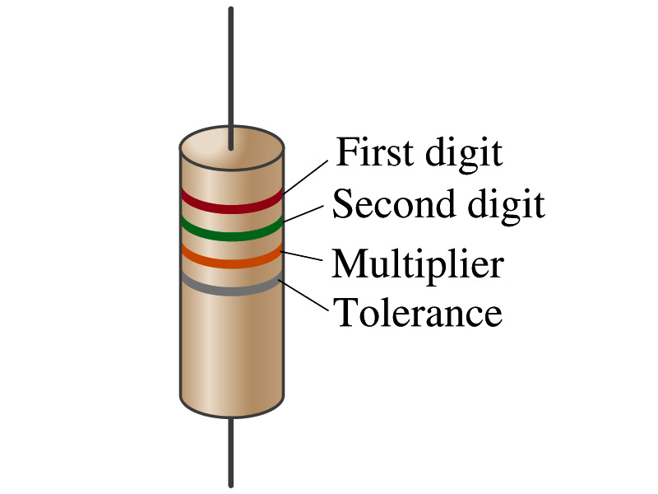
Ohm’s Law: Resistor Values
Resistors have its resistance color-coded on its body
The color-coding follows the convention below:
Color | Number | Multiplier | Tolerance
Black | 0 | 1=10⁰
Brown | 1 | 10¹
Red | 2 | 10²
Orange | 3 | 10³
Yellow | 4 | 10⁴
Green | 5 | 10⁵
Blue | 6 | 10⁶
Violet | 7 | 10⁷
Gray | 8 | 10⁸
White | 9 | 10⁹
Gold |  | 10-¹ | 5%
Silver |  | 10⁻² | 10%
None |  |  | 20%
What is the resistance of the resistor in this figure?

Slide 11
Resistivity
It is experimentally found that the resistance R of a metal wire is directly proportional to its length l and inversely proportional to its cross-sectional area A
How would you formularize this?
The proportionality constant ρ is called the resistivity and depends on the material used. What would be the unit of this constant?
ohm-m or Ω−m
The values depend on purity, heat treatment, temperature, etc
How does the resistance change dependent on the resistivity?
The higher the resistivity the higher the resistance
The lower the resistivity the lower the resistance and the higher the conductivity ➔ Silver has the lowest resistivity.
So silver is the best conductor
The reciprocal of the resistivity is called conductivity, σ,
A
l

Slide 12
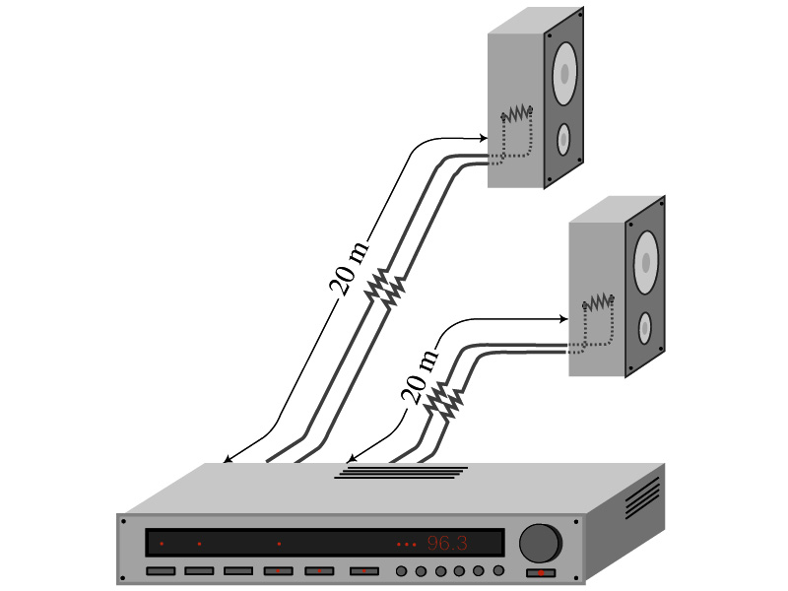
Example 25 – 5
Speaker wires: Suppose you want to connect your stereo to remote speakers. (a) If each wire must be 20m long, what diameter copper wire should you use to keep the resistance less than 0.1-Ω per wire? (b) If the current on each speaker is 4.0A, what is the voltage drop across each wire?
The resistivity of a copper is
Table 25.1
From the formula for resistance, we can obtain the formula for area
Solve for A
Solve for d
From Ohm’s law, V=IR, we obtain

Slide 13
Example 25 – 6
Stretching changes resistance: A wire of resistance R is stretched uniformly until it is twice its original length. What happens to its resistance?
What is the constant quantity in this problem?
The volume!
What is the volume of a cylinder of length L and radius r?
What happens to A if L increases factor two, L’=2L?
The cross-sectional area, A, halves. A’=A/2
The original resistance is
The new resistance is
The resistance of the wire increases by a factor of four if the length increases twice.

Slide 14
Temperature Dependence of Resistivity
Do you think the resistivity depends on temperature?
Yes
Would it increase or decrease with the temperature?
Increase
Why?
Because the atoms are vibrating more rapidly as temperature increases and are arranged in a less orderly fashion. So?
They might interfere more with the flow of electrons.
If the temperature change is not too large, the resistivity of metals usually increase nearly linearly with temperature
α is the temperature coefficient of resistivity
α of some semiconductors can be negative due to increased number of freed electrons.

Slide 15
Electric Power
Why is the electric energy useful?
It can transform into different forms of energy easily.
Motors, pumps, etc, transform electric energy to mechanical energy
Heaters, dryers, cook-tops, etc, transforms electricity to thermal energy
Light bulb filament transforms electric energy to light energy
Only about 10% of the energy turns to light and the 90% lost via heat
Typical household light bulb and heating elements have resistance of order a few ohms to a few hundred ohms
How does the electric energy transforms to thermal energy?
Flowing electrons collide with the vibrating atoms of the wire.
In each collision, part of electron’s kinetic energy is transferred to the atom it collides
KE of wire’s bound atoms increases, and thus the temperature of the wire increases.
The increased thermal energy can be transferred as heat through conduction and convection to the air in a heater or to food on a pan, through radiation to bread in a toaster or radiated as light.

Slide 16
Electric Power
How do we find out the power transformed by an electric device?
What is definition of the power?
The rate at which work is done or the energy is transformed
What is the energy transformed when an infinitesimal charge dq moves through a potential difference V?
dU=Vdq
If dt is the time required for an amount of charge dq to move through the fixed potential difference V, the power P is
Thus, we obtain .
What is the unit?
What kind of quantity is the electrical power?
Scalar
P=IV can apply to any devices while the formula with resistance can only apply to devices that has resistance.
What is this?
In terms of resistance
Watts = J/s

Slide 17
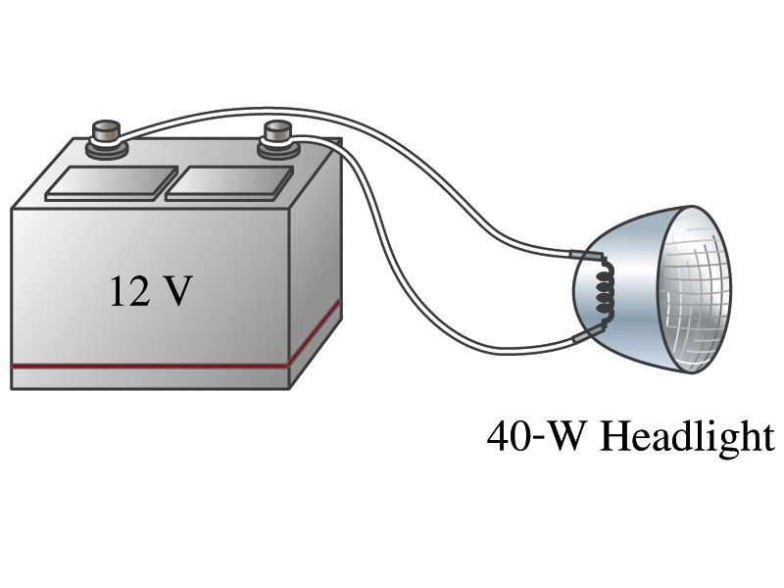
Example 25 – 8
Headlights: Calculate the resistance of a 40-W automobile headlight designed for 12V.
Since the power is 40W and the voltage is 12V, we use the formula with V and R.
Solve for R
What is the resistance of the filament of a 60W bulb?
A 60W equivalent LED bulb draws 9.5W power. What is its resistance?
A 100W equivalent LED bulb draws 17.5W power. What is its resistance?

Slide 18
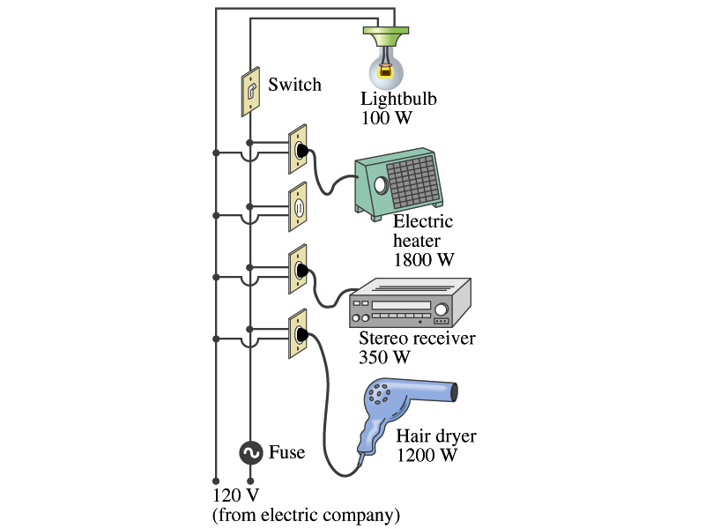
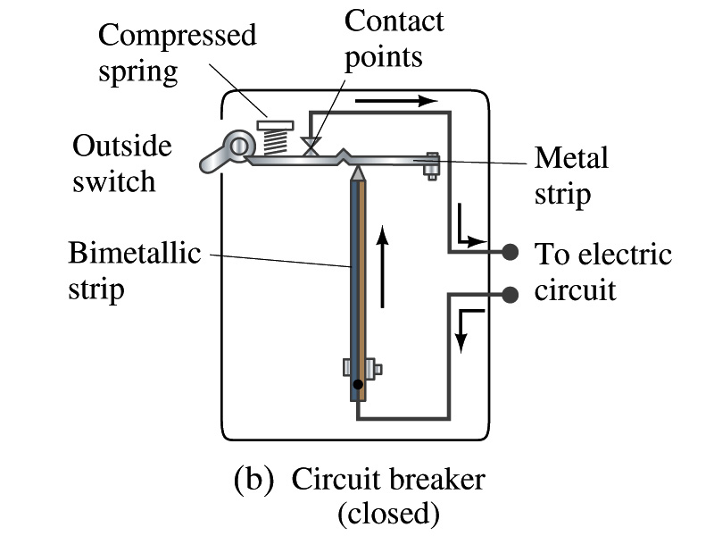
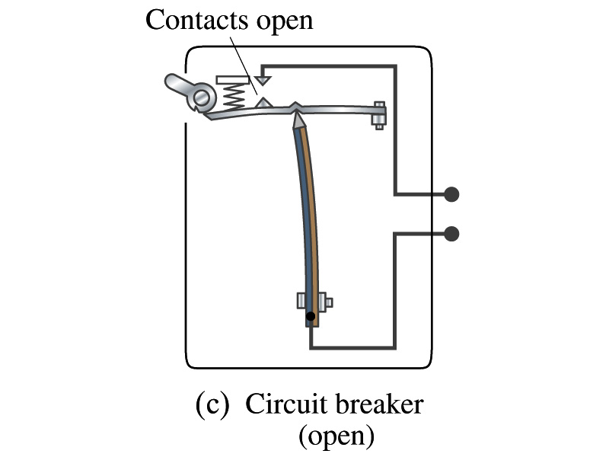
Power in Household Circuits
Household devices usually have small resistance
But since they draw current, if they become large enough, wires can heat up (overloaded)
Why is using thicker wires safer?
Thicker wires has less resistance, lower heat
Overloaded wire can set off a fire at home
How do we prevent this?
Put in a switch that would disconnect the circuit when overloaded
Fuse or circuit breakers
They open (or disconnect) the circuit when the current is over certain value
Overload

Slide 19
Example 25 – 11
Will the fuse blow?: Determine the total current drawn by all the devices in the circuit in the figure. Will a 20A breaker trip if all devices are on?
The total current is the sum of current drawn by individual device.
Solve for I
Bulb
Heater
Stereo
Dryer
Total current
What is the total power?

