Slide 1
PHYS 1444 – Section 002
Lecture #14
Monday, Mar. 30, 2020
Dr. Jaehoon Yu
The science of COVID-19
CH25
  Alternating Current
  Microscopic View of Electric Current
  Ohm’s Law in Microscopic View
CH 26
  EMF and Terminal Voltage
  Resistors in Series and Parallel
Today’s homework is homework #9, due 11pm, Monday, Apr. 13!!

Slide 2
Reminder: Basic Rules of the Online Classes
I will take attendance as if we are in the class room!
  Turn on your mic when joining the class but then mute once you have answered to the roll call!
All mics must be muted unless you have a question
  I will unmute all of you when I ask you a question for interactivity!
If you have a question, turn on your mic, pronounce your name and ask your question
Use appropriate languages on mic and on chat!
  You can only chat with me
You will be assigned into random breakout rooms for example problem solving. Please discuss amongst yourselves to take advantage of the session!
No recording of the lecture is permitted!

Slide 3
Announcements
Reading Assignments: CH25.9 and 25.10
Mid-term exam results
  Class average: 54.3/101 ➔ equivalent to 53.8/100
    Previous exam result: 59.7/100
  Top score: 94.1/101
Reminder: Grading scheme
Homework: 25%!!!
Exams
  Final Comprehensive Exam (5/6/20): 23%
  Mid-term Comprehensive Exam (3/25/20): 20%
  One better of the two term Exams (2/19/20 and 4/15/20): 12%
  Will get an F if you missed any exams!
Lab score: 10%
Pop-quizzes: 10%
Extra credits: 10% of the total
100%

Slide 4
Special Project #4
Make a list of the power consumption and the resistance of all electric and electronic devices at your home and compile them in a table. (10 points total for the first 10 items and 0.5 points each additional item.)
Estimate the cost of electricity for each of the items on the table using your own electric cost per kWh (if you don’t find your own, use $0.12/kWh) and put them in the relevant column. (5 points total for the first 10 items and 0.2 points each additional items)
Estimate the the total amount of energy in Joules and the total electricity cost per day, per month and per year for your home. (8 points)
Due: Beginning of the class Monday, Apr. 13
  Scan all pages of your special project into the pdf format
  Save all pages into one file with the filename SP5-YourLastName-YourFirstName.pdf
  Send me the file no later than 1pm Monday, Apr. 13

Slide 5
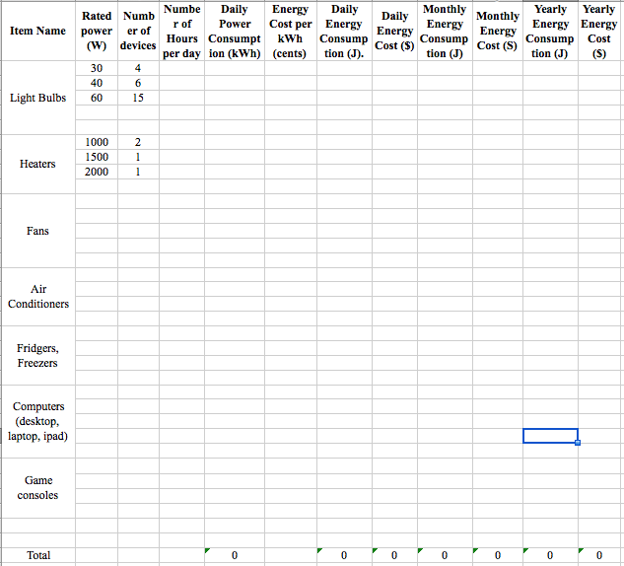

Slide 6
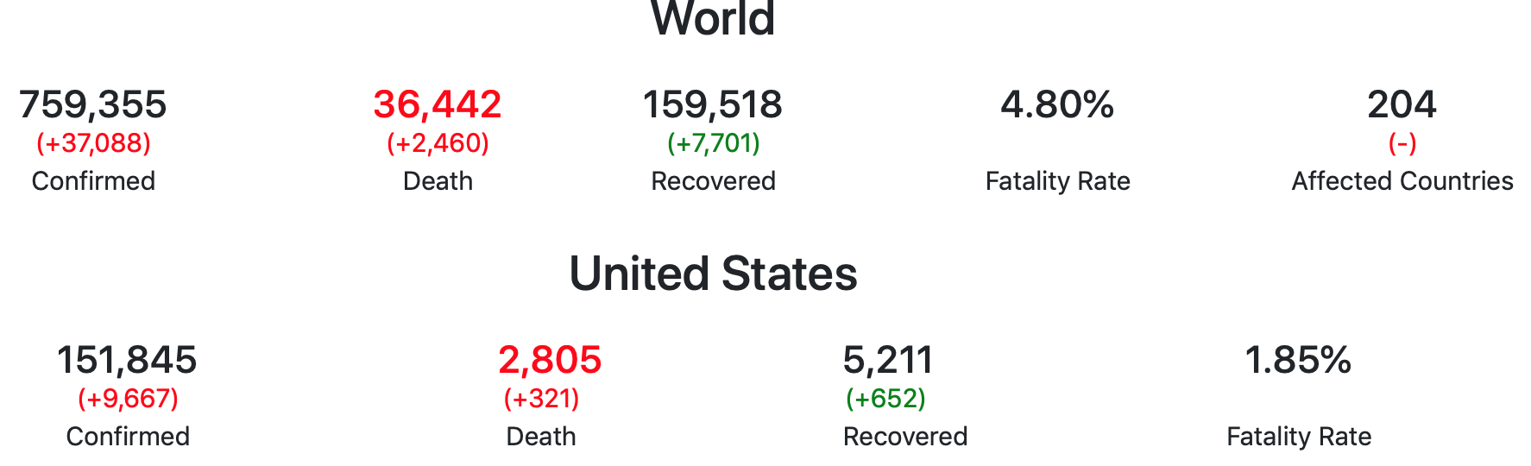
The Science of COVID-19 – I
The novel coronavirus, COVID-19 is extremely deadly
  Not well understood
  Very infectious and affects all ages!! ➔ doubling every week!
  Deadly: Death rate at 4.8%, about 50 times higher than the flu (~0.1%!!)
    Last year the flu took 37,000 lives ➔ Imagine what it would be with COVID-19!!

Slide 7
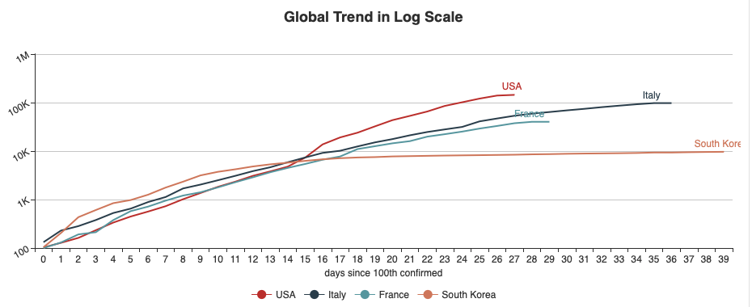
The Science of COVID-19 – II
The chart of ”confirmed” infections on semi-log scale
  What do you observe?
  South Korea and US quite peculiar
    SK took an aggressive testing, tracking and social distancing early! Keep people informed w/ absolute transparency! ➔ Prevented large number of deaths (161 as of this morning! ➔ equivalent to 966 in the US)
    US did not take any aggressive action for over two months! (>2800 deaths!)
      The leadership was too political! Cared only about small number of “confirmed” cases!
Number of days after 100 confirmed cases

Slide 8
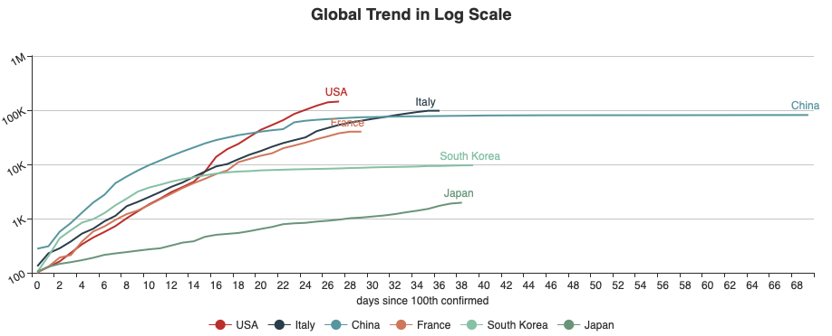
The Science of COVID-19 – III
The chart of ”confirmed” infections on semi-log scale
  Most the countries follow similar trend
  It took China for about a month since 100 cases before flattening out the curve
  Japan’s number starts low but keeps growing
    Even more political than the US!
Number of days after 100 confirmed cases

Slide 9
The Science of COVID-19 – Lessons
What we do must base on good for humanity
Scientists interested in the “TRUTH” not the appearances
  This is because we can get a handle on difficult battles like COVID-19 only if we have a full understanding of what it is!
  No spinning since it dilutes the truth and scares people
Leadership MUST be based on humanity and the fundamental human decency
  Compassion and empathy towards fellow human beings!
  Courage to take the ultimate responsibilities!
  Lives must take higher priorities over anything else
    Makes perfect logical sense since without getting a good handle on COVID-19, this tragedy will unnecessarily be prolonged, and the economy will suffer longer!
  Make decisions based on sound science and with absolute transparency
You must pay attention to scientists NOT politicians!
You then make a sound decision and reward properly!
  Requires your own thoughts and value systems!!

Slide 10
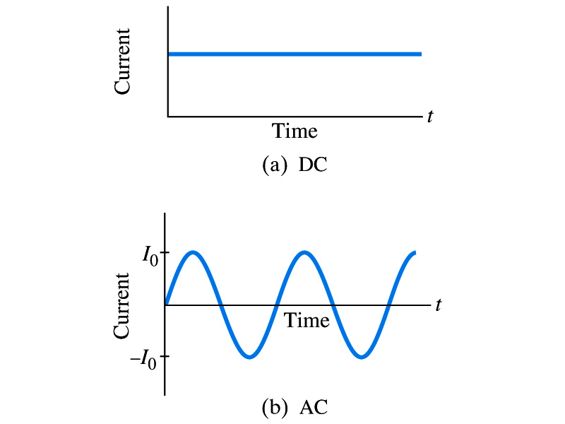
Alternating Current
Does the direction of the flow of current change while a battery is connected to a circuit?
  No. Why?
    Because its source of potential difference stays put.
  This kind of current is called the Direct Current (DC), and it does not change its direction of flow while the battery is connected.
    How would DC current look as a function of time?
      Straight line
The generators at electric power plant produce alternating current (AC)
  AC reverses direction many times a second
  AC is sinusoidal as a function of time
Most the currents supplied to homes and business are AC.

Slide 11
The Alternating Current
The voltage produced by an AC electric generator is sinusoidal
  This is why the current is sinusoidal
Voltage produced can be written as
What are the maximum and minimum voltages?
  Max: V₀ (–V₀) and Min: 0
  The potential oscillates between +V₀ and –V₀, the peak voltage or the amplitude
  What is f?
    The frequency, the number of complete oscillations made per second.
    What is the unit of f? What is the normal size of f in the US?
      f=60Hz in the US and Canada.
      Many European countries have f=50Hz.
  ω=2πf: angular frequency

Slide 12
Alternating Current
Since V=IR, if the voltage V applies across the resistance R, the current I is
What are the maximum and minimum currents?
  Max=I₀ (–I₀) and Min=0 A.
  The current oscillates between +I₀ and –I₀, the peak currents or the amplitude. The current is positive when electron flows to one direction and negative when they flow the opposite.
  AC is as many times positive as negative. What’s the average current?
    Zero. So there is no power and no heat is produced in a heater?
      Yes there is! The electrons actually flow back and forth, so power is delivered.
What is this?

Slide 13
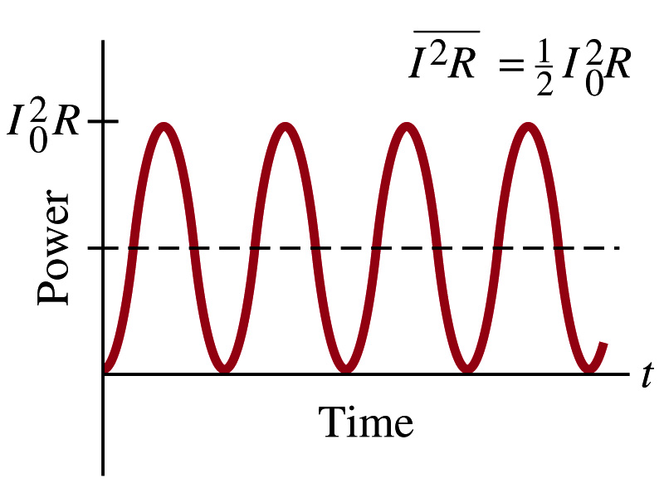
Power Delivered by Alternating Current
AC power delivered to a resistance is:
  Since the current is squared, the power is always positive
The average power delivered is
Since the power is also P=V²/R, we can obtain
The average of the square of current and voltage are important in calculating power:
Average power

Slide 14
Power Delivered by Alternating Current
The square root of each of these are called root-mean-square, or rms:
rms values are called the effective values
  These are useful quantities since they can substitute current and voltage directly in power, as it is in DC
  In other words, an AC of peak voltage V₀ or peak current I₀ produces as much power as DC voltage of V_{rms} or DC current I_{rms}.
  So normally, rms values in AC are specified or measured.
    US uses 115V rms voltage. What is the peak voltage?
    Europe uses 240V

Slide 15
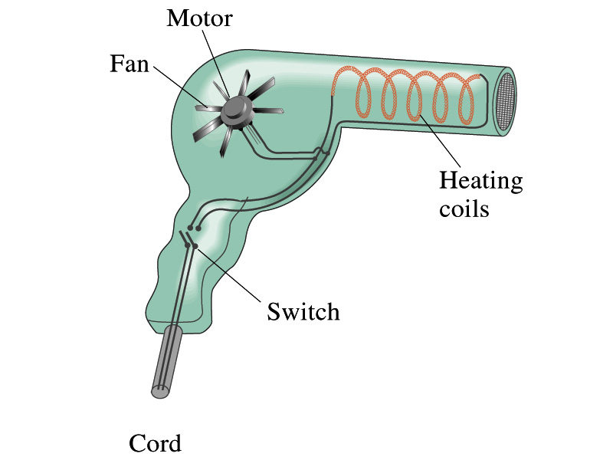
Example 25 – 13
Hair Dryer. (a) Calculate the resistance and the peak current in a 1000-W hair dryer connected to a 120-V AC line. (b) What happens if it is connected to a 240-V line in Britain?
The rms current is:
The peak current is:
Thus the resistance is:
(b) If connected to 240V in Britain …
The average power provide by the AC in UK is
So?
The heating coils in the dryer will melt!

Slide 16
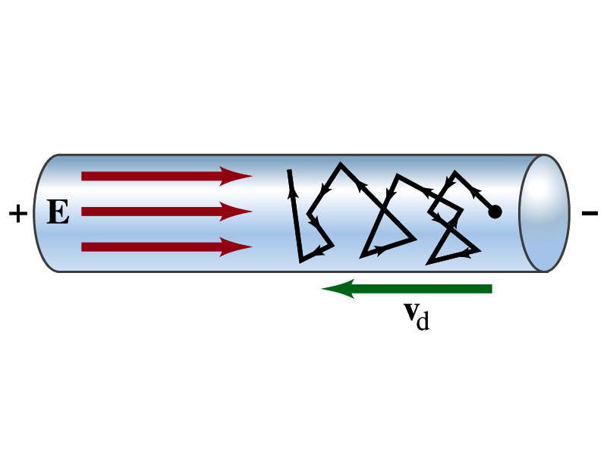
Microscopic View of Electric Current
When voltage is applied across the ends of a wire
Electric field is generated by the potential difference
Electrons feel the force and get accelerated
Electrons soon reach to a steady average speed due to collisions with atoms in the wire, called drift velocity, v_{d}
The drift velocity is normally much smaller than electrons’ average random speed.

Slide 17
Microscopic View of Electric Current
The drift velocity of electrons in a wire is only about 0.05mm/s. How could we get light turned on immediately then?
  While the electrons in a wire travel slow, the electric field travels essentially at the speed of light. Then what is all the talk about electrons flowing through?
    It is just like water. When you turn on the facet, water flows right off the facet despite the fact that the water travels slow.
    Electricity is the same. Electrons fill the conductor wire and when the switch is flipped on or a potential difference is applied, the electrons close to the positive terminal flows into the device.
    Interesting, isn’t it? Why is the field travel at the speed of light then?

Slide 18
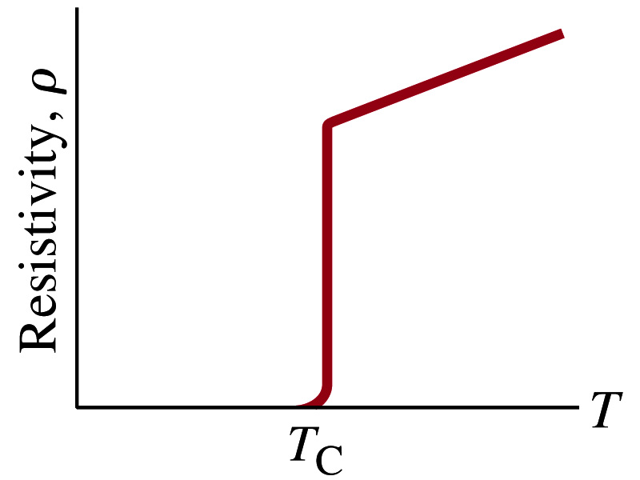
Superconductivity
At the temperature near absolute 0K, resistivity of certain materials become 0.
  This state is called the “superconducting” state.
  Observed in 1911 by H. K. Onnes when he cooled mercury to 4.2K (-269ºC). ➔ 1913 Nobel physics prize
    Resistance of mercury suddenly dropped to 0.
  In general superconducting materials become superconducting below a transition temperature (T_{c}).
  The highest temperature superconductivity seen is 160K
    First observation above the boiling temperature of liquid nitrogen is in 1987 at 90k observed from a compound of yttrium, barium, copper and oxygen.
Since much smaller amount of material can carry just as much current more efficiently, superconductivity can make electric cars more practical, computers faster, and capacitors store higher energy

Slide 19
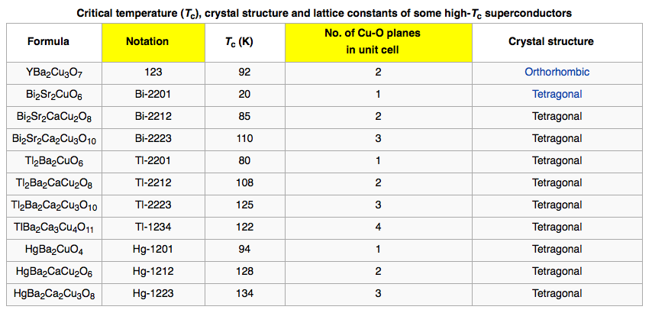
Critical Temperature of Superconductors

Slide 20
Electric Hazards: Leakage Currents
How does one feel shock by electricity?
  Electric current stimulates nerves and muscles, and we feel a shock
  The severity of the shock depends on the amount of current, how long it acts and through what part of the body it passes
  Electric current heats the tissue and can cause burns
Currents above 70mA on a torso for a second or more is fatal, causing heart to function irregularly, “ventricular fibrillation”.
A dry human body between two points on opposite side of the body is about 10⁴ to 10⁶ Ω.
When wet, it could be 10³Ω.
A person in good contact with the ground who touches 120V DC line with wet hands can get the current:
  Could be lethal

