Slide 1
PHYS 1444 – Section 002 Lecture #15
Wednesday, Apr. 1, 2020
Dr. Jaehoon Yu
CH 26
EMF and Terminal Voltage
Resistors in Series and Parallel
Kirchhoff’s rules
RC Circuit

Slide 2
Announcements
Reading Assignments: CH25.9 and 25.10
2nd Non-comprehensive term exam in class Wednesday, Apr. 15
Covers CH25.1 through what we finish Monday, Apr. 13
Do NOT miss the exam!
Quiz #4
Beginning of the class coming Monday, Apr. 6, from 1:07pm
Covers CH25.1 through what we finish today or CH26.4
Online quiz based on Quest but must join zoom class 12:55pm!
You can use your calculator but DO NOT input formula into it!
Cell phones or any types of computers cannot replace a calculator!
Turn off your phones!!
BYOF: You may prepare a one 8.5x11.5 sheet (front and back) of handwritten formulae and values of constants
No derivations, word definitions or solutions of any problems!
Let’s be fair to other students and not cheat!

Slide 3
Reminder: Special Project #4
Make a list of the power consumption and the resistance of all electric and electronic devices at your home and compile them in a table. (10 points total for the first 10 items and 0.5 points each additional item.)
Estimate the cost of electricity for each of the items on the table using your own electric cost per kWh (if you don’t find your own, use $0.12/kWh) and put them in the relevant column. (5 points total for the first 10 items and 0.2 points each additional items)
Estimate the the total amount of energy in Joules and the total electricity cost per day, per month and per year for your home. (8 points)
Due: Beginning of the class Monday, Apr. 13
Scan all pages of your special project into the pdf format
Save all pages into one file with the filename SP5-YourLastName-YourFirstName.pdf
Send me the file no later than 1pm Monday, Apr. 13
Spreadsheet has been posted on the class web page. Download ASAP.

Slide 4
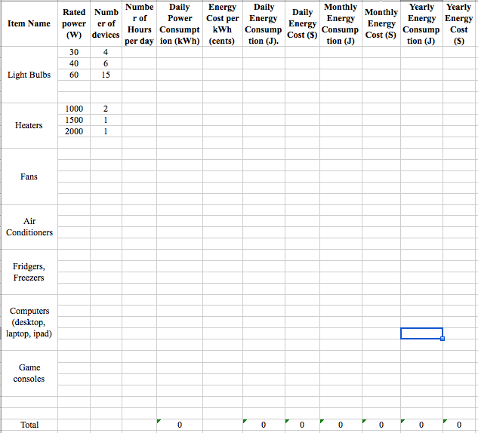

Slide 5
EMF and Terminal Voltage
What do we need to have a current in an electric circuit?
A device that provides a potential difference, such as a battery or a generator
They normally convert some types of energy into the electric energy
These devices are called source of electromotive force (emf)
This is does NOT refer to a real “force”.
Potential difference between terminals of an emf source, when no current flows to an external circuit, is called the emf (E) of the source.
The battery itself, however, has some internal resistance (r) due to the flow of charges in the electrolyte
Why does the headlight dim when you start the car?
The starter needs a large amount of current but the battery cannot provide charge fast enough to supply current to both the starter and the headlight

Slide 6
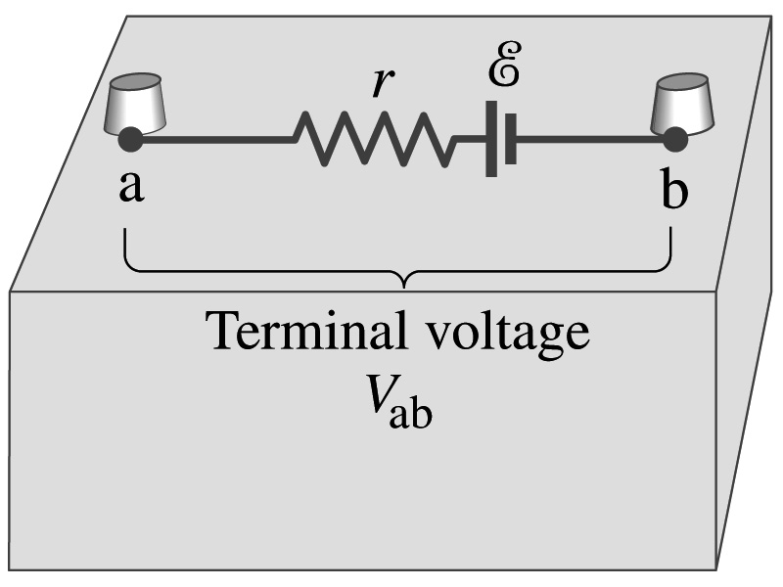
EMF and Terminal Voltage
Since the internal resistance is inside the battery, we can never separate them out.
So the terminal voltage difference is V_{ab}=V_{a}-V_{b}.
When no current is drawn from the battery, the terminal voltage equals the emf which is determined by the chemical reaction; V_{ab}= E.
However when the current I flows naturally from the battery, there is an internal drop in voltage which is equal to Ir. Thus the actual delivered terminal voltage to the circuit is

Slide 7
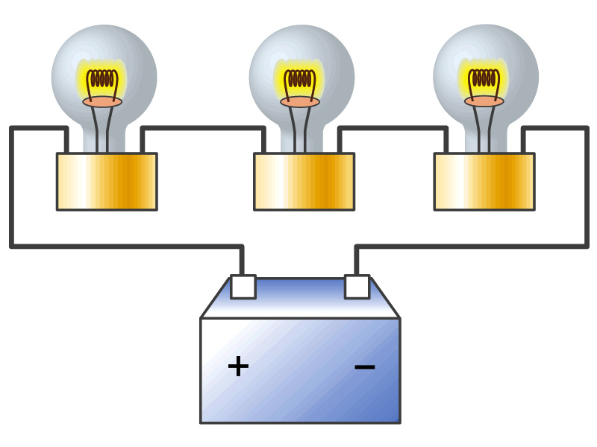
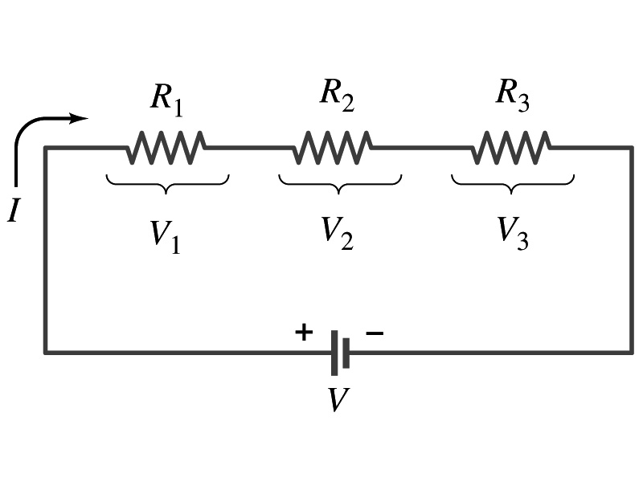
Resistors in Series
Resistors are in series when two or more resistors are connected end to end
These resistors represent simple resistors in circuit or electrical devices, such as light bulbs, heaters, dryers, etc
What is common for the devices in a series circuit?
Current is the same through all the elements in series
Potential difference (drop) across every element in the circuit is
V₁=IR₁, V₂=IR₂ and V₃=IR₃
Since the total potential difference is V, we obtain
V=IR_{eq}=V₁+V₂+V₃=I(R₁+R₂+R₃)
Thus, R_{eq}=R₁+R₂+R₃
Resistors in series
When resistors are connected in series, the total resistance increases, and the current decreases.

Slide 8
Energy Losses in Resistors
Why is it true that V=V₁+V₂+V₃?
What is the potential energy loss when charge q passes through resistors R₁, R₂ and R₃
ΔU₁=qV₁, ΔU₂=qV₂, ΔU₃=qV₃
Since the total energy loss should be the same as the total energy provided to the system (energy conservation), we obtain
ΔU=qV=ΔU₁+ΔU₂+ΔU₃=q(V₁+V₂+V₃)
Thus, V=V₁+V₂+V₃

Slide 9
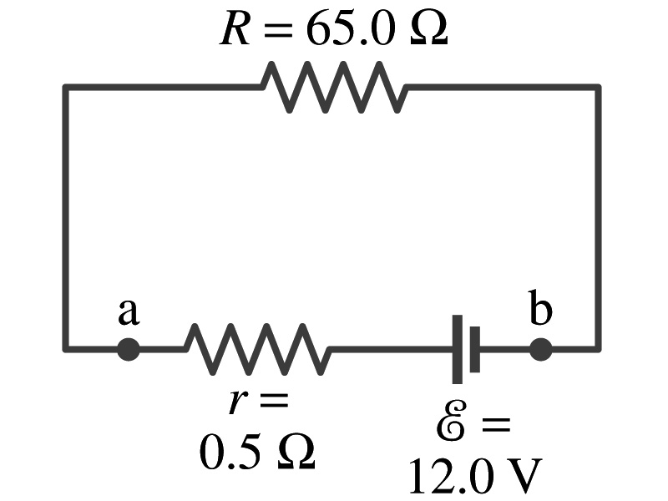
Example 26 – 1
Battery with internal resistance. A 65.0-Ω resistor is connected to the terminals of a battery whose emf is 12.0V and internal resistance is 0.5-Ω. Calculate (a) the current in the circuit, (b) the terminal voltage of the battery, V_{ab}, and (c) the power dissipated in the resistor R and in the battery’s internal resistor.
(a) Since
We obtain
What is this?
Solve for I
A battery or a source of emf.
(b) The terminal voltage V_{ab} is
(c) The power dissipated in R and r are

Slide 10
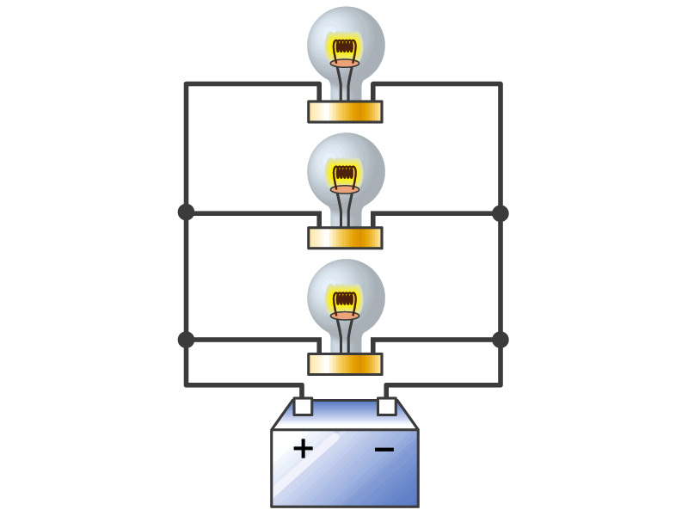
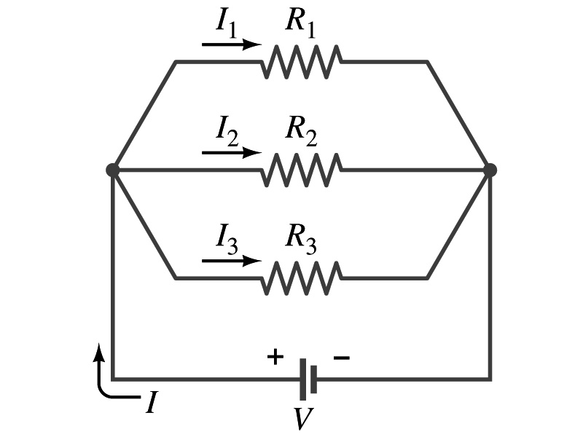
Resistors in Parallel
Resistors are in parallel when two or more resistors are connected in separate branches
Most the house and building wirings are arranged this way.
What is common for the devices in a parallel circuit?
The voltage is the same across all the resistors in the same circuit
The total current that leaves the battery is, however, split.
The current that passes through every element is
I₁=V/R₁, I₂=V/R₂, I₃=V/R₃
Since the total current is I, we obtain
I=V/R_{eq}=I₁+I₂+I₃=V(1/R₁+1/R₂+1/R₃)
Thus, 1/R_{eq}=1/R₁+1/R₂+1/R₃
Resistors in parallel
When resistors are connected in parallel, the total resistance decreases, and the current increases.

Slide 11
Resister and Capacitor Arrangements
Parallel Capacitor arrangements
Parallel Resistor arrangements
Series Capacitor arrangements
Series Resistor arrangements

Slide 12
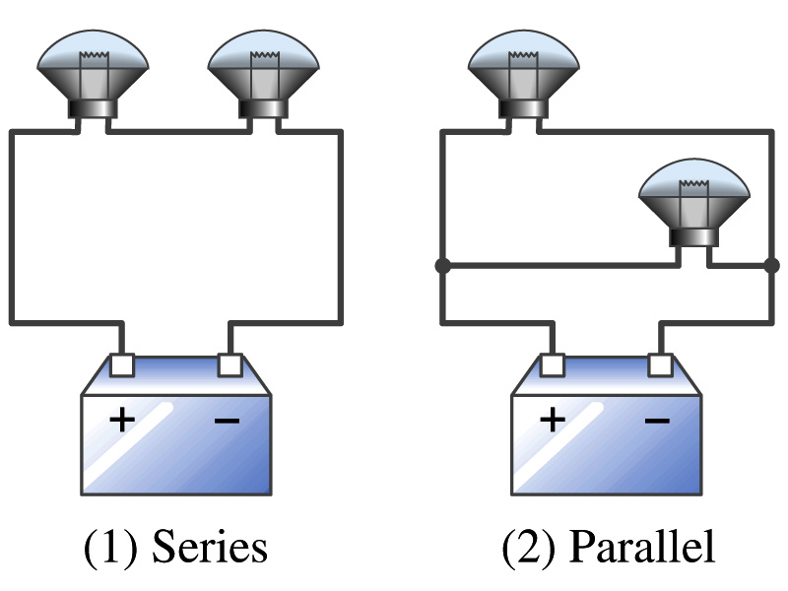
Example 26 – 2
Series or parallel? (a) The light bulbs in the figure are identical and have identical resistance R. Which configuration produces more light? (b) Which way do you think the headlights of a car are wired?
(a) What are the equivalent resistances for the two cases?
Series
Parallel
So
The bulbs get brighter when the total power transformed is larger.
series
parallel
So parallel circuit provides brighter lighting.
(b) Car’s headlights are in parallel to provide brighter lighting and also to prevent both lights going out at the same time when one burns out.
So what is bad about parallel circuits?
Uses more energy in a given time.

Slide 13
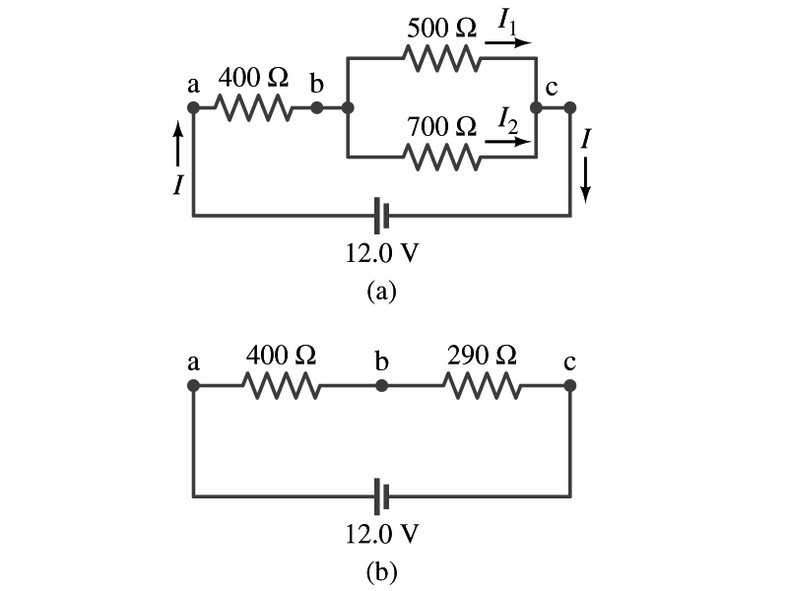
Example 26 – 5
Current in one branch. What is the current flowing through the 500-Ω resistor in the figure?
We need to find the total current.
What do we need to find first?
To do that we need to compute the equivalent resistance.
R_{eq} of the small parallel branch is:
R_{eq} of the circuit is:
Thus the total current in the circuit is
The voltage drop across the parallel branch is
The current flowing across 500-Ω resistor is therefore
What is the current flowing 700-Ω resister?

Slide 14
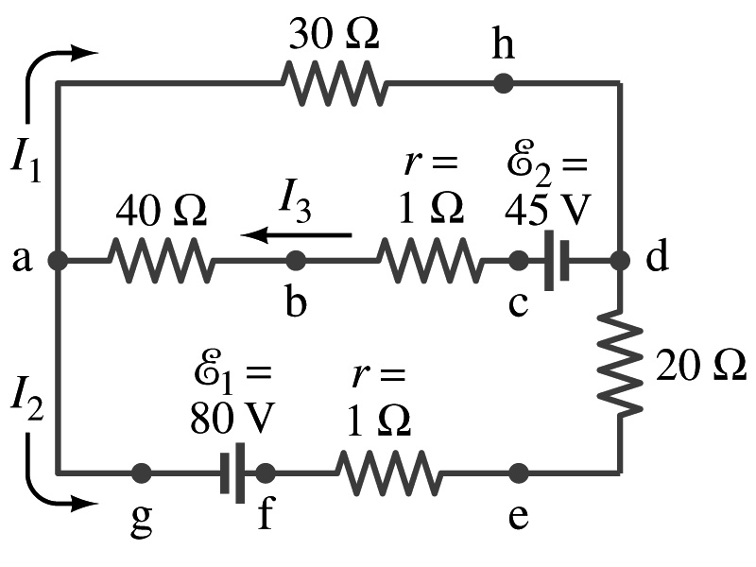
Kirchhoff’s Rules – 1st Rule
Some circuits are very complicated to do the analysis using simple combinations of resisters
G. R. Kirchhoff devised two rules to deal with complicated circuits.
Kirchhoff’s rules are based on conservation of charge and conservation of energy
Kirchhoff’s 1st rule: The junction rule, charge conservation.
At any junction point, the sum of all currents entering the junction must be equal to the sum of all currents leaving the junction.
In other words, what goes in must come out.
At junction a in the figure, I₃ comes into the junction while I₁ and I₂ leaves: I₃ = I₁+ I₂

Slide 15
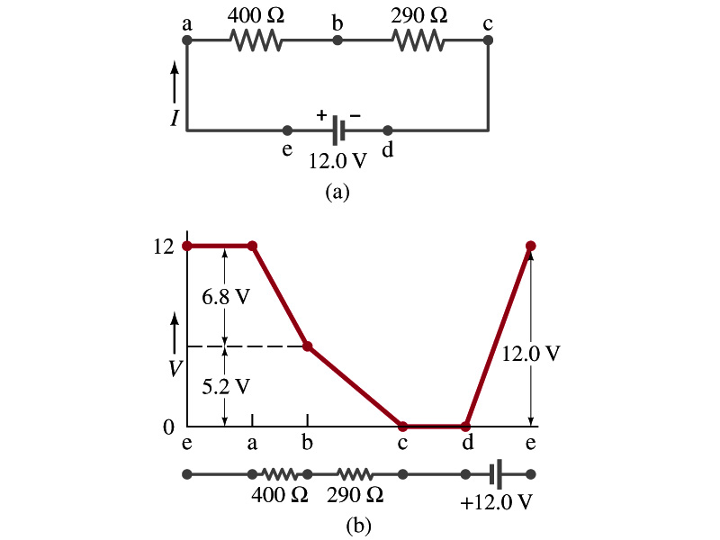
Kirchhoff’s Rules – 2nd Rule
Kirchoff’s 2nd rule: The loop rule, uses conservation of energy.
The sum of the changes in potential in any closed path of a circuit must be zero.
I=12/690=0.017A.
The current in the circuit in the figure is
Point e is the high potential point while point d is the lowest potential.
When the test charge starts at e and returns to e, the total potential change is 0.
Between point e and a, no potential change since there is no source of potential nor any resistance.
Between a and b, there is a 400Ω resistance, causing IR=0.017*400 =6.8V drop.
Between b and c, there is a 290Ω resistance, causing IR=0.017*290 =5.2V drop.
Since these are voltage drops, we use negative sign for these, -6.8V and -5.2V.
No change between c and d while from d to e there is +12V change.
Thus the total change of the voltage through the loop is: -6.8V-5.2V+12V=0V.

Slide 16
Kirchhoff’s Rules Summary
Kirchoff’s 1st rule: The junction rule uses charge conservation
At any junction point, the sum of all currents entering the junction must be equal to the sum of all currents leaving the junction.
Kirchoff’s 2nd rule: The loop rule uses conservation of energy.
The sum of the changes in potential in any closed path of a circuit must be zero.

Slide 17
How to use Kirchhoff’s Rules??
Determine the flow of currents at the junctions and label each and everyone of the independent currents.
It does not matter which direction, you decide but keep it!
You cannot have all current coming in or going out of a junction, though!
If the value of the current after completing the calculations are negative, you just need to flip the direction of the current flow.
Write down the current equation based on Kirchhoff’s 1st rule at various junctions.
Be sure to see if any of them are the same.
Choose closed loops in the circuit
Write down the potential in each interval of the junctions, keeping the proper signs as you decided in step 1 above.
Write down the potential equations for each loop.
Solve the equations for unknowns.

Slide 18
Example 26 – 9
Use Kirchhoff’s rules. Calculate the currents I₁, I₂ and I₃ in each of the branches of the circuit in the figure.

Slide 19
Example 26 – 9
Use Kirchhoff’s rules. Calculate the currents I₁, I₂ and I₃ in each of the branches of the circuit in the figure.
The directions of the current through the circuit is not known a priori but since the current tends to move away from the positive terminal of a battery, we arbitrarily choose the direction of the currents as shown.
We have three unknowns so we need three equations.
Using Kirchhoff’s junction rule at point a, we obtain
This is the same for junction d as well, so no additional information.
Now the second rule on the loop ahdcba.
The total voltage change in the loop ahdcba is.

Slide 20
Example 26 – 9, cnt’d
Now the second rule on the other loop agfedcba.
The total voltage change in loop agfedcba is.
So the three equations become
We can obtain the three current by solving these equations for I₁, I₂ and I₃.
Do this yourselves!!

