Slide 1
Online Quiz Rules
Leave the camera ON at all times
UNMUTE the mic at all times ➔ Do NOT MUTE! I will control.
If you have questions, type into the zoom chat window to me
POWER OFF your phone, iPADs and any other computing devices other than the computer you take test with
  Turn off your pop-up blocker to Quest!
Have your calculator, formula sheet and clean scrap sheets out
Write down your answers on your scrap sheet!
  Be sure to push the “Submit “ button when submitting your answer!
If you haven’t already, please send me the photos of the front and back of your formula sheet within 15min of the end of the class!

Slide 2
PHYS 1444 – Section 002
Lecture #16
Monday, Apr. 6, 2020
Dr. Jaehoon Yu
CH 26
  RC Circuit
CH 27: Magnetism & Magnetic Field
  Electric Current and Magnetism
  Magnetic Field
  Magnetic Force on a Moving Charge
Today’s homework is homework #10, due 11pm, Monday, Apr. 20!!

Slide 3
Announcements
Reading Assignments: CH27.6, 27.8 and 27.9
2nd Non-comprehensive term exam in class Wednesday, Apr. 15
  Do NOT miss the exam!
  This is one of the two exams that will be chosen for the final grade!
  Covers CH25.1 through what we finish Monday, Apr. 13
  Online exam based on Quest but must join zoom class 12:55pm!
  You can use your calculator but DO NOT input formula into it!
    Cell phones or any types of computers cannot replace a calculator!
    Turn off your phones!!
  BYOF: You may prepare a one 8.5x11.5 sheet (front and back) of handwritten formulae and values of constants
  No derivations, word definitions or solutions of any problems!
  Let’s be fair to other students and not cheat!

Slide 4
Reminder: Special Project #4
Make a list of the power consumption and the resistance of all electric and electronic devices at your home and compile them in a table. (10 points total for the first 10 items and 0.5 points each additional item.)
Estimate the cost of electricity for each of the items on the table using your own electric cost per kWh (if you don’t find your own, use $0.12/kWh) and put them in the relevant column. (5 points total for the first 10 items and 0.2 points each additional items)
Estimate the the total amount of energy in Joules and the total electricity cost per day, per month and per year for your home. (8 points)
Due: Beginning of the class Monday, Apr. 13
  Scan all pages of your special project into the pdf format
  Save all pages into one file with the filename SP5-YourLastName-YourFirstName.pdf
  Send me the file no later than 1pm Monday, Apr. 13
Spreadsheet has been posted on the class web page. Download ASAP.

Slide 5
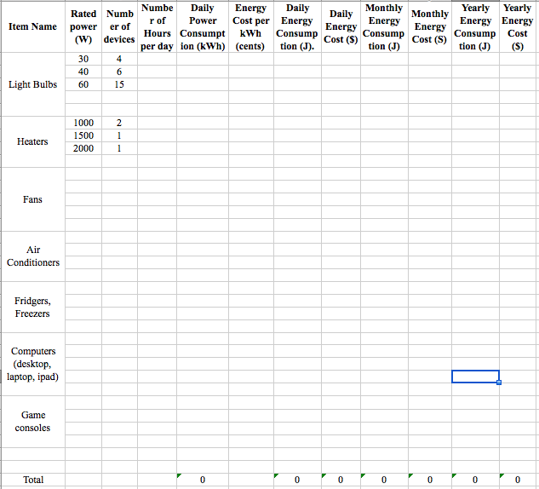

Slide 6
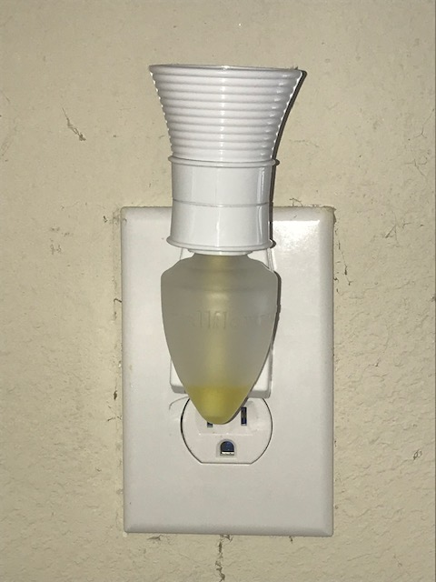
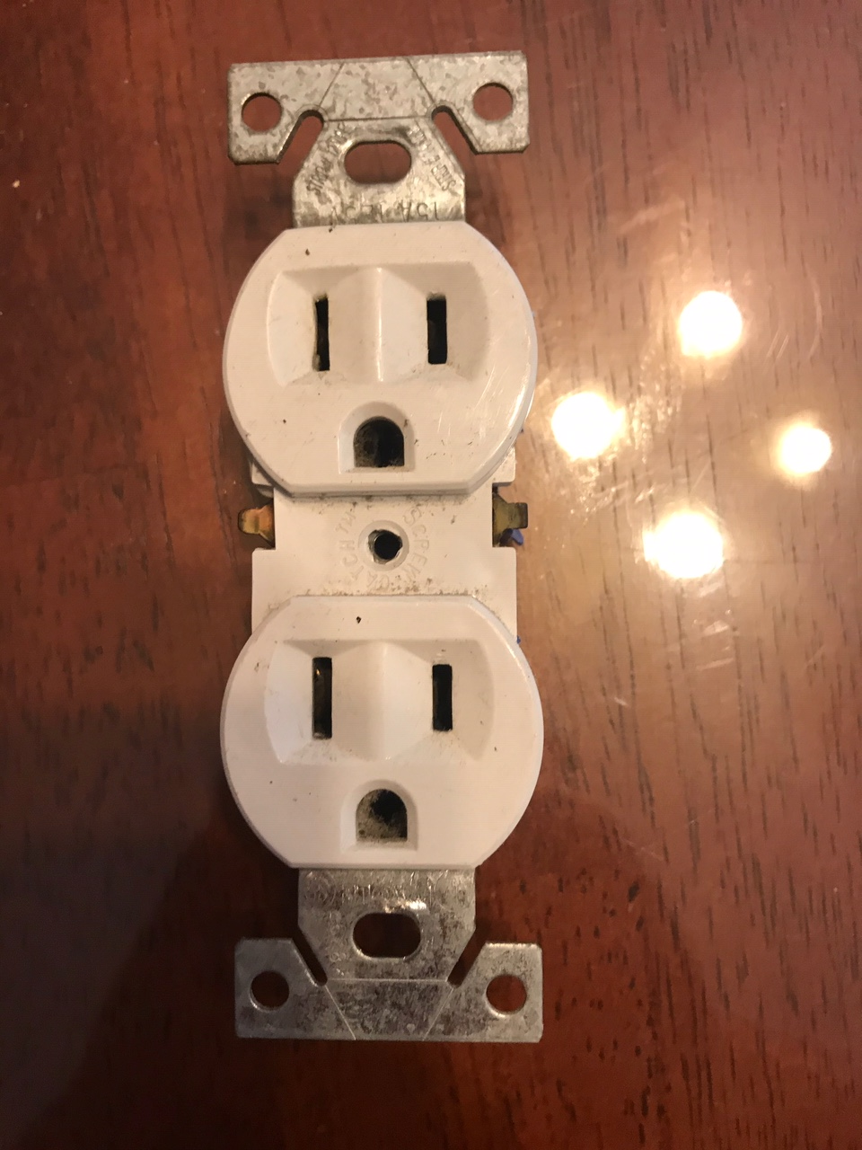
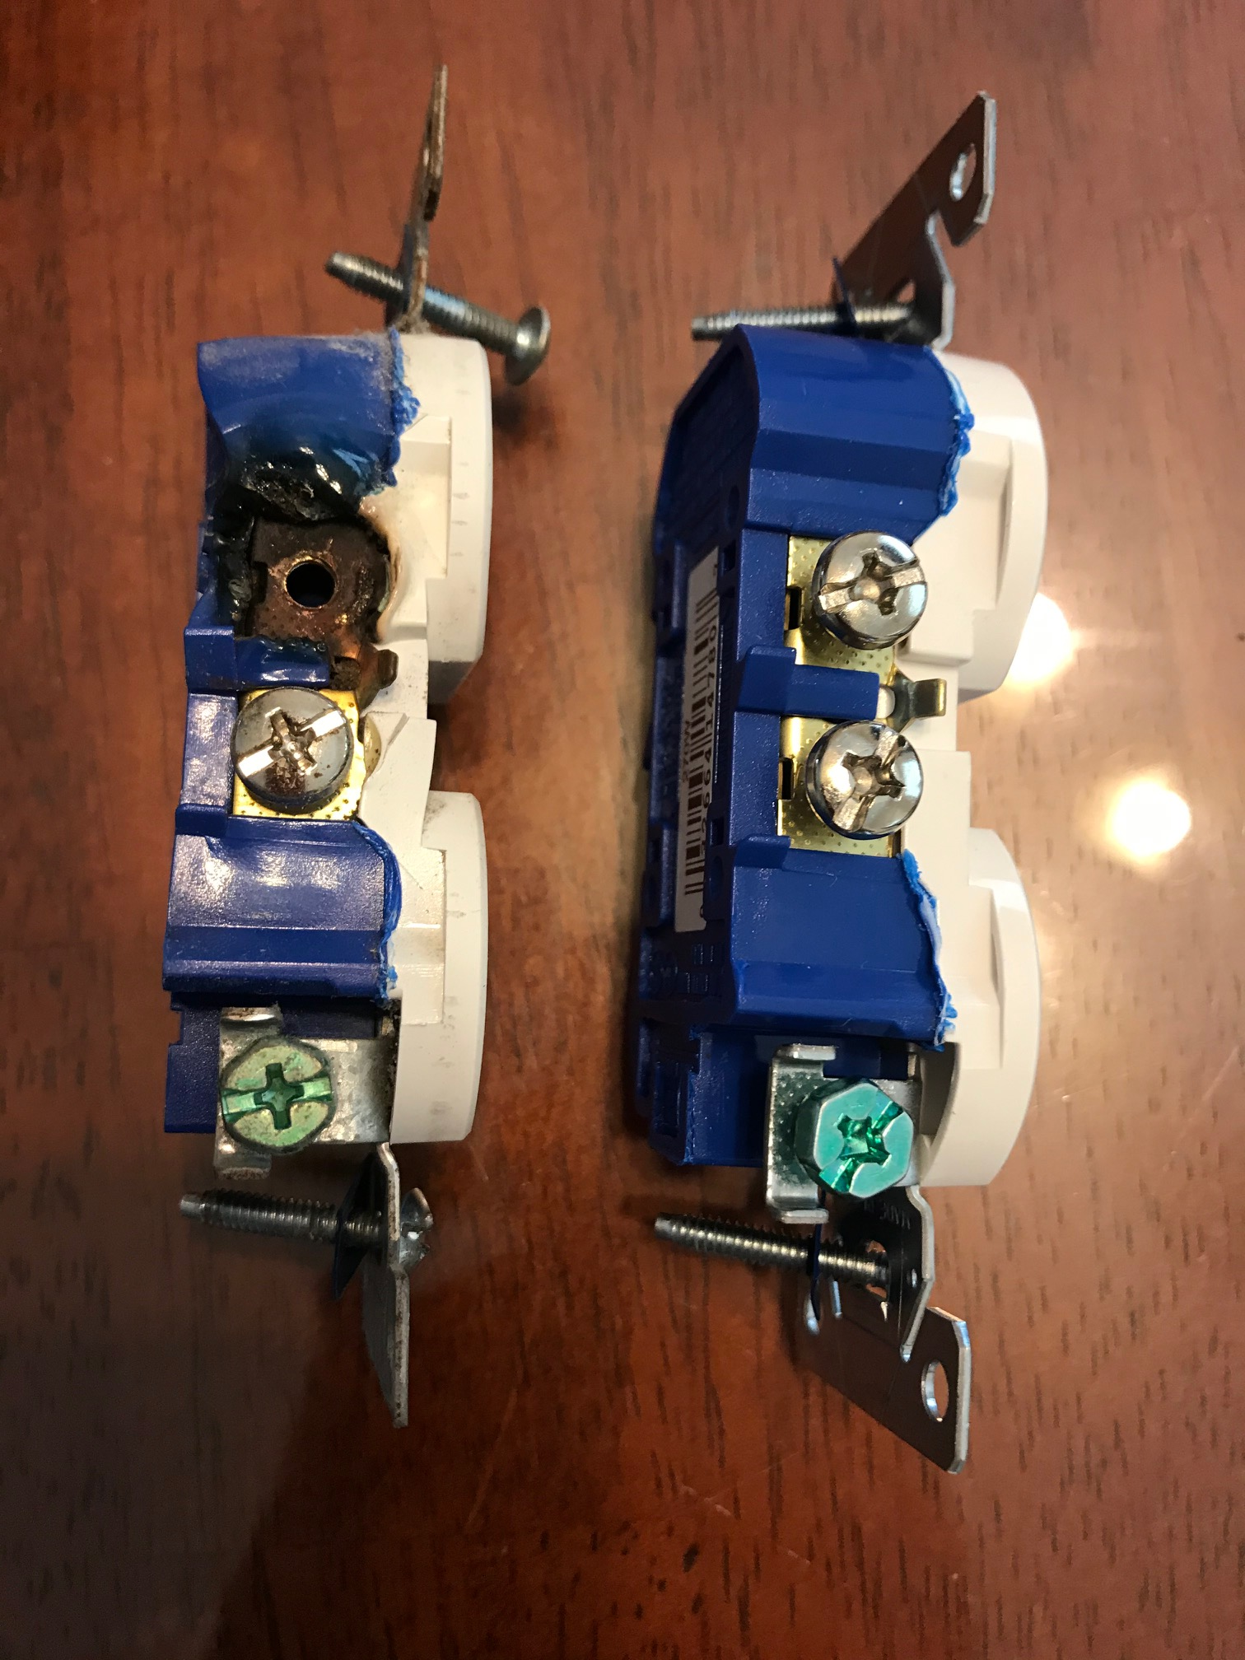
The Bad Receptacle Story!
What do you see?
What’s the big Q?
Why did this connection burnt in the first place?

Slide 7
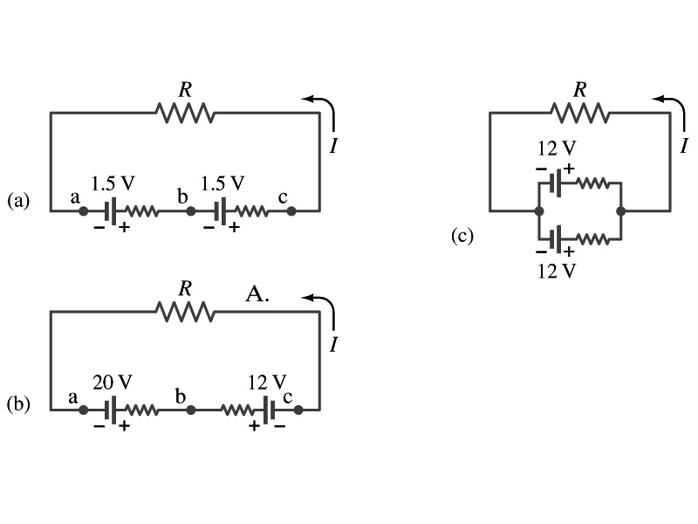
EMFs in Series and Parallel: Charging a Battery
When two or more sources of emfs, such as batteries, are connected in series
  The total voltage is the algebraic sum of their voltages, if their direction is the same
    V_{ab}=1.5 + 1.5=3.0V in figure (a).
  If the batteries are arranged in the opposite direction, the total voltage of the circuit is the difference between them
Parallel arrangements (c) are used only to increase currents. An example?
    V_{ac}=20 – 12=8.0V in figure (b)
    Connecting batteries in opposite direction is wasteful.
    This, however, is the way a battery charger works.
    Since the 20V battery is at a higher voltage, it forces charges into 12V battery
    Some battery are rechargeable since their chemical reactions are reversible but most the batteries do not reverse their chemical reactions

Slide 8
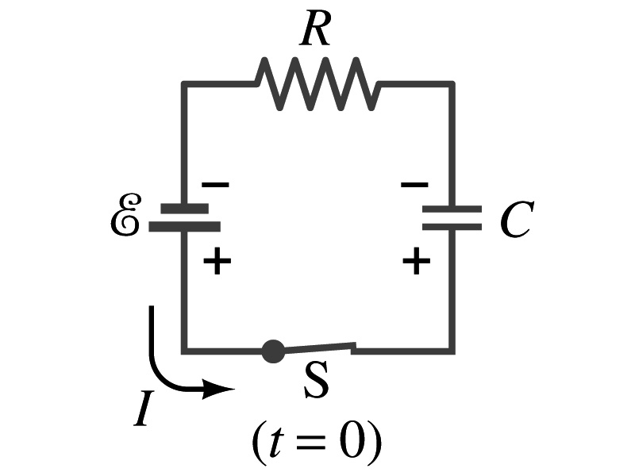
RC Circuits
Circuits containing both resisters and capacitors
  RC circuits are used commonly in everyday life
    Control windshield wiper timer
    Timing of traffic light from one color to another
    Camera flashes and heart pacemakers
How does an RC circuit look?
  There should be a source of emf, capacitors and resisters
What happens when the switch S is closed?
  Current immediately starts flowing through the circuit.
  Electrons flow out of negative terminal of the emf source, through the resister R and accumulates on the upper plate of the capacitor.
  The electrons from the bottom plate of the capacitor will flow into the positive terminal of the battery, leaving only positive charge on the bottom plate.
  As the charge accumulates on the capacitor, the potential difference across it increases
  The current reduces gradually to 0 till the voltage across the capacitor is the same as emf.
  The charge on the capacitor increases until it reaches to its maximum CE.

Slide 9
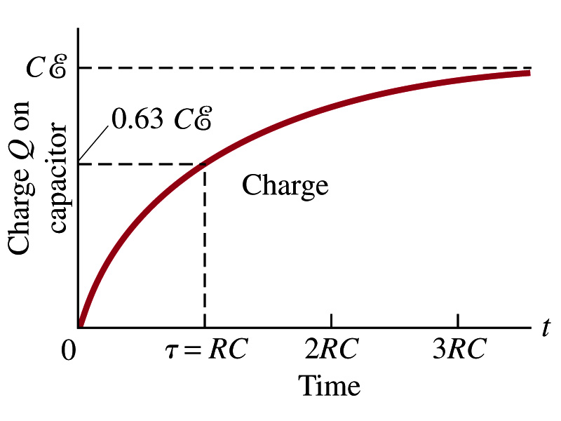
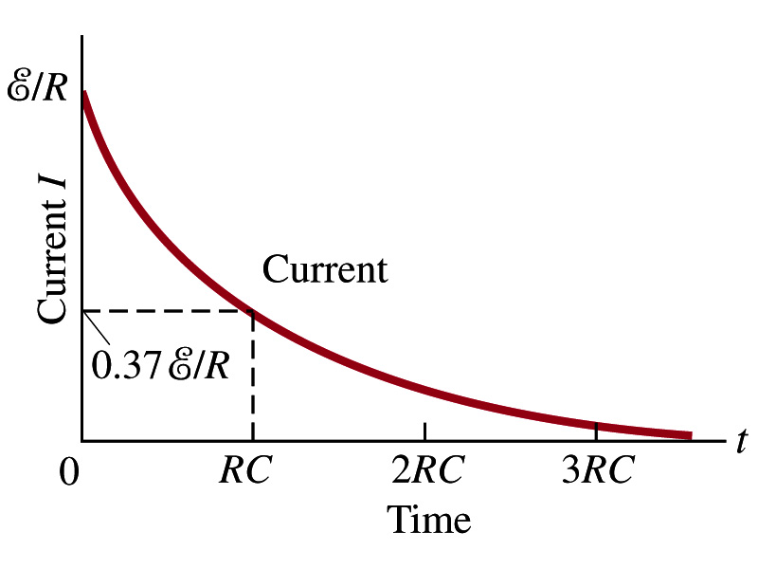
RC Circuits
How does all this look like in graphs?
  The charge and the current on the capacitor as a function of time
  From energy conservation (Kirchhoff’s 2nd rule), the emf E must be equal to the voltage drop across the capacitor and the resister
    E=IR+Q/C
    R includes all resistance in the circuit, including the internal resistance of the battery, I is the current in the circuit at any instance, and Q is the charge of the capacitor at that same instance.

Slide 10
Analysis of RC Circuits
In an RC circuit and
What can we see from the above equations?
  Q and V_{C} increase from 0 at t=0 to the maximum value Q_{max}=CE and V_{C}= E.
In how much time?
  The quantity RC is called the time constant of the circuit, τ
    τ=RC, What is the unit?
  What is the physical meaning?
    The time required for a capacitor to reach (1 - e⁻¹)=0.63 or 63% of the full charge
The current is
Sec.

Slide 11
Example 26 – 12
RC circuit, with emf. The capacitance in the circuit of the figure is C=0.30μF, the total resistance is 20kΩ, and the battery emf is 12V. Determine (a) the time constant, (b) the maximum charge the capacitor could acquire, (c) the time it takes for the charge to reach 99% of this value, (d) the current I when the charge Q is half its maximum value, (e) the maximum current, and (f) the charge Q when, the current I is 0.20 its maximum value.
(a) Since
We obtain
(b) Maximum charge is
(c) Since
For 99% we obtain
(d) Since
We obtain
The current when Q is 0.5Q_{max}
(e) When is I maximum?
when Q=0:
(f) What is Q when I=120mA?

Slide 12
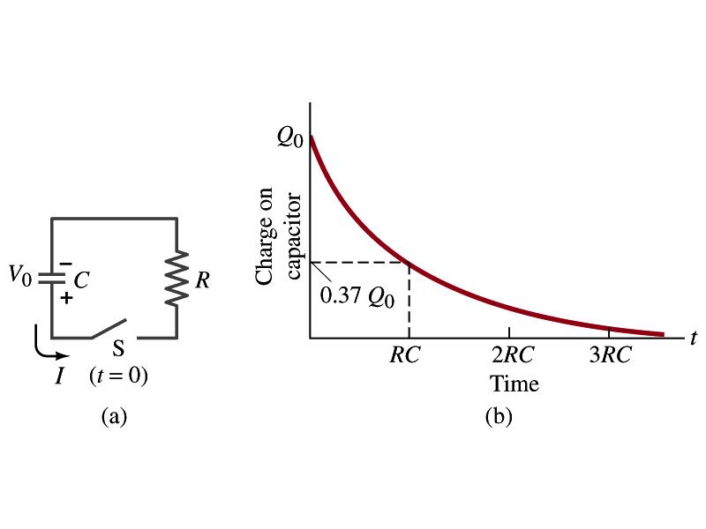
Discharging an RC Circuit
When a capacitor is already charged, it is allowed to discharge through the resistance R.
  When the switch S is closed, the voltage across the resistor at any instant equals that across the capacitor. Thus IR=Q/C.
  The rate at which the charge leaves the capacitor equals the negative of the current flows through the resistor
    I= - dQ/dt
    Negative since the current is leaving the capacitor
  Thus the voltage equation becomes a differential equation
Rearrange terms

Slide 13
Discharging an RC Circuit
  Now, let’s integrate from t=0 when the charge is Q₀ to t when the charge is Q
  The result is
  Thus, we obtain
  What does this tell you about the charge on the capacitor?
    It decreases exponentially w/ time at the time constant RC
    Just like the case of charging
  The current is:
    The current also decreases exponentially w/ time w/ the constant RC
What is this?

Slide 14
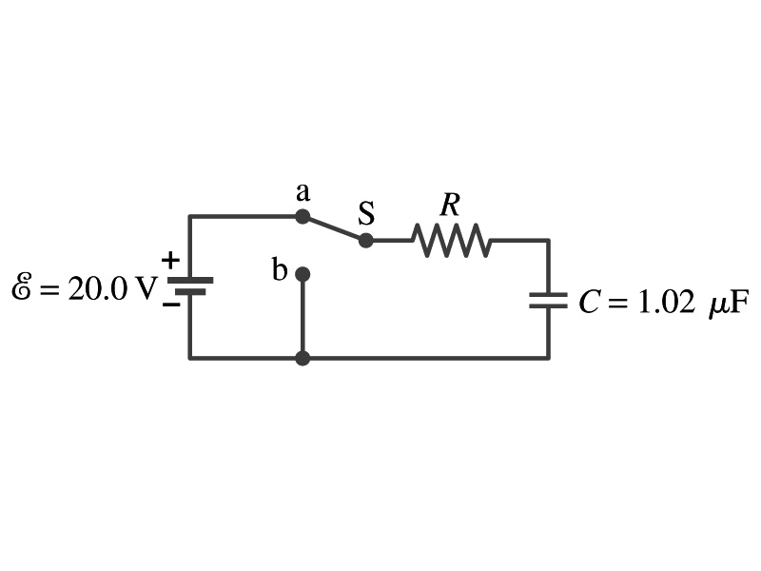
Example 26 – 13
Discharging RC circuit. In the RC circuit shown in the figure the battery has fully charged the capacitor, so Q₀=CE. Then at t=0, the switch is thrown from position a to b. The battery emf is 20.0V, and the capacitance C=1.02μF. The current I is observed to decrease to
0.50 of its initial value in 40μs. (a) what is the value of R? (b) What is the value of Q, the charge on the capacitor, at t=0? (c) What is Q at t=60μs?
(a) Since the current reaches to 0.5 of its initial value in 40μs, we can obtain
For 0.5I₀
Rearrange terms
Solve for R
(b) The value of Q at t=0 is
(c) What do we need to know first for the value of Q at t=60μs?
The RC time
Thus

Slide 15
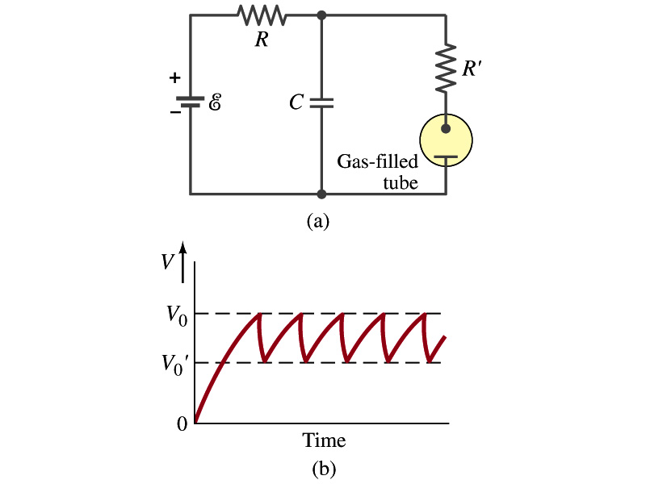
Application of the RC Circuit
What do you think the charging and discharging characteristics of RC circuits can be used for?
  To produce voltage pulses at a regular frequency
  How?
    The capacitor charges up to a particular voltage and discharges
    A simple way of doing this is to use breakdown of voltage in a gas filled tube
      The discharge occurs when the voltage breaks down at V₀
      After the completion of discharge, the tube no longer conducts
      Then the voltage is at V₀’ and it starts charging up
      How do you think the voltage as a function of time look?
        A sawtooth shape
    Pacemaker, intermittent windshield wiper, etc

