Slide 1
PHYS 1444 – Section 002 Lecture #18
Monday, Apr. 13, 2020
Dr. Jaehoon Yu
CH 27: Magnetism & Magnetic Field
Charged Particle Path in a Magnetic Field
The cyclotron frequency
Magnetic dipole Moment
CH 28:Sources of Magnetic Field
Magnetic Field Due to Straight Wire
Forces Between Two Parallel Wires
Today’s homework is homework #11, due 11pm, Monday, Apr. 27!!

Slide 2
Announcements
Reading Assignments: CH27.6, 27.8, 27.9 and 28.6 – 10
2nd Non-comprehensive term exam in class this Wed., Apr. 15
Do NOT miss the exam! Must be in a quiet place to take the exam!
This is one of the two exams that will be chosen for the final grade!
Covers CH25.1 through what we finish today (CH28.2)
Online exam based on Quest but must join zoom class by 12:55pm!
You can use your calculator but DO NOT input formula into it!
Cell phones or any types of computers cannot replace a calculator!
POWER OFF your phones!!
BYOF: You may prepare a one 8.5x11.5 sheet (front and back) of handwritten formulae and values of constants
No derivations, plots, pictures, word definitions or solutions or setups of any problems!
Please send me the photos of your formula sheet by 12:55pm
If you don’t have one, still send me email that you do not have one prepared!
Let’s be fair to other students and not cheat!

Slide 3
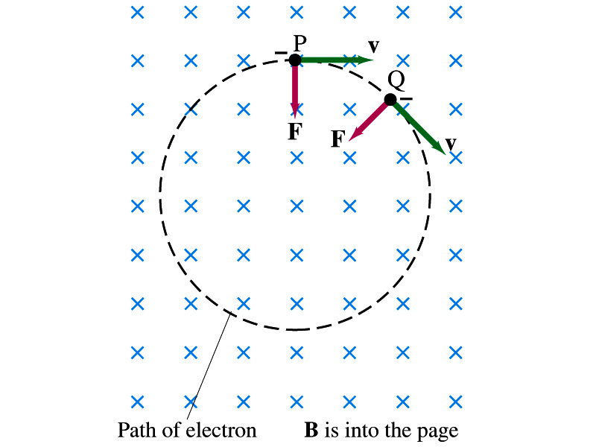
Charged Particle’s Path in Magnetic Field
What shape do you think is the path of a charged particle on a plane perpendicular to a uniform magnetic field?
Circle!! Why?
An electron moving to right at the point P in the figure will be pulled downward
At a later time, the force is still perpendicular to the velocity
Since the force is always perpendicular to the velocity, the magnitude of the velocity is constant
The direction of the force follows the right-hand-rule and is perpendicular to the direction of the magnetic field
Thus, the electron moves in a circular path with a centripetal force F.
What about a proton? What would be the shape of its path?

Slide 4
Example 27 – 7
Electron’s path in a uniform magnetic field. An electron travels at the speed of 2.0x10⁷m/s in a plane perpendicular to a 100-G magnetic field. What is the radius of the electron’s path?
What is formula for the centripetal force?
What is the formula for the magnetic force on a moving charged particle?
Since the magnetic field is perpendicular to the motion of the electron, the magnitude of the magnetic force is
Since the magnetic force provides the centripetal force, we can establish an equation with the two forces
Solving for r

Slide 5
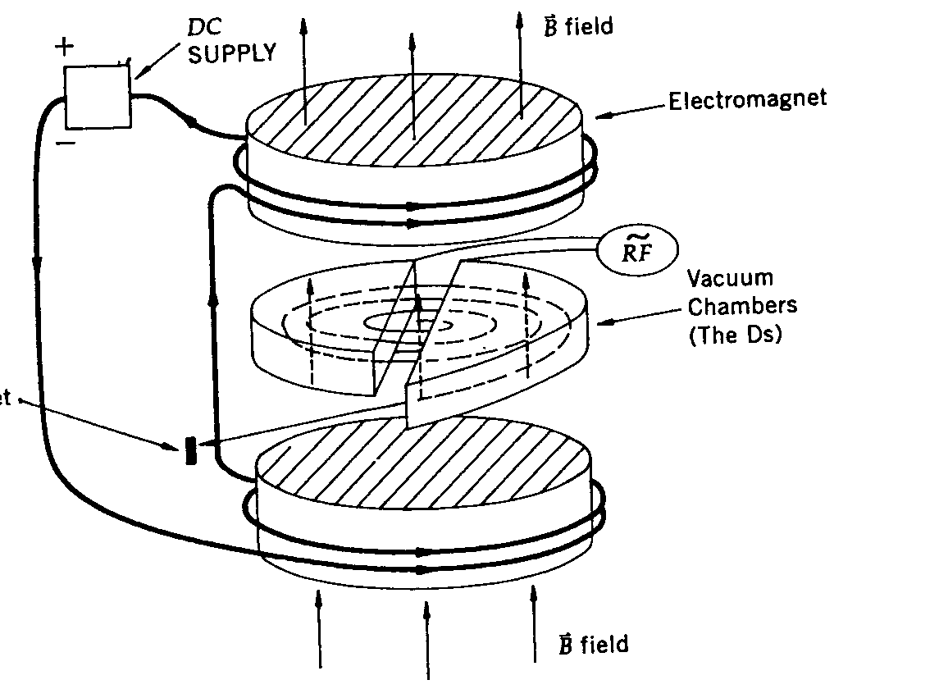
Cyclotron Frequency
The time required for a particle of charge q moving w/ a constant speed v to make one circular revolution in a uniform magnetic field, , is
Since T is the period of rotation, the frequency of the rotation is
This is the cyclotron frequency, the frequency of a particle with charge q in a cyclotron accelerator
While r depends on v, the frequency is independent of v and r.

Slide 6
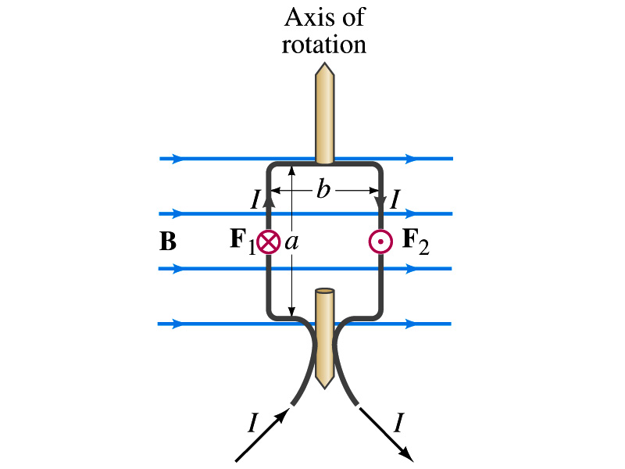
Torque on a Current Loop
What do you think will happen to a closed rectangular loop of wire with electric current as shown in the figure?
It will rotate! Why?
The magnetic field exerts a force on both vertical sections of wire.
Where is this principle used in?
Ammeters, motors, volt-meters, speedometers, etc
The two forces on the different sections of the wire exerts net torque in the same direction about the rotational axis along the symmetry axis of the wire.
What happens when the wire turns 90 degrees?
It will not turn unless there is more torque generated

Slide 7
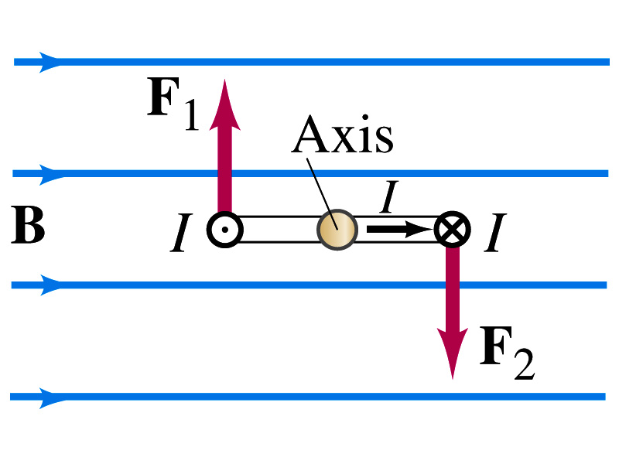
Torque on a Current Loop
So what would be the magnitude of this torque?
What is the magnitude of the force on the section of the wire with length a?
F_{a}=IaB
The moment arm of the coil is b/2
So the total torque is the sum of the torques by each of the forces
Where A=ab is the area of the coil loop
What is the total net torque if the coil consists of N loops of wire?
If the coil makes an angle θ w/ the field

Slide 8
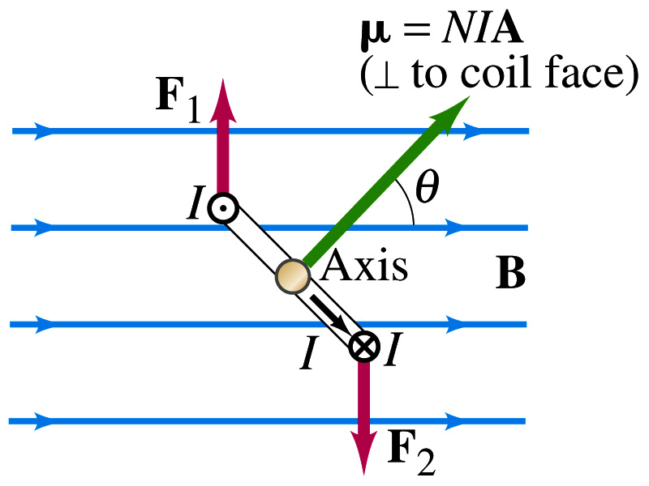
Magnetic Dipole Moment
The formula derived in the previous page for a rectangular coil is valid for any shape of the coil
The quantity NIA is called the magnetic dipole moment of the coil
It is considered a vector
Its direction is the same as that of the area vector A and is perpendicular to the plane of the coil consistent with the right-hand rule
Your thumb points to the direction of the magnetic moment when your finer cups around the loop in the direction of the current
Using the definition of magnetic moment, the torque can be written in vector form

Slide 9
Magnetic Dipole Potential Energy
Where else did you see the same form of the torque?
Remember the torque due to electric field on an electric dipole?
The potential energy of the electric dipole is
How about the potential energy of a magnetic dipole?
The work done by the torque is
If we chose U=0 at θ=π/2, then C=0
Thus the potential energy is
Very similar to the electric dipole

Slide 10
Example 27 – 12
Magnetic moment of a hydrogen atom. Determine the magnetic dipole moment of the electron orbiting the proton of a hydrogen atom, assuming (in the Bohr model) it is in its ground state with a circular orbit of radius 0.529x10⁻¹⁰m.
What provides the centripetal force?
The Coulomb force
So we can obtain the speed of the electron from
Solving for v
Since the electric current is the charge that passes through the given point per unit time, we can obtain the current
Since the area of the orbit is A=πr², we obtain the hydrogen magnetic moment

Slide 11
Sources of Magnetic Field
We have learned so far about the effects of magnetic field on electric current and a moving charge
We will now learn about the dynamics of magnetism
How do we determine magnetic field strengths in certain situations?
How do two wires with electric current interact?
What is the general approach to finding the connection between the electric current and the magnetic field?

Slide 12
Magnetic Field due to a Straight Wire
The magnetic field due to the current flowing through a straight wire forms a circular pattern around the wire
What do you imagine the strength of the field is as a function of the distance from the wire?
It must be weaker as the distance increases
How about as a function of the electric current?
Directly proportional to the current
Indeed, the above are experimentally verified
This is valid as long as r << the length of the wire
The proportionality constant is μ₀/2π, thus the field strength becomes
μ₀ is the permeability of free space
Merriam-Webster: Permeability is the property of a magnetizable substance that determines the degree in which it modifies the magnetic flux in the region occupied by it in a magnetic field

Slide 13
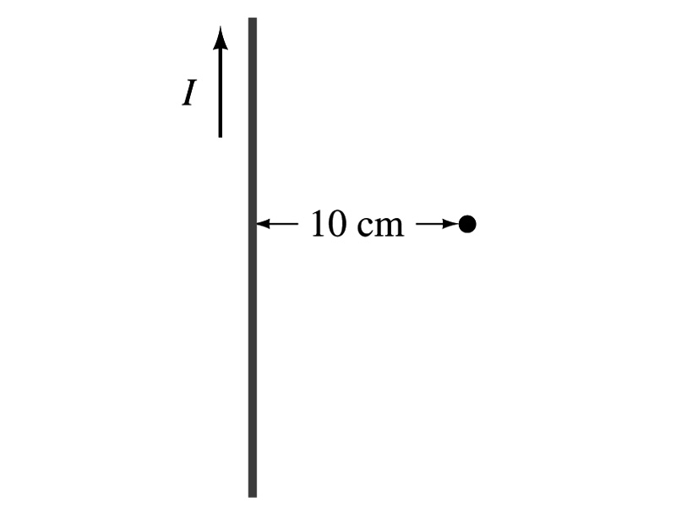
Example 28 – 1
Calculation of B near wire. A vertical electric wire in the wall of a building carries a DC current of 25A upward. What is the magnetic field at a point 10cm due East of this wire?
Using the formula for the magnetic field near a straight wire
So we can obtain the magnitude of the magnetic field at 10cm away as
Whaich direction?
Into the page!

Slide 14
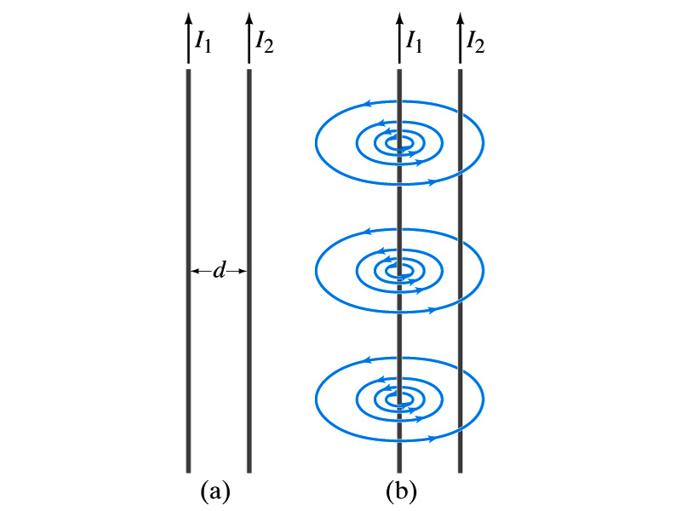
Force Between Two Parallel Wires
We have learned that a wire carrying electric current produces magnetic field
Now what do you think will happen if we place two current carrying wires next to each other?
They will exert force onto each other. Repel or attract?
Depending on the direction of the currents
This was first pointed out by Ampére.
Let’s consider two long parallel conductors separated by a distance d, carrying currents I₁ and I₂.
At the location of the second conductor, the magnitude of the magnetic field produced by I₁ is

Slide 15
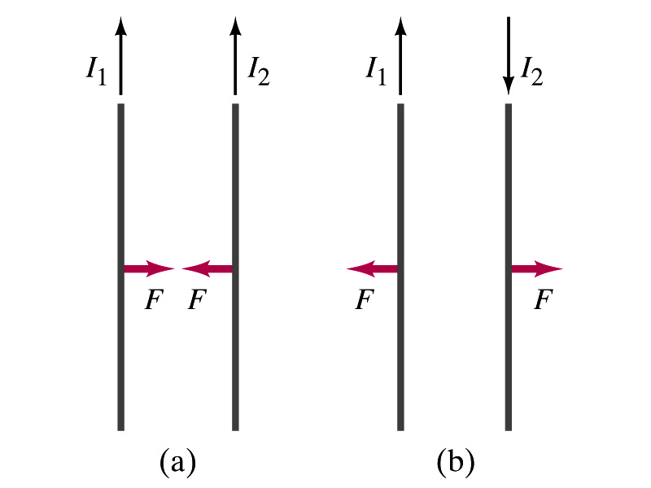
Force Between Two Parallel Wires
The force F by a magnetic field B₁ on a wire of length l, carrying the current I₂ when the field and the current are perpendicular to each other is:
So the force per unit length is
This force is only due to the magnetic field generated by the wire carrying the current I₁
There is the force exerted on the wire carrying the current I₁ by the wire carrying current I₂ of the same magnitude but in the opposite direction
So the force per unit length is
How about the direction of the force?
If the currents are in the same direction, the attractive force. If opposite, repulsive.

Slide 16
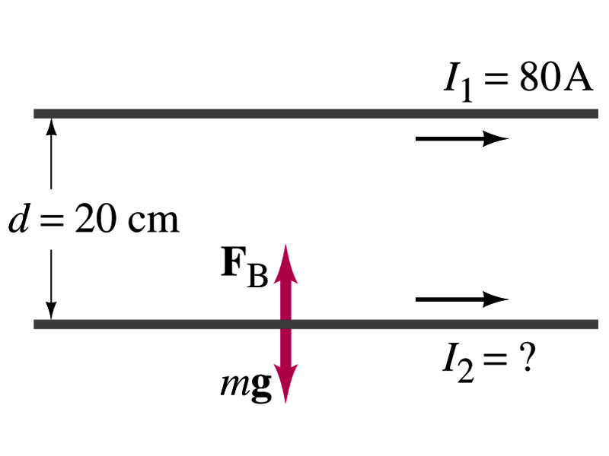
Example 28 – 5
Suspending a wire with current. A horizontal wire carries a current I₁=80A DC. A second parallel wire 20cm below it must carry how much current I₂ so that it doesn’t fall due to the gravity and in which direction? The lower has a mass of 0.12g per meter of length.
Which direction is the gravitational force?
Down to the center of the Earth
This force must be balanced by the magnetic force exerted on the wire by the first wire.
Solving for I₂

Slide 17
Operational Definition of Ampere and Coulomb
The permeability of free space is defined to be exactly
The unit of current, ampere, is defined using the definition of the force between two wires, each carrying 1A of current and separated by 1m
So 1A is defined as: the current flowing each of two long parallel conductors 1m apart, which results in a force of exactly 2x10⁻⁷N/m.
Coulomb is then defined as exactly 1C=1A s.
We do it this way since the electric current is measured more accurately and controlled more easily than the charge.

