Slide 1
PHYS 1444 – Section 002
Lecture #20
Wednesday, Apr. 22, 2020
Dr. Jaehoon Yu
CH 29:EM Induction & Faraday’s Law
  Induced EMF and EM Induction
  Faraday’s Law of Induction
  Lenz’s Law
  Generation of Electricity
  Transformer
  Electric Field Due to Changing Magnetic Flux

Slide 2
Announcements
Reading Assignments: 28.6 – 10, CH29.5 and 29.8
Final comprehensive exam: 1:00 – 2:20pm Wed. May 6
  Covers CH21.1 through what we finish Monday, May 4+ math refresher
Planetarium Extra Credit: Due 1pm, May 6
  Tape one end of the ticket stub on a sheet of paper with your name on
  Send me the photos of the sheet with the front of the ticket stubs and of the sheet with them flipped over, showing the back of them
  Email subject line must be: SP-Planetarium
Special seminar in class coming Monday
  Dr. Linda Lee on COVID-19 ➔ 30min talk + 15min Q&A
  Extra credit will be given for participating in this seminar
  Additional extra credit for asking questions relevant to her talk

Slide 3
Reminder: Special Project #5 – COVID-19
Make comparisons of COVID-19 statistics between the U.S., South Korea and Germany from https://coronaboard.com on spreadsheet
  Total 27 points: 1 point for each of the top 15 cells and 2 points for each of the 6 cells for testing
Make a timeline from Jan. 15, 2020 through Apr. 15 for The World Health Organization (WHO), U.S.A. and South Korea in their actions in response to COVID-19: One in Jan., one in Apr. and two each in Feb. and Mar.
  2 points each, totaling 30 points
What are the 3 most fundamental requirements for opening back up (2 points each, total 6 points)? Identify the two of these U.S. is ready (1 point each, total 2 points; do NOT just take politician’s words!) for opening.
  Must be quantitative!
Due: 1pm Monday, May 4
  Scan all pages of your special project into the pdf format
  Save all pages into one file with the filename SP5-YourLastName-YourFirstName.pdf
Spreadsheet has been posted on the class web page. Download ASAP.

Slide 5
Induced EMF
It has been discovered by Oersted and company in early 19th century that
  Magnetic field can be produced by the electric current
  Magnetic field can exert force on the electric charge
So if you were a scientist at that time, what would you wonder?
  Yes, you are absolutely right! You would wonder if the magnetic field can create the electric current.
  An American scientist Joseph Henry and an English scientist Michael Faraday independently found that it was possible
    Though, Faraday was given the credit since he published his work before Henry did
      He also did a lot of detailed studies on magnetic induction

Slide 6
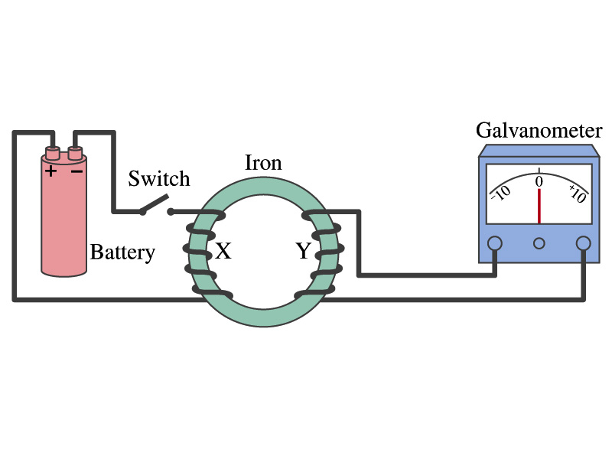
Electromagnetic Induction
Faraday used an apparatus below to show that magnetic field can induce current
Despite his hope he did not see steady current induced on the other side when the switch is thrown
But he did see that the needle on the Galvanometer turns strongly when the switch is initially thrown and is opened
  When the magnetic field through coil Y changes, a current flows as if there were a source of emf
Thus he concluded that an induced emf is produced by a changing magnetic field ➔ Electromagnetic Induction

Slide 7
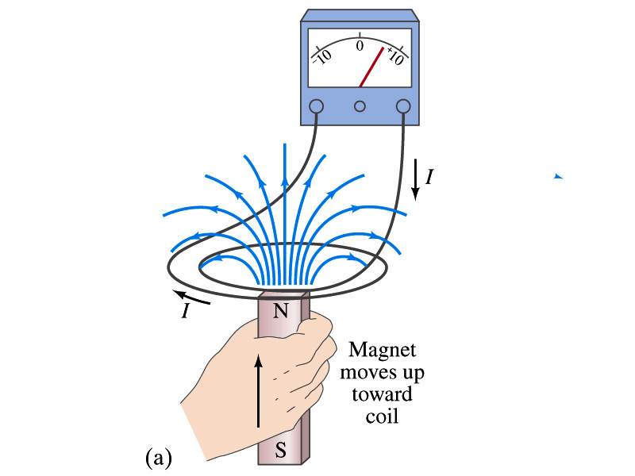
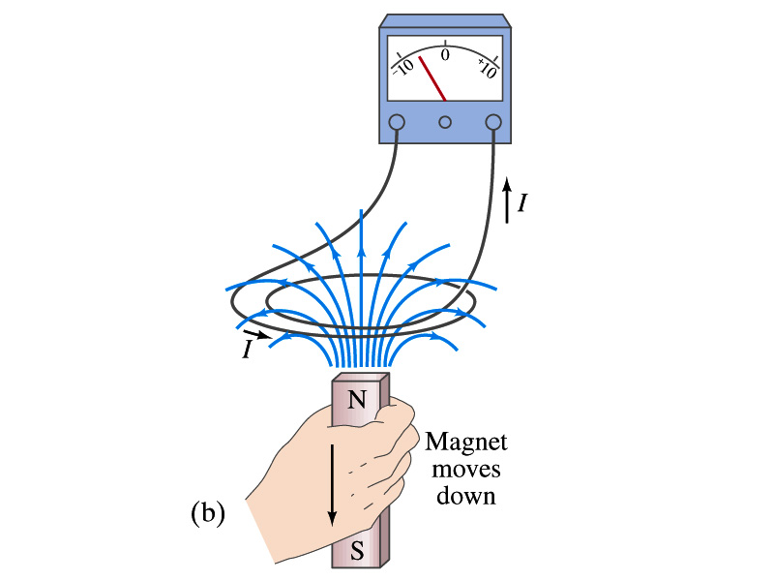
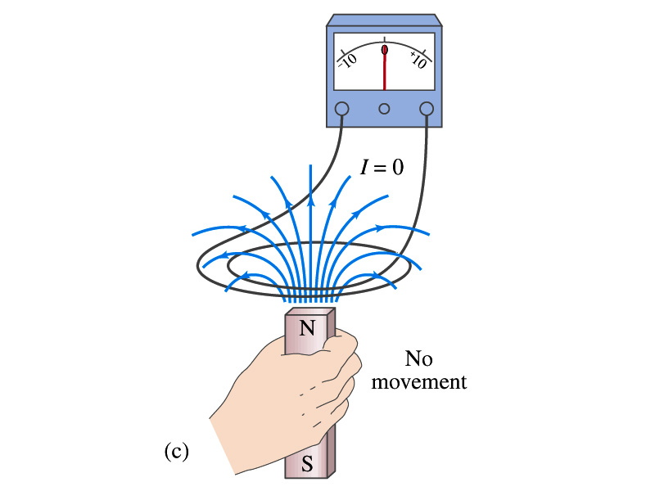
Electromagnetic Induction
Further studies on electromagnetic induction taught
  If a magnet is moved quickly into a coil of wire, a current is induced in the wire.
  If a magnet is removed from the coil, a current is induced in the wire in the opposite direction
  By the same token, the current can also be induced if the magnet stays put but the coil moves toward or away from the magnet
  Current is also induced if the coil rotates.
In other words, it does not matter whether the magnet or the coil moves. It is the relative motion that counts.

Slide 8
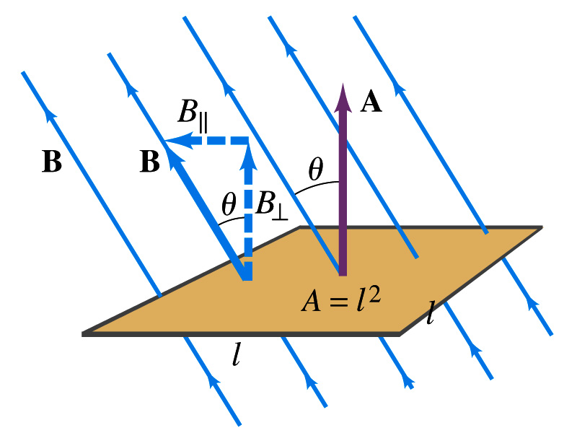
Magnetic Flux
So what do you think is the induced emf proportional to?
  The rate of changes of the magnetic field?
    the higher the changes of the field the higher the induction?
  Not really, it rather depends on the rate of change of the magnetic flux, Φ_{B}.
  Magnetic flux is defined as (just like the electric flux)
    θ is the angle between B and the area vector A whose direction is perpendicular to the face of the loop based on the right-hand rule
  What kind of quantity is the magnetic flux?
    Scalar. Unit?
    or weber
If the area of the loop is not simple or B is not uniform, the magnetic flux can be written as

Slide 9
Faraday’s Law of Induction
In terms of magnetic flux, we can formulate Faraday’s findings
  The emf induced in a circuit is equal to the rate of change of magnetic flux through the circuit
If the circuit contains N closely wrapped loops, the total induced emf is the sum of the emf induced in each loop
  Why negative?
    Has got a lot to do with the direction of induced emf…
Faraday’s Law of Induction

Slide 10
Lenz’s Law
It is experimentally found that
  An induced emf gives rise to a current whose magnetic field opposes the original change in flux ➔ This is known as Lenz’s Law
  In other words, an induced emf is always in the direction that opposes the original change in the flux that caused it.
  We can use Lenz’s law to explain the following cases in the figures
    When the magnet is moving into the coil
      Since the external flux increases, the field inside the coil takes the opposite direction to minimize the change and causes the current to flow clockwise
    When the magnet is moving out
      Since the external flux decreases, the field inside the coil takes the opposite direction to compensate the loss, causing the current to flow counter-clockwise
Which law is Lenz’s law result of?
  Energy conservation

Slide 11
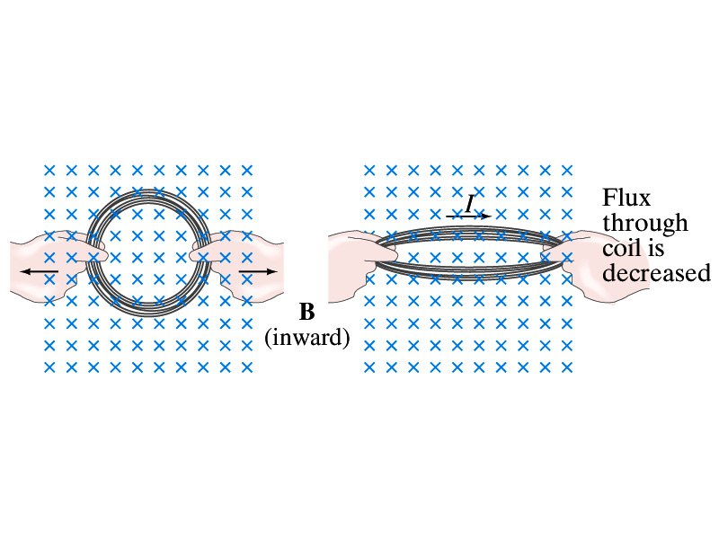
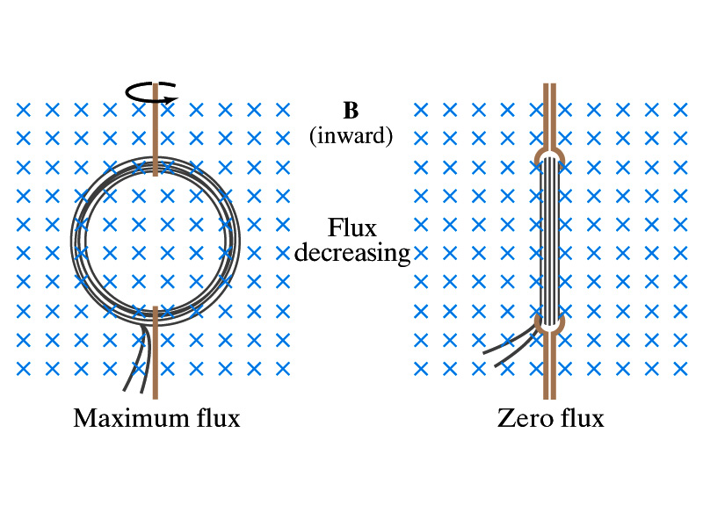
Induction of EMF
How can we induce emf?
Let’s look at the formula for the magnetic flux
What do you see? What are the things that can change with time to result in change of magnetic flux?
  Magnetic field
  The area of the loop
  The angle θ between the field and the area vector

Slide 12
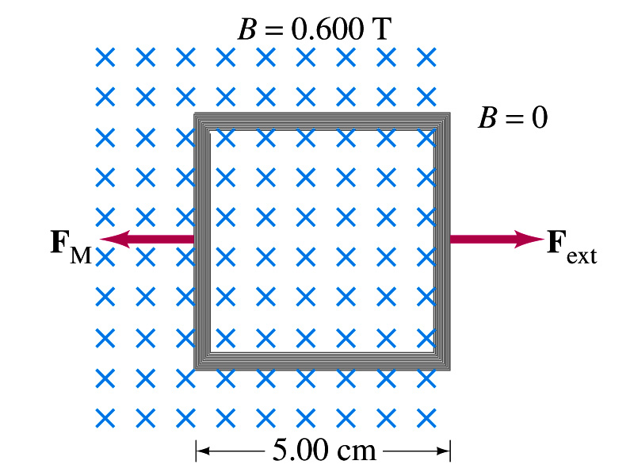
Example 29 – 5
Pulling a coil from a magnetic field. A square coil of wire with side 5.00cm contains 100 loops and is positioned perpendicular to a uniform 0.600-T magnetic field. It is quickly and uniformly pulled from the field (moving perpendicular to B) to a region where B drops abruptly to zero. At t=0, the right edge of the coil is at the edge of the field. It takes 0.100s for the whole coil to reach the field-free
region. Find (a) the rate of change in flux through the coil, (b) the emf and the current induced, and (c) how much energy is dissipated in the coil if its resistance is 100Ω. (d) what was the average force required?
What should be computed first?
The initial flux at t=0.
The flux at t=0 is
The change of flux is
Thus the rate of change of the flux is

Slide 13
Example 29 – 5, cnt’d
Thus the total emf induced in this period is
The induced current in this period is
Which direction would the induced current flow?
Clockwise
The total energy dissipated is
Force for each coil is
Force for N coil is

Slide 14
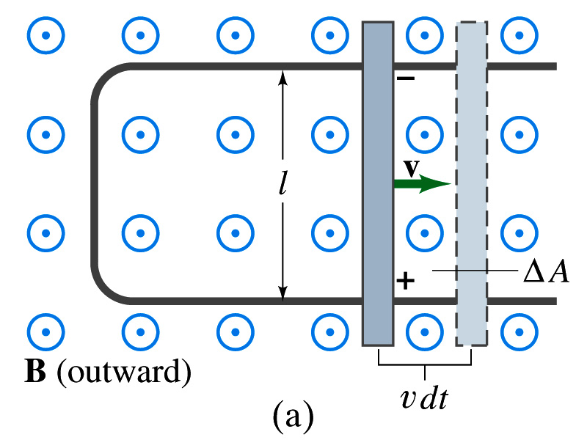
EMF Induced on a Moving Conductor
Another way of inducing emf is using a U-shaped conductor with a movable rod resting on it.
As the rod moves at speed v, it travels vdt in time dt, changing the area of the loop by dA=lvdt.
Using Faraday’s law, the induced emf for this loop is
  This equation is valid as long as B, l and v are perpendicular to each other. What do we do if not?
    Use the scalar product of the vector quantities
An emf induced on a conductor moving in a magnetic field is called the motional emf

Slide 15
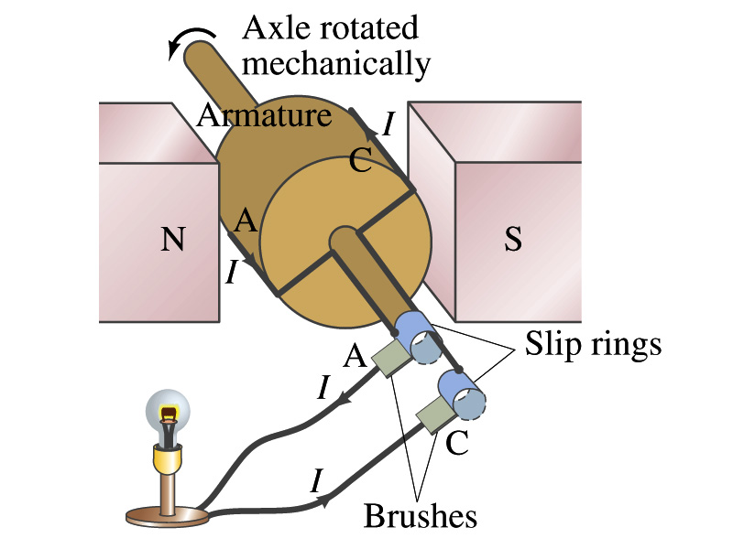
Electric Generators
What does a generator do?
  Transforms mechanical energy into electrical energy
  What does this look like?
    An inverse of an electric motor which transforms electrical energy to mechanical energy
  An electric generator is also called a dynamo
Whose law does the generator based on?
  Faraday’s law of induction

Slide 16
How does an Electric Generator work?
An electric generator consists of
  Many coils of wires wound on an armature that can rotate by mechanical means in a magnetic field (recall Faraday’s law!)
An emf is induced in the rotating coil
Electric current is the output of a generator
Which direction does the output current flow when the armature rotates counterclockwise?
  The conventional current flows outward on wire A toward the brush
  After half the revolution the wire A will be where the wire C is and the current flow on A is reversed
Thus the current produced is alternating its direction

Slide 17
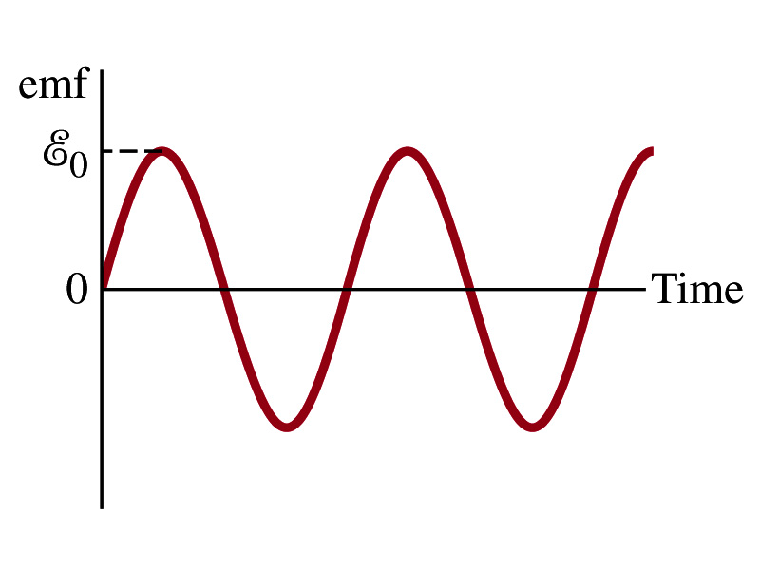

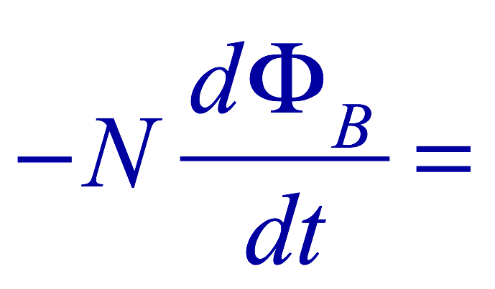
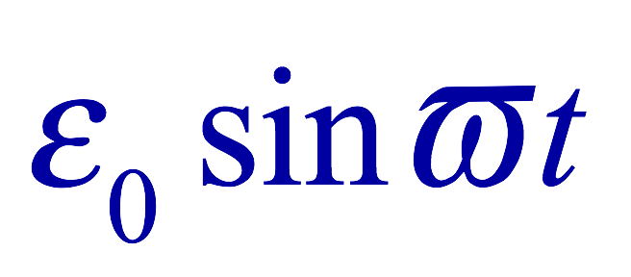
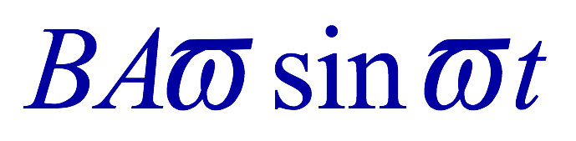
How does an Electric Generator work?
Let’s assume the loop is rotating in a uniform B field w/ a constant angular velocity ω. The induced emf is
What is the variable that changes above?
  The angle θ. What is dθ/dt?
    The angular speed ω.
  So θ=θ₀+ωt
  If we choose θ₀=0, we obtain
  If the coil contains N loops:
  What is the shape of the output?
    Sinusoidal w/ an amplitude ε₀=NBAω
USA frequency is 60Hz. Europe is at 50Hz
  Most the U.S. power is generated at steam plants

Slide 18
Example 29 – 9
An AC generator. The armature of a 60-Hz AC generator rotates in a 0.15-T magnetic field. If the area of the coil is 2.0x10⁻²m², how many loops must the coil contain if the peak output is to be ε₀=170V?
The maximum emf of a generator is
Solving for N
Since
We obtain

Slide 20
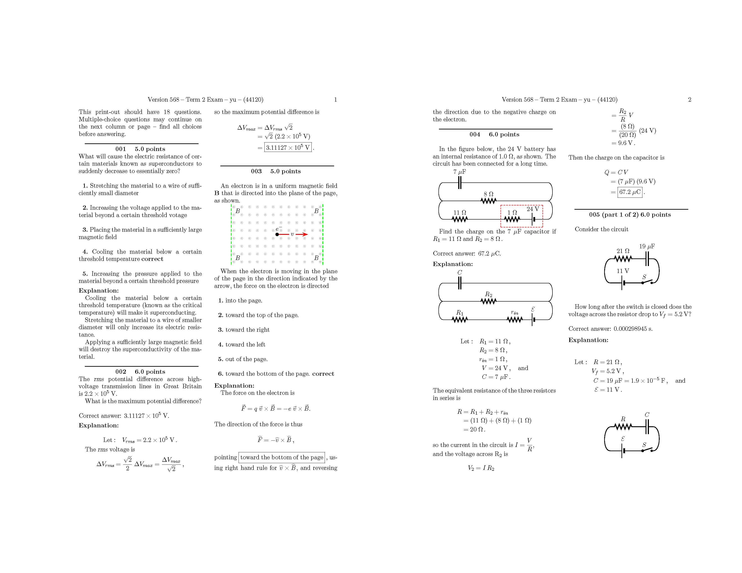

Slide 21
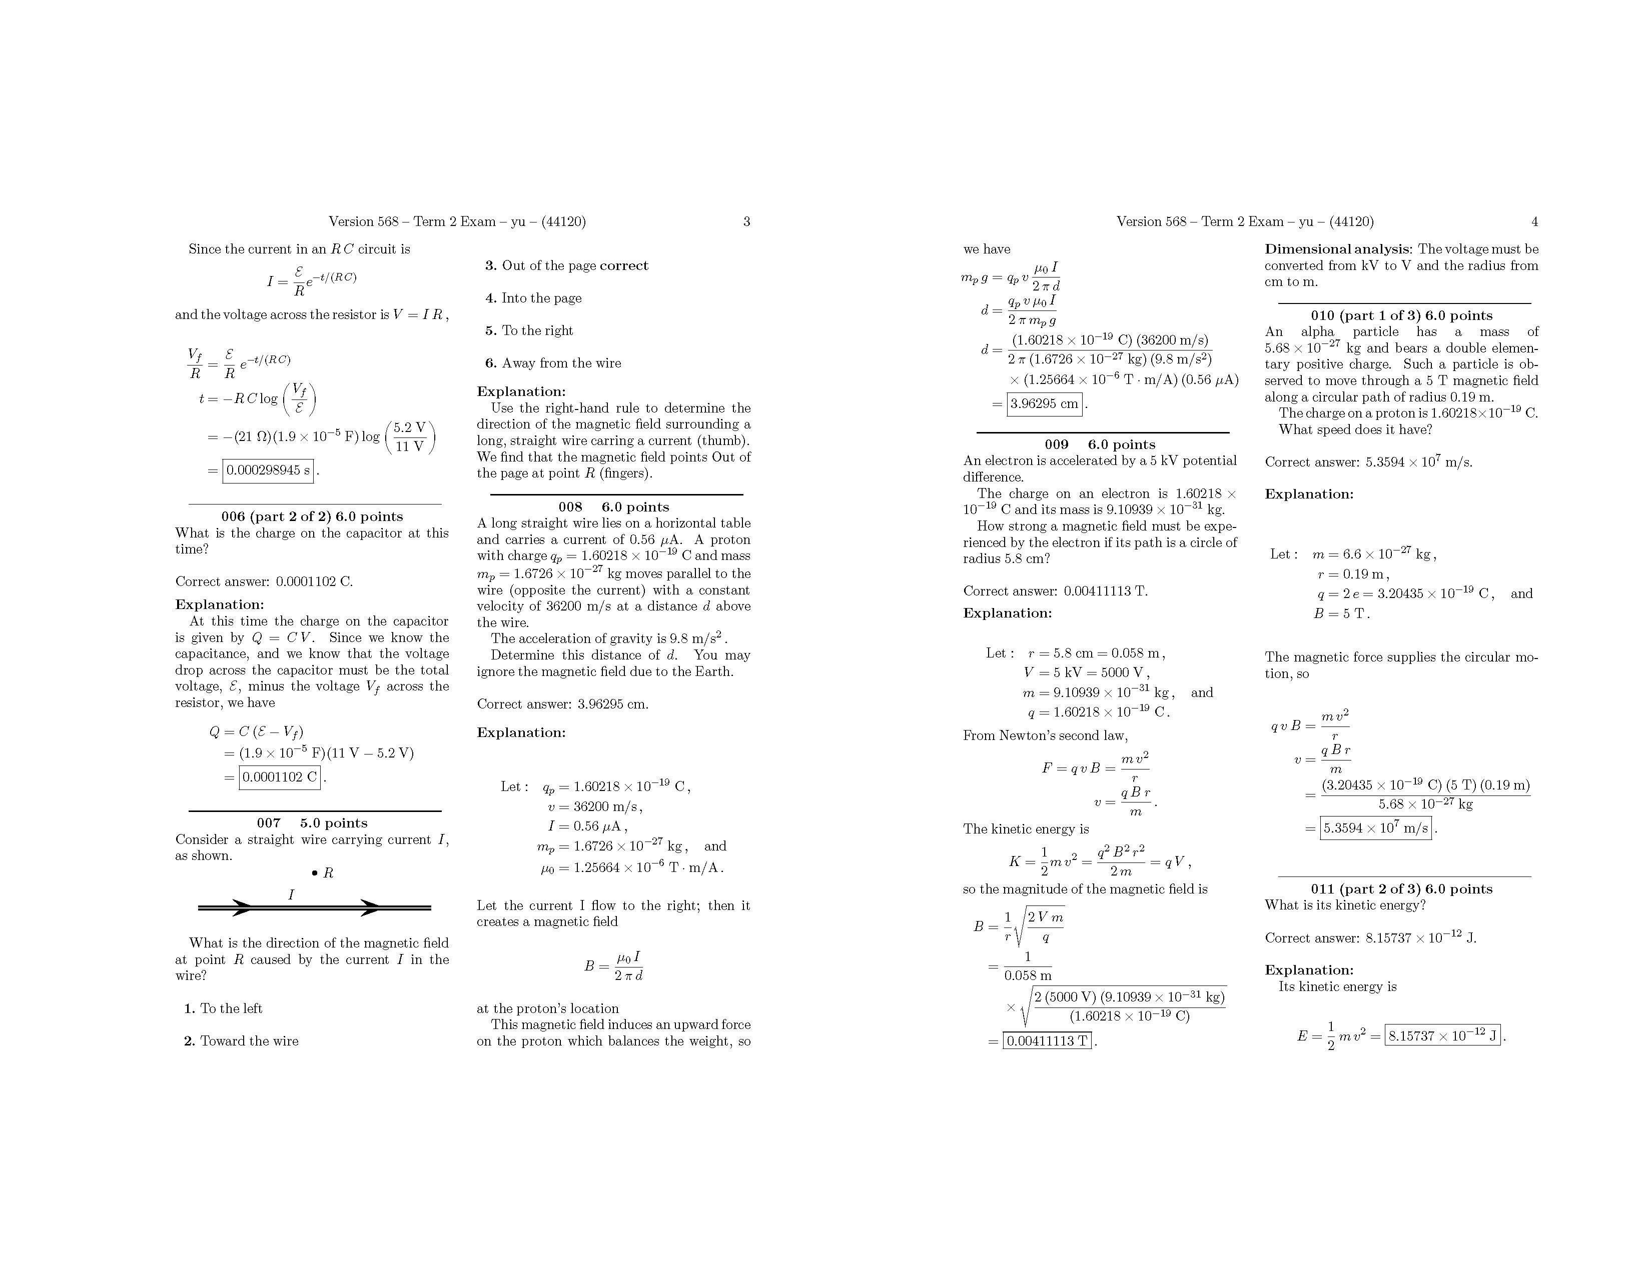

Slide 22
