Slide 1
PHYS 1444 – Section 002
Lecture #21
Monday, Apr. 27, 2020
Dr. Jaehoon Yu
Special Seminar on COVID-19
CH 29:EM Induction & Faraday’s Law
  Transformer
  Electric Field Due to Changing Magnetic Flux
Chapter 30: Inductance
  Inductance
  Mutual and Self Inductance
  Energy Stored in the Magnetic Field

Slide 2
Announcements
Final comprehensive exam: 1:00 – 2:20pm Wed. May 6
  Covers CH21.1 through what we finish Monday, May 4+ math refresher
  BYOF
Planetarium Extra Credit: Due 1pm, May 6
  Tape one end of the ticket stub on a sheet of paper with your name on
  Send me the photos of the sheet with the front of the ticket stubs and of the sheet with them flipped over, showing the back of them
  Email subject line must be: SP-Planetarium
Course evaluation
  Only 8 of you have done this! Please do this ASAP!
Special seminar for extra credit today
  Dr. Linda Lee on COVID-19 ➔ 30min talk + ~20min Q&A

Slide 3
Reminder: Special Project #5 – COVID-19
Make comparisons of COVID-19 statistics between the U.S., South Korea and Germany from https://coronaboard.com on spreadsheet
  Total 27 points: 1 point for each of the top 15 cells and 2 points for each of the 6 cells for testing
Make a timeline from Jan. 15, 2020 through Apr. 15 for The World Health Organization (WHO), U.S.A. and South Korea in their actions in response to COVID-19: One in Jan., one in Apr. and two each in Feb. and Mar.
  2 points each, totaling 30 points
What are the 3 most fundamental requirements for opening back up (2 points each, total 6 points)? Identify the two of these U.S. is ready (1 point each, total 2 points; do NOT just take politician’s words!) for opening.
  Must be quantitative!
Due: 1pm Monday, May 4
  Scan all pages of your special project into the pdf format
  Save all pages into one file with the filename SP5-YourLastName-YourFirstName.pdf
Spreadsheet has been posted on the class web page. Download ASAP.

Slide 5
US Electricity Sources

Slide 6
US Electric E Consumption by Users
US Energy Information Administration http://www.eia.gov/electricity/

Slide 7
The World Energy Consumption
In 2016, total worldwide energy consumption was 567 EJ (567×10¹⁸ J=157 PWh)➔ expected >1000EJ by 2050
  Equivalent to an average energy consumption rate of 18 terawatts (1.8×10¹³ W)
  US uses 39.1 PWh (1.38kWh/person, as of 2014)
The potential for renewable energy
  solar energy 1600 EJ (444,000 TWh)
  wind power 600 EJ (167,000 TWh)
  geothermal energy 500 EJ (139,000 TWh),
  biomass 250 EJ (70,000 TWh)
  hydropower 50 EJ (14,000 TWh) an
  ocean energy 1 EJ (280 TWh)
  Read this paper if you want to learn more

Slide 8
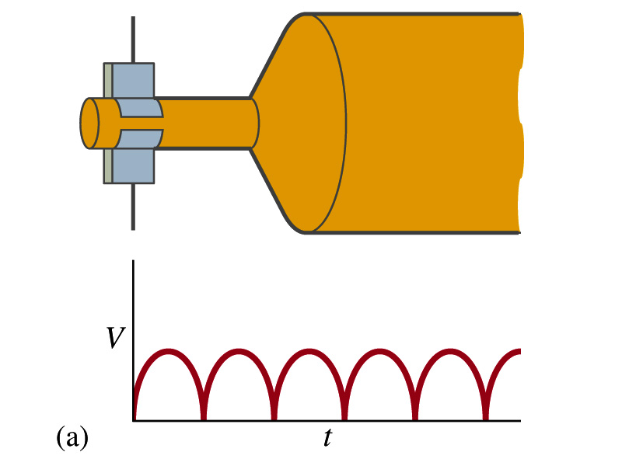
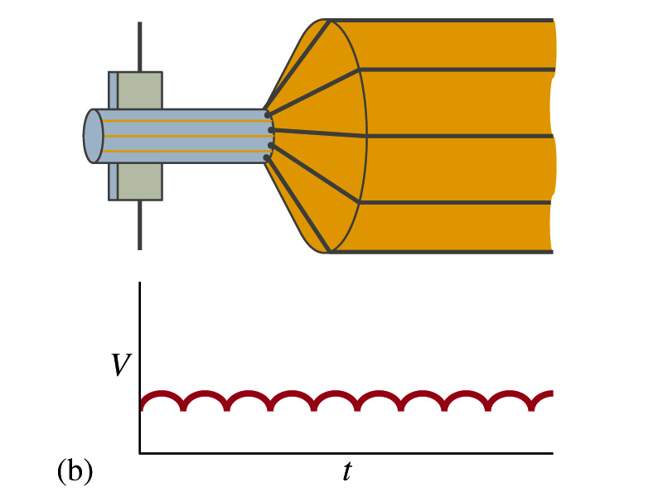
A DC Generator
A DC generator is almost the same as an AC generator except the slip rings are replaced by split-ring commutators
Output can be smoothed out by placing a capacitor in parallel to the output
  More commonly done using many armature windings
Smooth output using many windings

Slide 9
Who is Dr. Linda Lee?
A practicing physician and an assistant professor of dermatology at the Medical College of Wisconsin in Milwaukee, WI
Earned MD-PhD in cell biology and genetics at DUKE in 1998
Internship in internal medicine at the University of Washington in Seattle, WA
  This is one of the handful of institutions that provides modeling of COVID 19
Residency on dermatology at Duke, during which she was also awarded a post-doctoral fellowship in RNA aptamer studies.
After several years on faculty at Duke, she returned to Wisconsin to be closer to family. Through extensive professional and personal experiences, she developed a strong interest in education at all levels, especially for preserving and nurturing community and human connectivity, while taking maximal advantage of our ever-expanding digital technology.

Slide 10
Seminar Extra Credit Rules
Extra credit will be given for participating in this seminar through the end
Additional extra credit for relevant questions
  Type your questions into the chat window
  I will choose from the list and call your name
    Your zoom name must be consistent with the class so that I can give you the proper credit
  Unmute your mic and ask the question

