Slide 1
PHYS 1444 – Section 002
Lecture #22
Wednesday, Apr. 29, 2020
Dr. Jaehoon Yu
CH 29:EM Induction & Faraday’s Law
  Transformer
  Electric Field Due to Changing Magnetic Flux
Chapter 30: Inductance
  Inductance
  Mutual and Self Inductance
  Energy Stored in the Magnetic Field

Slide 2
Announcements
Reading assignments: CH30.7 – 30.11 & CH31.6 – 10
Final comprehensive exam: 1:00 – 2:20pm ext Wed. May 6
  Covers CH21.1 through what we finish Monday, May 4+ math refresher
  BYOF
Planetarium Extra Credit: Due 1pm, May 6
  Send me the photos of the sheet with the front of the ticket stubs and of the sheet with them flipped over, showing the back of them
  Email subject line must be: SP-Planetarium
Special project #6: Fill out the survey at
  https://s.surveyplanet.com/mw8bpHPyb
  15 points total for 7 questions
  Deadline: End of the day, Wednesday, May 6
Course evaluation now for 10 min

Slide 3
Reminder: Special Project #5 – COVID-19
Make comparisons of COVID-19 statistics between the U.S., South Korea and Germany from https://coronaboard.com on spreadsheet
  Total 27 points: 1 point for each of the top 15 cells and 2 points for each of the 6 cells for testing
Make a timeline from Jan. 15, 2020 through Apr. 15 for The World Health Organization (WHO), U.S.A. and South Korea in their actions in response to COVID-19: One in Jan., one in Apr. and two each in Feb. and Mar.
  2 points each, totaling 30 points
What are the 3 most fundamental requirements for opening back up (2 points each, total 6 points)? Identify the two of these U.S. is ready (1 point each, total 2 points; do NOT just take politician’s words!) for opening.
  Must be quantitative!
Due: 1pm Monday, May 4
  Scan all pages of your special project into the pdf format, including the spreadsheet
  Save all pages into one file with the filename SP5-YourLastName-YourFirstName.pdf
Spreadsheet has been posted on the class web page. Download ASAP.

Slide 5
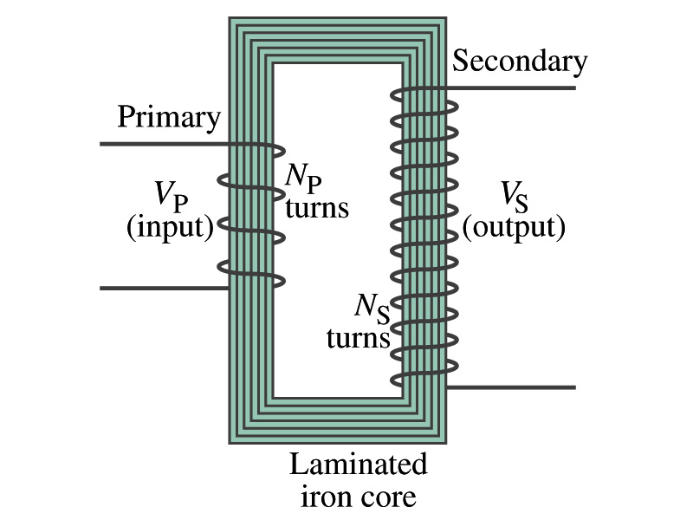
Transformer
What is a transformer?
  A device for increasing or decreasing an AC voltage
  A few examples?
    TV sets to provide the high voltage to picture tubes, portable electronic device converters, transformers on the pole, etc
A transformer consists of two coils of wires known as the primary and the secondary
  The two coils can be interwoven or linked by a laminated soft iron core to reduce losses due to Eddy current
Transformers are designed so that all magnetic flux produced by the primary coil pass through the secondary

Slide 6
How does a transformer work?
When an AC voltage is applied to the primary, the changing B it produces will induce the voltage of the same frequency in the secondary wire
So how would we make the voltage different?
  By varying the number of loops in each coil
  From Faraday’s law, the induced emf in the secondary is
  The input primary voltage is
  Since dΦ_{B}/dt is the same, we obtain
Transformer Equation

Slide 7
The Transformer Equation
The transformer equation does not work for DC current
  Since there is no change of magnetic flux!!
If N_{S}>N_{P}, the output voltage is greater than the input so it is called a step-up transformer while N_{S}<N_{P} is called step-down transformer
Now, it looks like energy conservation is violated since we can get more emf from smaller ones, right?
  Wrong! Wrong! Wrong! Energy is always conserved!
  A well designed transformer can be more than 99% efficient
  The power output is the same as the input:
The output current for a step-up transformer will be lower than the input, while it is larger for a step-down x-former than the input.

Slide 8
Example for A Transformer
Portable radio transformer. A transformer for home use of a portable radio reduces 120-V AC to 9.0V AC. The secondary contains 30 turns, and the radio draws 400mA. Calculate (a) the number of turns in the primary (b) the current in the primary and (c) the power transformed.
(a) What kind of a transformer is this?
A step-down x-former
Since
We obtain
We obtain
(b) Also from the transformer equation
(c) Thus the power transformed is
How about the input power?
The same assuming 100% efficiency.

Slide 9
Example 29 – 13: Power Transmission
Transmission lines. An average of 120kW of electric power is sent to a small town from a power plant 10km away. The transmission lines have a total resistance of 0.4Ω. Calculate the power loss if the power is transmitted at (a) 240V and (b) 24,000V.
We cannot use P=V²/R since we do not know the voltage along the transmission line. We, however, can use P=I²R.
(a) If 120kW is sent at 240V, the total current is
Thus the power loss due to transmission line is
(b) If 120kW is sent at 24,000V, the total current is
Thus the power loss due to transmission line is
The higher the transmission voltage, the smaller the current, causing less loss of energy. This is why power is transmitted w/ HV, as high as 170kV.

Slide 10
Electric Field due to Magnetic Flux Change
When the electric current flows through a wire, there is an electric field in the wire that moves electrons
We saw, however, that changing magnetic flux induces a current in the wire. What does this mean?
  There must be an electric field induced by the changing magnetic flux.
In other words, a changing magnetic flux produces an electric field
This result applies not just to wires but to any conductor or any region in space

Slide 11
Generalized Form of Faraday’s Law
Recall the relationship between the electric field and the potential difference
Induced emf in a circuit is equal to the work done per unit charge by the electric field
So we obtain
The integral is taken around the path enclosing the area through which the magnetic flux Φ_{Β} is changing.

Slide 12
Inductance
A changing magnetic flux through a circuit induces an emf in that circuit
An electric current produces a magnetic field
From these, we can deduce
  A changing current in one circuit must induce an emf in a nearby circuit ➔ Mutual inductance
  Or induce an emf in itself ➔ Self inductance

Slide 13
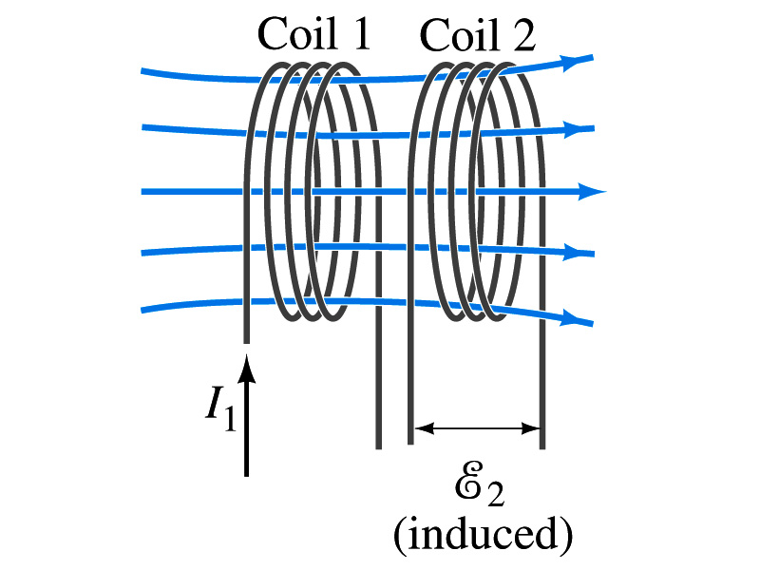
Mutual Inductance
If two coils of wire are placed near each other, a changing current in one will induce an emf in the other.
What is the induced emf in coil 2, ε₂, proportional to?
  Rate of the change of the magnetic flux passing through it
This flux is due to current I₁ in coil 1
If Φ₂₁ is the magnetic flux in each loop of coil 2 created by coil1 and N₂ is the number of closely packed loops in coil 2, then N₂Φ₂₁ is the total flux passing through coil 2.
If the two coils are fixed in space, N₂Φ₂₁ is proportional to the current I₁ in coil 1, .
The proportionality constant for this is called the Mutual Inductance and defined as .
The emf induced in coil 2 due to the changing current in coil 1 is

Slide 14
Mutual Inductance
The mutual induction of coil 2 with respect to coil 1, M₂₁,
  is a constant and does not depend on I₁.
  depends only on “geometric” factors such as the size, shape, number of turns and the relative position of the two coils, and whether a ferromagnetic material is present
    The farther apart the two coils are the less flux can pass through coil, 2, so M₂₁ will be less.
  In most cases the mutual inductance is determined experimentally
Conversely, the changing current in coil 2 will induce an emf in coil 1
  M₁₂ is the mutual inductance of coil1 with respect to coil2 and M₁₂ = M₂₁
  We can put M=M₁₂=M₂₁ and obtain
  SI unit for mutual inductance is Henry (H)
What? Does this make sense?

Slide 15
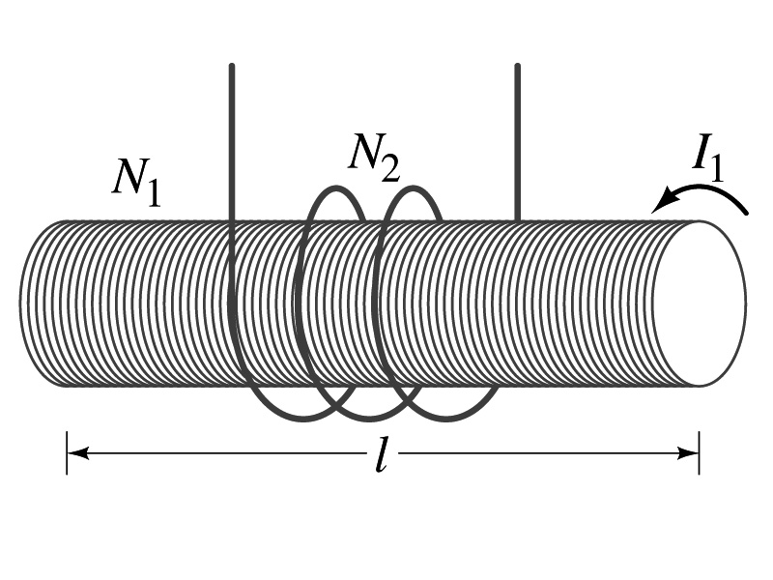
Example 30 – 1
Solenoid and coil. A long thin solenoid of length l and cross-sectional area A contains N₁ closely packed turns of wire. Wrapped around it is an insulated coil of N₂ turns. Assuming all the flux from coil 1 (the solenoid) passes through coil 2, calculate the mutual inductance.
First, we need to determine the flux produced by the solenoid.
What is the magnetic field inside the solenoid?
Since the solenoid is closely packed, we can assume that the field lines are perpendicular to the surface area of the coils. Thus the flux through coil 2 is
Thus the mutual inductance of coil 2 is
Note that M₂₁ only depends on geometric factors!

