Slide 1
PHYS 1444 – Section 002
Lecture #23
Monday, May 4, 2020
Dr. Jaehoon Yu
CH30: Inductance
  Self Inductance
  Energy Stored in the Magnetic Field
CH31: Maxwell’s equations
  Expansion of Ampere’s Law
  Gauss’ Law for Magnetism
  Production of EM Waves

Slide 2
Announcements – I
Final comprehensive exam: 1:00 – 2:20pm this Wed. May 6
  Do NOT miss the exam! Must be in a quiet place to take the exam!
    You will get an F no matter how well you’ve been doing!!
  Comprehensive: Covers CH21.1 – CH31-5 + Math Refresher
  Online exam based on Quest but must join zoom class by 12:55pm!
  You can use your calculator but DO NOT input formula into it!
    Cell phones or any types of computers cannot replace a calculator!
    POWER OFF your phones!!
  BYOF: You may prepare a one 8.5x11.5 sheet (front and back) of handwritten formulae and values of constants
    No derivations, plots, pictures, word definitions or solutions or setups of any problems!
      No names of the Maxwell’s equations
  Please send me the photos of your formula sheet by 12:00pm
    If you don’t have one, still send me email that you do not have one prepared!
  Let’s be fair to other students and not cheat!

Slide 3
Announcements – II
Reading assignments: CH30.7 – 30.11 & CH31.5 – 10
Planetarium Extra Credit: Due 1pm, May 6
  Send me the photos of the sheet with the front of the ticket stubs and of the sheet with them flipped over, showing the back of them
  Email subject line must be: SP-Planetarium
Be sure to submit the course feedback survey ASAP!

Slide 4
Reminder: Special Project #6
Special project #6: Fill out the survey at
  https://s.surveyplanet.com/mw8bpHPyb
  15 points total for 7 questions
  Deadline: End of the day, Wednesday, May 6

Slide 5
Self Inductance
The concept of the inductance applies to a single isolated coil of N turns. How does this happen?
  When a changing current passes through a coil
  A changing magnetic flux is produced inside the coil
  The changing magnetic flux in turn induces an emf in the same coil
  This emf opposes the change in flux. Whose law is this? (Poll 14)
    Lenz’s law
What would this do?
  When the current through the coil is increasing?
    The increasing magnetic flux induces an emf that opposes the original current
    This tends to impedes its increase, trying to maintain the original current
  When the current through the coil is decreasing?
    The decreasing flux induces an emf in the same direction as the current
    This tends to increase the flux, trying to maintain the original current

Slide 6
Self Inductance
Since the magnetic flux Φ_{B} passing through N turn coil is proportional to current I in the coil,
We define self-inductance, L:
The induced emf in a coil of self-inductance L is
  What is the unit for self-inductance?
What does magnitude of L depend on?
  Geometry and the presence of a ferromagnetic material
Self inductance can be defined for any circuit or part of a circuit
Self Inductance

Slide 7
So what in the world is the Inductance?
It is an impediment onto the electrical current due to the existence of changing magnetic flux
So what?
In other words, it is like the resistance to the varying current, such as AC, that causes the constant change of magnetic flux due to inductance
But it also provides means to store energy, just like the capacitance

Slide 8
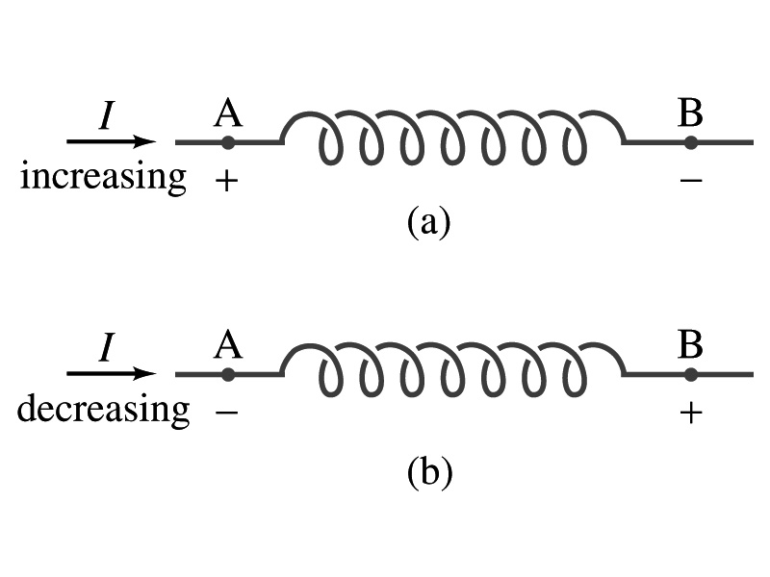
Inductor
An electrical circuit always contains some inductance but is normally negligibly small
  If a circuit contains a coil of many turns, it could have large inductance
A coil that has significant inductance, L, is called an inductor and is expressed with the symbol
  Precision resistors are normally wire wound
    Would have both resistance and inductance
    The inductance can be minimized by winding the wire back on itself in opposite direction to cancel magnetic flux
    This is called a “non-inductive winding”
If an inductor has negligible resistance, inductance controls the changing current
For an AC current, the greater the inductance the less the AC current
  An inductor thus acts like a resistor to impede the flow of alternating current (not to DC, though. Why? Poll 15)
  The quality of an inductor is indicated by the term reactance or impedance

Slide 9
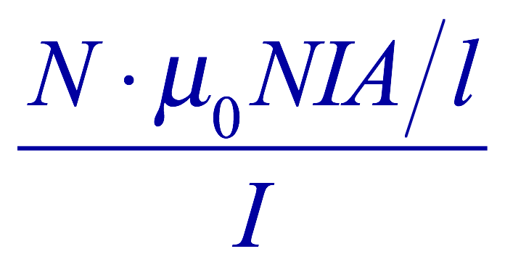
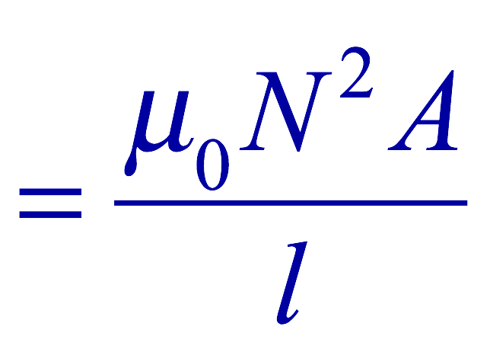
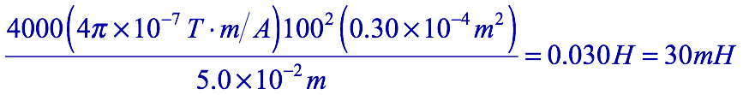
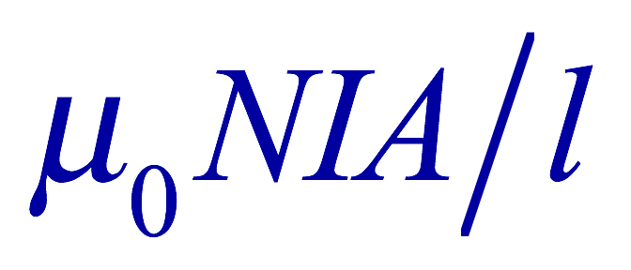
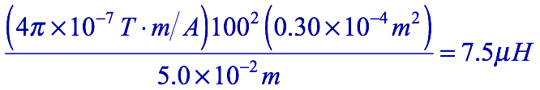
Example 30 – 3
Solenoid inductance. (a) Determine the formula for the self inductance L of a tightly wrapped solenoid ( a long coil) containing N turns of wire in its length l and whose cross-sectional area is A. (b) Calculate the value of L if N=100, l=5.0cm, A=0.30cm² and the solenoid is air filled. (c) calculate L if the solenoid has an iron core with μ=4000μ₀.
What is the magnetic field inside a solenoid?
The flux is, therefore,
Using the formula for self inductance:
(b) Using the formula above
(c) The magnetic field with an iron core solenoid is

Slide 10
Energy Stored in the Magnetic Field
The work done onto the system is the same as the energy stored in the inductor when it is carrying current I
  This is compared to the energy stored in a capacitor, C, when the potential difference across it is V:
  Just like the energy stored in a capacitor is considered to reside in the electric field between its plates
  The energy in an inductor can be considered to be stored in its magnetic field
Energy Stored in a magnetic field inside an inductor

Slide 11
Stored Energy in terms of B
So how is the stored energy written in terms of magnetic field B?
  Inductance of an ideal solenoid without the fringe effect
  The magnetic field in a solenoid is
  Thus the energy stored in an inductor is
  Thus the energy density is
  This formula is valid in any region of space
  If a ferromagnetic material is present, μ₀ becomes μ.
E
What is this?
E density
Volume V
What volume does Al represent?
The volume inside a solenoid!!

Slide 12
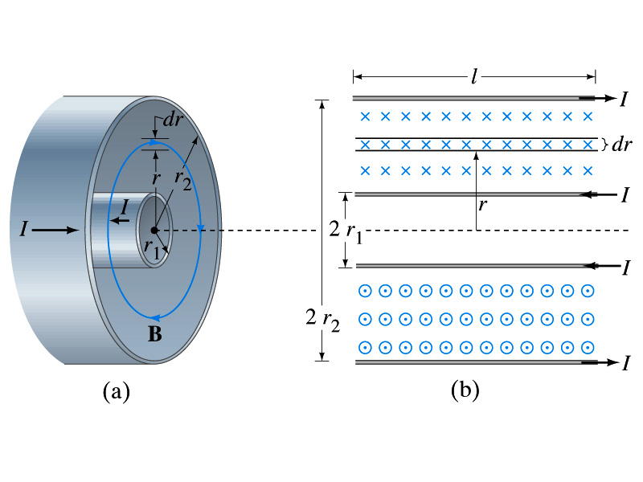
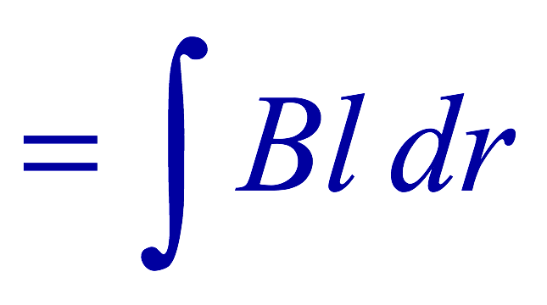
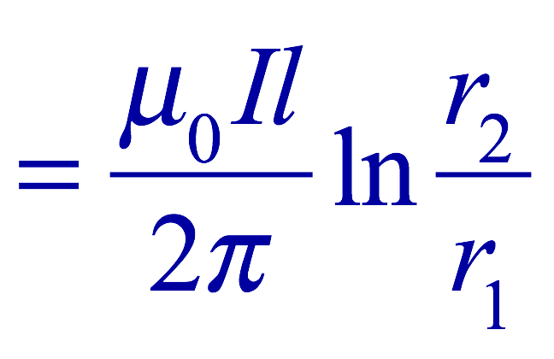
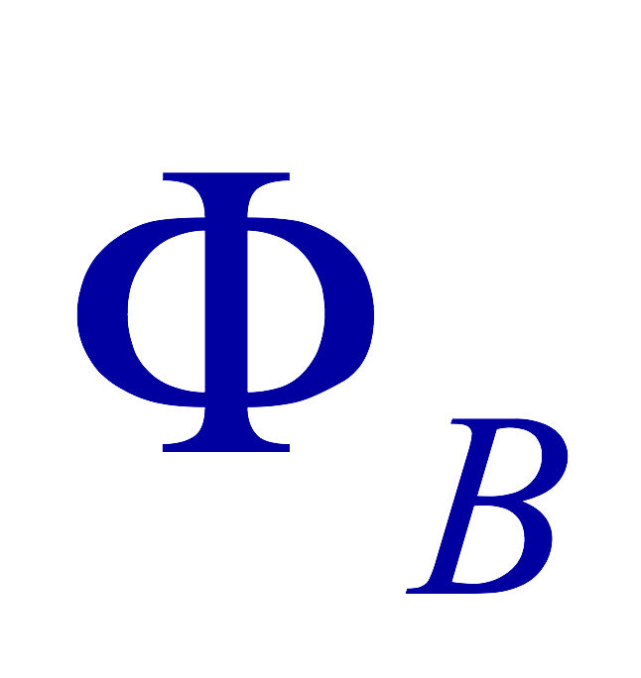
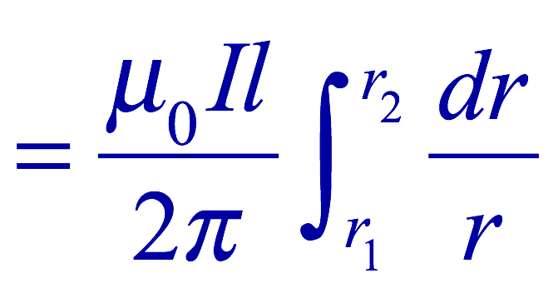
Example 30 – 5
Energy stored in a coaxial cable. (a) How much energy is being stored per unit length in a coaxial cable whose conductors have radii r₁ and r₂ and which carry a current I? (b) Where is the energy density highest?
(a) The total flux through l of the cable is
Thus inductance per unit length for a coaxial cable is
Thus the energy stored per unit length is
(b) Since the magnetic field is
The energy density is highest where B is highest. Since B is highest close to r=r₁, near the surface of the inner conductor.
And the energy density is

Slide 13
Maxwell’s Equations – I
The development of EM theory by Oersted, Ampere and others was not done in terms of EM fields
  The idea of fields was introduced somewhat by Faraday
Scottish physicist James C. Maxwell unified all the phenomena of electricity and magnetism in one theory with only four equations (Maxwell’s Equations) using the concept of fields
  This theory provided the prediction of EM waves
  As important as Newton’s law, since it provides the dynamics of electromagnetism
  This theory is also in agreement with Einstein’s special relativity

Slide 14
Maxwell’s Equations – II
The biggest achievement of 19th century electromagnetic theory is the prediction and experimental verifications that the EM waves can travel through the empty space
  What do you think this accomplishment did?
    Open a new world of communication
    It also yielded the prediction that the light is an EM wave
Since all of Electromagnetism is contained in the four Maxwell’s equations, this is considered as one of the greatest achievements of human intellect

Slide 15
Ampere’s Law
Do you remember the mathematical expression of Oersted discovery of a magnetic field produced by an electric current, given by Ampere? (Poll 16)
We’ve learned that a varying magnetic field produces an electric field (Poll 17)
Then can the reverse phenomena, that a changing electric field producing a magnetic field, possible?
  If this is the case, it would demonstrate a beautiful symmetry in nature between electricity and magnetism

Slide 16
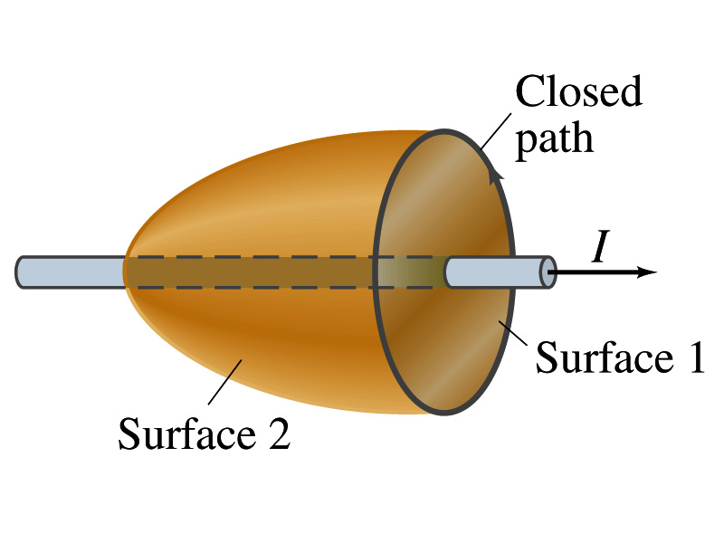
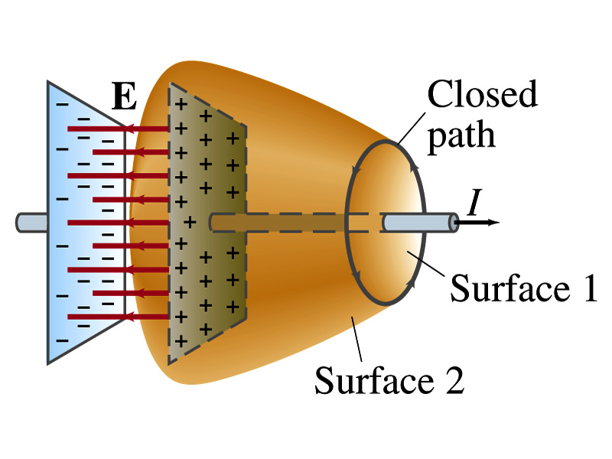
Expanding Ampere’s Law
Let’s consider a wire carrying current Ι
  The current that is enclosed in the loop passes through the surface # 1 in the figure
  We could imagine a different surface # 2 that shares the same enclosed path but cuts through the wire in a different location. What is the current that passes through this surface?
    Still Ι.
  So the Ampere’s law still works
We could then consider a capacitor being charged up or being discharged.
  The current Ι is enclosed in the loop passes through the surface #1
  However the surface #2 that shares the same closed loop do not have any current passing through it.
    There, however, is a magnetic field present since there is a current ➔ In other words, there is a changing electric field in between the plates
    Maxwell resolved this by adding an additional term to Ampere’s law involving the changing electric field

Slide 17
Modifying Ampere’s Law
To determine what the extra term should be, we first have to figure out what the electric field between the two plates is
  The charge Q on the capacitor with capacitance C is Q=CV
    Where V is the potential difference between the plates
  Since V=Ed
    Where E is the uniform field between the plates, and d is the separation of the plates
  And for parallel plate capacitor C=ε₀A/d
  We obtain

Slide 18
Modifying Ampere’s Law
  If the charge on the plate changes with time, we can write
  Using the relationship between the current and charge we obtain
    Where Φ_{Ε}=EA is the electric flux through the surface between the plates
  So in order to make Ampere’s law work for the surface 2 in the figure, we must write it in the following form
  This equation represents the general form of Ampere’s law
    This means that a magnetic field can be caused not only by an ordinary electric current but also by a changing electric flux
Extra term by Maxwell

Slide 19
Example 31 – 1
Charging capacitor. A 30-pF air-gap capacitor has circular plates of area A=100cm². It is charged by a 70-V battery through a 2.0-Ω resistor. At the instance the battery is connected, the electric field between the plates is changing most rapidly. At this instance, calculate (a) the current into the plates, and (b) the rate of change of electric field between the plates. (c) Determine the magnetic field induced between the plates. Assume E is uniform between the plates at any instant and is zero at all points beyond the edges of the plates.
Since this is an RC circuit, the charge on the plates is:
For the initial current (t=0), we differentiate the charge with respect to time.
The electric field is
Change of the electric field is

Slide 20
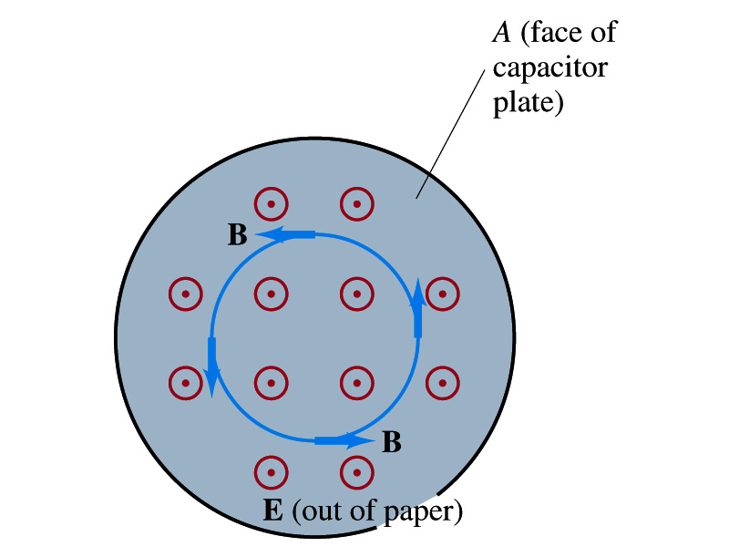
Example 31 – 1
(c) Determine the magnetic field induced between the plates. Assume E is uniform between the plates at any instant and is zero at all points beyond the edges of the plates.
The magnetic field lines generated by changing electric field is perpendicular to E and is circular due to symmetry
Whose law can we use to determine B?
Extended Ampere’s Law w/ Ι_{encl}=0!
We choose a circular path of radius r, centered at the center of the plane, following the B.
For r<r_{plate}, the electric flux is
since E is uniform throughout the plate
So from Ampere’s law, we obtain
Solving for B
For r<r_{plate}
Since we assume E=0 for r>r_{plate}, the electric flux beyond the plate is fully contained inside the surface.
So from Ampere’s law, we obtain
Solving for B
For r>r_{plate}

Slide 21
Displacement Current
Maxwell interpreted the second term in the generalized Ampere’s law equivalent to an electric current
  He called this term as the displacement current, Ι_{D}
  While the other term is called as the conduction current, Ι
Ampere’s law then can be written as
  Where
  While it is in effect equivalent to an electric current, a flow of electric charge, this actually does not have anything to do with the flow itself

Slide 22
Gauss’ Law for Magnetism
If there is a symmetry between electricity and magnetism, there must be an equivalent law in magnetism as the Gauss’ Law in electricity
For a magnetic field B, the magnetic flux Φ_{B} through the surface is defined as
  Where the integration is over the area of either an open or a closed surface
The magnetic flux through a closed surface which completely encloses a volume is
What was the Gauss’ law in the electric case?
  The electric flux through a closed surface is equal to the total net charge Q enclosed by the surface divided by ε₀.
Similarly, we can write Gauss’ law for magnetism as
Why is result of the integral zero? (poll 18)
  There is no isolated magnetic poles, the magnetic equivalent of single electric charges
Gauss’ Law for electricity
Gauss’ Law for magnetism

Slide 23
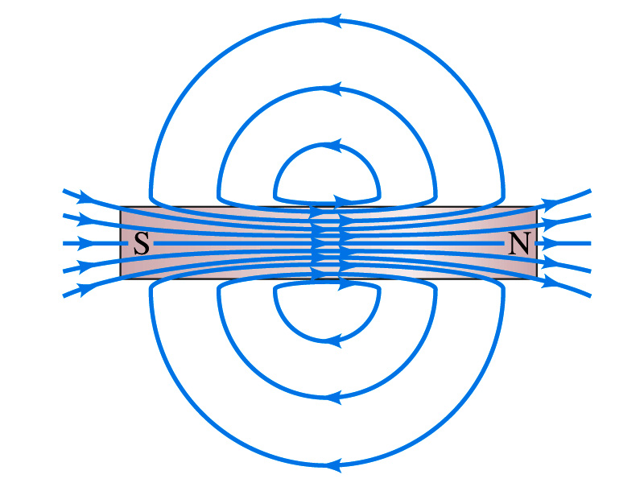
Gauss’ Law for Magnetism
What does the Gauss’ law in magnetism mean physically?
  There are as many magnetic flux lines that enter the enclosed volume as leave it
  If magnetic monopole does not exist, there is no starting or stopping point of the flux lines
    Electricity do have the source and the sink
  Magnetic field lines must be continuous
  Even for a bar magnet, the field lines exist both insides and outside of the magnet

Slide 24
Maxwell’s Equations
In the absence of dielectric or magnetic materials, the four equations developed by Maxwell are:
Gauss’ Law for electricity
A generalized form of Coulomb’s law relating electric field to its sources, the electric charge
Gauss’ Law for magnetism
A magnetic equivalent of Coulomb’s law relating magnetic field to its sources. This says there are no magnetic monopoles.
Faraday’s Law
An electric field is produced by a changing magnetic field
Ampére’s Law
A magnetic field is produced by an electric current or by a changing electric field

Slide 25
Maxwell’s Amazing Leap of Faith
According to Maxwell, a magnetic field will be produced even in an empty space if there is a changing electric field
  He then took this concept one step further & concluded that
    If a changing magnetic field produces an electric field, the electric field is also changing in time.
    This changing electric field in turn produces a magnetic field that changes.
    This changing magnetic field then in turn produces an electric field that changes.
    This process continues.
  With a manipulation of the equations, Maxwell found that the net result of this interacting changing fields is a wave of electric and magnetic fields that can actually propagate (travel) through the empty space

Slide 26
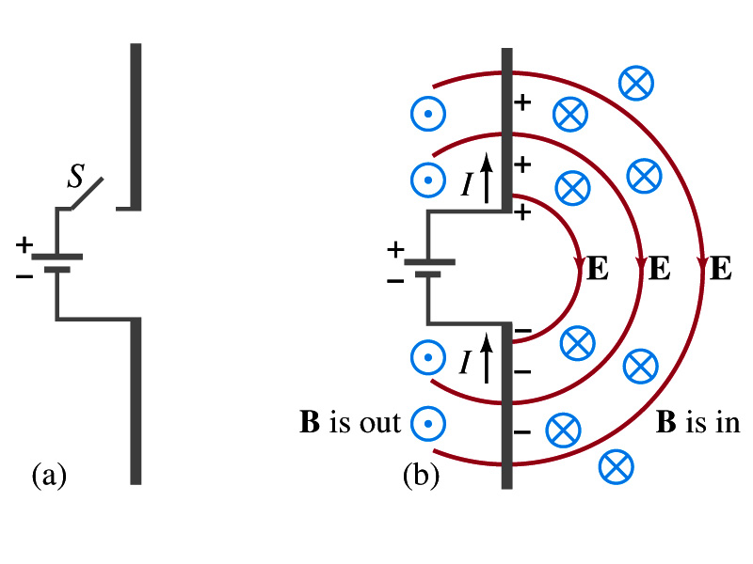
Production of EM Waves
Consider two conducting rods that will serve as an antenna are connected to a DC power source
  What do you think will happen when the switch is closed?
    The rod connected to the positive terminal is charged positively and the other negatively
    Then the electric field will be generated between the two rods
    Since there is the current that flows through, the rods generates a magnetic field around them
How far would the electric and magnetic fields extend?
  In static case, the field extends indefinitely
  When the switch is closed, the fields are formed nearby the rods quickly but
  The stored energy in the fields won’t propagate w/ infinite speed

Slide 27
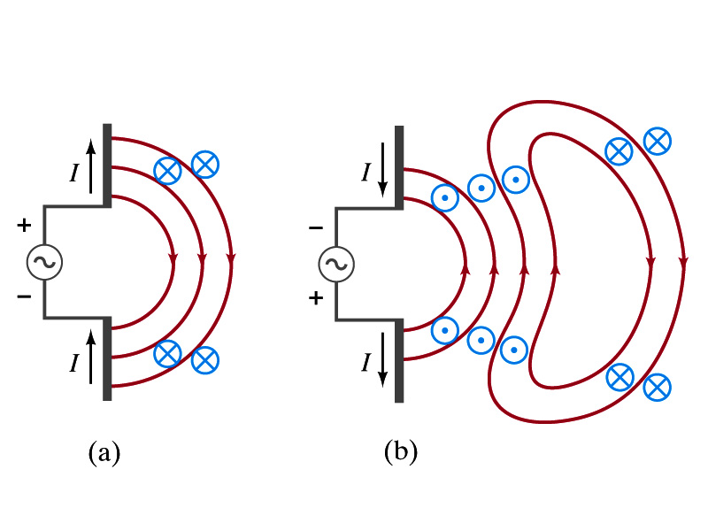
Production of EM Waves
What happens if the antenna is connected to an AC power source?
  When the connection was initially made, the rods are charging up quickly w/ the current flowing in one direction as shown in the figure
    The field lines form as in the dc case
    The field lines propagate away from the antenna
  Then the direction of the voltage reverses
    The new field lines with the opposite direction forms
    While the original field lines still propagates away from the rod reaching out far
      Since the original field propagates through an empty space, the field lines must form a closed loop (no charge exist)
    Since changing electric and magnetic fields produce changing magnetic and electric fields, the fields moving outward is self supporting and do not need antenna with flowing charge
  The fields far from the antenna is called the radiation field
  Both electric and magnetic fields form closed loops perpendicular to each other

Slide 28
Properties of Radiation Fields – I
The fields travel on the other side of the antenna as well
The field strength is the greatest in the direction perpendicular to the oscillating charge while it is 0 along the direction of the current
The magnitude of E and B in the radiation field decrease with distance as 1/r
The energy carried by the EM wave is proportional to the square of the amplitude, E² or B²
  So the intensity of wave decreases as 1/r²

Slide 29
Properties of Radiation Fields – II
The electric and magnetic fields at any point are perpendicular to each other and to the direction of the propagation (or motion)
The fields alternate in direction
  The field strengths vary from maximum in one direction, to 0 and to max in the opposite direction
The electric and magnetic fields are in phase
  B is maximum when E is maximum, vise versa
Very far from the antenna, the field lines are quite flat over a reasonably large area
  Called plane waves

Slide 30
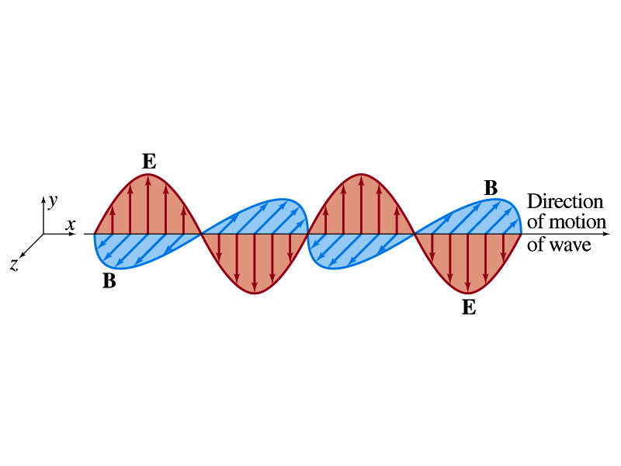
EM Waves
If the voltage of the source varies sinusoidal, the field strengths of the radiation field vary sinusoidal
We call these waves EM waves
They are transverse waves
EM waves are always those of fields
  Since these are fields, they can propagate through an empty space
In general accelerating electric charges give rise to electromagnetic waves
This prediction from Maxwell’s equations was experimentally proven by Heinrich Hertz through the discovery of radio waves

Slide 31
EM Waves and Their Speeds
Let’s consider a region of free space. What’s a free space?
  An area of space where there is no charges or conduction currents
  In other words, far from emf sources so that the wave fronts are essentially flat or not distorted over a reasonable area
  What are these flat waves called?
    Plane waves
    At any instance E and B are uniform over a large plane perpendicular to the direction of propagation
  So we can also assume that the wave is traveling in the x-direction w/ velocity, v=vi, and that E is parallel to y axis and B is parallel to z axis

Slide 32
Maxwell’s Equations w/ Q=Ι=0
In this region of free space, Q=0 and Ι=0, thus the four Maxwell’s equations become
Q_{encl}=0
No Changes
No Changes
I_{encl}=0
One can observe the symmetry between electricity and magnetism.
The last equation is the most important one for EM waves and their propagation!!

Slide 33
EM Waves from Maxwell’s Equations
If the wave is sinusoidal w/ wavelength λ and frequency f, such traveling wave can be written as
  Where
  What is v?
    It is the speed of the traveling wave
  What are E₀ and B₀?
    The amplitudes of the EM wave. Maximum values of E and B field strengths.
Thus

Slide 34
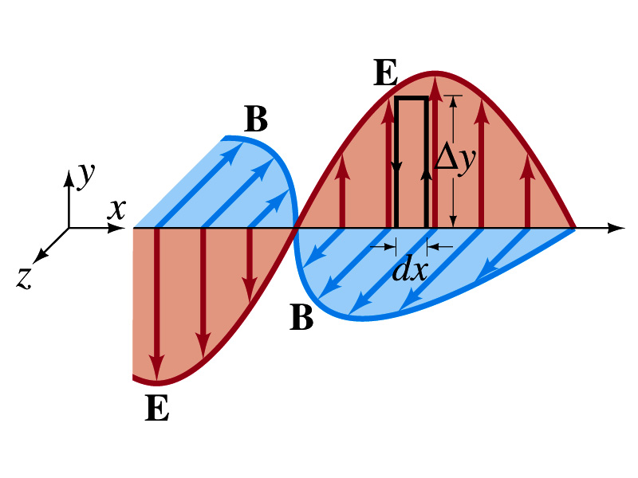
From Faraday’s Law
Let’s apply Faraday’s law
  to the rectangular loop of height Δy and width dx
along the top and bottom of the loop is 0. Why?
  Since E is perpendicular to dl.
  So the result of the integral through the loop counterclockwise becomes
  For the right-hand side of Faraday’s law, the magnetic flux through the loop changes as
Thus
Since E and B
depend on x and t

Slide 35
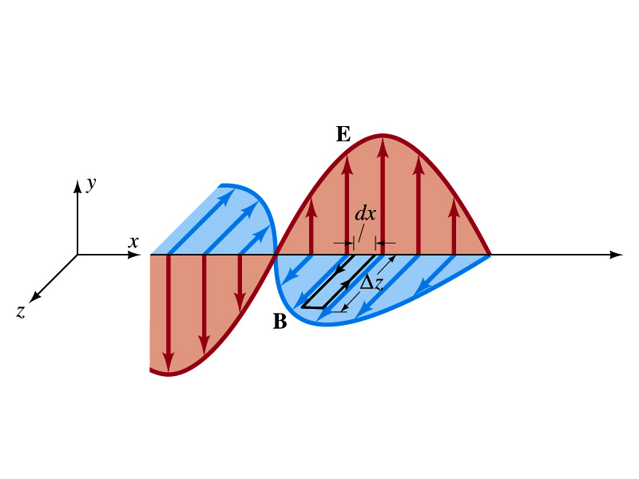
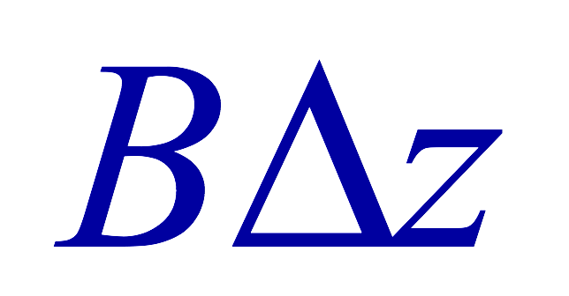
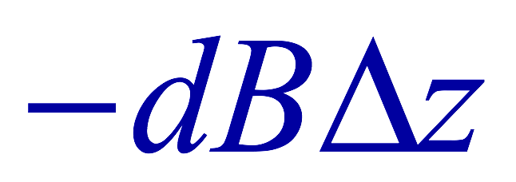
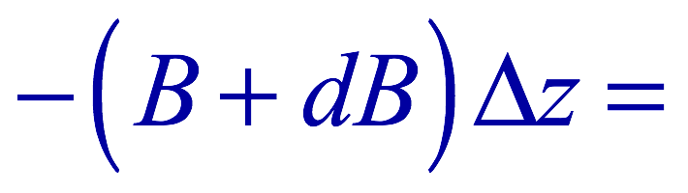
From Modified Ampére’s Law
Let’s apply Maxwell’s 4th equation
  to the rectangular loop of length Δz and width dx
along the x-axis of the loop is 0
  Since B is perpendicular to dl.
  So the result of the integral through the loop counterclockwise becomes
  For the right-hand side of the equation is
Thus
Since E and B
depend on x and t

Slide 36

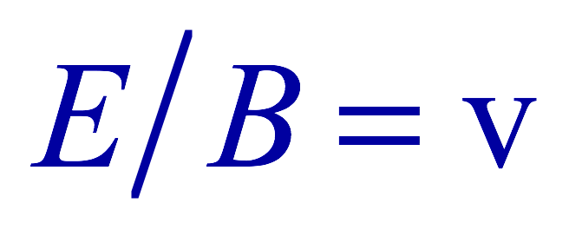
Relationship between E, B and v
Let’s now use the relationship from Faraday’s law
Taking the derivatives of E and B as given their traveling wave form, we obtain
  Since E and B are in phase, we can write
    This is valid at any point and time in space. What is v?
      The velocity of the wave
We obtain
Since
Thus

Slide 37
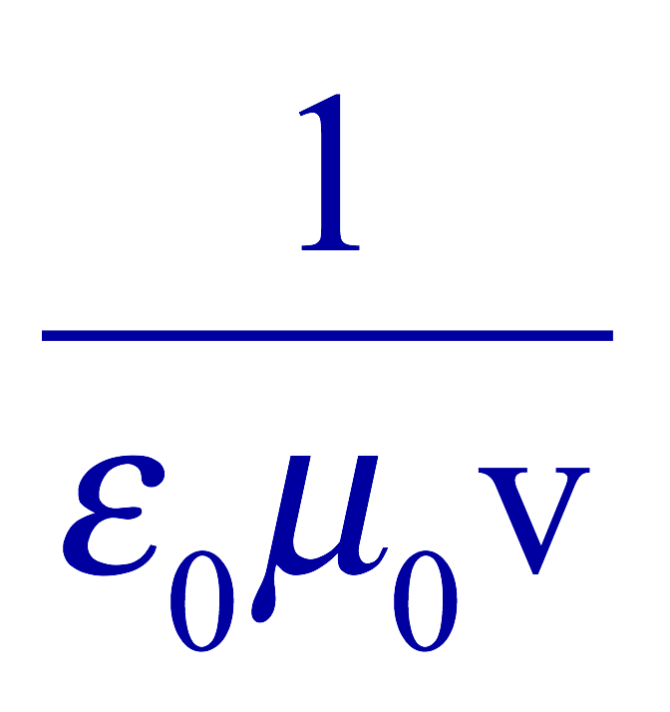
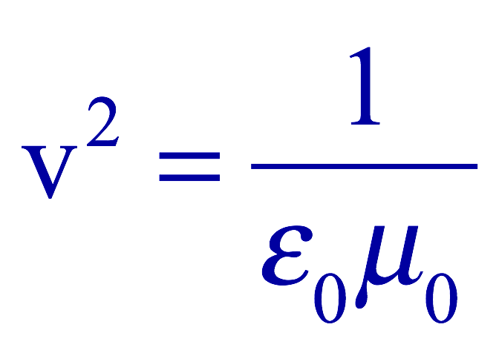
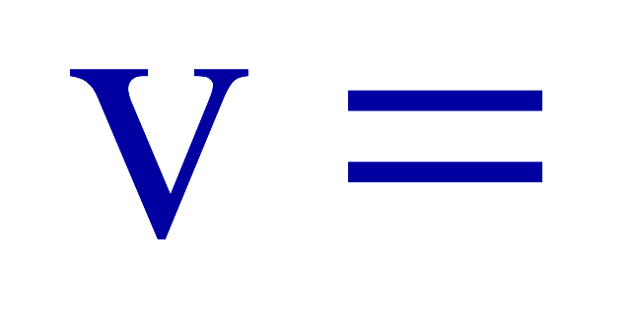
Speed of EM Waves
Let’s now use the relationship from Apmere’s law
Taking the derivatives of E and B as given their traveling wave form, we obtain
  However, from the previous page we obtain
  Thus
Since
We obtain
Thus
The speed of EM waves is the same as the speed of light. EM waves behaves like the light.

