Slide 1
PHYS 1443 – Section 003 Lecture #1
Wednesday, Jan. 20, 2020
Dr. Jaehoon Yu
Who am I?
How is this class organized?
What is Physics?
What do we want from this class?
Today’s homework is homework #1, due 11pm, Monday, Jan. 25!!

Slide 2
Requirements for Online Class
COVID – 19 forces us into a difficult and undesirable circumstance
I have never done online classes before late March 2020
Keeping grades fair to all students is of utmost importance
I apologize for it but at times the policies may be very strict
Be sure to prepare a camera and a headset (or an earphone) with mic in hand, installed and tested before this Sunday, Jan. 24, since these are required for quizzes and exams and for class activities!
Be in a quiet, isolated area during the class, especially during the quiz and exam periods so that you can focus on the class without disturbing others
Prepare a ring bound notebook for you to take notes during the class and keep the exercises you practiced in the class.
Prepare a calculator! Your cell phone or other computers are unallowed!
Have your zoom display name the same as it on MyMav!
Zoom settings ➔ profile➔ edit my profile ➔ edit the top portion on web

Slide 3
Basic Rules of the Online Classes
I will take attendance as if we are in the classroom!
Your mic will be automatically muted when joining the class
Please locate the video, mute/unmute, chat buttons and test
Unmute the mic when your name is called then mute after answering
Mute your mic during the lecture expect for questions or answers
If you have a question, “raise hand”, unmute your mic, pronounce your name and ask your question, as if you are in the class
Use only the appropriate languages on mic and on chat!
Lecture notes and recordings will be available after each class
Polls will be used to engage you in the class and thus you are strongly encouraged to participate in the poll (poll 1)
You will be in a study group w/ separate breakout rooms

Slide 4
Announcements
Plea to you: Please power off all your other electronic devices, including cell-phones and all types of computers before the start of all classes, except for the one used for the class!
Keep only the class zoom session on your computer!
Close all other apps and web pages
Reading assignment #1: Read and follow through all 9 sections (A1 – A9) in appendix A (math formulae) by Monday, Jan. 25
There will be a quiz on this and what we have learned in Ch. 1 on next Wednesday, Jan. 27.

Slide 5
Why do we do science?
Anything and everything we do must be built upon the fundamental HUMANITY and Human Decency!!
Science without humanity will be harmful to us all!
Policies without solid, sound science base will harm the entire humanity and fatal!
US COVID – 19 response (~25M confirmed cases, >410k deaths and growing!)
The total number of American Deaths at WW-II in 1941 – 45 was 405k!!
Daily COVID deaths in the US has been >3500 since Thanksgiving!
https://coronaboard.com
A selfish leadership choked the scientific truth to hide their incompetence!!
I want to teach you in this class
Physics knowledge you need to maximally optimize your career and life
But more importantly to help you become an independent thinker with a deep sense of fundamental humanity and human decency and dignity!

Slide 6
What is the human decency?
Compassion and empathy to fellow human beings!
Respect and care for other human beings
Listen and give sincere efforts to understand others
Put aside one’s own greed and eliminate any sense of divisive teams!
Help others when others are in need
True sense of courage
Ability to own one’s mistakes and make them right
Capable of acknowledging that others could be and are better than oneself
Capable of being grateful to others for their efforts
Be able to stand up for the whole human race before any ideologies!
The U.S. democracy is not just for the U.S. but the hope for the whole humanity!

Slide 7
Who am I?
Name: Dr. Jaehoon Yu (You can call me Dr. Yu)
Office: Rm 342, Chemistry and Physics Building
Extension: x22814, E-mail: jaehoonyu@uta.edu
My profession: High Energy Particle Physics (HEP)
Collide particles (protons on anti-protons or electrons on anti-electrons, positrons) at the energies equivalent to 10,000 Trillion degrees
To understand
Fundamental constituents of matter
Fundamental forces between the constituents
Origin of Mass
Search for Dark Matter and Making of Dark Matter Beams
The creation of the Universe
A pure scientific research endeavor
Direct use of the fundamental laws we find may take longer than we want but
Indirect product of research contribute to every day lives; eg. WWW
Why do we do with this in the first place?
Make everyday lives better and help the whole humanity live well as an integral partner of the universe
So science is doing God’s work as the God intended!

Slide 8
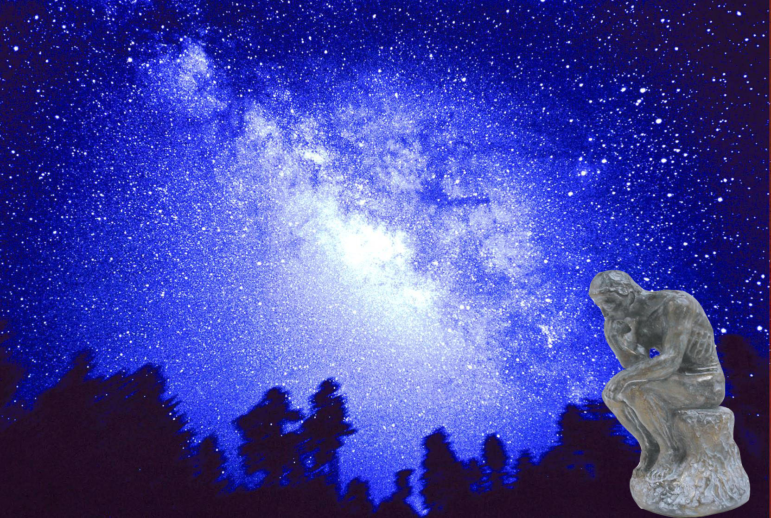
We always wonder…
What makes up the universe?
How does the universe work?
Where do we all come from?

Slide 9
High Energy Physics
Definition: A field of physics that pursues understanding the fundamental constituents of matter and basic principles of interactions between them.
Known interactions (forces – Poll 2):
Gravitational Force
Electromagnetic Force
Weak Nuclear Force
Strong Nuclear Force
Current theory: The Standard Model of Particle Physics

Slide 11
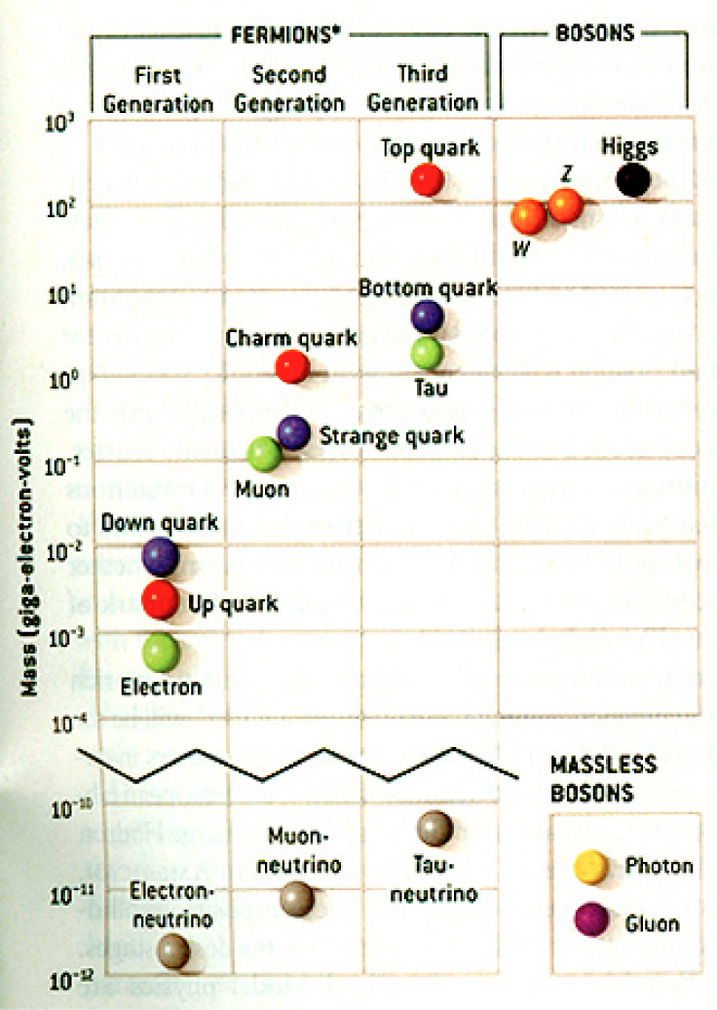
HEP and the Standard Model
Total of 16 particles (12+4 force mediators) make up all the visible matter in the universe! ➔ Simple and elegant!!!

Slide 12
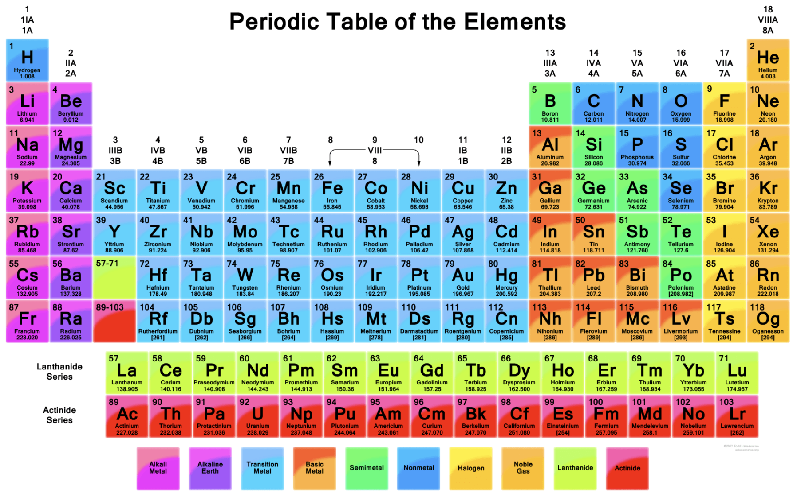
118 Elements!

Slide 13
HEP and the Standard Model
Discovered in 1995, ~175m_{p}
Make up most ordinary matters ~0.1m_{p}
Total of 16 particles (12+4 force mediators) make up all the visible matter in the universe! ➔ Simple and elegant!!!
Tested to a precision of 1 part per million!

Slide 14
What are some issues in HEP?
Why is the mass range so large (0.1m_{p} – 175 m_{p})?
Is the particle discovered at the LHC really the Higgs particle?
Why is the matter in the universe made only of particles?
Neutrinos have mass!! (OMG!! The SM is broken!!! )
What are the mixing parameters, particle-anti particle asymmetry and the neutrino mass ordering?
Why are there only four apparent forces?
Were they all unified at the Big Bang?
Me!
Notes:
----- Meeting Notes (2/12/14 10:16) -----

Slide 15
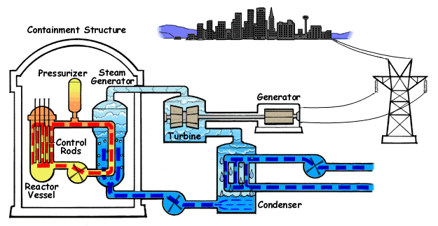
How does a nuclear power plant work?
Duke Energy
My 1000 year dream: Skip the whole thing!
Make electricity directly from nuclear force!

Slide 16
So what’s the problem?
Why is the mass range so large (0.1m_{p} – 175 m_{p})?
Is the particle we discovered in 2012 really the Higgs particle?
Why is the matter in the universe made only of particles?
Neutrinos have mass!! What are the mixing parameters, particle-anti particle asymmetry and mass ordering?
Why are there only four apparent forces?
Were they all unified at the Big Bang?
Is the picture we present the real thing?
Notes:
----- Meeting Notes (2/12/14 10:16) -----

Slide 17
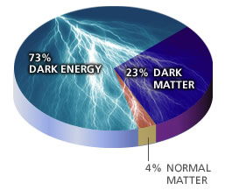
What makes up the universe?
~95% unknown!!
Notes:
----- Meeting Notes (2/12/14 10:16) -----

Slide 18
So what’s the problem?
Why is the mass range so large (0.1m_{p} – 175 m_{p})?
Is the particle we discovered really the Higgs particle?
Why is the matter in the universe made only of particles?
Neutrinos have mass!! What are the mixing parameters, particle-anti particle asymmetry and mass ordering?
Why are there only four apparent forces?
Were they all unified at the Big Bang?
Is the picture we present the real thing?
What makes up the remaining ~95% of the universe?
Are there any other particles we don’t know of?
Big deal for the new LHC Run and the new DUNE experiment in the US!
Where do we all come from?
How can we live well in the universe as an integral partner?
Notes:
----- Meeting Notes (2/12/14 10:16) -----

Slide 19
Accelerators are Powerful Microscopes.
They make high energy particle beams
that allow us to see small things.
seen by
low energy beam
(poorer resolution)
seen by
high energy beam
(better resolution)

Slide 20
Accelerators are also Time Machines.
They make particles last seen
in the earliest moments of the universe.
Energy
particle beam
energy
anti-particle beam
energy
Particle and anti-particle annihilate.
E = mc²

Slide 21
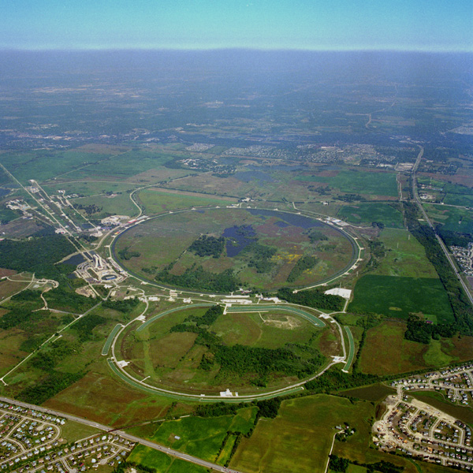
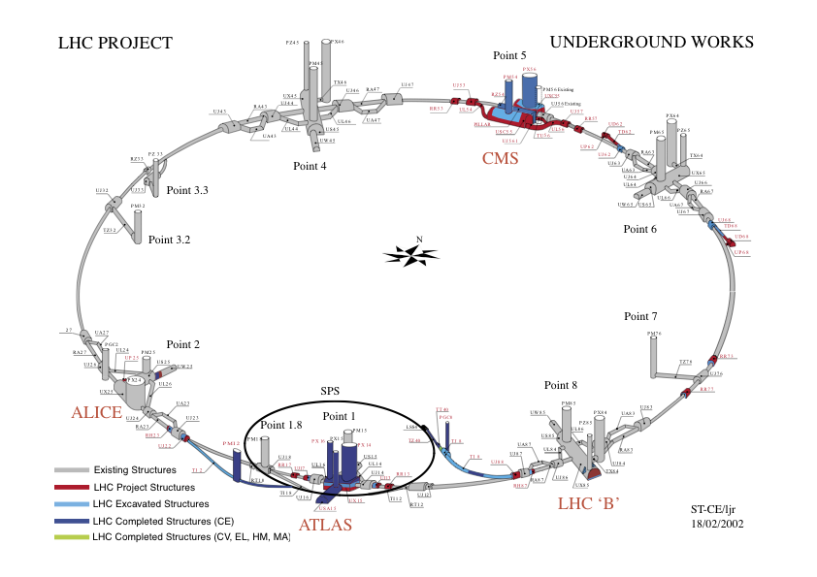
Fermilab Tevatron and LHC at CERN
World’s Highest Energy proton-anti-proton collider
4km (2.5mi) circumference
E_{cm}=2 TeV (=6.3x10⁻⁷J/p➔ 13M Joules on the area smaller than 10⁻⁴m²)
Equivalent to the kinetic energy of a 20t truck at the speed 130km/hr
~100,000 times the energy density at the ground 0 of the Hiroshima atom bomb
Tevatron was shut down in 2011
New frontiers with high intensity proton beams including the search for dark matter with beams!!
World’s Highest Energy p-p collider
27km (17mi) circumference, 100m (300ft) underground
Design E_{cm}=14 TeV (=44x10⁻⁷J/p➔ 362M Joules on the area smaller than 10⁻⁴m²)
Equivalent to the kinetic energy of a B727 (80tons) at the speed 310km/hr
~3M times the energy density at the ground 0 of the Hiroshima atom bomb
Discovered a new heavy particle that looks Higgs in 2012
Search for new particles has been ongoing!!
Shut down for HL LHC➔ About to resume!!
Chicago
CDF
p
DØ
Tevatron
p

Slide 22
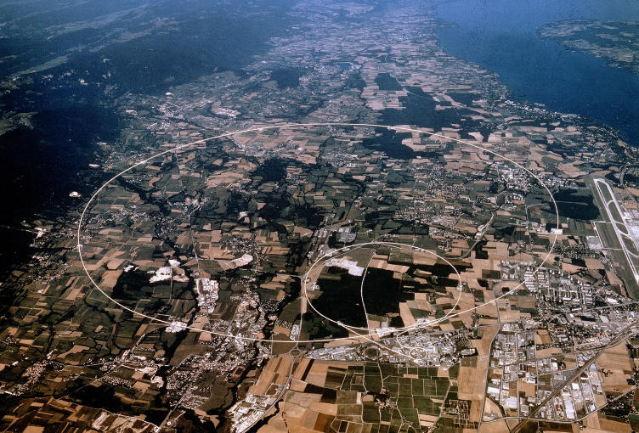
LHC @ CERN Aerial View
CMS
France
Geneva Airport
ATLAS
Swizerland

Slide 23
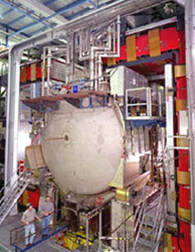
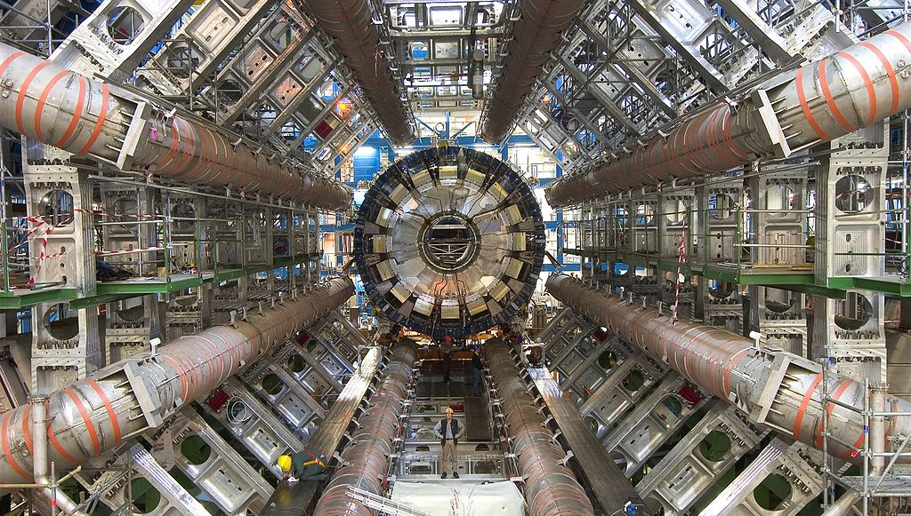
DZero Detector at Fermilab near Chicago
ATLAS Detector in Geneva Switzerland

Slide 24
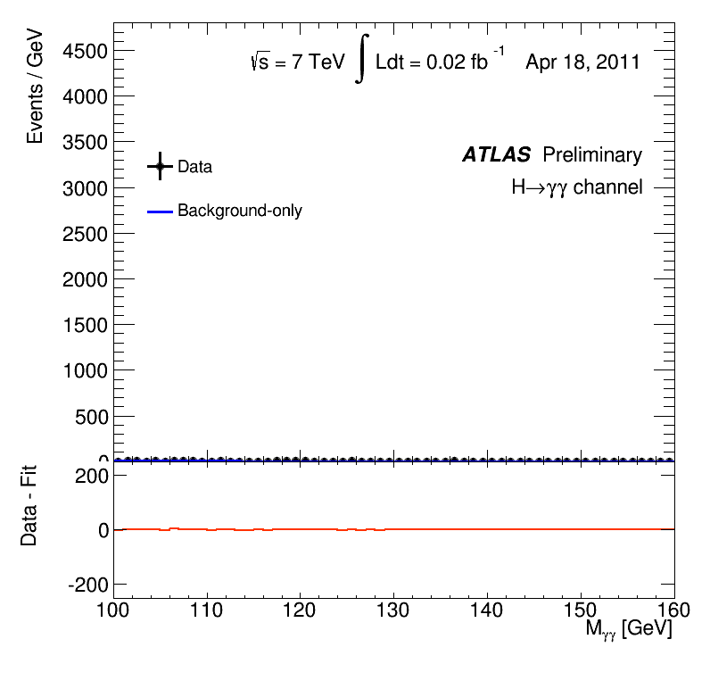
What did statistics do for Higgs→ γγ?

Slide 25
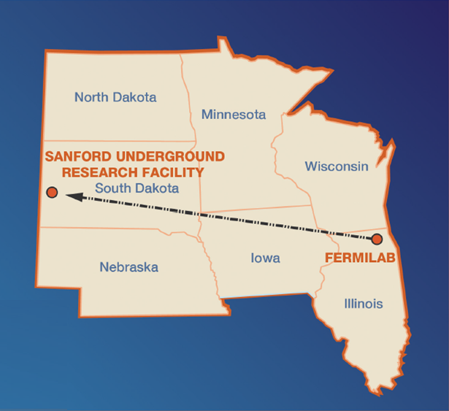
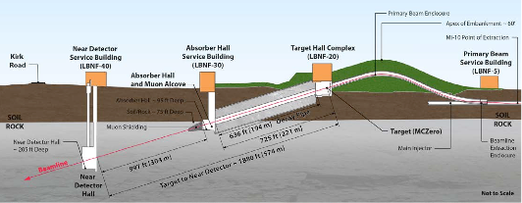
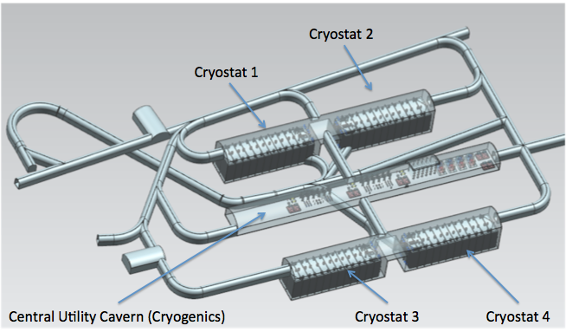
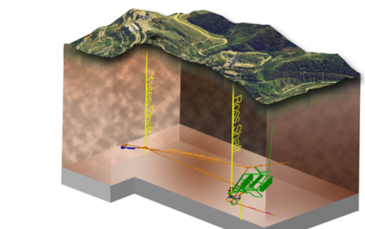
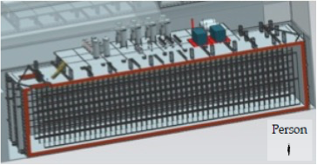
The Next Big Thing - DUNE Experiment
Stands for Deep Under Ground Neutrino Experiment
The $1.5B flagship long baseline (1300km) ν experiment
1500m underground in South Dakota
1300km (800 miles)
4 caverns with ~80,000t of Liquid Argon total
15m
66m
15m

Slide 26
The Map of the DUNE Experiment
1106 collaborators
184 institutions
31 countries

Slide 27
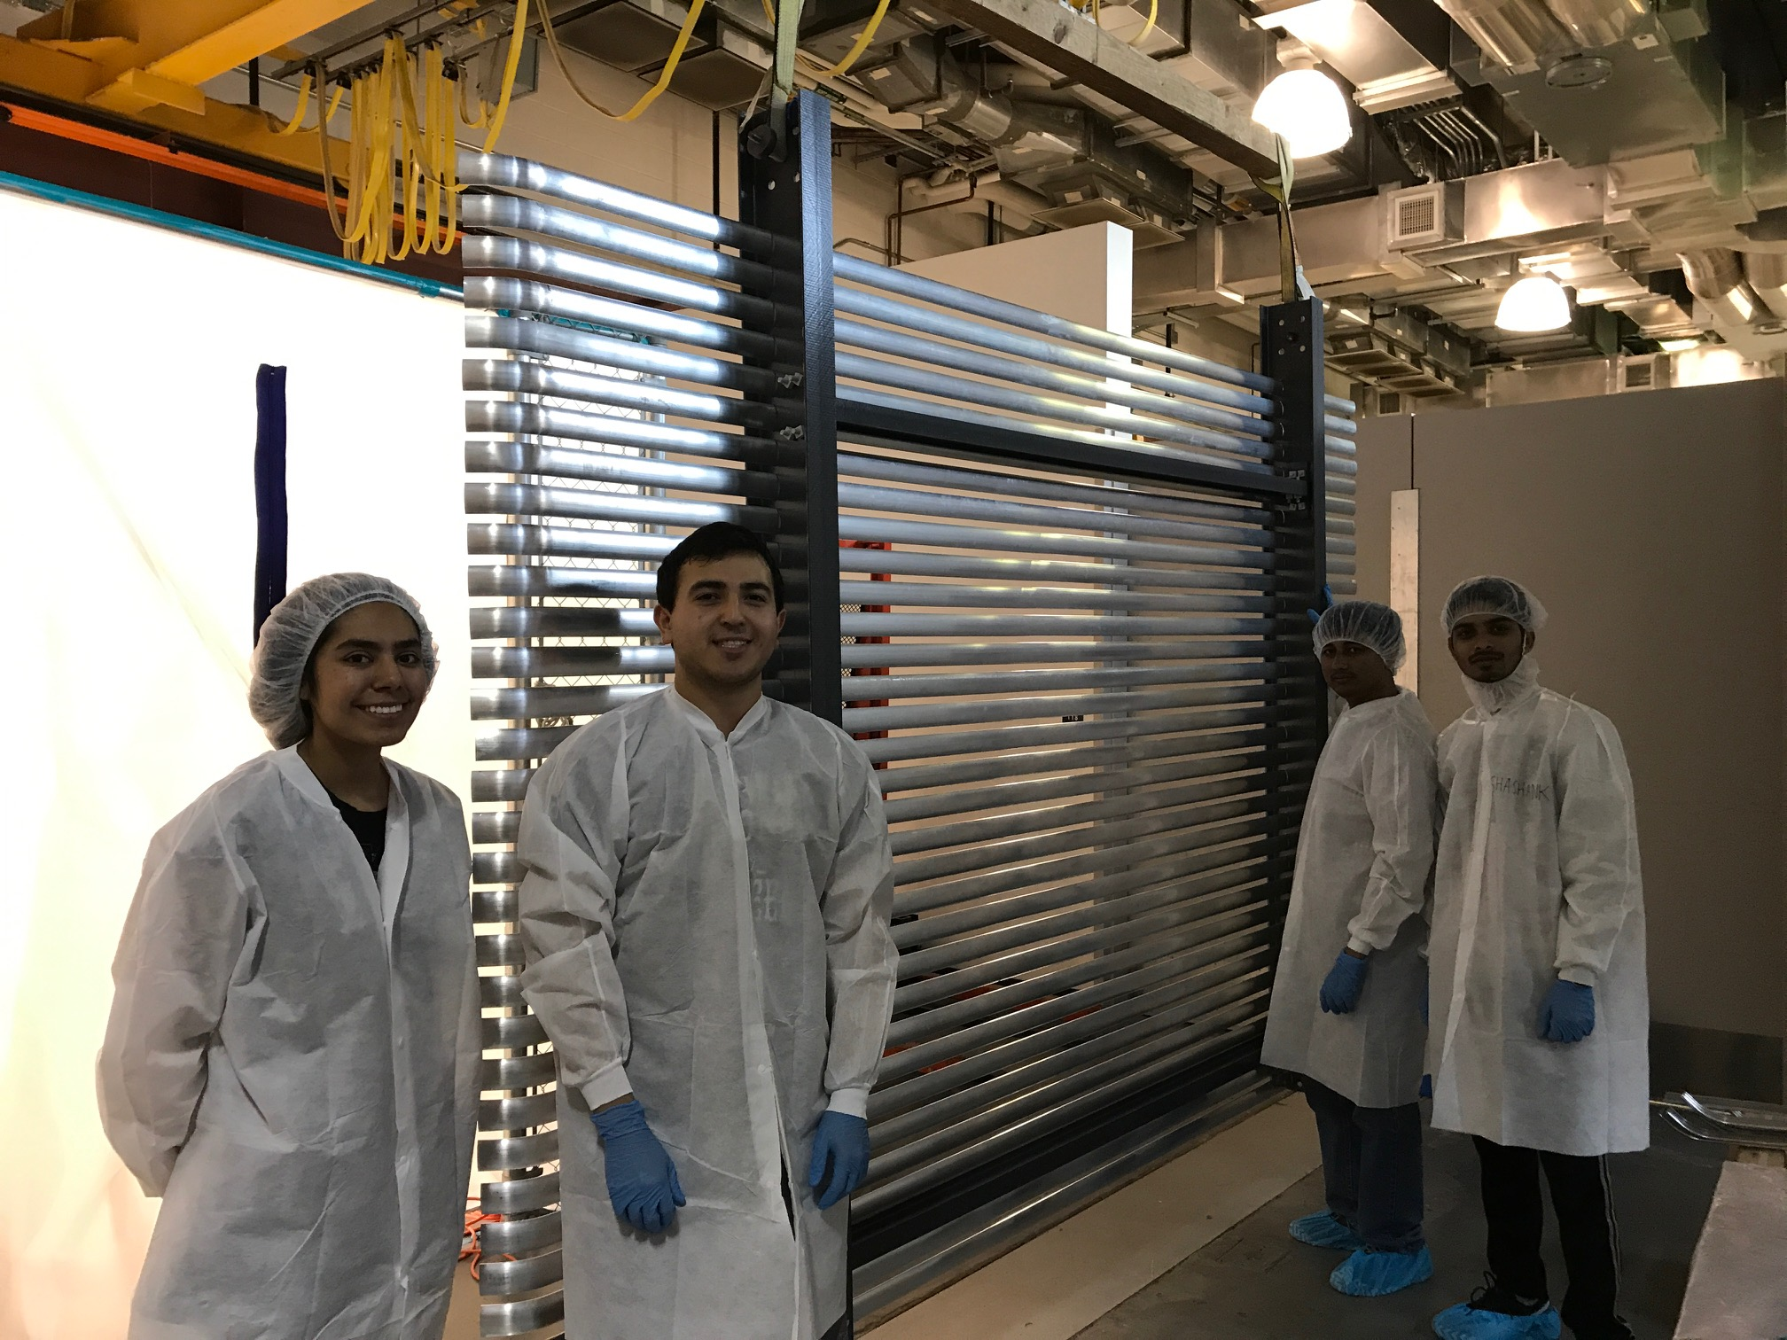
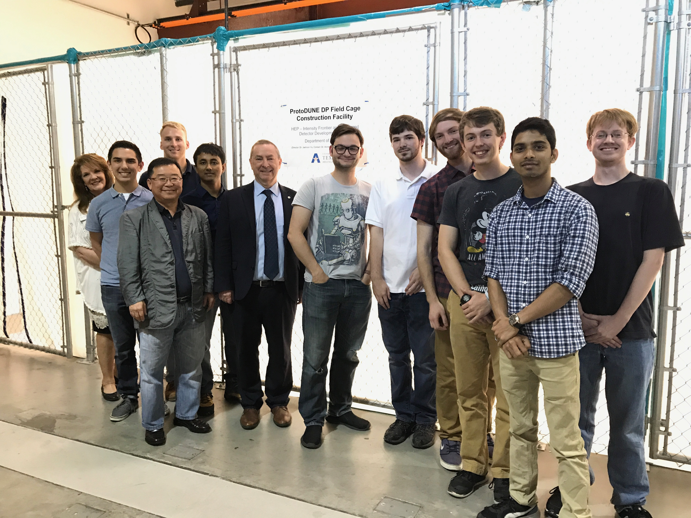
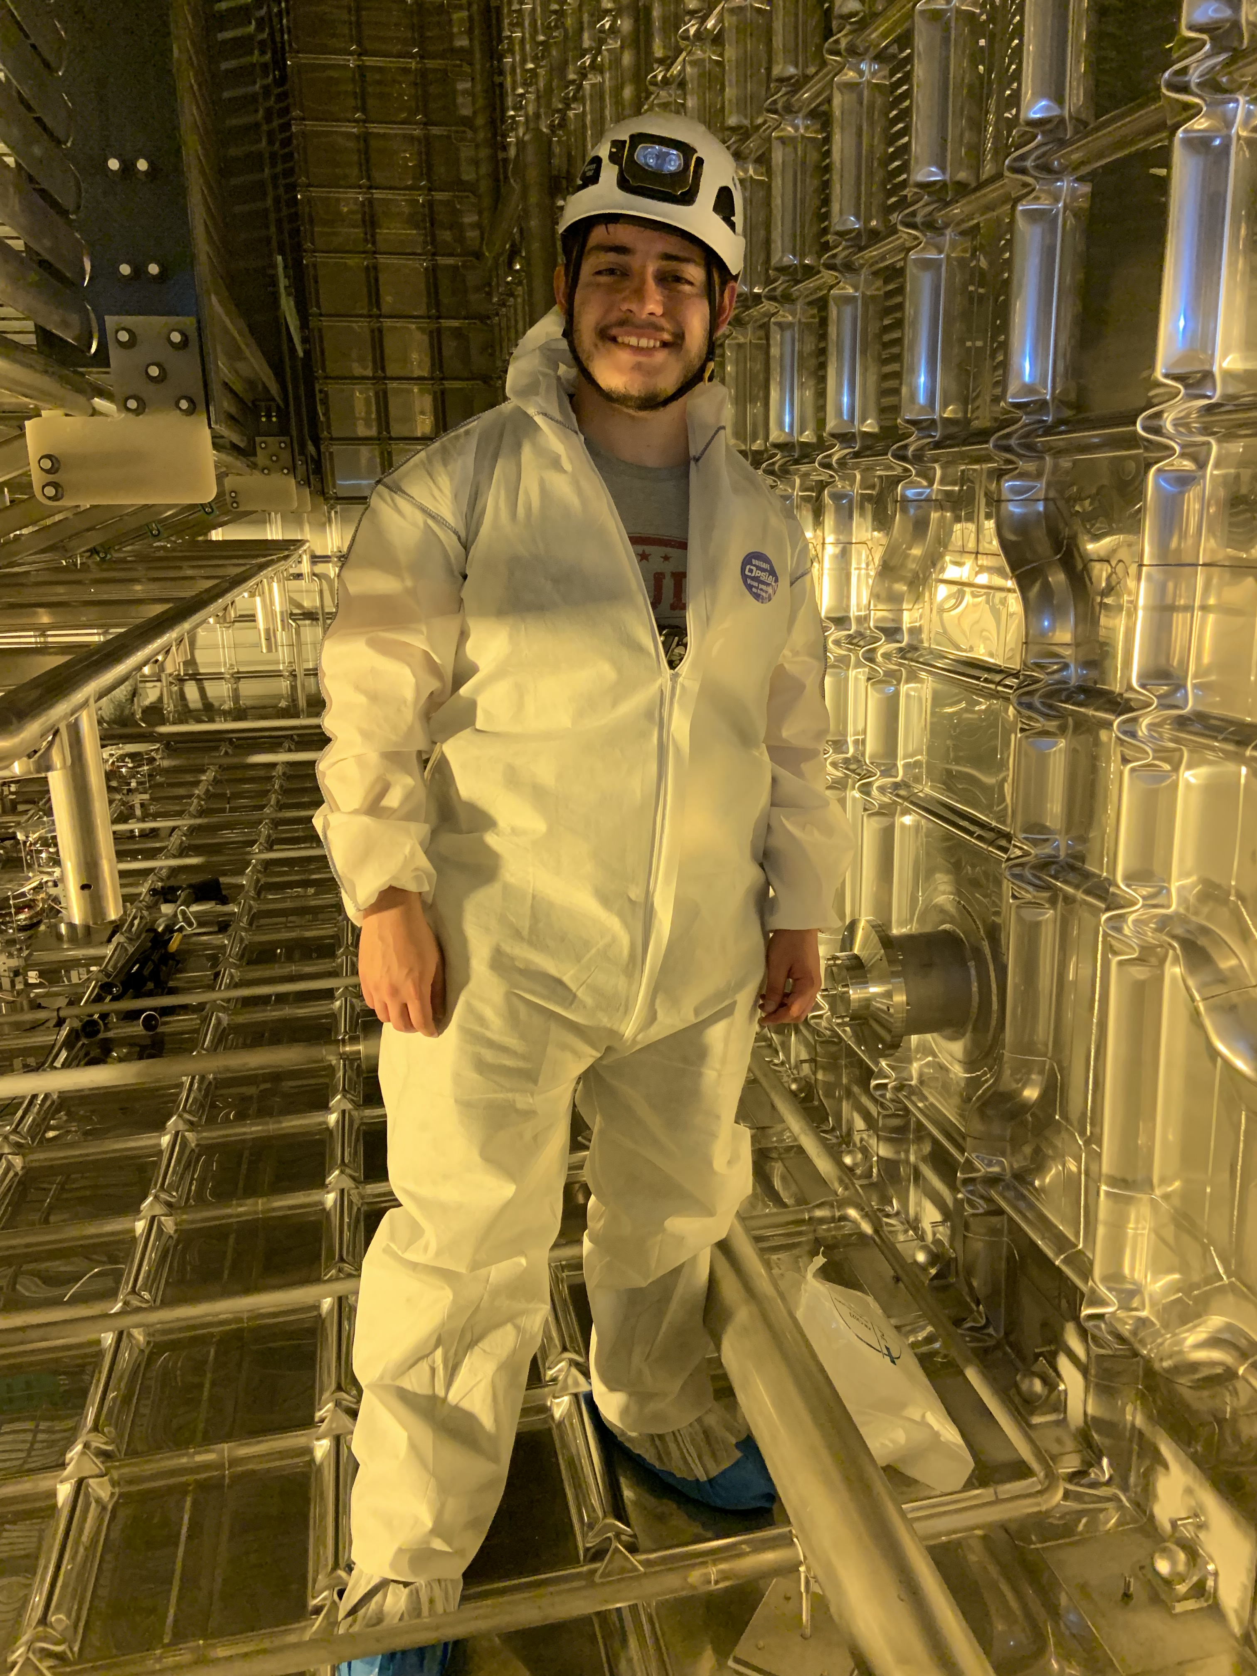
The UTA Field Cage Team
Hector Carranza @ CERN

Slide 28
DUNE Prototype Detector @ CERN
6m
6m

Slide 29
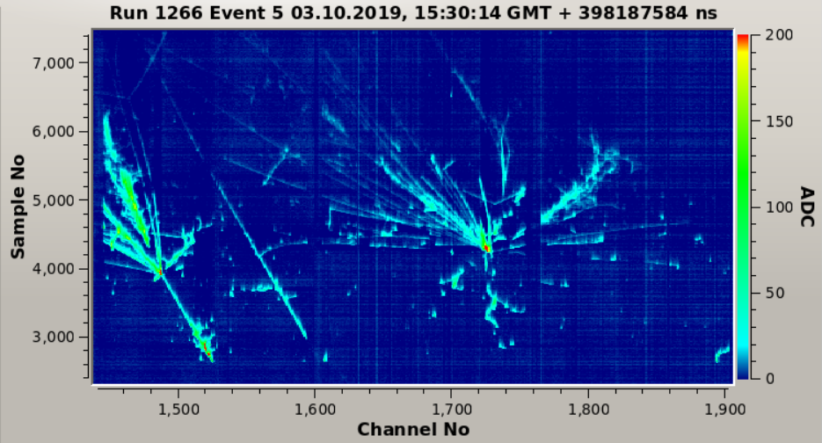
ProtoDUNE Event
Beam halo (high energy) muon with bremsstrahlung initiated E.M. shower
Collection plane view

Slide 30
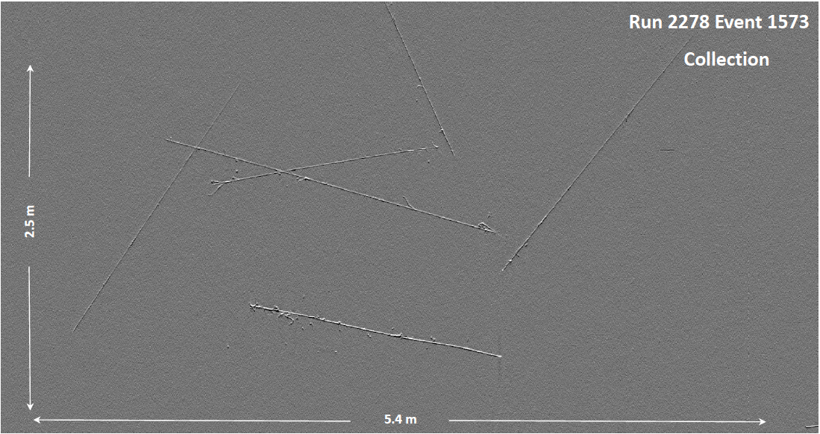
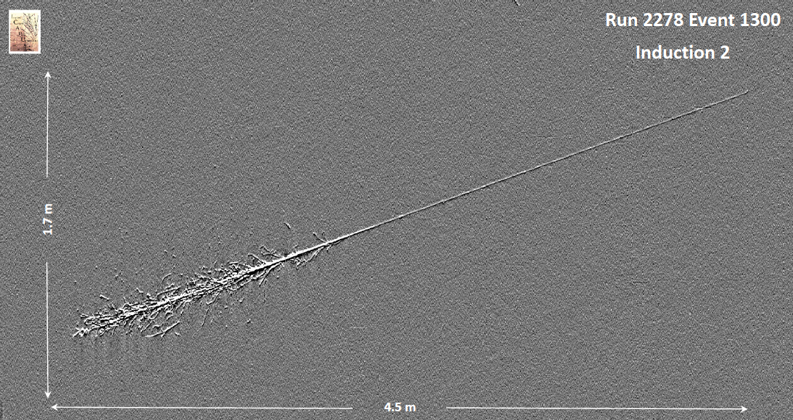
ICARUS Events
Cosmic Ray Particle Tracks
Collection plane view

Slide 31
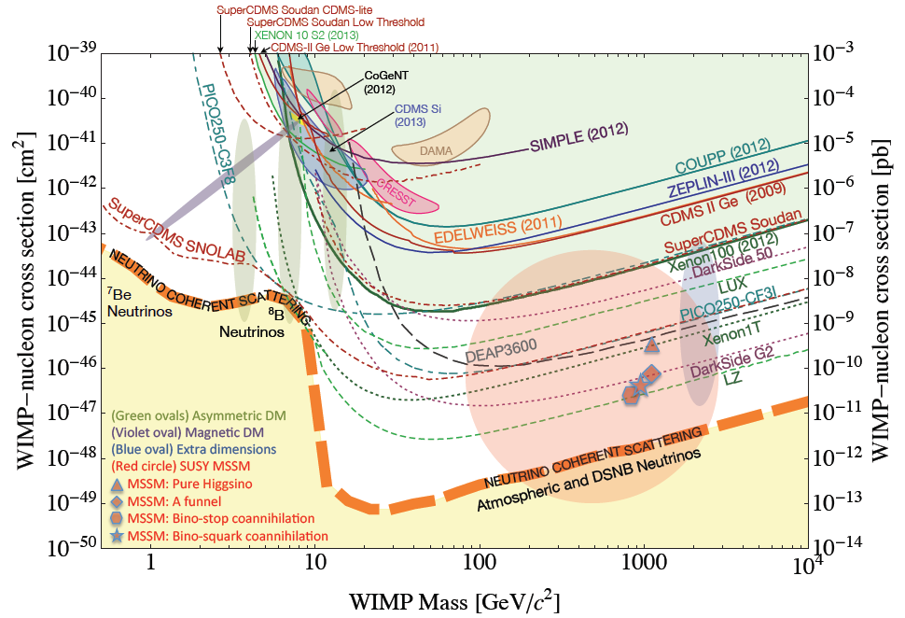
Let’s Look for Dark Matter!!
No DM
LHC
DUNE potential

Slide 32
So why is HEP relevant to you?
HEP explores the most fundamental nature of the Universe!
Discoveries will realize our 1000 year dreams
The discovery of the dark matter and making of dark matter beams will take us to the next Quantum level
Outcome and bi-products of HEP research improves our daily lives directly and indirectly
WWW came from HEP

Slide 33
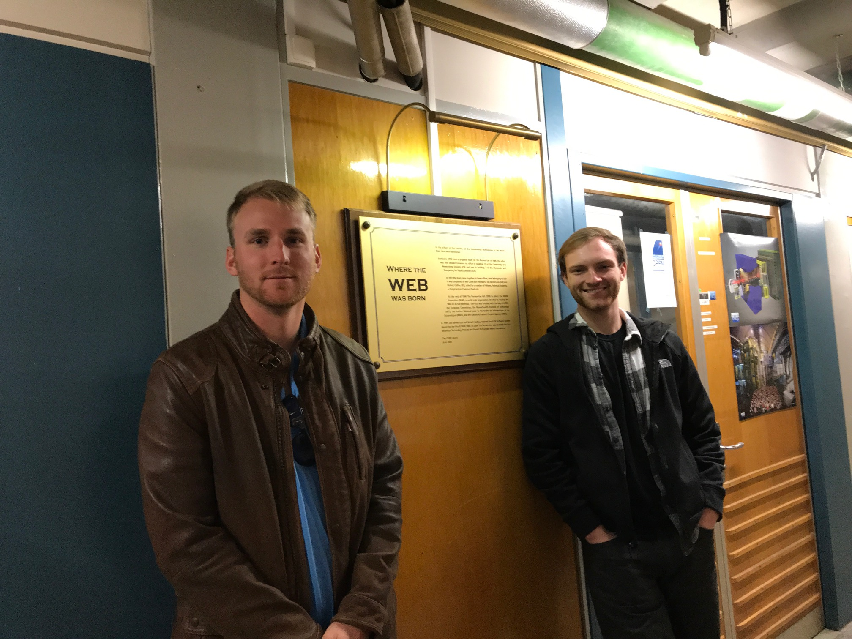

Slide 34
So why is HEP relevant to you?
HEP explores the most fundamentals of the Universe!
Discoveries will realize our 1000 year dreams
The discovery of the dark matter and making of dark matter beams will take us to the next Quantum level
Outcome and bi-products of HEP research improves our daily lives directly and indirectly
WWW came from HEP
Advanced detector technologies like GEM will make a large screen low dosage X-ray imaging possible

Slide 35
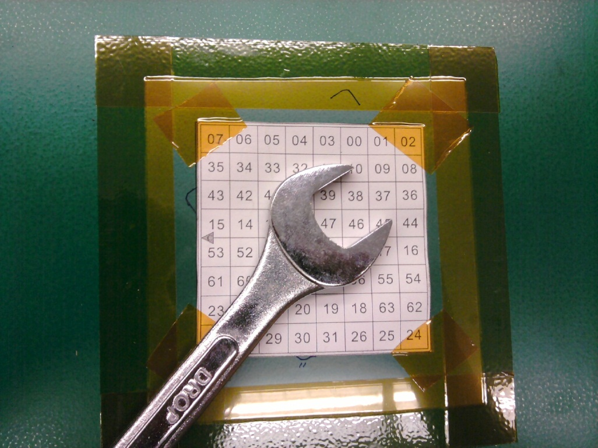
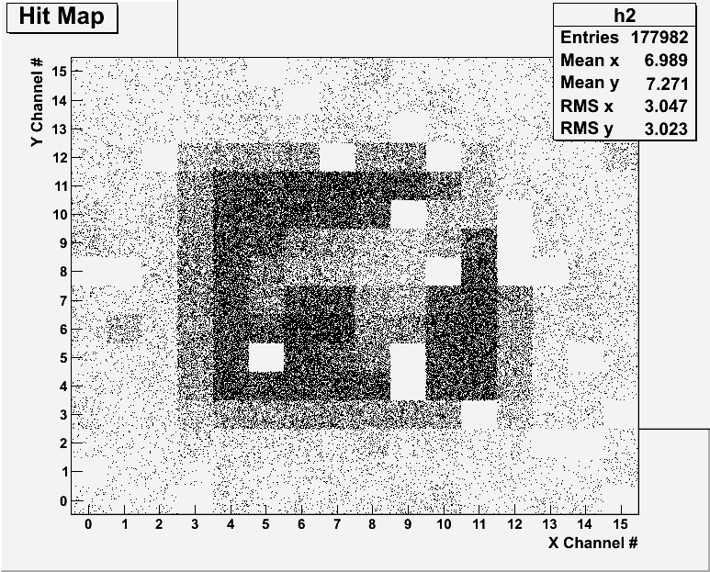
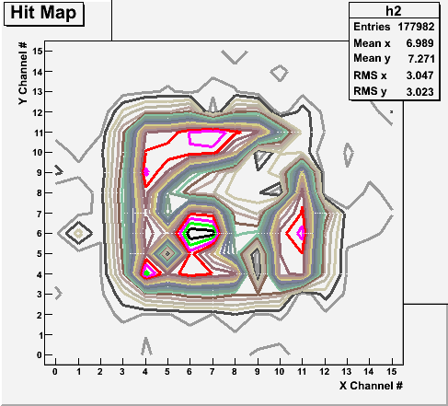
Bi-product of High Energy Physics Research
Can you see what the object is?
(GEM Detector X-ray Image)

Slide 36
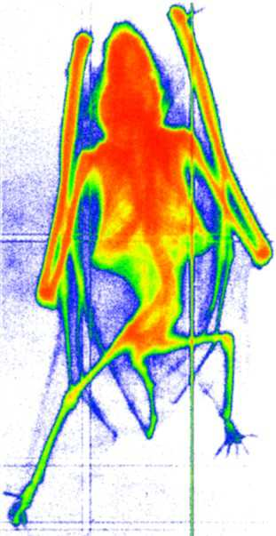
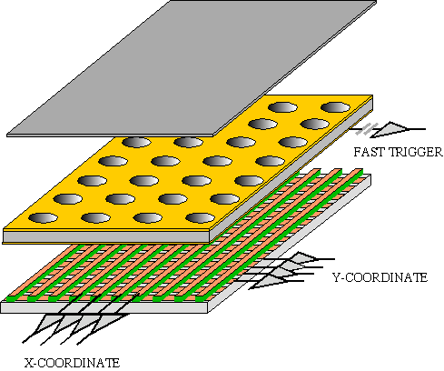
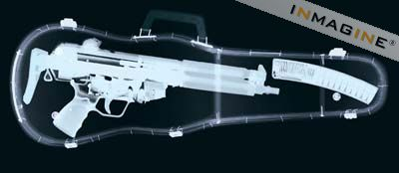
GEM Application Potential
FAST X-RAY IMAGING
Using the lower GEM signal, the readout can be self-triggered with energy discrimination:
9 keV absorption radiography of a small mammal (image size ~ 60 x 30 mm²)
A. Bressan et al,
Nucl. Instr. and Meth. A 425(1999)254
F. Sauli, Nucl. Instr. and Meth.A 461(2001)47

Slide 37
not just for tomorrow,
Let’s all dream,
not just for the next year,
but for 1000 years into the future for the whole humanity!!

Slide 38
Textbook
Title: Physics for Scientists and Engineers with Modern Physics
4th edition (but used should be fine except for a few minor differences)
Author: D.C. Giancoli
ISBN13: 978-0132273596
ISBN10: 9780132273596

Slide 39
Information & Communication Source
Course web page: http://www-hep.uta.edu/~yu/teaching/ spring21-1443-003/spring21-1443-003.html (Canvas has a link to this page)
Lecture notes and recordings
Contact information & Class Schedule
Syllabus
Homework
Important Dates
Evaluation Policy
Class Style & Communication
Other information
Primary communication tool is e-mail: Make sure that your e-mail at the time of course registration is the one you most often read!!
Office Hours: 4:00 – 5:00pm, MW or by appointments on zoom

Slide 40
Evaluation Policy
Homework: 25%!!!
Exams
Final Comprehensive Exam (2pm, Mon., 5/10/21): 23%
Mid-term Comprehensive Exam (2:30pm, Wed., 3/10/21): 20%
One better of the two term Exams (2/10/21 and 4/12/21): 12%
Missing an exam is not permissible unless pre-approved
No makeup test
You will get an F if you miss any of the exams without a prior approval no matter how well you’ve been doing in class!
Lab score: 10% (Starts Monday, Feb. 8, www.uta.edu/physics/labs )
If passed the lab before, can request a lab exemption (form available on web)
Pop-quizzes: 10%
Extra credits: 10% of the total
Random attendances
Strong participation in the class discussions
Special projects (BIGGGGG!!!)
Special seminars
Grading will be done on a sliding scale
100%

Slide 41
Homework
Solving homework problems is the only way to comprehend class material: ~1 homework per week
An electronic homework system has been setup for you
Details are on the class web
https://quest.cns.utexas.edu/student/courses/list
Choose the course PHYS1443-003-spring21, unique number 43121
Download the homework, solve the problems and submit them online
Multiple unsuccessful tries will deduct points after one free try
Roster will close at 11pm next Monday, Jan. 25
You need a UT e-ID (NOT the UTA NetID): Go and apply at the URL https://idmanager.its.utexas.edu/eid_self_help/?createEID&qwicap-page-id=EA027EFF7E2DA39E if you don’t have one.
Each homework carries the same weight
Homework problems will be slightly ahead of the class and tough!
No homework will be dropped from the final grade!!
Homework will constitute 25% of the total ➔ A good way of keeping your grades high
Strongly encouraged to collaborate ➔ Please be fair and keep integrity

Slide 42
Attendances and Class Style
Attendances : Will be used for extra credits
Zoom report will be used to check your attendance
Not acceptable for you to just join zoom and not attend the class
Will be verbally taken randomly for higher extra credit
Class style:
Lectures will be on electronic media
The lecture notes and video recording will be posted on the class web page AFTER each class
Active participation through questions and discussions are STRONGLY encouraged ➔ Extra credit….
Communication between you and me is extremely important
If you have problems, please do not hesitate talking to me

Slide 43
Extra credit
10% addition to the total
Could boost a B to A, C to B or D to C
What constitute for extra credit?
Special projects (biggest!!)
Attendances
Strong participation in the class discussions
Other opportunities ➔Special seminars

Slide 44
What can you expect from this class?
All A’s?
This would be really nice, wouldn’t it?
But if it is too easy it is not fulfilling or meaningful….
This class is not going to be a stroll in the park!!
You will earn your grade in this class.
You will need to put in sufficient time and sincere efforts
Exams and quizzes will be tough!!
Sometimes problems might not look exactly like what you learned in the class
Do the work with your own hands!
But you have a great control (up to 45%) of your grade in your hands
Homework is 25% of the total grade!!
Means you will have many homework problems
Sometimes much more than any other classes
Some homework problems will be something that you have yet to learn in class
Exam problems will be easier than homework problems but the same principles!!
Lab 10%
Extra credit 10%
I will work with you so that your efforts, despite COVID –19 related hardship are properly rewarded

